Slide 1
Business intelligence in Microsoft Project
Jan Kalis
http://blogs.msdn.com/jkalis
Product Marketing Manager
Microsoft Corporation

Slide 2
Agenda
What’s new for Project Business Intelligence (BI)
Project Desktop BI
Project Online and Project Server 2013 BI
Broader Platform investments
Architecture
OData
Retrieving data through OData
Demos

Slide 3
BI in the New Project
Project Desktop (Project Standard 2013, Project Professional 2013, Project Pro for Office365)
Project Manager’s view, including Master Project consolidated reports, no Programs or Portfolio Views
New Project Reports (includes Burndown reporting)
Introduces new Cumulative fields
Project Online and Project Server 2013
Portfolio reports across the whole organization – including progress, resources, costs, work, baseline,…
New way to access Reporting Data via OData Services

Slide 4
Project Desktop Business Intelligence

Slide 5
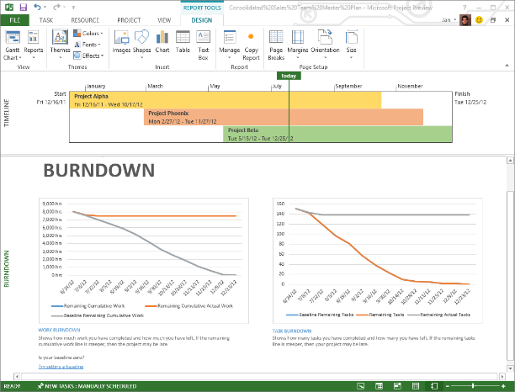
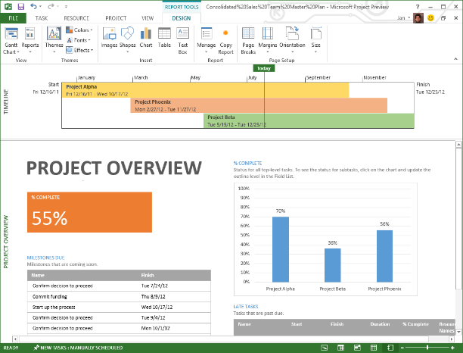
Project Manager’s dashboard
New “Excel-like” out of the box report templates
Charts, tables, shapes and images to compose the report
Copy/paste reports and individual items into Office applications
Good for viewing and printing

Slide 6
Business Intelligence
Project Standard
Project Professional
Project Pro for Office 365
demo

Slide 7
Project Online and Project Server 2013 Business Intelligence

Slide 8
Concepts
Two main data sources – relational Reporting database and multidimensional OLAP databases (on-premises only)
Data visualization is relying on the Microsoft BI products –
SharePoint BI Center
Excel, Excel Services and PowerView
Visio, Visio Services
… or your SharePoint Apps
…

Slide 9



Business Intelligence
Explore
Visualize
Control
Easily combine data from any source to create fully interactive reports and insights with guided exploration
Visually discover and share insights for collaborative decision making across the organization
Manage self-service BI with control & compliance for end user created assets

Slide 10
Business Intelligence – out of the box
Project Online
Project Server 2013
demo

Slide 11
What’s out of the box
Reporting infrastructure
Localized Data Connections (T-SQL and OData, OData only for online)
Localized Reports
Templates

Slide 12
What’s changed for Business Intelligence
4 separate databases are combined in a single database with different schemas
The default name of the Project database is ProjectService
Draft, Published, and Archive table names have prefixes: draft., pub., and ver
Direct access is not supported to draft, pub and ver
Existing Reports based on the Reporting tables and views still work
The Reporting tables retain their previous names
Some OLAP settings have been moved to SharePoint Central Admin
IT Pro related, instead of functional administration
Reporting Tables Data exposed as OData feeds

Slide 13
Comparing BI Tools
BI Tool | On Premise | Online | Notes
Direct access to Reporting Database | YES | NO | Via OData
Access to Reporting Data via OData | YES | YES
OLAP Database | YES | NO | As of spring 2013
SQL Reporting Services (SQL Query) | YES | Via OData
Excel 2010 with PowerPivot Add-In | YES | YES
Excel 2013 | YES | YES
Excel Services | YES | YES

Slide 14
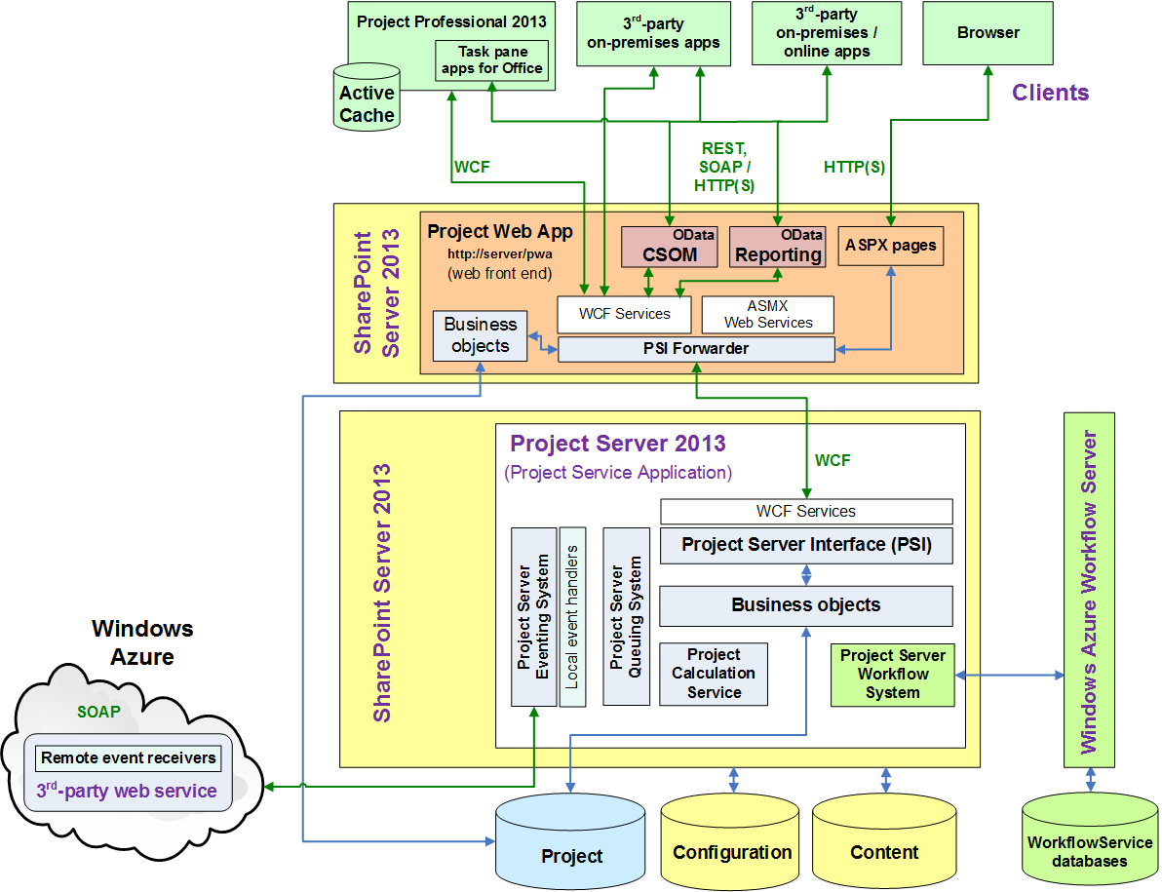
Project Server 2013 Architecture

Slide 15
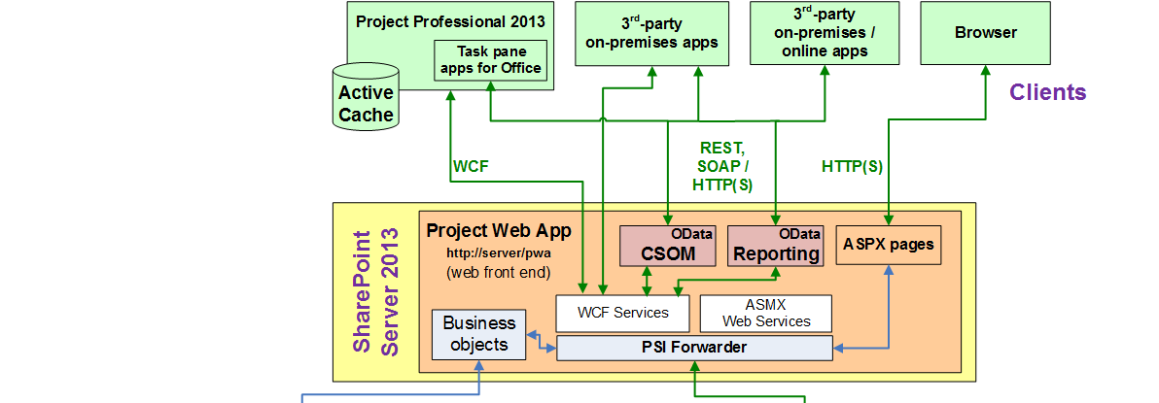
Project Server 2013 Architecture
Project Server BI

Slide 16
Infrastructure Changes
Project Online
Project Server 2013
demo

Slide 17
What is OData?
Web-Based Open-Standards Protocol for querying data http://www.odata.org
HTTP-based over port 80 or port 443
Can deliver data as Atom feed, JSON or as XML document
Available initially with SharePoint 2010 for list data, expanded in 2013
ODATA
AtomPub
JSON
XML

Slide 18
Getting started with OData feeds
Entity Data Model (EDM) http://ServerName/ProjectServerName/_api/ProjectData/$metadata
Object | URL
Project | …/_api/ProjectData/Projects/
Tasks | …/_api/ProjectData/Tasks/
Issues | …/_api/ProjectData/Issues/
Risks | …/_api/ProjectData/Risks/
Assignments | …/_api/ProjectData/Assignments/
ResourceTimephasedDataSet | …/_api/ProjectData/ResourceTimephasedDataSet/
Resources | …/_api/ProjectData/Resources/
Please note the Project Preview reports used the following format …/_vti_bin/client.svc/ProjectData/ to access the OData feeds. We do encourage to use the new …/_api/ProjectData/ format.

Slide 19
Get specific fields only
http://ServerName/ProjectServerName/_api/ProjectData/Resources?$select=ResourceName,ResourceNTAccount

Slide 20
Limiting the data: filter or use select
http://ServerName/ProjectServerName/_api/ProjectData/Projects?
$filter=ProjectStartDate gt datetime'2012-01-01T00:00:00'&
$orderby=ProjectName&
$select=ProjectName,ProjectStartDate,ProjectFinishDate,ProjectCost,EnterpriseProjectTypeName

Slide 21
Get an entity collection by using an association
http://ServerName/ProjectServerName/_api/ProjectData/Projects(guid'263fc8d7-427c-e111-92fc-00155d3ba208')/Assignments

Slide 22
OData feed from the reporting table(s)
List of Projects
using a web browser
using Excel 2013
demo

Slide 23
Next Steps
Explore the BI platform investments http://technet.microsoft.com/en-US/sharepoint/fp142398
Study OData standard http://www.odata.org/
Read the Project SDK http://msdn.Microsoft.com/project (Project Server Reporting feed)
Key resources
Product http://www.microsoft.com/project
Blog http://blogs.office.com/b/project/
TechNet http://technet.microsoft.com/projectserver
MSDN http://msdn.microsoft.com/project
Forums http://social.technet.microsoft.com/Forums/en-US/category/project

Slide 24

© 2012 Microsoft Corporation. All rights reserved. Microsoft, Windows, Windows Vista and other product names are or may be registered trademarks and/or trademarks in the U.S. and/or other countries.
The information herein is for informational purposes only and represents the current view of Microsoft Corporation as of the date of this presentation. Because Microsoft must respond to changing market conditions, it should not be interpreted to be a commitment on the part of Microsoft, and Microsoft cannot guarantee the accuracy of any information provided after the date of this presentation. MICROSOFT MAKES NO WARRANTIES, EXPRESS, IMPLIED OR STATUTORY, AS TO THE INFORMATION IN THIS PRESENTATION.

