Slide 1
Timesheet Updates
Christophe Fiessinger
http://blogs.msdn.com/chrisfie | http://twitter.com/cfiessinger
Product Marketing Manager
Microsoft Corporation

Slide 2
Agenda
Introduction to Project Server Timesheets
New and Updated Features
Demonstration

Slide 3
Timesheet Introduction
Project Online & Project Server

Slide 4
Timesheets Overview
Allow for Timephased (per-day) collection of actual work values
Also include the concept of non-work or “Administrative” time capture
Approvals process separate from project status
As of 2013, the preferred integration point for external systems relying on actuals

Slide 5
Timesheets Overview
Single Entry Mode (SEM)
Timesheets
My Work (Statusing)
Project Plan/Reporting

Slide 6
New & Updated Features
Project Online & Project Server

Slide 7
Observations
User Interface (UI) is too complex
Need way to track non-project work (Service Ticket Scenario)
Approval workflow
Get the right UI in front of the right people

Slide 8
End-User improvements
UI Simplification
Reduced Ribbon
Add-Line Improvements
Minor Interaction Improvements
Carry-Forward Admin Lines
Grouping and Sorting
Timesheet Improvements for End Users in Project Web App

Slide 9
PM/Admin improvements
Non-Project Time Tracking
Filter Categories by Department
More Control Over View Defaults
Grouping and Sorting
Always Show Administrative Categories
Timesheet Managers List (Non Fixed Approval Routing)
Close Tasks For Update
Log Level Manager

Slide 10
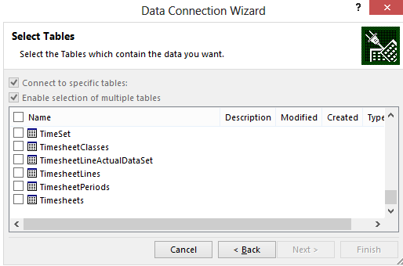
Developer/Backend Improvements
Better Eventing Model
Feedback From Event Handlers (OnUpdating, OnSubmitting)
Approval Routing Adjustment (OnReviewing, OnSubmitting)
Performance/Data Retention Improvements
Timesheet Jobs out of the Queue
Timesheet Improvements for Administrators and Developers in Project Web App

Slide 11
Timesheet Improvement
Demo
Project Online & Project Server 2013

Slide 12
Summary

Slide 13
Summary
Timesheets – source of most accurate timephased actual data
User-Facing and backend Improvements in 2013
Additional resources
TechNet Actuals Article: Best practices for submitting and reporting on actual work (Project Server 2010)
Key resources
Product http://www.microsoft.com/project
Blog http://blogs.office.com/b/project/
TechNet http://technet.microsoft.com/en-us/projectserver/fp123546
MSDN http://msdn.microsoft.com/en-us/office/aa905469
Forums http://social.technet.microsoft.com/Forums/en-US/category/project

Slide 14

© 2012 Microsoft Corporation. All rights reserved. Microsoft, Windows, Windows Vista and other product names are or may be registered trademarks and/or trademarks in the U.S. and/or other countries.
The information herein is for informational purposes only and represents the current view of Microsoft Corporation as of the date of this presentation. Because Microsoft must respond to changing market conditions, it should not be interpreted to be a commitment on the part of Microsoft, and Microsoft cannot guarantee the accuracy of any information provided after the date of this presentation. MICROSOFT MAKES NO WARRANTIES, EXPRESS, IMPLIED OR STATUTORY, AS TO THE INFORMATION IN THIS PRESENTATION.

