Slide 1
Current Project Approach
Unitech Wireless rollout services across 8 circles by 1st December 2009
Quantum of work increasing simultaneously across all functions, i.e.
- Network
- IT
- Marketing
- Sales & Distribution
- Real Estate (Admin & Facilities)
- Commercial
One single master project plan with individual function plan as its sub-tasks
Simultaneous updation in master project plan still an issue
Mitigation approach to give real time project information to be in place
Multiple ownership for single project plan

Slide 2
Proposed Approach
  Instead of having single project plan, we need to have hub / circle specific project plans
  Each project plan would include key activities/ milestones across functions which needs to be
  closely monitored
  Single ownership for individual project plans
  Centralized resource pool for optimum utilization
  Centralized and automated project tracking and monitoring
  Quantified reports with facts and data for senior management in line with business KPI’s

Slide 3
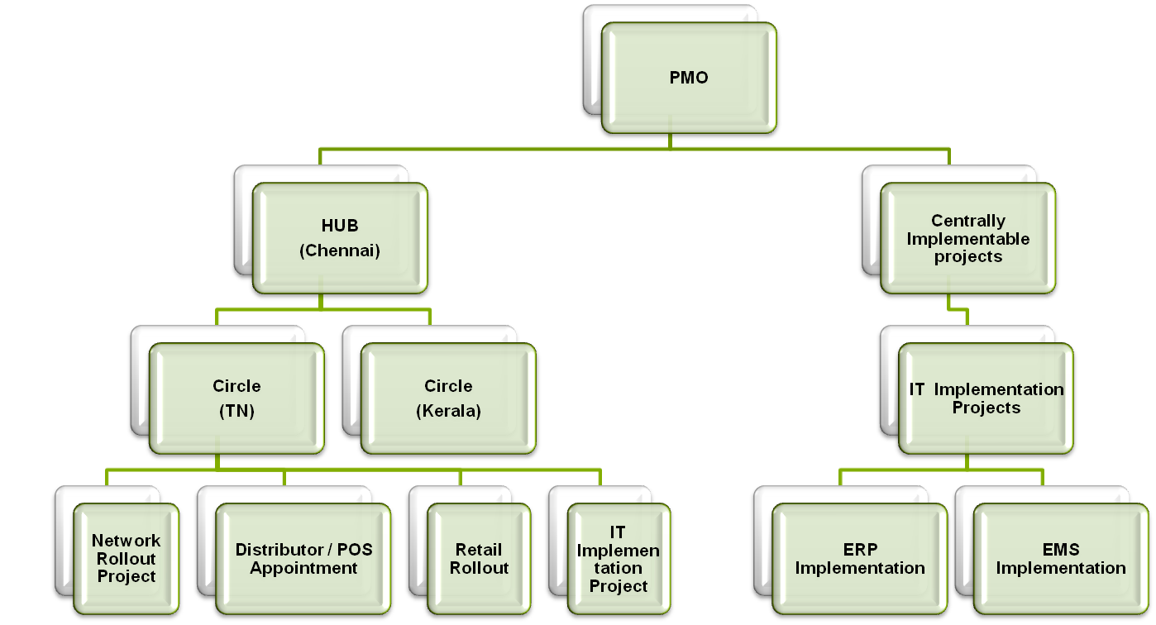
Proposed Plan Structure

Slide 4
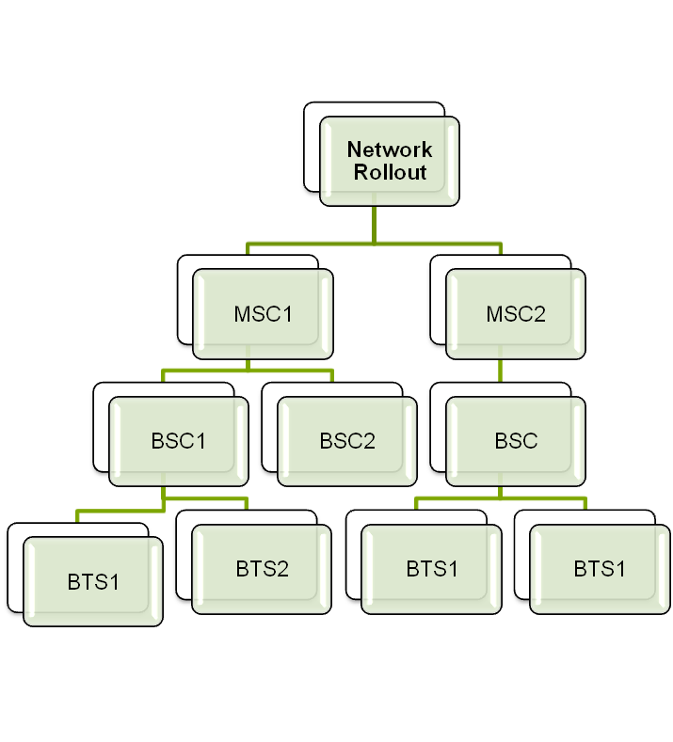
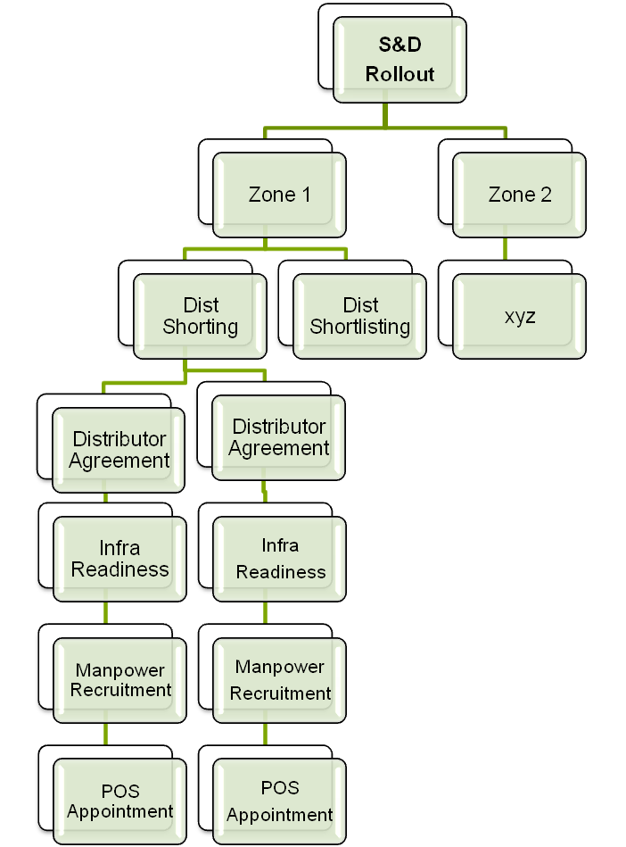
Proposed Plan Structure
Similar
activities
would
be replicated across zones
This structure would include all activities starting from MSC acquisition till the time BTS goes on AIr

Slide 5
Benefits of the Proposed Approach
Current Challenges | Mitigation Strategy
Cumbersome tracking and monitoring because of multiple ownership and complex project plan | Smooth tracking and monitoring through single ownership of every project plan and resources assigned to activities within that plan
Unavailability of quick real time data and hence wastage of time, energy and resource in report generation | Quicker reflection of real time data by achieving automatic generation of reports and dashboards - one time investment
No centralized resource pool | Centralized resource pool via EPM
No Centralised Document Mgmt | Centralized / Project specific Document Mgmt with version control
No Risks and Issue Mgmt | Individual Project Risks and Issues Mgmt

Slide 6
Way Ahead
Work streams to be identified for meeting initial target of 30th June.
All activities/milestones for identified work streams to be validated by
respective function heads.
Resource names to be reflected against each activities/milestones.
All dates mentioned in the project plan to be validated for effective monitoring.
All data and facts to be shared for tracking through the project plan.
All business reports/dashboards/alert mechanism to be identified by individual
streams owner in line with agreed KPI’s.
Clarity required on scope for Network in EPM and Rambase.

