Slide 1
Project Management Workshop
Trainer : Hari Prasad Thapliyal
(PMP, PMI-ACP, CSM, SPOC, SDC, SAM, MCT, SCT, MBA, MCA, PGDOM, PGDFM, CIC, PRINCE2-Practitioner, ZED Master Trainer)
[PMI-ACP : #318050]
[PMP : #1563385]
Copyright: Vedavit Project Solutions
hari.prasad@vedavit-ps.com
PMP, 'PMI-ACP‘ and 'PMI‘ are a registered marks of the Project Management Institute, Inc.

Slide 2
Workshop Agenda
Day 1:
PMI & PMP
Project Management Framework
Day 2:
Project Integration Management
Project Scope Management
Project Time Management
Day 3:
Project Cost Management
Project Quality Management
Project Human Resource Management
Day 4:
Project Communication Management
Project Stakeholder Management
Project Risk Management
Project Procurement Management
Professional Responsibility

Slide 3
Introduction

Slide 4
Project Management Framework

Slide 5
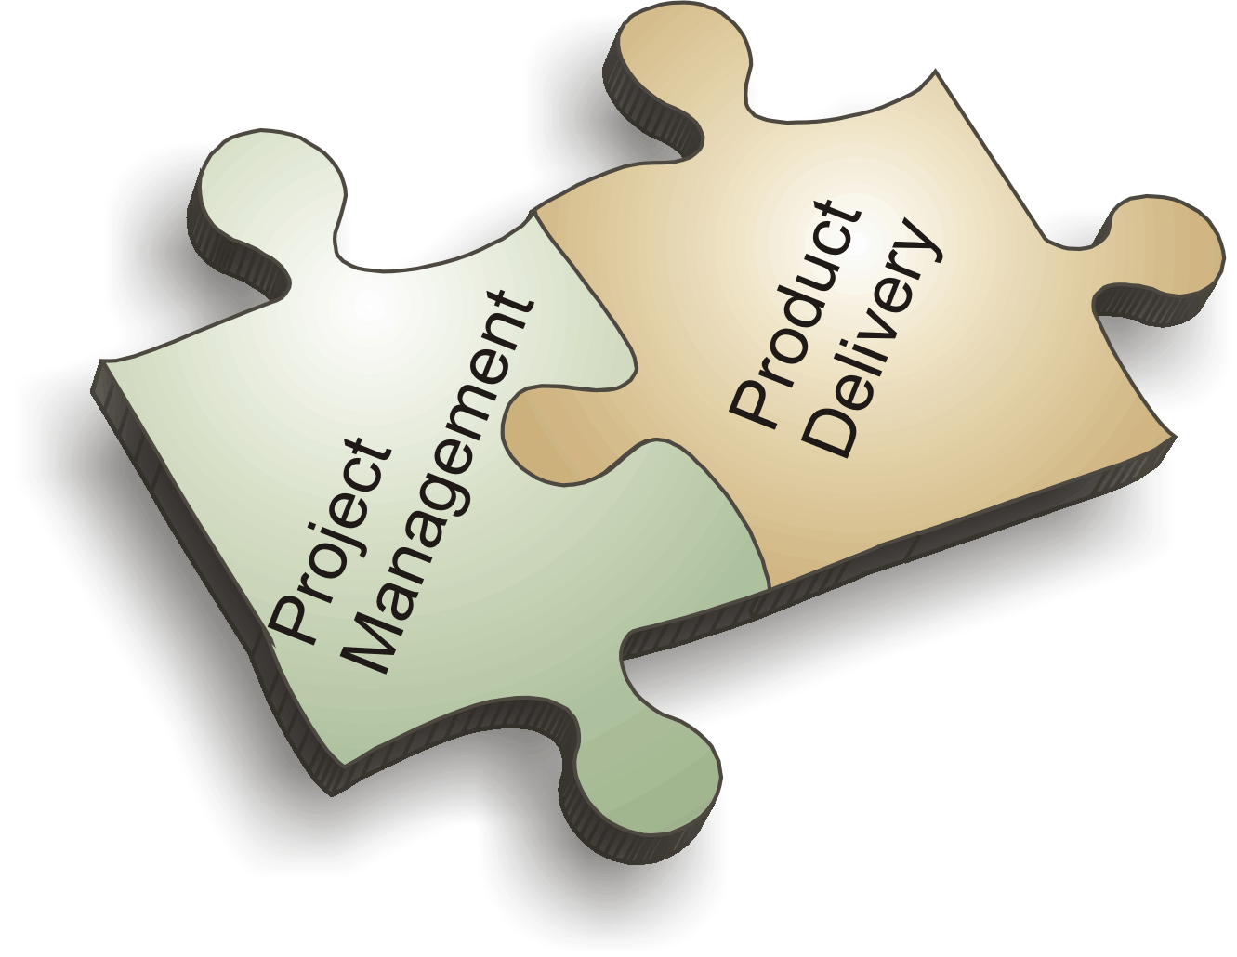

Slide 6
Topics
Project
Operations
Project Constraints
Project Phases, Milestones, Deliverables, Activities
Project Lifecycle (PLC) & Level of Activities
Typical Costing & Staffing across PLC
Risk, Cost of Change in PLC
Project Boundary
Relationship between Process Group & Phases
Project Management
Program Management
Portfolio Management
Program Management Office
Project Stakeholders
Stakeholder Register
Organization Types & Influence of Project Success
Project Management Methodologies
Configuration Management
Progressive Elaboration
Rolling Wave Planning
Project Documents
Project Management Plan
Organizational Process Assets
Enterprise Environmental Factors
Project Selection Criteria
Expert Judgement
Facilitation Techniques
Analytical Techniques
Meetings
Project Manager Responsibilities
Project Management Knowledge Areas
Process Groups

Slide 7
What is Project???

Slide 8
What is Project?
Project – A temporary endeavor undertaken to create a unique product, service or result
How Temporary?
Has a definite beginning and end, not an on-going effort
Ceases when objectives have been attained
Team is disbanded upon project completion
Unique?
The product or service is different in some way from other product or services
Product characteristics are progressively elaborated

Slide 9
Project has…
Project Characteristics
Goal (measurable/verifiable) Oriented
Finite duration with a beginning and end
Uniqueness to a great extent and related uncertainties
Coordinated undertaking of interrelated activities
Performing the activities involve resources
Resources cost money

Slide 10
Source of Project?
Need for improvement
Market Competition
Strategic/ Mission/ Vision
Government Regulation
Environmental Forces

Slide 11
“Projects” different from “operations”?
Contrast Projects & Operations
Projects
Permanent Project Charter
Catalyst for change
Unique product or service
Heterogeneous teams
Start and end date
Progressive elaboration
Operations
Semi-permanent charter
Maintains status quo
Standard product or service
Homogeneous teams
Ongoing
Predefined product

Slide 12






Project Constraints
Risk
Scope
Project and Product Quality
Schedule
Cost
Resource

Slide 13
Project Phases
Project Phases
Projects are divided into phases where extra control is required to effectively manage the completion of the major deliverables
Collectively, the project phases put together is known as Project life cycle
Each phase is marked by one or more tangible verification work product
The conclusion of a project phase is generally marked by a review
The phase end points are referred to as phase exits, milestones, phase gates, decision gates, stage gates or kill points
Starting a phase before approval of deliverables of a previous phase is called Fast Tracking
Phases are not cyclical they are sequential
Phases are not deliverables but deliverables are part of a Phase
E.g. Product Feasibility, Product Prototyping, Product Design, Development, System Testing, Deployment, Concept development, Customer requirements, Solution development, Build, Test, Transition, Commissioning

Slide 14
Milestones, Deliverables
Deliverables
Work product, product component developed by the project team
E.g. Wireframe, Database ER Diagrams, Sequence Diagram, Test Case, Test Results, Any Feature of the Product.
Milestone
Zero Duration Activity. Mark of Completion of some set of activities with deliverables
E.g. Design Complete, Security Testing Complete, Requirement Gathering Complete, Quality Audit Complete, Development Complete, Deployment Complete

Slide 15
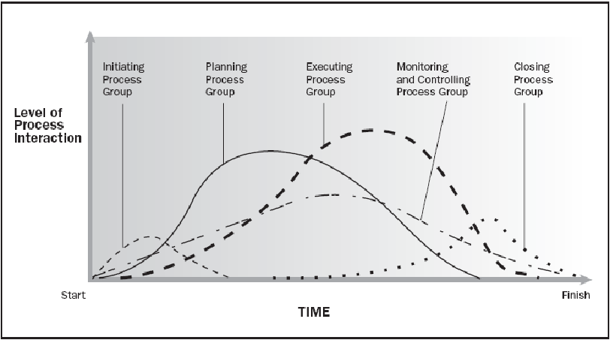
Project Lifecycle (PLC) & Level of Activities
Source PMBOK Guide Version 6.0

Slide 16
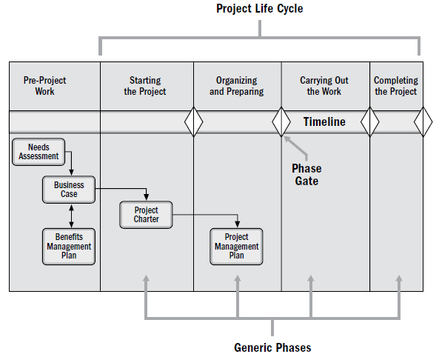
Typical Project Lifecycle
Source PMBOK Guide Version 6.0

Slide 17
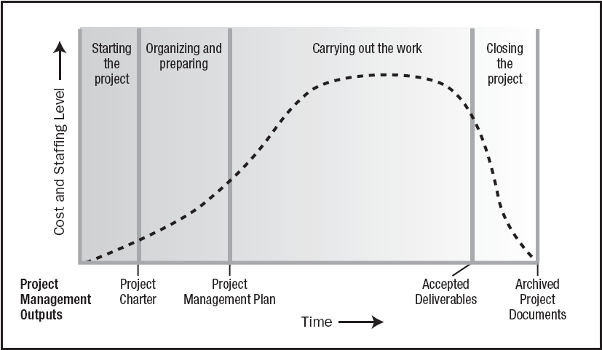
Typical Costing & Staffing across PLC
Source PMBOK Guide Version 6.0

Slide 18
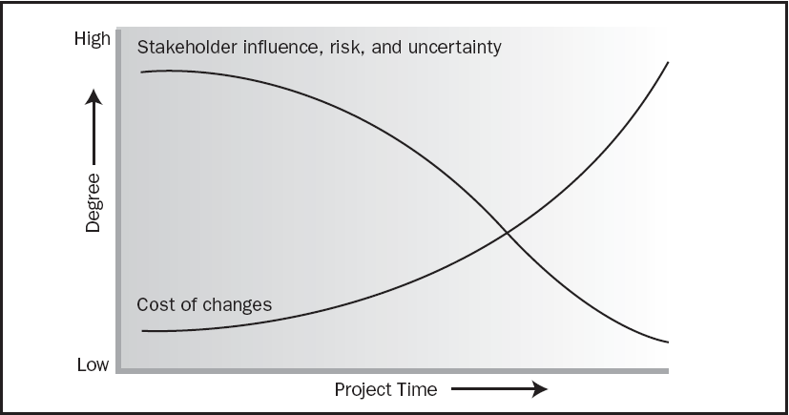
Risk, Cost of Change in PLC
Source PMBOK Guide Version 6.0

Slide 19
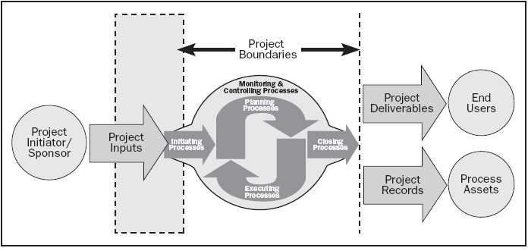
Project Boundaries are Important!
Project Boundaries
Source PMBOK Guide Version 6.0

Slide 20
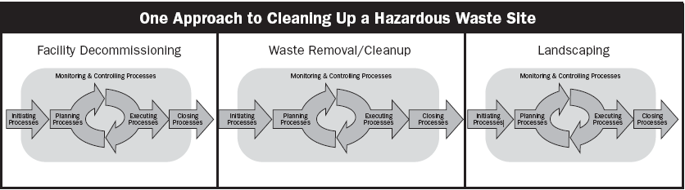
Relationship between Process Group & Phases
Source PMBOK Guide Version 6.0

Slide 21
Project Management
Project Management
The application of knowledge, skills, tools and techniques to project activities in order to meet the project requirements

Slide 22
Benefits of Project Management
Meet business objectives;
Satisfy stakeholder expectations;
Be more predictable;
Increase chances of success;
Deliver the right products at the right time;
Resolve problems and issues;
Respond to risks in a timely manner;
Optimize the use of organizational resources;
Identify, recover, or terminate failing projects;
Manage constraints (e.g., scope, quality, schedule, costs, resources);
Balance the influence of constraints on the project (e.g., increased scope may increase cost or schedule); and
Manage change in a better manner.

Slide 23
What is Program?
Project Management Context
Group of related projects managed in a coordinated way to obtain the benefits and control which will not be possible from managing them individually
Scope is least important. Benefit(s) are primary goal. Program manager is not responsible for delivery but for benefit realization. Addition/removal of projects in a program is in the hand of Program Manager
Several projects are required under a program because of different technology, different skills & different kind of teams, parallel work, different type of deliverables.
e.g. Bringing a new product (from conceptualization to Sale all project), New satellite in space, Health improvement of a cancer patient. An IT company want to enter into new market with Cloud Services for the customer.

Slide 24
Project Portfolio Management
Project Management Context
Collection of projects or programs and other work that are grouped together to facilitate effective management of that work to meet strategic business objectives
CEO (Mission/Vision)
Strategy
Portfolios
A Consumer Electronics Company
Laptop
TV
Servers
OS
Health
Education
Rehabilitation
An NGO

Slide 25
Relationship Between PPP
CEO
Portfolio 1
Portfolio 2
Program 1
Project A
Sub Portfolio 1-1
Sub Portfolio 1-2
Program 3
Program 2
Project 3
Project 4
Project 1
Project 2

Slide 26
PPP Overview
 | Project | Program | Portfolio
Definition | Temporary endeavor- unique P/S/R | Group of related projects, sub-prog, prog-activities to obtain benefits | Collection of Project/Prog/Sub-Portfolio/Operation to achieve strategic objective
Scope | Defined objective. Scope progressive elaborate. | Output and outcome of program component produce benefits to the org. | Changes with the change of org strategic objective
Change | Manage change in output | Manage changes in benefits from prog components | Manage changes in external/internal environment and impact on strategy
Planning | Plan progressively with high level plan | High level to track inter-dependencies of prog components. Guide for proj planning | Process to aggregate portfolio from program and project
Management | Project Team | Coordinating between project team to ensure program benefits | Portfolio staff which coordinate to aggregate results for portfolio
Monitoring | Monitor and Control the work which produce unique P/S/R | Monitor and Control the work which ensure program goal, objective, schedule, budget, benefits | Monitor and Control strategic change and resource allocation
Success | Cost, Time, Quality, Customer Satisfaction | Ability to deliver intended benefits in efficient way | ROI

Slide 27
What is PMO?
Project Management Office
Managing shared resources across all project administered by PMO
Identifying and developing project management methodology, best practices and standards
Coaching, mentoring, training and oversight
Monitoring compliance with project management standards, policies, procedures and templates via project audits
Developing and managing project policies, procedures, templates and other shared documentation (organizational process assets), and
Coordinating communication across projects

Slide 28
Who are Stakeholders?
Stakeholders
Persons or organizations who are actively involved in the project or whose interests maybe positively or negatively affected by the performance or completion of the project
Source PMBOK Guide Version 6.0

Slide 29
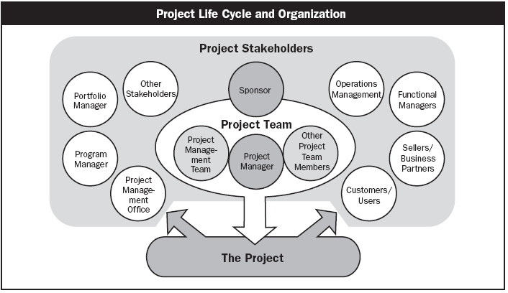
Stakeholders
Source PMBOK Guide Version 6.0

Slide 30
Stakeholder Register
ID
Name
Department
Internal vs External
Designation
Manager
Power (1-10)
Interest (1-10)
Current Position (Favorable, Against, Neutral)
Needed Position
Person Attributes (food, philosophy, ideology etc)
Person Preferences
Contact Details

Slide 31
Organizational Types
Functional
Matrix
Weak Matrix
Balanced Matrix
Strong matrix
Projectized

Slide 32
Functional
Chief Executive
Project Coordination
Functional Manager
Functional Manager
Functional Manager
Staff
Staff
Staff
Staff
Staff
Staff
Staff
Staff
Staff

Slide 33
Weak Matrix
Chief Executive
Functional Manager
Functional Manager
Functional Manager
Staff
Staff
Staff
Staff
Staff
Staff
Staff
Staff
Staff
Project Coordination

Slide 34
Balance Matrix
Chief Executive
Functional Manager
Functional Manager
Functional Manager
Staff
Staff
Staff
Staff
Staff
Staff
Project Manager
Staff
Staff
Project Coordination

Slide 35
Strong Matrix
Chief Executive
Functional Manager
Functional Manager
Functional Manager
Manager of Project Managers
Staff
Staff
Staff
Project Manager
Staff
Staff
Staff
Project Manager
Staff
Staff
Staff
Project Manager
Project Coordination

Slide 36
Projectized Matrix
Project Coordination
Chief Executive
Project Manager
Project Manager
Project Manager
Staff
Staff
Staff
Staff
Staff
Staff
Staff
Staff
Staff

Slide 37
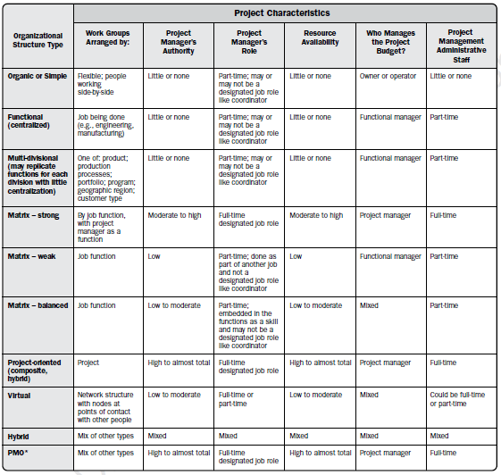
Organizational Influence
Source PMBOK Guide Version 6.0

Slide 38
Project Management Methodologies
All projects are not same. Bases on the project characteristics a project manager need to select a right PMM to deliver a project successfully. Broadly methodologies can be categorized in the 3 groups.
Waterfall Development
Iterative Development
Agile Development

Slide 39
Configuration Management System
A system to manage project artifacts, project’s product and project’s product’s components.
It helps in versioning, naming, storing, archiving, backup, securing project and product output.
e.g. SVN, VSS, TFS

Slide 40
Progressive Elaboration
Project scope unfolds during the project execution. Scope of the next phase depends upon the output or success of previous phase.
It is Scope Management Concept.

Slide 41
Rolling Wave Planning
Activities of any deliverable can be known when we know what need to delivered.
Attribute of the activities can be known only when we know what are the activities and what is deliverable.
It is Time Management Concept.

Slide 42
Project Documents
Documents being managed by the project team to perform the project
Document provided by customers, vendors, government agencies, management
Documents which are prepared by the team like Design Related, Requirement Related, Issue Register, Risk Register, Change Log
All document must be managed using some Configuration Management Tool.

Slide 43
Project Management Plan
Project Management Plan includes
All Subsidiary Plan (Configuration, Cost, Risk etc)
All Baselines Related to Project
Project Management Methodology
Project Lifecycle and Project Phases
Process Tailored List
Tailored Process

Slide 44
Project Benefits Management Plan
Target benefits (e.g., the expected tangible and intangible value to be gained by the implementation of the project; financial value is expressed as net present value);
Strategic alignment (e.g., how well the project benefits align to the business strategies of the organization);
Timeframe for realizing benefits (e.g., benefits by phase, short-term, long-term, and ongoing);
Benefits owner (e.g., the accountable person to monitor, record, and report realized benefits throughout the timeframe established in the plan);
Metrics (e.g., the measures to be used to show benefits realized, direct measures, and indirect measures);
Assumptions (e.g., factors expected to be in place or to be in evidence); and
Risks (e.g., risks for realization of benefits).

Slide 45
Subsidiary Plan
Subsidiary plan need to be developed for each aspect of the project. For every aspect (Scope, Time, Cost, Quality, Resources, Communication, Risk, Stakeholder) you need to know following
What are the activities which need to be done?
Who will perform these? Is any training required to perform these activities.
When these activities will be performed?
How will you measure success?
What tool you will use for this?
How will you execute the work of this aspect?
How will you control this aspect?
Most of these activities are related to Planning of the Plan and NOT of the planning of Execution

Slide 46
Organizational Process Assets
Process Assets which created by the organization while doing the project in past
Processes, Standards, Guidelines, Checklist, Templates standardized by the Quality Department or PMO
Lessons learned report of the previous projects
Consider them for project Initiation, Planning, Executing, Monitoring & Controlling and Closing. Do not reinvent the wheel in project management.
e.g. Time/Cost/Resource Estimation database, Risk database, Issue Register, Skills Database

Slide 47
Enterprise Environmental Factors
Constraints which are not in control of a Project Manager and the project manager has to consider them to make project successful.
These constraints are imposed by environment of those enterprises which are involved in the project
Consider them for project Initiation, Planning, Executing, Monitoring & Controlling and Closing
e.g. Skill Availability, Market Condition, Attitude of People, Organization Culture, Climatic Condition, Political Condition, Bosses etc.

Slide 48
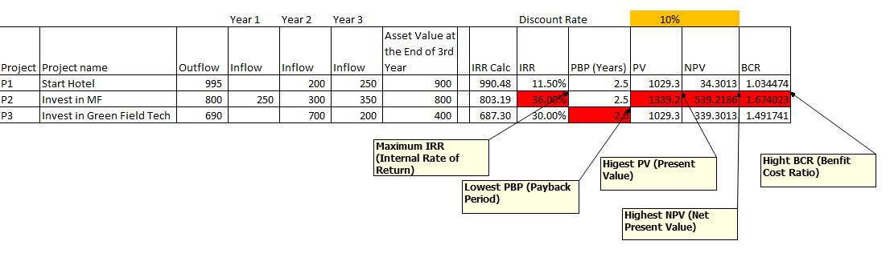
Project Selection Criteria
PBP- Payback Period is a time in which original invest is realized.
PV = FV / (1+ r)^n
PV= Present Value
FV= Future Value
r = Discount Rate
n = Number of Years
NPV = Inflow – Outflow (Take Positive Value)
IRR = A discount rate at which [Outflow – Inflow =0 ]
BCR = Benefits (Present Value) / Cost (Output)

Slide 49
Expert Judgement
Being an industry neutral, domain neutral, culture neutral standard PMBOK provides you a unique tool to deliver a successful project. This tool is called expert judgment.
Project managers highly rely on industry specific skills, input from local market experts, those who have done similar work earlier
E.g. SME, A department within Organization, Industry Group, Consultants, Experienced People within Org or Industry

Slide 50


Facilitation Techniques
Facilitation techniques enable us to conduct the fruitful sessions.
Structured problem solving/decision making
Working in pairs or trios
Three star rating
Round Robin
Ranking
Multi voting
Meta-planning (PostIt Note on Wall)
Ice Breakers
Group Review
Go Wild (wouldn’t it be good if…)
Flipchart
Brainstorming/ Reverse Brainstorming
Action planning

Slide 51

Analytical Techniques
Analytical techniques enable us to examine complex relationships between variables
Regression Analysis (Dependent/outcome variable is directly affected by one or more independent variables)
Grouping Methods
BCG (Boston) matrix
Brainstorming
Benchmarking
Gap Analysis
Mind Maps
Pareto principle, Pareto principle 80-20 rule
Six Questions
SWOT Analysis
Causal Analysis
Root Cause Analysis
Forecasting Methods (time series, simulation, scenario building etc)
Failure Mode and Effect Analysis (FMEA)
Fault Tree Analysis (FTA)
Reserve Analysis
Trend Analysis
Earned Value Management
Variance Analysis

Slide 52

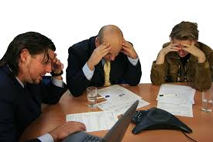
Meetings
Meetings with stakeholders helps us understand their viewpoint which is critical for making decisions.
F2F
Virtual
Formal
Informal
Standup Meeting
Kickoff Meetings
Adhoc Meeting
Review Meeting
Off-site Meetings
On-Site Meeting

Slide 53
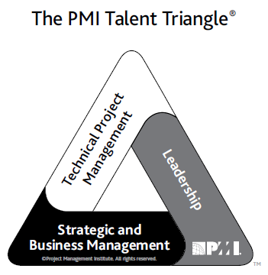
PMI Talent Triangle
Technical project management. The knowledge, skills, and behaviors related to specific domains of project, program, and portfolio management. The technical aspects of performing one’s role.
Leadership. The knowledge, skills, and behaviors needed to guide, motivate, and direct a team, to help an organization achieve its business goals.
Strategic and business management. The knowledge of and expertise in the industry and organization that enhanced performance and better delivers business outcomes.
Source PMBOK Guide Version 6.0

Slide 54
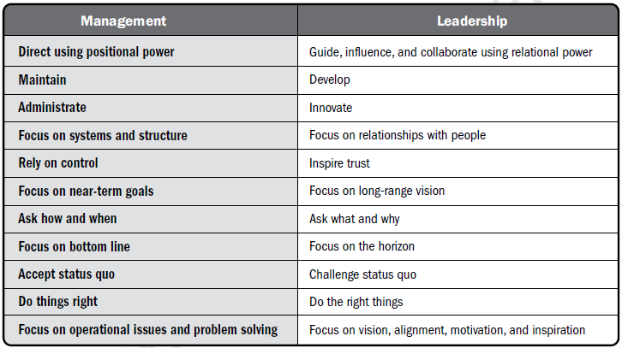
Management & Leadership
Source PMBOK Guide Version 6.0

Slide 55
PM Competencies
A Framework
Project Manager Competency Development Framework- 2nd Edition, 2007

Slide 56

Project Manager Responsibilities
Project Manager’s Role
Estimates of size, efforts & schedule
Risk identification, analysis, prioritization, monitoring & control
Resource allocation, resource backup and utilization
Scope management
Communication- reviews, steering committee meetings, stakeholder identification and expectation management
Stakeholder Expectation Management
Defect free product delivery on time within budget
Team motivation, team management, training & development, appreciation, career planning, interview
Deliver as per contract & proposal
Procure as per contract & proposal
Configuration management, data backup
Quality planning
Cost optimization
Presales & proposals
Technical guidance to team – if team members are not available do their work (after project manager has completed his work & he has spare time)

Slide 57
Project Manager Responsibilities
Project Manager’s Responsibilities in Project Lifecycle
Initiating a Project
Project aligned with org objectives & customer needs
High-level risks, assumptions and constraints are understood
Stakeholders identified and their need are understood
Project Charter approved
Planning a Project
Project scope agreed
Project schedule approved
Cost budget approved
Project team identified with roles and responsibilities agreed
Communication activities agreed
Quality management process established
Risk response plan approved
Integrated change control processes defined
Procurement plan approved
Project Plan approved

Slide 58
Project Manager Responsibilities
Project Manager’s Responsibilities in Project Lifecycle
Executing a Project
Project scope achieved
Project stakeholders expectations managed
Human resource managed
Quality managed against plan
Material resources managed
Monitoring & Controlling a Project
Project tracked and status communicated to stakeholders
Project change is managed
Quality is monitored and controlled
Risk is monitored and controlled
Project team managed
Contract administered
Closing a Project
Project outcomes accepted
Project resources released
Stakeholder perceptions measured and analyzed
Project formally closed

Slide 59
Project Manager Competencies
Personal Competence
Communication
Leading
Managing
Cognitive Ability
Effectiveness
Professionalism

Slide 60


Project Management Knowledge Areas
7- Communication
Project Manager
2- Scope
6- Human Resources
1- Integration
3-Time
9- Procurement
4- Cost
10- Stakeholders
5- Quality
8- Risk

Slide 61





Process Groups
Monitoring & Controlling
Executing
Initiating
Planning
Closing

