Slide 1
Project Integration Management

Slide 2
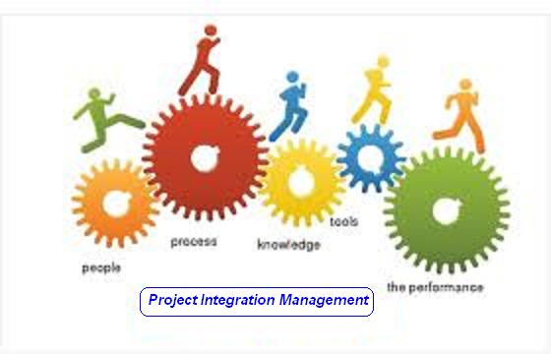

Slide 3
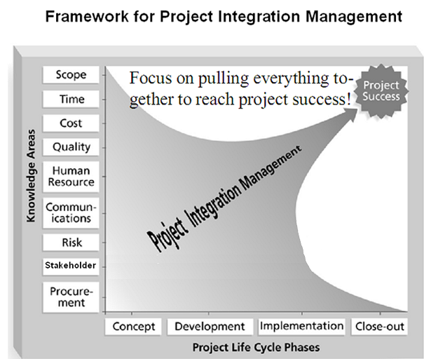

Slide 4
Project Integration Management
Processes and activities needed to identify, define, combine, unify, and coordinate the various processes and project management activities within the Project Management Process Groups

Slide 5
Project Integration Management
Develop Project Charter [INITIATING]
Develop Project Management Plan [PLANNING]
Direct and Manage Project Execution [EXECUTING]
Manage Project Knowledge [EXECUTING]
Monitor and Control Project Work [M&C]
Perform Integrated Change Control [M&C]
Close Project or Phase [CLOSING]

Slide 6
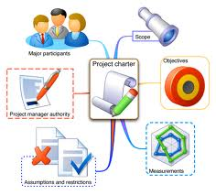
1. Develop Project Charter
The process of developing a document that formally authorizes the existence of a project and provides the project manager with the authority to apply organizational resources to project activities.

Slide 7
Develop Project Charter
PIM
INIT
.1 Business documents
• Business case
• Benefits management plan
.2 Agreements
.3 EEFs
.4 OPA
.1 Expert judgment
.2 Data gathering
• Brainstorming
• Focus groups
• Interviews
.3 Interpersonal and team skills
• Conflict management
• Facilitation
• Meeting management
.4 Meetings
.1 Project charter
.2 Assumption log

Slide 8
Project Charter Template
Project purpose or justification
Measurable project objectives and related success criteria
High – Level Requirements
High – Level Project description
High – Level Risks
Summary milestone schedule
Summary Budget
Project approval requirements
Assigned project manager, responsibility, and authority level
Name and authority of the sponsor or other person(s) authorizing the project charter

Slide 9
Exercise-1
15 Minutes
Prepare Project Charter for your Project

Slide 10

2. Develop Project Management Plan
The process of defining, preparing, and coordinating all plan components and consolidating them into an integrated project management plan.

Slide 11
Develop Project Management Plan
PIM
PLAN
.1 Project charter
.2 Outputs from other processes
.3 EEFs
.4 OPAs
.1 Expert judgment
.2 Data gathering
• Brainstorming
• Checklists
• Focus groups
• Interviews
.3 Interpersonal and team skills
• Conflict management
• Facilitation
• Meeting management
.4 Meetings
.1 Project management plan

Slide 12
Exercise-2
5 Minutes
Write name of all type of subsidiary plans for your Project

Slide 13

3. Direct & Manage Project Work
The process of leading and performing the work defined in the project management plan and implementing approved changes to achieve the project’s objectives.

Slide 14
Direct and Manage Project Work
PIM
EXEC
.1 Project management plan
• Any component
.2 Project documents
• Change log
• Lessons learned register
• Milestone list
• Project communications
• Project schedule
• RTM
• Risk register
• Risk report
.3 Approved change requests
.4 EEFs
.5 OPAs
.1 Expert judgment
.2 Project management information system
.3 Meetings
.1 Deliverables
.2 Work performance data
.3 Issue log
.4 Change requests
.5 PMP updates
• Any component
.6 Project documents updates
• Activity list
• Assumption log
• Lessons learned register
• Requirements Docs.
• Risk register
• Stakeholder register
.7 OPAs Updates

Slide 15
Exercise-3
5 Minutes
Write name of Deliverables & Name of work performance information for your Project

Slide 16

4. Manage Project Knowledge
The process of using existing knowledge and creating new knowledge to achieve the project’s objectives and contribute to organizational learning.

Slide 17
Manage Project Knowledge
PIM
EXEC
.1 Project management plan
• All components
.2 Project documents
• Lessons learned register
• Project team assignments
• Resource breakdown structure
• Source selection criteria
• Stakeholder register
.3 Deliverables
.4 EEFs
.5 OPAs
.1 Expert judgment
.2 Knowledge management
.3 Information management
.4 Interpersonal and team skills
• Active listening
• Facilitation
• Leadership
• Networking
• Political awareness
.1 Lessons learned register
.2 Project management plan
updates
• Any component
.3 OPAs updates

Slide 18
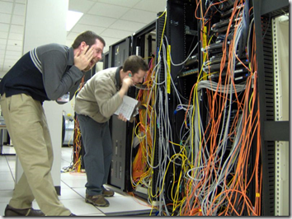
5. Monitor & Control Project Work
The process of tracking, reviewing, and reporting overall progress to meet the performance objectives defined in the project management plan.

Slide 19
Monitor and Control Project Work
PIM
M&C
.1 Project management plan
• Any component
.2 Project documents
• Assumption log
• Basis of estimates
• Cost forecasts
• Issue log
• Lessons learned register
• Milestone list
• Quality reports
• Risk register
• Risk report
• Schedule forecasts
.3 Work performance information
.4 Agreements
.5 EEFs
.6 OPA
.1 Expert judgment
.2 Data analysis
• Alternatives analysis
• Cost-benefit analysis
• Earned value analysis
• Root cause analysis
• Trend analysis
• Variance analysis
.3 Decision making
.4 Meetings
.1 Work performance reports
.2 Change requests
.3 PMP updates
• Any component
.4 Project documents updates
• Cost forecasts
• Issue log
• Lessons learned register
• Risk register
• Schedule forecasts

Slide 20
Exercise-4
5 Minutes
Write type & name of a few change requests for your Project

Slide 21

6. Perform Integrated Change Control
The process of reviewing all change requests; approving changes and managing changes to deliverables, organizational process assets, project documents, and the project management plan; and communicating the decisions.

Slide 22
Perform Integrated Change Control
PIM
M&C
.1 Project management plan
• Change management plan
• Configuration management plan
• Scope baseline
• Schedule baseline
• Cost baseline
.2 Project documents
• Basis of estimates
• Requirements traceability matrix
• Risk report
.3 Work performance reports
.4 Change requests
.5 EEFs
.6 OPAs
.1 Expert judgment
.2 Change control tools
.3 Data analysis
• Alternatives analysis
• Cost-benefit analysis
.4 Decision making
• Voting
• Autocratic decision making
• Multicriteria decision analysis
.5 Meetings
.1 Approved change requests
.2 PMP updates
• Any component
.3 Project documents updates
• Change log

Slide 23
Exercise-5
5 Minutes
Write change management process for your Project OR
Prepare a format of change request report for your project

Slide 24

7. Close Project or Phase
The process of finalizing all activities for the project, phase, or contract.

Slide 25
Close Project or Phase
PIM
Closing
.1 Project charter
.2 Project management plan
• All components
.3 Project documents
• Assumption log
• Basis of estimates
• Change log
• Issue log
• Lessons learned register
• Milestone list
• Project communications
• Quality control measurements
• Quality reports
• Requirements
documentation
• Risk register
• Risk report
.4 Accepted deliverables
.5 Business documents
• Business case
• Benefits management plan
.6 Agreements
.7 Procurement documentation
.8 OPA
.1 Expert judgment
.2 Data analysis
• Document analysis
• Regression analysis
• Trend analysis
• Variance analysis
.3 Meetings
.1 Project documents updates
• Lessons learned register
.2 Final product, service, or result transition
.3 Final report
.4 OPA updates

Slide 26
Exercise-6
5 Minutes
Write name of documents submitted to organization deliveries made to customer for your Project at the end of your project or project phase.

Slide 28
Project Scope Management

Slide 29


Slide 30
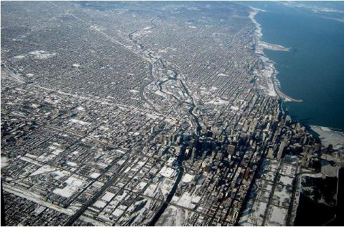





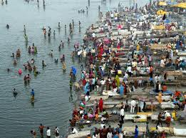
Level of Detailing in Scope

Slide 31
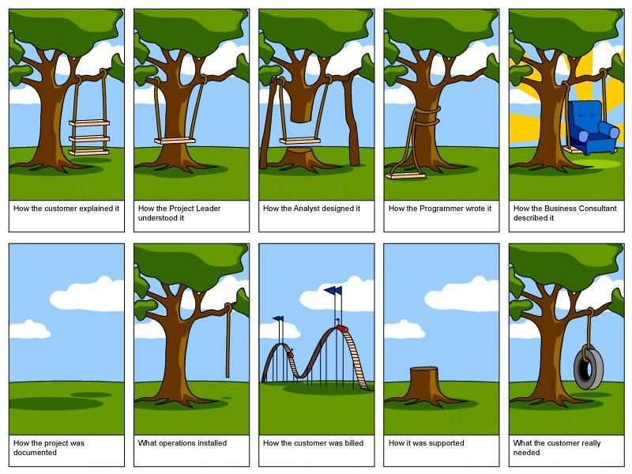
How the customer explained it
How the Project Leader understood it
How the Architect Designed it
How the Programmer wrote it
How the Business Consultant described it
How the project was documented
How operations installed it
What the customer really needed
How the customer was billed
How it was supported

Slide 32
Scope
Project Scope "The work that needs to be accomplished to deliver a product, service, or result with the specified features and functions."
Product Scope "The features and functions that characterize a product, service, or result."

Slide 33
Project Scope Management
Processes required to ensure that the project includes all the work required, and ONLY the work required to complete the project successfully

Slide 34
Project Scope Management
Plan Scope Management [PLANNING]
Collect Requirements [PLANNING]
Define Scope [PLANNING]
Create WBS [PLANNING]
Validate Scope [M&C]
Control Scope [M&C]

Slide 35
8. Plan Scope Management
Documenting how the project scope will be defined, validated and controlled

Slide 36
Plan Scope Management
PSM
PLAN
.1 Project charter
.2 Project management plan
• Quality management plan
• Project life cycle description
• Development approach
.3 EEFs
.4 OPAs
.1 Expert judgment
.2 Data analysis
• Alternatives analysis
.3 Meetings
.1 Scope management plan
.2 Requirements management plan

Slide 37
Plan Scope Management IO
Scope Management Plan includes
Process for preparing project scope statement (PSS)
Process that enable creation of WBS from PSS
Process that specifies how formal acceptance be obtained
Process to control changes to details PSS
Requirement Management Plan includes
Process of analyzing, documenting and managing requirements
Process of requirement prioritization
Product measurement metrics and their rationale
RTM structure
Configuration management activities related to product

Slide 38

9. Collect Requirements
The process of determining, documenting, and managing stakeholder needs and requirements to meet project objectives.

Slide 39
Collect Requirements
PSM
PLAN
.1 Project charter
.2 Project management plan
• Scope management plan
• Requirements management plan
• Stakeholder engagement plan
.3 Project documents
• Assumption log
• Lessons learned register
• Stakeholder register
.4 Business documents
• Business case
.5 Agreements
.6 EEFs
.7 OPAs
.1 Expert judgment
.2 Data gathering
• Brainstorming
• Interviews
• Focus groups
• Questionnaires and surveys
• Benchmarking
.3 Data analysis
• Document analysis
.4 Decision making
• Voting
• Multicriteria decision analysis
.5 Data representation
• Affinity diagrams
• Mind mapping
.6 Interpersonal and team skills
• Nominal group technique
• Observation/conversation
• Facilitation
.7 Context diagram
.8 Prototypes
.1 Requirements documentation
.2 Requirements traceability matrix

Slide 40


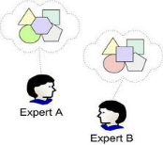
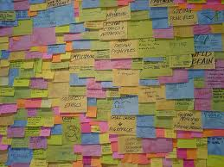
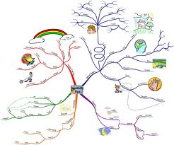
Collect Requirements
Focus groups
Guided by moderator, group’s final opinion is taken
Group creativity techniques
Brain storming
Nominal group techniques: Brainstorming only on most voted
Delphi Techniques: Only selected experts answers. Who answered what is not shared
Idea Mapping techniques: Individuals ideas mapped on single map
Affinity diagrams: Grouping and sorting of ideas for discussion
Group decision making techniques
Majority, Unanimity, Plurality, Dictatorship

Slide 41
Requirement Traceability Matrix
Tracing Requirements to
Business needs, opportunities, goals & objectives
Project objectives
Project scope/WBS deliverables
Product design
product development
Test strategy and test scenarios
Traces high-level requirements to more detailed requirements.
Attributes in RTM can be
Unique identified
Textual description of requirement
Rationale for inclusion
Owner
Source
Priority
Version
Current Status (active, cancelled, differed, added, approved)
Date completed
Stability
Complexity
Acceptance Criteria

Slide 42
Requirement vs Scope
Scope and requirement are two different things.
Requirements are only those, which are in scope!
Requirements are driven from scope
Boundaries are defined first (using SOW), requirements are collected next
Requirement must be measurable, testable, traceable, complete, consistent and acceptable to key stakeholders.

Slide 43
Requirement Documentation includes
Business need or opportunity to be seized, describing the limitation of the current situation and why the project has been undertaken
Business and project objectives for traceability
Functional requirements, describing business process, information, and interaction with the product, as appropriate which can be documented textually in a requirements list, in models, or both
Non-functional requirements like SLA, performance, safety, security, compliance, supportability, retention/purge
Quality requirements
Acceptance criteria
Business rules stating the guiding principles
Impacts to other organizational areas call centre, technology centre, sales force
Impacts to other entities inside or outside the performing organization
Support and training requirements
Requirements assumptions and constraints

Slide 44
Discussion/Exercise-7
5 Minutes
How to collect, analyze, document, prioritize, manage req; how change should be initiated and impact analysis done; Tracking changes, configuration management activities, RTM structure
Write Requirement Management Plan for your projects OR
Write Columns of RTM for your project

Slide 45

10. Define Scope
Developing a detailed description of the project and product.

Slide 46
Define Scope
PSM
PLAN
.1 Project charter
.2 Project management plan
• Scope management plan
.3 Project documents
• Assumption log
• Requirements documentation
• Risk register
.4 EEFs
.5 OPAs
.1 Expert judgment
.2 Data analysis
• Alternatives analysis
.3 Decision making
• Multicriteria decision analysis
.4 Interpersonal and team skills
• Facilitation
.5 Product analysis
.1 Project scope statement
.2 Project documents updates
• Assumption log
• Requirements documentation
• Requirements traceability matrix
• Stakeholder register

Slide 47
Define Scope
Product Analysis
Product breakdown
System analysis
Requirement analysis
System engineering: Deals with multiple complex systems
Value engineering: Functions, value, cost
Retain the function & value and reduce the cost
Value analysis: Debate the function and its cost
Discuss the value of function vs the cost
Alternative Identification
Alternative way of doing work

Slide 48
Scope Statement
Scope statement has following sections
Product Scope Description
Product Acceptance Criteria
Project Deliverables
Project Exclusions
Project Constraints (budget, imposed date, scheduled milestones, contractual provisions)
Project Assumptions
Organizational policies
Available skilled resources

Slide 49
Discussion/Exercise 8
5 Minutes
Product Scope Description, Product Acceptance Criteria, Project Deliverables
Project Exclusions, Project Constraints (budget, imposed date, scheduled milestones, contractual provisions), Project Assumptions, Organizational policies, Available skilled resources
Write Project Scope Statement for your project

Slide 50
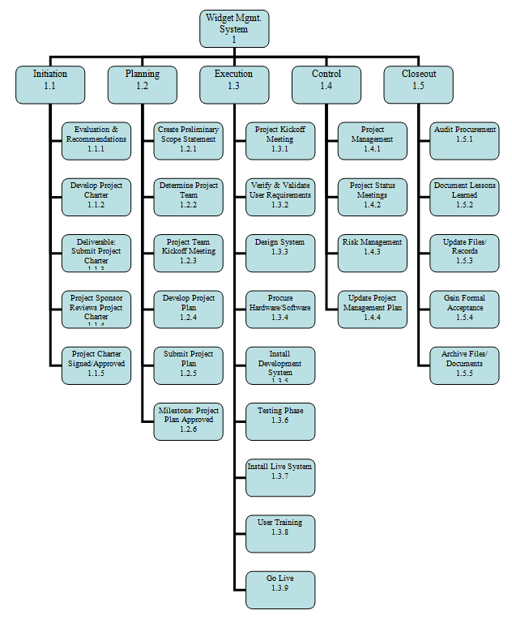
11. Create WBS
Subdividing project deliverables and project work into smaller, more manageable components.

Slide 51
Create WBS
PSM
PLAN
.1 Project management plan
• Scope management plan
.2 Project documents
• Project scope statement
• Requirements documentation
.3 EEFs
.4 OPAs
.1 Expert judgment
.2 Decomposition
1 Scope baseline
.2 Project documents updates
• Assumption log
• Requirements documentation

Slide 52
Scope baseline
Scope baseline is part of PMP, Scope baseline includes
Project Scope Statements
WBS
WBS Dictionary

Slide 53
WBS Types
Phase Driven
Department Driven
Milestone Driven
Component Driven
Location Driven
…….

Slide 54
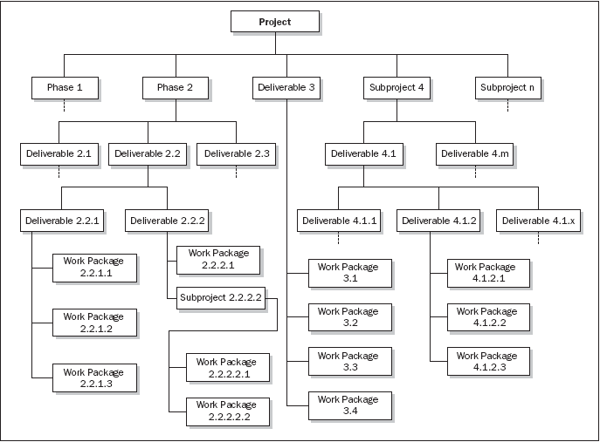
Phase oriented WBS

Slide 55
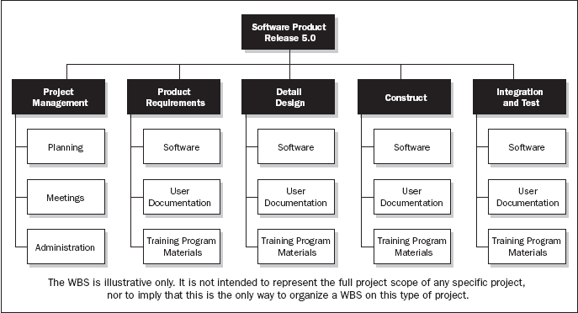
Department oriented WBS

Slide 56
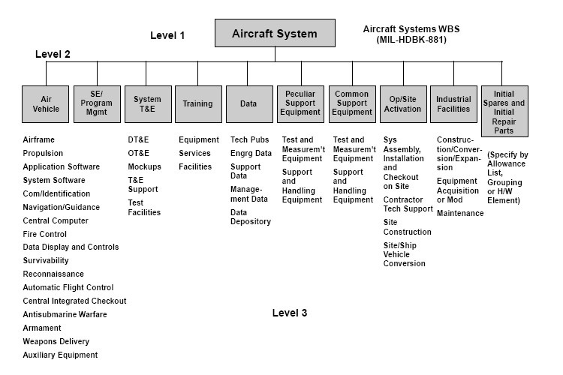
Subproject Oriented WBS

Slide 57
Discussion/Exercise 9
5 Minutes
Write 2 Level WBS & WBS Dictionary with min 5 deliverables for your project

Slide 58

12. Validate Scope
Formalizing acceptance of the completed project deliverables.

Slide 59
Validate Scope
PSM
M&C
.1 Project management plan
• Scope management plan
• Requirements management plan
• Scope baseline
.2 Project documents
• Lessons learned register
• Quality reports
• Requirements documentation
• Requirements traceability matrix
.3 Verified deliverables
.4 Work performance data
.1 Inspection
.2 Decision making
• Voting
.1 Accepted deliverables
.2 Work performance information
.3 Change requests
.4 Project document updates
• Lessons learned register
• Requirements documentation
• Requirements traceability matrix

Slide 60
Discussion/Exercise 10
5 Minutes
Write verify scope activities for your project; also write the name of deliverables verified.

Slide 61

13. Control Scope
Monitoring the status of the project and product scope and managing changes to the scope baseline.

Slide 62
Control Scope
PSM
M&C
.1 Project management plan
• Scope management plan
• Requirements management plan
• Change management plan
• Configuration management plan
• Scope baseline
• Performance measurement baseline
.2 Project documents
• Lessons learned register
• Requirements documentation
• Requirements traceability matrix
.3 Work performance data
.4 OPAs
.1 Data analysis
• Variance analysis
• Trend analysis
.1 Work performance information
.2 Change requests
.3 PMP updates
• Scope management plan
• Scope baseline
• Schedule baseline
• Cost baseline
• Performance measurement baseline
.4 Project documents updates
• Lessons learned register
• Requirements documentation
• Requirements traceability matrix

Slide 63
Discussion/Exercise-11
5 Minutes
Write work performance measurement metrics and their values for your project

