Slide 1
Project Time Management

Slide 2
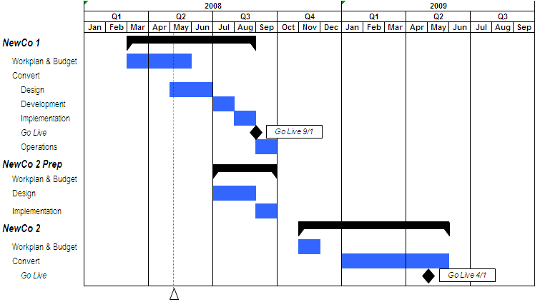
Project Time Management

Slide 3
Project Time Management
“Doing your project without a plan is like watching television with someone else holding the remote control”- Peter Turla
"The bad news is time flies. The good news is you're the pilot." - Michael Altshuler
"I made this letter longer than usual because I lack the time to make it shorter." – Pascal
“Time is a great teacher, but unfortunately it kills all its pupils." - Hector Louis Berlioz

Slide 4
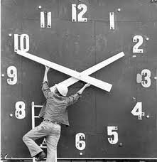
Project Time Management
Processes required to manage timely completion of the project.

Slide 5
Project Time Management
Plan Schedule Management [PLANNING]
Define Activities [PLANNING]
Sequence Activities [PLANNING]
Estimate Activity Durations [PLANNING]
Develop Schedule [PLANNING]
Control Schedule [M&C]

Slide 6
13. Plan Schedule Management
Establishing the policies, procedures and documentation for planning, developing, managing, executing, and controlling the project schedule

Slide 7
Plan Schedule Management
PScM
PLAN
.1 Project charter
.2 Project management plan
• Scope management plan
• Development approach
.3 EEFs
.4 OPAs
.1 Expert judgment
.2 Data analysis
• Alternatives analysis
.3 Meetings
.1 Schedule management plan

Slide 8
Schedule Management Plan
It includes
Scheduling tools to be used
Level of accuracy
Units of measure for each resource
Organizational procedure links
Process of updating the progress in schedule model
Control thresholds
Rules of performance measurement (baselines, %complete, fixed formula etc.)
Define scheduling reporting format

Slide 9

14. Define Activities
Identifying the specific actions to be performed to produce the project deliverables

Slide 10
Define Activities
PScM
PLAN
.1 Project management plan
• Schedule management plan
• Scope baseline
.2 EEFs
.3 OPAs
.1 Expert judgment
.2 Decomposition
.3 Rolling wave planning
.4 Meetings
.1 Activity list
.2 Activity attributes
.3 Milestone list
.4 Change requests
.5 PMP updates
• Schedule baseline
• Cost baseline

Slide 11
Activity Attributes
Dependency
Location of performance
Type of dependency
Level of efforts (work contour)
Efforts required
Related Deadline
Related WBS account
Critical activity
Type of task (fixed duration, resources, work)
Resource & skills required
Duration
Lead & Lag

Slide 12
Discussion/Exercise 12
5 Minutes
Write activities & their attributes for previously created 2 level WBS for your project

Slide 13
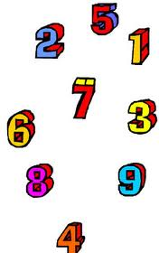
15. Sequence Activities
Identifying and documenting relationships among the project activities.

Slide 14
Sequence Activities
PScM
PLAN
.1 Project management plan
• Schedule management plan
• Scope baseline
.2 Project documents
• Activity attributes
• Activity list
• Assumption log
• Milestone list
.3 EEFs
.4 OPAs
.1 Precedence diagramming method
.2 Dependency determination and integration
.3 Leads and lags
.4 Project management information system
.1 Project schedule network diagrams
.2 Project documents updates
• Activity attributes
• Activity list
• Assumption log
• Milestone list

Slide 15
Discussion/Exercise 13
2 Minutes
Sequence Previously activities of your project write FS, SF, FF, SS after the activities
FS- (Finish first to start the next) Documentation – Review
FF- (Finish next to finish the previous) Documentation & Product
SF- (Start next to finish the previous) Shift working environment, changing mortor
SS- (Start next to start previous) Listening & Speaking, Start meeting & Start a topic to discuss

Slide 16
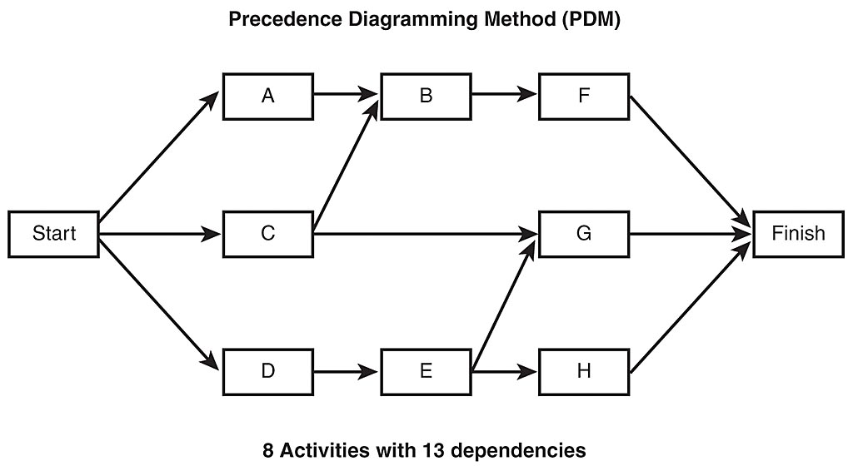
Precedence Diagramming Method (PDM)
Also known as Activity on Nodes (AON)
Notes:
134

Slide 17
Network Development
Precedence Diagramming Method (AON)
A
B
C
Start
Finish
D
E
F

Slide 18
Network Development
Precedence Diagramming Method (AOA)
A
B
C
Start
Finish
F
D
E

Slide 19

16. Estimate Activity Durations
Approximating the number of work periods needed to complete individual activities with estimated resources.

Slide 20
Estimate Activity Durations
PScM
PLAN
.1 Project management plan
• Schedule management plan
• Scope baseline
.2 Project documents
• Activity attributes
• Activity list
• Assumption log
• Lessons learned register
• Milestone list
• Project team assignments
• Resource breakdown structure
• Resource calendars
• Resource requirements
• Risk register
.3 EEFs
.4 OPAs
.1 Expert judgment
.2 Analogous estimating
.3 Parametric estimating
.4 Three-point estimating
.5 Bottom-up estimating
.6 Data analysis
• Alternatives analysis
• Reserve analysis
.7 Decision making
.8 Meetings
.1 Duration estimates
.2 Basis of estimates
.3 Project documents updates
• Activity attributes
• Assumption log
• Lessons learned register

Slide 21
PERT – Program Evaluation and Review Technique
PERT Estimate = (Optimistic + 4 * Most Likely + Pessimistic)/6
Standard Deviation (using PERT) = (Pessimistic-Optimistic)/6
Variance (using PERT) = ( (Pessimistic - Optimistic)/6)²

Slide 22
Discussion/Exercise 15
5 Minutes
Estimate Activity Duration for activities where resources are identified

Slide 23
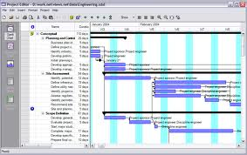
17. Develop Schedule
Analyzing activity sequences, durations, resource requirements and schedule constraints to create the project schedule.

Slide 24
Develop Schedule
PScM
PLAN
.1 Project management plan
• Schedule management plan
• Scope baseline
.2 Project documents
• Activity attributes
• Activity list
• Assumption log
• Basis of estimates
• Duration estimates
• Lessons learned register
• Milestone list
• Project schedule network diagrams
• Project team assignments
• Resource calendars
• Resource requirements
• Risk register
.3 Agreements
.4 EEFs
.5 OPAs
.1 Schedule network analysis
.2 Critical path method
.3 Resource optimization
.4 Data analysis
• What-if scenario analysis
• Simulation
.5 Leads and lags
.6 Schedule compression
.7 PMISs
.8 Agile release planning
.1 Schedule baseline
.2 Project schedule
.3 Schedule data
.4 Project calendars
.5 Change requests
.6 PMP Updates
• Schedule management plan
• Cost baseline
.7 Project documents updates
• Activity attributes
• Assumption log
• Duration estimates
• Lessons learned register
• Resource requirements
• Risk register

Slide 25
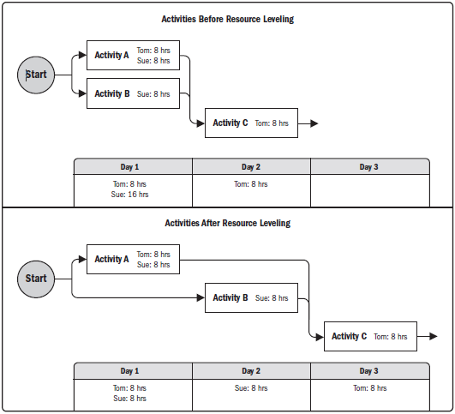
Resource Optimization techniques
Resource Levelling
Ensure resource are not allocated more than their availability for the given project. Can lead to change in critical path.
Resource Smoothing
Adjust activities in such a way that resources requirement do not exceed than defined limit. No change in critical path. Activities can be delayed within their float (free/total).

Slide 26
Modeling Techniques
What if scenario analysis
Assess the feasibility of project schedule under adverse conditions. Prepare a contingency plan to overcome the problems. Or prepare mitigation plan to reduce the impact of unexpected situations.
Simulation
Calculate multiple project duration using tools like Monte Carlo Simulation. In this case use assumptions and distribution constructed using 3 Point estimates.

Slide 27
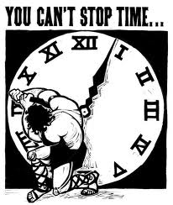
19. Control Schedule
Monitoring the status of the project to update project progress and manage changes to the schedule baseline

Slide 28
Control Schedule
PScM
M&C
.1 Project management plan
• Schedule management plan
• Schedule baseline
• Scope baseline
• Performance measurement baseline
.2 Project documents
• Lessons learned register
• Project calendars
• Project schedule
• Resource calendars
• Schedule data
.3 Work performance data
.4 OPAs
.1 Data analysis
• Earned value analysis
• Iteration burndown chart
• Performance reviews
• Trend analysis
• Variance analysis
• What-if scenario analysis
.2 Critical path method
.3 Project management
information system
.4 Resource optimization
.6 Leads and lags
.7 Schedule compression
.1 Work performance information
.2 Schedule forecasts
.3 Change requests
.4 Project management plan updates
• Schedule management plan
• Schedule baseline
• Cost baseline
• Performance measurement
baseline
.5 Project documents updates
• Assumption log
• Basis of estimates
• Lessons learned register
• Project schedule
• Resource calendars
• Risk register
• Schedule data

Slide 29
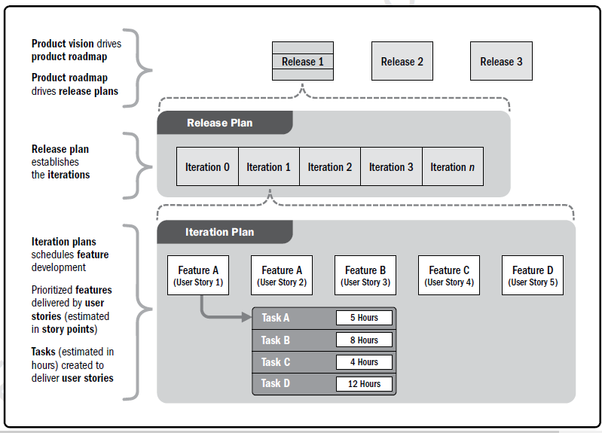
Product Vision, Release, Iteration Planning

Slide 30
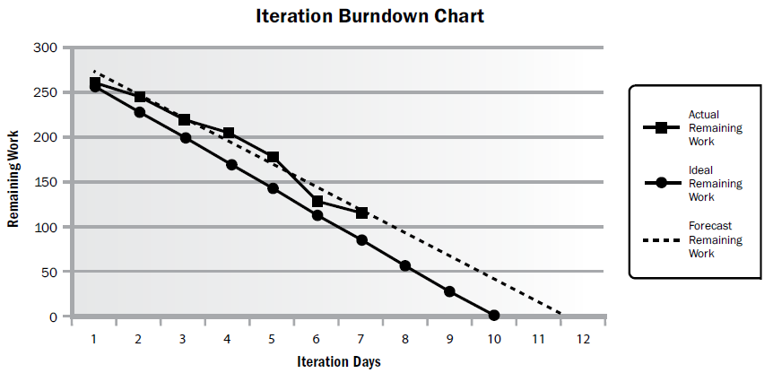
Burndown Chart

Slide 31
Discussion/Exercise 17
5 Minutes
Write work performance measures and their values of your project with respect to Schedule Management

Slide 32
Big Concepts
Critical Path Method (CPM)
Critical Chain Method (CCM)

Slide 33
Critical Path Method (CPM)

Slide 34
Critical Path Method (CPM)
Critical Path method is a planning technique that is used to demonstrate and view the chronological activities of a program or project, and identifies any possible timing risks and can be used to establish the least amount of time to complete a project.

Slide 35
Critical Path
ES EF
ES EF
ES EF
ES EF
ES EF
ES EF
Duration 7 Task A
Duration 6 Task C
Duration 3 Task G
LS LF
LS LF
ES EF
LS LF
Duration 2 Task H
Start
Finish
ES EF
ES EF
ES EF
LS LF
Duration 3 Task B
Duration 3 Task D
Duration 3 Task E
LS LF
LS LF
LS LF
ES EF
Duration 2 Task F
LS LF

Slide 36
Critical Path – Longest Path, Zero Float
0
0
0
ES EF
ES EF
ES EF
Duration 7 Task A
0
7
Duration 3 Task G
Duration 6 Task C
13
16
7
13
0
7
7
13
13
16
0
LS LF
LS LF
ES EF
LS LF
Duration 2 Task H
16
18
Start
Finish
7
7
7
16
18
ES EF
ES EF
ES EF
LS LF
Duration 3 Task B
0
3
Duration 3 Task D
3
6
Duration 3 Task E
6
9
7
10
10
13
13
16
LS LF
LS LF
LS LF
8
ES EF
Duration 2 Task F
3
5
11
13
LS LF

Slide 37
Discussion/Excertise-16
5 Minutes
ES EF
ES EF
ES EF
Duration 4 Task A
Duration 4 Task B
Duration 3 Task C
LS LF
LS LF
LS LF
ES EF
ES EF
Duration 10 Task G
Start
Duration 7 Task D
Finish
LS LF
ES EF
LS LF
ES EF
Duration 5 Task E
Duration 5 Task F
LS LF
LS LF

Slide 38
Network Exercise - solution
Critical Path : ADCG
ES EF
ES EF
ES EF
Duration 4 Task A
0
4
Duration 3 Task C
Duration 4 Task B
11
14
4
8
0
4
7
11
11
14
LS LF
LS LF
LS LF
ES EF
ES EF
Duration 10 Task G
14
24
Duration 7 Task D
Start
4
11
Finish
14
24
4
11
LS LF
ES EF
LS LF
ES EF
Duration 5 Task E
0
5
Duration 5 Task F
5
10
4
9
9
14
LS LF
LS LF
Notes:
Free float: An activity can be delayed without impacting the start of next activity
Total float: As many alternative path that many total float. Total float is available on non critical path. Activities can be delayed without delaying project
Free float on critical path activities is Zero

Slide 39
Facts/Tips for Critical Path
Total Float is the amount of time the task can delayed without delaying the project finish date.
Free float is the amount of time a task can slip without delaying the early start of any task that immediately follows it
It is possible that a zero float activity may not be on critical path
Longest path & shortest time possible to complete the project
A project can multiple critical paths
Difference between late and early is float
Positive float (the activity can wait to start even after previous activity finishes)
Negative float (the activity must start before previous finishes)
Zero float (the activity must immediately start after the finish of previous one)
Crashing activities to short the overall duration of project
Fast-tracking activities to short the overall duration of project
Be cautious that non-critical activity is not being delayed than the allowed free float
Take care of sub-critical path or non-critical path
Manage critical path resources very closely
Do not overload critical path activity resources
Avoid multitasking for resources working on critical path activities

Slide 40
Benefits of PERT/CPM
It Provides following information
Expected Project completion time
Probability of completion before a specified date
The critical path activities that directly impact the completion time
The activities that have slack time and that can lend resources to critical path activities
Activity start and end dates

Slide 41
Critical Chain Method (CCM)

Slide 42
Background
Eliyahu Goldratt proposed CCM
This is developed based on the TOC framework

Slide 43
Why CCM is needed?
You have CPM available why CCM is needed?
You can manage the delays on non-critical path using buffers/floats. BUT
How do you manage the delays on critical path?

Slide 44
Principles Behind CCM
Delays accumulate; gains don't advantage
Sequential Steps: Resources are not available to start early
Parallel Steps: Three activity each takes 5 days time start in parallel. If one activity takes 10 days and other finish on time, early activities will not be able to take advantage.
If above sequential and parallel activities are dependent then affect is magnified
Other Time Wasters
Multitasking
Student Syndrome
Parkinson's Law

Slide 45
Critical Chain Method
CPM is developed using the believe that book as many resource as in advance and they will be available when need because it has been promised
CCM says that if a resource is over booked on any activity he will not be available to work on that activity therefore level the resource on the project activities. Thus resource constrained critical path is critical chain.
CPM is about hoarding, greed. Therefore over-estimation and project management laws like Parkinson law, Murphy law, Student syndrome applies here.
CCM is about believe and assumption that it will available when needed but we need to have proper alert system in place.

Slide 46
CCM Concepts
Resource Buffer: Notify dependent task resources that when I will finish my work on regularly basis and final notification 1-2 days before. So that resource is available to start the work.
Safety or project buffer should be added at the end of critical-chain as non-activity buffer
Feeding buffer: Add buffer where chain of non-critical activity joins the critical path. This way non critical task can be avoided being critical

Slide 47
How to estimate in CCM
Resource will give t80, t90 estimate.
Half them to get t50 estimate.
Do not put end date to task and let people finish the task as early as possible.
No penalty for finish beyond t50.
Project Buffer should be 50% of the buffer removed from activity.

Slide 48
How to manage CCM
If activity finishes late time is borrowed from project buffer.
If activity finishes early, gained time is added to project buffer

Slide 50
Project Cost Management

Slide 51


Project Cost Management

Slide 52
Project Cost Management- A Thought
If you don't plan, it doesn't work. If you do plan, it doesn't work either. Why plan!
The same work under the same conditions will be estimated differently by ten different estimators or by one estimator at ten different times. So why to estimate!
Any project can be estimated accurately (once it's completed).
Nothing is impossible for the person who doesn't have to do it.

Slide 53
Project Cost Management
Processes involved in estimating, budgeting, and controlling costs so that the project can be completed within the approved budget

Slide 54
Project Cost Management
Project Cost Management [PLANNING]
Estimate Costs [PLANNING]
Determine Budget [PLANNING]
Control Costs [M&C]

Slide 55
Components of Contract Price
Contract Price = Material + Labor + Expenses + Overheads + Risk Management Budget + Profit Margins
Who estimates Material cost for your project?
Who estimates Labor cost for your project?
Who estimates Expenses cost for your project?
Who estimates Overhead cost for your project?
Where do you adjust the buffer?
Where do earn profit
What is the price?

Slide 56
Types of Cost
Fixed Cost vs Variable Cost
Direct vs Indirect Cost
Material, Labour, Services
Overhead Cost
Sunk Cost
Opportunity Cost

Slide 57
Types of Cost
Direct cost: purchased, used, consumed in the project directly.
Indirect cost: shared cost between project.

Slide 58
Types of Cost
Sunk Cost- Retrospective cost/ that cannot be recovered/ Cost gone and very low value or zero value was taken out. Plant developed but not of any use now additional money is required but by that money some better work can be done, so not to invest and let already invested money sunk. Software developed but it is not of any use now due any reason.
Perspective Cost- cost to be occurred in future
Allocated Cost- Cost of security service is shared by all division/companies of the building. Spreading the cost among those that use it.

Slide 59
Types of Cost
Apportioned Cost- To find apportioned cost you should know % of each appraised value (land, building, machine)
Value Added Cost- Sale price of a product and cost price of material is value add
Transfer Cost -Cost of transfer or transaction between two entities
Opportunity cost- Value lose because of exercising an option. It is just economic cost. Does not reflect in financial books

Slide 60
20. Plan Cost Management
Establishing policies, procedures and documentation for planning, managing, expending and controlling project costs

Slide 61
Plan Cost Management
PCM
PLAN
.1 Project charter
.2 Project management plan
• Schedule management plan
• Risk management plan
.3 EEFs
.4 OPAs
.1 Expert judgment
.2 Data analysis
• Alternatives analysis
.3 Meetings
.1 Cost management plan

Slide 62
Cost Management Plan
It includes
Cost management tools to be used
Level of accuracy (acceptable range +/- 5%)
Level of precision (US$ 100.01)
Units of measure for each resource
Organizational procedure links
Process of updating the progress in schedule model
Control thresholds (an allowed variation before some action need to be taken)
Rules of performance measurement (baselines, %complete, fixed formula etc.)
Project cost recording process
Currency exchange rate fluctuation adjustment process
Define scheduling reporting format

Slide 63
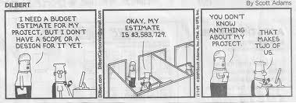
21. Estimate Costs
Developing an approximation of the costs of the resources needed to complete project activities.

Slide 64
Estimate Cost
PCM
PLAN
.1 Project management plan
• Cost management plan
• Quality management plan
• Scope baseline
.2 Project documents
• Lessons learned register
• Project schedule
• Resources requirements
• Risk register
.3 EEFs
.4 OPAs
.1 Expert judgment
.2 Analogous estimating
.3 Parametric estimating
.4 Bottom-up estimating
.5 Three-point estimating
.6 Data analysis
• Alternatives analysis
• Reserve analysis
• Cost of quality
.7 Project management
information system
.8 Decision making
• Voting
.1 Cost estimates
.2 Basis of estimates
.3 Project documents updates
• Assumption log
• Lessons learned register
• Risk register

Slide 65
Project Cost Estimation Ranges
Cost estimation may include only Direct Cost or in combination of with Indirect Costs
Class Name | % | Range
Definitive | - 5 -> +5% | 10%
Capital Cost | -15 -> +10% | 25%
Appropriation | -25 -> +15% | 40%
Budget Estimates | -10 -> +25% | 35%
Feasibility | -35 -> +25% | 60%
Order of Magnitude | -50 -> +50% | 100%

Slide 66
Exercise-18
3 Minutes
Write Activity cost estimates for 5 activities and their basis of estimates for your project

Slide 67
Three Point Estimates
Program Evaluation Review Technique (PERT)
ESTIMATED COST = (Pessimistic + 4*(Most Likely) + Optimistic) / 6

Slide 68
22. Determine Budget
Aggregating the estimated costs of individual activities or work packages to establish an authorized cost baseline

Slide 69
Determine Budget
PCM
PLAN
.1 Project management plan
• Cost management plan
• Resource management plan
• Scope baseline
.2 Project documents
• Basis of estimates
• Cost estimates
• Project schedule
• Risk register
.3 Business documents
• Business case
• Benefits management plan
.4 Agreements
.5 EEFs
.6 OPAs
.1 Expert judgment
.2 Cost aggregation
.3 Data analysis
• Reserve analysis
.4 Historical information review
.5 Funding limit reconciliation
.6 Financing
.1 Cost baseline
.2 Project funding requirements
.3 Project documents updates
• Cost estimates
• Project schedule
• Risk register

Slide 70
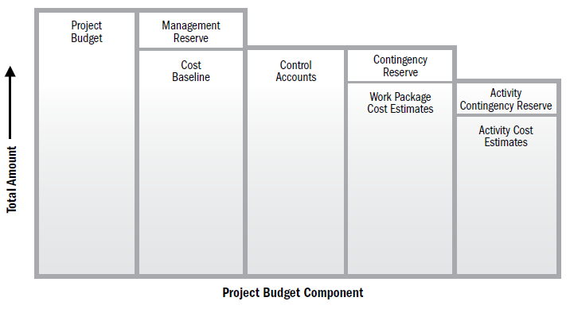
Project Budget Component

Slide 71
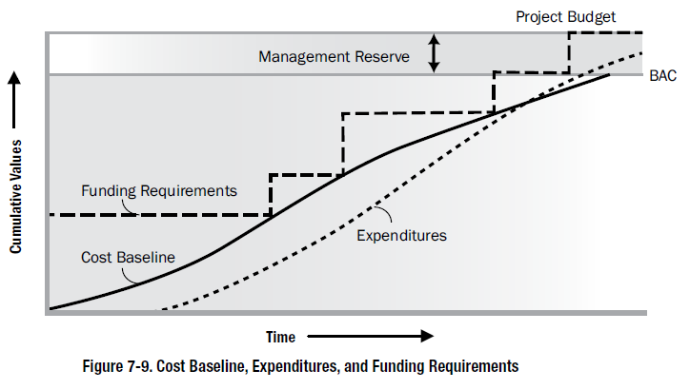

Slide 72
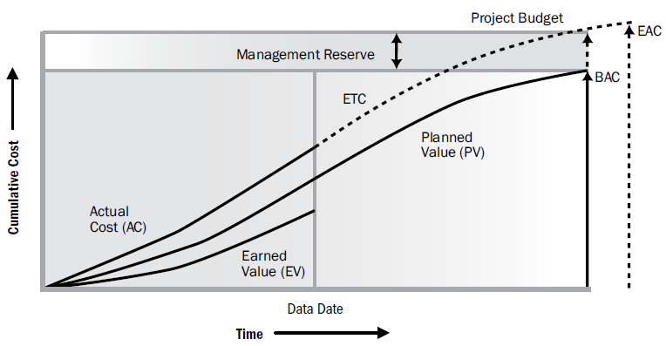

Slide 73
Estimation Traps
Customer: “How long will this project take?”
Project Manager: “What is the project about?”
Customer: “It is a systems upgrade project.”
Project Manager: “Can you tell me more about the project?”
Customer: “I don’t know, we will get into that later, but just tell me how long will it take.”

Slide 74
Five Ways to Avoid Estimation Traps
Provide a range instead of number.
Ranges reveals level of uncertainty in the scope. Customer will appreciate it if you tell him why that kind of range is given.
+/- 10 or +/- 50%. You can discuss cone of uncertainty with customer
Highlight underlying assumptions and constraints
Based on this (current information) assign confidence level or probability
Use objective estimation techniques like 3 Point or PERT
Don't play estimation games like padding estimates by dubuling and then customer make it halve. Next time you quadruple it. This unnecessarily creates cycle of mistrust.
Use a combination of techniques and solicit multiple perspectives
Track and compare actual results
Initially everybody fights for getting “accurate estimates” after that people forget about it
Next time you are asked to provide an accurate estimate, don’t fall into the trap. Instead, use it as an opportunity to engage and educate your stakeholders about the reality of estimates.
Notes:
http://www.pmi.org/eNews/Post/2011_02-11/NLU_Get-Real-About-Your-Estimates.html

Slide 75
Exercise-19
3 Minutes
Establish cost performance baseline for your project & write funding requirements for your project.

Slide 76
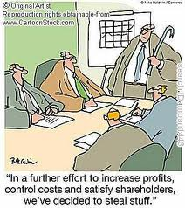
23. Control Costs
Monitoring the status of the project to update the project budget and managing changes to the cost baseline

Slide 77
Control Cost
PCM
M&C
.1 Project management plan
• Cost management plan
• Cost baseline
• Performance measurement baseline
.2 Project documents
• Lessons learned register
.3 Project funding requirements
.4 Work performance data
.5 OPAs
.1 Expert judgment
.2 Data analysis
• Earned value analysis
• Variance analysis
• Trend analysis
• Reserve analysis
.3 To-complete performance index
.4 PMIS
.1 Work performance information
.2 Cost forecasts
.3 Change requests
.4 PMP updates
• Cost management plan
• Cost baseline
• Performance measurement baseline
.5 Project documents updates
• Assumption log
• Basis of estimates
• Cost estimates
• Lessons learned register
• Risk register

Slide 78
Big Concepts
Earn Value Management

Slide 79
Earned Value Management – Basic Concepts
Planned Value (PV)- BCWS
Authorized budget assigned to the work to be accomplishes for an activity or work
breakdown structure component.
Earned Value (EV)- BCWP
Value of work performed expressed in terms of the approved budget assigned to
that work for an activity or work breakdown structure component.
Actual Cost (AC)- ACWP
Total cost actually incurred and recorded in accomplishing work performed for an
activity or work breakdown structure component.

Slide 80
Earn Value Rules
0% - 100%
50% - 50%
20% - 80%
25% - 75%

Slide 81
Earned Value Management – S Curve
PV
AC
Cost
CV
SV
Progress Review
ΔT
EV
Time

Slide 82
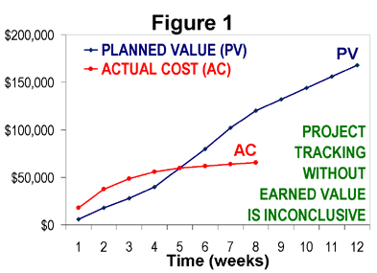
How project is progressing?

Slide 83
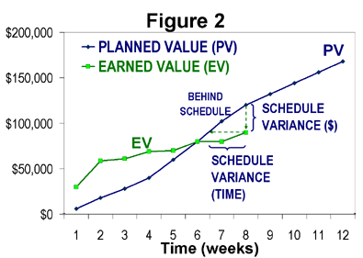
How project is progressing?

Slide 84
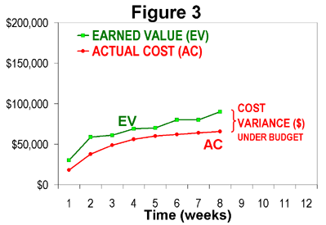
How project is progressing?

Slide 85
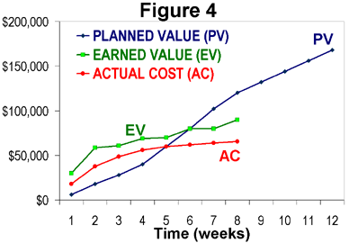
How project is progressing?

Slide 86
EVM-Variances
CV (Cost Variance) = EV- AC
CV = 0 => the Project is proceeding as per plan on cost
CV < 0 => the Project is over budget
CV > 0 => the Project is under budget
SV (Schedule Variance) = EV- PV
SV = 0 => the project is on plan, time-wise
SV < 0 => the project is BEHIND schedule
SV > 0 => the project is AHEAD of schedule

Slide 87
EVM- Indexes
CPI (Cost Performance Index) tells you how much worth of job you are getting for every $ being spent.
CPI = EV/AC
CPI = 1 => the project is on plan, cost wise
CPI < 1 => the project is over budget or under performing
CPI > 1 => the project is under budget or over performing
SPI tells the PM how much worth of job has been completed against planned work
SPI = EV / PV
SPI = 1 => the project is on schedule
SPI < 1 => the project is BEHIND schedule
SPI > 1 => the project is AHEAD of schedule

Slide 88
EVM- Critical Ratio
CR tells the PM the overall shape of your project
CR= CPI x SPI
CR = 1 => the project is on schedule & within budget
CR < 1 => the project is BEHIND schedule or budget or both
CR > 1 => the project is AHEAD of schedule or budget or both

Slide 89
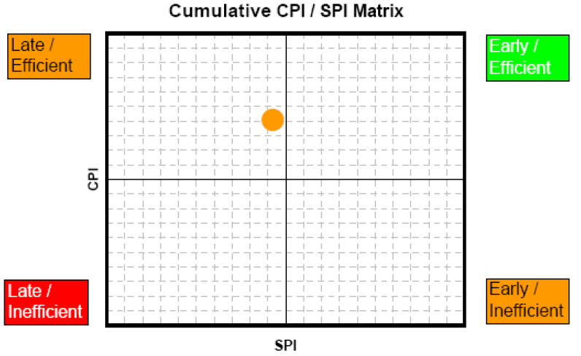
CPI & SPI Summary

Slide 90
Forecasting- ETC
Recalculate it, if original estimate are no longer valid now.
Calculate it manually based on the progress, if original estimates are still valid
ETC = BAC - EV

Slide 91
Forecasting- EAC
Estimate at Completion(EAC)
EAC (atypical) = AC + ETC (Re-estimated)
EAC (atypical) = AC + BAC – EV (Estimated based on Progress)
EAC (typical considering CPI & SPI) = AC + ETC/ (CPI x SPI)
EAC (typical)= AC + ETC / CPI = BAC/CPI
If you feel that you will be able to complete the project on time in spite of current delay then you can consider SPI as 1. In that case CR= SPI

Slide 92
Forecasting- Variance at Completion
Variance at Completion (VAC)
VAC = BAC – EAC
Variance at Completion (%)
PVAC= (BAC-EAC)/BAC

Slide 93
Forecasting: TCPI
TCPI (To complete Performance Index) can be calculated using BAC or EAC
TCPI using BAC = (BAC-EV) / (BAC-AC)
TCPI using EAC = (BAC-EV) / (EAC-AC)

Slide 94
Case Study — Case 1
PV = $ 500
EV = $ 500
AC = $ 500
This is the ideal situation where everything goes as per plan.

Slide 95
Case Study — Case 2
PV = $ 1,800
EV = $ 1,500
AC = $ 1,700
CV = EV – AC = - $ 200
SV = EV – PV = - $ 300
CPI = EV/AC = 0.88
SPI = EV/PV = 0.83
PV = $ 2,900
EV = $ 2,700
AC = $ 2,500
SV = -200
SPI = 0.92
CV = 200
CPI = 1.08
Calculate CV, SV, SPI, SPI

Slide 96
EVM- Case 3
PV = $ 1,700
BAC = $ 5000
EV = $ 1,800
AC = $ 1,600
CV = 200
SV = 100
CPI = 1.125
SPI = 1.058
EAC = BAC/ CPI = $4444
ETC =EAC-AC = 4444 – 1600 = $2844 (Org Estimate Incorrect)
ETC = BAC-EV = 5000 – 1800 = $3200 (Org Estimate Correct)
VAC = BAC – EAC= $556
TCPI using BAC = 5000-1800/5000-1600 = 0.941
TCPI using EAC = 5000-1800/4444-1600 = 1.125
Calculate CV, SV, CPI, SPI, EAC (Typical), ETC, VAC, TCPI

