Slide 1
Project Quality Management

Slide 2
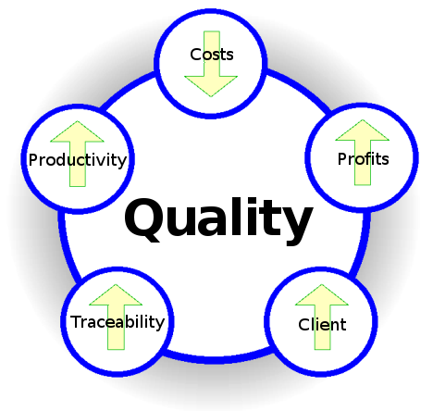
Project Quality Management

Slide 3
Quality Definitions from Quality Gurus
‘Quality is Predictability’- Deming
‘Conformance to requirements’ - Crosby
‘Fitness for use’ - Juran
‘Customer’s opinion’- Feigenbaum
‘The totality of characteristics of an entity that bear on its ability to satisfy stated and implied need’ - ISO 8402:1994
Conformance to “Valid Requirements“.
Customers' perception of the value of the suppliers‘ work output.
A perceived degree of excellence with a minimum, usually set forth by the customer.
Best value for money.

Slide 4
Quality Gurus
Philip B Corssby- Popularized concept of Zero Defect. He eliminate defects complete not only reduce it to acceptable quality level
Dr. Eliyahu M Goldratt- Theory of Constraints. Focus on single element on process chain which can address 99% problems.
Dr. Edward Deming- Deming Cycle (85% Quality Problems are related to Management)
Dr. Joseph M Juran- Developed Quality Triology (Q-Planning, Q-Improvement, Q-Control)
Dr. Walter Shewhart- PDCA (Theory of process control or Shewart Transformation Process)
Dr. Genichi Taguchi- Taguchi Methodology or Designing in Quality (Making a design which is less sensitive to variation rather than control the manufacturing variation)
Dr. Kaoru Ishikawa- Philosophy of Total Quality, Ishikawa Diagram
Shigeo Shingo- Developed lean concepts, refined JIT (lean manufacturing)
Taiichi Ohno- Developed concept of Seven Wastes; this is used to identify non-value-added activity
Armand V Feigenbaum: Developed Idea of Total Quality Control

Slide 5
Project Quality Management
Processes and activities of the performing organization that determine quality policies, objectives, and responsibilities so that the project will satisfy the needs for which it was undertaken

Slide 6
Project Quality Management
Plan Quality Management [PLANNING]
Perform Quality Assurance [EXECUTING]
Control Quality [M&C]

Slide 7
24. Plan Quality Management
Identifying quality requirements and/or standards for the project and product, and documenting how the project will demonstrate compliance.

Slide 8
Plan Quality Management
PQM
PLAN
.1 Project charter
.2 Project management plan
• Requirements management plan
• Risk management plan
• Stakeholder engagement plan
• Scope baseline
.3 Project documents
• Assumption log
• Requirements documentation
• Requirements traceability matrix
• Risk register
• Stakeholder register
.4 EEFs
.5 OPAs
.1 Expert judgment
.2 Data gathering
• Benchmarking
• Brainstorming
• Interviews
.3 Data analysis
• Cost-benefit analysis
• Cost of quality
.4 Decision making
• Multicriteria decision analysis
.5 Data representation
• Flowcharts
• Logical data model
• Matrix diagrams
• Mind mapping
.6 Test and inspection planning
.7 Meetings
.1 Quality management plan
.2 Quality metrics
.3 PMP updates
• Risk management plan
• Scope baseline
.4 Project documents updates
• Lessons learned register
• Requirements traceability matrix
• Risk register
• Stakeholder register

Slide 9
Cost of Quality
Cost of Conformance Cost of Nonconformance
Prevention Costs
(Build a quality product)
Training
Document processes
Equipment
Time to do it right
Appraisal Costs (Assess the quality)
Testing
Destructive testing loss
Inspections
Internal Failure Costs (Failures found by the project)
Rework
Scrap
External Failure Costs (Failures found by the customer)
Liabilities
Warranty work
Lost business
Money spent during the project to avoid failures
Money spent during and after the project because of failures
Source : PMI PMBOK® Guide Fifth Edition

Slide 10
Cost of Nonconformance- Iceberg
SCRAP
DOCUMENTED
REWORK
WARRANTY
WORK
FAILURE
ANALYSIS
LATE PENALTIES
CONFUSION
OVERTIME
RUSH
DELIVERIES
CUSTOMER
DISSATISFACTION
MISSED
OPPORTUNITIES
PRODUCT
IMAGE
REDESIGN
HIDDEN
REWORK
CORPORATE
IMAGE
LATE
DELIVERIES
DUPLICATION
OF EFFORT

Slide 11
Exercise-21
5 Minutes
Write sections of QMP of your project OR
Write Quality Metrics for your projects, their goal, and threshold values OR
Identify the name of checklists used in your project

Slide 12
25. Manage Quality
The process of translating the quality management plan into executable quality activities that incorporate the organization’s quality policies into the project.

Slide 13
Manage Quality
PQM
EXEC
.1 Project management plan
• Quality management plan
.2 Project documents
• Lessons learned register
• Quality control measurements
• Quality metrics
• Risk report
.3 OPAs
.1 Data gathering
• Checklists
.2 Data analysis
• Alternatives analysis
• Document analysis
• Process analysis
• Root cause analysis
.3 Decision making
• Multicriteria decision analysis
.4 Data representation
• Affinity diagrams
• Cause-and-effect diagrams
• Flowcharts
• Histograms
• Matrix diagrams
• Scatter diagrams
.5 Audits
.6 Design for X
.7 Problem solving
.8 Quality improvement methods
.1 Quality reports
.2 Test and evaluation
documents
.3 Change requests
.4 PMP updates
• Quality management plan
• Scope baseline
• Schedule baseline
• Cost baseline
.5 Project documents updates
• Issue log
• Lessons learned register
• Risk register

Slide 14
Exercise-22
5 Minutes
Write the number of NCs were discovered in your project corresponding to the processes
Who is responsible to close NCs and report their status
List the corrective or preventive actions suggested by auditors

Slide 15
26. Control Quality
Monitoring and recording results of executing the quality activities to assess performance and recommend necessary changes.

Slide 16
Control Quality
PQM
M&C
.1 Project management plan
• Quality management plan
.2 Project documents
• Lessons learned register
• Quality metrics
• Test and evaluation documents
.3 Approved change requests
.4 Deliverables
.5 Work performance data
.6 EEFs
.7 OPAs
.1 Data gathering
• Checklists
• Check sheets
• Statistical sampling
• Questionnaires and surveys
.2 Data analysis
• Performance reviews
• Root cause analysis
.3 Inspection
.4 Testing/product evaluations
.5 Data representation
• Cause-and-effect diagrams
• Control charts
• Histogram
• Scatter diagrams
.6 Meetings
.1 Quality control measurements
.2 Verified deliverables
.3 Work performance
information
.4 Change requests
.5 PMP updates
• Quality management plan
.6 Project documents updates
• Issue log
• Lessons learned register
• Risk register
• Test and evaluation
documents

Slide 17
7 Basic Quality Tools
Cause & Effect Diagram/ Fish Bone Diagram
Flowcharts
Checksheets
Pareto Diagram
Histograms
Control Charts
Scatter Diagrams

Slide 18
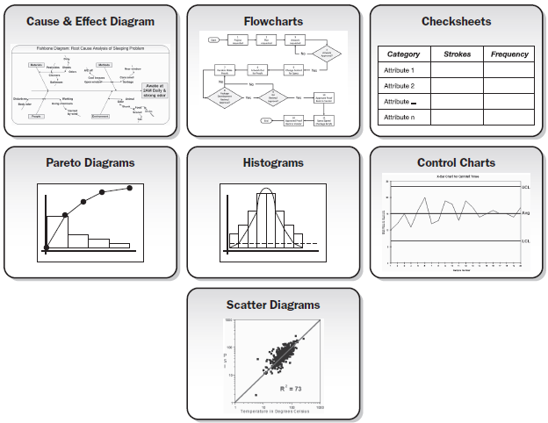
7 Basic Quality Tools

Slide 19
Sigma Values
Sigma | Yield | Defects in Millions
+/-2 | 95.44% | 45600
+/-3 | 99.73% | 2700
+/-6 | 99.9999997% | 0.002
Sigma level (with 1.5 sigma shift) | DPMO | Percentage yield
1 | 691,462 | 30.8550%
2 | 308,538 | 69.1462%
3 | 66,807 | 93.3193%
4 | 6,210 | 99.3790%
5 | 233 | 99.9770%
6 | 3.4 | 99.99966%
7 | 0.019 | 99.999966%

Slide 20
Exercise-23
5 minutes
Write the Quality control activities on your project
List the values of various quality control measures on your project.
List the validated deliverables

Slide 22
Project Resource Management

Slide 23
Project Resource Management
Includes the processes to identify, acquire, and manage the resources needed for the successful completion of the project.

Slide 24
Project Resource Management
Plan Human Resource Management [PLANNING]
Estimate Activity Resources [PLANNING]
Acquire Resources [EXECUTING]
Develop Team [EXECUTING]
Manage Team [EXECUTING]
Control Resources [M&C]

Slide 25
27. Plan Resource Management
The process of defining how to estimate, acquire, manage, and utilize physical and team resources.

Slide 26
Plan Human Resource Management
PRM
PLAN
.1 Project charter
.2 Project management plan
• Quality management plan
• Scope baseline
.3 Project documents
• Project schedule
• Requirements documentation
• Risk register
• Stakeholder register
.4 EEFs
.5 OPAs
.1 Expert judgment
.2 Data representation
• Hierarchical charts
• Responsibility assignment matrix
• Text-oriented formats
.3 Organizational theory
.4 Meetings
.1 Resource management plan
.2 Team charter
.3 Project documents updates
• Assumption log
• Risk register

Slide 27
Human Resource Management Plan
Roles & Responsibilities (Role, Authority, Responsibility, Competency)
Project organization chart
Staffing management plan
Staff acquisition plan: From where and when the people will come, at what location they will come to work, what are the cost associated with each expertise, what kind of assistance is required from HR and functional manager of the resource
Resource calendar: When the recruitment should start, resource availability (resource histogram),
Staff release plan: When and how to release resources for smooth transition, so that resource cost is not counted in the project
Training need
Recognition & rewards
Complying with union contracts, government regulation or other HR policies

Slide 28
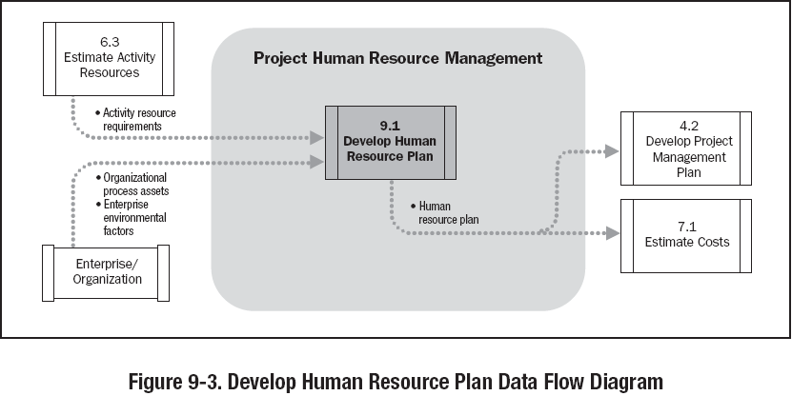

Slide 29
Responsibility Assignment Matrix - RAM
PERSON
Shiv Ram Jim Karl Rita Mohan …
PHASE
Requirements
S R A P P
Functional
S A P P
Design
S R A l P
Development
R S A P P
Testing
S P l A P
P = Participant A = Accountable R = Review required
I = input required S = Sign-off required

Slide 30
Resource Histogram
Staff hours
300
275
Senior Designers
250
225
200
175
Resource Usage
150
125
100
75
50
25
0
9
16
23
30
6
13
20
27
6
13
20
27
3
10
17
24
1
8
15
22
Jan
Feb
Mar
Apr
May
Weekly Resource Usage Staff Hours

Slide 31
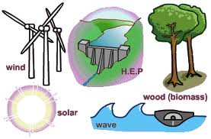
28. Estimate Activity Resources
Estimating the type and quantities of material, people, equipment or supplies required to perform each activity.

Slide 32
Estimate Activity Resources
PRM
PLAN
.1 Project management plan
• Resource management plan
• Scope baseline
.2 Project documents
• Activity attributes
• Activity list
• Assumption log
• Cost estimates
• Resource calendars
• Risk register
.3 EEFs
.4 OPAs
.1 Expert judgment
.2 Bottom-up estimating
.3 Analogous estimating
.4 Parametric estimating
.5 Data analysis
• Alternatives analysis
.6 PMIS
.7 Meetings
.1 Resource requirements
.2 Basis of estimates
.3 Resource breakdown
structure
.4 Project documents updates
• Activity attributes
• Assumption log
• Lessons learned register

Slide 33
Resource Breakdown Structure
Project ABC RBS
Labor |  |  |  |  |  |  |  |  |  |  | Material | Expenses
PM (1) | Config Mgmt |  | Technical Leaderhsip |  |  | Dev Team |  |  | Test Team
 | Config Mgr | Release Mgr | Arch (1) | UIExpert (1) | DBA (1) | Sr.Dev (4) | Jr.Dev (3) | TL (1) | Test Mgr | Tester (4) | Laptop (10 Units) | Procurement Team
 |  |  |  |  |  |  |  |  |  |  | Desktop (Units) | Systems Team
 |  |  |  |  |  |  |  |  |  |  | Leaseline (2 Mpbs) | Travel Cost (3 People)
 |  |  |  |  |  |  |  |  |  |  | Servers (2 Units | Boarding Lodging Cost (60 Days)
 |  |  |  |  |  |  |  |  |  |  |  | HR

Slide 34
Discussion/Exercise 14
2 Minutes
Estimate Activity Resources for previously sequenced activities of your project

Slide 35
29. Acquire Resources
Confirming human resource availability and obtaining the team necessary to complete project assignments

Slide 36
Acquire Resources
PRM
EXEC
.1 Project management plan
• Resource management plan
• Procurement management plan
• Cost baseline
.2 Project documents
• Project schedule
• Resource calendars
• Resource requirements
• Stakeholder register
.3 EEFs
.4 OPAs
.1 Decision making
• Multicriteria decision analysis
.2 Interpersonal and team skills
• Negotiation
.3 Pre-assignment
.4 Virtual teams
.1 Physical resource assignments
.2 Project team assignments
.3 Resource calendars
.4 Change requests
.5 PMP updates
• Resource management plan
• Cost baseline
.6 Project documents updates
• Lessons learned register
• Project schedule
• Resource breakdown structure
• Resource requirements
• Risk register
• Stakeholder register
.7 EEFs updates
.8 OPAs updates

Slide 37
30. Develop Team
Process of improving competencies, team interaction, and the overall team environment to enhance project performance.

Slide 38
Develop Team
PRM
EXEC
.1 Project management plan
• Resource management plan
.2 Project documents
• Lessons learned register
• Project schedule
• Project team assignments
• Resource calendars
• Team charter
.3 EEFs
.4 OPAs
.1 Colocation
.2 Virtual teams
.3 Communication technology
.4 Interpersonal and team skills
• Conflict management
• Influencing
• Motivation
• Negotiation
• Team building
.5 Recognition and rewards
.6 Training
.7 Individual and team assessments
.8 Meetings
1. Team performance assessments
.2 Change requests
.3 PMP updates
• Resource management plan
.4 Project documents updates
• Lessons learned register
• Project schedule
• Project team assignments
• Resource calendars
• Team charter
.5 EEFs updates
.6 OPAs updates

Slide 39
Team Performance Assessment..
Skills acquired which increased productivity
Reduced turnover rate
Perform better within team
Increased cohesiveness- sharing info/ openness

Slide 40
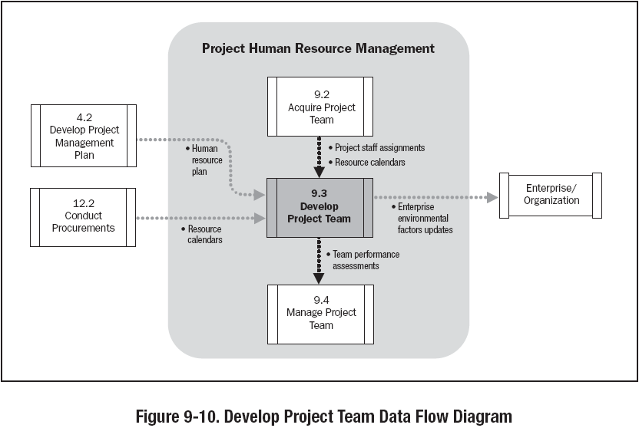

Slide 41
31. Manage Team
Tracking team member performance, providing feedback, resolving issues and managing changes to optimize project performance.

Slide 42
Manage Team
PRM
EXEC
.1 Project management plan
• Resource management plan
.2 Project documents
• Issue log
• Lessons learned register
• Project team assignments
• Team charter
.3 Work performance reports
.4 Team performance assessments
.5 EEFs
.6 OPAs
.1 Interpersonal and team skills
• Conflict management
• Decision making
• Emotional intelligence
• Influencing
• Leadership
.2 PMIS
.1 Change requests
.2 PMP updates
• Resource management plan
• Schedule baseline
• Cost baseline
.3 Project documents updates
• Issue log
• Lessons learned register
• Project team assignments
.4 EEFs updates

Slide 43
Types of Power
Formal – positional, granted by organizational/upper mgmt
Expert – power earned through a recognized level of knowledge or skill in a specific area
Reward – the power to give a positive consequences, like promotions, salary rise etc.
Penalty – the power to provide negative consequences, like suspension, termination, reprimands
Referent – power gained when team members admire, and willingly follow an individual as a role model

Slide 44
Team Development / Tuckman Model
Five Stages of Team development
Forming – Members of the group get to know each other and try to set up some ground rules about behavior
Storming – Conflicts arise as various members of the group try to exert leadership and the methods of operation are being established
Norming – Conflicts are largely settled and a feeling of group identity emerges
Performing – Emphasis now is the task at hand
Adjourning – The group disbands
Sequence is followed for each individual/group

Slide 45
32. Control Resources
The process of ensuring that the physical resources assigned and allocated to the project are available as planned, as well as monitoring the planned versus actual use of resources, and performing corrective action as necessary

Slide 46
Control Resources
PRM
M&C
.1 Project management plan
• Resource management plan
.2 Project documents
• Issue log
• Lessons learned register
• Physical resource assignments
• Project schedule
• Resource breakdown structure
• Resource requirements
• Risk register
.3 Work performance data
.4 Agreements
.5 OPAs
.1 Data analysis
• Alternatives analysis
• Cost-benefit analysis
• Performance reviews
• Trend analysis
.2 Problem solving
.3 Interpersonal and team skills
• Negotiation
• Influencing
.4 PMIS
.1 Work performance information
.2 Change requests
.3 PMP updates
• Resource management plan
• Schedule baseline
• Cost baseline
.4 Project documents updates
• Assumption log
• Issue log
• Lessons learned register
• Physical resource assignments
• Resource breakdown structure
• Risk register

Slide 47
Big Concepts
Conflict Resolution
Motivational Theories
Leadership Styles
Management Theories

Slide 48
Conflict Management
Conflicts - good or bad ???
Traditional view – Conflicts are bad, created by people and to be avoided
Current view – Conflicts are good and need to be confronted in order to bring out real issues and resolve them
Hot Topics

Slide 49
Conflict Management
Sources of conflict
Schedules
Project Priorities
Technical Issues
Personality Conflict
Cost
Scarce resources
Personal work styles
Administrative Procedures

Slide 50
Conflict Management
Characteristics of conflict
Conflict is natural and forces a search for alternatives
Conflict is team issue
Openness resolves conflict
Conflict resolution should focus on issues, not personalities
Conflict resolution should focus on the present not on the past

Slide 51
Conflict Resolution
Withdrawal – avoiding, giving up, stop gap, passive reaction, buying time, appropriate for “cooling off” time, no solution. Lose-lose outcome
Smoothing – grudging agreement, avoids conflict, appeasing, friendly atmosphere. No lasting solution, lose outcome
Compromising – bargaining, acceptable agreement, some satisfaction to each party, not ideal solution, trade off, a form of definitive solution. Lose outcome.
Confronting/Problem Solving – approached as an issue to be solved by examining alternatives. Give and take attitude, open dialog – direct approach, pinpoints problem, develops alternatives, objectively resolves issues, time consuming, ultimate solution, Win-Win outcome
Collaborating – leading to consensus and commitment by incorporating multiple viewpoints and insights from differing perspectives.
Forcing – Uses power, used as a last resort, ill feeling may result, Win-lose outcome. Win-Lose outcome
Notes:
Withdraw: Many times collation parties gives warning and then withdraw the support. When one party feel that discussion will not bring any result and another party is strong
Smoothing: When both parties are trying to cover the actual issue to avoid the argument.
Compromising: When both parties leave something in order to achieve some peaceful solution

Slide 52
Conflict Resolution
HIGH
SMOOTHING
(ACCOMMODATING)
PROBLEM-SOLVING
(COLLABORATING)
RELATIONSHIP
ORIENTATION
COMPROMISE
WITHDRAWAL
(AVOIDING)
FORCING
(COMPETING)
LOW
LOW OBJECTIVE ORIENTATION HIGH

Slide 53

Motivational Theories

Slide 54
Motivational Theories
Frederick Herzberg's Hygiene & Motivation Factors
Abraham Maslow’s Hierarchy of Needs
Expectancy Theorem of Motivation by Victor Vroom
Job characteristics model of Oldham-Hackman
Theory X & Y of McGregor

Slide 55
Motivational Theories
Frederick Herzberg Hygiene Factors and Motivating Agents (1954)
Hygiene factors
Supervision
Company policy and administrator
Positive working Condition
Interpersonal relations
Job Security
Status
Compensation
Personal life
Presence will not guarantee higher productivity Absence will result in poor productivity

Slide 56
Motivational Theories
Frederick Herzberg Hygiene Factors and Motivating Agents (1954)
Motivating factors
Achievements
Recognitions
Work Itself
Responsibility
Advancement
Possibility for growth
Motivation will not work without Hygiene.

Slide 57
Motivational Theories
Abraham Maslow’s Hierarchy of Needs (1954)
(In order of priority)
Self Actualization
Self fulfillment, growth, learning
Accomplishment, Respect, Attention, Appreciation
Esteem
Love, affection, approval, friends, association
Social
Security, stability, freedom from threat and physical harm
Safety
Physiological
Air, water, food, house, clothing

Slide 58
Motivational Theories
Expectancy Theorem of Motivation by Victor Vroom
The extent to which an individual is motivated…
The level of expectation of their efforts will result in a desired outcome (effort performance linkage)
(Is the work important?)
The expectation that good work will be rewarded (Performance-reward linkage)
(Will I be rewarded?)
Attractiveness of the reward
(What is the value of the reward?)
Motivation will be high when all three factors are high

Slide 59
Motivational Theories
The Oldham-Hackman job characteristics model
Skill Variety – the number of job skills that the job holder has the opportunity to exercise
Task Identity – the degree to which your work and its result are identifiable as belonging to you
Task Significance – the degree to which your job has an influence on others
Autonomy – the discretion you have about the way that you do the job
Feedback – the information that you get back about the result of your work

Slide 60
Motivational Theories
McGregor’s Theory X
The average worker is inherently lazy and needs supervisions
The average worker dislikes work and avoids work whenever possible
To induce adequate effort, the supervisor must threaten punishment and exercise careful supervision
The average worker avoids increased responsibility and seeks to be directed
Theory X relies on Strict Rules, Performance incentives, Rewards, Threats to job security

Slide 61
Motivational Theories
McGregor’s Theory Y
Workers are willing to do the job without continuous supervision
The average worker wants to be active and finds the physical and mental effort on the job satisfying
Greatest results come from willing participation which will tend to produce self-direction towards goals without coercion and control
The average worker seeks opportunity for personal improvement and self respect
Theory Y relies on worker participation in decisions, cordial manager-worker relationships, worker designed job methodology, worker individualism

Slide 62
Leadership Theories
Leadership Theories
Theory Z of William Ouchi
Contingency Theory of Fred Fiedler

Slide 63
Leadership Theories
Theory Z Proposed by William Ouchi
According to Theory Z, people who don’t fit either Theory X or Theory Y are really a combination of the two.
People who develop a leadership style based on Theory Z, use different styles of leadership with different people, depending on the situation.

Slide 64
Leadership Theories
Contingency Theory of Fred Fiedler
No theory is best theory. Because best depends upon individual manager and organization.
Built on a combination of Theory Y behaviors and the Hygiene Theory
People are motivated to achieve level competency and will continue to be motivated by this need even after competency is reached

Slide 65
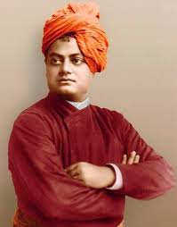
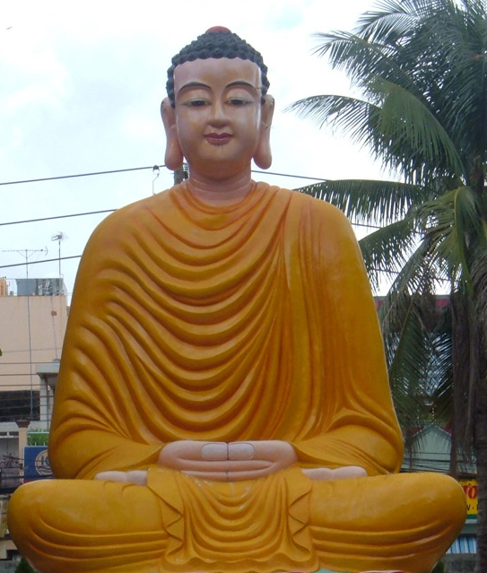
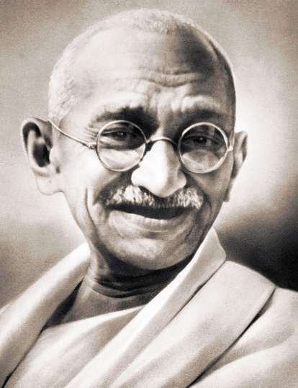
Leadership

Slide 66
Leadership Style
How leaders lead the group

Slide 67
Leadership Style
1. Transactional Leadership
This style of leadership starts with the premise that team members agree to obey their leader totally when they take a job on.
The “transaction” is usually that the organization pays the team members, in return for their effort and compliance.
Notes:
As such, the leader has the right to “punish” team members if their work doesn’t meet the pre-determined standard.
Team members can do little to improve their job satisfaction under transactional leadership.
The leader could give team members some control of their income/reward by using incentives that encourage even higher standards or greater productivity.
Alternatively a transactional leader could practice “management by exception”, whereby, rather than rewarding better work, he or she would take corrective action if the required standards were not met.

Slide 68
Leadership Style
2. Autocratic Leadership
Under the autocratic leadership styles, all decision-making powers are centralized in the leader as shown such leaders are dictators.
Autocratic leadership is an extreme form of transactional leadership, where a leader exerts high levels of power over his or her employees or team members.
Notes:
People within the team are given few opportunities for making suggestions, even if these would be in the team’s or organization’s interest.

Slide 69
Leadership Style
3. Transformational Leadership
Transformational leadership is a leadership style that is defined as leadership that creates valuable and positive change in the followers.
A person with this leadership style is a true leader who inspires his or her team with a shared vision of the future.
Transformational leaders are highly visible, and spend a lot of time communicating.
Notes:
A transformational leader focuses on “transforming” others to help each other, to look out for each other, to be encouraging and harmonious, and to look out for the organization as a whole.
In this leadership, the leader enhances the motivation, morale and performance of his follower group.
They don’t necessarily lead from the front, as they tend to delegate responsibility amongst their teams. While their enthusiasm is often infectious, they can need to be supported by “detail people”.

Slide 70
Leadership Style
4. Servant Leadership
When someone, at any level within an organization, leads simply by virtue of meeting the needs of his or her team, he or she is described as a “servant leader”.
Servant Leadership’s focus was on the leader as a servant, with his or her key role being in developing, enabling and supporting team members, helping them fully develop their potential and deliver their best.
Notes:
This term, coined by Robert Greenleaf in the 1970s, describes a leader who is often not formally recognized as such.
In many ways, servant leadership is a form of democratic leadership, as the whole team tends to be involved in decision-making.

Slide 71
Leadership Style
5. Charismatic Leadership
Charismatic leaders can tend to believe more in themselves than in their teams.
Transformational Leader has a basic focus of transforming the organization and, quite possibly, their followers, the Charismatic Leader may not want to change anything.
Notes:
The Charismatic Leader and the Transformational Leader can have many similarities, in that the Transformational Leader may well be charismatic.
A charismatic leadership style can appear similar to a transformational leadership style, in that the leader injects huge doses of enthusiasm into his or her team, and is very energetic in driving others forward.

Slide 72
Leadership Style
6. Democratic or Participative Leadership
Although a democratic leader will make the final decision, he or she invites other members of the team to contribute to the decision-making process.
Notes:
This not only increases job satisfaction by involving employees or team members in what’s going on, but it also helps to develop people’s skills.
Employees and team members feel in control of their own destiny, and so are motivated to work hard by more than just a financial reward.
Democratic leadership can produce high quantity work for long periods of time. Many employees like the trust they receive and respond with cooperation, team spirit, and high morale.

Slide 73
Leadership Style
7. Laissez-Faire Leadership
This French phrase means “leave it be”
It is one in which the manager provides little or no direction and gives employees as much freedom as possible.
Notes:
The laissez-faire leadership style is also known as the “hands-off¨ style.
All authority or power is given to the employees and they must determine goals, make decisions, and resolve problems on their own.

Slide 74
Leadership Style
8. Bureaucratic Leadership
This is style of leadership that emphasizes procedures and historical methods regardless of their usefulness in changing environments.
Bureaucratic leaders attempt to solve problems by adding layers of control, and their power comes from controlling the flow of information.
Notes:
Bureaucratic leaders work “by the book”, ensuring that their staff follow procedures exactly.
This is a very appropriate style for work involving serious safety risks such as working with machinery, with toxic substances, at heights or where large sums of money are involved such as cash-handling.

Slide 75
Management Theories
The way managers manage their work and people

Slide 76
Management Theories
Management styles are characteristic ways of making decisions and relating to subordinates
Autocratic – traditional figure of a boss who makes binding decisions regardless of what subordinates think or desire
Laissez-Fare – Other extreme of autocratic, the staff can pursue anything they wish, enhances free thinking
Democratic – participative, decisions made jointly by management and staff
MBWA- Management by Walking around

Slide 77
Key to Successful Team Management
Listens to subordinates to diagnose or solve problems
Sets goals and develops short- and long- range action plans
Gives directions about who is to do which tasks to what standards
Provides feedback on task performance
Rewards or disciplines task performance and personal characteristics
Develops subordinates

Slide 78
Key to Successful Team Management
Understanding that team is an Integral Unit of Organization
A team mission, objective, goals, strategy and role definition
A leader and an organizational support system
Managers responsive to needs of team members
Encourage participation and effective communication
Foster an atmosphere of trust among team members
Provide feedback effectively
A collective culture and style
Motivate team members with challenges & rewards

Slide 79
Halo effect
The halo effect is the assumption that because the person is good at a technology they’d also be good at managing a project. (Which may be wrong assumption).

Slide 80
Exercise-24
5 Minutes
Prepare Human Resource Management Plan Including
Staffing Management Plan for your project
Project Organization Structure
Ground Rules for working in project
Prepare Project Calendar
Prepare a training plan
Prepare a hiring plan
Appraisal and Feedback Plan
Discuss servant Leadership

