Slide 1
Project Communication Management

Slide 2

Project Communications Management

Slide 3
Project Communication Management
Processes required to ensure timely and appropriate generation, collection, distribution, storage, retrieval and ultimate disposition of project information.

Slide 4
Project Communications Management
Plan Communications [PLANNING]
Manage Communication[EXECUTING]
Monitor Communications[M&C]

Slide 5
33. Plan Communications
Determining the project stakeholder information needs and defining a communication approach.

Slide 6
Plan Communication Management
PCOM
PLAN
.1 Project charter
.2 Project management plan
• Resource management plan
• Stakeholder engagement plan
.3 Project documents
• Requirements documentation
• Stakeholder register
.4 EEFs
.5 OPAs
.1 Expert judgment
.2 Communication requirements analysis
.3 Communication technology
.4 Communication models
.5 Communication methods
.6 Interpersonal and team skills
• Communication styles assessment
• Political awareness
• Cultural awareness
.7 Data representation
• Stakeholder engagement assessment matrix
.8 Meetings
.1 Communications management plan
.2 PMP updates
• Stakeholder engagement plan
.3 Project documents updates
• Project schedule
• Stakeholder register

Slide 7
Communication Requirements Analysis
Project resources should be expended only on communicating information that contributes to success or where a lack of communication can lead to failure.
Depends upon the responsibilities and relationship between performing organization and stakeholder.
Depends upon disciplines, departments, and specialties involved in the project.
Depends upon logistics of how many individuals will be involved with the project and at which locations.
Depends upon internal and External communication needs

Slide 8
Number of Communication Channels
N(N-1)/2
Two People, One Channel
Three People, Three Channel
Four People, Six Channel
Six People, Fifteen Channel

Slide 9
Communication Methods
Which communication technology should be used depends upon what communication method is the needed
Three Communication Methods
Interactive Communication
Phone, audio/video conferences, moderator lead discussion, workshop
Push Communication
Letters, memos, reports, emails, faxes, voice mail, press releases
Pull Communication
e-learning, knowledge repository, unknown people

Slide 10
Communication Model
Source
Encoding
Message
channel
Decoding
Receiver
Noise
Feedback

Slide 11
34. Manage Communication
As per the communication management plan creating, collecting, distributing, storing, retrieving and ultimate disposition of project information

Slide 12
Manage Communications
PCOM
EXEC
.1 Project management plan
• Resource management plan
• Communications management plan
• Stakeholder engagement plan
.2 Project documents
• Change log
• Issue log
• Lessons learned register
• Quality report
• Risk report
• Stakeholder register
.3 WPR
.4 EEFs
.5 OPAs
.1 Communication technology
.2 Communication methods
.3 Communication skills
• Communication competence
• Feedback
• Nonverbal
• Presentations
.4 PMIS
.5 Project reporting
.6 Interpersonal and team skills
• Active listening
• Conflict management
• Cultural awareness
• Meeting management
• Networking
• Political awareness
.7 Meetings
.1 Project communications
.2 PMP updates
• Communications management plan
• Stakeholder engagement plan
.3 Project documents updates
• Issue log
• Lessons learned register
• Project schedule
• Risk register
• Stakeholder register
.4 OPAs updates

Slide 13
Communication Methods
Individual Meetings
Group Meetings
Audio & Video conferences
Computer chats
Remote communication methods

Slide 14
Information distribution tools
Hardcopy distribution, manual filing systems, press released, shared access to electronic database
Electronic communication & conferencing tool: email, fax, voice mail, telephone, video, web conferencing, websites and web publishing
Electronic tools for project management web interfaces to scheduling and project management software, meeting and virtual office software, portals and collaborating work management tool

Slide 15
Distribute Information
Top Mgmt /Client/Sponsor
Up
Horizontal
Horizontal
Ext.Stk.Holder/
Reg.Agencies/
Press
Funct. Mgr/
Other.Mgrs.
Proj.Mgr.
Down
Team Members/ Contr./Sub-Contr.

Slide 16
35. Control Communications
Monitoring and controlling communication throughout project life cycle to ensure the information needs of the project stakeholders are met

Slide 17
Monitor Communications
PCOM
M&C
.1 Project management plan
• Resource management plan
• Communications management plan
• Stakeholder engagement plan
.2 Project documents
• Issue log
• Lessons learned register
• Project communications
.3 Work performance data
.4 EEFs
.5 OPAs
.1 Expert judgment
.2 PMIS
.3 Data analysis
• Stakeholder engagement assessment matrix
.4 Interpersonal and team skills
• Observation/ conversation
.5 Meetings
.1 Work performance
information
.2 Change requests
.3 PMP updates
• Communications management plan
• Stakeholder engagement plan
.4 Project documents updates
• Issue log
• Lessons learned register
• Stakeholder register

Slide 18
Communication Types
Informal | Meeting, Conversation | Email, Status Update, Memos
Formal | Speech, Presentation | Project Plan, Contract, Charter
 | Verbal | Written

Slide 19
Communication Management
Filtering – A phenomenon that occurs when a large portion of the message is lost in vertical/horizontal communication
Nonverbal communication carries 55% of the message
Progress Reports generally show problems after they have occurred.
A communication matrix is an excellent tool to identify the stakeholders and their requirements for communication.

Slide 20
Communication Management
Probable Factors
Senders reputation
Status within the organization
Environmental Background
Dysfunctional emotional behaviors
Situational Consideration – Predefined Mindset
Historical Consideration in message interpretation
Other Factors
Ambiguity in language
Culture
Semantics
Knowledge Base
Message Content – hidden agendas

Slide 21
Cross Cultural Problems
Project may require inputs from individual and groups from different countries
Relevant concerns are -
Differences in culture
Differences in project environments.
Attitude – perceiving others using one’s own standards rather than other’s.
Stereotypes – sticking to a particular culture to apply in any situation
Thought patterns – differing culture across geographical distances/organizations
Time sense – differing sense of urgency

Slide 22
Exercise 25
30 Min
Prepare Communication Management Plan for your project
Information to be shared
Report formats (Name & Identifiers)
Reporting frequency
Reporting Technology
Purpose of Communication
Presenter
Audience (Name & Number)
Prepare different reporting formats
Progress Reports
Status Reports
Forecast Reports

Slide 24
Project Risk Management

Slide 25
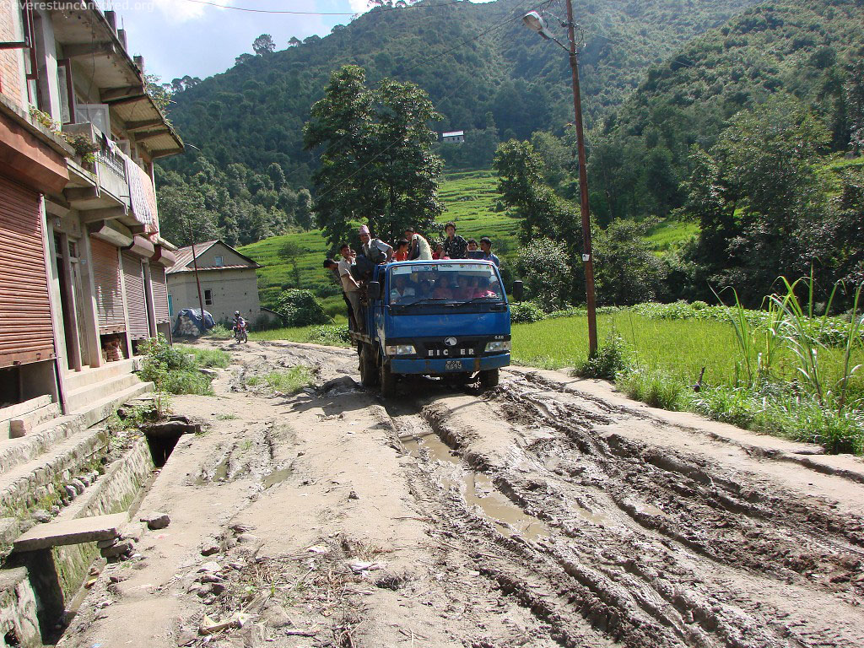

Slide 26
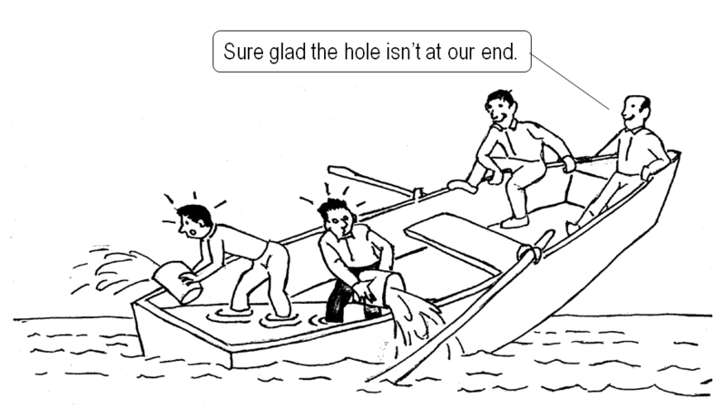

Slide 27


Slide 28
Project Risk Management
Processes for conducting risk management planning, identification, analysis, response planning and monitoring and control on a project.

Slide 29
Project Risk Management
Plan Risk Management [PLANNING]
Identify Risks [PLANNING]
Perform Qualitative Risk Analysis [PLANNING]
Perform Quantitative Risk Analysis [PLANNING]
Plan Risk Responses [PLANNING]
Implement Risk Responses [EXECUTING]
Control Risks [M&C]

Slide 30
Personal Attitude to Risk
Individuals fall into one of the three categories
Risks Averse
Risk Seeking
Risk Neutral

Slide 31
36. Plan Risk Management
Defining how to conduct risk management activities for a project .

Slide 32
Plan Risk Management
PRKM
PLAN
.1 Project charter
.2 Project management plan
• All components
.3 Project documents
• Stakeholder register
.4 EEFs
.5 OPAs
.1 Expert judgment
.2 Data analysis
• Stakeholder analysis
.3 Meetings
.1 Risk management plan

Slide 33
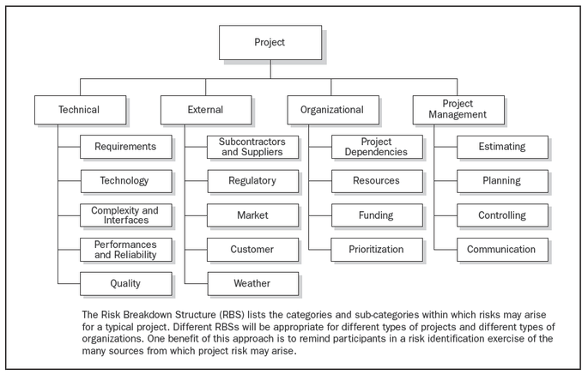
Risk Breakdown Structure
Source : PMI PMBOK® Fourth Edition

Slide 34
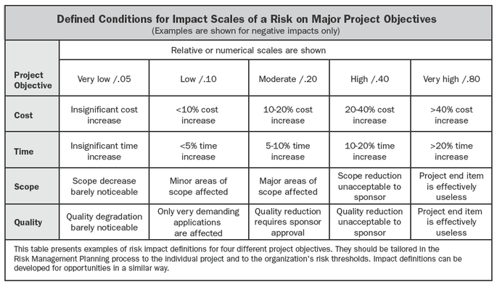
Definition of Impact
Source : PMI PMBOK® Fourth Edition

Slide 35
37. Identify Risks
Determining which risks may affect the project and documenting their characteristics

Slide 36
Identify Risks
PRKM
PLAN
.1 Project management plan
• Requirements management plan
• Schedule management plan
• Cost management plan
• Quality management plan
• Resource management plan
• Risk management plan
• Scope baseline
• Schedule baseline
• Cost baseline
.2 Project documents
• Assumption log
• Cost estimates
• Duration estimates
• Issue log
• Lessons learned register
• Requirements documentation
• Resource requirements
• Stakeholder register
.3 Agreements
.4 Procurement documentation
.5 EEFs
.6 OPAs
.1 Expert judgment
.2 Data gathering
• Brainstorming
• Checklists
• Interviews
.3 Data analysis
• Root cause analysis
• Assumption and constraint analysis
• SWOT analysis
• Document analysis
.4 Interpersonal and team skills
• Facilitation
.5 Prompt lists
.6 Meetings
.1 Risk register
.2 Risk report
.3 Project documents updates
• Assumption log
• Issue log
• Lessons learned register

Slide 37
Diagramming Techniques
Cause and effect diagrams
System or process flow charts
Influence Diagram

Slide 38
38. Perform Qualitative Risk Analysis
Prioritizing risks for further analysis or action by assessing and combining their probability of occurrence and impact.

Slide 39
Perform Qualitative Risk Analysis
PRKM
PLAN
.1 Project management plan
• Risk management plan
.2 Project documents
• Assumption log
• Risk register
• Stakeholder register
.3 EEFs
.4 OPAs
.1 Expert judgment
.2 Data gathering
• Interviews
.3 Data analysis
• Risk data quality assessment
• Risk probability and impact assessment
• Assessment of other risk parameters
.4 Interpersonal and team skills
• Facilitation
.5 Risk categorization
.6 Data representation
• Probability and impact matrix
• Hierarchical charts
.7 Meetings
.1 Project documents updates
• Assumption log
• Issue log
• Risk register
• Risk report

Slide 40
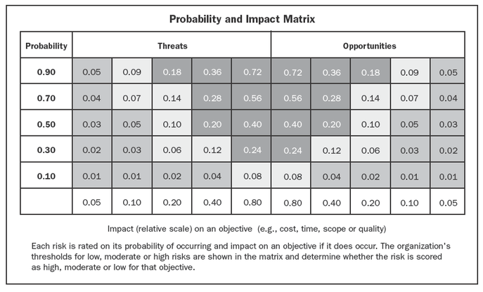
Probability Impact Matrix
Define Threshold
High risk (“red condition”)
Medium risk (“yellow condition”)
Low risk (“green condition”)
Source : PMI PMBOK® Fourth Edition

Slide 41
39. Perform Quantitative Risk Analysis
Numerically analyzing the effect of identified risks on overall project objectives.

Slide 42
Perform Quantitative Risk Analysis
PRKM
PLAN
.1 Project management plan
• Risk management plan
• Scope baseline
• Schedule baseline
• Cost baseline
.2 Project documents
• Assumption log
• Basis of estimates
• Cost estimates
• Cost forecasts
• Duration estimates
• Milestone list
• Resource requirements
• Risk register
• Risk report
• Schedule forecasts
.3 EEFs
.4 OPAs
.1 Expert judgment
.2 Data gathering
• Interviews
.3 Interpersonal and team skills
• Facilitation
.4 Representations of
uncertainty
.5 Data analysis
• Simulations
• Sensitivity analysis
• Decision tree analysis
• Influence diagrams
.1 Project documents updates
• Risk report

Slide 43
PQnRA- Tools & Techniques
Data Gathering & Representation Techniques
Interview
Probability Distribution (Normal, Beta, Triangular)
Quantitative Risk Analysis Modeling Techniques
Sensitivity analysis- helps to determine which risks have the most potential impact- Tornado diagrams (compare relative importance and impact of variables of high degree of uncertainty)
Expected monetary value analysis (EMV)- Calculates average outcome of future scenarios that may or may not happen
Modeling & Simulation- Monte Carlo techniques

Slide 44
Formulae
Probability = Number of Occurrences / Total Number occurrences
= Frequency of Related Events / Total Number of Events
Probability = Frequency of Related Events /
Total Number of Possible Events
Expected Monetary Value (EMV) = Risk Event Probability X Risk Event Value
The sum of their probabilities of occurrence is 1.0

Slide 45
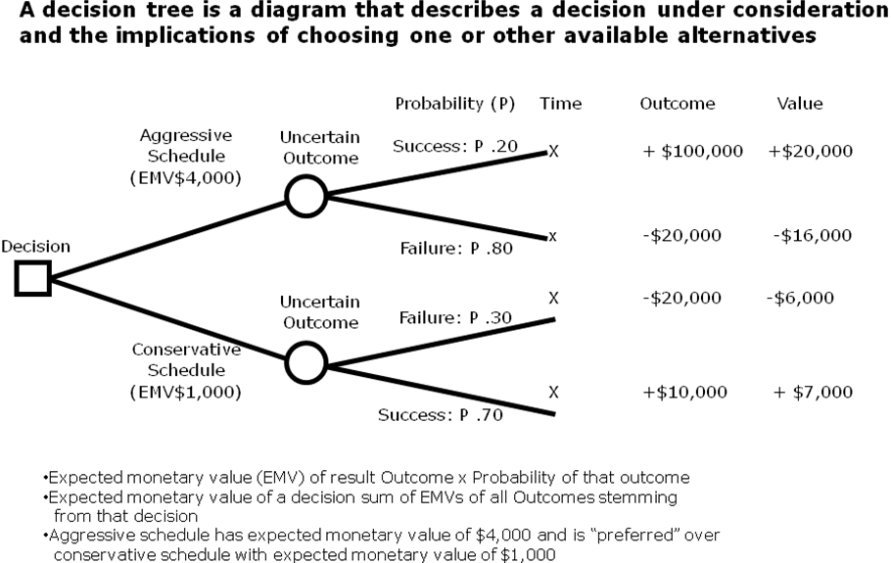
Decision Tree

Slide 46
Decision Tree
A Fixed Price Contract worth $150,000 has a clause of $1000 penalty per day of schedule delay. The following estimates for Cost and Schedule are provided:
Self-execute
Cost can vary : with a likelihood 80% ➔ 120,000 vs. with a likelihood of 20% ➔ 140,000
Schedule: can vary : 95% on time, 5% possibility of 2 days delay
Subcontract
Cost can vary : with a likelihood of 60% ➔ 110,000 vs. with a likelihood of 40% ➔ 120,000
Schedule can vary:: 80% on time, 20% possibility of 20 days delay

Slide 47
Decision Tree- Solution
Cost
Schedule
Probability
Profit Potential
.95
.76
150,000-120,000 = 30,000
22,800
Self -execute
.04
150,000-(120,000+2000) = 28,000
1,120
.05
.8
.95
.19
150,000-140,000 = 10,000
1,900
.2
.05
.01
150,000-(140,000+2000) = 8,000
80
25,900
.8
.48
150,000-110,000 = 40,000
19,200
.6
Subcontract
.2
.12
150,000-(110,000+20,000) = 20,000
2,400
.4
.8
9,600
.32
150,000-120,000 = 30,000
.2
150,000-(120,000+20,000) = 10,000
800
.08
32,000

Slide 48
40. Plan Risk Response
Developing options and actions to enhance opportunities and reduce threats to project objectives.

Slide 49
Plan Risk Response
PRKM
PLAN
.1 Project management plan
• Resource management plan
• Risk management plan
• Cost baseline
.2 Project documents
• Lessons learned register
• Project schedule
• Project team assignments
• Resource calendars
• Risk register
• Risk report
• Stakeholder register
.3 EEFs
.4 OPAs
.1 Expert judgment
.2 Data gathering
• Interviews
.3 Interpersonal and team skills
• Facilitation
.4 Strategies for threats
.5 Strategies for opportunities
.6 Contingent response strategies
.7 Strategies for overall project risk
.8 Data analysis
• Alternatives analysis
• Cost-benefit analysis
.9 Decision making
• Multicriteria decision analysis
.1 Change requests
.2 PMP updates
• Schedule management plan
• Cost management plan
• Quality management plan
• Resource management plan
• Procurement management plan
• Scope baseline
• Schedule baseline
• Cost baseline
.3 Project documents updates
• Assumption log
• Cost forecasts
• Lessons learned register
• Project schedule
• Project team assignments
• Risk register
• Risk report

Slide 50
Risk Response Strategies
Risk Responses: Threats & Opportunities
Threats or Negative Risk Positive Risk or Opportunities
Avoid Exploit
Mitigate Enhance
Transfer Share
Acceptance Acceptance

Slide 51
Negative Risk Responses
Avoid
Risk avoidance involves changing the project management plan to eliminate the threat posed by an adverse risk, to isolate the project objectives from the risk’s impact or to relax the objective that is in jeopardy, such as extending the schedule or reducing scope.
Transfer
It requires shifting the negative impact of a threat, along with ownership of the response, to a third party.
Mitigate
It implies a reduction in the probability and / or impact of an adverse risk event to an acceptable threshold. Transference is a form of mitigation.

Slide 52
Positive Risk Responses
Exploit
It seeks to eliminate the uncertainty associated with a particular upside risk by making the opportunity definitely happen. It may be selected for opportunities where the organization wishes to ensure that it is realized.
Examples include assigning more talented resources to the project to reduce time to completion or to provide better quality than originally planned.
- It is analogous to ‘avoidance’
Share
It involves allocating ownership to a third-party who is best able to capture the opportunity for the benefit of the project.
Examples include forming risk-sharing partnerships or joint ventures.
- It is analogous to ‘transference’.

Slide 53
Positive Risk Responses
Enhance
It modifies the ‘size’ of an opportunity by Increasing probability and / or positive impacts and identifying and maximizing key drivers of positive- impact risks.
It seeks to facilitate or strengthen the cause of the opportunity and proactively target and reinforce it’s trigger conditions to increase the probability.
It is analogous to ‘mitigation’.

Slide 54
+/- Risk Responses
Accept
It is a strategy that is adopted because it is seldom possible to eliminate all risk from a project.
It indicates that the project team
Has decided not to change the project management plan to deal with risk or
Is unable to identify any other suitable response strategy.
Active Acceptance most commonly involves establishing a
‘contingency reserve’, including amounts of time, money or resources to handle known or unknown threats or opportunities.
Passive Acceptance requires no action, leaving the project team to deal with threats or opportunities as they occur.

Slide 55
Understanding Reserves
Contingency reserves : Known – Unknown
It is designed for use only if certain events occur or only under certain predefined conditions, provided there is sufficient warning to implement the response.
Examples of events that may trigger the contingency response include missing intermediate milestones or gaining higher priority with a supplier.
Events triggering the contingency response should be triggered and tracked.
Management reserves: Unknown – Unknown
It is defined for use only if ‘the events that occur or only under certain conditions’, where information about the event & its occurrence is absolutely NOT available.

Slide 56
41. Implement Risk Responses
The process of implementing agreed-upon risk response plans.

Slide 57
Implement Risk Responses
PRKM
EXEC
.1 Project management plan
• Risk management plan
.2 Project documents
• Lessons learned register
• Risk register
• Risk report
.3 OPAs
.1 Expert judgment
.2 Interpersonal and team skills
• Influencing
.3 PMIS
.1 Change requests
.2 Project documents updates
• Issue log
• Lessons learned register
• Project team assignments
• Risk register
• Risk report

Slide 58
42. Monitor Risks
The process of monitoring the implementation of agreed-upon risk response plans, tracking identified risks, identifying and analyzing new risks, and evaluating risk process effectiveness throughout the project.

Slide 59
Control Risks
PRKM
M&C
.1 Project management plan
• Risk management plan
.2 Project documents
• Issue log
• Lessons learned register
• Risk register
• Risk report
.3 Work performance data
.4 Work performance reports
.1 Data analysis
• Technical performance analysis
• Reserve analysis
.2 Audits
.3 Meetings
.1 Work performance information
.2 Change requests
.3 Project management plan updates
• Any component
.4 Project documents updates
• Assumption log
• Issue log
• Lessons learned register
• Risk register
• Risk report
.5 OPAs updates

Slide 60
Risk Management Terms
Contingency Reserve
A separately planned quantity used to allow for future situations which may be planned for only in part (sometimes called “Known-unknowns”)
Intended to reduce the impact of missing cost or schedule objectives
Normally included in the project costs
Management Reserves
“A separately planned quantity used to allow for future situations which are impossible to predict (sometimes called “Unknown- unknowns”)
Intended to reduce the risk of missing cost or schedule objectives
Use of Management reserves requires a change to the project’s cost baseline
Residual Risks
Residual risks are those that remain after response measures have been taken.
Include minor risks that have been accepted and addressed. E.g., By adding contingency amounts to the cost or by allowing time
Secondary risks
Risks that arise as a result of implementing risk response
Should be identified and responses planned

Slide 61
Exercise 26
30 Min
Prepare Risk Management Plan for your project
Setup a template to capture all the information to manage risk
Training content for risk awareness
Training audience
Roles & Responsibilities for Risk Management Activities
Risk assessment techniques & tools
Risk Manager, Risk Audits Frequency, Risk Auditor
Define Impact Table
Define Probability and Impact Table/ Risk Tolerances of Stakeholders
Prepare Risk Register
Analyse Assumptions, Constraints, Dependencies of your project
Identify Risk for your projects
Prepare Risk Response Plan
Prepare Risk Response Strategy for every risk which cannot be tolerated
Establish Contingency Fund
Discuss Unknown-Unknown and Management Reserve

