Slide 1
PRINCE2 Summary

Slide 2
PRINCE2 Manual Important Pages
17 A summary of the themes within PRINCE2 (useful for those questions on themes)
23 Useful diagram on the business case development path
33 Useful diagram of the organization structure recommended by PRINCE2
49 Quality audit train, this diagram has been used in some practitioner questions
55 This is one of only two ‘grey boxes' that are included in the syllabus (the other being product based planning)
63 Diagram showing the planning procedure
86 List of risk threat and opportunity responses
95 Change management procedure
102 The six tolerances areas by level
115 If you have a magnifying glass this diagram could be useful
216 The factors that lead to tailoring the method
219 This diagram shows a project in the context of programme
222 Tale with examples of different scales of projects
235 In appendix A the product descriptions in alphabetical order, and should be referenced as needed
269 In appendix C the roles and responsibilities are in A-Z order. Useful when tackling the organization questions

Slide 3
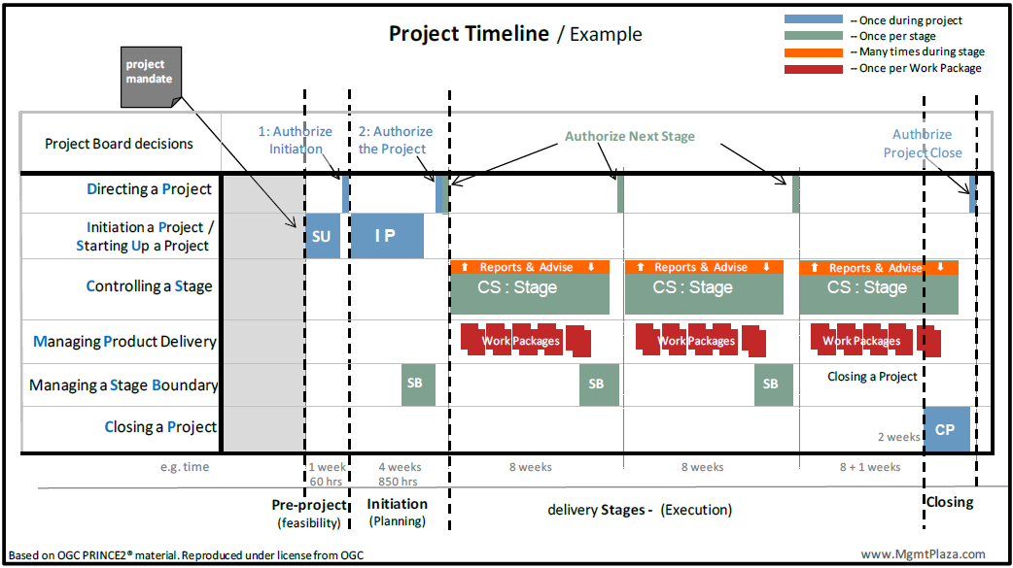
Project Timeline

Slide 4
P2F: Student Book Summary
Student Book | Start | End | Total Pages
PRINCE2 Syllabus Explained | 12 | 38 | 24
Main Course Slides | 39 | 426 | 389
Case Study (32 Exercises) | 427 | 468 | 42
Ques Set 1 | 471 |  | 29
Explanation Set 1 |  |  | 26
Ques Set 2 |  |  | 29
Explanation Set 2 |  |  | 25
Glossary | 583 | 600 | 18

Slide 5
P2P: Student Book Summary
Student Book | Start | End | Total Pages
PRINCE2 Syllabus Explained | 12 | 38 | 24
Exam Information | 39 | 65 | 27
Additional Info (Tailoring, C/S Relationship, Themes, Management Products) | 66 | 157 | 42
Case study (52 Exercises) | 161 | 237 | 77
Ques Set 1 (Calendar) | 240 |  | 27
Explanation Set 1 |  |  | 17
Ques Set 2 (Restructuring) |  |  | 27
Explanation Set 2 |  |  | 17
Glossary | 364 | 383 | 18

Slide 6
P2F: Case Study/Activity Summary
# Page in Book |  |  |  | 582 | 562 | 317
Case Study | Case Study Page# | # of Activities | Exercise During Training | Student Book | eBook IM | eBook IS | Day
Organization | 430 | 2 | Yes | 108 | 99 | 62 | Day1 / Before Lunch
Outline Business Case | 433 | 1
Business Case (Read) | 434 | 1 | Yes | 143 | 131 | 91 | Day1 / Before Second Tea Break
Project Brief | 435 | 1
Directing a Project | 437 | 3 | Yes | 162 | 148 | 107 | Day1 / Before EOD
Initiating a Project | 438
Themes & Plan | 439 | 1
PBS and Product Flow Diagram | 441 | 2 | Yes | 224 | 207 | 158 | Day2/ After Lunch
Risk Management | 444 | 2 | Yes | 251 | 233 | 180 | Day2/ Before Second Tea Break
Controls | 446 | 2
Project Initiation Document | 449 | 3 | Yes | 188 | 173 | 130 | Day2 / Before First Tea Break
End Stage Assessment | 452 | 3
Exceptions | 455 | 3
Work Pacakage | 458 | 1
Quality and Quality Review | 460 | 5 | Yes
Closing a Project | 465 | 2 | Yes | 398 | 370 | 302 | Day3 / After Lunch
Final Assessment | 467 | 1

Slide 7
PRINCE2 Management Product
12-BL-Baseline, 6-REC-Record, 8-REP-Report
Product Name | Type | Theme | Product Name | Type | Theme
Benefit Review Plan | BL | BC | Lesson Log | REC
Business Case | BL | BC | Lesson Report | REP
Checkpoint Report | REP | PRO | Plan (Project, Stage, Team, Exception) | BL | PLN
Communication Management Strategy | BL | PRO | Product Description | BL | QLT
Configuration Item Record | REC | CHG | Product Status Account | REP | CNG
Configuration Management Strategy | BL | CHG | Project Brief | BL
Daily Log | REC |  | Project Initiation Documentation | BL
End Project Report | REP | PRO | Project Product Description | BL | QLT
End Stage Report | REP | PRO | Quality Management Strategy | BL | QLT
Exception Report | REP | PRO | Quality Register | REC | QLT
Highlight Report | REP | PRO | Risk Management Strategy | BL | RSK
Issue Register | REC | CHG | Risk Register | REC | RSK
Issue Report | REP |  | Work Package | BL

Slide 8
PRINCE2 Roles
Program Management
Executive
Senior User
Senior Supplier
Project Manager
Team Manager
Project Assurance
Change Authority
Project Support

Slide 9
7-7-7 of PRINCE2
Principle | Themes | Processes
Continuous Business Justification Learn from Experience Description of Roles & Responsibilities Manage by Stages Manage by Exceptions Product Focus Tailoring | Business Case (Why?) Change (What impact?) Organization (Who?) Plan (When, How, How much) Progress (Where are we, are we going in right direction, should be continue Quality (What?) Risk (What if?) | Starting up a Project Directing a Project Initiating a Project Controlling a Project Managing Product Delivery Managing a Stage Boundary Closing a Project

Slide 10
PRINCE2 Process, PRINCE2 Product Mapping
PRINCE2 Process | Products
Starting up a Project | PB
Directing a Project
Initiating a Project | PID BRP
Controlling a Project | WP
Managing Product Delivery
Managing a Stage Boundary | Stage Plan, Exception Plan
Closing a Project | BRP Updated

Slide 11
Project Management Team Structure

Slide 12
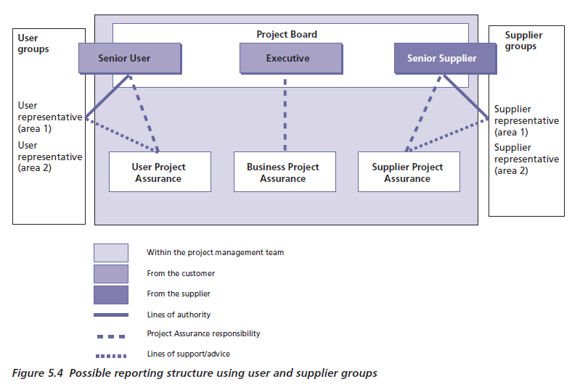
Project Assurance

Slide 13
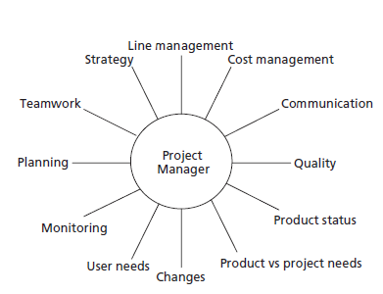
Facets of Project Manager Role

Slide 14
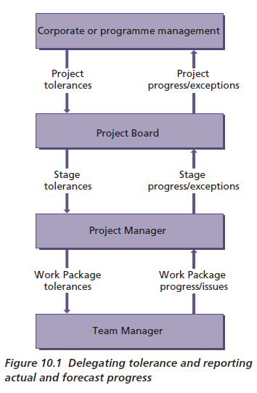
Delegating Tolerance

Slide 15
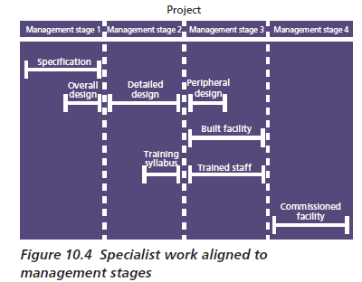
Technical & Management Stages

Slide 16
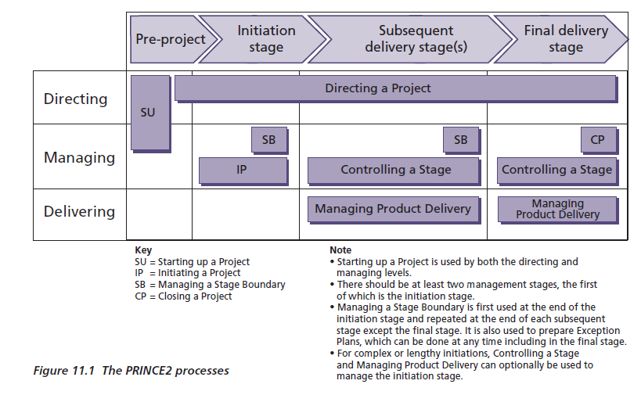
PRINE2 Processes and Stages

Slide 17
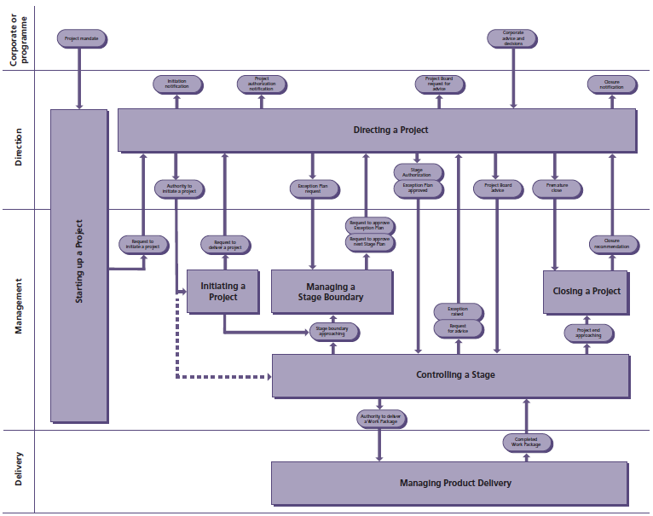
PRINCE2 Processes

Slide 18
Key PRINCE2 Products
Project Mandate
PPD (Project Product Description) = Dev Skills Required + Acceptance Criteria + Project Level Quality Tolerances + Acceptance Method + Acceptance Responsibilities
PB = Project Definition + OBC + PPD + Project Approach + PM Team Structure + Role Description
BC = Executive Summary + Reasons + Business Options + Expected Benefits + Expected Dis-benefits +timescale+ Costs + Investment Appraisal + Major Risks
PD (Product Description) = Composition + Derivation + Dev Skills Required + Quality Responsibilities (P/R/A) + Quality criteria + Quality tolerance + Quality methods + Quality skills required
Plan = Description + Prerequisites + External Dependencies + Lessons Incorporated + Monitoring and Control + Budget+ Tolerances (T/C/S for Level of Plan. May stage/team related Risk) + Product Description + Schedule
PID = Project Definition + BC + Project Approach + PM Team Structure + Role Description + PP + Project Controls + 4 Strategies + Tailoring of PRINCE2
Work Package= Techniques, process & procedures + Development Interfaces + Ops/Maintenance Interfaces + Configuration Mgmt Req + Joint Agreements (efforts, cost, date, key milestones) + Tolerance (T/C may be S/R) + Constraints+ Reporting Arrangements + Problem handling and escalation + approval methods + extracts from stage plan and product description
PPD -> PBS -> Product Description -> Product Flow Diagram

Slide 19
Technique: Product Based Planning

Slide 20
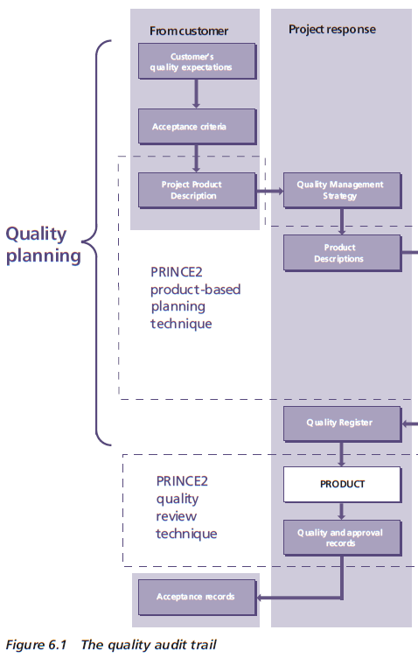
Technique: Quality Review
Review team roles
Chair This role is responsible for the overall conduct of the review
Presenter This role introduces the product for review and represents the producer(s) of the product. The presenter also coordinates and tracks the work after the review, i.e. applying the changes to the product agreed by the team
Reviewer This role reviews the product,
submits questions and confirms corrections and/or improvements
Administrator This role provides administrative support for the chair and records the result and actions.
Approver If the person (or group) who will approve the product participates in the quality review, it may be possible to approve the product as part of the review.

Slide 21
Estimation Techniques
Top down estimating
Bottom up estimating
Top-down and bottom-up approach
Comparative estimating
Parametric estimating
Single point estimating
Three point estimating
Delphi techniques

Slide 22
Basic rules for estimating
Assume that resources will only be productive for, say, 80% of their time
Resources working on multiple projects take longer to complete tasks because of time lost switching between them
People are generally optimistic and often underestimate how long tasks will take
Estimate numbers should be accompanied by assumptions.
Make use of other people’s experiences and your own
Ensure that the person responsible for creating the product is also responsible for providing the effort estimates
Always build in provision for problem solving, meetings and other unexpected events
Cost each activity rather than trying to cost the plan as a whole
Communicate any assumptions, exclusions or constraints you have to the user(s).

Slide 23
Threat and opportunity responses
Threat responses | Opportunity responses
Avoid | Exploit
Reduce (probability and/or impact) | Enhance
Fallback (reduces impact only)
Transfer (reduces impact only, and often only the financial impact)
Accept | Reject
Share | Share

Slide 24
The Risk Management Procedure
Identify
Assess
Plan
Implement
Communicate

Slide 25
Risk Register
Who raised the risk
When it was raised
The category of risk
The description of the risk (cause, risk event, effect)
Probability, impact and expected value
Proximity
Risk response category
Risk response actions
Risk status
Risk owner
Risk actionee.

Slide 26
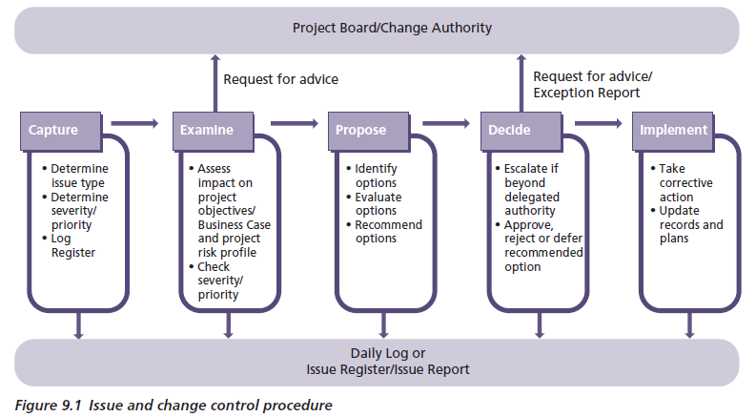
Issue and Change Control Procedure
Types of Issue
Request for Change
Off-specification
Problem/Concerns

Slide 27
Request for Change Possible Decisions
Approve the Change
Reject the Change
Defer decision
Request more info
Ask for an Exception Plan

