Slide 1
11 - Project Risk Management
Created by ejlp12@gmail.com, June 2010
Project Management Training

Slide 2
Project Risk Management
Monitoring &
Controlling Processes
Planning
Processes
Enter phase/
Start project
Initiating
Processes
Closing
Processes
Exit phase/
End project
Executing
Processes
Knowledge Area | Process
 | Initiating | Planning | Executing | Monitoring & Contol | Closing
Risk |  | Plan Risk Management Identify Risk Perform Qualitative Risk Analysis Perform Quantitative Risk Analysis Plan Risk Response |  | Monitor and Control Risks

Slide 3

Project Risk Management
Risk is an uncertain event or condition that, if occurs, has an effect on at least one project objective.
Risk management objectives:
increase the probability and impact of positive events (opportunities).
decrease the probability and impact of negative events (threat).
Terms & concepts:
Uncertainty: a lack of knowledge about an event that reduces confidence
Risk averse: someone who does not want to take risks.
Risk tolerances: area of risk that are acceptable/unacceptable.
Risk thresholds: the point at which a risk become unacceptable
Remember that in this area there is no activity in executing process group

Slide 4
Project Risk Management
Risk factors
1.
The probability that it will occur
2.
The range of possible outcome (impact)
3.
Expected timing (when) in the project life cycle
4.
The anticipated frequency of risk event
(how often)

Slide 5
11.1 Plan Risk Management
The process of defining how to conduct risk management activities for a project.
Inputs
Project scope statement Cost management plan Schedule management plan Communication management plan Enterprise environmental factors Organizational process assets
Tools & Techniques
Planning meetings and analysis
Outputs
Risk management plan

Slide 6
Plan Risk Management
Importance of Risk Management Planning
Ensure that the degree, type, and visibility of risk management are commensurate
Provide sufficient resource and time for risk management activities
Establish an agreed-upon basis for evaluating risk
Risk Categories
A standard list of risk categories can help to make sure areas of risk are not forgotten.
Companies and PMO should have standard list of risk categories to help identify risk.
2 Main type of Risk
Business – Risk of gain or loss
Pure (insurable) risk – Only a risk of loss (i.e. fire, theft, personal injury, etc)
Sources of risk = risk categories
Risk categories may be structured into Risk Breakdown Structure (RBS)

Slide 7

Risk Management Plan
Risk management plan describe how risk management will be structured and performed on the project.
Subset of project management plan.
May includes:
Methodology
Roles & responsibilities
Budgeting
Timing
Risk categories.
Definition of probability and impact
Stakeholder tolerances
Reporting formats
Tracking
Probability and impact matrix (?)

Slide 8
8.2 Identify Risk
The process of obtaining seller responses, selecting a seller, and awarding a contract.
Inputs
Project management plan Procurement documents Source selection criteria Qualified seller list Seller proposals Project documents Make-or-buy decisions Teaming agreements Organizational process assets
Tools & Techniques
Documentation reviews Information gathering techniques Checklist analysis Assumptions analysis Diagramming techniques SWOT analysis Expert judgment
Outputs
Risk register
Q: Who should be involved in risk identification?
A: EVERYONE

Slide 9
Identify Risk
Risk should be continually reassessed (iterative) such as in integrated change control activity, when working with resources, when dealing with issues.
Information gathering techniques
Brainstorming
Delphi technique: Expert participate anonymously; facilitator use questionnaire; consensus may be reached in a few rounds; Help reduce bias in the data and prevent influence each others.
Interviewing: interviewing experts, stakeholders, experienced PM
Root cause analysis: Reorganizing the identified risk by their root cause may help identify more risks
Checklist analysis: checklist developed based on accumulated historical information from previous similar project
Assumption analysis: identify risk from inaccuracy, instability, inconsistency, incompleteness.
SWOT analysis – Strengths, Weaknesses, Opportunities, Threats

Slide 10
Diagramming techniques
Cause and effect diagrams (fish-bone diagram)
System or process flow charts.
Influence diagrams
show the casual influences among project variables, the timing or time ordering of events, and the relationships among other project variables and their outcomes.
excellent for displaying a decision’s structure
Described in Quality Management
Risk Register
After Indentify Risk process the output is initial entries into the risk register. It includes:
List of risk
List of POTENTIAL responses
Root causes of risks
Updated risk categories

Slide 11
11.3 Perform Qualitative Risk Analysis
The process of prioritizing risks for further analysis of action by assessing and combining their probability of occurrence and impact.
Inputs
Risk register Risk management plan Project scope statement Organizational process assets
Tools & Techniques
Risk probability and impact assessment Probability and impact matrix Risk data quality assessment Risk categorization Risk urgency assessment Expert judgment
Outputs
Risk register updates

Slide 12
Qualitative Risk Analysis
Help to focus on high priority risks
A subjective analysis
Analysis using…
Relative probability or likelihood of occurrence
Impact on project objective
Time frame response
Organization’s risk tolerance
Etc.
Can be also used to:
Compare risk to the overall risk of other projects
Determine whether the project should be selected, continued or terminated.
Determine whether to proceed to Perform Quantitative Risk Analysis

Slide 13
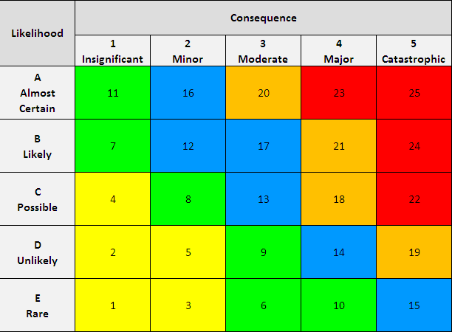
Probability Impact Matrix
Different matrices can be used for cost, time, scope
It helps guide risk responses (priority action & response strategies)
Colors shows level of importance
No | Category | Description of Risk | IMPACT | PROBA BILITY | RISK LEVEL
1 | Resource | Testing environment not available | 4 | B | ORANGE
2 | Schedule | Documentation approval took longer time | 4 | A | RED

Slide 14
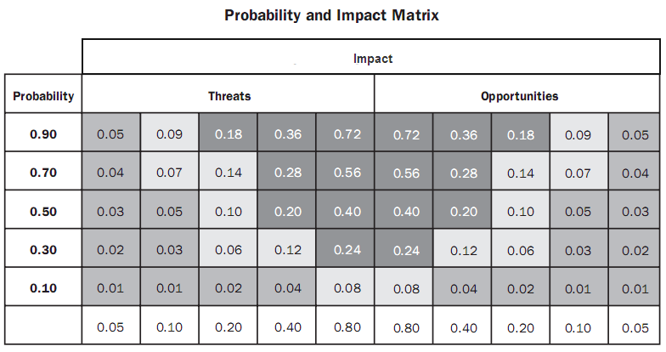
Probability Impact Matrix
Different matrices can be used for threats and opportunities
Sample from
PMBOK
Image Source: PMBOK Guide 4th Edition. PMI © 2009, p.292

Slide 15
Risk Register Updates
Update/add additional information to previous output i.e. Risk Register, which include:
Relative ranking/priority
Risk grouped by categories
List of risk requiring additional analysis in the near term
List of risk for additional analysis and response
Watch-list (non-critical or non-top risks)
Trends Since risk analysis process is iterative, PM should know if risk is increasing, decreasing or staying the same
Cause of risk requiring particular attention

Slide 16
11.4 Perform Quantitative Risk Analysis
The process of numerically analyzing the effect of identified risks on overall project objectives.
Inputs
Risk register Risk management plan Cost management plan Project scope statement Organizational process assets
Tools & Techniques
Data gathering and representation techniques Quantitative risk analysis and modeling techniques Expert judgment
Outputs
Risk register updates
If not necessary, this process may be skipped.

Slide 17
Quantitative Risk Analysis
Is a numerical evaluation (more objective)
This process may be skipped.
Purpose of this process
Determine which risk events warrant a response.
Determine overall project risk (risk exposure).
Determine the quantified probability of meeting project objectives.
Determine cost and schedule reserves.
Identify risks requiring the most attention.
Create realistic and achievable cost, schedule, or scope targets.

Slide 18
Quantitative Risk Analysis: Tools & Techniques
Determining Quantitative Probability and Impact might be done by:
Interviewing
Cost and time estimating
Delphi technique
Use of historical records from previous projects
Expert judgment
Sensitivity analysis – tornado diagram
Expected monetary value (EMV) analysis
Decision tree
Monte Carlo analysis (simulation)

Slide 19
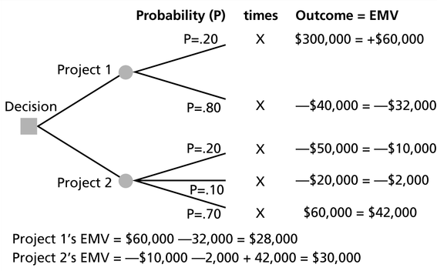
Decision Tree and EMV
EVM used with Decision Tree to choose between many alternative which take into account the future events
Example:
Example Source:

Slide 20
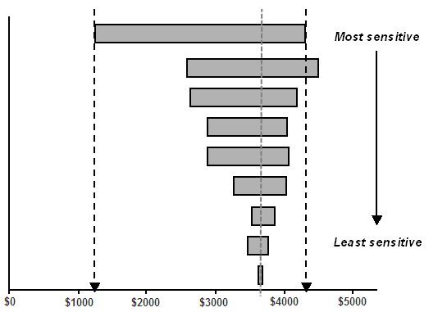
Sensitivity Analysis
To determine which risks have the most potential impact to the project
Changing one or more elements/variables and set other elements to its baseline then see the impact.
One typical display of sensitivity analysis is the tornado diagram

Slide 21
Risk Register Updates
Update/add additional information to previous output i.e. Risk Register, which include:
Prioritize list of quantified risks
Amount of contingency time and cost reserve needed
Possible realistic and achievable completion dates, project cost, with confidence level
The quantified probability of meeting project objectives
Trends

Slide 22
11.5 Plan Risk Response
The process of developing option and action to enhance opportunities and to reduce threats to project objectives.
Inputs
Risk register Risk management plan Cost management plan Project scope statement Organizational process assets
Tools & Techniques
Strategies for negative risks or threats Strategies for positive risks or opportunities Contingent response strategies Expert judgment
Outputs
Risk register updates Risk-related contract decisions Project management plan updates Project document updates

Slide 23
Plan Risk Responses/Mitigation
Do something to eliminate threats before they happens
Do something to make sure the opportunities happens
Decrease the probability and/or impact of threats
Increase the probability and/or impact of opportunities
For the remaining (residual) threats that cannot be eliminated:
Do something if the risk happens (contingency plan).
Do something if contingency plan not effective (fallback plan)

Slide 24
Strategies for Threats
Avoid
Eliminate the threat entirely
Isolate project objectives from the risk’s impact
Transfer (Deflect, Allocate)
Shift some or all the negative impact of a threat to a third party
Mitigate
Implies a reduction in the probability and/or impact of an adverse risk event to be within acceptable threshold limits
Accept
Deal with the risks
Project management plan is not changed
Transferring a risk will leave some risk behind.

Slide 25
Strategies for Opportunities
Exploit
Seek to ensure the opportunities definitely happen
Share
Allocate some or all of the ownership of the opportunity to a third party who is best able to capture the opportunity for the project benefit.
Enhance
Increase the probability and/or the positive impacts of an opportunity.
Accept
Not actively pursuing an opportunity

Slide 26
11.6 Monitor & Control Risk
The process of ..
implementing risk response plans,
tracking identified risks,
monitoring residual risks,
identifying new risks, and
evaluating risk process effectiveness throughout the project.
Inputs
Risk register Project management plan Work performance information Performance report
Tools & Techniques
Risk reassessment Risk audits Variance and trend analysis Technical performance measurement Reserve analysis Status meetings
Outputs
Risk register updates Organizational process assets updates Change requests Project management plan updates Project document updates

Slide 27
Risk Monitoring & Controlling
Other purposes are to determines if
Project assumptions are still valid
Risk has changed or can be retired
Risk management policy & procedure are being followed
Align contingency reserves with current risk assessment

Slide 28
BaCKUP SLIDES

Slide 29
Important Terms
Mutual Exclusive: if two events cannot both occur in a single trial
Probability: something will occur
Normal Distribution: common probability density distribution chart
Statistical independence: the probability of one event occurring does not affect the probability of another event occurring
Standard deviation (or Sigma): how far you are from the mean
3 or 6 sigma
Represent the level of quality has decided to try to achieve
6σ is higher quality standard than 3σ
Used to calculate the upper and lower control limits in a control chart
Number of σ | Percentage of occurrences between two control limits
1 | 68.26%
2 | 95.64%
3 | 99.73%
6 | 99.99985%

Slide 30
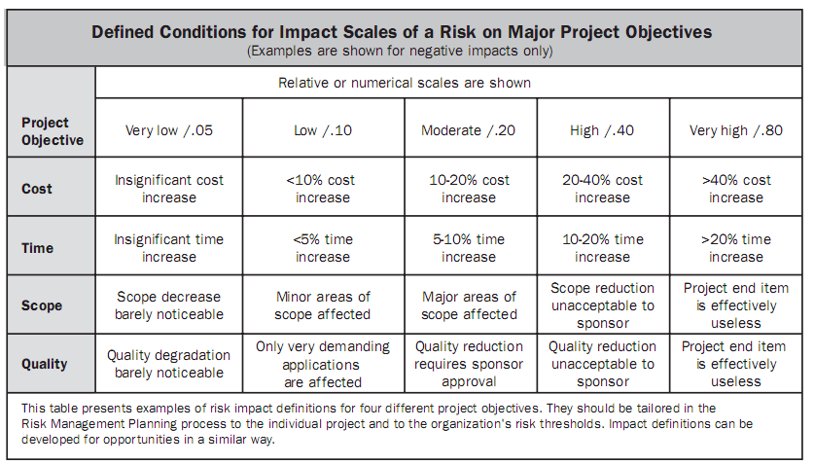
Example: Definition of Risk Probability and Impact
This should be defined in Risk Management Plan
Required for Perform Qualitative Risk Analysis
Can reduce the influence of bias
Image Source: PMBOK Guide 4th Edition. PMI © 2009, p.281

Slide 31
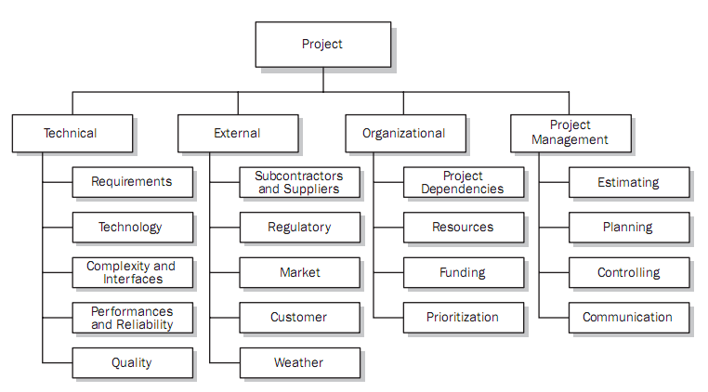
Example: Risk Breakdown Structure (RBS)
Showing risk categorization
Help to ensure a comprehensive process of systematically identifying risk to a consistent level of detail
Image Source: PMBOK Guide 4th Edition. PMI © 2009, p.281

Slide 32
Example: Influence Diagram
Diagramming technique used when Identify Risk
Decision Node
ValueNode
Usage
decision
Test
Survey
Economic
Value
Chance event Node
Human
Exposure
Net
Value
Cancer
Cost
Carcinogenic
potential
Cancer
Risk
Image Source: Influence Diagram & Decision Trees, Lecture slide MHA 6350, Dr. Lloyd R. Burton

Slide 33
Next topic: Project Procurement Management
Thank You

