Slide 1
SharePoint Workflow
Notes:
This module covers the new workflow capabilities of SharePoint 2010 and the tools that are used to author these workflows. Things to begin introducing in this first slide is how SharePoint Designer now has a concept of reuse, and how it plays together with Visio in the workflow authoring process. You can also mention how the workflow internals have been opened up for extension through Visual Studio 2010.

Slide 2
Outline
What’s New in SharePoint 2010 Workflow
Designing Workflows with SPD
Developing Workflows with VS 2010
Notes:
This module has three parts. The first part discusses the concept of workflow and what is new for end-users. The next two parts focus on developing workflows using SharePoint Designer and Visual Studio.

Slide 3













Process Automation in SharePoint
Event
Workflow
Messaging
Collaboration
SharePoint 2010
LOB Apps
Notes:
This slide discusses the concept of automating tasks that people need to perform inside SharePoint and the technologies that you commonly use (Events and Workflow).
It is important not to over-emphasize Business Process Automation, but to introduce it as task-automation

Slide 4
Windows Workflow Foundation
Workflow engine shipped as part of the .NET 3.0 Framework
Model workflows as state machines or sequential steps
Long-running and stateful
Notes:
This slide introduces Windows Workflow Foundation which is the framework used by SharePoint to drive the workflow feature. WF is a part of the .NET 3.0 framework and allows for modeling two types of workflow. State machine is commonly used for authoring system processes with little or no human interaction (sanitizing a saved document). State machines typically model processes heavy on human interaction (document approval).
One thing to note is that SharePoint 2010 will not support workflows created using the new features of the .NET 4.0 framework. The release schedule for the two products were not in sync enough to allow this.

Slide 5
"What's New" for SharePoint 2010
For the end-user
New targets to run a workflow
Visio visualization
For the power-user
Improved nested logic
New Task Process designer
Customizable OOB workflows
For the developer
Visual Studio 2010 SharePoint tools
Workflow Events
Pluggable External Data Exchange Services
Notes:
This slide introduces all the new things you can do with workflow on SharePoint 2010. This deck first covers what is new for end-users, next are the new features of SharePoint Designer and finally the new capabilities of Visual Studio 2010 will be discussed.

Slide 6
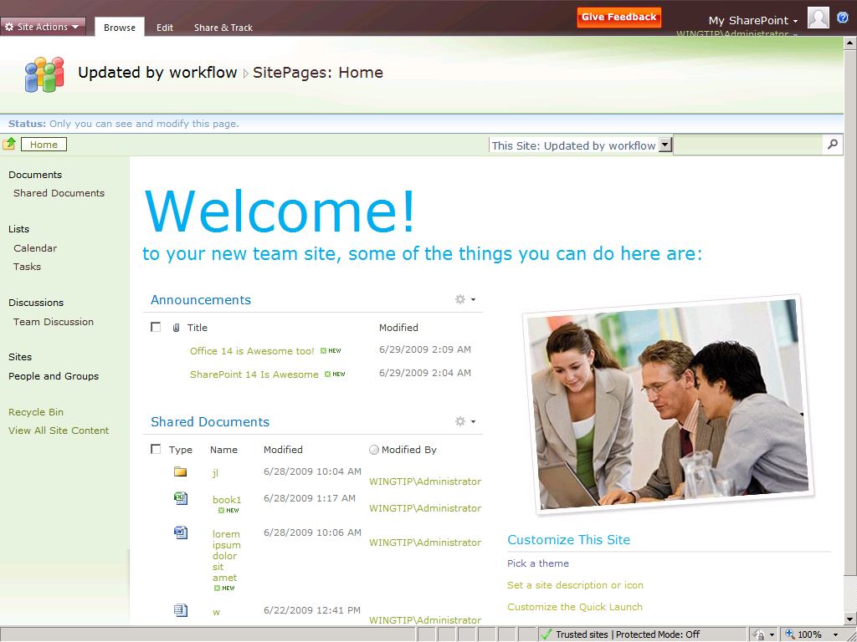
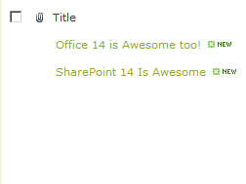
SharePoint 2010 Workflow Targets
Site
List Item
Notes:
Users have a desire to run a workflow outside of the context of a specific list item. You can think of a general clean-up or validation process that needs information from multiple lists. In the previous version of SharePoint people would create a hidden list to allow for this. SharePoint 2010 now allows a site as a target for running a workflow against.
Note that there is no built-in way of auto-starting a workflow like you can with a list-item. You can develop such a feature yourself using event receivers.

Slide 7
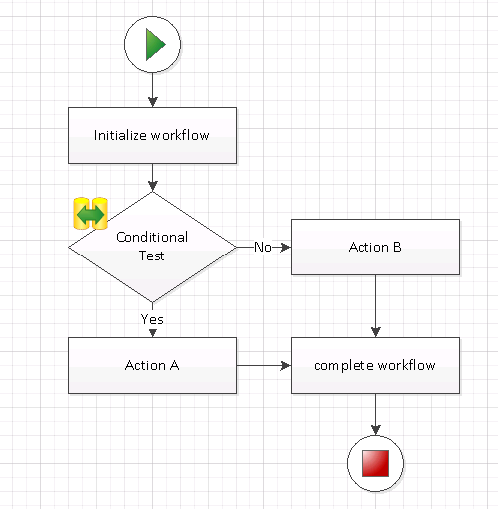
Creating Workflows in Visio
Visio has SharePoint Workflow template
Allows you to create workflow design in Visio
Workflow can be exported to SharePoint Designer
Notes:
A cool new feature of SharePoint 2010 is workflow visualization. This feature builds upon the Visio viewing capabilities of MOSS. In order to make use of this feature the workflow author needs to publish a Visio sheet along with the workflow.

Slide 8
Creating Workflows
demo

Slide 9
Outline
What’s New in SharePoint 2010 Workflow
Designing Workflows with SPD
Developing Workflows with VS 2010
Notes:
This module has three parts. The first part discusses the concept of workflow and what is new for end-users. The next two parts focus on developing workflows using SharePoint Designer and Visual Studio.

Slide 10
SharePoint Designer Improvements
For Design
New declarative workflow designer
Advanced task process designer
InfoPath Forms
Visio workflow designer
For Development
Reusable workflows
Visio visualizations
Export as WSP
Notes:
SharePoint Designer has undergone a major change. As an application SharePoint Designer is much more focused on SharePoint with the new UI. The new capabilities of SharePoint Designer in the field of workflow will often negate the need for Visual Studio 2010. When you have requirements that need custom development SharePoint Designer is an awesome tool to prototype a workflow before taking it into Visual Studio, especially combined with using Visio as the starting point.

Slide 11
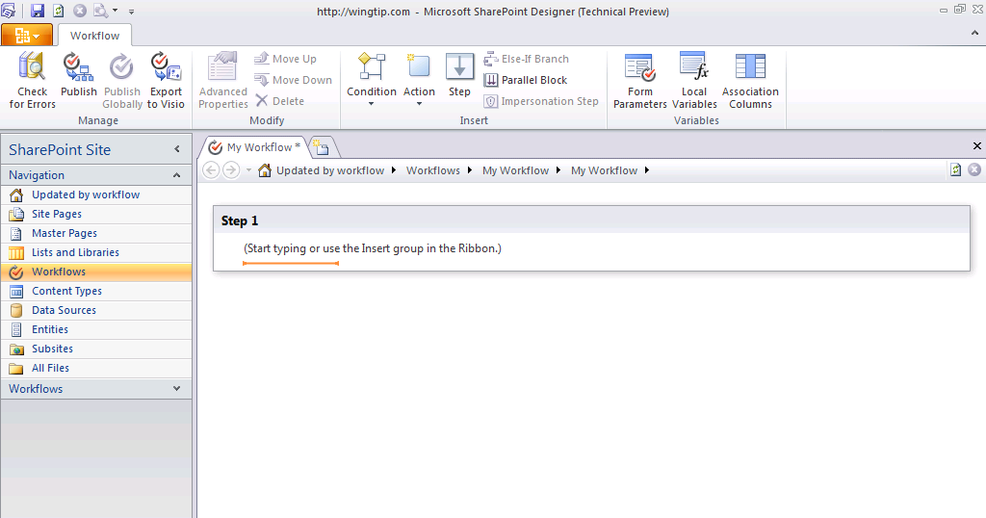
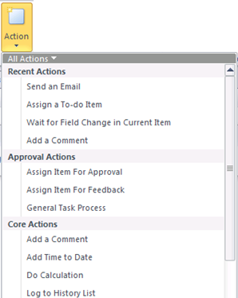
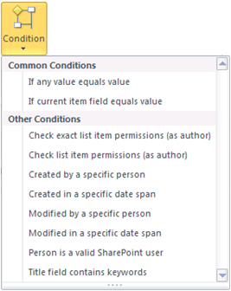
SharePoint Designer Workflows
Improved declarative workflow designer
Notes:
The workflow designer is completely overhauled. By making use of the ribbon a more natural feel to the authoring of workflows is provided. Users of the existing SharePoint Designer 2007 product will have little difficulty applying what they know of authoring workflows.
Note that the new designer still creates sequential workflows, but also note that there have been other investments in the field of creating workflows heavy on human interaction.
Note that the new designer does not break any existing workflow investments you have made.

Slide 12
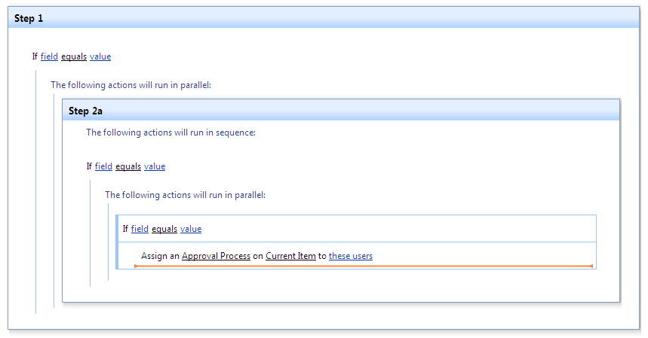
Nested logic in SharePoint Designer
Notes:
SharePoint Designer 2007 had some limitations to nesting logical operations combined with parallel and sequential blocks of actions. These limitations have now been removed.

Slide 13
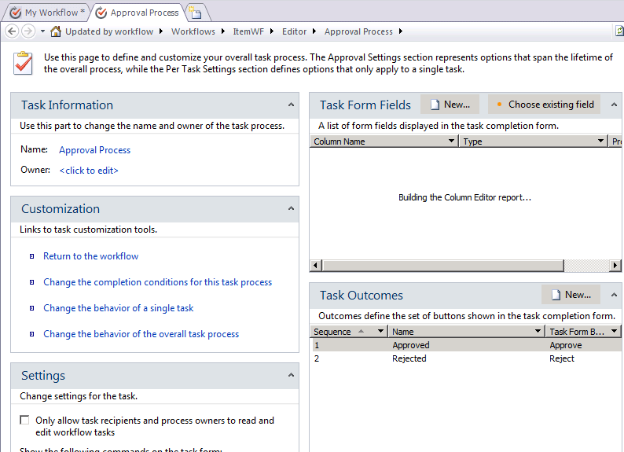
The Task Process Designer
Notes:
The Task Process Designer is a workflow designer within a workflow designer. It allows you design a single workflow task type that you can assign to users and groups, who will execute these tasks sequentially or parallel to each-other. You can create more than one of these blocks of users:
Assign to Group A, Group B, User A. Execute in parallel
Assign to User B, User C. Execute sequential (B first, then C)
Assign to Group C, User D. Execute in parallel
At each step within a task instance (creation, change etc..) you can model specific steps to be performed.
You can declare at what point in time the mini-workflow completes
You can declare what happens when it completes.
The general idea here is that this task designer gives a small state-machine like workflow within the sequential steps of the real workflow.

Slide 14
Prototype, Design and Develop
SharePoint 2010 offers new development process
Envision workflows in Visio
Import into SharePoint Designer
Parameterize
Export to Visual Studio 2010
Add code
Visio
SPD
VS10
Notes:
There is a new capability in Visio where it allows you to model a workflow using shapes. You can then export these shapes into SharePoint Designer. Note that SharePoint Designer does not link to the Visio source. Making changes to the Visio sheet after you have imported the sheet into SharePoint Designer does not update the designed workflow.

Slide 15
SharePoint Designer Workflows
demo

Slide 16
Outline
What’s New in SharePoint 2010 Workflow
Designing Workflows with SPD
Developing Workflows with VS 2010
Notes:
This module has three parts. The first part discusses the concept of workflow and what is new for end-users. The next two parts focus on developing workflows using SharePoint Designer and Visual Studio.

Slide 17
What’s new in Visual Studio 2010
Site Workflows
ASP.NET Form Templates
New events
External Data Exchange
Notes:
There have been many improvements in the field of workflow. Of course Site workflows are now supported, but the real excitement lies in the field of tooling, and the support for external data.

Slide 18
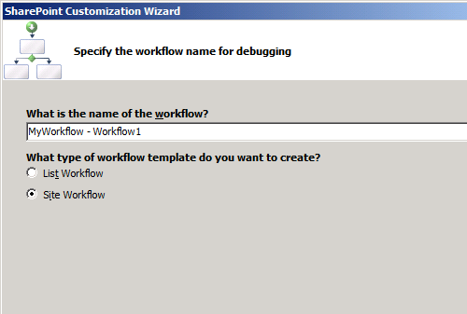
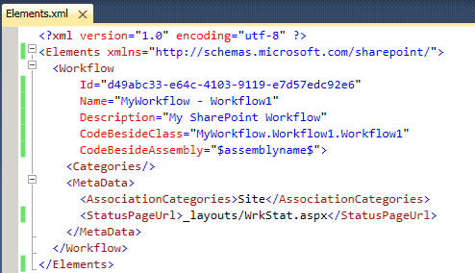
Developing Site Level Workflows
Site Workflows
List / Item properties are null
No auto-start

Slide 19
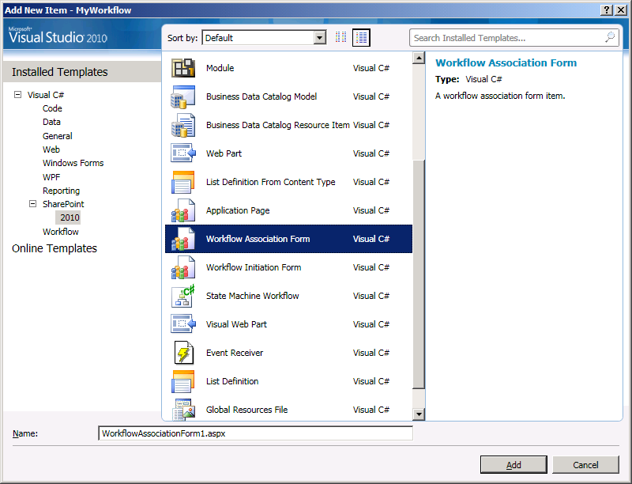
Creating ASP.NET Workflow Forms
Generates the required code
Updates the elements.xml file
Available:
Association
Initiation
Notes:
Creating ASP.NET workflow forms is a complex undertaking. There are many intricate steps you need to take to ensure that your workflow supports the rich features of the SharePoint workflow environment. Many of the settings that a user can configure on any workflow (like whether it will auto-start on change), need to be persisted through code in the workflow form. The new ASP.NET workflow form support in Visual Studio 2010 make creating Association and Initiation forms much easier. Hopefully the extensibility model of Visual Studio 2010 will enable the community to pick up on the Task and Modification forms.

Slide 20
Workflow Events
Events fired during workflow lifetime
Started, Completed…
Scenarios
Call sub-workflows and wait for completion
Provide more elaborate error handling
Familiar model for developers
Notes:
Important to note if there are questions about it, is that the events cannot be used to access workflows as they are re-hydrating after being persisted. So you cannot modify any running worklflow instance.

Slide 21
SPWorklowEventReceiver
Base class for handling workflow events
Register on site / list / content type
public class MyWorkflowEventReceiver
: SPWorkflowEventReceiver
{
public override void WorkflowStarting(
SPWorkflowEventProperties properties)
{
// your code here
base.WorkflowStarting(properties);
}
}

Slide 22



External Data in SharePoint 2007
SharePoint Data
External Data
Correlated Events
Notes:
A core concept of workflow is calling an external system and waiting (with the workflow persisted in a database) for that system to complete its work.
When working with external data in a WF workflow it is important to support the concept of correlation. Correlation provides a generic way for allowing the workflow runtime to route incoming calls from external systems to the right workflow that is waiting for that event. SharePoint 2007 only allowed correlation with SharePoint list data. For a workflow to call into an external system and wait for that system to complete its task you need to route through a hidden SharePoint list.

Slide 23
Pluggable EDE Services
Interact with LOB systems by using custom External Data Exchange services
Requires low-level understanding of WF layer
You can write your own events
No partial trust
Notes:
SharePoint 2010 now allows for pluggable external data exchange services. An EDE service lies at the core of the WF environment. It is the component that is called by a workflow to reach out into an external system and get a response back. Creating these services is not an easy task though and requires a solid understanding of the SharePoint workflow environment.

Slide 24
Flow of Events
Workflow
Call External Method
Workflow Runtime
Raise Event
External System
EDE Service
Or
Subscriptions
External System
WCF Service
Notes:
From the Workflow perspective the flow of events when working with an external system are as follows.
The workflow uses an CallExternalMethod activity which calls a method on the EDE Service (routed through the runtime based on .NET interface)
The workflow does other things
The workflow uses a HandleExternalEvent activity to wait for a response from the external system. It uses the same correlation information as the first step to ensure the right even will be received
From the perspective of the EDE Service
The EDE service receives a call from a workflow (method call)
The EDE services calls into an external system. It either receives a response immediately or it will receive a response through a different communication channel such as a WCF service hosted in SharePoint
It notifies the runtime that the event has arrived, which notifies the workflow (dehydrating it from the database)

Slide 25
Developing Workflows with Visual Studio 2010
demo

Slide 26
Summary
What’s New in SharePoint 2010 Workflow
Designing Workflows with SPD
Developing Workflows with VS 2010
Notes:
This module has three parts. The first part discusses the concept of workflow and what is new for end-users. The next two parts focus on developing workflows using SharePoint Designer and Visual Studio.

