Slide 2
At Organization Level
Identify roles required to manage any project at FFI (Done)
Establish responsibilities of every role at org level (Done)
Start Every Project with Project Charter (Max 1 Page)... Content discussed later.
Assign Project Code this Project
Setup a Configuration Management System for this project
Assign Each Roles for this project
Once again walk through the agile practice for the project
Identify a project area with project white-board
Setup information radiator for the project

Slide 3
For every project
Start project with product backlog
Setup 1 day session for refining, prioritizing product backlog and estimating the work
Product backlog grooming should be done on regular basis
Do not change stories of current sprint
Automate Unit, Functional, Acceptance test cases
Practice Test Driven Development (TDD)
Automate built & deployment process
Development and testing should be simultaneous process not sequential process

Slide 4
MBE- Management by Exception
Project Sponsor
Corporate Governance
Keenen
MBE
Project Board
Senior User
Executive
Senior Supplier
Project Steering Committee
Future Focus
Change Authority
Account Manager
Customer Executive
Scrum Team
MBE
Product Owner
Scrum Master
Project Manager /
Scrum Team*
Project Support
MBE
Development Team
(Programmer/ Tester/BA/UI)
Team Manager /
Scrum Team*
Project Team

Slide 5
Project: Role & Responsibility Descriptions
Role | Responsibilities
Customer Executive | Manage by exception
Account Manager | Manage by exception
Change Authority | Approve Changes within Exception
Project Manager
Product Owner | Explain Requirements, Prioritize Product Backlog, UAT, Accept /Reject Product, Product Backlog Grooming
Scrum Master | Ensure impediments are addressed, team is living agile values & principles, team is following agile practices, all agile are performing their role
Project Support | Record management, configuration management, backup/ restore, security setting, IT support, Prepare Reports, Analyse data, management product (non-customer) documentation
Project Team | Estimate, plan, commit, develop, test, deliver a defect free product, follow all agile practices and update burndown, burnup charts, Kanban board

Slide 6
Project: Market Place
Role | Person
Customer Executive | Mr. Bharath
Account Manager | Mr. Veeren Mathur
Change Authority | Mr.
Project Manager | Mr. Ahmed
Product Owner | Mr. Padmanabham
Scrum Master | Mr. Ahmed
Project Support
Project Team Members | Person
.NET Expert
.NET Export
Automation Testing Expert

Slide 7
Project: private exchange
Role | Person
Customer Executive | Mr. Bharath
Account Manager | Mr. Veeren Mathur
Change Authority | Mr.
Project Manager | Not Required
Product Owner | Mr. Padmanabham
Scrum Master | Mr. Sheshan
Project Support | ??
Project Team Members | Person
.NET Expert
.NET Export
Automation Testing Expert

Slide 8
Change management
In Agile change means change of scope which is impact any aspect* of the project
Aspects: Timeline, Cost, Scope, Quality, Risk, Benefits

Slide 9
Requirement management
Product back log for every project is separate

Slide 10
Issue management
Any deviation reported by customer should be treated as Issue. It can be
Problem or Concern
Defects
Change Request
Off Specification

Slide 11
Configuration management
All baseline management products, reports, registers & customer product should be maintained under configuration management system.
If any document/product is not in CMS then it is part of project.

Slide 12
Communication management
Meet Name/ Communication | Frequency | Communication Method | Ownership | Max Duration | Accountability
Kanban chart & burn down/up chart | Continuously | Physical | Team | 5 Min | PM / SM
Standup Meeting | Daily | Physical | Team | 15 Min | PM / SM
Customer Update | Daily | By email/ Conference Call | SM & Team | 15 Min | PM
Weekly Update | Weekly | Conference Call | PM | 30 Min | Project Board

Slide 13
Test driven Development
Every code which dev team is writing for that Unit test case must be written by Dev Team
Every functionality which QA team is testing for that Functional Test must be written by Test Team
Every scenario which is being delivered to customer for that UATC must be ensured by Test Team
Since source of information for writing test cases is PO

Slide 14
Agile practices

Slide 15
Project charter
Every project should have a project charter with following headings.
Project Name
Project Code
Customer Name
PM Name
Project Objective
High Level Requirement
Approval Requirements
High Level Milestones
Assumptions
Project Inherent Risks
Project Board Members
Project Sponsor

Slide 16
Product Backlog
Grooming
ID
User
What
Why
Priority
Planning/Estimation
Value
Complexity
Actual Efforts
Release Name
Sprint #
Execution
Status
Delivery
# of Defects Leaked

Slide 17
Sprint backlog
User Story
Task
Efforts
Assigned to
Task Type
Status

Slide 18
Daily standup
Time & Location of Daily up should be agreed with team
Ground rule for every standup need to be setup
Regular Cadence need to maintained by the team
Do not solve issues in daily standup

Slide 19
Information radiators
Decide lanes of Kanban Board
Every project should maintain & display following
Update Kanban board on regular basis
Burndown & burnup charts
Velocity charts
Release burnup and burndown charts
Team member information
Impediments

Slide 20
Product Demo

Slide 21
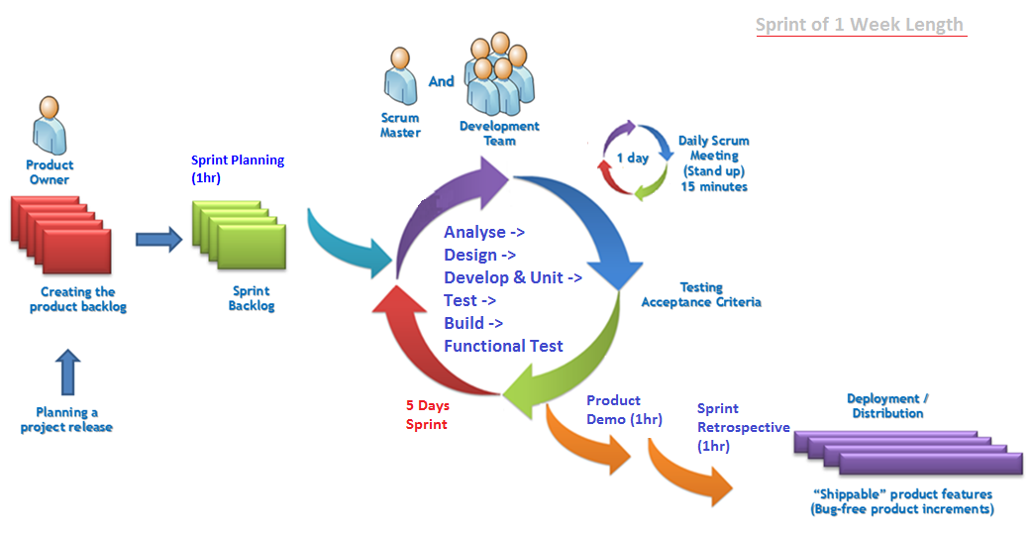
Scrum framework

Slide 22
Sprint Retrospective
At the end of every sprint
Define goal of retrospective
Try different methods
Ensure learnings are incorporated
Calculate Return on Time on Invested of Every Sprint

Slide 23
Agile health checkup
Are we .... | Rate on 1-10 (Put Sum-total of team vote here)
Doing Daily Standup (at same time, at same place, fix duration)
Updating Information Radiators
Doing Self Assignment of Work
Committing and User story and Ticket commitment Not tasks
Doing regular sprint planning
Doing regular retrospective
Focused in planning, execution, decision making
Thinking as a whole team
Having Personal Safety
Having Sunny Day Visibility
Doing Close Communication
Having Strong Technical Environment

Slide 24
Agile – information radiators
Kanban Board
Burndown chart
Burnup chart
Velocity Chart
Release Burnup Chart
Impediment List
Agile Health Trend
Photo & Name, Phone, Extn. of Team Members

Slide 25
Definition of Done (DOD)
Story DOD
Discussed & Understood
Analyzed
Unit Test Cases (UTC) Written
UTC Successfully Executed
Functional Test Cases (FTC) Written
FTC Successfully Executed
Sprint DOD
Sprint Planning is done
Committed / Negotiated User Stories are done
Entire built is successful
Acceptance Testing (AT) of all User Stories is success
Product Demo is done
Sprint Retrospective is done

