Slide 1
CPM & CCM Critical Path & Critical Chain
Hari P. Thapliyal
MCA, MBA (Operations), PGDFM, ZED Master Trainer, PMP, MCITP,
PMI-ACP, PRINCE2 Practitioner, SCT, CSM, MCT, SDC, SCM, SPOC, SAMC

Slide 2
Disclaimer
We are not perfect being. Be are striving for the perfection.
We are first time trying to visualize the entire project in the form of critical path and critical chain. Therefore there are many opportunities for the improvements. Let’s start doing it and on the way if any opportunity is identified we can incorporate the inputs.
There are many ways of estimating efforts, duration, resources, cost and many ways to optimize the schedule some will be discussed in this workshop of 4 hours but many others will not be discussed.
Feel free to share your inputs today or anytime in future.

Slide 3
This is not
A Meeting
A Lecture of a professor
A Speech of some senior person
One more training in your hectic routine
This is a workshop to reset our style of estimating, scheduling and making/taking commitment to/from our stakeholders (management, customer, vendors, team members). Here we are trying to understand how to make commitment where chances of failure can be minimized drastically.

Slide 4
Agenda
What do you estimate?
Why do you estimate?
How do you estimate?
Range of Estimate & Basis of Estimate
Confidence Level of Estimate
What is critical in CPM?
What is CPM?
What is CCM?
What is buffer? What is float?
Contingency Reserve vs Management Reserve
Some diseases of project network path
Process of Scheduling

Slide 5
How do you estimate?
Analogous Estimate
Parametric Estimate
3 Point Estimate
Bottom-up Estimate
Published Estimating Data

Slide 6
Project Schedule Management

Slide 7
Project Schedule Management
Plan Schedule Management [PLANNING]
Define Activities [PLANNING]
Sequence Activities [PLANNING]
Estimate Activity Resources [PLANNING]
Estimate Activity Durations [PLANNING]
Develop Schedule [PLANNING]
Control Schedule [M&C]

Slide 8
Plan Schedule Management
Establishing the policies, procedures and documentation for planning, developing, managing, executing, and controlling the project schedule

Slide 9
Schedule Management Plan
It includes
Scheduling tools to be used
Level of accuracy
Units of measure for each resource
Organizational procedure links
Process of updating the progress in schedule model
Control thresholds
Rules of performance measurement (baselines, %complete, fixed formula etc.)
Define scheduling reporting format

Slide 10

Define Activities
Identifying the specific actions to be performed to produce the project deliverables

Slide 11
Define Activities
PScM
PLAN
.1 Project management plan
.2 EEFs
.3 OPAs
.1 Expert judgment
.2 Decomposition
.3 Rolling wave planning
.4 Meetings
.1 Activity list
.2 Activity attributes
.3 Milestone list

Slide 12
Activity Attributes
Dependency
Location of performance
Type of dependency
Level of efforts (work contour)
Efforts required
Related Deadline
Related WBS account
Critical activity
Type of task (fixed duration, resources, work)
Resource & skills required
Duration
Lead & Lag

Slide 13
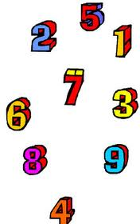
Sequence Activities
Identifying and documenting relationships among the project activities.

Slide 14
Sequence Activities
PScM
PLAN
.1 Schedule management plan
.2 Project documents
• Activity attributes
• Activity list
• Assumption log
• Milestone list
.3 EEFs
.4 OPAs
.1 Precedence diagramming method
.2 Dependency determination and integration
.3 Leads and lags
.4 PMIS
.1 Project schedule network diagrams
.2 Project documents updates
• Activity attributes
• Activity list
• Assumption log
• Milestone list

Slide 15
Discussion
Sequence Previously activities of your project write FS, SF, FF, SS after the activities
FS- (Finish first to start the next) Documentation & Review, Design & Development
FF- (Finish next to finish the previous) Product Documentation & Product System Testing
SF- (Start next to finish the previous) Shift working environment, changing motor, shifting applications from servers A to B, shifting work environment from A to B.
SS- (Start next to start previous) Listening & Speaking, Start meeting & Start a topic to discuss, Listening & Making Notes, Requirement Gathering & Requirement Analysis

Slide 16
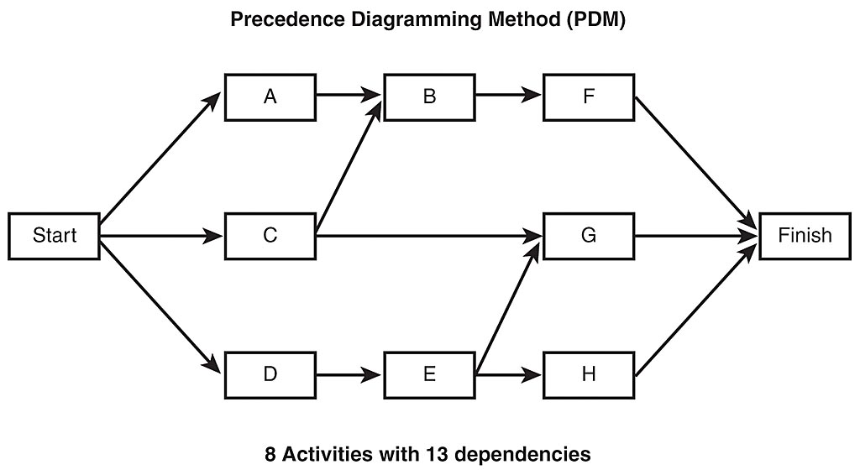
Precedence Diagramming Method (PDM)
Also known as Activity on Nodes (AON)
Notes:
16

Slide 17
Activity Type
Fixed Work
Effort driven. Can change the duration by adding/ removing resources. E.g. To attempt 60 questions 60 min required. If you distributed between people duration can be altered.
Fixed Duration
Time driven. Can not change the duration by adding/removing resources. E.g. Duration of the training does not depend upon # of participants. It is fixed.
Fixed Units
Resource driven. Cannot change the duration by adding/removing resources. In fact altering number/type of resources make activity undoable. e.g Remove one person from review process where min 2 people are required.

Slide 18
Time Constraints
ASAP
ALAP
SNET
SNLT
FNLT
FNET
MFO
MSO

Slide 19
Network Development
Precedence Diagramming Method (AON)
A
B
C
Start
Finish
D
E
F

Slide 20
Network Development
Precedence Diagramming Method (AOA)
A
B
C
Start
Finish
F
D
E

Slide 21

Estimate Activity Durations
Approximating the number of work periods needed to complete individual activities with estimated resources.

Slide 22
Estimate Activity Durations
PScM
PLAN
.1• Schedule management plan
• Scope baseline
.2 Project documents
• Activity attributes
• Activity list
• Assumption log
• Lessons learned register
• Milestone list
• Project team assignments
• Resource breakdown structure
• Resource calendars
• Resource requirements
• Risk register
.3 EEFs
.4 OPAs
.1 Expert judgment
.2 Analogous estimating
.3 Parametric estimating
.4 Three-point estimating
.5 Bottom-up estimating
.6 Data analysis
• Alternatives analysis
• Reserve analysis
.1 Duration estimates
.2 Basis of estimates
.3 Project documents updates
• Activity attributes
• Assumption log
• Lessons learned register

Slide 23
PERT – Program Evaluation and Review Technique
Beta Distribution
PERT Estimate tE= (Optimistic + 4 * Most Likely + Pessimistic)/6
Triangular Distribution
tE= (Optimistic + Most Likely + Pessimistic)/3
Standard Deviation (using PERT) = (Pessimistic-Optimistic)/6
Variance (using PERT) = ( (Pessimistic - Optimistic)/6)²

Slide 24
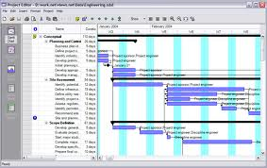
Develop Schedule
Analyzing activity sequences, durations, resource requirements and schedule constraints to create the project schedule.

Slide 25
Develop Schedule
PScM
PLAN
.1• Schedule management plan
• Scope baseline
.2 Project documents
• Activity attributes
• Activity list
• Assumption log
• Basis of estimates
• Duration estimates
• Lessons learned register
• Milestone list
• Project schedule network diagrams
• Project team assignments
• Resource calendars
• Resource requirements
• Risk register
.3 Agreements
.4 EEFs
.5 OPAs
.1 Schedule network analysis
.2 Critical path method
.3 Resource optimization
.4 Data analysis
• What-if scenario analysis
• Simulation
.5 Leads and lags
.6 Schedule compression
.7 PMISs
.8 Agile release planning
.1 Schedule baseline
.2 Project schedule
.3 Schedule data
.4 Project calendars
.5 Change requests
.

Slide 26
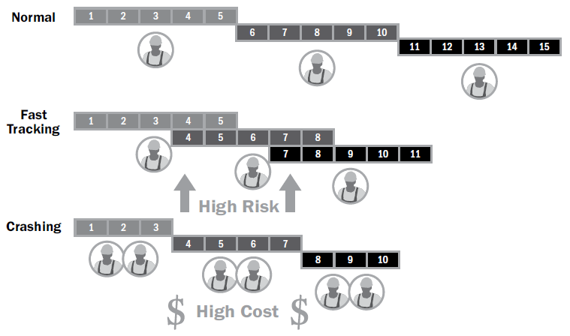
Schedule Compression Techniques

Slide 27
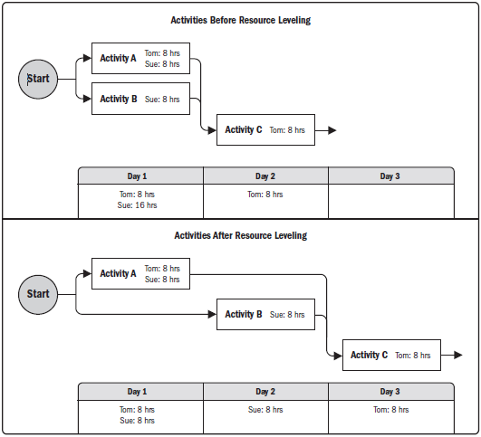
Resource Optimization techniques
Resource Levelling
Ensure resource are not allocated more than their availability for the given project. Can lead to change in critical path.
Resource Smoothing
Adjust activities in such a way that resources requirement do not exceed than defined limit. No change in critical path. Activities can be delayed within their float (free/total).

Slide 28
Modeling Techniques
What if scenario analysis
Assess the feasibility of project schedule under adverse conditions. Prepare a contingency plan to overcome the problems. Or prepare mitigation plan to reduce the impact of unexpected situations.
Simulation
Calculate multiple project duration using tools like Monte Carlo Simulation. In this case use assumptions and distribution constructed using 3 Point estimates.

Slide 29
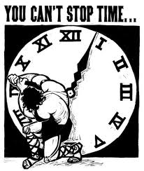
Control Schedule
Monitoring the status of the project to update project progress and manage changes to the schedule baseline

Slide 30
Control Schedule
PScM
M&C
.1• Schedule management plan
• Schedule baseline
• Scope baseline
• Performance measurement baseline
.2 Project documents
• Lessons learned register
• Project calendars
• Project schedule
• Resource calendars
• Schedule data
.3 Work performance data
.4 OPAs
.1 Data analysis
• Earned value analysis
• Iteration burndown chart
• Performance reviews
• Trend analysis
• Variance analysis
• What-if scenario analysis
.2 Critical path method
.3 Project management
information system
.4 Resource optimization
.6 Leads and lags
.7 Schedule compression
.1 Work performance information
.2 Schedule forecasts
.3 Change requests
.4 Project management plan updates
• Schedule management plan
• Schedule baseline
• Cost baseline
• Performance measurement
baseline
.5 Project documents updates
• Assumption log
• Basis of estimates
• Lessons learned register
• Project schedule
• Resource calendars
• Risk register
• Schedule data

Slide 31
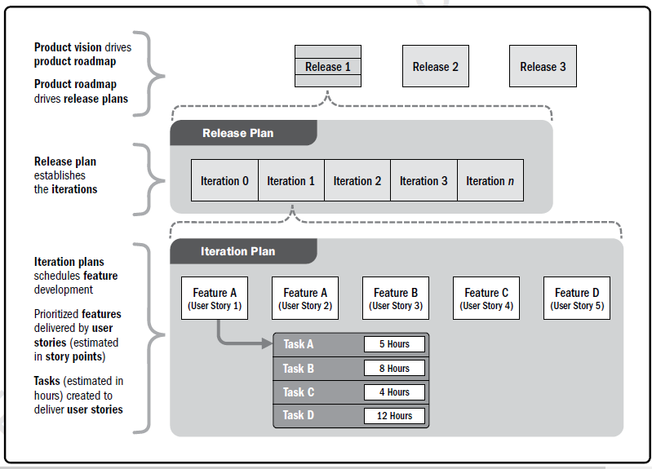
Product Vision, Release, Iteration Planning

Slide 32
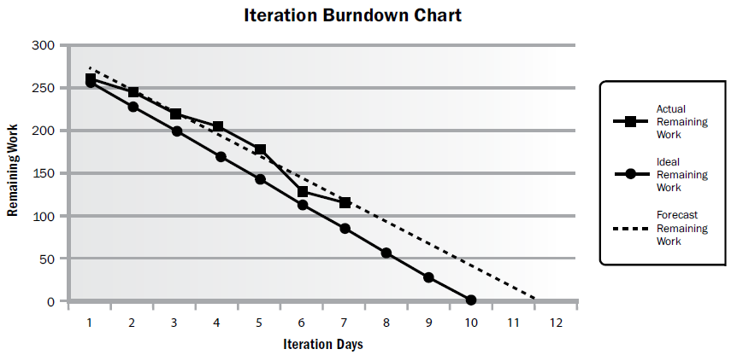
Burndown Chart

Slide 33
Critical Path Method (CPM)

Slide 34
Critical Path Method (CPM)
Critical Path method is a planning technique that is used to demonstrate and view the chronological activities of a program or project, and identifies any possible timing risks and can be used to establish the least amount of time to complete a project.

Slide 35
Critical Path
ES EF
ES EF
ES EF
ES EF
ES EF
ES EF
Duration 7 Task A
Duration 6 Task C
Duration 3 Task G
LS LF
LS LF
ES EF
LS LF
Duration 2 Task H
Start
Finish
ES EF
ES EF
ES EF
LS LF
Duration 3 Task B
Duration 3 Task D
Duration 3 Task E
LS LF
LS LF
LS LF
ES EF
Duration 2 Task F
LS LF

Slide 36
Critical Path – Longest Path, Zero Float
0
0
0
ES EF
ES EF
ES EF
0
7
13
16
Duration 7 Task A
7
13
Duration 3 Task G
Duration 6 Task C
0
7
7
13
13
16
0
LS LF
LS LF
ES EF
LS LF
16
18
Duration 2 Task H
Start
Finish
7
7
7
16
18
ES EF
ES EF
ES EF
LS LF
Duration 3 Task B
Duration 3 Task D
Duration 3 Task E
0
3
3
6
6
9
7
10
10
13
13
16
LS LF
LS LF
LS LF
8
ES EF
3
5
Duration 2 Task F
11
13
LS LF

Slide 37
Discussion/Excertise-16
5 Minutes
ES EF
ES EF
ES EF
Duration 4 Task A
Duration 4 Task B
Duration 3 Task C
LS LF
LS LF
LS LF
ES EF
ES EF
Duration 10 Task G
Start
Duration 7 Task D
Finish
LS LF
ES EF
LS LF
ES EF
Duration 5 Task E
Duration 5 Task F
LS LF
LS LF

Slide 38
Network Exercise - solution
Critical Path : ADCG
ES EF
ES EF
ES EF
Duration 4 Task A
Duration 3 Task C
0
4
Duration 4 Task B
11
14
4
8
0
4
7
11
11
14
LS LF
LS LF
LS LF
ES EF
ES EF
14
24
Duration 10 Task G
4
11
Start
Duration 7 Task D
Finish
14
24
4
11
LS LF
ES EF
LS LF
ES EF
0
5
5
10
Duration 5 Task E
Duration 5 Task F
4
9
9
14
LS LF
LS LF
Notes:
Free float: An activity can be delayed without impacting the start of next activity
Total float: As many alternative path that many total float. Total float is available on non critical path. Activities can be delayed without delaying project
Free float on critical path activities is Zero

Slide 39
Facts/Tips for Critical Path
Total Float is the amount of time the task can delayed without delaying the project finish date.
Free float is the amount of time a task can slip without delaying the early start of any task that immediately follows it
It is possible that a zero float activity may not be on critical path
Longest path & shortest time possible to complete the project
A project can multiple critical paths
Difference between late and early is float
Positive float (the activity can wait to start even after previous activity finishes)
Negative float (the activity must start before previous finishes)
Zero float (the activity must immediately start after the finish of previous one)
Crashing activities to short the overall duration of project
Fast-tracking activities to short the overall duration of project
Be cautious that non-critical activity is not being delayed than the allowed free float
Take care of sub-critical path or non-critical path
Manage critical path resources very closely
Do not overload critical path activity resources
Avoid multitasking for resources working on critical path activities

Slide 40
Benefits of PERT/CPM
It Provides following information
Expected Project completion time
Probability of completion before a specified date
The critical path activities that directly impact the completion time
The activities that have slack time and that can lend resources to critical path activities
Activity start and end dates

Slide 41
Critical Chain Method (CCM)

Slide 42
Background
Eliyahu Goldratt proposed CCM
This is developed based on the TOC framework

Slide 43
Why CCM is needed?
You have CPM available why CCM is needed?
You can manage the delays on non-critical path using buffers/floats. BUT
How do you manage the delays on critical path?

Slide 44
Principles Behind CCM
Delays accumulate; gains don't advantage
Sequential Steps: Resources are not available to start early
Parallel Steps: Three activity each takes 5 days time start in parallel. If one activity takes 10 days and other finish on time, early activities will not be able to take advantage.
If above sequential and parallel activities are dependent then affect is magnified
Other Time Wasters
Multitasking
Student Syndrome
Parkinson's Law

Slide 45
Critical Chain Method
CPM is developed using the believe that book as many resource as in advance and they will be available when need because it has been promised
CCM says that if a resource is over booked on any activity he will not be available to work on that activity therefore level the resource on the project activities. Thus resource constrained critical path is critical chain.
CPM is about hoarding, greed. Therefore over-estimation and project management laws like Parkinson law, Murphy law, Student syndrome applies here.
CCM is about believe and assumption that it will available when needed but we need to have proper alert system in place.

Slide 46
CCM Concepts
Resource Buffer: Notify dependent task resources that when I will finish my work on regularly basis and final notification 1-2 days before. So that resource is available to start the work.
Safety or project buffer should be added at the end of critical-chain as non-activity buffer
Feeding buffer: Add buffer where chain of non-critical activity joins the critical path. This way non critical task can be avoided being critical

Slide 47
How to estimate in CCM
Resource will give t80, t90 estimate.
Half them to get t50 estimate.
Do not put end date to task and let people finish the task as early as possible.
No penalty for finish beyond t50.
Project Buffer should be 50% of the buffer removed from activity.

Slide 48
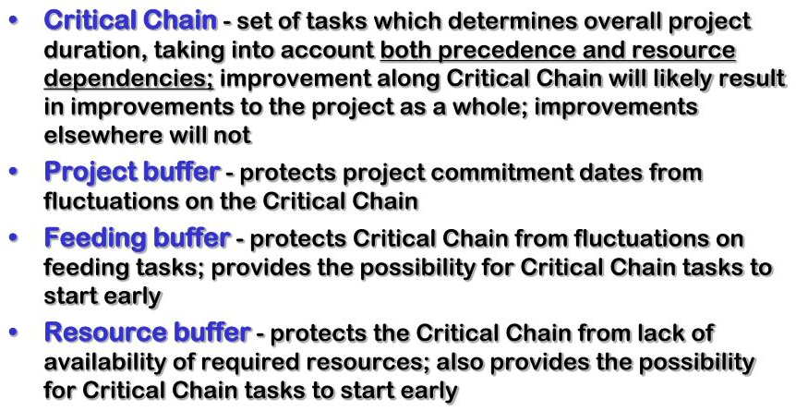
Buffer Types

Slide 49
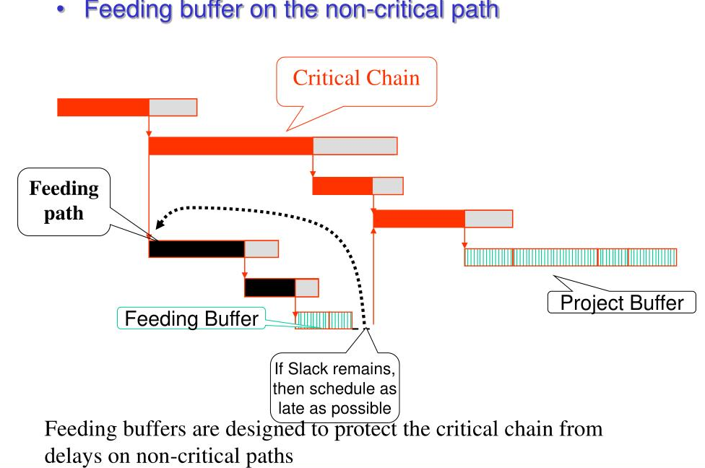
Where to put Buffer

Slide 50
How to manage CCM
If activity finishes late time is borrowed from project buffer.
If activity finishes early, gained time is added to project buffer

Slide 51
Microsoft Project Demo

Slide 52
Am I missing anything?
Do you have any question?

Slide 53
Next Program
Project Risk Management
Who should Participate: All who face risk of failure. I think HOD, PM, PMT
Time : 13-Dec, Tuesday 10.00am – 12am.
Location: Admin Block Training Room

Slide 54

Hari P Thapliyal,
PMO Architect & Project Management Trainer & Coach
Vedavit Project Solutions
Reach Me:
hari.prasad@vedavit-ps.com
Skype: hari.thapliyal, YM: hari_thapliyal, Twitter: harithapliyal
Mobile: +91 9535999336
Profile: http://in.linkedin.com/in/harithapliyal
Blog: http://pmlogy.com/

