Slide 1
Daily Standup
Hari P. Thapliyal
MCA, MBA (Operations), PGDFM, ZED Master Trainer, PMP, MCITP,
PMI-ACP, PRINCE2 Practitioner, SCT, CSM, MCT, SDC, SCM, SPOC, SAMC

Slide 2
Disclaimer
We are not perfect being. Be are striving for the perfection.
We are trying to develop some good work habits. There are opportunities of improvement. Let’s start doing it and on the way if any opportunity is identified we can incorporate the inputs.
There are many ways of keeping your standup meeting an exciting event of the day. So be creative. But do not play with the spirit of the practice.
Feel free to share inputs to make this an exciting event of the day. Today or anytime in future.

Slide 3
Agenda
What Information Radiator?
What Osmotic Communication?
What is Daily Standup?
Why Daily Standup?
Questions & Answers (QA) session. -15 min

Slide 4
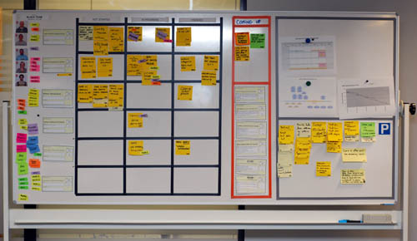
Information Radiator
Team Members
Work Progress
Impediments
Work Progress
Work Completed
Parking Lot

Slide 5
Osmotic Communication
Agile project relies on collocation, minimum documentation, least reporting, maximum constructive engagement. This can be achieved if frequently sought important information is available in published form in team space
Whoever need the information can go and get the information without wasting time in requesting, making, sending, receiving the information
Benefits
Least cost, effort and time waste in communication
Updated information is always available without making new reports
People can get whatever particular information they are looking for
Happens at the same time
Feedback loop is quick
Those people who are left in regular reporting also get benefitted
No junk, old, repetitive information, but fresh and useful.
Dis-benefits
Some people get extra information which they do not need
It is left to individual’s interpretation

Slide 6
Daily Stand-ups
Plan the work and work the plan on daily basis
Daily stand-up is heart beat of agile project management
Team meets daily (typically in working area, war room) at fixed time (time should not be changed) preferable first thing in morning
This is not reporting session but information sharing among team members
Only “Pigs” allowed to speak, “chicken” should listen (they are not allowed to interfere or ask while stand up meeting is in progress)
It is 15-20 min meeting, conducted while everybody is standing (showing the sense of urgency). A person should not take more than 2 min to update this work status.
Any one in the team can facilitate this meeting
Project manager notes the impediments and start working on those immediately after the meeting is over.

Slide 7
TEAM : Daily Standup
Every function/department must be represented in Daily standup
It is project wise information share
One department at a time. Two people should not speak same time.
Other people should listen carefully and analyze the impact of other’s information on their work
Kanban Board Should be updated before you start standup
Daily Standup in the Kanban Board area.

Slide 8
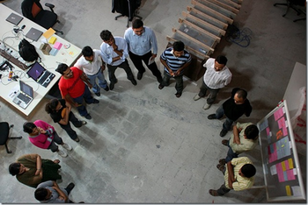
Daily Stand-ups
Three Questions of standup meeting which every team member must address are….
What did they do yesterday?
What are they planning to do today?
Any impediments on the way today?

Slide 9
How to Address Impediments
Within max next 24 hours. Otherwise it will be escalated.
Project either own or assign it to some PMT member
Till the time impediment is not resolved PM & PMT should prioritize the work for PMT member

Slide 10
Dimensions of Communications
Internal vs External
Formal vs Informal
Vertical vs Horizontal
Official vs Unofficial
Written vs Oral
Verbal vs Non-verbal

Slide 11
Am I missing anything?
Do you have any question?

Slide 12
Next Program
Critical Chain Method, Critical Path Method of Project Scheduling
Time : 2-Dec-17 9am to 1pm.
Location: This Room

Slide 13

Hari P Thapliyal,
PMO Architect & Project Management Trainer & Coach
Vedavit Project Solutions
Reach Me:
hari.prasad@vedavit-ps.com
Skype: hari.thapliyal, YM: hari_thapliyal, Twitter: harithapliyal
Mobile: +91 9535999336
Profile: http://in.linkedin.com/in/harithapliyal
Blog: http://pmlogy.com/

