Slide 1

Enterprise Project Management Office (EPMO)
Hari P. Thapliyal
MCA, MBA (Operations), PGDFM, ZED Master Trainer, PMP, MCITP,
PMI-ACP, PRINCE2 Practitioner, SCT, CSM, MCT, SDC, SCM, SPOC, SAMC

Slide 2
Agenda
Role of Functional Manager & Project Manager
Introduction to PMO
PMO as a Solution
Q&A

Slide 3
In the interest of “project success” if you have any input please do not hesitate to share with me but do not get disheartened if your ideas/suggestions is not implemented. After discussion with all stakeholders and analyzing impact on the project management culture ideas/suggestions will be implemented.

Slide 4

Role of Parents in Family & Functional Heads
Nurturing talents of staff
Improving competencies
Giving feedback to team members
Help in choosing their career path
Functional manager more as a leader and less as manager of resources

Slide 5

Role of Colonel in Unit on Mission & Project Managers
Using the talent of team member
Giving them feedback and sending back to training camp
Giving feedback to HQ for their career path/ promotion
Colonel is mission driven. They plan and execute the plan with their team
Project manager more like Colonel
Project manager more like as a manager & lesser like a leader of resources

Slide 6
Functional Manager vs Project Manager
Functional Managers & Project Managers are not replacement of each other. They complement each other
They both help in the growth of organization and individual team members from different level
They both have responsibilities, accountabilities and enjoy some level of authorities for different purposes

Slide 7

My Role
My Role as project management coach is to help strengthening project management role for the success of the organization
I am not touching or diluting any other designation or role with in the organization.
I am more focused on the role of an individual in a project and less concerned about role of an individual in any function
So, I need your support to make TEAM as a company a best project management company in the Industrial Engineering work
Relax: I am not touching your functional authority, responsibilities & accountabilities

Slide 8
Your Role
We will do a 2 hours R&R workshop for the relevant stakeholders in this week.

Slide 9

Project – An Elephant
Temporary organization
Output is Unique (Product/Service/Result)
Heterogeneous Team
Requirements keep evolving
High uncertainty
Stakeholder’s influence is high
Determining budget is challenging
Commitment of people for project work
A Project has minimum one critical path

Slide 10
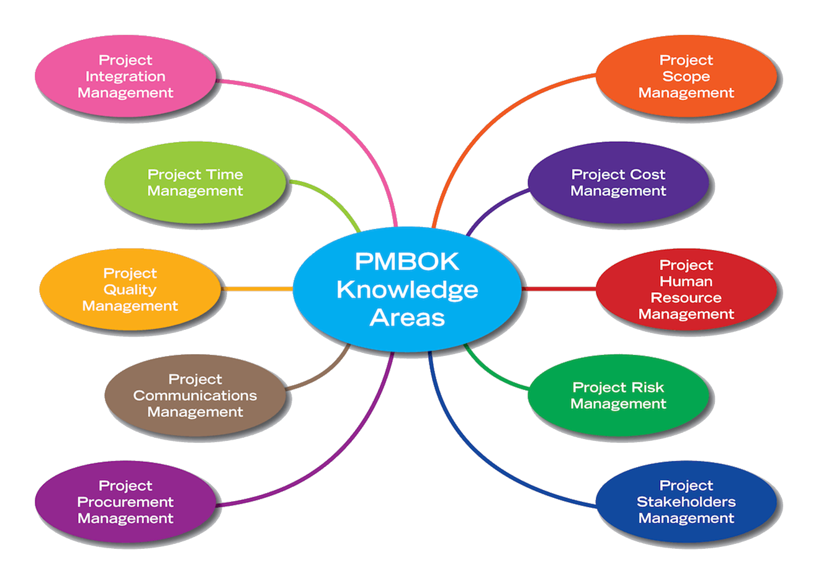
Critical Aspects of a Project

Slide 11
Accountable vs Responsible Person
Project Accountability
Project Responsibility
Getting work done
Result driven
Has authority to plan, approve, reject
Deliver result within cost and time to customer
Works with plan B
Works with tolerance limits
Works with buffers
Getting right resource
Optimum resource utilization for project
Dependency management
To make customer happy
Doing work
Task driven
Has responsibility of planning
Finish the activity within the time
To complete the work

Slide 12
Organizational Structure for Project Management
Chairman / COO
Functional Heads & PMO Head
Project Managers
Project Management Team
Project Team
Project Selection, Strategic Decision about projects
Project Management Directions, Learning Management, Institutionalization, Capability Building
Project Management (planning, execution, governance)
Key Business User/Suppliers/Managers for regular estimation, planning prioritization, acceptance, risk management
SME / Doers to execute the project work

Slide 13
Responsibilities of PMO
Project Level
Helps PM in Project Estimation
Helps PM in Project Planning
Helps PM in Defining Project Governance at Desired Levels
Helps PM in Delivering Project within agreed threshold
Helps PM in using appropriate lessons learned
Helps PM in performing continuous business justification
Help PM in Baselining Project Objectives and reporting against the objectives set.

Slide 14
Responsibilities of PMO
Organizational Level
Creating project management standards
Templates, Processes, Checklists, Guidelines, Forms, Methodologies
Managing & Maintaining Project Management Standards
Consolidation, Refining, Access Permission, Retiring
Sharing PM Standards & Best Practices across projects and verticals
Evaluating PM tools and adopting right tools for Project Management
Trainings on various project management related key topics
Ensuring optimum resource (equipments, human, machine, general expenses, vendor services) utilization on any projects across organization
For effective decision making managing project progress across the organization using same parameters and reporting to senior management
Ensure every project follows the agreed processes
Manage a pool of project managers
First Level of Escalation for Project Managers
Approving project charter
Post Project Implementation Review
Maintain and Ensure Inventory of Resources for Projects

Slide 15



Types Of PMO
Controlling PMO
Supporting PMO
Directing PMO
Choose your best type based on the organization culture and need

Slide 16
High-Level Roadmap of PMO
Setup a PMO: Define R&R of PMO Head, PM, Consultants
A workshop for Project Management Team/ department heads
Design PMO Dashboard
Create Knowledge Repository of PMO. Define access control.
Keep templates/standards/guidelines/checklist/forms under repository. PMO Team should manage this and have access to it
Define processes of updating & Sharing OPA
Select First Project Under PMO

Slide 17

Next Action
Select projects for Piloting in the PMO
Setup a Kanban Board
List of All the Resources
Setup a Configuration Management System
Some hands on workshop on project management for relevant stakeholders

