Slide 1
PMO Roles & Responsibilities
Hari P. Thapliyal
MCA, MBA (Operations), PGDFM, ZED Master Trainer, PMP, MCITP,
PMI-ACP, PRINCE2 Practitioner, SCT, CSM, MCT, SDC, SCM, SPOC, SAMC

Slide 2
Disclaimer
We are not perfect being. Be are striving for the perfection.
We are first time trying to define Roles & Responsibilities of all players in the project keeping projects in the centre. Therefore there are opportunities of improvements. Let’s start doing it and on the way if any opportunity is identified we can incorporate the inputs.
There are many ways of defining roles and responsibilities but we have chosen one in which project, project’s output and customer is the centre.
So many thoughts up to last moments so there are may work in progress ideas…
Feel free to share your inputs today or anytime in future.

Slide 3
This is not
A Meeting
A Lecture of a professor
A Speech of some senior person
One more training in your hectic routine
This is a workshop to reset our style of working. Here we are trying to understand our Role & Responsibilities to make our projects more successful.

Slide 4
Agenda
Meaning of Responsibility
Designations vs Roles
What is PMO?
Roles
Corporate Governance (CEO/COO) – Out of scope in this workshop
Executive / PMO Head
Sr. User / Sales/ Marketing/ Customer Rep
Sr. Supplier / HoD / Supplier Partners
Project Board (Executive + Sr. User + Sr. Supplier)
Project Manager
Project Assurance
Project Support
Change Authority
Team Managers / PMT (Project Management Team)
PMT Members

Slide 5
Responsibility = Ability to Response
What is meaning of Response?

Slide 6
Who we are?
We are not typical manufacturing company
We are not typical project company
We are not typical service company
We are a company who do projects but have our production facility.

Slide 7
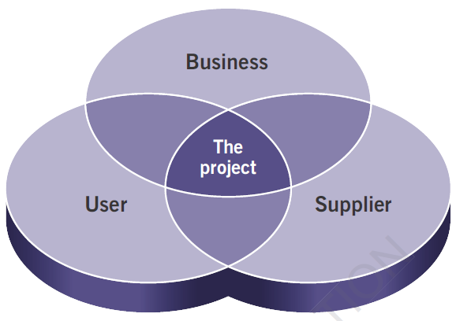
The Project
Reference PRINCE2 Manual 2017

Slide 8
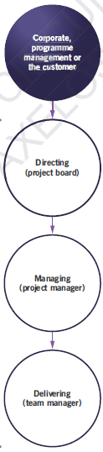
Hierarchy in Managing Project
Reference PRINCE2 Manual 2017

Slide 9
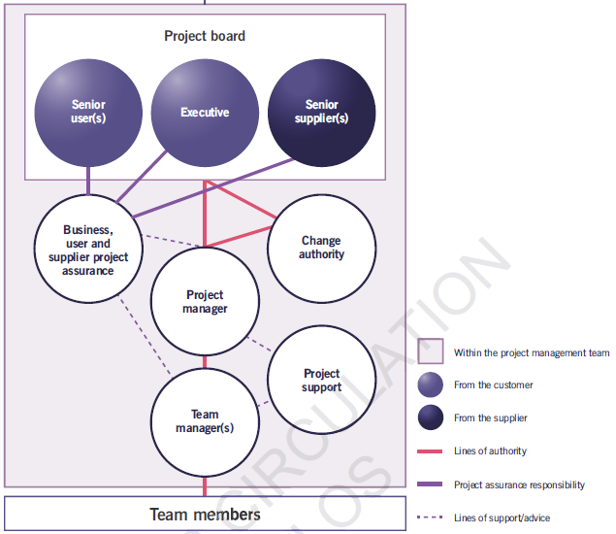
Hierarchy in Managing Project
Reference PRINCE2 Manual 2017

Slide 10
One Important Role But….
PMT (Project Management Team)
PMT Members
Why this is called so?
How this named in other organizations?
How PMT role is different from “PMT Member” role?

Slide 11
Designation vs Roles
Designation
Roles
Fixed
One person has one
It is a Title
Glued to sitting place
Has seniority and Juniority
Fixed Reporting Structure
Reporting towards upward only
More Administrative in nature
Better performance leads to promotion to next in hierarchy
Part of Hierarchy
Formal power used to get the work done
Dynamic.
One person can have many
It is not Title
Not related to sitting place
No seniority and juniority
Reporting to Role player
No upward or downward
Playing real sport in the field
Better performance leads to bonus, more complex work
Matrix in nature without hierarchy
Referent power is used to get the work done

Slide 12
Powers
How to get the work done in project environment? Through the power which are vested in you or which you acquire by networking and other interpersonal skills.
Formal : Organization Positional. Designation.
Penalty : Threat. Fine. Punishment
Reward : Appreciation. Prize. Bonus. Incentive. Award
Expert : Skills, Knowledge, Proficiency, Efficiency in the work. Respect as SME.
Referent : Influencing through other people. Gained through Networking, Influencing skills. For this you need to invest in building relations and rapport.

Slide 13
Major Work in Project Life Cycle
Pre Project
Work Assessment, Feasibility,
Resource Capability, Availability
Estimation, Profitability
Initiation
Project Charter Preparation & PM Assignment
Planning
High Level Plan
At the start of project, Reassessment, Feasibility, Estimation, High Level Schedule,
Detail & Daily Plan
Based on the workflow and feedback authorizing next work, adjusting resources and speed
Execution
Doing the work as per the plan. Solving impediments. Keeping team aligned, motivated and focused.
Stakeholder engagement. Satisfy stakeholder’s project related need.
Purchase, Delivery and Payment & Receipts
Governance
Reporting, Variance Analysis, corrective and preventive action
Learning and sharing from doing
Closure
Feedback to players, from customer
Archiving project document
Final lesson learned documentation and sharing

Slide 14
Am I missing anything?
Do you have any question?

Slide 15
Next Program
What is Critical Chain & Critical Path Method?
Who should Participate: All Estimators, Schedulers, Who Control Resources & Their Assignment. I think HOD, PM, PMT
Time : 07-Dec, Thu 9am - 1pm.
Location: Admin Block, Training Room

Slide 16

Hari P Thapliyal,
PMO Architect & Project Management Trainer & Coach
Vedavit Project Solutions
Reach Me:
hari.prasad@vedavit-ps.com
Skype: hari.thapliyal, YM: hari_thapliyal, Twitter: harithapliyal
Mobile: +91 9535999336
Profile: http://in.linkedin.com/in/harithapliyal
Blog: http://pmlogy.com/

