Slide 1
Project Risk Management
Hari P. Thapliyal
MCA, MBA (Operations), PGDFM, ZED Master Trainer, PMP, MCITP,
PMI-ACP, PRINCE2 Practitioner, SCT, CSM, MCT, SDC, SCM, SPOC, SAMC

Slide 2
Disclaimer
We are not perfect being. Be are striving for the perfection.
We are first time trying to visualize consequences of failing assumptions and dependencies in terms of the project and trying to look beyond issues in a systematic way. Therefore there are many opportunities for the improvements. Let’s start doing it and on the way if any opportunity is identified we can incorporate the inputs.
There are many ways of individuals and organizations for looking and managing uncertainties we trying to define something for us. Let’s understand, define and implement. If it does not work we will refine it but we will not abandon this on the way.
Feel free to share your inputs today or anytime in future.

Slide 3
This is not
A Meeting
A Lecture of a professor
A Speech of some senior person
One more training in your hectic routine
This is a workshop to reset our style of managing uncertainties. Here we are trying to understand how to manage risk where chances of success can be improved significantly.

Slide 4
Agenda
What is risk?
What is Issue, Concern, Problem?
What is Risk Management Framework?
How to Identify Risk?
How to Prioritize Risk?
How to Prepare Responses to a Risk?
How to Implement Response Strategy?
How to Monitor & Control risk?

Slide 5
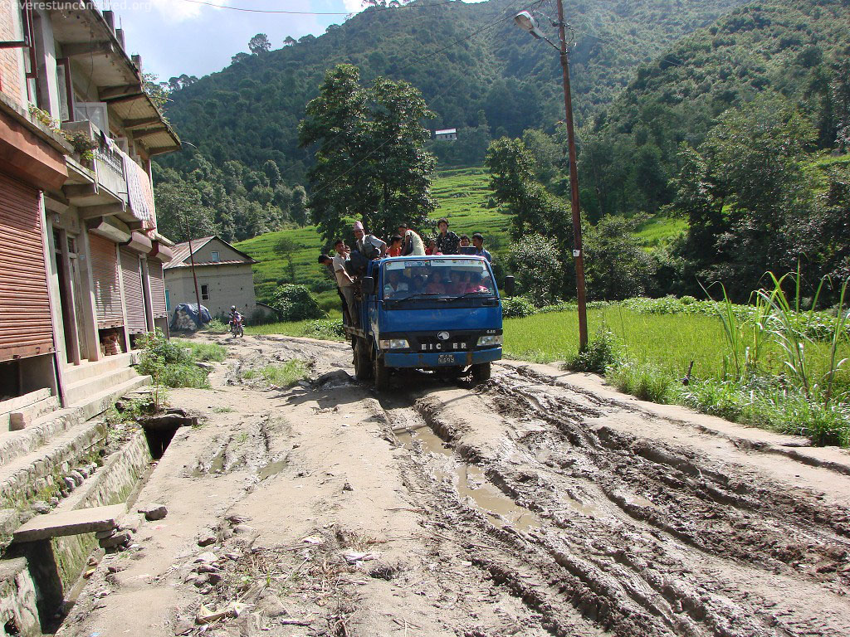

Slide 6
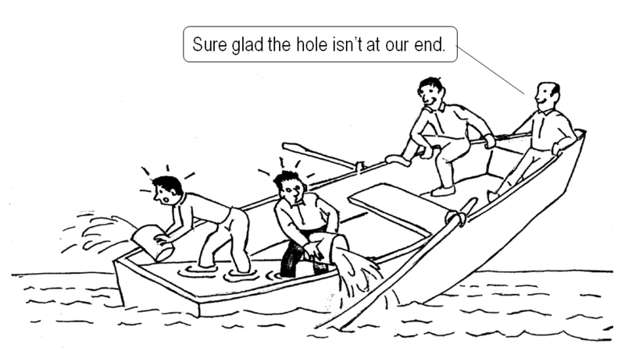

Slide 7


Slide 8
What is Risk?
An event which has probability of happening and it may effect project objective negatively or positively
Based of Impact Risk May be
Negative Risk
Positive Risk

Slide 9
What is Issue, Concern, Problem?
An event which has happened and it was not planned and need management attention.
Types of issues
Request for Change (requirement changed by user)
Off-specification (missing product or product not meeting its specifications)
Problem or Concern (a team member is sick and it will affect delivery / vendor insolvency and he cannot perform)

Slide 10
Risk Management Framework
Risk Sources
Risk Breakdown Structure
Risk Probability
Risk Impact
Risk Attitude
Risk Appetite
Risk Register
Risk Exposure
Risk Urgency
Risk Categorization

Slide 11
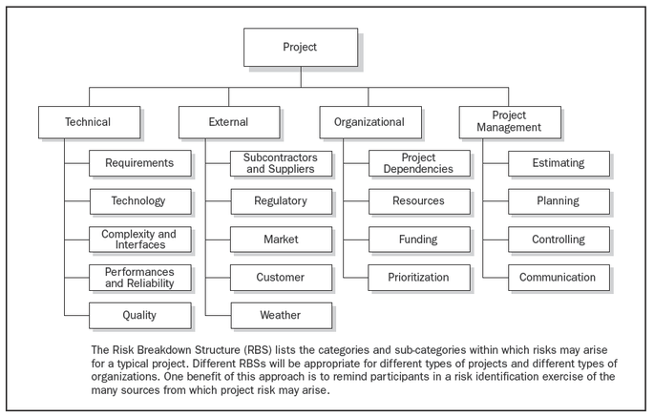
Risk Breakdown Structure
Source : PMI PMBOK® Fourth Edition

Slide 12
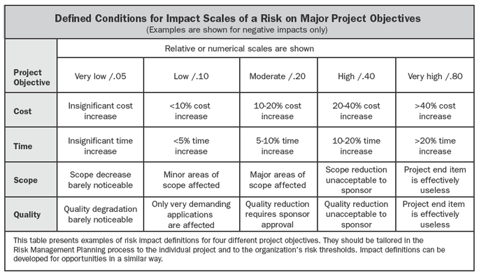
Definition of Impact
Source : PMI PMBOK® Fourth Edition

Slide 13
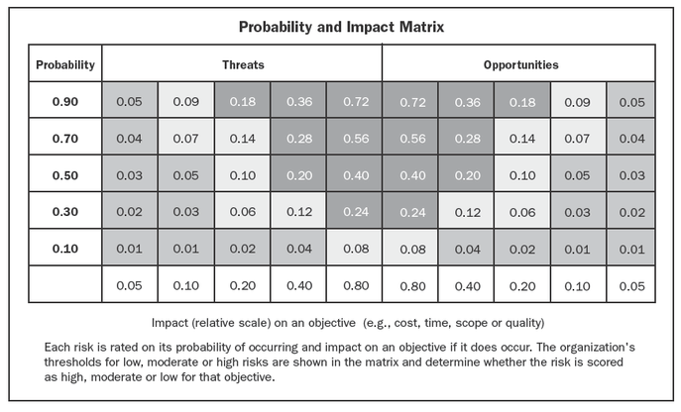
Probability Impact Matrix
Define Threshold
High risk (“red condition”)
Medium risk (“yellow condition”)
Low risk (“green condition”)
Source : PMI PMBOK® Fourth Edition

Slide 14
How to Identify Risk?
Who is responsible for identifying risk?
Who is responsible for managing risk?

Slide 15
How to Prioritize Risk?
E = P x I (Probability x Impact)
Based on accepted appetite of Exposure (E)

Slide 16
How to Prepare Responses to a Risk?
Negative Risk

Slide 17
Risk Response Strategies
Negative Risk or
Threats
Escalate
Avoid (remove the cause of threat)
Mitigate (reduce the probability or impact)
Transfer (Shifting ownership)
Acceptance
Positive Risk or
Opportunities
Escalate
Exploit (ensure the opportunity is realized)
Enhance (enhance the probability or impact)
Share (Transferring ownership)
Acceptance

Slide 18
Negative Risk Responses
Avoid
Removing the cause of a threat, extending the schedule, changing the project strategy, or reducing scope. Some risks can be avoided by clarifying requirements, obtaining information, improving communication, or acquiring expertise.
Mitigate
Designing redundancy into a system may reduce the impact from a failure of the original component.
Transfer
Transfer ownership of a specific risk. Buy insurance, performance bonds, warranties, guarantees.
Accept
Acceptance can be either active or passive. The most common active acceptance strategy is to establish a contingency reserve. Passive acceptance involves no proactive action apart from periodic review.

Slide 19
Positive Risk Responses
Exploit
Examples: if you are getting some good quality resources at lower cost at certain location then offloading work to that location.
Enhance
Examples: if you are getting some good quality resources at lower cost at certain location then assigning offloading more and more work to that location.
Share
Examples: If you have some business opportunity which you cannot fulfill because of your know-how limitation then you can partner with company and you both can explore to work together to realize the benefits
Accept
Acceptance can be either active or passive. The most common active acceptance strategy is to establish a contingency reserve. Passive acceptance involves no proactive action apart from periodic review.

Slide 20
Understanding Reserves
Contingency reserves : Known – Unknown
It is designed for use only if certain events occur or only under certain predefined conditions, provided there is sufficient warning to implement the response.
Examples of events that may trigger the contingency response include missing intermediate milestones or gaining higher priority with a supplier.
Events triggering the contingency response should be triggered and tracked.
Management reserves: Unknown – Unknown
It is defined for use only if ‘the events that occur or only under certain conditions’, where information about the event & its occurrence is absolutely NOT available.

Slide 21
How to Monitor & Control a Risk?

Slide 22
Am I missing anything?
Do you have any question?

Slide 23
Next Program
Project Stakeholder & Communication Management
Who should Participate: All who need to manage stakeholders. I think HOD, PM, PMT
Time : 27-Dec, Wed, 10.00am – 12am.
Location: Admin Block Training Room

Slide 24

Hari P Thapliyal,
PMO Architect & Project Management Trainer & Coach
Vedavit Project Solutions
Reach Me:
hari.prasad@vedavit-ps.com
Skype: hari.thapliyal, YM: hari_thapliyal, Twitter: harithapliyal
Mobile: +91 9535999336
Profile: http://in.linkedin.com/in/harithapliyal
Blog: http://pmlogy.com/

