Slide 1
Project Stakeholder Engagement & Communication Management
Hari P. Thapliyal
MCA, MBA (Operations), PGDFM, ZED Master Trainer, PMP, MCITP,
PMI-ACP, PRINCE2 Practitioner, SCT, CSM, MCT, SDC, SCM, SPOC, SAMC

Slide 2
Disclaimer
We are not perfect being. Be are striving for the perfection.
Perhaps the first time we are trying to visualize customer-vendor relationship between the various department of TEAM. Therefore there are many opportunities for the improvements even beyond this workshop ideas.
Feel free to share your inputs today or anytime in the future.

Slide 3
This is not
A Meeting
A Lecture of a professor
A Speech of some senior person
One more training in your hectic routine
This is a workshop to reset our style of communication and stakeholder engagement. Here we are trying to understand how to be effective in stakeholder engagement.

Slide 4
Agenda
Who are stakeholders?
Understanding the duality of customer and vendor
Understanding the dimensions of communication
How to be an effective communicator
What is engagement?
How to Prioritize work?

Slide 5
A Request
Daily standup is running smoothly. To strengthen it and improve it we need 100% support from every department.
100% support mean.
To ensure daily standup start and finish on time please make sure that your department PMT reaches 5 min before. So be time sensitive.
Every department representative must be present in the daily standup
Takes impediments identified during the DS as serious stuff otherwise it leads to unnecessary escalations
Every project has a Project Manager, so discuss the impediments with PM
PM is owner of impediments. Responsibility can be shared not the accountability
Kanban board should be updated before standup meeting start
Kanban board should reflect weekly task of every department
Min 80% work of the department should get reflected on the Kanban board

Slide 6
Preworkshop
Let us measure how we are perceived in terms of our communication and stakeholder management
Pre Workshop Name: (Optional)
 | Communication | Stakeholder Engagement
Person Name1 | 1-10 (1 Lowest – 10 Highest) | 1-10 (1 Lowest – 10 Highest)
Person Name2
Person Name3

Slide 7
Important Quotes
“I am responsible for my words till they reach to your ear. After that what you make of those in your mind is not my business. But I am affected by your business.”
“We see and hear only for which we are waiting. In the name of knowing the truth we want to know our version of the truth”

Slide 8
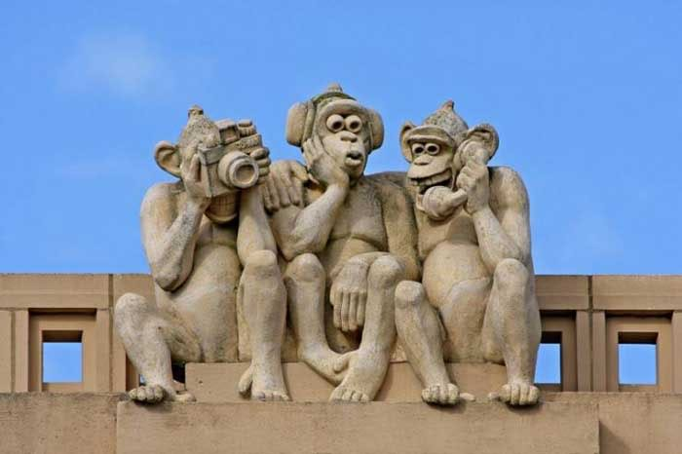
Project Communications

Slide 9
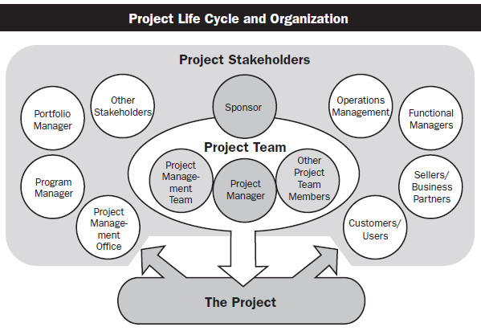
Who are stakeholders
A stakeholder is an individual, group, or organization who may affect, be affected by, or perceive itself to be affected by a decision, activity, or outcome of a project.
Stakeholders may be actively involved in the project or have interests that may be positively or negatively affected by the performance or completion of the project.
Different stakeholders may have competing expectations that might create conflicts within the project.

Slide 10
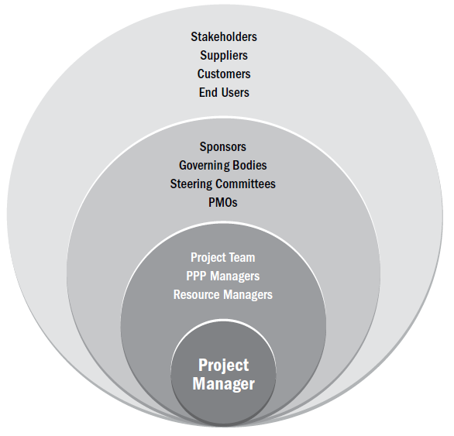
Stakeholder’s Expectations & PM’s Circle of Influence
Know the acceptance criteria of your work
Measure success from stakeholder’s perspective
Ask your customer a most important action plan to improve your services & product

Slide 11
Who is a customer and who is a vendor?
Customer
Vendor
Giver of an idea (Project)
Sponsor of idea (giving money)
Gets value
User of your work (product, services, results)
Acceptor or rejecter of work
Delivery Planner of a given idea
Deliverer of idea (receives money)
Get currency note
Maker of product/service
Submitter of work

Slide 12
Customer is Indian Philosophical Context
Devata or Devi is one who give. What she/he gives?
Do they give it free or your need to also give them?
What do you give them? You pay the price, by doing Tapas, doing Yagya, offering to Poor etc.
When Deva is happy with the price you paid they give you the boon of getting more whatever you want.
So Devi & Devta is giver of whatever you ask. He/She is ??
And Bhakta is giver of price and in return he gets value. He/She is ??
Who is Big? Deva or Bhakta?

Slide 13
Customer vs Vendor in TEAM’s Context
External Customer
TEAM &Top Management
Project Management
(Vendor) Design
(Vendor) PPC
(Vendor) Procurement
(Vendor) Production
(Vendor) QC
Sales & Marketing

Slide 14
Role of Trust in Communication
With you share the data?
With whom you share the factual data?

Slide 15
Data vs Information

Slide 16
What is communication?

Slide 17
What is over communication?

Slide 18
Communication Requirement Analysis

Slide 19
What is cost of communication
Time spent
Money spent
Energy drained out

Slide 20
Communication Technologies

Slide 21
Communication Methods
Which communication technology should be used depends upon what communication method is the needed
Three Communication Methods
Interactive Communication
Phone, audio/video conferences, moderator lead discussion, workshop
Push Communication
Letters, memos, reports, emails, faxes, voice mail, press releases
Pull Communication
e-learning, knowledge repository, unknown people

Slide 22
Number of Communication Channels
N(N-1)/2
Two People, One Channel
Three People, Three Channel
Four People, Six Channel
Six People, Fifteen Channel

Slide 23
Communication Model
Source
Encoding
Message
channel
Decoding
Receiver
Noise
Feedback

Slide 24
Directions of Communications & Loss of Message
Top Management /Client/Sponsor
Up
Horizontal
Horizontal
External Stakeholders/
Regulatory Agencies/
Press
Functional Manager/
Other Mgrs.
Project Manager
Down
Team Members/
Contributor/
Sub-Contractor

Slide 25
Communication Management
Probable Factors
Sender’s reputation
Sender’s status within the organization
Environmental Background
Dysfunctional emotional behaviors
Situational Consideration – Predefined Mindset
Historical Consideration in message interpretation
Other Factors
Ambiguity in language
Culture
Semantics
Knowledge Base
Message Content – hidden agendas
Use of idiomatic language
Use of abbreviations

Slide 26
Let us do an Exercise
Let us create a task card

Slide 27
Let us do an Exercise
Moral of the story
Notes:
Wood cutter story
Drunker and Baba story

Slide 28
Post Workshop
Let us measure how we are perceived in terms of our communication and stakeholder management
Post Workshop Name: (Optional)
 | Communication | Stakeholder Engagement
Person Name1 | 1-10 (1 Lowest – 10 Highest) | 1-10 (1 Lowest – 10 Highest)
Person Name2
Person Name3

Slide 29
Am I missing anything?
Do you have any question?

Slide 30
Next Program
Enterprise Project Management
Who should Participate: All who need to manage stakeholders. I think HOD, PM, PMT
Time : 16-Jan, Tue, 10.00am – 12am.
Location: Admin Block Training Room

Slide 31

Hari P Thapliyal,
PMO Architect & Project Management Trainer & Coach
Vedavit Project Solutions
Reach Me:
hari.prasad@vedavit-ps.com
Skype: hari.thapliyal, YM: hari_thapliyal, Twitter: harithapliyal
Mobile: +91 9535999336
Profile: http://in.linkedin.com/in/harithapliyal
Blog: http://pmlogy.com/

