Slide 1
Project Management Training
Tagros Chemicals
Hari Prasad Thapliyal
PMP, PMI-ACP, CSM, MBA, MCA, PGDOM, PGDFM, CIC, PRINCE2-Practitioner
PMO Architect & Project Management Evangelist
Vedavit Project Solutions
Cell: +91-95-3599-9336
Email: hari.Prasad@vedavit-ps.com
Website: www.pmlogy.com
'PMI-ACP', 'PMI', PMP, and 'ACP' are a registered marks of the Project Management Institute, Inc.

Slide 2
Introduction
Name
Role
Challenges
Expectations

Slide 3
Challenges in Projects within Tagros
Manual Reporting (20% of PM time goes in reporting to management and management is not satisfied with reports)
Critical path is not documented & managed
Resources assignment for project activities is not documented & communicated
Lessons learned & Estimation are not consolidated and used.
Real time project progress is not known
Earned value of the work at any point of time is not known
KPI to compare various project’s performance is not established
Resource planning/loading/levelling is not proper
Risk Management Framework is not in place
Historical data is not used in Estimation of resources/durations/costs
Work-flow of designing and planning processes is required
Quality management metrics are not in place
Quality Policy is not driving daily decision making of any project
This is based on inputs from senior people involved in initial discussions

Slide 4
Project Management is a Waste of Time
If you think that
10. Our customers love us unconditionally, so they don't care if our products are late and don't work.
09. Organizing to manage projects isn't compatible with our culture. The last thing we need around this place is change.
08. All our projects are easy, and they don't have cost, schedule, and technical risks anyway.
07. We thing that it's more profitable to have 50% overruns than to spend 10% on project management to fix them.
06. We might have to understand our customers' requirements and document a lot of stuff, and that is such a bother.
05. Project management requires integrity and courage, I think they need to pay me extra for that.
04. Our bosses won't provide the support needed for project management; they want us to get better results through magic.
03. We'd have to apply project management blindly to all projects regardless of size and complexity. This is stupid thing.
02. I know there is a well-developed project management body of knowledge, but I can't find it under this mess on my desk.
01. We aren't smart enough to implement project management without oppressing creativity and offending our technical geniuses.

Slide 5
Themes
Day 1 : General Understanding
Day 2 : Project Planning
Day 3 : Project Execution
Day 4 : Governance
Day 5 : Closing

Slide 6
General Understanding
Some Important Definitions Related to Project Management
Process Groups & Level of Activities
Organization Types & Project Success
Project Success Criteria
Typical Costing and Staffing Across PLC
Cost of Change & Degree of Risk
Project Initiation & Exercises of the day

Slide 7
Some Important Definitions
Project, Program, Portfolio and Interdependencies
Project Left Cycle: Phases, Milestones, Deliverables
Project Boundary
Project Constraints
Project Management Office
Project Management Methodologies

Slide 8
Projects & Operations
 | Project | Operations
Duration | Has start and end date | Has only start date
Output | Unique Product/Service/Result or some Uniqueness | Standard
Team | Heterogeneous | Homogeneous
Requirements | Progressive Elaboration | Known in Advance
Resources | Hired Temporarily and Released. All based on the Need | Permanent
Risk | Relatively High | Relatively Less
Dependencies | Critical Path | Managed Differently
Change | Catalyst of Change | Maintain Status Quo
Charter | Permanent | Semi-Permanent

Slide 9
Project Management
The application of knowledge, skills, tools and techniques to perform project activities in order to meet the project objectives

Slide 10
Program Management
Managing multiple related projects which cannot give you the benefits if you manage these project individually
Benefit driven not the delivery driven
Has longer life than projects and interacts with operations on periodic basis to know whether existing project within the program will help in getting program benefits or not.
Notes:
You want to reduce your weight by 10%. (Program)
Projects
- Start one our gym/running every day.
- Change eating habits (content, quality, quantity, timing)
- Reading habits
- Work habits
- Start doing some pranayams
- Sleep on time
- No TV, no Talk while eating
- Eat only when sitting
If any of these project is not helping you in reducing 10% weight then you can drop the project.
Only dropping weight is not mandate. You need to ensure it is sustained. So do not build those habits or do those things which you cannot sustain
All these projects can run independently
Over all objective is to reduce the weight which is longer than any particular project

Slide 11
Strategic Drivers
Example
In next 5 year be number one global supplier of ABC product
In next 5 year be largest manufacturer of XYZ in the World.

Slide 12
Business Drivers
That reflect the performance and progress of your business.
Are measurable.
Can be compared to a standard, such as a budget or last year’s figures, or an industry average.
Can be acted upon
PMCA

Slide 13
Business Drivers
Which drives the business. Example:
Sales
Cost
Cash Flow
Margins

Slide 14
Portfolio Management
Collection of projects or programs and other work
To facilitate effective strategic business objective (mission and vision) of an organization
Makes financial decisions about projects & programs
Project/Program prioritization & selection
Provides business justification of the project/program to the BOD

Slide 15
Project Left Cycle
Phases
Milestones
Deliverables
Activities

Slide 16
Project Phases
Project Phases
Projects are divided into phases where extra control is required to effectively manage the completion of the major deliverables
Collectively, the project phases put together is known as Project life cycle
Each phase is marked by one or more tangible verification work product
The conclusion of a project phase is generally marked by a review
The phase end points are referred to as phase exits, milestones, phase gates, decision gates, stage gates or kill points
Starting a phase before approval of deliverables of a previous phase is called Fast Tracking

Slide 17
Deliverables
A deliverable of a project is a tangible, measurable and auditable output which is expected to be gained or produced upon successful accomplishment of the whole project or its certain part.
Example:
Well-trained employees
Improved skills
Increased performance
Copies of the system are installed on all employee computers within the department
All staff members know how to operate and use the new system.

Slide 18
Project Management Methodologies
Waterfall
Agile
Scrum
RAD
PRINC2
Kanban
Six Sigma
DMAIC

Slide 19
Project Management Office
Project Management Office
Managing shared resources across all project administered by PMO
Identifying and developing project management methodology, best practices and standards
Coaching, mentoring, training and oversight
Monitoring compliance with project management standards, policies, procedures and templates via project audits
Developing and managing project policies, procedures, templates and other shared documentation (organizational process assets), and
Coordinating communication across projects

Slide 20
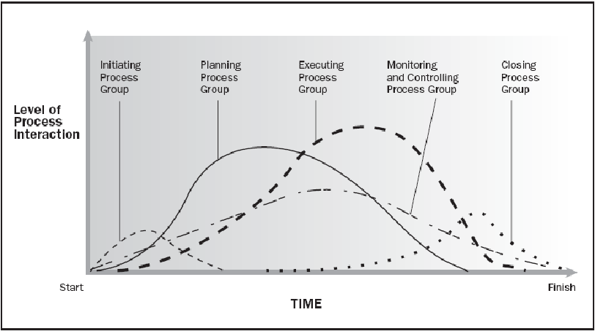
Process Groups & Level of Activities
Source PMBOK Guide Version 5.0

Slide 21
Organization Types & Project Success
Chief Executive
Project
Coordination
Functional Manager
Functional Manager
Functional Manager
Manager of
PM
Staff
Staff
Staff
PM
Staff
Staff
Staff
PM
Project
Coordination
Staff
Staff
Staff
PM
1. Project Manager Authority | 4. Resource Availability
2. Project Budget Control | 5. PM Role
3. PM Admin Staff

Slide 22
Project Boundary
Limits the scope
Helps in change control
Aligned with project objective
Part of Project Scope Statement
Example :
This project will affect Bangalore operations only. All other locations are out of scope.
We will deliver our solution to the Finance and HR departments. All other departments are out of scope.

Slide 23






Project Constraints
Risk
Scope
Project and Product Quality
Schedule
Cost
Resource

Slide 24
Project Success Criteria
Related to Project
Timely Delivery
Features & Functions Delivered
Delivery within agreed budget
Quality
Risk Management
Issues & Escalations
Related to Project’s Product
Business Value Addition
Efficiency/Productivity Improvement Due to Project’s Product

Slide 25
Results of a Project
Project produces output. It can be a product or service or result
If you use the product of a project then outcome is visible. Outcome cannot be measured. It is more subjective.
Benefits can be measured. If it more objective
Example
You implemented ERP through a project (Output)
People use/do not use/ complain / suggest something else than ERP (outcome)
Organization get benefit of ERP implementation cost saving, sales increasing, stress coming down, improved quality with lessor effort, real time data for decision making (benefit)

Slide 26
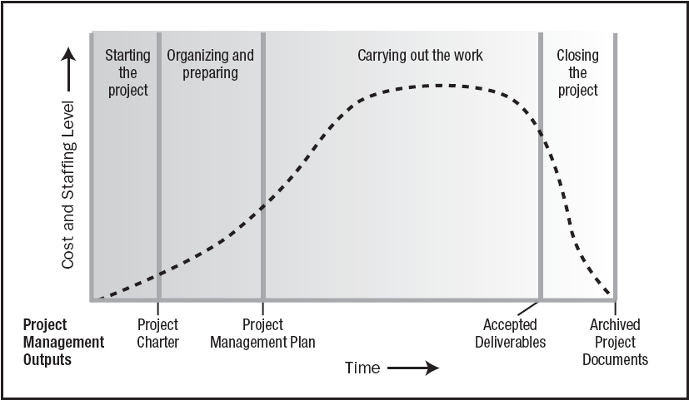
Typical Costing & Staffing across PLC
Source PMBOK Guide Version 5.0

Slide 27
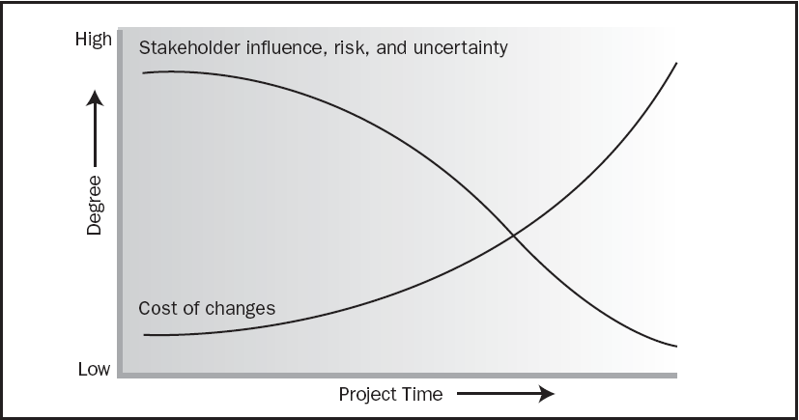
Cost of Change & Degree of Risk
Source PMBOK Guide Version 5.0

Slide 28
Project Initiation & Exercises
Organization Process Assets
Enterprise Environmental Factors
Stakeholders Management
Project Manager: Skills, R&R, Authority
Project Charter

Slide 29
Organization Process Assets
Knowledge base of the organization which helps you doing business in a better way.
Processes, Templates, Guidelines, Standards, Checklists, Forms, Procedures developed at organization level. Compiled by Quality or PMO Department
Lessons learned from previous projects. Documented and shared by earlier project managers.
Previous projects historical data available in archival. It is provided to IT Security department by Project manager at the end of every project.
Notes:
For doing business rely on the organizational learning and therefore build it systematically and regularly.

Slide 30
Enterprise Environmental Factors
Constraints imposed by the enterprise(s) or environment where you are doing the business. Do not underestimate them.
Political environment of vendor, customer, project management company or state
Climatic conditions
Regulatory decisions
Skills available in the market
Attitude of the people towards project, team, organization, management, customer, work etc.
Organizational systems and policies
Organizational culture, management, hierarchies
Terrorism, communal sensitivity

Slide 31
Stakeholder Management

Slide 32
Stakeholders
A stakeholder is an individual, group, or organization
Who may affect, be affected by, or perceive itself to be affected by a decision, activity, or outcome of a project.
Stakeholders may be actively involved in the project
Stakeholders may have interests that may be positively or negatively affected by the performance or completion of the project.
Different stakeholders may have competing expectations that might create conflicts within the project.

Slide 33
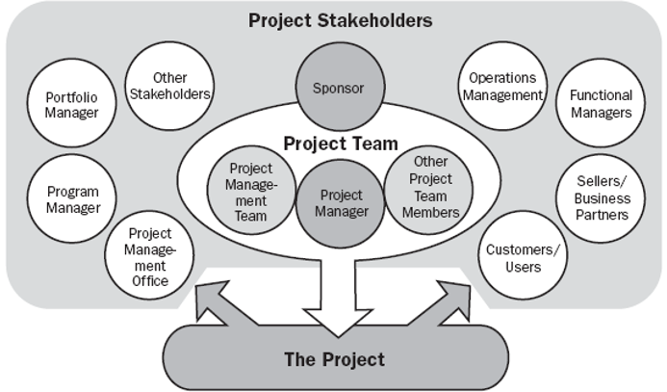
Stakeholders
Product User
Customer
Sponsor
PMO
Regulators
Government
Local Public
Vendors
Local Politicians
Management
Quality Department
Project Team

Slide 34
Stakeholder Register
General
ID
Name
Role/Title
Organization
Department
When (Start, Phase1, Phase2, Phase3, Throughout)
Internal/External
Manager
Contact
Phone
Email-id
City
Management
Expectation
Influence
Interest
Current Position (Champion/Supporter/Neutral/Resist)
Needed Position
Personal Attributes
Engagement Plan

Slide 35
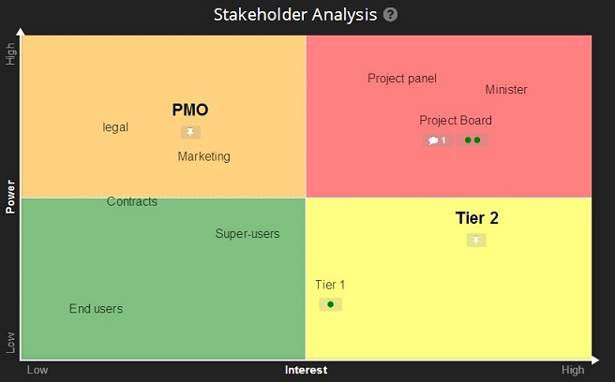
Stakeholder Analysis

Slide 36
Stakeholder Management Plan
Stakeholder Name
Engagement Approach
Responsibility
Accountability
Frequency
When
Efforts Associated

Slide 37
Project Manager: Skills, R&R, Authority

Slide 38
On Any Project : PM Responsibilities
Project Manager’s Role
Accountable
Communication- reviews, steering committee meetings, stakeholder identification and expectation management
Stakeholder Expectation Management
Cost optimization
Resource allocation, resource backup and utilization
Team motivation, team management, training & development, appreciation, career planning, interview
Delegate, Assurance, Ensure through Expert’s Help
Estimates of size, efforts & schedule
Risk identification, analysis, prioritization, monitoring & control
Scope management
Defect free product delivery on time within budget
Deliver as per contract & proposal
Dependency Management
Procure as per contract & proposal
Configuration management, data backup
Quality planning
Presales & proposals
Technical guidance to team – if team members are not available do their work (after project manager has completed his work & he has spare time)

Slide 39
PM Responsibilities
Project Manager’s Responsibilities in Project Lifecycle
Initiating a Project
Project aligned with org objectives & customer needs. Understand Why?
High-level risks, assumptions and constraints are understood
Stakeholders identified and Profiling is done as per their need, power & interest
Project Charter approved
Planning a Project
Project scope, schedule, budget is agreed & approved.
Project team identified with roles and responsibilities agreed
Communication activities agreed
Quality management process established
Risk response plan approved
Integrated change control processes defined & agreed
Procurement plan is place, approved and dependencies identified

Slide 40
Project Manager Responsibilities
Project Manager’s Responsibilities in Project Lifecycle
Executing a Project
Project scope achieved
Project status/progress is tracked and communicated
Project stakeholders expectations managed
Human resource, Machine & Material resources managed
Quality managed against plan
Monitoring & Controlling a Project
Variances identified & RCA is performed
Project change management is performed systematically
Quality is monitored and controlled
Risks are monitored and controlled
Contract administered
Closing a Project
Project outcomes accepted
Project resources released & stakeholders are communicated
Stakeholder perceptions measured and analyzed
Project formally closed
Documents archived, LL documented

Slide 41
Project Manager Skills
Personal Competence
Negotiate
Influence
Manage (Resources, Scope, Time, Cost etc.)
Communicate
Present
Organize
Lead
Conflict Management
Cognitive Ability
Effectiveness
Professionalism

Slide 42
Authority
Manage through servant leadership
Manage through referent power
Implement decision made by stakeholders
Make decisions & take calculated risk

Slide 43
Develop Project Charter
Project Charter should be signed by Project Sponsor and handed over to PM
Use Business Case, SOW, Agreements, Lessons Learned, EEF to make this.
It is first and must have document of any project

Slide 44
Project Charter
Objective
High Level Scope
Project Boundary
High Level Requirements
High Level Deliverables
High Level Milestones
Assumption
Inherent and known risks
High Level Timeline
High Level Budget
Measurable Project Success Criteria
Initial Team
Project Start Date
High Level Approval Requirements
Name and Sign of Project Manager
Name and Sign of Project Sponsor

Slide 45
Day 2

Slide 46
Themes
Day 1 : General Understanding
Day 2 : Project Planning
Day 3 : Project Executions
Day 4 : Project Governance
Day 5 : Closing

Slide 47
Planning
Project Integration Planning
Project Scope Planning
Project Time Planning
Project Cost Planning
Project Quality Planning
Project Communication Planning
Project Human Resource Planning
Project Risk Management
Project Procurement Management

Slide 48
Planning for Project Integration (Overall)
Determine Project Management Methodology
Determine Project Lifecycle
Determine Processes Required to Manage Project
Determine different type of Baselines & SLAs
Determine Configuration Management System
Determine Overall Monitor & Control Plan & Processes
Determine Change Management Processes

Slide 49
Planning for Configuration Management
How will you preserve baselines
Identify what will be Configurable items (CI) and what will be records
Establish how will you name and version documents and product of this project
Tools to be used for Configuration Management
Security Permission for CI & Records
Assign configuration manager for the project

Slide 50
Planning for Monitoring & Controlling
Identify what do you want to monitor & control regularly or periodically. Like work progress, time, cost, risk, issues etc.
When, how & who is responsible for data collection, compilation and analysis
What kind of reports are expected in part of Monitoring & Controlling
Who will take action on the analysis and how that action will trigger

Slide 51
Planning for Change Management
Identify type of changes (scope, cost, time, quality, process, people, training, risk appetite, project objective etc.) which you want to track
Setup threshold limits for each type of change
Setup change control boards (CCB) and their authority and scope of discussion
Setup impact analysis process and identify people who perform this
Define meeting frequency of CCB
Define templates and guidelines for Change Management

Slide 52
Tools/Techniques for Project Integration Planning
Expert Judgment
Meetings

Slide 53
Scope Management

Slide 54
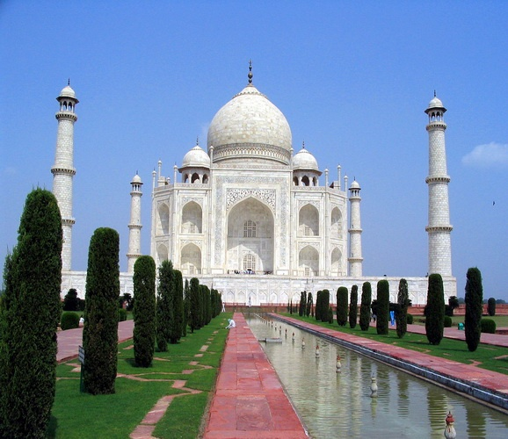

Slide 55
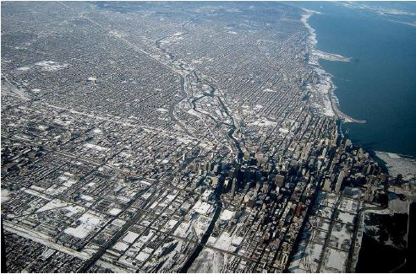

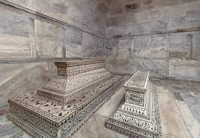


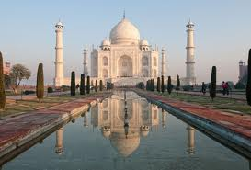
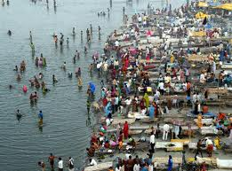
Level of Detailing in Scope

Slide 56
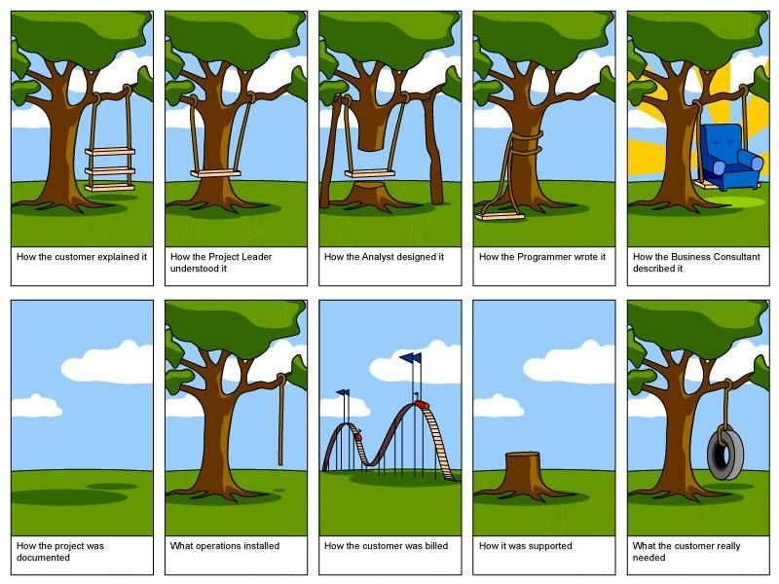
How the customer explained it
How the Project Leader understood it
How the Architect Designed it
How the Programmer wrote it
How the Business Consultant described it
How the project was documented
How operations installed it
What the customer really needed
How the customer was billed
How it was supported

Slide 57
Scope
Project Scope "The work that needs to be accomplished to deliver a product, service, or result with the specified features and functions."
Product Scope "The features and functions that characterize a product, service, or result."

Slide 58
Requirements
Product requirements (features). Product requirements describe the characteristics of the deliverables.
Process requirements (functions). Process requirements describe how people interact with a product and how a product interacts with other products.
Notes:
For example, If you were building a bridge, for instance, most of the requirements would be product based. These might include the number of cars the bridge would hold, the strength of the steel, the water level it needs to span, the color of the bridge, etc.
For example, when you discuss how data gets moved and how business transactions flow from one point to another, you are describing process requirements. If you need to describe the requirements for billing transactions, most of the requirements could end up being process oriented. This would include how billing transactions move from orders to invoicing to accounts receivable. They can describe at what points people look up a status, how people manually update an invoice and what people should do if accounts are out of balance.

Slide 59
Project Scope Management Planning
Establish a process & plan to manage scope (SMP)
Establish a process & plan to manage requirement: collection, elicitation, approval, prioritization (RMP)
Establish a process & plan to trace requirements throughout the project lifecycle (RMP)
Establish a process & plan for requirement acceptance testing (SMP)
Determine scope related metrics to manage the scope (SMP)
Identify the systems, tools which you will use to capture and analyze requirements (SMP)

Slide 60
Tools/Tech for Scope Mgmt. Planning
Expert Judgment
Meetings

Slide 61
Scope Management
Collect Requirements as per SMP & RMP
Analyse Requirements & Develop solution with various possible alternatives
Prepare a detail list of deliverables & related risk
Develop a WBS, WBS Dictionary
Establish control account
Document exclusions
Baseline Scope

Slide 62
Tools/Techniques for Collecting Requirements
Interviews
Focus Groups
Facilitated Workshops
Group Creativity Technique
Group Decision Making Techniques
Questionnaires and Surveys
Observations
Prototypes
Benchmarking
Context diagrams
Document Analysis

Slide 63
Tools/Techniques for Define/Baseline Scope
Expert Judgment
Product Analysis
System Analysis
Decomposition
Alternative Generation

Slide 64
Project Time Management

Slide 65
Project Time Management Planning
Establish a process and plan to manage time of project activities (ScMP)
Tools for Schedule Planning and Reporting
Schedule Thresholds
Metrics
Responsibility, frequency, time of schedule data analysis
Determine which attributes of the activities need to captured to manage them

Slide 66
Project Scheduling
Define activities as per ScMP (DA)
Sequence activities as Activity Attributes (SA)
Estimate Activity Resources (EAR)
Estimate Activity Duration (EAD)
Develop Schedule (DSc)
Baseline Schedule

Slide 67
Define Activities
Use Scope baseline for this
Prepare a list of activities, milestones, activity attributes
Activity Attribute Example :
Name, Location, Department, Dependency, Type, Constraints, Tracking Method, WBS Code, Cost, Duration, Resource Requirement, % Complete

Slide 68
Sequence Activities
Use lead and lag time properly
Understand dependency type apply them properly
FS, SS, FF, SF
Use deadlines and time constraints of activities properly
Understand dependency is Hard Logic or Soft Logic

Slide 69
Estimate Activity Resources
Estimate skills required to perform activities
Estimate number and type of equipments, support services, material required to perform activities
Whether these resources are available within the organization or need to purchased/hired from outside
If they are available within organization can they be available for your project when and where you need them
Develop a Resource Breakdown Structure and Resource Requirements

Slide 70
Estimate Activity Duration
Consider risk around activities
Establish your project calendar (work timings, days in a week, off days of week, holidays, working hours everyday)
Consider availability of resources. Sometimes they are available but not 100%.
Consider productivity of resources. It is never 100%.
Know you are estimating ideal duration, not the actual duration, not the effort
Understand that every activity’s duration cannot be crashed by adding resources.
Methods of duration estimation: PERT, Analogous, Published Data, Parametric
PERT method help you in knowing confidence of your schedule
Finally 24 hours work duration is not 3 days, even if your office works 8 hours a day.

Slide 71
Develop Schedule
Analyse Dependencies
Analyse Lead/Lag
Analyse Constraints
Identify Critical Path
Identify Critical Activities
Identify Float of Activities
Understand where applying more resources will help you reducing project duration
Determine how you want to manage buffers
Discuss, negotiate, agree before you baseline schedule

Slide 72
Critical Path
ES EF
ES EF
ES EF
ES EF
ES EF
ES EF
7
6
3
A
C
G
LS LF
LS LF
ES EF
LS LF
2
Start
Finish
H
ES EF
ES EF
ES EF
LS LF
3
3
3
B
D
E
LS LF
LS LF
LS LF
ES EF
2
F
LS LF

Slide 73
Critical Path – Longest Path, Zero Float
ES EF
ES EF
ES EF
0
7
7
7
6
13
13
3
16
A
C
G
0
0
7
7
0
13
13
0
16
LS LF
LS LF
ES EF
LS LF
16
2
18
Start
Finish
H
16
0
18
ES EF
ES EF
ES EF
LS LF
0
3
3
3
3
6
6
3
9
B
D
E
7
7
10
10
7
13
13
7
16
LS LF
LS LF
LS LF
ES EF
3
2
5
F
11
8
13
LS LF

Slide 74
Facts/Tips for Critical Path
Total Float is the amount of time the task can delayed without delaying the project finish date.
Free float is the amount of time a task can slip without delaying the early start of any task that immediately follows it
It is possible that a zero float activity may not be on critical path
Longest path & shortest time possible to complete the project
A project can multiple critical paths
Difference between late and early is float
Positive float (the activity can wait to start even after previous activity finishes)
Negative float (the activity must start before previous finishes)
Zero float (the activity must immediately start after the finish of previous one)
Crashing activities to short the overall duration of project
Fast-tracking activities to short the overall duration of project
Be cautious that non-critical activity is not being delayed than the allowed free float
Take care of sub-critical path or non-critical path
Manage critical path resources very closely
Do not overload critical path activity resources
Avoid multitasking for resources working on critical path activities

Slide 75
Project Cost Management

Slide 76
Project Cost Management- A Thought
If you don't plan, it doesn't work. If you do plan, it doesn't work either. Why plan!
The same work under the same conditions will be estimated differently by ten different estimators or by one estimator at ten different times. So why to estimate!
Any project can be estimated accurately (once it's completed).
Nothing is impossible for the person who doesn't have to do it.
Right answers to wrong questions are just as wrong as wrong answers to right questions.

Slide 77
Project Cost Management Planning
Establish a process and plan to manage cost of project activities (CMP)
Consider the cost of procurements, risk management activities
Setup cost reporting systems and train project team
Understand different types of cost and their accrual methods

Slide 78
Cost Management Plan
It includes
Cost management tools to be used
Level of accuracy (acceptable range +/- 5%)
Level of precision (US$ 100.01)
Units of measure for each resource
Organizational procedure links
Process of updating the progress in schedule model
Control thresholds (an allowed variation before some action need to be taken)
Rules of performance measurement (baselines, %complete, fixed formula etc.)
Project cost recording process
Currency exchange rate fluctuation adjustment process
Define scheduling reporting format

Slide 79
Tools/Tech. for Cost Management Planning
Expert Judgment
Analytical Tools
Meetings

Slide 80
Cost Planning
Estimate Cost of Each Activities (EC)
Document assumptions of estimation
Consider risks while estimating cost
Develop project funding requirements (DB)
Consider cash flow and payout while developing funding requirements
Baseline Project Cost

Slide 81
Tools for Cost Planning
Analogous Estimating
Parametric Estimating
Bottom-up estimating
Three-point estimates
Reserve Analysis
Cost of Quality
Project Management Software
Vendor Bid Analysis
Group Decision Making Techniques
Funding Requirement Reconciliation
Cost Aggregation
Reserve Analysis
Historical Relationships

Slide 82
Project Cost Estimation Ranges
Cost estimation may include only indirect Cost along with direct Costs
Class Name | % | Range
Definitive | - 5 -> +5% | 10%
Capital Cost | -15 -> +10% | 25%
Appropriation | -25 -> +15% | 40%
Budget Estimates | -10 -> +25% | 35%
Feasibility | -35 -> +25% | 60%
Order of Magnitude | -50 -> +50% | 100%

Slide 83
Project Quality Management

Slide 84
Quality Definitions from Quality Gurus
“Quality is Predictability”- Deming
“Conformance to requirements” - Crosby
“Fitness for use” - Juran
“Customer’s opinion”- Feigenbaum
Conformance to “Valid Requirements“.
“Customers' perception of the value of the suppliers” work output.
A perceived degree of excellence with a minimum, usually set forth by the customer.
Best value for money.

Slide 85
Project Quality Planning
Understand Quality Expectations of the Stakeholders
Develop Quality Checklist
Understand Cost of Quality
Identify Quality Metrics to measure, improve project/product quality
Develop Quality Assurance Plan & Process
Develop Quality Management Plan & Process (QMP)

Slide 86
Tools/Tech for Quality Management
Cost-benefit analysis
Cost of Quality
Seven basic quality tools
Benchmarking
Design of experiments
Statistical sampling
Additional quality planning tools
Meetings

Slide 87
Seven basic quality tools
Control Chart
Fishbone Diagram
Pareto Chart
Scattered Diagram
Histogram
Flowchart
Check sheet

Slide 88
Cost of Quality
Cost of Conformance | Cost of Non-conformance
Prevention Costs (Build a quality product) Training Document processes Equipment Time to do it right Appraisal Costs (Assess the quality) Testing Destructive testing loss Inspections | Internal Failure Costs (Failures found by the project) Rework Scrap External Failure Costs (Failures found by the customer) Liabilities Warranty work Lost business

Slide 89
Project Human Resource Planning
Establish Project Calendar
Create Role & Responsibilities based on skills required to perform project activities
Develop RACI Chart
Establish/Refine Job Description
Establish Project Organization
Establish Performance Appraisal Systems
Establish Conflict Management System
Establish Staffing Management Plan
Establish Team Building Plan
Identify type of trainings required to ensure people understand processes, they understand temperaments and work style of fellow team members, expectations from them. Establish Training Need and Training Plan
Establish Hiring Systems
Approve human resource management plan (HMP)

Slide 90
Project Communication Management
Understand communication need of different stakeholders
Group stakeholders based on their communication need
Understand number of communication channels involved
Identify possible communication technologies and their benefits and cost of setup and operation
Define Roles & Responsibilities for managing communication
Make decision about communication technologies to be used
Establish how will you ensure effectiveness of communication
Establish communication metrics
Put all above information in Communication Management Plan (CoMP)

Slide 91
Tools/Tech for Communication Planning
Communication Requirement Analysis
Communication Technology
Communication Models
Communication Methods
Meetings

Slide 92
Project Risk Management

Slide 93
Risk Management Planning
Identify who is responsible for risk management
Establish tools/template to capture risk
R&R for Risk Assessment, Audit
Risk appetite of stakeholders
Develop impact table
Develop probability and impact table
Methods of risk categorization
Put all above information in Risk Management plan (RMP)

Slide 94
Tool/Tech for Risk Management Planning
Expert Judgment
Analytical techniques
Meetings

Slide 95
Risk Management
Identify Risks
Assess Probability of Risks Identified
Assess Impact of Risks Identified
Assess Urgency of Risks Identified
Establish which risk must have response plan
Assign Risk Owner
Establish Risk Response Plan for High Exposure Risk
Assign Risk Actionee
Categorize Risks
Establish contingency funds

Slide 96
Funding for Risk Management
Contingency Reserves
Management Reserves

Slide 97
Tools/Tech for Risk Management
Expert Judgment
Documentation Reviews
Information Gathering Techniques
Checklist Analysis
Assumptions Analysis
Diagramming Techniques
SWOT Analysis
Risk Probability and Impact Assessment
Probability and Impact Matrix
Risk Data Quality Assessment
Risk Categorization
Risk Urgency Assessment
Data Gathering and Representation Techniques
Quantitative Risk Analysis and Modelling Techniques
Strategies for Negative Risk or Threats
Strategies for Positive Risks or Opportunities
Contingent Response Strategies

Slide 98
Project Procurement Management Planning
Identify what resources/work needed for project cannot be produced by the project team (what you need)
Establish procurement statement of work
Identify when you need and who are potential supplier
Establish cost of each procurement need
Identify different contract type
Establish contract change control systems
Establish procurement evaluation systems

Slide 100
Day 3

Slide 101
Themes
Day 1 : General Understanding
Day 2 : Project Planning
Day 3 : Project Execution
Day 4 : Project Governance
Day 5 : Closing

Slide 102
Project Execution
Direct and Manage Project Work (DMPW)
Perform Quality Assurance (PQA)
Acquire Project Team (APT)
Develop Project Team (DPT)
Manage Project Team (MPT)
Manage Communications (MC)
Conduct Procurement (CoP)
Manage Stakeholder Engagement (MSE)

Slide 103
Direct and Manage Project Work
Execute Project as per the Baselined Project Management Plan
Produce only those deliverables which are valued by customer
For any deviation use only “Approved” Change Requests
If work is not possible as per the baselined plan then team should make Project Manager aware about it. This is change request.
As a practice project manager should not make decision about deviation from baselined plan immediately.
Change request should be evaluated based on the urgency and then decision is either made by project change control board or Project Manager depending on impact and urgency.
Project work progress data, any issue, impediments should be captured on daily basis. Automate this step as much possible so that your get correct data
Coordinate project related dependencies between departments, agencies, consultants, experts, management and other stakeholders on daily basis.

Slide 104
Tools/Technique for Direct & Manage Project Work
Meetings
Project Management Information Systems
Expert Judgment

Slide 105
Perform Quality Assurance
A mechanism to determine that everybody including the project manager is following processes
Deviation from the plan is acceptable but deviation from the process is compliance issue and taken very seriously by management, regulators, customer etc.
Project manager should perform quality assurance for his team
External to project (Auditor) who has knowledge about audit process and project processes should perform regular audit. Project Manager should plan for this in his plan. A surprise audit asked by management, regulator or customer is also possible.
Auditors should identify area of improvement, provide recommendation, appreciate best practices, take best practices at organization level. (Change Request)
Auditors should make stakeholders aware about non-compliance
An auditor must use project’s project plan, project reports, quality report to perform the audit

Slide 106
Tools/Techniques for Perform Quality Assurance
Process Analysis
Process Audits
Inspection
Cost Benefit Analysis
Cost of Quality (COQ)
Seven Basic Quality Tools
Benchmarking
Design of Experiments
Statistical Sampling
Flow charting
Additional Quality Planning Tools
Approved Change Requests Review
Meetings

Slide 107
Acquire Project Team
Hire right people on right time and assign them the work as per their capability
Negotiate role, responsibilities, work time, position, compensation, reporting relationship, joining time, location of work and agree before you confirm any person in the project team
Interview every person you are taking on the project based on the level of expertise and skills expected for the project work

Slide 108
Tools/Techniques for Acquire Project Team
Pre-assignment
Negotiation
Acquisition
Virtual Teams
Multi-criteria decision analysis

Slide 109
Develop Project Team
In a project chemistry is more important than physics
Project is delivered by team not by individuals
Conduct trainings
Conduct team building activities
Define ground rules as a team
Develop binding between virtual teams
Evaluate continually that how team is maturing

Slide 110
Tools/Techniques for Develop Project Team
Interpersonal Skills
Training
Team-building activities
Ground Rules
Co-location
Recognition and Rewards
Personnel Assessment Tools

Slide 111
Manage Project Team
Do not monitor and control people. Be objective and manage your team using project objectives.
Appraise and provide feedback on regular basis
Identify improvement need of individuals and team (Change Request)
Maintain issue log of team conflicts and keep resolving it based of priority
Assign only those people for conflict management who have competency

Slide 112
Tools/Techniques for Manage Project Team
Observation & Conversation
Project Performance Appraisals
Conflict Management
Interpersonal Skills

Slide 113
Five Stages of Team development
Forming
Storming
Norming
Performing
Adjourning

Slide 114
Type of Powers
Formal
Expert
Reward
Penalty
Referent

Slide 115
Conflict Management

Slide 116
Sources of conflict
Schedules
Project Priorities
Technical Issues
Personality Conflict
Cost
Scarce resources
Personal work styles
Administrative Procedures

Slide 117
Characteristics of conflict
Conflict is team issue
Conflict is natural and forces a search for alternatives
Openness resolves conflict
Conflict resolution should focus on issues, not personalities
Conflict resolution should focus on the present not on the past

Slide 118
Conflict Resolutions
HIGH
SMOOTHING
(ACCOMMODATING)
PROBLEM-SOLVING
(COLLABORATING)
RELATIONSHIP
ORIENTATION
COMPROMISE
WITHDRAWAL
(AVOIDING)
FORCING
(COMPETING)
LOW
LOW OBJECTIVE ORIENTATION HIGH

Slide 119
Motivational Theories

Slide 120
Motivational Theories
Frederick Herzberg - Hygiene & Motivation Factors
Abraham Maslow - Hierarchy of Needs
Victor Vroom - Expectancy Theorem of Motivation
Oldham and Hackman - Job characteristics model
McGregor - Theory X & Y

Slide 121
Frederick Herzberg - Hygiene & Motivation Factors
Hygiene Factors | Motivating Factors
Supervision Company policy and administrator Positive working Condition Interpersonal relations Job Security Status Compensation Personal life | Achievements Recognitions Work Itself Responsibility Advancement Possibility for growth
Present does not guarantee high productivity. Absence guarantee low productivity | Motivation will not work without Hygiene.

Slide 122
Abraham Maslow - Hierarchy of Needs
Self Actualization
Self fulfillment, growth, learning
Accomplishment, Respect, Attention, Appreciation
Esteem
Love, affection, approval, friends, association
Social
Security, stability, freedom from threat and physical harm
Safety
Physiological
Air, water, food, house, clothing

Slide 123
Victor Vroom - Expectancy Theorem of Motivation
The extent to which an individual is motivated…
Is the work important?
The level of expectation of their efforts will result in a desired outcome?
Will I be rewarded?
The expectation that good work will be rewarded
What is the value of the reward?
Attractiveness of the reward
Motivation will be high when all three factors are high

Slide 124
Oldham and Hackman - Job characteristics model
Skill Variety – the number of job skills that the job holder has the opportunity to exercise
Task Identity – the degree to which your work and its result are identifiable as belonging to you
Task Significance – the degree to which your job has an influence on others
Autonomy – the discretion you have about the way that you do the job
Feedback – the information that you get back about the result of your work

Slide 125
McGregor - Theory X & Y
Theory X | Theory Y
The average worker is inherently lazy and dislikes work so avoid whenever possible. Therefore needs supervisions To induce adequate effort, the supervisor must threaten punishment The average worker avoids increased responsibility and seeks to be directed | The average worker wants to be active and finds the satisfaction in his work. So they work better without continuous supervision Greatest results come from willing participation and this leads to self-directed towards goals without coercion and control The average worker seeks opportunity for personal improvement and self respect
Theory X relies on strict rules, performance incentives, rewards, threats to job security | Theory Y relies on worker participation in decision making, cordial manager-worker relationships, worker designed job methodology, worker individualism

Slide 126
Key to Successful Team Management
Listens to subordinates to diagnose or solve problems
Sets goals and develops short- and long- range action plans
Gives directions about who is to do which tasks to what standards
Provides feedback on task performance
Rewards
Develops subordinates
Understanding that team is an Integral Unit of Organization
A team mission, objective, goals, strategy and role definition
A leader and an organizational support system
Managers responsive to needs of team members
Encourage participation and effective communication
Foster an atmosphere of trust among team members
Provide feedback effectively
A collective culture and style
Motivate team members with challenges & rewards

Slide 127
Manage Communication
Send out all communication as per the plan
Identify any ad-hoc communication need and send out those communications
Minimize ad-hoc communications
Ensure the communications send out is available for future references
Ensure the communication is available only those who are authorize to use it.

Slide 128
Tools/Techniques for Manage Communications
Communication Techniques
Communication Models
Communication Methods
Information Management Systems
Performance Reporting

Slide 129
Conduct Procurement
Evaluate proposals received from suppliers
Ensure that they understand what you expect and when
Perform SWOT analysis for identified supplier
Understanding various contracting type and award contract

Slide 130
Tools/Techniques – Conduct Procurement
Expert Judgment
Bidder conferences
Proposal evaluation techniques
Independent estimates
Advertising
Analytical techniques
Procurement Negotiation

Slide 131
Manage Stakeholders Engagements
Engage relevant stakeholders are proper level as per the plan
Understand the issue which they are raising (Change Request)
Analyze these issue and address them appropriately or set the right expectations
While addressing issue keep change log with you.

Slide 132
Tools/Techniques – Manage Stakeholders Engagements
Communication Methods
Interpersonal Skills
Management Skills

Slide 133
Interpersonal Skills
Leadership
Team Building
Motivation
Communication
Influencing
Decision Making
Political & Cultural Awareness
Negotiation

Slide 134
Management Skills
Presentation Skills
Negotiating Skills
Writing Skills
Public Speaking Skills

Slide 136
Day 4

Slide 137
Themes
Day 1 : General Understanding
Day 2 : Project Planning
Day 3 : Project Execution
Day 4 : Project Governance
Day 5 : Closing

Slide 138
Project Governance
Monitor & Control Project Work (MCPW)
Perform Integrated Change Control (PICC)
Validate Scope (VC)
Control Scope (CS)
Control Schedule (CSc)
Control Cost (CC)
Control Quality (CQ)
Control Communications (CCom)
Control Risks (CR)
Control Procurements (CnP)
Control Stakeholders Engagements (CSE)

Slide 139
Monitor & Control Project Work
Compare actual progress against the plan
Identify whether the variance is within control limit
Perform root cause analysis for any exceptional variance
Prepare reports of progress, status, forecast
Identify change request for course correction, defect fix, preventive action
Who will collect data, track the progress, perform analysis and prepare those reports should be part of Planning.
Ensure whether action taken in previous cycle has resolved the issues

Slide 140
Tools/Tech for Monitor & Control Project Work
Expert judgment
Analytical techniques (Grouping Methods, Regression Analysis, Causal Analysis)
Project management information system
Meetings

Slide 141
Perform Integrated Change Control
Any deviation from the plan is change. While doing project many a times it is must to initiate a change request to meet project objective
Change may happen in plan, document, process, team
Change may impact cost, quality, scope, time, risk, benefits
Implementing small change requests without approval may lead to scope creep
One sided decision on CR should not be made by sponsor or PM. This should be carried out by CCB after the impact evaluation

Slide 142
Perform Integrated Change Control
Evaluate any change request in terms of impact on scope, time, cost, quality, risk and benefit of project and impact on existing or previously delivered subsystems.
Forward change and impact to CCB and follow up with CCB to make decision whether change request should be approved or not
Project manager make decisions only about those change which are in his/her threshold limit.
Document the decisions and related information of any change request irrespective of CR is accepted or rejected
Maintain a change log. This is very important input for conflict management and stakeholder expectations management
If you manage stakeholders expectations effectively and routinely many of change requests can be avoided

Slide 143
Tools/Tech for Perform Integrated Change Controls
Expert Judgment
Change Control Tools
Meetings

Slide 144
Validate Scope
Show the product of project to customer so that he can accept or recommend changes
Big-bang delivery to customer should be avoided, unless there is some specific reason.
Periodically carry out this process and take feedback so that project team know that they are going in right direction
Before you show something to customer you must get it validated by internal quality team
This process is for only customer valuable deliverable and not for internal documentation or plan.

Slide 145
Tools/Tech. for Validate Scope
Inspection
Group Decision Making Techniques

Slide 146
Control Scope
To avoid scope creep you should know how many scope related CR has been approved in last period
Total how many CR were raised
How much time went into analyzing those CRs
Report these metrics as a part of project status reporting
Report work status
List of work items completed
List of work items dropped
List of work in progress
List of work items for next cycle

Slide 147
Tools/Tech for Control Scope
Variance Analysis

Slide 148
Control Schedule
Report project efficiency in terms of time. Schedule performance index.
How much we are behind/ahead of the schedule. SV% or No of days.
How much more time is required to complete the work. Or can we complete project earlier. (Schedule Forecast)
Why are we behind/ahead the schedule
Preventive and corrective actions (Change Request)
New project schedule

Slide 149
Tools/Tech. for Control Schedule
Performance Reviews
Project Management Software
Resource Optimization Techniques
Modeling Techniques
Leads and Lags
Schedule Compression
Scheduling Tool

Slide 150
Control Cost
Report project efficiency in terms of cost. Cost performance index (CPI).
How much we are over/under budget, CV%.
How much more money is required to complete the work. Or can we complete the work in lessor money. (Cost Forecast)
How much total money will go out in this project by the time it is complete. (Cost Forecast)
What should be resource utilization from tomorrow onwards so that we can complete the project within cost and on time. (TCPI)
Why are we behind the schedule. RCA.
Preventive and corrective actions (Change Request)
New Cost Baseline

Slide 151
Tools/Tech for Control Cost
EVM
Forecasting
TCPI
Performance Reviews
Project Management Software
Reserve Analysis

Slide 152
Earn Value Management

Slide 153
Earned Value Management – Basic Concepts
Planned Value (PV)- BCWS
Authorized budget assigned to the work to be accomplishes for an activity or work
breakdown structure component.
Earned Value (EV)- BCWP
Value of work performed expressed in terms of the approved budget assigned to
that work for an activity or work breakdown structure component.
Actual Cost (AC)- ACWP
Total cost actually incurred and recorded in accomplishing work performed for an
activity or work breakdown structure component.

Slide 154
Earn Value Rules
0% - 100%
50% - 50%
20% - 80%
25% - 75%

Slide 155
Earned Value Management – S Curve
PV
AC
Cost
CV
SV
Progress Review
ΔT
EV
Time

Slide 156
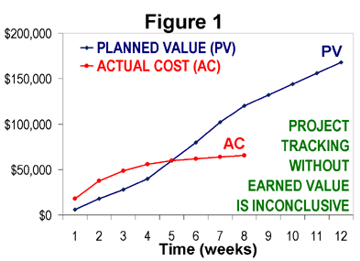
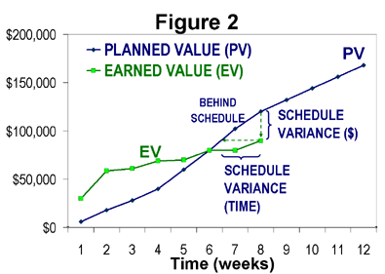
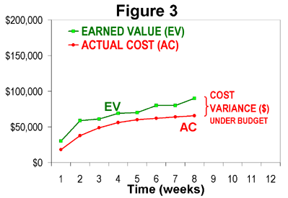
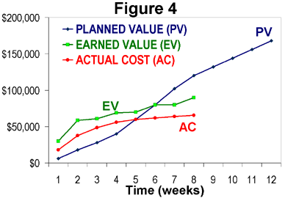
How project is progressing?

Slide 157
EVM-Variances
CV (Cost Variance) = EV- AC
CV = 0 => the Project is proceeding as per plan on cost
CV < 0 => the Project is over budget
CV > 0 => the Project is under budget
SV (Schedule Variance) = EV- PV
SV = 0 => the project is on plan, time-wise
SV < 0 => the project is BEHIND schedule
SV > 0 => the project is AHEAD of schedule

Slide 158
EVM- Indexes
CPI (Cost Performance Index) tells you how much worth of job you are getting for every $ being spent.
CPI = EV/AC
CPI = 1 => the project is on plan, cost wise
CPI < 1 => the project is over budget or under performing
CPI > 1 => the project is under budget or over performing
SPI tells the PM how much worth of job has been completed against planned work
SPI = EV / PV
SPI = 1 => the project is on schedule
SPI < 1 => the project is BEHIND schedule
SPI > 1 => the project is AHEAD of schedule

Slide 159
EVM- Critical Ratio
CR tells the PM the overall shape of your project
CR= CPI x SPI
CR = 1 => the project is on schedule & within budget
CR < 1 => the project is BEHIND schedule or budget or both
CR > 1 => the project is AHEAD of schedule or budget or both

Slide 160
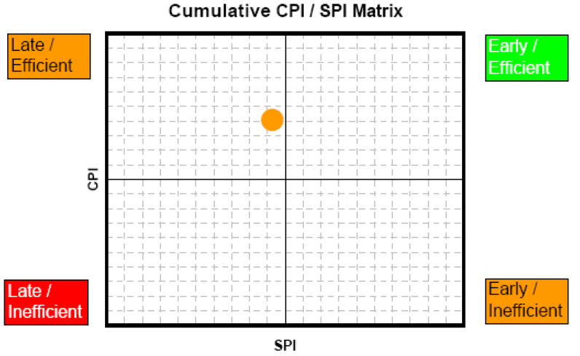
CPI & SPI Summary

Slide 161
Forecasting- ETC
Recalculate it, if original estimate are no longer valid now.
Calculate it manually based on the progress, if original estimates are still valid
ETC = BAC - EV

Slide 162
Forecasting- EAC
Estimate at Completion(EAC)
EAC (atypical) = AC + ETC (Re-estimated)
EAC (atypical) = AC + BAC – EV (Estimated based on Progress)
EAC (typical considering CPI & SPI) = AC + ETC/ (CPI x SPI)
EAC (typical)= AC + ETC / CPI = BAC/CPI
If you feel that you will be able to complete the project on time in spite of current delay then you can consider SPI as 1. In that case CR= SPI

Slide 163
Forecasting- Variance at Completion
Variance at Completion (VAC)
VAC = BAC – EAC
Variance at Completion (%)
PVAC= (BAC-EAC)/BAC

Slide 164
Forecasting: TCPI
TCPI (To complete Performance Index) can be calculated using BAC or EAC
TCPI using BAC = (BAC-EV) / (BAC-AC)
TCPI using EAC = (BAC-EV) / (EAC-AC)

Slide 165
Control Quality
Project quality team ensuring that as a project team we ensure that we deliver that product to customer which s/he wanted.
They can pass or fail the product. Passed product is called Validated Deliverables. You can show this to customer.
Failed product need to be fixed by the project team before it is tested again by quality team.
Quality team need to test only those deliverables which valued by the customer.

Slide 166
Tools/Tech for Control Quality
Seven basic quality tools
Statistical sampling
Inspection
Approved Change Request Review

Slide 167
Control Communications
To ensure that project communications are happening as per the plan.
To ensure that those communications are sufficient and stakeholders are happy
To ensure that there are minimum ad-hoc communication
To ensure there are minimum communication escalations

Slide 168
Tools/Tech for Control Communications
Expert Judgment
Information Management Systems
Meetings

Slide 169
Control Risk
Are risk management strategies effective?
Is there any change in probability, impact, exposure, assignment, response plan of existing risk, ownership etc.?
Any new risk identified? If yes then perform assess it crease a response plan.
Any residual risk?
An secondary risk?
Contingency reserve kept for risk management is sufficient?

Slide 170
Tools/Tech for Control Risks
Risk Reassessment
Risk Audits
Variance and trend analysis
Technical performance measurement
Reserve Analysis
Meetings

Slide 171
Control Procurements
Is supplier providing services as per the agreement signed?
Maintaining vouchers, challans, invoices
Tracking quality and payment
Is there any change required in existing procurement contract?
Make timely payments to your suppliers
Accepting supplier provided product/services or raising change request.

Slide 172
Control Procurements
How many times supplier failed to deliver as per quality or on time?
How many times change requests were raised?
How many times we failed to make payment on time?
How many times procurement process non-compliance occurred?
How many times false payment claims were raised?

Slide 173
Tools/Tech. for Control Procurements
Contract Change Control System
Procurement Performance Reviews
Inspections and Audits
Performance Reporting
Payment Systems
Claim Administration
Records Management Systems

Slide 174
Control Stakeholder Engagements
Are stakeholder on the project feeling engaged?
Are they supporting your project?
Could you covert some of the stakeholders in your favor?
Is there any change in strategy required?
Is there any new stakeholder has come or existing stakeholder’s interest or position has changed?
How many issues they raised vs how many were addressed on time vs how many turned to be change requests?
How many escalations happened in the project?
Perform root cause analysis using about data points and suggest preventive and corrective actions.

Slide 175
Tools/Tech for Control Stakeholder Engagements
Expert Judgment
Information Management Systems
Meetings

Slide 177
Day 5

Slide 178
Themes
Day 1 : General Understanding
Day 2 : Project Planning
Day 3 : Project Execution
Day 4 : Project Governance
Day 5 : Closing

Slide 179
Closing
Close Project or Phase
Close Procurements
Professional Ethics
Microsoft Project 2013

Slide 180
Close Project or Phase
Must be performed at the end of every phase or at project closure
Project can be closed because
it achieved its objective or
Objective no longer valid or
Cannot be delivered or
Wrong decision was made initially or
Money is not there
Priority changed so will do it later
This is the final step and formal step. No work is produced for the customer here, no testing no negotiation.

Slide 181
Close Project or Phase
Prepare a handover report
Handover the final product to customer
Ensure all the agreement clauses are fulfilled. Close the contract.
Lessons learned exercise should be performed with the project team and lessons learned should be documented
Team should be informed and disbanded
Lessons learned should be shared with PMO
Project documents should be archived by IT
Stakeholders should be communicated
Department should be communicated
Project Declared Closed

Slide 182
Close Procurements
Procurement may be closed
Either all the items has been delivered or
Product/Services not required
Product/Services are not of good quality
Audit all procurements
Settle payments with supplier
Conduct lessons learned exercise for each procurement, document lessons learned and share with organization
Inform to your accounting and legal departments

Slide 183
Professional Ethics

Slide 184
Honesty
Honesty is our duty to understand the truth and act in a Truthful manner both in our communication and in our conduct
We earnestly seek to understand the truth
We are truthful in our communications and conduct and provide in timely manner
We make commitments and promises in good faith ( implied & explicit)
We do not engage on or condone behavior that is designated to deceive others
We do not engage in dishonest behavior with the intention of personal gain or at the expense of other.

Slide 185
Responsibility
Responsibility is our duty to take ownership for the decisions we make or fail to make, the actions we take or fail to take & the consequences that result
Make decisions and take actions based on the BEST interests of society, Public safety and the environment
We accept those assignments that are consistent with our background, experience, skills and qualifications
We inform ourselves and uphold the policies, rules and regulations and laws that govern s our work, professional and volunteer activities
We report unethical or illegal conduct to appropriate management & if necessary to those affected by the conduct
We bring violations of this Code to the attention of the appropriate body for resolution. We only file ethics complaints when they are substantiated by facts.
Notes:
PMP Preparation Processes
www.Compulinkgroup.com
185

Slide 186
Respect
Respect is our duty to show a high regard for ourselves, others and the resources entrusted to us
We inform ourselves about norms and customs of others and avoid engaging in behaviors they might consider disrespectful
We listen to others points of view , seeking to understand them
We approach directly those persons with whom we have conflict
We conduct ourselves in a professional manner
We negotiate in good faith, do not exercise the power of our expertise or position to influence decisions

Slide 187
Fairness
Fairness is our duty to make decisions and act impartially & Objectively. Our conduct must be free from competing self interest , Prejudice and favoritism.
We demonstrate transparency in decision making and constantly re-examine our impartiality .
We provide equal access to information to those authorized & equal opportunities to qualified candidates
We do not discriminate against others based on, but not limited to , Gender, Race, Age, Religion, Disability, Nationality or Sexual orientation.

Slide 188
Fairness
Conflict of Interest:
We proactively and fully disclose any real or potential conflicts of interest to the appropriate stakeholders.
When we realize that we have a real or potential conflict of interest :
We refrain from engaging in the decision making process or otherwise
attempting to influence outcome s, unless or until we have made full
disclosure to the affected stakeholders.
We do not hire or fire, reward or punish, or award or deny contracts based on personal considerations. Including but not limited to Favoritism, Nepotism, or Bribery.

Slide 189
Ethics Quick Test
Texas Instruments “Ethics Quick Test” for making ethical decisions
Is the action legal?
Does it comply with your understanding of company values?
If you do it, will you feel bad?
How will it look in the newspaper?
If you know it is wrong, do not do it.
If you are not sure, ask.
Keep asking until you get an answer.
Notes:
What are some examples of projects?

Slide 190
Project Manager’s Oath of Professional Responsibility

Slide 191
Professional Responsibility
Ensure individual integrity
Adhere to legal requirements and ethical standards
Protect Stakeholders
Share lessons learned and other relevant information
Build capabilities of colleagues
Advance project management professionalism
Improve competencies as project manager
Balance stakeholder interests in project
Respect cultural ethnic and personal differences
Ensure collaborative project management environment
Comply with all organizational rules and policies

Slide 192
Professional Responsibility
Provide accurate and truthful representations in cost estimates
Provide accurate and truthful representations in project reports
Report violations of policies, procedures and code of ethics
Strive for fair resolutions
Satisfy competing needs and objectives
Interact with others in a professional manner
Be responsible for satisfying the complete scope and objectives of customer requirements
Maintain and respect confidential information

Slide 193
Professional Responsibility
Ensure that a conflict of interest does not interfere with professional judgment
Disclose conflict of interest to customer
Disclose circumstances that could be construed as conflicts of interest
Refrain from offering or accepting inappropriate payments, gifts, or other forms of compensation
Adhere to all applicable laws or customs of the country where services are being provided
Respect intellectual property developed or owned by others
Act in a accurate, truthful and competent manner

Slide 195
Microsoft Project 2013

Slide 196

Hari P Thapliyal,
PMP, PMI-ACP, MCITP, Princ2 Practitioner, CSM, MBA, MCA, CIC, PGDFM
PMO Architect & Project Management Evangelist
Profile: http://in.linkedin.com/in/harithapliyal
For content related queries please contact me via
hari.prasad@vedavit-ps.com
This document is proprietary and confidential. It remains the property of Vedavit Project Solutions at all times. No part of this document may be used, reproduced, or transmitted in any form or by any means electronic, including photocopying and recording, for any purpose without express consent of Vedavit Project Solutions.

