Slide 1
Project Management Training
Tagros Chemicals
Hari Prasad Thapliyal
PMP, PMI-ACP, CSM, MBA, MCA, PGDOM, PGDFM, CIC, PRINCE2-Practitioner
PMO Architect & Project Management Evangelist
Vedavit Project Solutions
Cell: +91-95-3599-9336
Email: hari.Prasad@vedavit-ps.com
Website: www.pmlogy.com
'PMI-ACP', 'PMI', PMP, and 'ACP' are a registered marks of the Project Management Institute, Inc.

Slide 2
Introduction
Name
Role
Challenges
Expectations

Slide 3
Challenges in Projects within Tagros
Manual Reporting (20% of PM time goes in reporting to management and management is not satisfied with reports)
Critical path is not documented & managed
Resources assignment for project activities is not documented & communicated
Lessons learned & Estimation are not consolidated and used.
Real time project progress is not known
Earned value of the work at any point of time is not known
KPI to compare various project’s performance is not established
Resource planning/loading/levelling is not proper
Risk Management Framework is not in place
Historical data is not used in Estimation of resources/durations/costs
Work-flow of designing and planning processes is required
Quality management metrics are not in place
Quality Policy is not driving daily decision making of any project
This is based on inputs from senior people involved in initial discussions

Slide 4
Project Management is Waste of Time
If you think that
10. Our customers love us unconditionally, so they don't care if our products are late and don't work.
09. Organizing to manage projects isn't compatible with our culture. The last thing we need around this place is change.
08. All our projects are easy, and they don't have cost, schedule, and technical risks anyway.
07. We thing that it's more profitable to have 50% overruns than to spend 10% on project management to fix them.
06. We might have to understand our customers' requirements and document a lot of stuff, and that is such a bother.
05. Project management requires integrity and courage, I think they need to pay me extra for that.
04. Our bosses won't provide the support needed for project management; they want us to get better results through magic.
03. We'd have to apply project management blindly to all projects regardless of size and complexity. This is stupid thing.
02. I know there is a well-developed project management body of knowledge, but I can't find it under this mess on my desk.
01. We aren't smart enough to implement project management without oppressing creativity and offending our technical geniuses.

Slide 5
Themes
Day 1 : General Understanding
Day 2 : Project Planning
Day 3 : Project Execution
Day 4 : Governance
Day 5 : Closing

Slide 6
General Understanding
Some Important Definitions Related to Project Management
Process Groups & Level of Activities
Organization Types & Project Success
Project Success Criteria
Typical Costing and Staffing Across PLC
Cost of Change & Degree of Risk
Project Initiation & Exercises of the day

Slide 7
Some Important Definitions
Project, Program, Portfolio and Interdependencies
Project Left Cycle: Phases, Milestones, Deliverables
Project Boundary
Project Constraints
Project Management Office
Project Management Methodologies

Slide 8
Projects & Operations
 | Project | Operations
Duration | Has start and end date | Has only start date
Output | Unique Product/Service/Result or some Uniqueness | Standard
Team | Heterogeneous | Homogeneous
Requirements | Progressive Elaboration | Known in Advance
Resources | Hired Temporarily and Released. All based on the Need | Permanent
Risk | Relatively High | Relatively Less
Dependencies | Critical Path | Managed Differently
Change | Catalyst of Change | Maintain Status Quo
Charter | Permanent | Semi-Permanent

Slide 9
Project Management
The application of knowledge, skills, tools and techniques to perform project activities in order to meet the project objectives

Slide 10
Program Management
Managing multiple related projects which cannot give you the benefits if you manage these project individually
Benefit driven not the delivery driven
Has longer life than projects and interacts with operations on periodic basis to know whether existing project within the program will help in getting program benefits or not.
Notes:
You want to reduce your weight by 10%. (Program)
Projects
- Start one our gym/running every day.
- Change eating habits (content, quality, quantity, timing)
- Reading habits
- Work habits
- Start doing some pranayams
- Sleep on time
- No TV, no Talk while eating
- Eat only when sitting
If any of these project is not helping you in reducing 10% weight then you can drop the project.
Only dropping weight is not mandate. You need to ensure it is sustained. So do not build those habits or do those things which you cannot sustain
All these projects can run independently
Over all objective is to reduce the weight which is longer than any particular project

Slide 11
Strategic Drivers
Example
In next 5 year be number one global supplier of ABC product
In next 5 year be largest manufacturer of XYZ in the World.

Slide 12
Business Drivers are..
That reflect the performance and progress of your business.
Are measurable.
Can be compared to a standard, such as a budget or last year’s figures, or an industry average.
Can be acted upon
PMCA

Slide 13
Business Drivers
Which drives the business. Example:
Sales
Cost
Cash Flow
Margins

Slide 14
Portfolio Management
Collection of projects or programs and other work
To facilitate effective strategic business objective (mission and vision) of an organization
Makes financial decisions about projects & programs
Project/Program prioritization & selection
Provides business justification of the project/program to the BOD

Slide 15
Project Left Cycle
Phases
Milestones
Deliverables
Activities

Slide 16
Project Phases
Project Phases
Projects are divided into phases where extra control is required to effectively manage the completion of the major deliverables
Collectively, the project phases put together is known as Project life cycle
Each phase is marked by one or more tangible verification work product
The conclusion of a project phase is generally marked by a review
The phase end points are referred to as phase exits, milestones, phase gates, decision gates, stage gates or kill points
Starting a phase before approval of deliverables of a previous phase is called Fast Tracking

Slide 17
Deliverables
A deliverable of a project is a tangible, measurable and auditable output which is expected to be gained or produced upon successful accomplishment of the whole project or its certain part.
Example:
Well-trained employees
Improved skills
Increased performance
Copies of the system are installed on all employee computers within the department
All staff members know how to operate and use the new system.

Slide 18
Project Management Methodologies
Waterfall
Agile
Scrum
RAD
PRINC2
Kanban
Six Sigma
DMAIC

Slide 19
Project Management Office
Project Management Office
Managing shared resources across all project administered by PMO
Identifying and developing project management methodology, best practices and standards
Coaching, mentoring, training and oversight
Monitoring compliance with project management standards, policies, procedures and templates via project audits
Developing and managing project policies, procedures, templates and other shared documentation (organizational process assets), and
Coordinating communication across projects

Slide 20
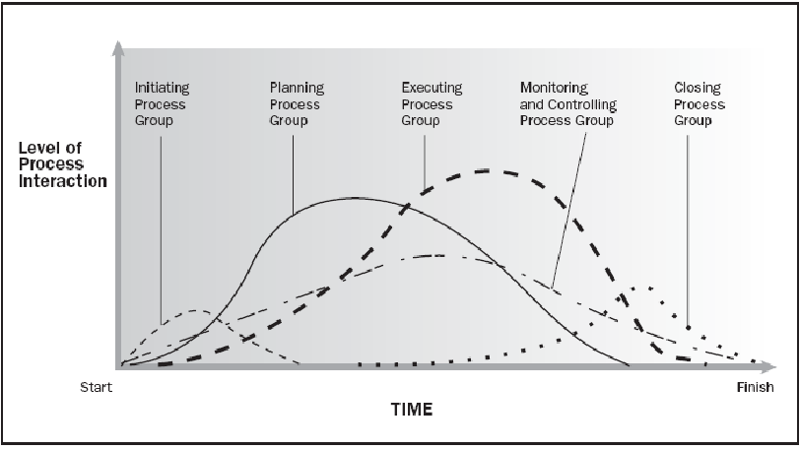
Process Groups & Level of Activities
Source PMBOK Guide Version 5.0

Slide 21
Organization Types & Project Success
Chief Executive
Project
Coordination
Functional Manager
Functional Manager
Functional Manager
Manager of
PM
Staff
Staff
Staff
PM
Staff
Staff
Staff
PM
Project
Coordination
Staff
Staff
Staff
PM
1. Project Manager Authority | 4. Resource Availability
2. Project Budget Control | 5. PM Role
3. PM Admin Staff

Slide 22
Project Boundary
Limits the scope
Helps in change control
Aligned with project objective
Part of Project Scope Statement
Example :
This project will affect Bangalore operations only. All other locations are out of scope.
We will deliver our solution to the Finance and HR departments. All other departments are out of scope.

Slide 23






Project Constraints
Risk
Scope
Project and Product Quality
Schedule
Cost
Resource

Slide 24
Project Success Criteria
Related to Project
Timely Delivery
Features & Functions Delivered
Delivery within agreed budget
Quality
Risk Management
Issues & Escalations
Related to Project’s Product
Business Value Addition
Efficiency/Productivity Improvement Due to Project’s Product

Slide 25
Results of a Project
Project produces output. It can be a product or service or result
If you use the product of a project then outcome is visible. Outcome cannot be measured. It is more subjective.
Benefits can be measured. If it more objective
Example
You implemented ERP through a project (Output)
People use/do not use/ complain / suggest something else than ERP (outcome)
Organization get benefit of ERP implementation cost saving, sales increasing, stress coming down, improved quality with lessor effort, real time data for decision making (benefit)

Slide 26
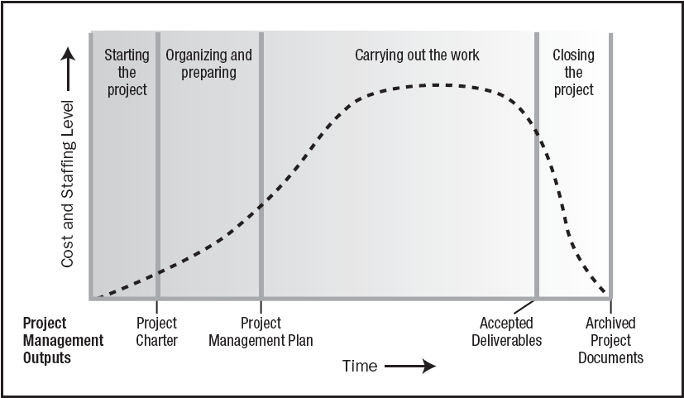
Typical Costing & Staffing across PLC
Source PMBOK Guide Version 5.0

Slide 27
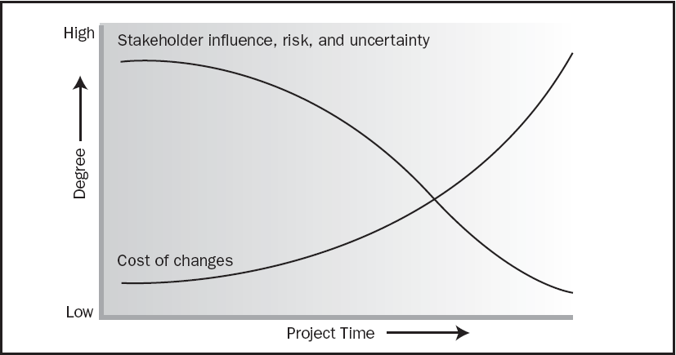
Cost of Change & Degree of Risk
Source PMBOK Guide Version 5.0

Slide 28
Project Initiation & Exercises
Organization Process Assets
Enterprise Environmental Factors
Stakeholders Management
Project Manager: Skills, R&R, Authority
Project Charter

Slide 29
Organization Process Assets
Knowledge base of the organization which helps you doing business in a better way.
Processes, Templates, Guidelines, Standards, Checklists, Forms, Procedures developed at organization level. Compiled by Quality or PMO Department
Lessons learned from previous projects. Documented and shared by earlier project managers.
Previous projects historical data available in archival. It is provided to IT Security department by Project manager at the end of every project.
Notes:
For doing business rely on the organizational learning and therefore build it systematically and regularly.

Slide 30
Enterprise Environmental Factors
Constraints imposed by the enterprise(s) or environment where you are doing the business. Do not underestimate them.
Political environment of vendor, customer, project management company or state
Climatic conditions
Regulatory decisions
Skills available in the market
Attitude of the people towards project, team, organization, management, customer, work etc.
Organizational systems and policies
Organizational culture, management, hierarchies
Terrorism, communal sensitivity

Slide 31
Stakeholder Management

Slide 32
Stakeholders
A stakeholder is an individual, group, or organization
Who may affect, be affected by, or perceive itself to be affected by a decision, activity, or outcome of a project.
Stakeholders may be actively involved in the project
Stakeholders may have interests that may be positively or negatively affected by the performance or completion of the project.
Different stakeholders may have competing expectations that might create conflicts within the project.

Slide 33
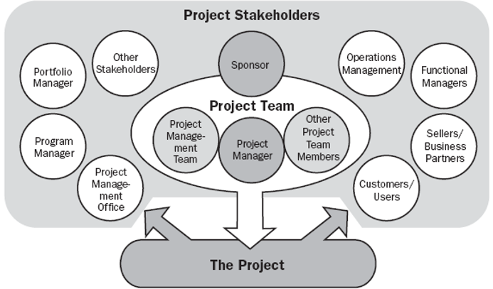
Stakeholders
Product User
Customer
Sponsor
PMO
Regulators
Government
Local Public
Vendors
Local Politicians
Management
Quality Department
Project Team

Slide 34
Stakeholder Register
General
ID
Name
Role/Title
Organization
Department
When (Start, Phase1, Phase2, Phase3, Throughout)
Internal/External
Manager
Contact
Phone
Email-id
City
Management
Expectation
Influence
Interest
Current Position (Champion/Supporter/Neutral/Resist)
Needed Position
Personal Attributes
Engagement Plan

Slide 35
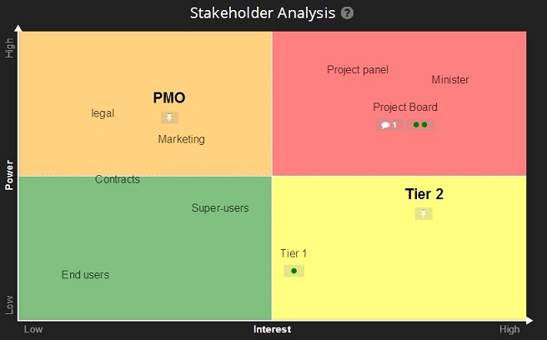
Stakeholder Analysis

Slide 36
Stakeholder Management Plan
Stakeholder Name
Engagement Approach
Responsibility
Accountability
Frequency
When
Efforts Associated

Slide 37
Project Manager: Skills, R&R, Authority

Slide 38
On Any Project : PM Responsibilities
Project Manager’s Role
Accountable
Communication- reviews, steering committee meetings, stakeholder identification and expectation management
Stakeholder Expectation Management
Cost optimization
Resource allocation, resource backup and utilization
Team motivation, team management, training & development, appreciation, career planning, interview
Delegate, Assurance, Ensure through Expert’s Help
Estimates of size, efforts & schedule
Risk identification, analysis, prioritization, monitoring & control
Scope management
Defect free product delivery on time within budget
Deliver as per contract & proposal
Dependency Management
Procure as per contract & proposal
Configuration management, data backup
Quality planning
Presales & proposals
Technical guidance to team – if team members are not available do their work (after project manager has completed his work & he has spare time)

Slide 39
PM Responsibilities
Project Manager’s Responsibilities in Project Lifecycle
Initiating a Project
Project aligned with org objectives & customer needs. Understand Why?
High-level risks, assumptions and constraints are understood
Stakeholders identified and Profiling is done as per their need, power & interest
Project Charter approved
Planning a Project
Project scope, schedule, budget is agreed & approved.
Project team identified with roles and responsibilities agreed
Communication activities agreed
Quality management process established
Risk response plan approved
Integrated change control processes defined & agreed
Procurement plan is place, approved and dependencies identified

Slide 40
Project Manager Responsibilities
Project Manager’s Responsibilities in Project Lifecycle
Executing a Project
Project scope achieved
Project status/progress is tracked and communicated
Project stakeholders expectations managed
Human resource, Machine & Material resources managed
Quality managed against plan
Monitoring & Controlling a Project
Variances identified & RCA is performed
Project change management is performed systematically
Quality is monitored and controlled
Risks are monitored and controlled
Contract administered
Closing a Project
Project outcomes accepted
Project resources released & stakeholders are communicated
Stakeholder perceptions measured and analyzed
Project formally closed
Documents archived, LL documented

Slide 41
Project Manager Skills
Personal Competence
Negotiate
Influence
Manage (Resources, Scope, Time, Cost etc.)
Communicate
Present
Organize
Lead
Conflict Management
Cognitive Ability
Effectiveness
Professionalism

Slide 42
Authority
Manage through servant leadership
Manage through referent power
Implement decision made by stakeholders
Make decisions & take calculated risk

Slide 43
Develop Project Charter
Project Charter should be signed by Project Sponsor and handed over to PM
Use Business Case, SOW, Agreements, Lessons Learned, EEF to make this.
It is first and must have document of any project

Slide 44
Project Charter
Objective
High Level Scope
Project Boundary
High Level Requirements
High Level Deliverables
High Level Milestones
Assumption
Inherent and known risks
High Level Timeline
High Level Budget
Measurable Project Success Criteria
Initial Team
Project Start Date
High Level Approval Requirements
Name and Sign of Project Manager
Name and Sign of Project Sponsor

Slide 45
Day 2

Slide 46
Themes
Day 1 : General Understanding
Day 2 : Project Planning
Day 3 : Project Executions
Day 4 : Project Governance
Day 5 : Closing

Slide 47
Planning
Project Integration Planning
Project Scope Planning
Project Time Planning
Project Cost Planning
Project Quality Planning
Project Communication Planning
Project Human Resource Planning
Project Risk Management
Project Procurement Management

Slide 48
Project Integration Planning
Determine Project Management Methodology
Determine Project Lifecycle
Determine Processes Required to Manage Project
Determine Configuration Management, Tools, Security Permission
Determine Change Management Processes

Slide 49
Tools/Techniques for Project Integration Planning
Expert Judgment
Meetings

Slide 50
Scope Management

Slide 51
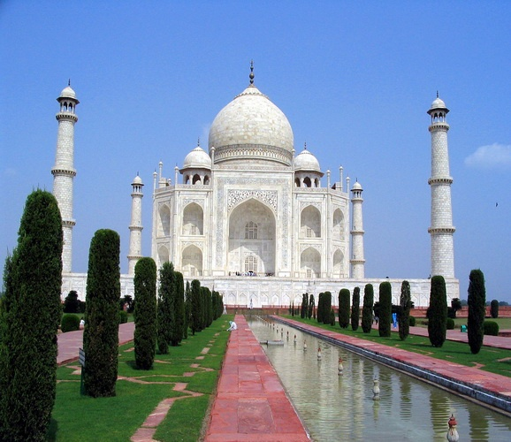

Slide 52
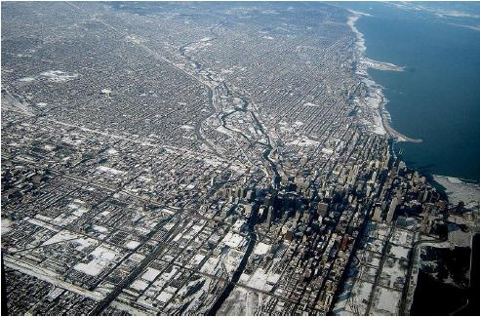

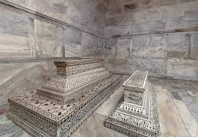


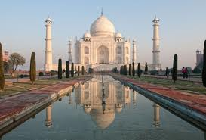
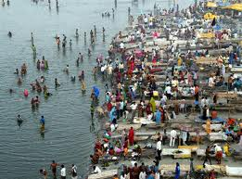
Level of Detailing in Scope

Slide 53
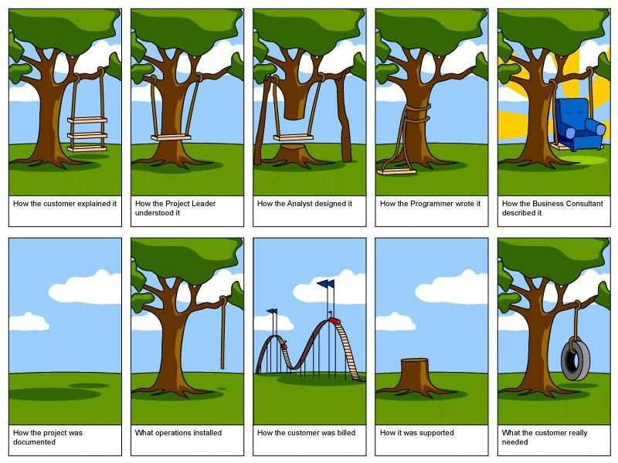
How the customer explained it
How the Project Leader understood it
How the Architect Designed it
How the Programmer wrote it
How the Business Consultant described it
How the project was documented
How operations installed it
What the customer really needed
How the customer was billed
How it was supported

Slide 54
Scope
Project Scope "The work that needs to be accomplished to deliver a product, service, or result with the specified features and functions."
Product Scope "The features and functions that characterize a product, service, or result."

Slide 55
Requirements
Product requirements (features). Product requirements describe the characteristics of the deliverables.
Process requirements (functions). Process requirements describe how people interact with a product and how a product interacts with other products.
Notes:
For example, If you were building a bridge, for instance, most of the requirements would be product based. These might include the number of cars the bridge would hold, the strength of the steel, the water level it needs to span, the color of the bridge, etc.
For example, when you discuss how data gets moved and how business transactions flow from one point to another, you are describing process requirements. If you need to describe the requirements for billing transactions, most of the requirements could end up being process oriented. This would include how billing transactions move from orders to invoicing to accounts receivable. They can describe at what points people look up a status, how people manually update an invoice and what people should do if accounts are out of balance.

Slide 56
Project Scope Management Planning
Establish a process & plan to manage scope (SMP)
Establish a process & plan to manage requirement: collection, elicitation, approval, prioritization (RMP)
Establish a process & plan to trace requirements throughout the project lifecycle (RMP)
Establish a process & plan for requirement acceptance testing (SMP)
Determine scope related metrics to manage the scope (SMP)
Identify the systems, tools which you will use to capture and analyze requirements (SMP)

Slide 57
Tools/Tech for Scope Mgmt. Planning
Expert Judgment
Meetings

Slide 58
Scope Management
Collect Requirements as per SMP & RMP
Analyse Requirements & Develop solution with various possible alternatives
Prepare a detail list of deliverables & related risk
Develop a WBS, WBS Dictionary
Establish control account
Document exclusions
Baseline Scope

Slide 59
Tools/Techniques for Collecting Requirements
Interviews
Focus Groups
Facilitated Workshops
Group Creativity Technique
Group Decision Making Techniques
Questionnaires and Surveys
Observations
Prototypes
Benchmarking
Context diagrams
Document Analysis

Slide 60
Tools/Techniques for Define/Baseline Scope
Expert Judgment
Product Analysis
System Analysis
Decomposition
Alternative Generation

Slide 61
Project Time Management

Slide 62
Project Time Management Planning
Establish a process and plan to manage time of project activities (ScMP)
Tools for Schedule Planning and Reporting
Schedule Thresholds
Metrics
Responsibility, frequency, time of schedule data analysis
Determine which attributes of the activities need to captured to manage them

Slide 63
Project Scheduling
Define activities as per ScMP (DA)
Sequence activities as Activity Attributes (SA)
Estimate Activity Resources (EAR)
Estimate Activity Duration (EAD)
Develop Schedule (DSc)
Baseline Schedule

Slide 64
Define Activities
Use Scope baseline for this
Prepare a list of activities, milestones, activity attributes
Activity Attribute Example :
Name, Location, Department, Dependency, Type, Constraints, Tracking Method, WBS Code, Cost, Duration, Resource Requirement, % Complete

Slide 65
Sequence Activities
Use lead and lag time properly
Understand dependency type apply them properly
FS, SS, FF, SF
Use deadlines and time constraints of activities properly
Understand dependency is Hard Logic or Soft Logic

Slide 66
Estimate Activity Resources
Estimate skills required to perform activities
Estimate number and type of equipments, support services, material required to perform activities
Whether these resources are available within the organization or need to purchased/hired from outside
If they are available within organization can they be available for your project when and where you need them
Develop a Resource Breakdown Structure and Resource Requirements

Slide 67
Estimate Activity Duration
Consider risk around activities
Establish your project calendar (work timings, days in a week, off days of week, holidays, working hours everyday)
Consider availability of resources. Sometimes they are available but not 100%.
Consider productivity of resources. It is never 100%.
Know you are estimating ideal duration, not the actual duration, not the effort
Understand that every activity’s duration cannot be crashed by adding resources.
Methods of duration estimation: PERT, Analogous, Published Data, Parametric
PERT method help you in knowing confidence of your schedule
Finally 24 hours work duration is not 3 days, even if your office works 8 hours a day.

Slide 68
Develop Schedule
Analyse Dependencies
Analyse Lead/Lag
Analyse Constraints
Identify Critical Path
Identify Critical Activities
Identify Float of Activities
Understand where applying more resources will help you reducing project duration
Determine how you want to manage buffers
Discuss, negotiate, agree before you baseline schedule

Slide 69
Critical Path
ES EF
ES EF
ES EF
ES EF
ES EF
ES EF
7
6
3
A
C
G
LS LF
LS LF
ES EF
LS LF
2
Start
Finish
H
ES EF
ES EF
ES EF
LS LF
3
3
3
B
D
E
LS LF
LS LF
LS LF
ES EF
2
F
LS LF

Slide 70
Critical Path – Longest Path, Zero Float
ES EF
ES EF
ES EF
0
7
7
7
6
13
13
3
16
A
C
G
0
0
7
7
0
13
13
0
16
LS LF
LS LF
ES EF
LS LF
16
2
18
Start
Finish
H
16
0
18
ES EF
ES EF
ES EF
LS LF
0
3
3
3
3
6
6
3
9
B
D
E
7
7
10
10
7
13
13
7
16
LS LF
LS LF
LS LF
ES EF
3
2
5
F
11
8
13
LS LF

Slide 71
Facts/Tips for Critical Path
Total Float is the amount of time the task can delayed without delaying the project finish date.
Free float is the amount of time a task can slip without delaying the early start of any task that immediately follows it
It is possible that a zero float activity may not be on critical path
Longest path & shortest time possible to complete the project
A project can multiple critical paths
Difference between late and early is float
Positive float (the activity can wait to start even after previous activity finishes)
Negative float (the activity must start before previous finishes)
Zero float (the activity must immediately start after the finish of previous one)
Crashing activities to short the overall duration of project
Fast-tracking activities to short the overall duration of project
Be cautious that non-critical activity is not being delayed than the allowed free float
Take care of sub-critical path or non-critical path
Manage critical path resources very closely
Do not overload critical path activity resources
Avoid multitasking for resources working on critical path activities

Slide 72
Project Cost Management

Slide 73
Project Cost Management- A Thought
If you don't plan, it doesn't work. If you do plan, it doesn't work either. Why plan!
The same work under the same conditions will be estimated differently by ten different estimators or by one estimator at ten different times. So why to estimate!
Any project can be estimated accurately (once it's completed).
Nothing is impossible for the person who doesn't have to do it.
Right answers to wrong questions are just as wrong as wrong answers to right questions.

Slide 74
Project Cost Management Planning
Establish a process and plan to manage cost of project activities (CMP)
Consider the cost of procurements, risk management activities
Setup cost reporting systems and train project team
Understand different types of cost and their accrual methods

Slide 75
Cost Management Plan
It includes
Cost management tools to be used
Level of accuracy (acceptable range +/- 5%)
Level of precision (US$ 100.01)
Units of measure for each resource
Organizational procedure links
Process of updating the progress in schedule model
Control thresholds (an allowed variation before some action need to be taken)
Rules of performance measurement (baselines, %complete, fixed formula etc.)
Project cost recording process
Currency exchange rate fluctuation adjustment process
Define scheduling reporting format

Slide 76
Tools/Tech. for Cost Management Planning
Expert Judgment
Analytical Tools
Meetings

Slide 77
Cost Planning
Estimate Cost of Each Activities (EC)
Document assumptions of estimation
Consider risks while estimating cost
Develop project funding requirements (DB)
Consider cash flow and payout while developing funding requirements
Baseline Project Cost

Slide 78
Tools for Cost Planning
Analogous Estimating
Parametric Estimating
Bottom-up estimating
Three-point estimates
Reserve Analysis
Cost of Quality
Project Management Software
Vendor Bid Analysis
Group Decision Making Techniques
Funding Requirement Reconciliation
Cost Aggregation
Reserve Analysis
Historical Relationships

Slide 79
Project Cost Estimation Ranges
Cost estimation may include only indirect Cost along with direct Costs
Class Name | % | Range
Definitive | - 5 -> +5% | 10%
Capital Cost | -15 -> +10% | 25%
Appropriation | -25 -> +15% | 40%
Budget Estimates | -10 -> +25% | 35%
Feasibility | -35 -> +25% | 60%
Order of Magnitude | -50 -> +50% | 100%

Slide 80
Project Quality Management

Slide 81
Quality Definitions from Quality Gurus
“Quality is Predictability”- Deming
“Conformance to requirements” - Crosby
“Fitness for use” - Juran
“Customer’s opinion”- Feigenbaum
Conformance to “Valid Requirements“.
“Customers' perception of the value of the suppliers” work output.
A perceived degree of excellence with a minimum, usually set forth by the customer.
Best value for money.

Slide 82
Project Quality Planning
Understand Quality Expectations of the Stakeholders
Develop Quality Checklist
Understand Cost of Quality
Identify Quality Metrics to measure, improve project/product quality
Develop Quality Assurance Plan & Process
Develop Quality Management Plan & Process (QMP)

Slide 83
Tools/Tech for Quality Management
Cost-benefit analysis
Cost of Quality
Seven basic quality tools
Benchmarking
Design of experiments
Statistical sampling
Additional quality planning tools
Meetings

Slide 84
Seven basic quality tools
Control Chart
Fishbone Diagram
Pareto Chart
Scattered Diagram
Histogram
Flowchart
Check sheet

Slide 85
Cost of Quality
Cost of Conformance | Cost of Non-conformance
Prevention Costs (Build a quality product) Training Document processes Equipment Time to do it right Appraisal Costs (Assess the quality) Testing Destructive testing loss Inspections | Internal Failure Costs (Failures found by the project) Rework Scrap External Failure Costs (Failures found by the customer) Liabilities Warranty work Lost business

Slide 86
Project Human Resource Planning
Establish Project Calendar
Create Role & Responsibilities based on skills required to perform project activities
Develop RACI Chart
Establish/Refine Job Description
Establish Project Organization
Establish Performance Appraisal Systems
Establish Conflict Management System
Establish Staffing Management Plan
Establish Team Building Plan
Identify type of trainings required to ensure people understand processes, they understand temperaments and work style of fellow team members, expectations from them. Establish Training Need and Training Plan
Establish Hiring Systems
Approve human resource management plan (HMP)

Slide 87
Project Communication Management
Understand communication need of different stakeholders
Group stakeholders based on their communication need
Understand number of communication channels involved
Identify possible communication technologies and their benefits and cost of setup and operation
Define Roles & Responsibilities for managing communication
Make decision about communication technologies to be used
Establish how will you ensure effectiveness of communication
Establish communication metrics
Put all above information in Communication Management Plan (CoMP)

Slide 88
Tools/Tech for Communication Planning
Communication Requirement Analysis
Communication Technology
Communication Models
Communication Methods
Meetings

Slide 89
Project Risk Management

Slide 90
Risk Management Planning
Identify who is responsible for risk management
Establish tools/template to capture risk
R&R for Risk Assessment, Audit
Risk appetite of stakeholders
Develop impact table
Develop probability and impact table
Methods of risk categorization
Put all above information in Risk Management plan (RMP)

Slide 91
Tool/Tech for Risk Management Planning
Expert Judgment
Analytical techniques
Meetings

Slide 92
Risk Management
Identify Risks
Assess Probability of Risks Identified
Assess Impact of Risks Identified
Assess Urgency of Risks Identified
Establish which risk must have response plan
Assign Risk Owner
Establish Risk Response Plan for High Exposure Risk
Assign Risk Actionee
Categorize Risks
Establish contingency funds

Slide 93
Funding for Risk Management
Contingency Reserves
Management Reserves

Slide 94
Tools/Tech for Risk Management
Expert Judgment
Documentation Reviews
Information Gathering Techniques
Checklist Analysis
Assumptions Analysis
Diagramming Techniques
SWOT Analysis
Risk Probability and Impact Assessment
Probability and Impact Matrix
Risk Data Quality Assessment
Risk Categorization
Risk Urgency Assessment
Data Gathering and Representation Techniques
Quantitative Risk Analysis and Modelling Techniques
Strategies for Negative Risk or Threats
Strategies for Positive Risks or Opportunities
Contingent Response Strategies

Slide 95
Project Procurement Management Planning
Identify what resources/work needed for project cannot be produced by the project team (what you need)
Establish procurement statement of work
Identify when you need and who are potential supplier
Establish cost of each procurement need
Identify different contract type
Establish contract change control systems
Establish procurement evaluation systems

Slide 97
Day 3

Slide 98
Themes
Day 1 : General Understanding
Day 2 : Project Planning
Day 3 : Project Execution
Day 4 : Project Governance
Day 5 : Closing

Slide 99
Project Execution
Direct and Manage Project Work (DMPW)
Perform Quality Assurance (PQA)
Acquire Project Team (APT)
Develop Project Team (DPT)
Manage Project Team (MPT)
Manage Communications (MC)
Conduct Procurement (CoP)
Manage Stakeholder Engagement (MSE)

Slide 100
Direct and Manage Project Work
Execute Project as per the Baselined Project Management Plan
Produce only those deliverables which are valued by customer
For any deviation use only “Approved” Change Requests
If work is not possible as per the baselined plan then team should make Project Manager aware about it. This is change request.
As a practice project manager should not make decision about deviation from baselined plan immediately.
Change request should be evaluated based on the urgency and then decision is either made by project change control board or Project Manager depending on impact and urgency.
Project work progress data, any issue, impediments should be captured on daily basis. Automate this step as much possible so that your get correct data
Coordinate project related dependencies between departments, agencies, consultants, experts, management and other stakeholders on daily basis.

Slide 101
Tools/Technique for Direct & Manage Project Work
Meetings
Project Management Information Systems
Expert Judgment

Slide 102
Perform Quality Assurance
A mechanism to determine that everybody including the project manager is following processes
Deviation from the plan is acceptable but deviation from the process is compliance issue and taken very seriously by management, regulators, customer etc.
Project manager should perform quality assurance for his team
External to project (Auditor) who has knowledge about audit process and project processes should perform regular audit. Project Manager should plan for this in his plan. A surprise audit asked by management, regulator or customer is also possible.
Auditors should identify area of improvement, provide recommendation, appreciate best practices, take best practices at organization level. (Change Request)
Auditors should make stakeholders aware about non-compliance
An auditor must use project’s project plan, project reports, quality report to perform the audit

Slide 103
Tools/Techniques for Perform Quality Assurance
Process Analysis
Process Audits
Inspection
Cost Benefit Analysis
Cost of Quality (COQ)
Seven Basic Quality Tools
Benchmarking
Design of Experiments
Statistical Sampling
Flow charting
Additional Quality Planning Tools
Approved Change Requests Review
Meetings

Slide 104
Acquire Project Team
Hire right people on right time and assign them the work as per their capability
Negotiate role, responsibilities, work time, position, compensation, reporting relationship, joining time, location of work and agree before you confirm any person in the project team
Interview every person you are taking on the project based on the level of expertise and skills expected for the project work

Slide 105
Tools/Techniques for Acquire Project Team
Pre-assignment
Negotiation
Acquisition
Virtual Teams
Multi-criteria decision analysis

Slide 106
Develop Project Team
In a project chemistry is more important than physics
Project is delivered by team not by individuals
Conduct trainings
Conduct team building activities
Define ground rules as a team
Develop binding between virtual teams
Evaluate continually that how team is maturing

Slide 107
Tools/Techniques for Develop Project Team
Interpersonal Skills
Training
Team-building activities
Ground Rules
Co-location
Recognition and Rewards
Personnel Assessment Tools

Slide 108
Manage Project Team
Do not monitor and control people. Be objective and manage your team using project objectives.
Appraise and provide feedback on regular basis
Identify improvement need of individuals and team (Change Request)
Maintain issue log of team conflicts and keep resolving it based of priority
Assign only those people for conflict management who have competency

Slide 109
Tools/Techniques for Manage Project Team
Observation & Conversation
Project Performance Appraisals
Conflict Management
Interpersonal Skills

Slide 110
Five Stages of Team development
Forming
Storming
Norming
Performing
Adjourning

Slide 111
Type of Powers
Formal
Expert
Reward
Penalty
Referent

Slide 112
Conflict Management

Slide 113
Sources of conflict
Schedules
Project Priorities
Technical Issues
Personality Conflict
Cost
Scarce resources
Personal work styles
Administrative Procedures

Slide 114
Characteristics of conflict
Conflict is team issue
Conflict is natural and forces a search for alternatives
Openness resolves conflict
Conflict resolution should focus on issues, not personalities
Conflict resolution should focus on the present not on the past

Slide 115
Conflict Resolutions
HIGH
SMOOTHING
(ACCOMMODATING)
PROBLEM-SOLVING
(COLLABORATING)
RELATIONSHIP
ORIENTATION
COMPROMISE
WITHDRAWAL
(AVOIDING)
FORCING
(COMPETING)
LOW
LOW OBJECTIVE ORIENTATION HIGH

Slide 116
Motivational Theories

Slide 117
Motivational Theories
Frederick Herzberg - Hygiene & Motivation Factors
Abraham Maslow - Hierarchy of Needs
Victor Vroom - Expectancy Theorem of Motivation
Oldham and Hackman - Job characteristics model
McGregor - Theory X & Y

Slide 118
Frederick Herzberg - Hygiene & Motivation Factors
Hygiene Factors | Motivating Factors
Supervision Company policy and administrator Positive working Condition Interpersonal relations Job Security Status Compensation Personal life | Achievements Recognitions Work Itself Responsibility Advancement Possibility for growth
Present does not guarantee high productivity. Absence guarantee low productivity | Motivation will not work without Hygiene.

Slide 119
Abraham Maslow - Hierarchy of Needs
Self Actualization
Self fulfillment, growth, learning
Accomplishment, Respect, Attention, Appreciation
Esteem
Love, affection, approval, friends, association
Social
Security, stability, freedom from threat and physical harm
Safety
Physiological
Air, water, food, house, clothing

Slide 120
Victor Vroom - Expectancy Theorem of Motivation
The extent to which an individual is motivated…
Is the work important?
The level of expectation of their efforts will result in a desired outcome?
Will I be rewarded?
The expectation that good work will be rewarded
What is the value of the reward?
Attractiveness of the reward
Motivation will be high when all three factors are high

Slide 121
Oldham and Hackman - Job characteristics model
Skill Variety – the number of job skills that the job holder has the opportunity to exercise
Task Identity – the degree to which your work and its result are identifiable as belonging to you
Task Significance – the degree to which your job has an influence on others
Autonomy – the discretion you have about the way that you do the job
Feedback – the information that you get back about the result of your work

Slide 122
McGregor - Theory X & Y
Theory X | Theory Y
The average worker is inherently lazy and dislikes work so avoid whenever possible. Therefore needs supervisions To induce adequate effort, the supervisor must threaten punishment The average worker avoids increased responsibility and seeks to be directed | The average worker wants to be active and finds the satisfaction in his work. So they work better without continuous supervision Greatest results come from willing participation and this leads to self-directed towards goals without coercion and control The average worker seeks opportunity for personal improvement and self respect
Theory X relies on strict rules, performance incentives, rewards, threats to job security | Theory Y relies on worker participation in decision making, cordial manager-worker relationships, worker designed job methodology, worker individualism

Slide 123
Key to Successful Team Management
Listens to subordinates to diagnose or solve problems
Sets goals and develops short- and long- range action plans
Gives directions about who is to do which tasks to what standards
Provides feedback on task performance
Rewards
Develops subordinates
Understanding that team is an Integral Unit of Organization
A team mission, objective, goals, strategy and role definition
A leader and an organizational support system
Managers responsive to needs of team members
Encourage participation and effective communication
Foster an atmosphere of trust among team members
Provide feedback effectively
A collective culture and style
Motivate team members with challenges & rewards

Slide 124
Manage Communication
Send out all communication as per the plan
Identify any ad-hoc communication need and send out those communications
Minimize ad-hoc communications
Ensure the communications send out is available for future references
Ensure the communication is available only those who are authorize to use it.

Slide 125
Tools/Techniques for Manage Communications
Communication Techniques
Communication Models
Communication Methods
Information Management Systems
Performance Reporting

Slide 126
Conduct Procurement
Evaluate proposals received from suppliers
Ensure that they understand what you expect and when
Perform SWOT analysis for identified supplier
Understanding various contracting type and award contract

Slide 127
Tools/Techniques – Conduct Procurement
Expert Judgment
Bidder conferences
Proposal evaluation techniques
Independent estimates
Advertising
Analytical techniques
Procurement Negotiation

Slide 128
Manage Stakeholders Engagements
Engage relevant stakeholders are proper level as per the plan
Understand the issue which they are raising (Change Request)
Analyze these issue and address them appropriately or set the right expectations
While addressing issue keep change log with you.

Slide 129
Tools/Techniques – Manage Stakeholders Engagements
Communication Methods
Interpersonal Skills
Management Skills

Slide 130
Interpersonal Skills
Leadership
Team Building
Motivation
Communication
Influencing
Decision Making
Political & Cultural Awareness
Negotiation

Slide 131
Management Skills
Presentation Skills
Negotiating Skills
Writing Skills
Public Speaking Skills

Slide 133
Day 4

Slide 134
Themes
Day 1 : General Understanding
Day 2 : Project Planning
Day 3 : Project Execution
Day 4 : Project Governance
Day 5 : Closing

Slide 135
Project Governance
Monitor & Control Project Work (MCPW)
Perform Integrated Change Control (PICC)
Validate Scope (VC)
Control Scope (CS)
Control Schedule (CSc)
Control Cost (CC)
Control Quality (CQ)
Control Communications (CCom)
Control Risks (CR)
Control Procurements (CnP)
Control Stakeholders Engagements (CSE)

Slide 136

11. Validate Scope
Formalizing acceptance of the completed project deliverables.

Slide 137
Validate Scope
Project Scope Management
Project Monitoring & Controlling
Project Management Plan
Requirements Documentation
Requirement Traceability Matrix
Verified deliverables
Work Performance Data
Inspection
Group Decision Making Techniques
Accepted Deliverables
Change Requests
Work Performance Information
Project Documents Updates

Slide 138
Discussion/Exercise 10
5 Minutes
Write verify scope activities for your project; also write the name of deliverables verified.

Slide 139
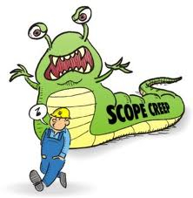
12. Control Scope
Monitoring the status of the project and product scope and managing changes to the scope baseline.

Slide 140
Control Scope
Project Scope Management
Project Monitoring & Controlling
Project Management Plan
Requirements Documentation
Requirement Traceability Matrix
Work Performance Data
Organization Process Assets
Variance Analysis
Work Performance Information
Change Requests
Project Management Plan Updates
Project Documents Updates
Organization Process Assets Updates

Slide 141
Discussion/Exercise-11
5 Minutes
Write work performance measurement metrics and their values for your project

Slide 142
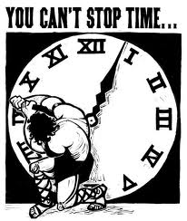
19. Control Schedule
Monitoring the status of the project to update project progress and manage changes to the schedule baseline

Slide 143
Control Schedule
Project Time Management
Project Monitoring and Controlling
Project Management Plan
Project Schedule
Work Performance Data
Project Calendars
Schedule Data
Organization Process Assets
Performance Reviews
Project Management Software
Resource Optimization Techniques
Modeling Techniques
Leads and Lags
Schedule Compression
Scheduling Tool
Work Performance Information
Schedule Forecasts
Change Requests
Project Management Plan Updates
Project Documents Updates
Organization Process Assets Updates

Slide 144
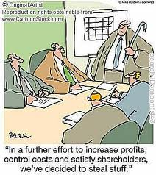
23. Control Costs
Monitoring the status of the project to update the project budget and managing changes to the cost baseline

Slide 145
Control Cost
Project Cost Management
Project Monitoring & Controlling
Project Management Plan
Project Funding requirements
Work Performance Data
Organization Process Assets
EVM
Forecasting
TCPI
Performance Reviews
Project Management Software
Reserve Analysis
Work Performance Information
Cost Forecasts
Change Requests
Project Management Plan Updates
Project Documents Updates
Organization Process Assets Updates

Slide 146
Earn Value Management

Slide 147
Earned Value Management – Basic Concepts
Planned Value (PV)- BCWS
Authorized budget assigned to the work to be accomplishes for an activity or work
breakdown structure component.
Earned Value (EV)- BCWP
Value of work performed expressed in terms of the approved budget assigned to
that work for an activity or work breakdown structure component.
Actual Cost (AC)- ACWP
Total cost actually incurred and recorded in accomplishing work performed for an
activity or work breakdown structure component.

Slide 148
Earn Value Rules
0% - 100%
50% - 50%
20% - 80%
25% - 75%

Slide 149
Earned Value Management – S Curve
PV
AC
Cost
CV
SV
Progress Review
ΔT
EV
Time

Slide 150
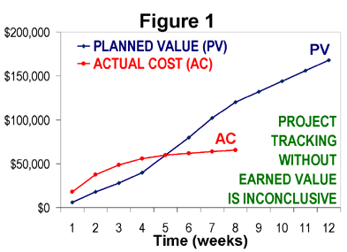
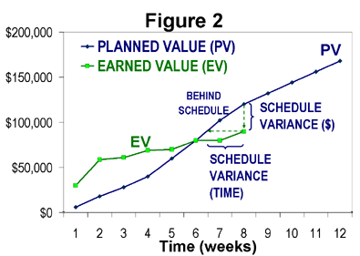
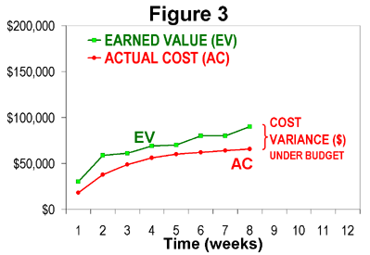
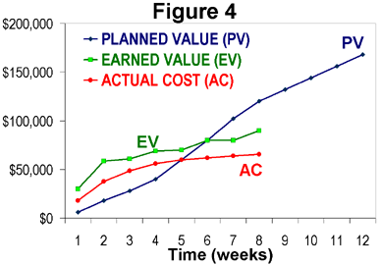
How project is progressing?

Slide 151
EVM-Variances
CV (Cost Variance) = EV- AC
CV = 0 => the Project is proceeding as per plan on cost
CV < 0 => the Project is over budget
CV > 0 => the Project is under budget
SV (Schedule Variance) = EV- PV
SV = 0 => the project is on plan, time-wise
SV < 0 => the project is BEHIND schedule
SV > 0 => the project is AHEAD of schedule

Slide 152
EVM- Indexes
CPI (Cost Performance Index) tells you how much worth of job you are getting for every $ being spent.
CPI = EV/AC
CPI = 1 => the project is on plan, cost wise
CPI < 1 => the project is over budget or under performing
CPI > 1 => the project is under budget or over performing
SPI tells the PM how much worth of job has been completed against planned work
SPI = EV / PV
SPI = 1 => the project is on schedule
SPI < 1 => the project is BEHIND schedule
SPI > 1 => the project is AHEAD of schedule

Slide 153
EVM- Critical Ratio
CR tells the PM the overall shape of your project
CR= CPI x SPI
CR = 1 => the project is on schedule & within budget
CR < 1 => the project is BEHIND schedule or budget or both
CR > 1 => the project is AHEAD of schedule or budget or both

Slide 154
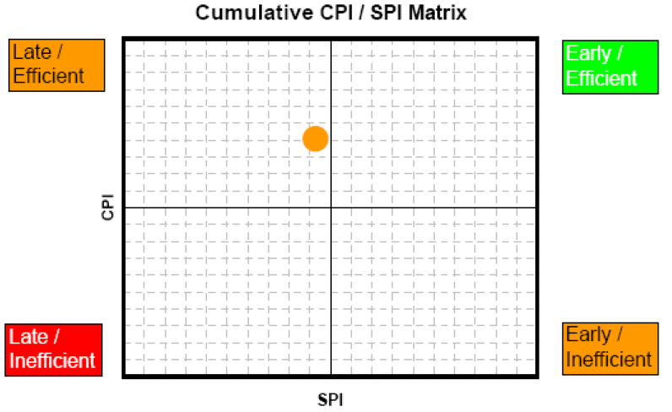
CPI & SPI Summary

Slide 155
Forecasting- ETC
Recalculate it, if original estimate are no longer valid now.
Calculate it manually based on the progress, if original estimates are still valid
ETC = BAC - EV

Slide 156
Forecasting- EAC
Estimate at Completion(EAC)
EAC (atypical) = AC + ETC (Re-estimated)
EAC (atypical) = AC + BAC – EV (Estimated based on Progress)
EAC (typical considering CPI & SPI) = AC + ETC/ (CPI x SPI)
EAC (typical)= AC + ETC / CPI = BAC/CPI
If you feel that you will be able to complete the project on time in spite of current delay then you can consider SPI as 1. In that case CR= SPI

Slide 157
Forecasting- Variance at Completion
Variance at Completion (VAC)
VAC = BAC – EAC
Variance at Completion (%)
PVAC= (BAC-EAC)/BAC

Slide 158
Forecasting: TCPI
TCPI (To complete Performance Index) can be calculated using BAC or EAC
TCPI using BAC = (BAC-EV) / (BAC-AC)
TCPI using EAC = (BAC-EV) / (EAC-AC)

Slide 159
23. Perform Quality Control
Monitoring and recording results of executing the quality activities to assess performance and recommend necessary changes.

Slide 160
Quality Control
Project Quality Management
Project Monitoring & Controlling
Project Management Plan
Quality Metrics
Quality Checklist
Work Performance Data
Approved Change Requests
Deliverables
Project documents
Organization Process Assets
Seven basic quality tools
Statistical sampling
Inspection
Approved Change Request Review
Quality Control Measurements
Validated Changes
Verified deliverables
Work Performance Information
Change Requests
Project Management Plan Updates
Project Documents Updates
Organization Process Assets Updates

Slide 161
33. Control Communications
Monitoring and controlling communication throughout project life cycle to ensure the information needs of the project stakeholders are met

Slide 162
Control Communications
Project Communication Management
Project Monitoring & Controlling
Project Management Plan
Project Communications
Issue Log
Work Performance Data
Organization Process Assets
Expert Judgement
Information Management Systems
Meetings
Work Performance Information
Change Requests
Project Management Plan Updates
Project Documents Updates
Organization Process Assets Updates

Slide 163
39. Control Risks
Implementing risk response plans, tracking identified risks, monitoring residual risks, identifying new risks, and evaluating risk process effectiveness throughout the project.

Slide 164
Control Risks
Project Risk Management
Project Monitoring & Controlling
Project Management Plan
Risk Register
Work Performance Data
Work Performance Report
Risk Reassessment
Risk Audits
Variance and trend analysis
Technical performance measurement
Reserve Analysis
Meetings
Work Performance Information
Change Requests
Project Management Plan Updates
Project Documents Updates
Organization Process Assets Updates

Slide 165
42. Control Procurement
Managing procurement relationships, monitoring contract performance and making changes and corrections as needed.

Slide 166
Control Procurement
Project Procurement Management
Project Monitoring & Controlling
Project Management Plan
Procurement Documents
Agreements
Approved Change Requests
Work Performance Reports
Work Performance Data
Contract Change Control System
Procurement Performance Reviews
Inspections and Audits
Performance Reporting
Payment Systems
Claim Administration
Records Management Systems
Work Performance Information
Change Requests
Project Management Plan Updates
Procurement Documents Updates
Organization Process Assets Updates

Slide 167
47. Control Stakeholder Engagements
Monitoring overall project stakeholder relationships and adjusting strategies and plans to engage stakeholders.

Slide 168
Control Stakeholder Engagements
Project Stakeholder Management
Project Monitoring & Controlling
Project Management Plan
Issue Log
Work Performance Data
Project Documents
Expert Judgement
Information Management Systems
Meetings
Work Performance Information
Change Requests
Project Management Plan Updates
Project Documents Updates
Organization Process Assets Updates

Slide 170
Day 5

Slide 171
Themes
Day 1 : General Understanding
Day 2 : Project Planning
Day 3 : Project Execution
Day 4 : Project Governance
Day 5 : Closing

Slide 172
Closing
Close Project or Phase
Close Procurements
Professional Ethics
Microsoft Project 2013

Slide 173
Close Project or Phase
Must be performed at the end of every phase or at project closure
This is the final step and formal step. No work is produced for the customer here, no testing no negotiation.
Prepare a handover report
Handover the final product to customer
Ensure all the agreement clauses are fulfilled. Close the contract.
Lessons learned exercise should be performed with team and lessons learned should be documented
Team should be informed and disbanded
Stakeholders should be communicated
Department should be communicated

Slide 174
Close Procurements
Procurement may be closed
Either all the items has been delivered or
Product/Services not required
Product/Services are not of good quality
Audit all procurements
Settle payments with supplier
Conduct lessons learned exercise for each procurement, document lessons learned and share with organization
Inform to your accounting and legal departments

Slide 175
Professional Ethics

Slide 176
Honesty
Honesty is our duty to understand the truth and act in a Truthful manner both in our communication and in our conduct
We earnestly seek to understand the truth
We are truthful in our communications and conduct and provide in timely manner
We make commitments and promises in good faith ( implied & explicit)
We do not engage on or condone behavior that is designated to deceive others
We do not engage in dishonest behavior with the intention of personal gain or at the expense of other.

Slide 177
Responsibility
Responsibility is our duty to take ownership for the decisions we make or fail to make, the actions we take or fail to take & the consequences that result
Make decisions and take actions based on the BEST interests of society, Public safety and the environment
We accept those assignments that are consistent with our background, experience, skills and qualifications
We inform ourselves and uphold the policies, rules and regulations and laws that govern s our work, professional and volunteer activities
We report unethical or illegal conduct to appropriate management & if necessary to those affected by the conduct
We bring violations of this Code to the attention of the appropriate body for resolution. We only file ethics complaints when they are substantiated by facts.
Notes:
PMP Preparation Processes
www.Compulinkgroup.com
177

Slide 178
Respect
Respect is our duty to show a high regard for ourselves, others and the resources entrusted to us
We inform ourselves about norms and customs of others and avoid engaging in behaviors they might consider disrespectful
We listen to others points of view , seeking to understand them
We approach directly those persons with whom we have conflict
We conduct ourselves in a professional manner
We negotiate in good faith, do not exercise the power of our expertise or position to influence decisions

Slide 179
Fairness
Fairness is our duty to make decisions and act impartially & Objectively. Our conduct must be free from competing self interest , Prejudice and favoritism.
We demonstrate transparency in decision making and constantly re-examine our impartiality .
We provide equal access to information to those authorized & equal opportunities to qualified candidates
We do not discriminate against others based on, but not limited to , Gender, Race, Age, Religion, Disability, Nationality or Sexual orientation.

Slide 180
Fairness
Conflict of Interest:
We proactively and fully disclose any real or potential conflicts of interest to the appropriate stakeholders.
When we realize that we have a real or potential conflict of interest :
We refrain from engaging in the decision making process or otherwise
attempting to influence outcome s, unless or until we have made full
disclosure to the affected stakeholders.
We do not hire or fire, reward or punish, or award or deny contracts based on personal considerations. Including but not limited to Favoritism, Nepotism, or Bribery.

Slide 181
Ethics Quick Test
Texas Instruments “Ethics Quick Test” for making ethical decisions
Is the action legal?
Does it comply with your understanding of company values?
If you do it, will you feel bad?
How will it look in the newspaper?
If you know it is wrong, do not do it.
If you are not sure, ask.
Keep asking until you get an answer.
Notes:
What are some examples of projects?

Slide 182
Project Manager’s Oath of Professional Responsibility

Slide 183
Professional Responsibility
Ensure individual integrity
Adhere to legal requirements and ethical standards
Protect Stakeholders
Share lessons learned and other relevant information
Build capabilities of colleagues
Advance project management professionalism
Improve competencies as project manager
Balance stakeholder interests in project
Respect cultural ethnic and personal differences
Ensure collaborative project management environment
Comply with all organizational rules and policies

Slide 184
Professional Responsibility
Provide accurate and truthful representations in cost estimates
Provide accurate and truthful representations in project reports
Report violations of policies, procedures and code of ethics
Strive for fair resolutions
Satisfy competing needs and objectives
Interact with others in a professional manner
Be responsible for satisfying the complete scope and objectives of customer requirements
Maintain and respect confidential information

Slide 185
Professional Responsibility
Ensure that a conflict of interest does not interfere with professional judgment
Disclose conflict of interest to customer
Disclose circumstances that could be construed as conflicts of interest
Refrain from offering or accepting inappropriate payments, gifts, or other forms of compensation
Adhere to all applicable laws or customs of the country where services are being provided
Respect intellectual property developed or owned by others
Act in a accurate, truthful and competent manner

Slide 187
Microsoft Project 2013

Slide 188

Hari P Thapliyal,
PMP, PMI-ACP, MCITP, Princ2 Practitioner, CSM, MBA, MCA, CIC, PGDFM
PMO Architect & Project Management Evangelist
Profile: http://in.linkedin.com/in/harithapliyal
For content related queries please contact me via
hari.prasad@vedavit-ps.com
This document is proprietary and confidential. It remains the property of Vedavit Project Solutions at all times. No part of this document may be used, reproduced, or transmitted in any form or by any means electronic, including photocopying and recording, for any purpose without express consent of Vedavit Project Solutions.

