Slide 1
Project Management Training
Tagros Chemicals
Hari Prasad Thapliyal
PMP, PMI-ACP, CSM, MBA, MCA, PGDOM, PGDFM, CIC, PRINCE2-Practitioner
PMO Architect & Project Management Evangelist
Vedavit Project Solutions
Cell: +91-95-3599-9336
Email: hari.Prasad@vedavit-ps.com
Website: www.pmlogy.com
'PMI-ACP', 'PMI', PMP, and 'ACP' are a registered marks of the Project Management Institute, Inc.

Slide 2
Introduction
Name
Role
Challenges
Expectations

Slide 3
Challenges in Projects within Tagros
Manual Reporting (20% of PM time goes in reporting to management and management is not satisfied with reports)
Critical path is not documented & managed
Resources assignment for project activities is not documented & communicated
Lessons learned & Estimation are not consolidated and used.
Real time project progress is not known
Earned value of the work at any point of time is not known
KPI to compare various project’s performance is not established
Resource planning/loading/levelling is not proper
Risk Management Framework is not in place
Historical data is not used in Estimation of resources/durations/costs
Work-flow of designing and planning processes is required
Quality management metrics are not in place
Quality Policy is not driving daily decision making of any project
This is based on inputs from senior people involved in initial discussions

Slide 4
Project Management is Waste of Time
If you think that
10. Our customers love us unconditionally, so they don't care if our products are late and don't work.
09. Organizing to manage projects isn't compatible with our culture. The last thing we need around this place is change.
08. All our projects are easy, and they don't have cost, schedule, and technical risks anyway.
07. We thing that it's more profitable to have 50% overruns than to spend 10% on project management to fix them.
06. We might have to understand our customers' requirements and document a lot of stuff, and that is such a bother.
05. Project management requires integrity and courage, I think they need to pay me extra for that.
04. Our bosses won't provide the support needed for project management; they want us to get better results through magic.
03. We'd have to apply project management blindly to all projects regardless of size and complexity. This is stupid thing.
02. I know there is a well-developed project management body of knowledge, but I can't find it under this mess on my desk.
01. We aren't smart enough to implement project management without oppressing creativity and offending our technical geniuses.

Slide 5
Themes
Day 1 : General Understanding
Day 2 : Project Planning
Day 3 : Project Execution
Day 4 : Governance
Day 5 : Closing

Slide 6
General Understanding
Some Important Definitions Related to Project Management
Process Groups & Level of Activities
Organization Types & Project Success
Project Success Criteria
Typical Costing and Staffing Across PLC
Cost of Change & Degree of Risk
Project Initiation & Exercises of the day

Slide 7
Some Important Definitions
Project, Program, Portfolio and Interdependencies
Project Left Cycle: Phases, Milestones, Deliverables
Project Boundary
Project Constraints
Project Management Office
Project Management Methodologies

Slide 8
Projects & Operations
 | Project | Operations
Duration | Has start and end date | Has only start date
Output | Unique Product/Service/Result or some Uniqueness | Standard
Team | Heterogeneous | Homogeneous
Requirements | Progressive Elaboration | Known in Advance
Resources | Hired Temporarily and Released. All based on the Need | Permanent
Risk | Relatively High | Relatively Less
Dependencies | Critical Path | Managed Differently
Change | Catalyst of Change | Maintain Status Quo
Charter | Permanent | Semi-Permanent

Slide 9
Project Management
The application of knowledge, skills, tools and techniques to perform project activities in order to meet the project objectives

Slide 10
Program Management
Managing multiple related projects which cannot give you the benefits if you manage these project individually
Benefit driven not the delivery driven
Has longer life than projects and interacts with operations on periodic basis to know whether existing project within the program will help in getting program benefits or not.
Notes:
You want to reduce your weight by 10%. (Program)
Projects
- Start one our gym/running every day.
- Change eating habits (content, quality, quantity, timing)
- Reading habits
- Work habits
- Start doing some pranayams
- Sleep on time
- No TV, no Talk while eating
- Eat only when sitting
If any of these project is not helping you in reducing 10% weight then you can drop the project.
Only dropping weight is not mandate. You need to ensure it is sustained. So do not build those habits or do those things which you cannot sustain
All these projects can run independently
Over all objective is to reduce the weight which is longer than any particular project

Slide 11
Strategic Drivers
Example
In next 5 year be number one global supplier of ABC product
In next 5 year be largest manufacturer of XYZ in the World.

Slide 12
Business Drivers are..
That reflect the performance and progress of your business.
Are measurable.
Can be compared to a standard, such as a budget or last year’s figures, or an industry average.
Can be acted upon
PMCA

Slide 13
Business Drivers
Which drives the business. Example:
Sales
Cost
Cash Flow
Margins

Slide 14
Portfolio Management
Collection of projects or programs and other work
To facilitate effective strategic business objective (mission and vision) of an organization
Makes financial decisions about projects & programs
Project/Program prioritization & selection
Provides business justification of the project/program to the BOD

Slide 15
Project Left Cycle
Phases
Milestones
Deliverables
Activities

Slide 16
Project Phases
Project Phases
Projects are divided into phases where extra control is required to effectively manage the completion of the major deliverables
Collectively, the project phases put together is known as Project life cycle
Each phase is marked by one or more tangible verification work product
The conclusion of a project phase is generally marked by a review
The phase end points are referred to as phase exits, milestones, phase gates, decision gates, stage gates or kill points
Starting a phase before approval of deliverables of a previous phase is called Fast Tracking

Slide 17
Deliverables
A deliverable of a project is a tangible, measurable and auditable output which is expected to be gained or produced upon successful accomplishment of the whole project or its certain part.
Example:
Well-trained employees
Improved skills
Increased performance
Copies of the system are installed on all employee computers within the department
All staff members know how to operate and use the new system.

Slide 18
Project Management Methodologies
Waterfall
Agile
Scrum
RAD
PRINC2
Kanban
Six Sigma
DMAIC

Slide 19
Project Management Office
Project Management Office
Managing shared resources across all project administered by PMO
Identifying and developing project management methodology, best practices and standards
Coaching, mentoring, training and oversight
Monitoring compliance with project management standards, policies, procedures and templates via project audits
Developing and managing project policies, procedures, templates and other shared documentation (organizational process assets), and
Coordinating communication across projects

Slide 20
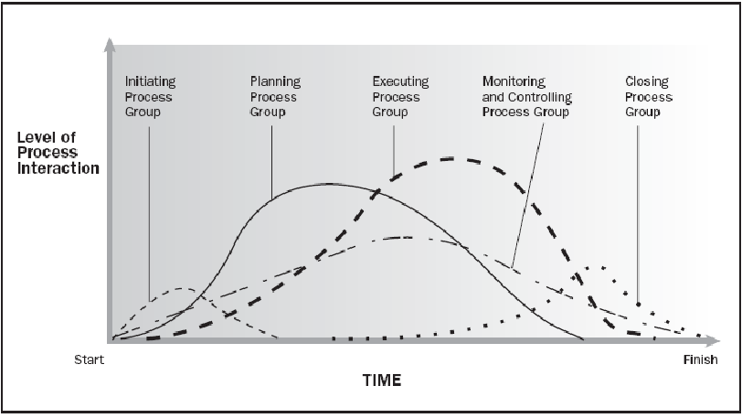
Process Groups & Level of Activities
Source PMBOK Guide Version 5.0

Slide 21
Organization Types & Project Success
Chief Executive
Project
Coordination
Functional Manager
Functional Manager
Functional Manager
Manager of
PM
Staff
Staff
Staff
PM
Staff
Staff
Staff
PM
Project
Coordination
Staff
Staff
Staff
PM
1. Project Manager Authority | 4. Resource Availability
2. Project Budget Control | 5. PM Role
3. PM Admin Staff

Slide 22
Project Boundary
Limits the scope
Helps in change control
Aligned with project objective
Part of Project Scope Statement
Example :
This project will affect Bangalore operations only. All other locations are out of scope.
We will deliver our solution to the Finance and HR departments. All other departments are out of scope.

Slide 23






Project Constraints
Risk
Scope
Project and Product Quality
Schedule
Cost
Resource

Slide 24
Project Success Criteria
Related to Project
Timely Delivery
Features & Functions Delivered
Delivery within agreed budget
Quality
Risk Management
Issues & Escalations
Related to Project’s Product
Business Value Addition
Efficiency/Productivity Improvement Due to Project’s Product

Slide 25
Results of a Project
Project produces output. It can be a product or service or result
If you use the product of a project then outcome is visible. Outcome cannot be measured. It is more subjective.
Benefits can be measured. If it more objective
Example
You implemented ERP through a project (Output)
People use/do not use/ complain / suggest something else than ERP (outcome)
Organization get benefit of ERP implementation cost saving, sales increasing, stress coming down, improved quality with lessor effort, real time data for decision making (benefit)

Slide 26
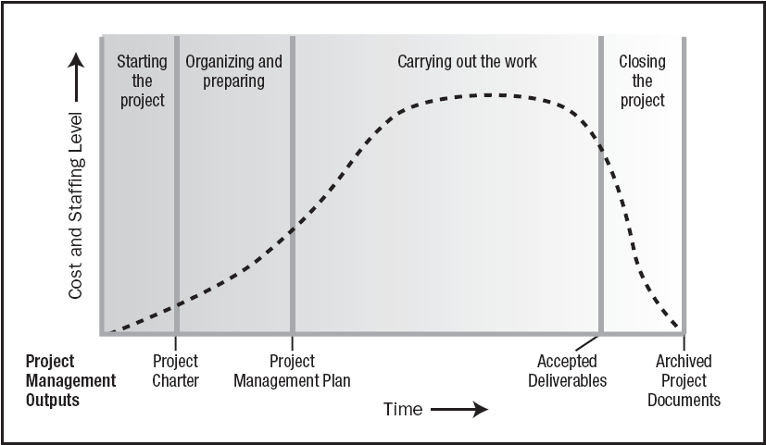
Typical Costing & Staffing across PLC
Source PMBOK Guide Version 5.0

Slide 27
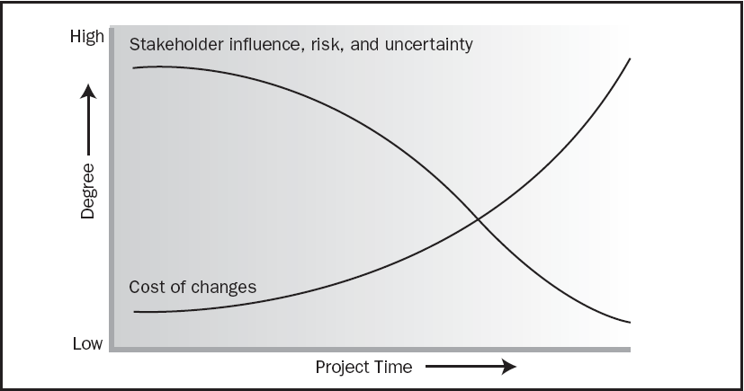
Cost of Change & Degree of Risk
Source PMBOK Guide Version 5.0

Slide 28
Project Initiation & Exercises
Organization Process Assets
Enterprise Environmental Factors
Stakeholders Management
Project Manager: Skills, R&R, Authority
Project Charter

Slide 29
Organization Process Assets
Knowledge base of the organization which helps you doing business in a better way.
Processes, Templates, Guidelines, Standards, Checklists, Forms, Procedures developed at organization level. Compiled by Quality or PMO Department
Lessons learned from previous projects. Documented and shared by earlier project managers.
Previous projects historical data available in archival. It is provided to IT Security department by Project manager at the end of every project.
Notes:
For doing business rely on the organizational learning and therefore build it systematically and regularly.

Slide 30
Enterprise Environmental Factors
Constraints imposed by the enterprise(s) or environment where you are doing the business. Do not underestimate them.
Political environment of vendor, customer, project management company or state
Climatic conditions
Regulatory decisions
Skills available in the market
Attitude of the people towards project, team, organization, management, customer, work etc.
Organizational systems and policies
Organizational culture, management, hierarchies
Terrorism, communal sensitivity

Slide 31
Stakeholder Management

Slide 32
Stakeholders
A stakeholder is an individual, group, or organization
Who may affect, be affected by, or perceive itself to be affected by a decision, activity, or outcome of a project.
Stakeholders may be actively involved in the project
Stakeholders may have interests that may be positively or negatively affected by the performance or completion of the project.
Different stakeholders may have competing expectations that might create conflicts within the project.

Slide 33
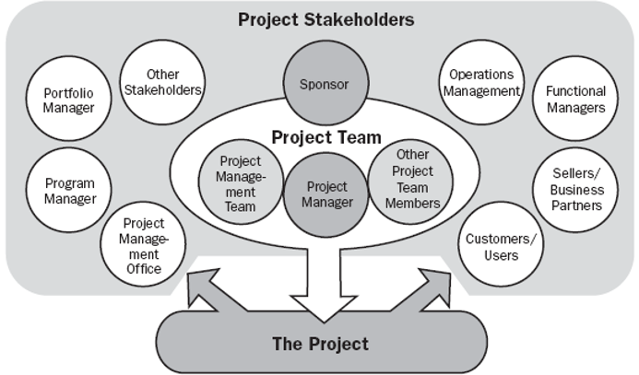
Stakeholders
Product User
Customer
Sponsor
PMO
Regulators
Government
Local Public
Vendors
Local Politicians
Management
Quality Department
Project Team

Slide 34
Stakeholder Register
General
ID
Name
Role/Title
Organization
Department
When (Start, Phase1, Phase2, Phase3, Throughout)
Internal/External
Manager
Contact
Phone
Email-id
City
Management
Expectation
Influence
Interest
Current Position (Champion/Supporter/Neutral/Resist)
Needed Position
Personal Attributes
Engagement Plan

Slide 35
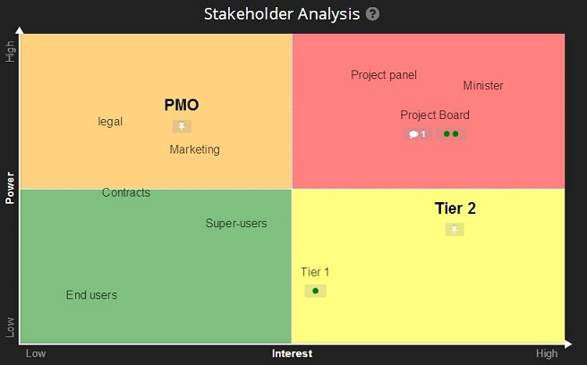
Stakeholder Analysis

Slide 36
Stakeholder Management Plan
Stakeholder Name
Engagement Approach
Responsibility
Accountability
Frequency
When
Efforts Associated

Slide 37
Project Manager: Skills, R&R, Authority

Slide 38
On Any Project : PM Responsibilities
Project Manager’s Role
Accountable
Communication- reviews, steering committee meetings, stakeholder identification and expectation management
Stakeholder Expectation Management
Cost optimization
Resource allocation, resource backup and utilization
Team motivation, team management, training & development, appreciation, career planning, interview
Delegate, Assurance, Ensure through Expert’s Help
Estimates of size, efforts & schedule
Risk identification, analysis, prioritization, monitoring & control
Scope management
Defect free product delivery on time within budget
Deliver as per contract & proposal
Dependency Management
Procure as per contract & proposal
Configuration management, data backup
Quality planning
Presales & proposals
Technical guidance to team – if team members are not available do their work (after project manager has completed his work & he has spare time)

Slide 39
PM Responsibilities
Project Manager’s Responsibilities in Project Lifecycle
Initiating a Project
Project aligned with org objectives & customer needs. Understand Why?
High-level risks, assumptions and constraints are understood
Stakeholders identified and Profiling is done as per their need, power & interest
Project Charter approved
Planning a Project
Project scope, schedule, budget is agreed & approved.
Project team identified with roles and responsibilities agreed
Communication activities agreed
Quality management process established
Risk response plan approved
Integrated change control processes defined & agreed
Procurement plan is place, approved and dependencies identified

Slide 40
Project Manager Responsibilities
Project Manager’s Responsibilities in Project Lifecycle
Executing a Project
Project scope achieved
Project status/progress is tracked and communicated
Project stakeholders expectations managed
Human resource, Machine & Material resources managed
Quality managed against plan
Monitoring & Controlling a Project
Variances identified & RCA is performed
Project change management is performed systematically
Quality is monitored and controlled
Risks are monitored and controlled
Contract administered
Closing a Project
Project outcomes accepted
Project resources released & stakeholders are communicated
Stakeholder perceptions measured and analyzed
Project formally closed
Documents archived, LL documented

Slide 41
Project Manager Skills
Personal Competence
Negotiate
Influence
Manage (Resources, Scope, Time, Cost etc.)
Communicate
Present
Organize
Lead
Conflict Management
Cognitive Ability
Effectiveness
Professionalism

Slide 42
Authority
Manage through servant leadership
Manage through referent power
Implement decision made by stakeholders
Make decisions & take calculated risk

Slide 43
Develop Project Charter
Project Charter should be signed by Project Sponsor and handed over to PM
Use Business Case, SOW, Agreements, Lessons Learned, EEF to make this.
It is first and must have document of any project

Slide 44
Project Charter
Objective
High Level Scope
Project Boundary
High Level Requirements
High Level Deliverables
High Level Milestones
Assumption
Inherent and known risks
High Level Timeline
High Level Budget
Measurable Project Success Criteria
Initial Team
Project Start Date
High Level Approval Requirements
Name and Sign of Project Manager
Name and Sign of Project Sponsor

Slide 46

Hari P Thapliyal,
PMP, PMI-ACP, MCITP, Princ2 Practitioner, CSM, MBA, MCA, CIC, PGDFM
PMO Architect & Project Management Evangelist
Profile: http://in.linkedin.com/in/harithapliyal
For content related queries please contact me via
hari.prasad@vedavit-ps.com
This document is proprietary and confidential. It remains the property of Vedavit Project Solutions at all times. No part of this document may be used, reproduced, or transmitted in any form or by any means electronic, including photocopying and recording, for any purpose without express consent of Vedavit Project Solutions.

