Slide 1
Project Management Training
Tagros Chemicals
Hari Prasad Thapliyal
PMP, PMI-ACP, CSM, MBA, MCA, PGDOM, PGDFM, CIC, PRINCE2-Practitioner
PMO Architect & Project Management Evangelist
Vedavit Project Solutions
Cell: +91-95-3599-9336
Email: hari.Prasad@vedavit-ps.com
Website: www.pmlogy.com
'PMI-ACP', 'PMI', PMP, and 'ACP' are a registered marks of the Project Management Institute, Inc.

Slide 2
Themes
Day 1 : General Understanding
Day 2 : Project Planning
Day 3 : Project Executions
Day 4 : Project Governance
Day 5 : Closing

Slide 3
Planning
Project Integration Planning
Project Scope Planning
Project Time Planning
Project Cost Planning
Project Quality Planning
Project Communication Planning
Project Human Resource Planning
Project Risk Management
Project Procurement Management

Slide 4
Project Integration Planning
Determine Project Management Methodology
Determine Project Lifecycle
Determine Processes Required to Manage Project
Determine Configuration Management, Tools, Security Permission
Determine Change Management Processes

Slide 5
Tools/Techniques for Project Integration Planning
Expert Judgment
Meetings

Slide 6
Scope Management

Slide 7
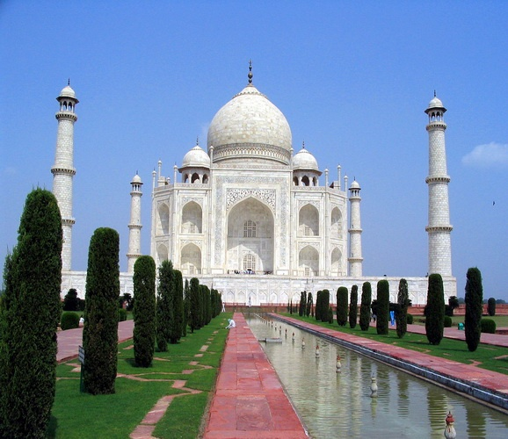

Slide 8
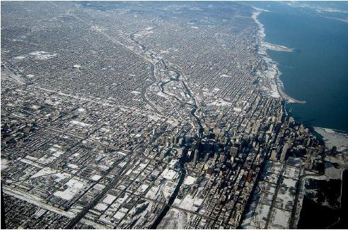

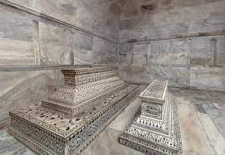

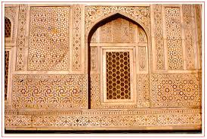
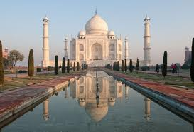
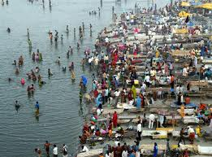
Level of Detailing in Scope

Slide 9
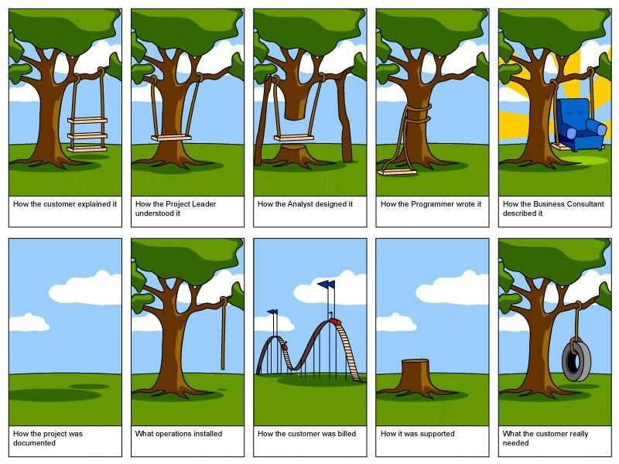
How the customer explained it
How the Project Leader understood it
How the Architect Designed it
How the Programmer wrote it
How the Business Consultant described it
How the project was documented
How operations installed it
What the customer really needed
How the customer was billed
How it was supported

Slide 10
Scope
Project Scope "The work that needs to be accomplished to deliver a product, service, or result with the specified features and functions."
Product Scope "The features and functions that characterize a product, service, or result."

Slide 11
Requirements
Product requirements (features). Product requirements describe the characteristics of the deliverables.
Process requirements (functions). Process requirements describe how people interact with a product and how a product interacts with other products.
Notes:
For example, If you were building a bridge, for instance, most of the requirements would be product based. These might include the number of cars the bridge would hold, the strength of the steel, the water level it needs to span, the color of the bridge, etc.
For example, when you discuss how data gets moved and how business transactions flow from one point to another, you are describing process requirements. If you need to describe the requirements for billing transactions, most of the requirements could end up being process oriented. This would include how billing transactions move from orders to invoicing to accounts receivable. They can describe at what points people look up a status, how people manually update an invoice and what people should do if accounts are out of balance.

Slide 12
Project Scope Management Planning
Establish a process & plan to manage scope (SMP)
Establish a process & plan to manage requirement: collection, elicitation, approval, prioritization (RMP)
Establish a process & plan to trace requirements throughout the project lifecycle (RMP)
Establish a process & plan for requirement acceptance testing (SMP)
Determine scope related metrics to manage the scope (SMP)
Identify the systems, tools which you will use to capture and analyze requirements (SMP)

Slide 13
Tools/Tech for Scope Mgmt. Planning
Expert Judgment
Meetings

Slide 14
Scope Management
Collect Requirements as per SMP & RMP
Analyse Requirements & Develop solution with various possible alternatives
Prepare a detail list of deliverables & related risk
Develop a WBS, WBS Dictionary
Establish control account
Document exclusions
Baseline Scope

Slide 15
Tools/Techniques for Collecting Requirements
Interviews
Focus Groups
Facilitated Workshops
Group Creativity Technique
Group Decision Making Techniques
Questionnaires and Surveys
Observations
Prototypes
Benchmarking
Context diagrams
Document Analysis

Slide 16
Tools/Techniques for Define/Baseline Scope
Expert Judgment
Product Analysis
System Analysis
Decomposition
Alternative Generation

Slide 17
Project Time Management

Slide 18
Project Time Management Planning
Establish a process and plan to manage time of project activities (ScMP)
Tools for Schedule Planning and Reporting
Schedule Thresholds
Metrics
Responsibility, frequency, time of schedule data analysis
Determine which attributes of the activities need to captured to manage them

Slide 19
Project Scheduling
Define activities as per ScMP (DA)
Sequence activities as Activity Attributes (SA)
Estimate Activity Resources (EAR)
Estimate Activity Duration (EAD)
Develop Schedule (DSc)
Baseline Schedule

Slide 20
Define Activities
Use Scope baseline for this
Prepare a list of activities, milestones, activity attributes
Activity Attribute Example :
Name, Location, Department, Dependency, Type, Constraints, Tracking Method, WBS Code, Cost, Duration, Resource Requirement, % Complete

Slide 21
Sequence Activities
Use lead and lag time properly
Understand dependency type apply them properly
FS, SS, FF, SF
Use deadlines and time constraints of activities properly
Understand dependency is Hard Logic or Soft Logic

Slide 22
Estimate Activity Resources
Estimate skills required to perform activities
Estimate number and type of equipments, support services, material required to perform activities
Whether these resources are available within the organization or need to purchased/hired from outside
If they are available within organization can they be available for your project when and where you need them
Develop a Resource Breakdown Structure and Resource Requirements

Slide 23
Estimate Activity Duration
Consider risk around activities
Establish your project calendar (work timings, days in a week, off days of week, holidays, working hours everyday)
Consider availability of resources. Sometimes they are available but not 100%.
Consider productivity of resources. It is never 100%.
Know you are estimating ideal duration, not the actual duration, not the effort
Understand that every activity’s duration cannot be crashed by adding resources.
Methods of duration estimation: PERT, Analogous, Published Data, Parametric
PERT method help you in knowing confidence of your schedule
Finally 24 hours work duration is not 3 days, even if your office works 8 hours a day.

Slide 24
Develop Schedule
Analyse Dependencies
Analyse Lead/Lag
Analyse Constraints
Identify Critical Path
Identify Critical Activities
Identify Float of Activities
Understand where applying more resources will help you reducing project duration
Determine how you want to manage buffers
Discuss, negotiate, agree before you baseline schedule

Slide 25
Critical Path
ES EF
ES EF
ES EF
ES EF
ES EF
ES EF
7
6
3
A
C
G
LS LF
LS LF
ES EF
LS LF
2
Start
Finish
H
ES EF
ES EF
ES EF
LS LF
3
3
3
B
D
E
LS LF
LS LF
LS LF
ES EF
2
F
LS LF

Slide 26
Critical Path – Longest Path, Zero Float
ES EF
ES EF
ES EF
0
7
7
7
6
13
13
3
16
A
C
G
0
0
7
7
0
13
13
0
16
LS LF
LS LF
ES EF
LS LF
16
2
18
Start
Finish
H
16
0
18
ES EF
ES EF
ES EF
LS LF
0
3
3
3
3
6
6
3
9
B
D
E
7
7
10
10
7
13
13
7
16
LS LF
LS LF
LS LF
ES EF
3
2
5
F
11
8
13
LS LF

Slide 27
Facts/Tips for Critical Path
Total Float is the amount of time the task can delayed without delaying the project finish date.
Free float is the amount of time a task can slip without delaying the early start of any task that immediately follows it
It is possible that a zero float activity may not be on critical path
Longest path & shortest time possible to complete the project
A project can multiple critical paths
Difference between late and early is float
Positive float (the activity can wait to start even after previous activity finishes)
Negative float (the activity must start before previous finishes)
Zero float (the activity must immediately start after the finish of previous one)
Crashing activities to short the overall duration of project
Fast-tracking activities to short the overall duration of project
Be cautious that non-critical activity is not being delayed than the allowed free float
Take care of sub-critical path or non-critical path
Manage critical path resources very closely
Do not overload critical path activity resources
Avoid multitasking for resources working on critical path activities

Slide 28
Project Cost Management

Slide 29
Project Cost Management- A Thought
If you don't plan, it doesn't work. If you do plan, it doesn't work either. Why plan!
The same work under the same conditions will be estimated differently by ten different estimators or by one estimator at ten different times. So why to estimate!
Any project can be estimated accurately (once it's completed).
Nothing is impossible for the person who doesn't have to do it.
Right answers to wrong questions are just as wrong as wrong answers to right questions.

Slide 30
Project Cost Management Planning
Establish a process and plan to manage cost of project activities (CMP)
Consider the cost of procurements, risk management activities
Setup cost reporting systems and train project team
Understand different types of cost and their accrual methods

Slide 31
Cost Management Plan
It includes
Cost management tools to be used
Level of accuracy (acceptable range +/- 5%)
Level of precision (US$ 100.01)
Units of measure for each resource
Organizational procedure links
Process of updating the progress in schedule model
Control thresholds (an allowed variation before some action need to be taken)
Rules of performance measurement (baselines, %complete, fixed formula etc.)
Project cost recording process
Currency exchange rate fluctuation adjustment process
Define scheduling reporting format

Slide 32
Tools/Tech. for Cost Management Planning
Expert Judgment
Analytical Tools
Meetings

Slide 33
Cost Planning
Estimate Cost of Each Activities (EC)
Document assumptions of estimation
Consider risks while estimating cost
Develop project funding requirements (DB)
Consider cash flow and payout while developing funding requirements
Baseline Project Cost

Slide 34
Tools for Cost Planning
Analogous Estimating
Parametric Estimating
Bottom-up estimating
Three-point estimates
Reserve Analysis
Cost of Quality
Project Management Software
Vendor Bid Analysis
Group Decision Making Techniques
Funding Requirement Reconciliation
Cost Aggregation
Reserve Analysis
Historical Relationships

Slide 35
Project Cost Estimation Ranges
Cost estimation may include only indirect Cost along with direct Costs
Class Name | % | Range
Definitive | - 5 -> +5% | 10%
Capital Cost | -15 -> +10% | 25%
Appropriation | -25 -> +15% | 40%
Budget Estimates | -10 -> +25% | 35%
Feasibility | -35 -> +25% | 60%
Order of Magnitude | -50 -> +50% | 100%

Slide 36
Project Quality Management

Slide 37
Quality Definitions from Quality Gurus
“Quality is Predictability”- Deming
“Conformance to requirements” - Crosby
“Fitness for use” - Juran
“Customer’s opinion”- Feigenbaum
Conformance to “Valid Requirements“.
“Customers' perception of the value of the suppliers” work output.
A perceived degree of excellence with a minimum, usually set forth by the customer.
Best value for money.

Slide 38
Project Quality Planning
Understand Quality Expectations of the Stakeholders
Develop Quality Checklist
Understand Cost of Quality
Identify Quality Metrics to measure, improve project/product quality
Develop Quality Assurance Plan & Process
Develop Quality Management Plan & Process (QMP)

Slide 39
Tools/Tech for Quality Management
Cost-benefit analysis
Cost of Quality
Seven basic quality tools
Benchmarking
Design of experiments
Statistical sampling
Additional quality planning tools
Meetings

Slide 40
Seven basic quality tools
Control Chart
Fishbone Diagram
Pareto Chart
Scattered Diagram
Histogram
Flowchart
Check sheet

Slide 41
Cost of Quality
Cost of Conformance | Cost of Non-conformance
Prevention Costs (Build a quality product) Training Document processes Equipment Time to do it right Appraisal Costs (Assess the quality) Testing Destructive testing loss Inspections | Internal Failure Costs (Failures found by the project) Rework Scrap External Failure Costs (Failures found by the customer) Liabilities Warranty work Lost business

Slide 42
Project Human Resource Planning
Establish Project Calendar
Create Role & Responsibilities based on skills required to perform project activities
Develop RACI Chart
Establish/Refine Job Description
Establish Project Organization
Establish Performance Appraisal Systems
Establish Conflict Management System
Establish Staffing Management Plan
Establish Team Building Plan
Identify type of trainings required to ensure people understand processes, they understand temperaments and work style of fellow team members, expectations from them. Establish Training Need and Training Plan
Establish Hiring Systems
Approve human resource management plan (HMP)

Slide 43
Project Communication Management
Understand communication need of different stakeholders
Group stakeholders based on their communication need
Understand number of communication channels involved
Identify possible communication technologies and their benefits and cost of setup and operation
Define Roles & Responsibilities for managing communication
Make decision about communication technologies to be used
Establish how will you ensure effectiveness of communication
Establish communication metrics
Put all above information in Communication Management Plan (CoMP)

Slide 44
Tools/Tech for Communication Planning
Communication Requirement Analysis
Communication Technology
Communication Models
Communication Methods
Meetings

Slide 45
Project Risk Management

Slide 46
Risk Management Planning
Identify who is responsible for risk management
Establish tools/template to capture risk
R&R for Risk Assessment, Audit
Risk appetite of stakeholders
Develop impact table
Develop probability and impact table
Methods of risk categorization
Put all above information in Risk Management plan (RMP)

Slide 47
Tool/Tech for Risk Management Planning
Expert Judgment
Analytical techniques
Meetings

Slide 48
Risk Management
Identify Risks
Assess Probability of Risks Identified
Assess Impact of Risks Identified
Assess Urgency of Risks Identified
Establish which risk must have response plan
Assign Risk Owner
Establish Risk Response Plan for High Exposure Risk
Assign Risk Actionee
Categorize Risks
Establish contingency funds

Slide 49
Funding for Risk Management
Contingency Reserves
Management Reserves

Slide 50
Tools/Tech for Risk Management
Expert Judgment
Documentation Reviews
Information Gathering Techniques
Checklist Analysis
Assumptions Analysis
Diagramming Techniques
SWOT Analysis
Risk Probability and Impact Assessment
Probability and Impact Matrix
Risk Data Quality Assessment
Risk Categorization
Risk Urgency Assessment
Data Gathering and Representation Techniques
Quantitative Risk Analysis and Modelling Techniques
Strategies for Negative Risk or Threats
Strategies for Positive Risks or Opportunities
Contingent Response Strategies

Slide 51
Project Procurement Management Planning
Identify what resources/work needed for project cannot be produced by the project team (what you need)
Establish procurement statement of work
Identify when you need and who are potential supplier
Establish cost of each procurement need
Identify different contract type
Establish contract change control systems
Establish procurement evaluation systems

Slide 53

Hari P Thapliyal,
PMP, PMI-ACP, MCITP, Princ2 Practitioner, CSM, MBA, MCA, CIC, PGDFM
PMO Architect & Project Management Evangelist
Profile: http://in.linkedin.com/in/harithapliyal
For content related queries please contact me via
hari.prasad@vedavit-ps.com
This document is proprietary and confidential. It remains the property of Vedavit Project Solutions at all times. No part of this document may be used, reproduced, or transmitted in any form or by any means electronic, including photocopying and recording, for any purpose without express consent of Vedavit Project Solutions.

