Slide 1
Project Management Training
Tagros Chemicals
Hari Prasad Thapliyal
PMP, PMI-ACP, CSM, MBA, MCA, PGDOM, PGDFM, CIC, PRINCE2-Practitioner
PMO Architect & Project Management Evangelist
Vedavit Project Solutions
Cell: +91-95-3599-9336
Email: hari.Prasad@vedavit-ps.com
Website: www.pmlogy.com
'PMI-ACP', 'PMI', PMP, and 'ACP' are a registered marks of the Project Management Institute, Inc.

Slide 2
Themes
Day 1 : General Understanding
Day 2 : Project Planning
Day 3 : Project Execution
Day 4 : Project Governance
Day 5 : Closing

Slide 3
Project Governance
Monitor & Control Project Work (MCPW)
Perform Integrated Change Control (PICC)
Validate Scope (VC)
Control Scope (CS)
Control Schedule (CSc)
Control Cost (CC)
Control Quality (CQ)
Control Communications (CCom)
Control Risks (CR)
Control Procurements (CnP)
Control Stakeholders Engagements (CSE)

Slide 4
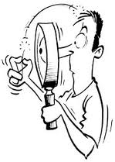
11. Validate Scope
Formalizing acceptance of the completed project deliverables.

Slide 5
Validate Scope
Project Scope Management
Project Monitoring & Controlling
Project Management Plan
Requirements Documentation
Requirement Traceability Matrix
Verified deliverables
Work Performance Data
Inspection
Group Decision Making Techniques
Accepted Deliverables
Change Requests
Work Performance Information
Project Documents Updates

Slide 6
Discussion/Exercise 10
5 Minutes
Write verify scope activities for your project; also write the name of deliverables verified.

Slide 7
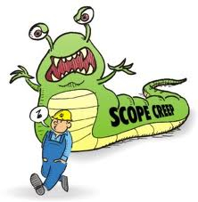
12. Control Scope
Monitoring the status of the project and product scope and managing changes to the scope baseline.

Slide 8
Control Scope
Project Scope Management
Project Monitoring & Controlling
Project Management Plan
Requirements Documentation
Requirement Traceability Matrix
Work Performance Data
Organization Process Assets
Variance Analysis
Work Performance Information
Change Requests
Project Management Plan Updates
Project Documents Updates
Organization Process Assets Updates

Slide 9
Discussion/Exercise-11
5 Minutes
Write work performance measurement metrics and their values for your project

Slide 10
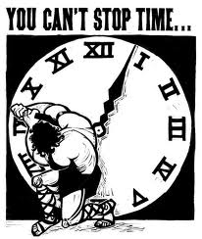
19. Control Schedule
Monitoring the status of the project to update project progress and manage changes to the schedule baseline

Slide 11
Control Schedule
Project Time Management
Project Monitoring and Controlling
Project Management Plan
Project Schedule
Work Performance Data
Project Calendars
Schedule Data
Organization Process Assets
Performance Reviews
Project Management Software
Resource Optimization Techniques
Modeling Techniques
Leads and Lags
Schedule Compression
Scheduling Tool
Work Performance Information
Schedule Forecasts
Change Requests
Project Management Plan Updates
Project Documents Updates
Organization Process Assets Updates

Slide 12
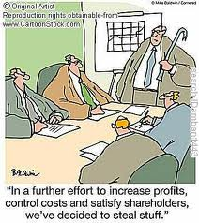
23. Control Costs
Monitoring the status of the project to update the project budget and managing changes to the cost baseline

Slide 13
Control Cost
Project Cost Management
Project Monitoring & Controlling
Project Management Plan
Project Funding requirements
Work Performance Data
Organization Process Assets
EVM
Forecasting
TCPI
Performance Reviews
Project Management Software
Reserve Analysis
Work Performance Information
Cost Forecasts
Change Requests
Project Management Plan Updates
Project Documents Updates
Organization Process Assets Updates

Slide 14
Earn Value Management

Slide 15
Earned Value Management – Basic Concepts
Planned Value (PV)- BCWS
Authorized budget assigned to the work to be accomplishes for an activity or work
breakdown structure component.
Earned Value (EV)- BCWP
Value of work performed expressed in terms of the approved budget assigned to
that work for an activity or work breakdown structure component.
Actual Cost (AC)- ACWP
Total cost actually incurred and recorded in accomplishing work performed for an
activity or work breakdown structure component.

Slide 16
Earn Value Rules
0% - 100%
50% - 50%
20% - 80%
25% - 75%

Slide 17
Earned Value Management – S Curve
PV
AC
Cost
CV
SV
Progress Review
ΔT
EV
Time

Slide 18
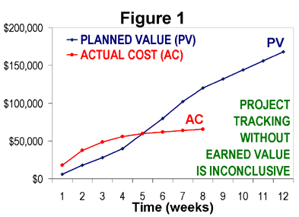
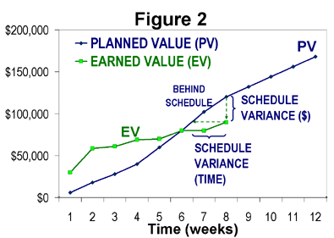
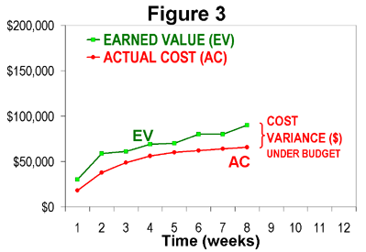
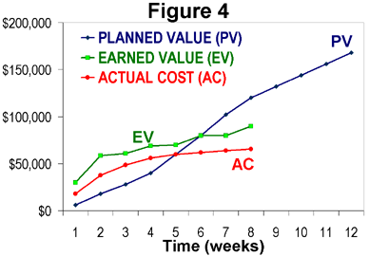
How project is progressing?

Slide 19
EVM-Variances
CV (Cost Variance) = EV- AC
CV = 0 => the Project is proceeding as per plan on cost
CV < 0 => the Project is over budget
CV > 0 => the Project is under budget
SV (Schedule Variance) = EV- PV
SV = 0 => the project is on plan, time-wise
SV < 0 => the project is BEHIND schedule
SV > 0 => the project is AHEAD of schedule

Slide 20
EVM- Indexes
CPI (Cost Performance Index) tells you how much worth of job you are getting for every $ being spent.
CPI = EV/AC
CPI = 1 => the project is on plan, cost wise
CPI < 1 => the project is over budget or under performing
CPI > 1 => the project is under budget or over performing
SPI tells the PM how much worth of job has been completed against planned work
SPI = EV / PV
SPI = 1 => the project is on schedule
SPI < 1 => the project is BEHIND schedule
SPI > 1 => the project is AHEAD of schedule

Slide 21
EVM- Critical Ratio
CR tells the PM the overall shape of your project
CR= CPI x SPI
CR = 1 => the project is on schedule & within budget
CR < 1 => the project is BEHIND schedule or budget or both
CR > 1 => the project is AHEAD of schedule or budget or both

Slide 22
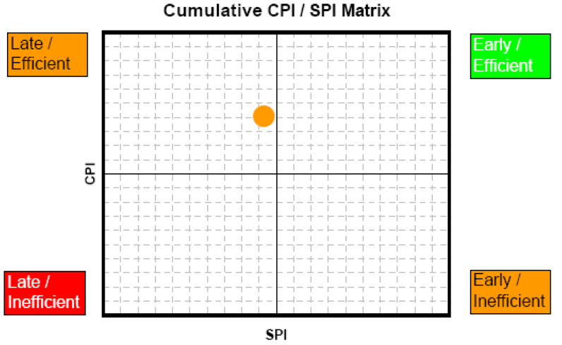
CPI & SPI Summary

Slide 23
Forecasting- ETC
Recalculate it, if original estimate are no longer valid now.
Calculate it manually based on the progress, if original estimates are still valid
ETC = BAC - EV

Slide 24
Forecasting- EAC
Estimate at Completion(EAC)
EAC (atypical) = AC + ETC (Re-estimated)
EAC (atypical) = AC + BAC – EV (Estimated based on Progress)
EAC (typical considering CPI & SPI) = AC + ETC/ (CPI x SPI)
EAC (typical)= AC + ETC / CPI = BAC/CPI
If you feel that you will be able to complete the project on time in spite of current delay then you can consider SPI as 1. In that case CR= SPI

Slide 25
Forecasting- Variance at Completion
Variance at Completion (VAC)
VAC = BAC – EAC
Variance at Completion (%)
PVAC= (BAC-EAC)/BAC

Slide 26
Forecasting: TCPI
TCPI (To complete Performance Index) can be calculated using BAC or EAC
TCPI using BAC = (BAC-EV) / (BAC-AC)
TCPI using EAC = (BAC-EV) / (EAC-AC)

Slide 27
23. Perform Quality Control
Monitoring and recording results of executing the quality activities to assess performance and recommend necessary changes.

Slide 28
Quality Control
Project Quality Management
Project Monitoring & Controlling
Project Management Plan
Quality Metrics
Quality Checklist
Work Performance Data
Approved Change Requests
Deliverables
Project documents
Organization Process Assets
Seven basic quality tools
Statistical sampling
Inspection
Approved Change Request Review
Quality Control Measurements
Validated Changes
Verified deliverables
Work Performance Information
Change Requests
Project Management Plan Updates
Project Documents Updates
Organization Process Assets Updates

Slide 29
33. Control Communications
Monitoring and controlling communication throughout project life cycle to ensure the information needs of the project stakeholders are met

Slide 30
Control Communications
Project Communication Management
Project Monitoring & Controlling
Project Management Plan
Project Communications
Issue Log
Work Performance Data
Organization Process Assets
Expert Judgement
Information Management Systems
Meetings
Work Performance Information
Change Requests
Project Management Plan Updates
Project Documents Updates
Organization Process Assets Updates

Slide 31
39. Control Risks
Implementing risk response plans, tracking identified risks, monitoring residual risks, identifying new risks, and evaluating risk process effectiveness throughout the project.

Slide 32
Control Risks
Project Risk Management
Project Monitoring & Controlling
Project Management Plan
Risk Register
Work Performance Data
Work Performance Report
Risk Reassessment
Risk Audits
Variance and trend analysis
Technical performance measurement
Reserve Analysis
Meetings
Work Performance Information
Change Requests
Project Management Plan Updates
Project Documents Updates
Organization Process Assets Updates

Slide 33
42. Control Procurement
Managing procurement relationships, monitoring contract performance and making changes and corrections as needed.

Slide 34
Control Procurement
Project Procurement Management
Project Monitoring & Controlling
Project Management Plan
Procurement Documents
Agreements
Approved Change Requests
Work Performance Reports
Work Performance Data
Contract Change Control System
Procurement Performance Reviews
Inspections and Audits
Performance Reporting
Payment Systems
Claim Administration
Records Management Systems
Work Performance Information
Change Requests
Project Management Plan Updates
Procurement Documents Updates
Organization Process Assets Updates

Slide 35
47. Control Stakeholder Engagements
Monitoring overall project stakeholder relationships and adjusting strategies and plans to engage stakeholders.

Slide 36
Control Stakeholder Engagements
Project Stakeholder Management
Project Monitoring & Controlling
Project Management Plan
Issue Log
Work Performance Data
Project Documents
Expert Judgement
Information Management Systems
Meetings
Work Performance Information
Change Requests
Project Management Plan Updates
Project Documents Updates
Organization Process Assets Updates

Slide 37

Hari P Thapliyal,
PMP, PMI-ACP, MCITP, Princ2 Practitioner, CSM, MBA, MCA, CIC, PGDFM
PMO Architect & Project Management Evangelist
Profile: http://in.linkedin.com/in/harithapliyal
For content related queries please contact me via
hari.Prasad@vedavit-ps.com
This document is proprietary and confidential. It remains the property of Vedavit Project Solutions at all times. No part of this document may be used, reproduced, or transmitted in any form or by any means electronic, including photocopying and recording, for any purpose without express consent of Vedavit Project Solutions.

