Slide 1


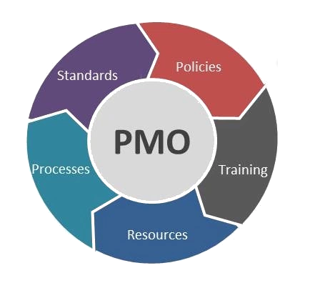
Enterprise Project Management Office (EPMO)
Hari P. Thapliyal
MCA, MBA (Operations), PGDFM, ZED Master Trainer, PMP, MCITP,
PMI-ACP, PRINCE2 Practitioner, SCT, CSM, MCT, SDC, SCM, SPOC, SAMC

Slide 2
Agenda
1. Introduction. - 15 min
2. Interactions with TEAM mates -30 min
Understand the requirement from technical/commercial team (all key stakeholders)
3. Review of existing facility/systems to analyze the gap. - 45 min
4. PMO as a Solution- 30 min
5. Review of existing manpower/capabilities for PMO – 45 min
To explore the possibility of creating/establishing a PMO Office with the available resources.
6. Understanding the training needs and freezing of training date along with the participants. - 30 min
7. Questions & Answers (QA) session. -15 min
8. Action plan for the implementation including the establishment of PMO. - 30 min

Slide 3

Project – An Elephant
Temporary organization
Output is Unique (Product/Service/Result)
Heterogeneous Team
Requirements keep evolving
High uncertainty
Stakeholder’s influence is high
Determining budget is challenging
Commitment of people for project work
A Project has a critical path

Slide 4
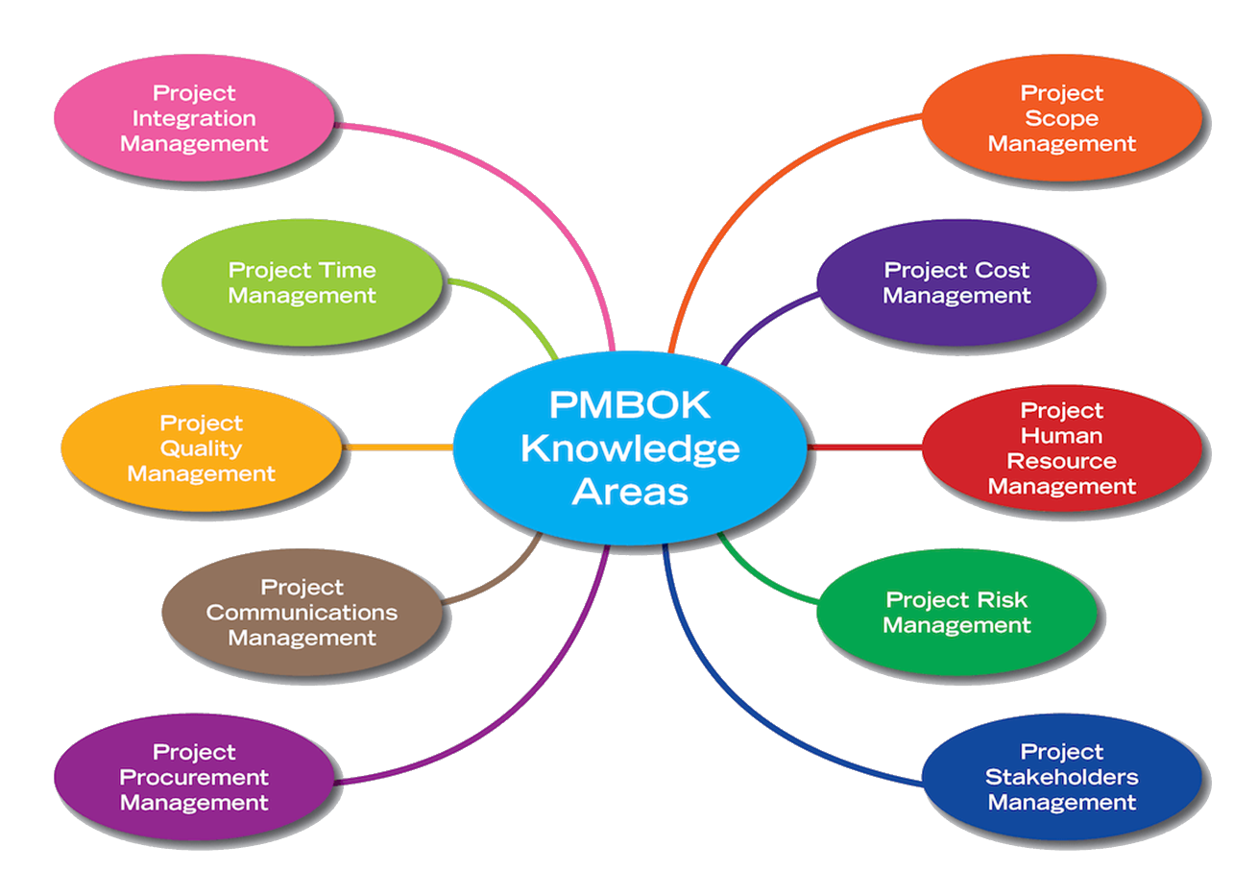
Critical Aspects of a Project

Slide 5
Accountable vs Responsible Person
Project Accountability
Project Responsibility
Getting work done
Result driven
Has authority to plan, approve, reject
Deliver result within cost and time to customer
Works with plan B
Works with tolerance limits
Works with buffers
Getting right resource
Optimum resource utilization for project
Dependency management
To make customer happy
Doing work
Task driven
Has responsibility of planning
Finish the activity within the time
To complete the work

Slide 6
Organizational Structure for Project Management
CEO/President
Portfolio Managers/Vice Presidents
PMO
Project Managers
Project Management Team
Project Team
Project Selection, Strategic Decision about projects
Project Management Directions, Learning Management, Institutionalization
Project Management (planning, execution, governance)
Key Business User for regular estimation, planning prioritization, acceptance, risk management
SME related to project work execution

Slide 7
Responsibilities of PMO
Project Level
Helps PM in Project Estimation
Helps PM in Project Planning
Helps PM in Defining Project Governance at Desired Levels
Helps PM in Delivering Project within agreed threshold
Helps PM in using appropriate lessons learned
Helps PM in performing continuous business justification
Help PM in Baselining Project Objectives and reporting against the objectives set.

Slide 8
Responsibilities of PMO
Organizational Level
Creating project management standards
Templates, Processes, Checklists, Guidelines, Forms, Methodologies
Managing & Maintaining Project Management Standards
Consolidation, Refining, Access Permission, Retiring
Sharing PM Standards & Best Practices across projects and verticals
Evaluating PM tools and adopting right tools for Project Management
Trainings on various project management related key topics
Ensuring optimum resource (equipments, human, machine, general expenses, vendor services) utilization on any projects across organization
For effective decision making managing project progress across the organization using same parameters and reporting to senior management
Ensure every project follows the agreed processes
Manage a pool of project managers
First Level of Escalation for Project Managers
Approving project charter
Post Project Implementation Review
Maintain and Ensure Inventory of Resources for Projects

Slide 9



Types Of PMO
Controlling PMO
Supporting PMO
Directing PMO
Choose your best type based on the organization culture and need

Slide 10
Document strategic plan
Plan PMO objectives and charter
Define PMO structure and roles
Establish process framework and controls
Train the team
Implement and review periodically

Slide 11
High-Level Roadmap of PMO
Setup a PMO: Define R&R of PMO, PM, Consultants
A workshop for Project Management Team/ department heads/ senior consultants
Design PMO Dashboard
Create Knowledge Repository of PMO. Define access control.
Keep templates/standards/guidelines/checklist/forms under repository. PMO Team should manage this and have access to it
Define processes of updating & Sharing OPA
Select First Project Under PMO
Work on the project for ?? days and define PM consultant’s engagement level* and project management methodology & approach.
*Engagement level will decide time and frequency of PM Consultant need to get involved in project life cycle.

Slide 12
Consulting Deliverables
PMO Defined with Roles & Responsibilities
OPA Established
Project Charter, Stakeholder Register in Place
Project Management Framework (processes) in place
Stakeholders Expectations set
High level Project Scope, Efforts, Cost & Schedule Baselined
PMO staffed is trained on required processes and documentation
Future level of engagement of PM Consultant is determined

Slide 13
Corporate Workshops
Accenture | ISKCON | SiTEL
Amadeus | JP Morgan | Tagros Chemical
Andritz | KPMG | Tensor Infotech
Aurovision | L&T Infotech | Tyco
AXA | Mphasis | Uninor
Bank of America CS | Multi Media Communication | United Health Group
Birlasoft | Reliance Industries Limited | Vikram Solar
Chemfab | SAP | WNS
Dell | Schneider Electrics | Zamil Infrastructure
Deutsche Bank | Hewitt Aon | Infinite Computers
ECCI | Hibu | UTC Climate, Controls & Security
Ericsson | IBM
Future Focus Infotech | Infineon

Slide 14
Public Workshop People Participated from..
ABB | Cisco | Godrej
ABM Knowledge Ltd | Cognizant | Gujarat gas
Acer Dubai | CSC | HCL
Airtel | Dell | HDI System Technologies
Allsec | Delphi | Honeybell
Analoug | Department of Finance (PH) | HP
ANZ bank | Dover India | HSBC
Arcelor Mittal | Dreamorbit | Huari Telecom
Avaya | EDS | Huwei
Bank of New York | Ellucian | IBM
Birla Sunline Insurnace | Emerio | ICICI Pru
Caliber Point | Emerson | Infosys
California software | Federal Mugal | INSEAD
Capgemini | Feedback Infra | Intelent Global
CBAY Systems | Gammon India Ltd | ITC Intotech
CGI | Genpact | ITC

Slide 15
Public Workshop People Participated from..
Kale consultants | Pyramid IT | SXChange
L&T Infotech | Qualcomm | Tagros Chemicals
LeoTech | RBS | TATA AIG
Mayniland Waters | Real Page | Tata Elexi
Multi Media Communication | Reckitt | TCS
NCS | Reliance Communication | Temenos
Netambit | Rockwell | Thales Software India
NICT | Rolta | TOYOTA
NIIT Technologies Limited | S & P Capital IQ | Turner & Toronsent
Nokia Seimens | Samin Tech. India Pvt Ltd. | TWISS
Opera Solutions | Schneider Electrics | Uninor
Orange | Service India | Verizon
Pata Infotech | Smart Communications | Wheels India
Pepsico | Smart Telecoms | Wipro
Pratt and Whitney | Standard Charted Bank | Wire & Wireless India Ltd
Punjab infotech | Sun Guard | Xansa
 | Sutherland | Xerox

Slide 16

Hari P Thapliyal,
PMO Architect & Project Management Trainer & Coach
Vedavit Project Solutions
Reach Me:
hari.prasad@vedavit-ps.com
Skype: hari.thapliyal, YM: hari_thapliyal, Twitter: harithapliyal
Mobile: +91 9535999336
Profile: http://in.linkedin.com/in/harithapliyal
Blog: http://pmlogy.com/

