Slide 1
METRICS AND MEASUREMENTS IN SOFTWARE DEVELOPMENT
Alper ACAR & Ercan AY & Aycan AYYILMAZ

Slide 2
Outline
PRODUCTIVITY
PRODUCTIVITY MEASUREMENTS AND METRICS
METHODS OF MEASUREMENTS
CONCLUSION

Slide 3
Introduction
The aim of this paper is to show why measurement and metrics of software is necessary and how to measure it with different kinds of methods.

Slide 4
Productivity
Measurement and metrics are all about productivity, so what is productivity?
In manufacturing, productivity can be defined as the ratio of outputs, which is produced through a production process to inputs used for producing such outputs.(Calabrese, 2011)
In software point of view; number of inputs, outputs, inquries and master files should counted, weighted, summed and adjusted for complexity for each project.

Slide 5
Productivity
Blackburn et al. 2002 measures the productivity in general by using the formula:
Productivity = Number of Function Points / Effort in Man months.

Slide 6
Measurements
The measurement process is flexible, tolerable and adaptable to the needs of different users”
International Organization for Standardization (2002) summarized measurement as;
Establish and Maintain Measurement Capability
Plan Measurement
Perform Measurement
Evaluate Measurement
Improve Measurement

Slide 7
Measurements
It is clearly stated that no single measure of productivity is likely to be able to serve all the different needs of a complex software organization, including project estimation, tracking process performance improvement, benchmarking, and demonstrating value to the customer. Multiple measures of productivity may be needed. (Card, 2006)
April et al. (2004) claim that Lines of code and Function point measures can be used as factors to compare the similar systems between themselves and to the industry.

Slide 8
5 perspectives for measurement
“Performance—What is the process producing now with respect to measurable attributes of quality, quantity, cost, and time?
Stability—Is the process that we are managing behaving predictably?
Compliance—Are the processes sufficiently supported? Are they faithfully executed? Is the organization fit to execute the process?
Capability—Is the process capable of delivering products that meet requirements?
Improvement—What can we do to improve the performance of the process? What would enable us to reduce variability? What would let us move the mean to a more profitable level? How do we know that the changes we have introduced are working?”(Florak, Park, & Carleton, 1997)

Slide 9
Metrics
Code metrics can be defined as the set of software measures that enable software developers with a better understanding of the code.

Slide 10
Metrics
Visual Studio calculates as
Maintability Index-takes values beetween 0 and 100 and a high values means high maintability.
Cyclomatic Complexity- Measures the structural complexity.
Depth of Inheritance - Indicates the number of class definitions that extend to the root of the class hierarchy.
Class Coupling – A good software design has types and methods that have high cohesion and low coupling.
Lines of Codes – Represnt the approximate lines in the code. (MSDN, 2010).

Slide 11
METHODS OF MEASUREMENTS
Subjective measurement, this method uses survey questions to employees, stakeholders, clients and suppliers. (Kemppilla’s and Lonqqvist 2003)
Multiple size measurment; such as the total number of Web pages, the total number of high effort functions and total number of new images. (Mendes & Kitchenham, 2004)

Slide 12
IEEE Standards
This standard defines a framework for measuring and reporting software productivity. It focuses on definitions of how to measure software productivity and what to report when giving productivity results. It is meant for those who want to measure the productivity of the software process in order to create code and documentation products.(IEEE Standards Board, 1993)

Slide 13
ISO/IEC Standard 15939
This International Standard defines a measurement process applicable to system and software engineering and management disciplines.
They summarize this standard as,
• Provides structure and order in measurement programs
• Enables effective communication between stakeholder and measurement program responsible
• Applicable for establishing measurement programs for products, projects and processes
• Provides a distinction between reusable (base measures) and purpose specific (indicators) elements
• One needs guidance on how to use it
• Needs complementing with other standards

Slide 14
In Conclusion
Most of the researchers uses different measures and techniques to calculate software productivity. They generally uses the simple formula of output per input. On the other hand, some of the software-specific measurements are more popular than the others such as FPA or lines of codes, but this does not means that, anyone can recommend only one of these methods because productivity measurement is directly related to companies, departments, processes and people that take part in the development process.

Slide 15
In Conclusion
When we look at the organizational pont of view, productivity measuremnt provide organizaiton with making better decisions about investments in processes, methods, tools, and outsourcing and monitoring the current productivity of its services that helps them to increase customer satisfaction.

Slide 16
In Conclusion
To conclude, taking these methods into consideraion and deciding the best model for each specific topic should be done by experts of this issue.

Slide 17
Software Measurement: A Necessary Scientific Basis By Norman Fenton (1994)
Alper ACAR
2011765000

Slide 18
Outline
What is measurement?
How do we measure?
Types of measurement.
Representation of measurement.
Usage of measurement
Different types os software measurement

Slide 19
What is measurement?
Measurement is defined as the process by which numbers or symbols are assigned to attributes of entities in the real world in such a way as to describe them according to clearly defined rules.
An entity may be an object, such as a person or a software specification, or an event.
An attribute is a feature or property of the entity, such as the height or blood pressure of a person.

Slide 20
How do we measure?
The assignment of numbers or symbols must preserve any intuitive and empirical observations about the attributes and entities.
In most situations an attribute, even one as well understood as height of humans, may have a different intuitive meaning to different people.
The normal way to get round this problem is to define a model for the entities being measured. The model reflects a specific viewpoint.

Slide 21
Types of measurement
Direct measurement of an attribute is measurement which does not depend on the measurement of any other attribute.
Indirect measurement of an attribute is measurement which involves the measurement of one or more other attributes

Slide 22
Representational Theory of Measurement
Empirical Relation Systems: Direct measurement of a particular attribute possessed by a set of entities must be preceded by intuitive understanding of that attribute.
Representation Condition: To measure the attribute that is characterized by an empirical relation system requires a mapping into a numerical relation system.

Slide 23
Representational Theory of Measurement
Scale Types and Meaningfulness: There may in general be many ways of assigning numbers which satisfy the representation condition. For example, if person A is taller than person B, then M( A) > M(B) irrespective of whether the measure M is in inches, feet, centimeters meters, etc. Thus, there are many different measurement representations for the normal empirical relation system for the attribute of height of people.

Slide 24
Representational Theory of Measurement
Researchers have continued to search for single real-valued complexity measures which are expected to have the magical properties of being key indicators of such diverse attributes as comprehensibility, correctness,maintainibility, reliability, testibility, and use of implementation

Slide 25
Unifying Framework For Software Measurement
In software measurement activity, there are three classes of;
Processes: are any software related activities which take place over time.
Products: are any artifacts, deliverables or documents which arise out of the processes.
Resources: are the items which are inputs to processes.

Slide 26
Unifying Framework For Software Measurement
Internal attributes of a product, process, or resource are those which can be measured purely in terms of the product, process, or resource itself.
External attributes of a product, process, or resource are those which can only be measured with respect to how the product, process, or resource relates to other entities in its environment.

Slide 27
Software Metrics Activities Within the Framework
Cost Modeling: is generally concerned with predicting the attributes of effort or time required for the process of development.
Software Quality Models and Reliability Models: The popular quality models break down quality into “factors,” “criteria,” and “metrics” and propose relationships between them.

Slide 28
Validating Software Measures
The measure is “validated” by showing that it correlates with some other existing measure. What this really means is that the proposed measure is the main independent variable in a prediction system.

Slide 29
Summary
The entities of interest in software can be classified as processes, products, or resources. Anything we may wish to measure or predict is an identifiable attribute of these. Attributes are either internal or external. Although external attributes like reliability of products, stability of processes, or productivity of resources tend to be the ones we are most interested in measuring, we cannot do so directly. We are generally forced to measure indirectly in terms of intemal attributes.

Slide 30
Summary
Predictive measurement requires a prediction system. This means not just a model but also a set of prediction procedures for determining the model parameters and applying the results. These in tum are dependent on accurate measurements in the assessment sense.

Slide 31

The End

Slide 32
Brooks’Law Revisited: Improving Software Productivity by Managing Complexity
Joseph D. Blackburn, Michael A. Lapré
Vanderbilt University (2002)
LukN. Van Wassenhove
INSEAD

Slide 33
Brooks’Law (1975)
Adding manpower to a late software project makes it later.
Software development is complex
Additional communication burden quickly dominates decrease in individual task time brought about by partitioning
# concurrent modules↑, required effort↑, productivity↓
Hoedemakeret al. 1999

Slide 34
Data
The Experience database:
provided by Software Technology Transfer Finland (STTF)
used for project planning, cost estimation, productivity benchmarking
provides descriptive information about project size, effort, duration, business application, language, etc. and ratings on factors thought to influence productivity
comprised of surveys on 117 projects completed between 1996 and 2000 from 26 companies in Finland

Slide 35
Software Productivity
Function Points per Man Month of Labor
Determined by:
counting inputs, out-puts, inquiries, entities, interfaces, and algorithms
rating the functions in each category by difficulty on a five-point scale
calculating total weighted function points using the counts, difficulty ratings, and empirically determined weighting factors
(Maxwell and Forselius, 2000)
Banker et al. 1998, Ethirajet al. 2005, Kemerer1993

Slide 36
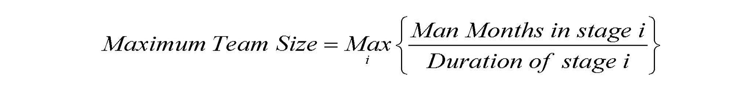
Maximum Team Size
The tendency of a project manager to compress the project schedule by adding more people to the project

Slide 37
Independent Variables
Based on five-point Likert scales coded by project managers
Listed as:
Logical Complexity
Complexity across Software
Complexity across Projects
Stable Standards Familiar to Team
Tool Skills of Team
Experience of Project Manager
Size
Usage of Tools
Requirements Ambiguity
User Requirements

Slide 38
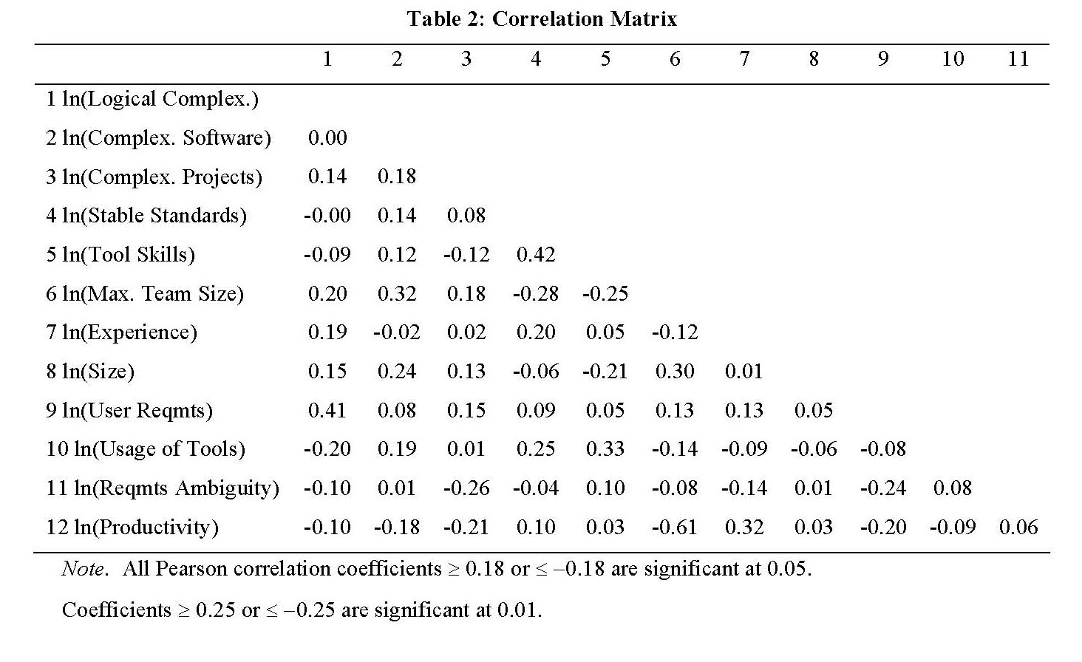
Analysis Plan

Slide 39
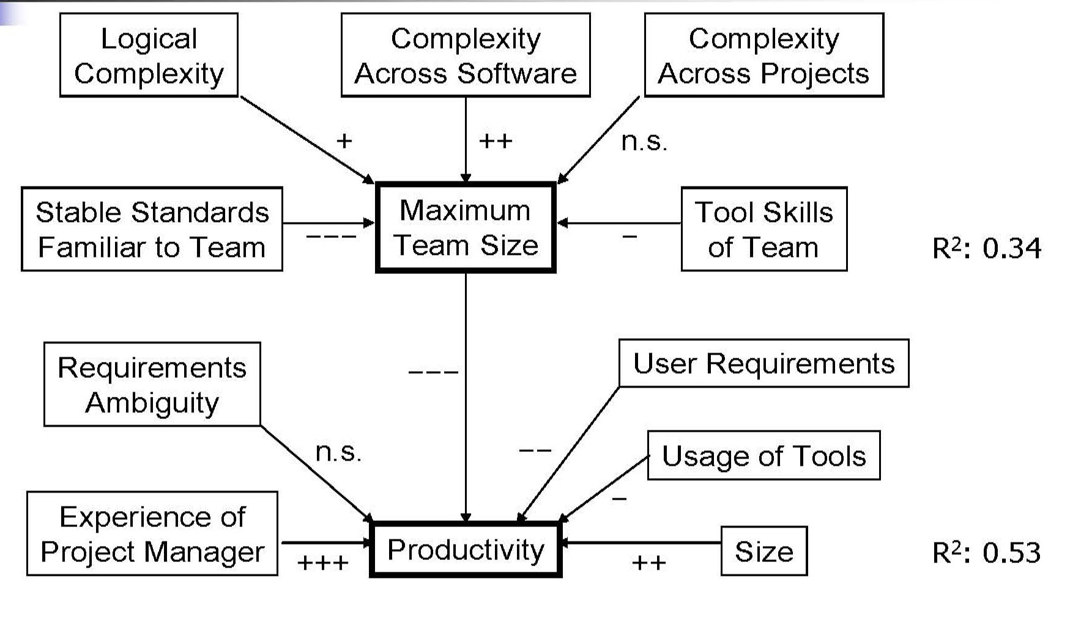
Summary of Results (N=117)

Slide 40
Conclusion
The common problem many software companies have is how to get relatively large groups of people with varying abilities and skills to work together as talented small teams
Complexity↑, Max Team Size↑, Productivity↓

Slide 41
Software Engineering Productivity Measurement Using Function Points: A Case Study
MIS 518 - Advanced Operations Management - Spring 2012
Aycan Ayyılmaz

Slide 42
It is obvious that software engineering productivity is more complex since inputs and outputs are not always clearly defined and they are also unstable like in all knowledge intensive activities.
Especially four software metrics are popular in the measurement of productivity of software development activity. These metrics are;
Halstead’s software science,
McCabe’s syclomatic complexity,
Lines of codes
Function point analysis (FPA).
The last one, FPA, has gained much research attention and there are a lot of publications about this specific metric.
In this research paper, large financial services company that has used FPA for 6 years, is studied. This paper examines the problems and issues faced in using FPA to measure software engineering productivity.

Slide 43
What is FPA?
FPA stands for Functional Point Analysis
FPA was proposed by IBM’s Allen J. Albrecht in 1979
It sizes an application system from the end-user’s perspective by identifying data exchanges between users and the software application and those between the software application with other applications.
it can be used;
measuring the speed and cost of development,
quality and productivity of an information centre,
the accuracy of projection of a project’s duration,
the efficiency of software maintenance,
the usefulness of applications,
the productivity gains from improvement program,
a project control tool or a diagnostic tool.
FPA is a useful management tool for an IS department if used effectively.
FPA has two counting standards – one issued by the International Function Point User Group (IFPUG) and the other by the UK Function Point User Group covering the MKII method

Slide 44
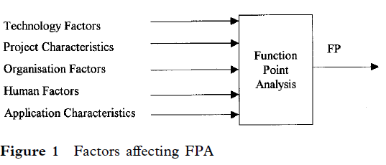
FPA is influenced by these;
The technology used,
Application characteristics,
Project characteristics,
Organization,
The people involved.
Hence, any estimation of project resources using FPA should take into account new staff, increased project complexity and other development characteristics.

Slide 45
ABOUT CASE STUDY: ECHO
Institutionalizing an FPA productivity measurement program requires many years of effort. Therefore, the research site must have mature and established FPA practices. The research site in this study is the IS division of ECHO (a synonym), a large financial services company.
ECHO has implemented FPA for over 6 years.
Its IS division has 120 software engineers
it has more than 35
Years of software development experience, beginning in 1963 with an IBM mainframe computer.
More than 5000 program developed in-house are in use in ECHO today.
ECHO operates a variety of computer platforms – a mainframe computer, a minicomputer and 700 PCs connected to several local area networks (LANs) and wide area networks (WANs).
It uses network and relational databases and more than ten software languages which includes Cobol, CICS, ADS/O, SAS, Easytrieve Plus, Database IV, Rexx, C, Assembler, SQL Windows and Pascal.

Slide 46
The IS division of ECHO has three departments.
Departments A and B develop and maintain the
mission-critical mainframe applications which support
the main business activities of ECHO.
Department C develops and maintains the applications which support ECHO’s internal operations such as procurement,
general ledger and payroll.
These applications make use of a combination of off-the-shelf packages, client server and mainframe. Departments A and B have more experienced staff than department C due to the mission critical applications they support
ECHO uses an FP productivity indicator (FPPI) to monitor the monthly productivity performance of the IS division and its three departments. The FPPI is a simple measure of year-to-date FPs delivered per man-day.

Slide 47
METHODS USED IN RESEARCH
This study investigated the entire process of productivity measurement of ECHO.
Data were collected from multiple sources through interviews, inspection of past FPA records and direct observations. The inspections were carried out on the in-house FPA documentation to ascertain their level of knowledge of FPA.
The observations were made on management’s interpretation of the FPPI in six IS division monthly management meetings in which the FPPI figures were discussed. The computer records of 1649 FP computations between 1989 and 1993 were analyzed to study the characteristics of the FP computations.
Semi-structured interviews were conducted with the project leaders, their supervisors and managers involved in the FP computation in order to understand the problems and issues faced.

Slide 48
ECHO’s Productivity Measurement Process and Problems
A software metric engineer (SME) who has 6 years experience in FPA heads ECHO’s software engineering productivity program.
ECHO’s IS staff are trained in FPA by the SME a few months after they join the company. They go through a 1-day intensive training course in FPA. In addition, ECHO has in-house standards to guide the counting of various commonly used data types.
He/she makes use of project documentation which includes the documentation of database, le, screen, report and program logic in their computation. This computation is first reviewed by the supervisor
ECHO’s FPA process starts with project leaders computing FPs upon completion of the respective projects. He/she makes use of project documentation which includes the documentation of database, file, screen, report and programme logic in their computation. This computation is first reviewed by the supervisor

Slide 49
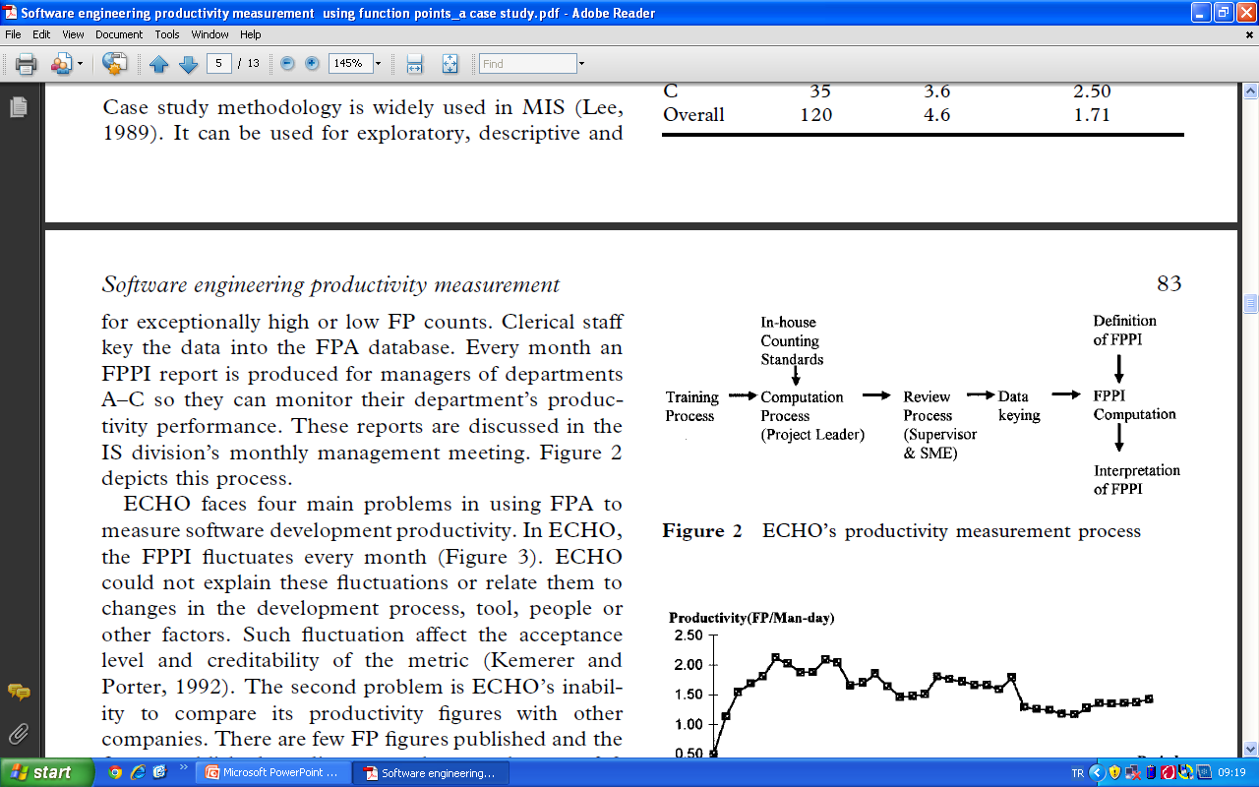
Every month an FPPI report is produced for managers of departments A–C so they can monitor their department’s productivity performance. These reports are discussed in the IS division’s monthly management meeting. Figure 2 depicts this process.

Slide 50
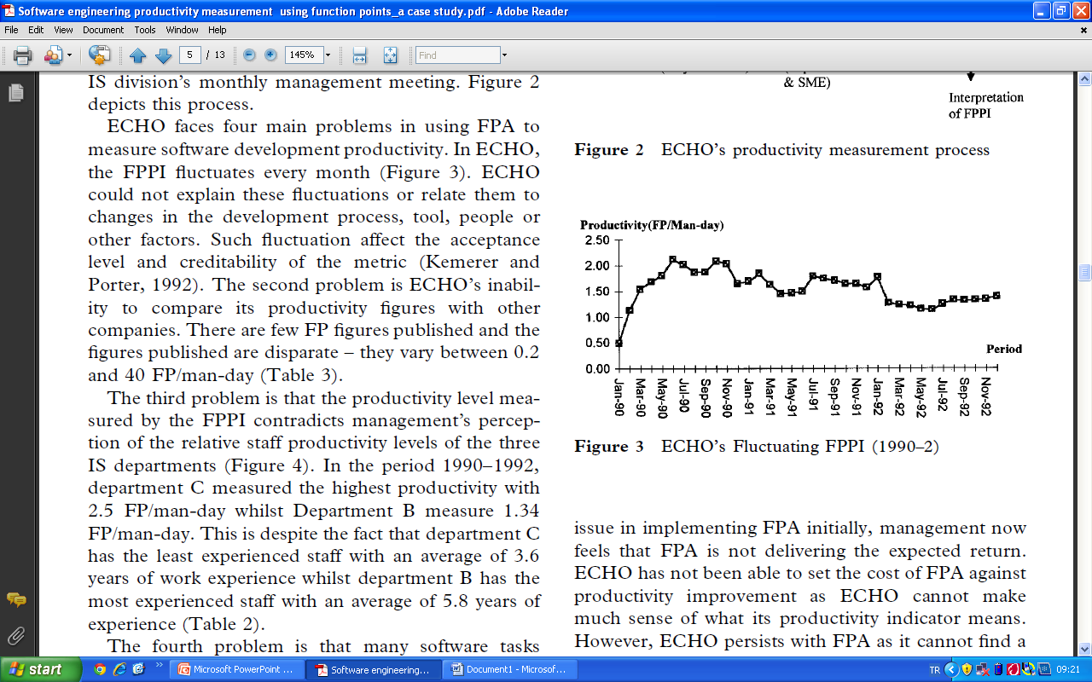
The first problem in ECHO, the FPPI fluctuates every month (Figure 3). ECHO could not explain these fluctuations or relate them to changes in the development process, tool, people or other factors. Such fluctuation affect the acceptance level and creditability of the metric.(Kemerer and Porter, 1992).

Slide 51
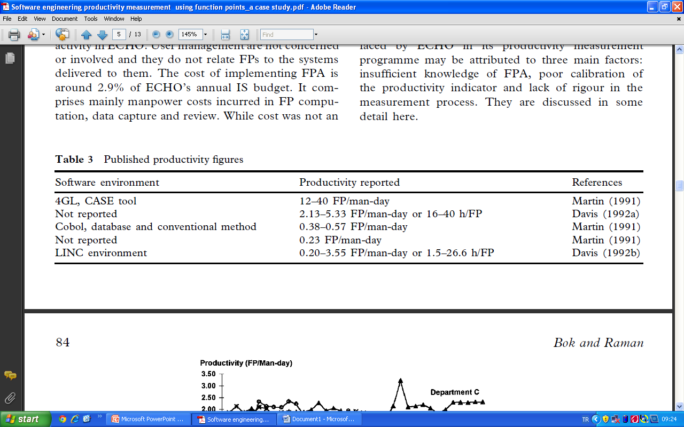
The second problem is ECHO’s inability to compare its productivity figures with other companies. There are few FP figures published and the figures published are disparate – they vary between 0.2 and 40 FP/man-day (Table 3).

Slide 52
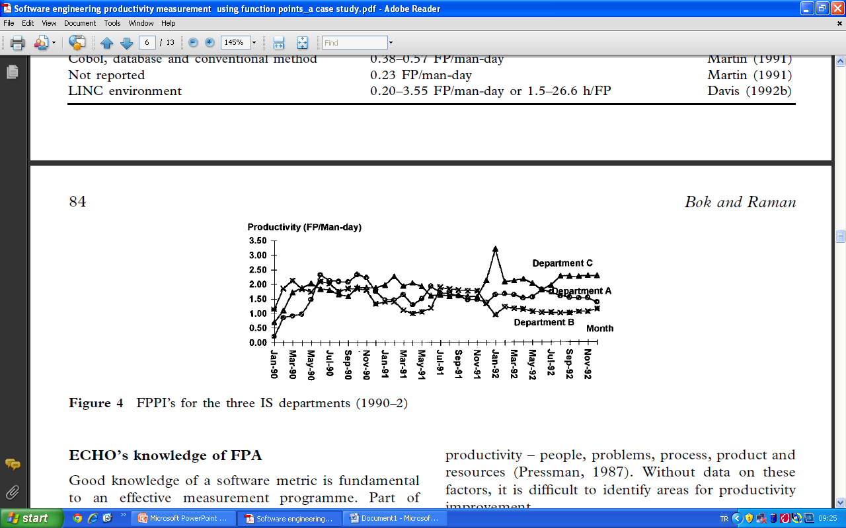
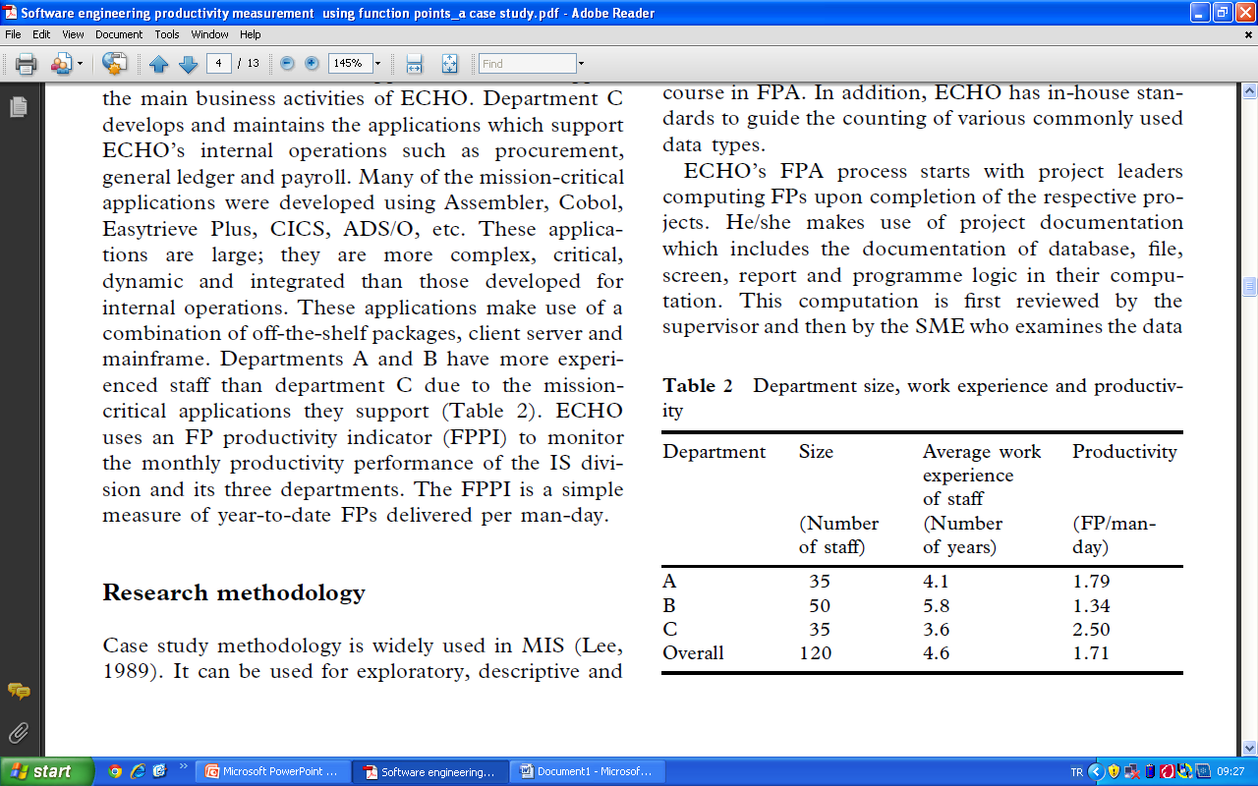
The third problem is that the productivity level measured by the FPPI contradicts management’s perception of the relative staff productivity levels of the three IS departments (Figure 4).
In the period 1990–1992, department C measured the highest productivity with 2.5 FP/man-day whilst Department B measure 1.34 FP/man-day. This is despite the fact that department C has the least experienced staff with an average of 3.6 years of work experience whilst department B has the most experienced staff with an average of 5.8 years of experience (Table 2).

Slide 53
The fourth problem is that many software tasks requested by users do not yield FPs despite substantial effort spent on them. Of the 1649 tasks analyzed between 1989 and 1993, only 31% yielded FPs, 47% of them yielded no FPs and the remaining 22% were user support activities where FPs are not computed. ECHO’s management questioned whether FPA measures all values delivered to users fairly.
To sum up;
The problems faced by ECHO in its productivity measurement programme may be attributed to three main factors: insufficient knowledge of FPA, poor calibration of the productivity indicator and lack of rigour in the measurement process.
Good knowledge of a software metric is fundamental to an effective measurement program. Part of ECHO’s problems can be attributed to its lack of in-depth knowledge of FPA such as its definitions, purpose, assumptions and applications.

Slide 54
For instance, five factors influence software engineering productivity;
People,
Problems,
Process,
Product,
Resources (pressman, 1987).
Without data on these factors, it is difficult to identify areas for productivity improvement.
ECHO’s IS division performs three activities:
software development,
software maintenance,
user support.
However, ECHO only measures the productivity of its development and maintenance activities.
This becomes a problem when the work activities of its three IS departments are not homogeneous – departments A and B spend 43.7 and 60% more resources on user support services, respectively, than department C.
These findings suggest that ECHO has inadequate knowledge on the assumptions and limitations of FPA and its applications.

Slide 55
Different technologies are capable of delivering different productivity (Martin, 1991).
Disparities in the dominant technology platforms used in the different departments suggest that a productivity comparison across departments must consider the effect of the different technologies used.
Disregarding the different dominant technologies used in the three departments makes productivity comparison between them difficult.
For instance, over 70% of the projects in departments A and B use conventional mainframe technologies, which is significantly higher than the 33.3% of department C (Table 4).

Slide 56
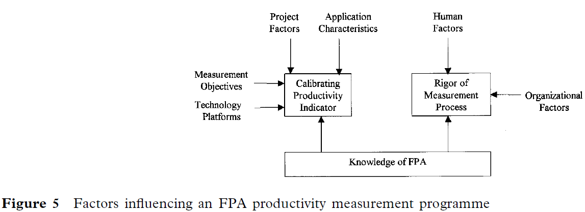
CONCLUSION
This case study suggests that a good knowledge of FPA is fundamental to a successful FPA productivity programme (Figure 5). More importantly, a good knowledge of FPA would help calibrate an FPPI which meets the measurement objectives.

Slide 57
In addition to good knowledge of FPA, organizations must acquire the expertise for calibrating a productivity indicator which is valid for the measurement objectives. Otherwise the indicator will confuse rather than clarify the productivity performance of the organization, as in the case of ECHO. Last but not least, the measurement process must be rigorous enough to ensure that accurate data are collected and correctly analyzed.

Slide 58
THANK YOU...
Aycan Ayyılmaz-Spring 2012

