Slide 1
Project Management Workshop
Trainer :Hari Prasad Thapliyal
MBA, MCA, PGDOM, PGDFM, CIC, MCITP, MCTS, CSM, PMP, PMI-ACP, PRINCE2, Agile
Project Management Mentor, Trainer & Coach
[PMI-ACP : #318050]
[PMP : #1563385]
Content related queries please write to hari.prasad@vedavit-ps.com
This content is legal only for participants of VGL Jaipur May’16 Training
'PMI-ACP', 'PMI', and 'ACP' are a registered marks of the Project Management Institute, Inc.

Slide 2
Trainer Introduction
MCA, MBA (Operations), PGDFM, PMP, MCITP, PMI-ACP, Prince2 Practitioner and CSM
2 decades of experience in IT Delivery, Training, Consulting, Agile/Scrum. 16+ years in various IT delivery positions, 6 years as Project Management Trainer/Coach/Mentor.
Trained 3000+ leaders in India and internationally
190+ corporate / open-house trainings on PMP®, Agile Project Management, PMI-ACP®, PRINCE2, PMI-RM®, PMI-SM®, CAPM®, Microsoft Project® 2007 & 2010, Enterprise Microsoft Project Server® 2007 & 2010, AgileEVM, Earn Value Management, Function Point Estimation (FPA)
Delivered many trainings at international location for the citizen of Philippines, Singapore, Indonesia, Malaysia, Thailand, Japan
Class room training experience of around 5500+ hours
FPA counting experience of more than 30000 FP of 15+ proposals/projects
CMMI (1.1, 1.2), ISO9001:2000 initiative rollout
Ex-Vice President- Volunteer Development with PMI Chennai Chapter
Ex-Vice President- Volunteer Development with PMI Mumbai Chapter
Ex-Chair of Ethics Committee of PMI Mumbai Chapter
Member of PMI Mumbai Chapter & PMI Chennai Chapter
Member of PMI (Project Management Institute) USA

Slide 3
Working Agreements
Working Time
Break Time
Electronics
Corner Talk
Group Exercises
Participation
Our Values (for this project)
Focus
Communication
Respect
Openness
Courage
Share
Everybody
Notes:
Project Management Concepts
06/28/13
Version 3.1, 4/01 © 2003 by AstroWix
3

Slide 4
Workshop Agenda Project Planning & Management
Project Planning
Stakeholder Identification
WBS (Work breakdown Structure)
Risk Identification and Planning
Communication Planning & Management
Software Estimation techniques
Scheduling and Controlling (Waterfall/Iterative /Agile)
Resource planning & Management

Slide 5
Workshop Agenda Requirement/ Design/ Test
Project Management
Importance of requirements for project success
Project Management Methodology / Lifecycle Selection
Effective requirement gathering techniques
Business Requirements v/s Software Requirements
Verifying and Validating Requirements
Managing Scope
Requirements phase in different development models (Waterfall/Iterative/Agile)
Requirement Elicitation techniques
Change Management
Stakeholder Management
Design
Analysis vs Design in IT Projects
Design Methodologies
Test Management
Test strategy and planning
Test design
Test case preparation
Test Execution
Defect tracking and reporting
Requirements Traceability Matrix
UAT

Slide 6
Workshop Agenda ITIL Processes
Production Support and Issue Management
Release Management

Slide 7
A Small Warning
With this huge agenda it looks we are going to discuss everything under the sun of the software project management and ITES in next 12 hours!
Impossible task! Agree?
We will touch all the “What” need to be done of Software Project Management. Not how, why, when, who.
The objective is to make you conscious about these terms. So that you research, explore and equip yourself more around knowing these terms.
Because it is “what” focused it will not be that much exercised based or case-study based as any depth driven workshop.

Slide 8
Project Management

Slide 9
Project Planning
10 Dimension of Planning
Component of Planning
How to Execute
What
Who
When
How to do
How to Monitor & Control (M&C)
What to monitor
How to measure
Who will measure
How to control
How to report

Slide 10
Choose Right Methodology
Waterfal
Iterative
Agile

Slide 11
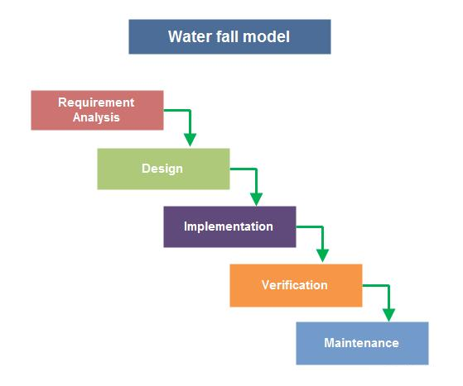

Waterfall

Slide 12
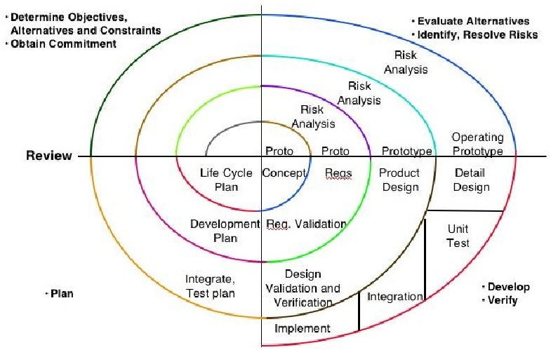
Spiral

Slide 13
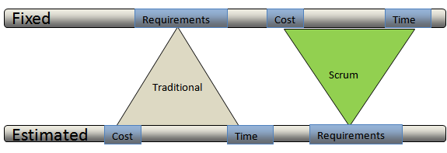
Agile vs Traditional

Slide 14
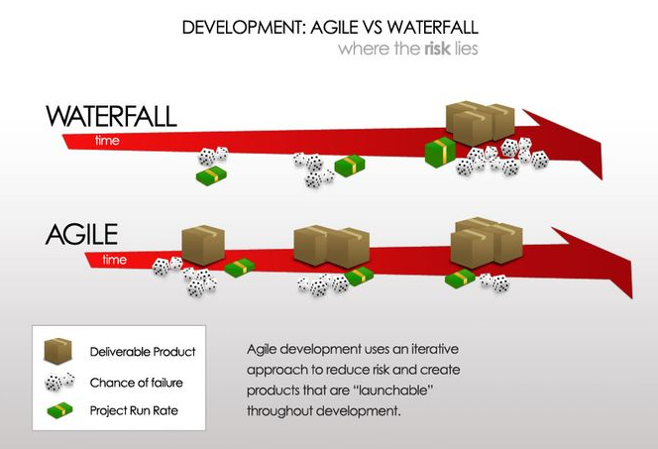
Value, Risk, Productivity in Agile vs Traditional

Slide 15
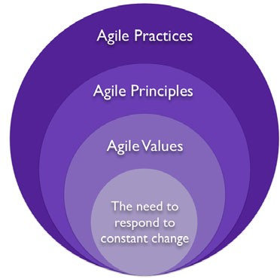
Core of Agile

Slide 16
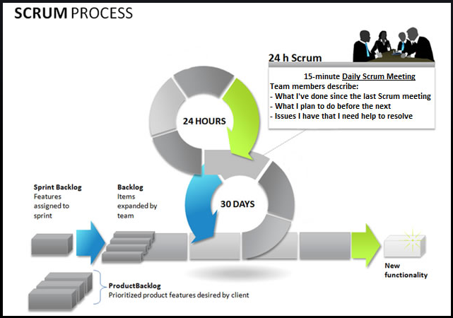
Scrum in a Glance

Slide 17
Stakeholder Identification & Management
Who are stakeholders?
Prepare Stakeholder Register for Every Critical Project
Perform stakeholder interest and influence analysis
Development stakeholder management approach for every key stakeholders
Apply the approach (plan)
Keep your stakeholder register updated
Keep evaluating your approach and aligning it to the need

Slide 18
WBS (Work Breakdown Structure)
What is WBS?
Why WBS is Important?
How many ways of creating WBS?

Slide 19
Risk Identification and Planning
What is Risk?
Prepare Risk Register for every critical project
Analyse impact, probability, exposure of every risk
Prioritize risks based on the exposure
Understand risk tolerance of stakeholders
Based on the exposure and tolerance make decision which risk must have response plan
Prepare risk response plan for every high priority risk
Every risk must have a risk owner
Keep risk register updated
Periodically keep evaluating your risk response plan

Slide 20
Communication Planning & Management
Every critical project should know what information need to be communicated, to whom, at what frequency, via what channel and when. And who is responsible for a particular communication.
Keep your various approved reporting format ready during the project planning or modify it based on the need
Keep communicating as per the plan
Track adhoc communication
Evaluate your communication effectiveness on periodic basis and alter it based on the need.
Track your communication efforts at some place

Slide 21
Software Estimation Techniques
Judgement, Experience
Analogous Estimation
3 Point Estimation
Parametric Estimation
Story Points
Scientific Techniques
Function Point
Use Case

Slide 22
Estimation: Important Points
No estimation is without assumptions. So document the assumptions.
Estimation is never absolute number. So communicate estimation with range
Estimation must be done of every important aspect of the project like size, duration, cost, efforts
4 Persons for 10 month = 40 person months <> 10 Persons 4 Months ☹
Mind the difference between calendar days, duration, efforts, ideal engineering efforts
Even if you have to backward planning (from project end date) in a short duration project. Estimation and negotiation is must.
That estimation is of no use which has not been communicated, agreed and basedlined for tracking purpose. So communicate and get approval.
Estimate buffer (efforts, time, cost) separately and track it separately.
Estimate, provision and track separately change budget

Slide 23
Scheduling and Controlling
Every project manager must know the critical path and critical activities of his project.
Critical activities are those where float / slack is zero.
Float is not same as buffer
Every schedule must be baselined before PM start tracking activities
Perform plan vs actual analysis on regular basis even when stakeholders are not asking for
Whenever deviation is beyond the threshold limit corrective and preventive action need to taken and this must be communicated to relevant stakeholders.
Track your buffer your separately

Slide 24
Resource Planning & Management
Every activity cannot be fastracked.
Every activity cannot be crashed
Resources should not be overloaded than their availability
Productivity is never 100%
Things will go wrong so plan resources accordingly so that you do not fail on your committed baselines.
Manager buffer resources and buffer time/cost of resources carefully
If deadlines, budget is impractical then raise flag communicate effectively even if you have no choice

Slide 25
Requirements, Design & Test

Slide 26
Requirement Management: Important Points
Functional Requirement and Specification documents should have analyzed requirements. Customer should know functional architecture of the system.
If requirements are not part of SRS then they are not part of the project
Use difference level of abstraction diagram to visualize the functional system.
Use difference type of architecture to visualize the solution
Document how will you test and prove that the functional and non-functional requirements of the system are completely built or partially built.
Involve testers throughout the project lifecycle. Tester and developers should not understand requirements from each other but from business analyst and customer.
In an agile built solution and deliver value in increments. No big bang requirements or design phase
Document and track every functional and non-functional requirement through a central system

Slide 27
Importance of Requirements for Project Success
Test case for every functionality is must. This is success criteria of delivery of functionality
Test product against the functional and non-functional requirements both
Change management system should be agreed with stakeholders and it must be in place for fixed price/time project.

Slide 28
Effective Requirement Gathering Techniques
Observation & Conversation
Interviews
Surveys & Questionnaires
Prototyping
Focus Groups
* Do not make any absolute commitment to customer about the requirement implementation till the time requirement are not analyzed and feasibility of the requirements are not verified by the technical team.

Slide 29
Requirement Elicitation Techniques
Use reference document, reference product
Para-phrasing
Throwaway prototype (paper, board, electronic)
Speak user’s language

Slide 30
Requirements Types
Business Requirements
Stakeholder Requirements
System Requirements ( functional and non-functional)
Transition Requirements

Slide 31
Business Requirements
Business Requirements describe why the organization is undertaking the project. Project charter, business case, or in a project vision and scope statement. You can’t build software from such high-level information. It help get the project owner, stakeholders and project team on the same song sheet.
Problem Statement
Project Vision
Project Constraints (Budget, Schedule, and Resource)
Business Objectives
Project Scope Statements (Features)
Business Process Analysis
Stakeholder Analysis
IT Service Impact Analysis
Ex: "We need to establish an online customer portal.” “The portal should list our products under various categories."

Slide 32
Stakeholder Requirements (Software Req.)
Stakeholder Requirements, user needs, user requirements, describe what users do with the system, such as the activities that users must be able to perform. These are generally documented using narrative text, use cases, scenarios, user stories, or event-response tables. Generally documented in a User Requirements Document (URD). Signed off by user community.
Ex: Use Case for Login
1. Go to website
2. Click on login
3. Enter username and password
4. You are redirected to the start page.

Slide 33
Solution Requirements (Software Req.)
Solution (System) Requirements are what the developers use to build the system. These are the traditional “shall” statements that describe what the system “shall do.” System requirements are classified as either functional or nonfunctional requirements.
A functional requirement specifies something that the developer needs to build to deliver the solution.
Ex: "The system shall be able to register a product using the following fields: Name (20 characters long), Details (2000 characters long), Price (currency), Category (pick list).“
Ex: "The system shall support that up to 5 pictures can be listed per product.“

Slide 34
Non-Functional Requirements
Nonfunctional requirements specify all the remaining requirements not covered by functional requirements.
Ex: “System should be able to support 50 concurrent users” “Interest and due calculation report should be ready with 3 seconds” “Application should work on all latest browsers”
Business continuity, Compliance, Interoperability, Maintainability, Performance
Interface: Integration with other system
Operations: Installation, system management
Reliability: Failure rates, availability, recoverability
Usability: Different ability people, navigation, help, documentation, difference experience level people
Legal, packaging, hardware

Slide 35
Transition Requirements (Software Req.)
Transition Requirements describe capabilities that the solution must have in order to facilitate transition from the current state of the enterprise to a desired future state, but that will not be needed once that transition is complete. They are differentiated from other requirements types because they are always temporary in nature and because they cannot be developed until both an existing and new solution are defined. They typically cover data conversion from existing systems, skill gaps that must be addressed, and other related changes to reach the desired future state. They are developed and defined through solution assessment and validation.”

Slide 36
Transition Requirements (Software Req.)
Data Conversion and Migration Data conversions Temporary interfaces User Access and Security Rights Security privileges User access User Acceptance Testing Test case development Test facility Production Turnover and Transition User support and help desk Operations Application support User Preparation and Transition Skill enhancements Training delivery One-on-one support Super user programs Customer and Supplier Preparation and Transition Communications and notifications Data interchange | Pilot Testing Model office Pilot test Organizational Changes Temporary staffing for backfill New hires Transfers Outplacements Infrastructure Transition Servers Storage Network Personal computing devices Changes to Policies, Procedures and Forms Policies Procedures Workflow Forms Business Continuity BC contracts DR Testing
No matter how good the code, with out attention to transition requirements, stakeholder won’t be satisfied with the result.

Slide 37
Verifying and Validating Requirements
Verification is the process of confirming that the designed and built product fully addresses documented requirements. Verification consists of performing various inspections, tests, and analyses throughout the product lifecycle to ensure that the design, iterations, and the finished product fully addresses the requirements.
Validation is the process of confirming the completeness and correctness of requirements. Validation also ensures that the requirements: 1) achieve stated business objectives, 2) meet the needs of stakeholders, and 3) are clear and understood by the developers. Validation is essential to identification of missing requirements and to ensure that the requirements meet certain quality characteristics.

Slide 38
Managing Scope & Change Management
Define change control board and their threshold limits.
Define process of managing changes and make sure team follow that
Understand the meaning of scope creep and manage it
Have project boundary defined in terms of within scope and out of scope in business requirement document.

Slide 39
Requirements Phase in Different Development Models
Waterfall : The first phase of project lifecycle
Iterative : At the start of every iteration. Output of iteration may be architecture, non-working prototype, POC
Agile : Requirements are elaborated during product backlog grooming in every sprint for the future sprint work.

Slide 40
Analysis vs Design in IT Projects
During Analysis Phase/ Activity you
Define the Business Rule
Define the Workflow
Remove the duplicate requirements
Prioritize requirement based on risk, feasibility, dependency
Analyse Usecase of every stakeholder requirement
Analyse the Consistency of requirement with respect to the whole system.

Slide 41
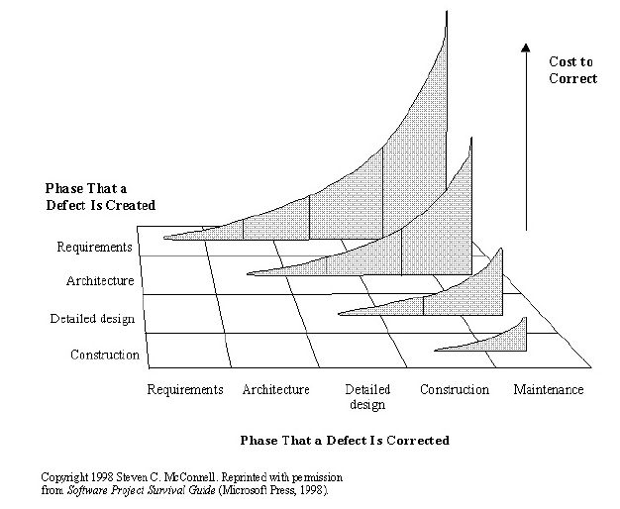
Why are Requirements so Important

Slide 42
Integration & Integration Testing
No last-minute change request.
Defect is not change request.
Ensure defect fix do not break other part of the system (automation)
Automate as much as possible to guarantee high quality
Involve customer

Slide 43
Agile Methods / Practices
Agile Unified Process
DRY
XP
DSDM (Dynamic Systems Development Method)
Agile Software Development
KISS
RUP (Rational Unified Process)
Scrum
TDD
Unified Process
YAGNI
Waterfall
Spiral

Slide 44
Design Methodologies
Hierarchy Architecture / Structured Analysis and Design Technique: This approach utilizes a diagram to describe the hierarchy of a system's functions.
Data Structured Systems Development: Data structure determines the system structure in this methodology.
Object Oriented Design: This methodology is based on a system of interacting objects.
Agile Design
Heterogeneous Architecture
SOA Architecture
Interaction Oriented Software Architecture
Master/Slaves Software Architecture
Data Flow Architecture
Top Down Design or Stepwise Refinement: This starts from the end solution and works backwards, refining each step along the way.
Bottom Up Design: This methodology starts with a foundation and works up towards a solution.
Structured Design: This is an industry standard. The technique starts by identifying inputs and desired outputs to create a graphical representation.

Slide 45
Test Design /Test Strategy and Planning
Based on the complexity of application make what different level of testing will be performed.
Make a plan to ensure each type of testing. (Infrastructure, Responsibilities, Activities, Schedule, Cost, Test Case, Reporting, Defect Fixing)
Is any third party certification required after testing

Slide 46
Processes for Testing & reporting
Test case preparation
Test case review
Test case execution
Reporting Test Results
Defect Logging

Slide 47
Defect Tracking and Reporting
Defect Logging
Defect Prioritization
Defect Assignment to Dev
Defect fix confirmation (update test case pass/fail)

Slide 48
Requirements Traceability Matrix
Use RTM to track the progress of each functionality
RTM is excel sheet kind of column structure
RTM contains: Req Id, BC Ref, Design Ref, TC Ref, Dev Ref, Delivery Status, Rel. #, Owner
Update RTM during and verification and validation
Use RTM for preparing delivery status report

Slide 49
UAT
Help customer in writing User Acceptance Testcases in advance
Encourage customer to test the product using UA Testcases
Define UAT environment and validate before UAT start
Train customer about how/where to log UAT defects
Dedicated team to fix the UAT defects on priority and made decision
Do not work on any new requirements while fixing any UAT defect

Slide 50
ITIL Processes

Slide 51
IT Systems Includes
Firewalls
Various type of local, intranet and cloud Storage
Directory Services
Various Types of Database Servers
Various Types of OS
Various Types of Web Client
DHCP Services
Application Servers
Various type of Network devices and protocols

Slide 52
Challenges
Change in business happening every moment and this sends out it ripples
Challenges is how to ensure high security, performance, availability with distributed and heterogeneous system and manage all this with lesser cost and outsourced team!

Slide 53
So..
How they manage the complex challenges
Banks,
Insurance
FMCG
Transporters
Airlines
Financial Security
Defence
Oil & Gas
Universities

Slide 54
Learn from others…
Processes
Functions
Roles
That how they manage services and service lifecycle

Slide 55
What is service?
The best way to think about a service is to think terms of customer. Why should they pay for it? Business is the customer of IT.
If services are not available then it's not a service. So availability management is the key.
All the service support and service delivery disciplines work together to deliver agreed levels of service availability to our customers.

Slide 56
Functions and Roles
4 Functions
The Service Desk
Technical Management,
Application Management,
IT Operations Management
Roles & RACI
Process owner
Service owner
Technology and Architecture for Service Management & Service Automation

Slide 57
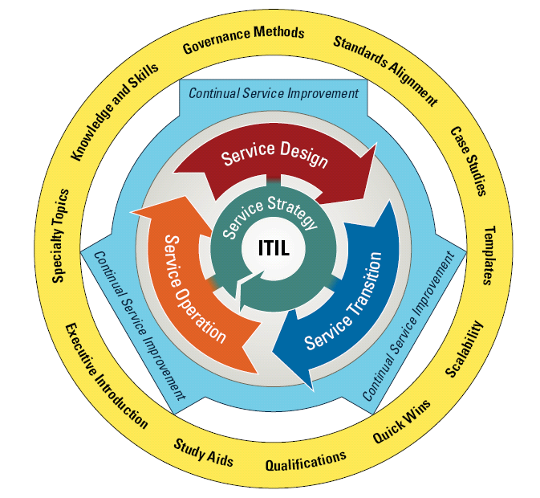
The ITIL V3 Service Lifecycle
ITIL Core
ITIL Complimentary Guidance
ITIL Web

Slide 58
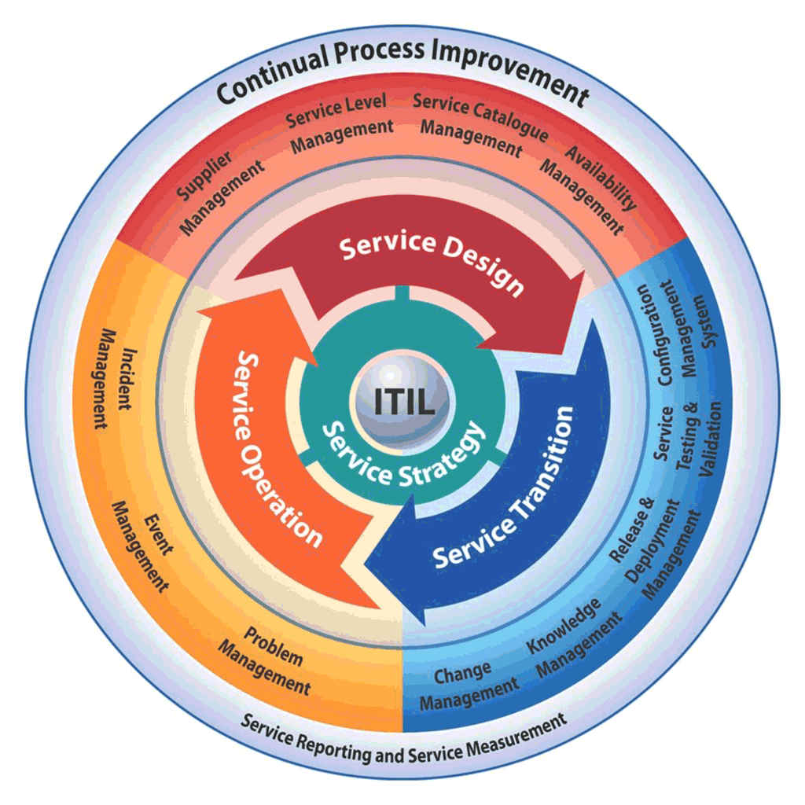
ITL Core Processes

Slide 59
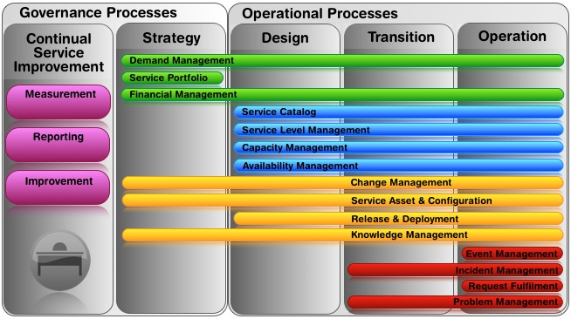

Slide 60
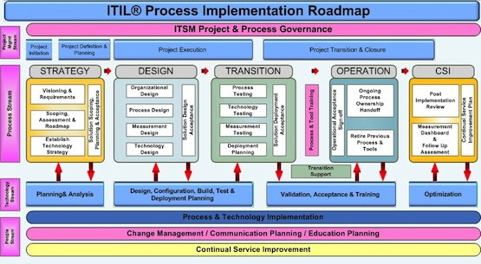

Slide 61
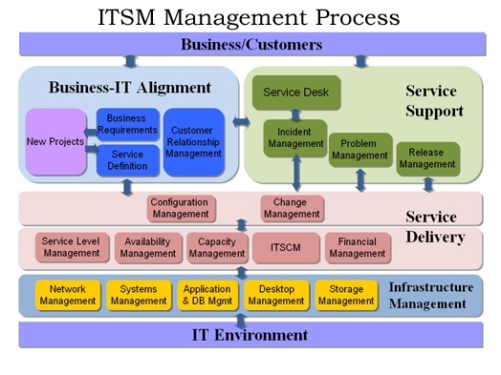

Slide 62
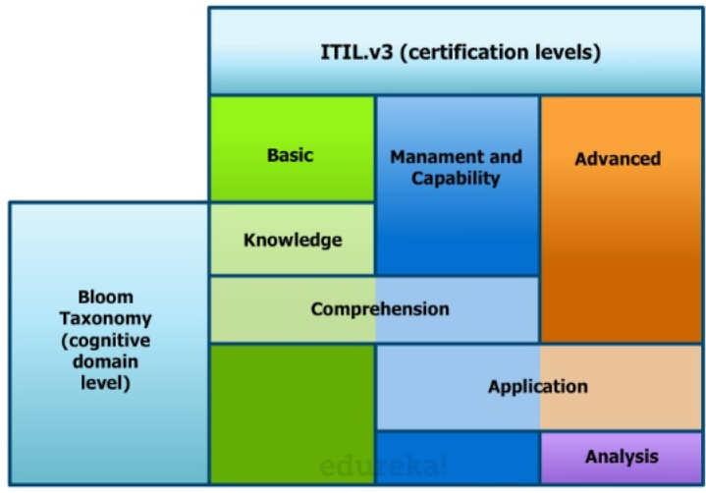
ITIL Levels

Slide 63
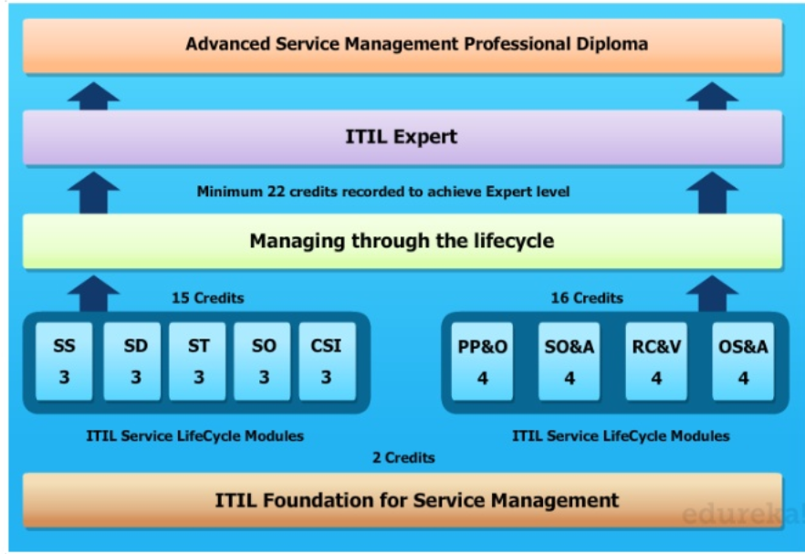
ITIL Levels

Slide 64
Processes
IT Service Strategy | IT Service Design | IT Service Transition | IT Service Operation | IT Continual Service Improvement
Portfolio Management Financial Management Demand Management | Service Catalogue Management Service Level Management Capacity Management Availability Management Continuity Management Information Security Management Supplier Management | Support & Transition Management Change Management Asset & Configuration Management Release & Deploy Management Validation Management Evaluation Management Knowledge Management | Event Management Incident Management Problem Management Fulfillment Management Access Management Service Desk Function Management Service Operations Function Management Technical Operations Function Management Application Operations Function Management | IT Governance Management (using COBIT best practices) IT Resource Management IT Quality Management (using Six Sigma methods) IT Security Management (using ISO standards) Service Measurement Service Reporting Service Improvement

Slide 65
Products (Tools)
IT Service Strategy | IT Service Design | IT Service Transition | IT Service Operation | IT Continual Service Improvement
Service Request & Planning Tools Service Knowledge & Configuration Management Tools (SK-CMS) | Service Catalogue Tools Service Level Management Tools Capacity Planning Tools Service Modeling Tools SK-CMS | Asset Management Tool Service provision Tool Run Book Task Automation Tools SK-CMS | Service Desk with Incident Management Tool Problem Management Tool Event Management Tool Run Book Technology Troubleshooting Tool Run Book Application Troubleshooting Tool SK-CMS | Compliance Management & Measurement Tools SK-CMS

Slide 66
People
IT Service Strategy | IT Service Design | IT Service Transition | IT Service Operation | IT Continual Service Improvement
Service Definition Manager Service Research Manager Financial Analysis Manager Service Marketing Manager Service Forecast Manager | Engineering Manager for Security Desktop Network Systems, Servers & Storage Applications | Assets Manager for Security Desktop Network Systems, Servers & Storage Applications | Operation Manager for Security Desktop Network Systems, Servers & Storage Applications | Service Measurement Manager Quality Measurement Manager Compliance Measurement Manager Security Measurement Manager Resource Measurement Manager

Slide 67
Release Management
Release calendar
Release plan (hardware/software, responsibilities, activities, validation, plan B)
Migration Strategy
Minimal Downtime
Configuration Control
Release Documents
Committed Team
Defect Prioritization

Slide 68
Production Support & Issue Management
Setup a Service Support Desk
Group the incoming call/email/tickets
Service Request, Incident, Complaint
Identify the impact of incident & assign Level to it
Assign Incident
Incident addressed
Incident closure is verified
Incident ticket is closed

