Slide 1
Important Information
I am still working on this training material. I will finish this by this weekend.
It will be available to you for printing on by Monday Morning.
Sending this training ppt along with few exercise for your review and knowing that we have enough emphasis on operational excellence
I am sending you pre-read and references. You can share those with participants.
Please share Monthly Status report of L&T TS with me
Krittika, please go ahead to use the material here to prepare handouts

Slide 2
Operation Excellence
Workshop
Trainer : Hari Prasad Thapliyal
(PMP, PMI-ACP, CSM, MBA, MCA, PGDOM, PGDFM, CIC, PRINCE2-Practitioner)
[PMI-ACP : #318050]
[PMP : #1563385]
Copyright: Vedavit Project Solutions
Hari.prasad@vedavit-ps.com
+91-9535999336
This content is legal only for participants of L&T TS Vadodara Nov’16 Training
'PMI-ACP', 'PMI', and 'ACP' are a registered marks of the Project Management Institute, Inc.

Slide 3
Pre-read & Work
Read
Case Study: Product Development & Collaboration Platform
Optional: Walk through the reference links given at the end of this presentation.
Write
Create a WBS for Case Study Project and share with Trainer.
Prepare a list of key challenges which you want to address through this workshop. Share a summarized list along with participants name with trainer
Setup
Microsoft Project 2013 Installed & active on every trainee’s machine

Slide 4
Workshop Objective
Operational Excellence
Delivery Excellence:
Planning & Organizing. Analytical Thinking and Decision Making
Adherence to Project Metrics. BSC
Control to Project Metrics
Business Acumen:
Finance for non-finance Managers
Notes:
Project Management Concepts
06/28/13
Version 3.1, 4/01 © 2003 by AstroWix
4

Slide 6
Introduction
Introduction & Expectation Setting
Name
Role
Total Experience /PM Experience
Expectations

Slide 7
Workshop Ground Rule
Please keep your mobile on the silent mode. Always take your calls outside the training room.
No corner talk! Discussions only when group discussion is allowed
Keep your focus on the ongoing topic. Await your turn during the questionnaire round.
Strictly follow the workshop schedule for management of time.
There is parking lot. Write you questions and post with your name on parking lot.
Breaks only on agreed time
Tea
Lunch
Tea
Everybody need to contribute
Use your experience only for relating the processes and best practices. To avoid confusion keep it outside of the class. Unlearning is first and biggest learning to learn something new.
Two Bowls

Slide 8
Theme of Workshop
Proactiveness
Plan
the work and work the plan
Transparency
Report the progress
Create Alternative Solutions
Report with solution and seek advice
Self Motivation
Remain Motivated
Measure
Measurement is the key to improve
Value Chain
Value for Customer
Communication

Slide 9
Workshop Agenda
Day 1:
Define Project
Planning with Microsoft Project
Buffer Management
Day 2:
Project Tracking
Communication & Reporting
Risk Management
How to bring almost failed project on track
Business Acumen

Slide 10
Case Study Introduction
PLM Practice: Developing, deploying and implementing the technologies, products, application. Helps in lowering cost, delivering value, saving time, ensuring quality.
Client: Automobile part manufacturer in Japan. Specialized in Global procurement needs of automobile manufacturers
Business Perspective: Provide secure, reliable, cost-effective end-to-end implementation, maintenance and support of PLM System
Project Work: PLM System has Product Development (PD) Collaboration Framework (PDCF).
Replace existing env with PDCF, so that a global repository is in place
Integrate PDCF with existing legacy system
Release Design data for OEM
Automating the processes
Intercontinental network connectivity and caching using Akamai Tech.
Accommodating new requirements to PDCF
Global support model
Approach
Setup a Offshore Del Centre (to handle complete process)
Study (legal system and file transfer tool) to establish bi-directional communication with PDCF
Design (network layout and installation) of secured volume server
Creation of custom service (for inter application communication with high performance and no data-loss)
Import legacy data to PDCF
Creating monolith JT and HPGL files (through TeamCenter Dispatcher)
Handover of design and drawings (across global sites)
Setting up 4-tier architecture (without disturbing existing 2-tier arch)
Suggesting and implementing best solution to resolve Functional and op issues
Consultation to enhance business process
Tools: PLM TeamCentre 8.3, Akamai (Terra Solutions, Apache Tomcat Web Server)
Impact: 80% reduction (in post production defects), 40% faster (business process, decreased time to market), 25% reduction (IT and systems support costs), 20% reduction (cost in specific operational areas), 10% increase (profit)
Final Result: Complete control over usage of licenses, Reduced COQ, Reduced TTM (lead time), Improved data security, Reduced failure risk, Better global collaboration

Slide 11
Operational Excellence
Operational Excellence =
Strategy Deployment+
Performance Management +
High Performance Work Teams +
Process Excellence
Process Excellence = Efficiency + Effectiveness
Lean = Efficiency : is about reducing the lead time of a process or value stream.
SixSigma = Effectiveness : is about reducing the variation in a process or value stream.

Slide 12
Operational Excellence
Operational Excellence is an element of organizational leadership that stresses the application of a variety of principles, systems, and tools toward the sustainable improvement of key performance metrics.
Improvement: Lower operating cost or reduced inventory while others describe it in terms of increased efficiency or better quality.

Slide 13
Key Concepts of Continuous Improvement
What
Customer Focus
Work Process Improvement
Continuous Measurement
Supportive Work Environment
How
Doing the Right Things
Doing Things Right
Fact-based
Involving Everyone in making it happen

Slide 14
Define Project & Scope

Slide 15
Scope Management Concepts
High-level scope is defined in project charter and consists of boundary statements and deliverables.
Project boundary: (Example)
This application affects only finance department
Security implementation to all the legacy application
Only procurement and legal department workflow integration is part of this application. Others are out of scope.
Scope (List of deliverables: documents, trainings, product, components, supports etc)
Product Scope
Project Scope
Business Requirement
Functional Requirements (behaviour, how system)
Non-functional Requirements or Features (usability, performance, security etc)
In PLC business requirements may change not the boundary nor the deliverables.

Slide 16
Scope Management Concepts
Output: Product delivered by the project to the customer
Outcome: Operation results to the customer by the use of product. Number of incident decreased, efficiency increased, defect decreased, easy handling
Benefits (Business value) : Value which customer gets from the usage of product. % save in money, % defects decrease, % productivity increase.
Scope Creep: Unapproved, unplanned, unbaselined small work, which is done at the customer request to keep him happy.

Slide 17
Change Management
What is change?
Anything which you have to do to make project successful and customer happy but it is not part of the baseline plan is change.
A request for the change may be for scope, requirement, process, human resources, report
Change has impact on project objectives
Cost, Schedule, Scope and Quality
Change can introduce new risks
Every change request should be evaluated and decision should be made by project manager or above authorities
Based on the impact decision making is done by different change control board.

Slide 18
Exercise Scope Management

Slide 19
Success Criteria
Project Success Criteria
In project life cycle project progress need to tracked using certain metrics like SV, CV, Defects, Requirement Stability, Change Request, Productivity, Resource Utilization, Resource Iterations, # of communication, Cost of Communication,
Project success criteria for every stakeholder may be different.
Product Acceptance Criteria
When product will be shown to the customer he will test the product against some parameters. Define those criteria as early as possible in PLC
Product Success Criteria
When customer uses product and it impacts his operational efficiency, profit margins, reduces defects, productivity that he considers the product success.

Slide 20
Project Sing-off Checklist
90% of the work happens in 90% of the time and 10% of the work takes another 90% of the time.
If PM does not have a well defined checklist for the project signoff he may spend huge amount of time towards the end of project.
Prepare a checklist of project signoff and keep that in mind from the first day of the project.
Checklist may be
Features Delivered/committed : 100%
No of known defects: xx
No of trainings conducted/committed: 100%
Documentation completeness : 100%
Release note prepared: Yes

Slide 21
Exercise Success Criteria

Slide 22
Test Cases
Quality Test Cases
Test cases defined by the Quality team of L&T to test the product develop by the team
Test results of quality testing shows maturity of development processes
Acceptance Test Cases
Test cases defined by the customer of L&T to test the product delivered by L&T
Test results of acceptance testing shows the maturity of L&T delivery

Slide 23
Exercise Test Cases

Slide 24
Stakeholders
Individuals or organizations who are affected or perceives as affected by the progress or completion of the project.
Example: Sponsor, Management, PMO, Departments, Govt, Community, Competitor, Vendors etc.
Every project manager need to maintain a stakeholder register and manage the engagement using this document.

Slide 25
Exercise Prepare Stakeholder Register

Slide 26
Requirement Traceability Matrix
What is RTM?
When to setup & update this?
How to use it?
Structure of RTM
Requirement #
SOW Ref#
Functional Requirement Ref#
Design Ref#
Test Ref#
UAT Test Ref#
Status
Requirement Owner (Stakeholder)
Due Date
Type of Requirement

Slide 27
Planning with Microsoft Project

Slide 28
WBS
Understand WBS
WBS type
Control Accounts
Which type of WBS is suitable for my project?

Slide 29
Exercise Create/Review WBS

Slide 30
Steps for Preparing Project Schedule
Identify Activities
Sequence Activities
Estimate Activity Resources
Estimate Activity Durations
Critical Path Analysis
Schedule Compression
Fast Tracking
Lead & Lag Analysis
Schedule Optimization
Negotiate Schedule
Critical Path Simulation
Baseline Schedule

Slide 31
Facts/Tips for Critical Path
Total Float is the amount of time the task can delayed without delaying the project finish date.
Free float is the amount of time a task can slip without delaying the early start of any task that immediately follows it
It is possible that a zero float activity may not be on critical path
Longest path & shortest time possible to complete the project
A project can multiple critical paths
Difference between late and early is float
Positive float (the activity can wait to start even after previous activity finishes)
Negative float (the activity must start before previous finishes)
Zero float (the activity must immediately start after the finish of previous one)
Crashing activities to short the overall duration of project
Fast-tracking activities to short the overall duration of project
Be cautious that non-critical activity is not being delayed than the allowed free float
Take care of sub-critical path or non-critical path
Manage critical path resources very closely
Do not overload critical path activity resources
Avoid multitasking for resources working on critical path activities

Slide 32
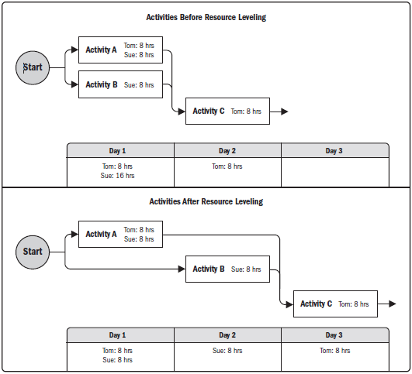
Resource Optimization Techniques
Resource Levelling
Ensure resource are not allocated more than their availability for the given project. Can lead to change in critical path.
Resource Smoothing
Adjust activities in such a way that resources requirement do not exceed than defined limit. No change in critical path. Activities can be delayed within their float (free/total).

Slide 33
Estimation
Estimate resources, duration, cost.
Range of Estimate
Analogous Estimation
PERT Estimation
Parametric Estimation
Bottom-up Estimation
Basis of Estimation
Alternative Analysis
Reserve Analysis (Buffer Estimation)

Slide 34
Project Baseline
What is a baseline?
What does it comprised of?
Importance of baseline.
Best practices for project baselining.
Negotiating baseline with relevant stakeholders.

Slide 35
Exercise Complete Project Baseline

Slide 36
Buffer Management
Difference between slack & buffer.
How to estimate buffer?
What should be part of buffer?
Relationship between buffers and risk

Slide 37
Project Tracking, Project Governance

Slide 38
Measurement: KPI, BSC
If you cannot measure you cannot manage
Vision or Destination Statement
Strategic Objective
BSC 4 Perspective
Financial Performance (increase revenue, increase profit, lower cost)
Internal Business Process: Efficiency (process efficiency, lower cycle time, reduce waste)
Customer: Satisfaction (lower wait time, improve customer retention)
Organizational Capacity: Knowledge and Innovation (Improve Skills, Improve Tools, Improve Technology)
Create Strategy Map
Performance Measure & Target Strategic Initiative

Slide 39
Measurement: Project Metrics & Data
Identify project metrics which can be mapped to minimum one KPI of either of 4 perspective of BSC (Balance Score Card)
Identify what data is required is generate the metrics
Define processes to get that data on the source. Define roles, responsibilities & frequency of data collection. Automatic data collection is better.
Define frequency you analyse the data, compile metrics and reflect overall progress on BSC. Automatic KPI generation is better.

Slide 40
Project Governance
Define Project Governance Structures
Define who will review what metrics and KPI (senior management do this) with whom
Define who prepare CAPA plan
Define who makes decision for the course correction

Slide 41
Analytical Thinking & Decision making

Slide 42
"As much as 95% of quality related problems in the factory can be solved with seven fundamental quantitative tools." - Kaoru Ishikawa

Slide 43
DOE
Design of Experiments is an analytical technique, which aims using testing (experiments) to test different values ​​of quality system or product.
Reduce time and cost, design and testing of a product or system
Improving the quality of a product or system
Reducing the cost of pilot series

Slide 44
Mind Map
Mind Maps are highly efficient analytical technique applicable particular in problem solving, learning and personal development.

Slide 45
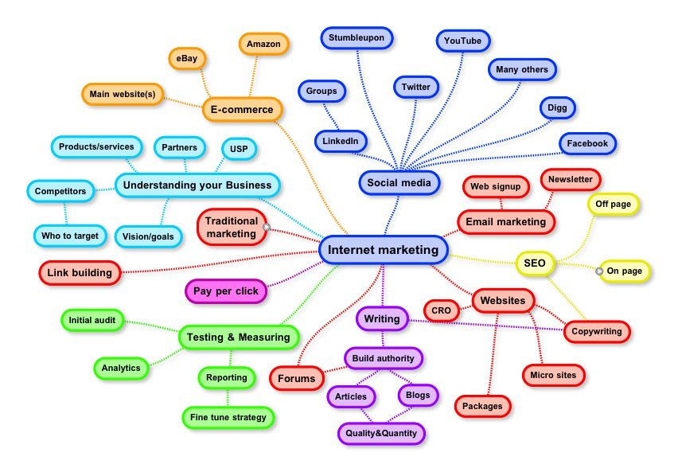
Mind Map

Slide 46
PESTLE
PESTLE Analysis is an analytical technique used for the strategic analysis of organizational surroundings.
Political
Economical
Social
Technological
Legal
Ecological

Slide 47
QFD (Quality Function Deployment)
QFD is used for quality planning in the development of customer requirements into product requirements. It therefore converts customer requirements to product characteristics. This method
Reducing the number of product changes
Reducing the cost of the product development
Shorten the product development time
Transfer the customer requirements into the final product

Slide 48
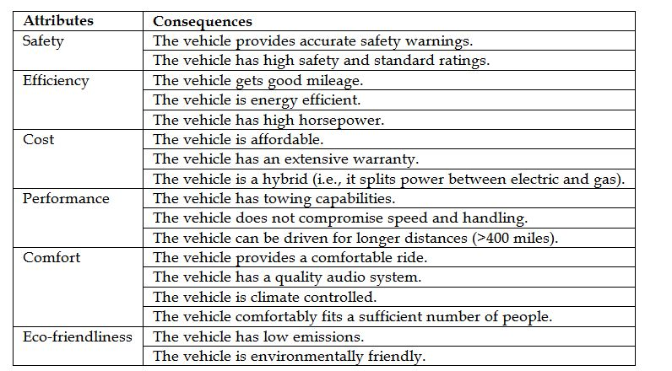
QFD

Slide 49
Value Stream Mapping (VSM)
It uses a graphical display of the flow value (flow value visualization), which can be financial, material, information or other and it helps deeper understanding of the entire flow of the production processes that pass through the entire organization and its relation to the organizational management system, planning and customer requirements.

Slide 50
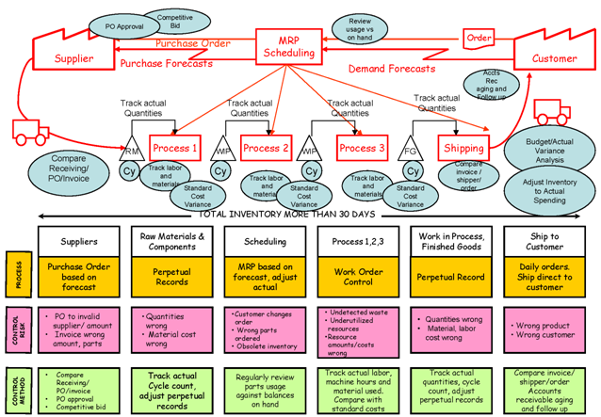
Value Stream Mapping (VSM)

Slide 51
Variance Analysis
Compare actual vs planned

Slide 52
Check Sheet

Slide 53
Histogram
From a set of data compute
Sum
Mean (x)
Max
Min

Slide 54
Histogram
Data Set from last Thursday(pizza slices of Pizza Hut)
2 2 1 2 2 4 1 3 1 2 1 2 2 4 3 4 1 4 3 2 2 3 2 1 2 2 1 2 2 1 4 2 2 1 2 1 2 2 1 2 1 2 1 2 1 2 1 2 1 2 2 2 1 2 1 2 1 1 2 2 2 3 1 4 2 2 3 2 2 2 1 2 3 2 2 4 2 2 4 4 1 2 2 2 3 2 2 1 2 2 4 2 1 2 4 2 1 7 2 1 2 2 3 1 2 1 1 2 1 2 2 2 1 2 2 1 2 1 2 2 2 4 0 4
Mean = 2.032258
Max = 7
Min = 0

Slide 55
Histogram
How to use this information for strategic planning?

Slide 56
Pareto Chart
80/20 Rule
Slices | Frequency | %
0 | 1 | 0.8%
1 | 33 | 27.5%
2 | 65 | 54.2%
3 | 8 | 6.7%
4 | 12 | 10.0%
5 | 0 | 0.0%
6 | 0 | 0.0%
7 | 1 | 0.8%

Slide 57
Pareto Chart

Slide 58
Pareto Chart
How to use this information for strategic planning?

Slide 59
Scattered Diagram
Minutes Defective
Cooking Pies
10 1
45 8
30 5
75 20
60 14
20 4
25 6
In this simple example, you can find the existing relationship without much difficulty but…
Defective Pizzas
Time Cooking (minutes)

Slide 60
Flowchart
A graphical picture of a PROCESS
Process
Decision
The process flow

Slide 61
Fishbone Diagram
Problem: High Inventory Shrinkage at local Drug Store
Employee
Attitude
Training
New Trainee
Benefits
Practices
Shrinkage
Anti-theft tags poorly designed
Expensive merchandise out in the open
No security/ surveillance
Shoplifters

Slide 62
Run Charts
Pizza Hut counter.
What do you interpret from this chart?
Slices/hour
5
10 15 20 25 30 35 40 45 50 55 60 65 70 75 80 85 90 95 100
8 9 10 11 12 1 2 3 4
8 9 10 11 12 1 2 3 4
8 9 10 11 12 1 2 3 4
Time
PM- AM
PM- AM
PM- AM
Thursday
Week 1
Thursday
Week 2
Thursday
Week 3

Slide 63
Control Chart
Pizza Hut Management wants to get in on the control chart action
Average Diameter = 16 inches
Upper Limit = 17 inches
Lower Limit = 15 inches

Slide 64
Control Chart
What do you interpret from this chart?
Upper Limit
17 inches
Lower Limit
15 Inches
16 inches=
X
Small Pie

Slide 65
What if Scenario Analysis
Assess the feasibility of project schedule under adverse conditions. Prepare a contingency plan to overcome the problems. Or prepare mitigation plan to reduce the impact of unexpected situations.

Slide 66
Decision Tree

Slide 67
Communication & Reporting

Slide 68
How to establish the purpose of every communication. What to communicate?

Slide 69
Decision making process, speed of decision making and technology of communication

Slide 70
What should be part of a status report?

Slide 71
What should be part of a progress report?

Slide 72
What should be part of a forecast report?

Slide 73
Interpersonal Skills of PM
Leadership
Team Building
Motivation
Communication
Influencing
Decision Making
Political & Cultural Awareness
Negotiation

Slide 74
Perception Management
People give their own meaning to the data, event, behavior to the world around them is perception creation.
Perception is about organizing the data, image in mind. On the validation you can find that perception may be true or may not be.

Slide 75

What do you see?

Slide 76
Perception Management Steps
Think: How people are perceiving you
Know: How you are actually being perceived
Decide: How you want to be perceived
Story: Create a full end-to-end consistent story, which you want tell to achieve your goal
Meet: Meet to the people and tell your story
Feedback: Ask them questions which helps you in knowing whether your goal is achieved
Confirm: Paraphrase the feedback to confirm whether you understood properly
Thanks: Say thanks to people who have given time to listen your story.
By: Hari Thapliyal

Slide 77
Management by Exception
Project Manager should have enough control required to manage the project with minimum day intervention from the Management
Project boards should have checkpoint and event based control over the project
Project manager and project board should work within their tolerance limit of scope, time, cost and quality
Tolerance limit should be defined in project management plan.

Slide 78
Risk Management

Slide 79
What is the meaning of risk? How to identify risk? Relationship between risk, assumption, dependency, constraints, risk impact

Slide 80
Prepare a risk register

Slide 81
Risk assessment

Slide 82
Strategies to manage threats (negative risks)

Slide 83
Strategies to manage opportunities (positive risks)

Slide 84
How to establish contingency buffer to manager risks

Slide 85
Risk tracking & reporting. Timing, Responsibilities, Format

Slide 86
Failed Project Case Study

Slide 87
How to bring almost failed project on track

Slide 88
Business Acumen

Slide 89

Value Chain Analysis
Value Chain Analysis is a useful tool for working out how you can create the greatest possible value for your customers.
Activity Analysis: First, you identify the activities you undertake to deliver your product or service.
Value Analysis: Second, for each activity, you think through what you would do to add the greatest value for your customer.
Evaluation and Planning: Thirdly, you evaluate whether it is worth making changes, and then plan for action.

Slide 90
Exercise Value Chain Analysis

Slide 91
Type of Costs
Transaction cost: Example- Buying a used car. Search, Bargain, Policy
Sunk/Retrospective Cost: a cost that has already been incurred and cannot be recovered. Sinking cost in installation of some software/systems. Selling a newly purchased car.
Opportunity Cost: choice of a best alternative lost while making a decision. The opportunity cost of leaving their money in the Chinese stock market or Chinese real estate market is too high relative to yields available in the USA real estate market. The cash expenditure of $100 represents a lost opportunity to purchase something else with the $100.
Material Cost: Material are those things which will be consumed in the project and cannot be taken out of the project after product is handover to customer.
Labour Cost: Cost of human resources, for which project has to pay for every hours of timesheet.
Service Cost: Cost of equipment, testing, training, third party audit.
License Cost, Network equipment Cost are material cost

Slide 92
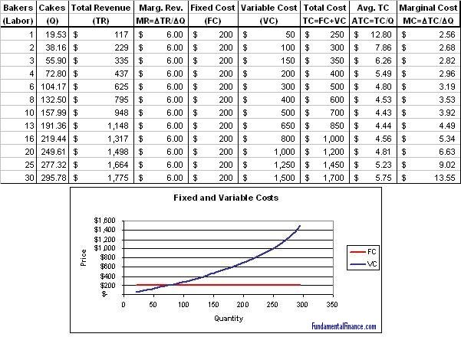
Classification: Type of Cost
Variable Cost: Pay on usage. Depends upon output.
Fixed Cost: Fixed for per period irrespective of usage.

Slide 93
Classification: Type of Cost
Direct Cost : Cost of resources, which are used for a specific activity.
Indirect Cost or Overhead Cost: Cost of resources, which are used for multiple activities. Admin Salaries, Rent, Utilities,
Admin Overhead
Manufacturing Overhead

Slide 94
Total Cost of Ownership
Cost of Development
Cost of Deployment
Cost of Maintenance
Cost of Support
Cost of Phasing out

Slide 95
Metrics
Metric is just another number if there is no interpretation, communication, action plan and implementation of plan to take timely measures.

Slide 96
Financial Ratio
Ratio analysis is based on line items in financial statements like the balance sheet, income statement and cash flow statement;
Helps in diagnosing the financial health of my company
Help managers make decisions about investments or projects that the company is considering to take, such as acquisitions, or expansion
Used to know company’s operating and financial performance such as its efficiency, liquidity, profitability and solvency.
The trend of these ratios over time is studied to check whether they are improving or deteriorating.
Ratios are also compared across different companies in the same sector
For a specific ratio, most companies have values that fall within a certain range.

Slide 97
Types Financial Ratio
Profitability Ratios
Liquidity Ratios
Activity Ratios (Efficiency Ratios)
Debt Ratios (leveraging ratios)
Market Ratios
Capital Budgeting Ratios

Slide 98
Read one L&T monthly report and understand

Slide 99
Reading Balance Sheet Reading Income Statement Analyse Financial Ratios

Slide 100
Invoicing Cycle & Billing Analysis

Slide 101
Session Closure: Action Planning

Slide 102
The Top 10 Must Do’s for Operational Excellence
Communication: IT is working on a project in the Bangalore adding a new feature but Operations is unaware of this work. Therefore, Operations needing this area fixed purchases a solution or manufactures a workaround.
Training: If people don’t know the proper processes, they create inefficient steps gradually chipping away at productivity numbers. A customized training program should blend your operational process with the vendor-generic features.
It is important to know your operation: Once you have your process map flow the next step is to audit the process.
Know that you are in the “People Business”: Invest time on creating a team of passionate player
Customer Service is essential: Every department needs to know who their customer is and communicate with them. Survey them and find out how to better service them and from these support teams you can improve productivity.
X is the most costly process in the distribution center: Perform Value Chain Analysis. Identify new technologies for improvement.
Remove barriers of success: Associates tools weren’t organized creating a 30 minute search at the beginning of each shift. No batteries for RF. The IT control freak insisted on keeping extra batteries in his office which was 500,000 sq.ft away.
Continually raise the bar: A school wanted increase their revenue. They started evening hobby classes.
Know the value of fresh eyes! We do not know what we don't know.
Educate yourself about the industry trend
Notes:
http://www.werc.org/assets/1/workflow_staging/Publications/686.PDF

Slide 103
References
Book: Design for Operational Excellence by Kevin's Duggan
8 Operational Excellence Principles to Grow your Business: http://www.processexcellencenetwork.com/lean-six-sigma-business-transformation/articles/8-operational-excellence-principles-to-grow-your-b
Strategy Planning and Deployment Process: https://flevy.com/browse/business-document/strategy-planning-and-deployment-process-597
Kaizen: https://flevy.com/browse/business-document/kaizen-153
An Introduction to Operational Excellence: http://www.operational-excellence-consulting.com/training-modules/an-introduction-to-operational-excellence
Certification:
http://www.pmi.org/certifications/types/certified-associate-capm
http://www.pmi.org/certifications/types/project-management-pmp
Project Management Plan & Content of a Plan: http://pmlogy.com/pml/glossary/project-management-plan/
What is Project Management: https://www.pmi.org/about/learn-about-pmi/what-is-project-management
Balance Score Card: http://balancedscorecard.org/Resources/About-the-Balanced-Scorecard
Type of Costs: http://layman-blog.blogspot.in/2010/06/different-types-of-costs-with-examples.html
Do’s of Operational Excellence: http://www.werc.org/assets/1/workflow_staging/Publications/686.PDF
Financial Ratio: https://en.wikipedia.org/wiki/Financial_ratio

Slide 104

Hari P Thapliyal,
PMP, PMI-ACP, MCITP, Princ2 Practitioner, CSM, MBA, MCA, CIC, PGDFM
PMO Architect & Project Management Evangelist
Profile: http://in.linkedin.com/in/harithapliyal
For content related queries please contact me via
hari.Prasad@vedavit-ps.com
www.pmlogy.com
This document is proprietary and confidential. It remains the property of Vedavit Project Solutions at all times. No part of this document may be used, reproduced, or transmitted in any form or by any means electronic, including photocopying and recording, for any purpose without express consent of Vedavit Project Solutions.

