Slide 1
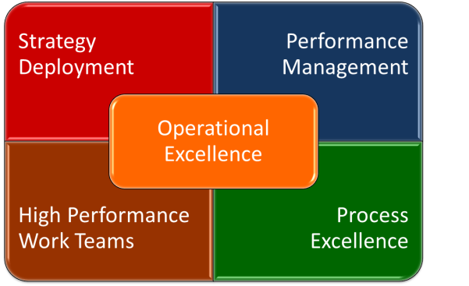
An Introduction to Operational Excellence An Integrated Business Execution System
by Operational Excellence Consulting LLC

Slide 2
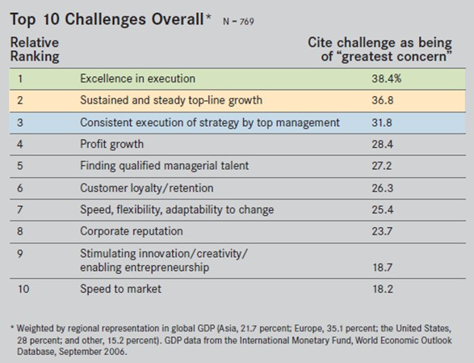
Top 10 CEO Challenges & Priorities

Slide 3
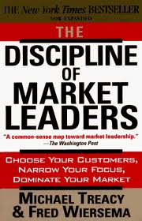
Operational Excellence – A Definition
A Business Strategy: In "The Discipline of Market Leaders“ (1995), Michael Treacy and Fred Wiersema describe three distinct value propositions or disciplines: Product Leadership, Customer Intimacy and Operational Excellence.
Market leaders choose to excel in delivering extraordinary levels of one of these three value propositions, while maintaining reasonable standards in the other disciplines.
Market leaders will not pursue a diffused business strategy across two or even all three disciplines, but will continually focus on their organizational design, processes, technology and competencies to improve the one particular value discipline that they want to provide to their Customers better than anyone else.
Organizations pursuing an Operational Excellence strategy, strive to deliver a combination of quality, price, and ease of purchase and service that no other organization in their market or industry can match.

Slide 4
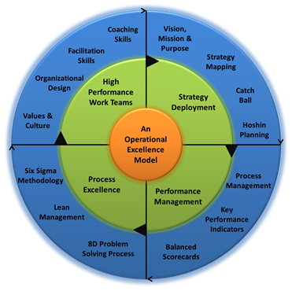
What is Operational Excellence?
Achieving Operational Excellence requires the successful implementation of a integrated Business Execution System that effectively and seamlessly integrates the following four building blocks: Strategy Deployment, Performance Management, Process Excellence, and High Performance Work Teams.
Operational Excellence can be achieved and sustained with the right attitude, the right mindset, and the right competencies.
Strategy or Policy Deployment is the process that aligns and links business strategy and execution.
Well designed, efficient, and effective Management, Value Chain, and Support Processes are necessary to deliver world-class results.
Performance Management is the process that translates strategic initiatives into measurable objectives and goals.

Slide 5
What is Operational Excellence?
Achieving Operational Excellence requires the successful implementation of a integrated Business Execution System that effectively and seamlessly integrates the following four building blocks: Strategy Deployment, Performance Management, Process Excellence, and High Performance Work Teams.
Strategy or Policy Deployment is the process that aligns and links business strategy and execution.

Slide 6
Operational Excellence – Strategy Deployment
Strategy is an expression of what an organization intents to do to get from a current state to a future state. Strategy is often expressed in terms of a vision statement, objectives, goals, and initiatives.
Only 5% of the workforce understands their company strategy.
Only 25% of managers have incentives linked to strategy.
60% of organizations don’t link budgets to strategy.
86% of executive teams spend less than one hour per month discussing strategy.
Source: Balanced Scorecard Collaborative

Slide 7
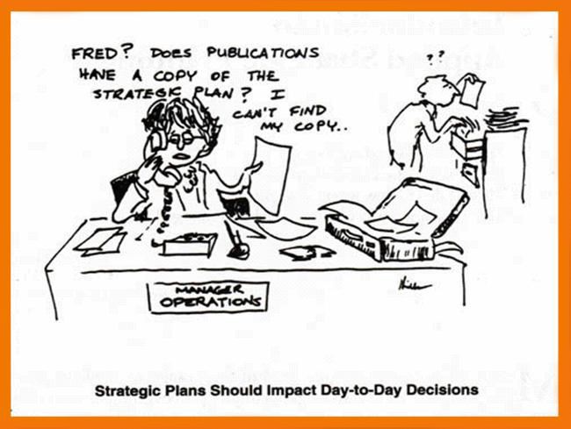

Slide 8
Operational Excellence – Strategy Deployment Process
Phase I – Organize the Process
Phase II – Current State Analysis (CSA)
Phase III – Strategic Vision Elements
Phase IV – Strategic Breakthrough Objectives
Phase V – Strategic Initiatives & Tactics
Phase VI – Strategy Implementation & Review

Slide 9
Operational Excellence – Strategy Deployment Process
Strategy Maps or Strategic Grids:
Strategic Focus Area: Increase Shareholder Value
Financials
Revenue Growth of 20% by 2014
Customers
Acquire More Customers
Become the Price Leader
Internal
Processes
Improve Operational Efficiency
Dimensions or Perspectives
Cost Reduction Program
Knowledge Based
System
Reduce
Non-Core Activities
Learning &
Growth
Training – Lean Six Sigma Program
Database Network on Operational Performance
Re-Align Organization with Core Competencies
Once you have completed the strategic grid, go back and make sure everything fits with your overall strategy. A set of strategic grids should provide the strategic model for running the business, outlining the specifics of the strategy. All stakeholders should be able to look at the grids and follow the flow of the organization’s strategy.

Slide 10
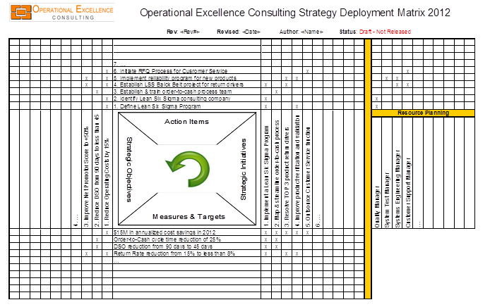
Operational Excellence – Strategy Deployment Process
The Hoshin X-Matrix is a tool that visualizes an organization’s
strategic objectives,
strategic initiatives,
key performance indicators,
key projects & action items, and
human resources requirements
in one simple matrix.
The Hoshin X-Matrix enables an organization to easily review the alignment of its strategic objectives, strategic initiatives, key performance indicators, key action items and human resources.
The Hoshin X-Matrix, if used properly, improves the likelihood of a successful execution of the strategic plan.

Slide 11
Operational Excellence – Strategy Deployment Process
Organization’s Tactical Projects & Action Items
Organization’s Human Resource Allocation
Organization’s Strategic Objectives & Goals
Organization’s Strategic Initiatives & Tactics
Organization’s Key Performance Indicator (Balanced Scorecard)

Slide 12
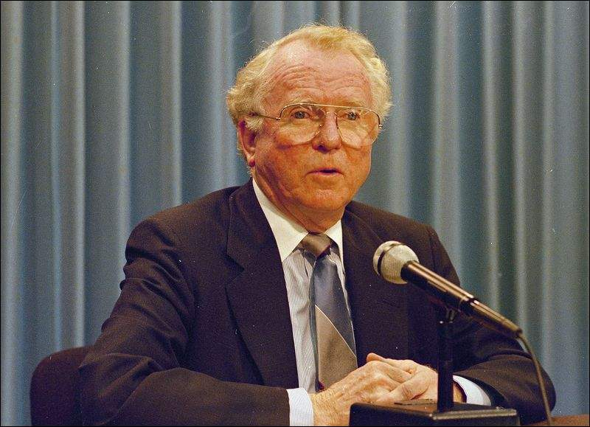
Operational Excellence – Strategy Deployment
“I sure wish I’d done a better job of communicating with GM people. I’d do that differently a second time around and make sure they understand and shared my vision for the company. Then they would know why I was
tearing the place up, taking out whole divisions, changing our whole production structure . . . I never got this across.”
Roger Smith, CEO of General Motors (1981 - 1990)

Slide 13
Strategy Planning & Deployment – Resources
Ackoff, R.L. – A Concept of Corporate Planning (New York, New York: Wiley, 1970)
Colletti, Joseph F. – A Field Guide to Focused Planning: Hoshin Kanri - American Style (The Woodledge Group, 1995)
Cowley, Michael and Domb, Ellen – Beyond Strategic Vision: Effective Corporate Action with Hoshin Planning (Burlington, Massachusetts: Butterworth-Heinemann, 1997)
Kaplan, R.S. and Norton, D.P. – Strategy Maps: Converting intangible Assets into tangible Outcomes (Cambridge, Massachusetts: Harvard Business School Publishing Corporation, 2004)
Mintzberg, Henry; Lampel, Joseph B.; Ghoshal, Sumantra and Quinn, James B. – The Strategy Process: Concept, Context, Cases (London, UK: Prentice-Hall Inc., 2002)
Treacy, Michael and Wiersema, Fred - The Discipline of Market Leaders: Choose Your Customers, Narrow Your Focus, Dominate Your Market (New York, New York: HarperCollins Publishers, 1995)

Slide 14
What is Operational Excellence?
Achieving Operational Excellence requires the successful implementation of a integrated Business Execution System that effectively and seamlessly integrates the following four building blocks: Strategy Deployment, Performance Management, Process Excellence, and High Performance Work Teams.
Strategy or Policy Deployment is the process that aligns and links business strategy and execution.
Performance Management is the process that translates strategic initiatives into measurable objectives and goals.

Slide 15
Operational Excellence – Performance Management
“Balanced Scorecards tell you the knowledge, skills and systems that your employees will need (learning and growth) to innovate and build the right strategic capabilities and efficiencies (internal processes) that deliver specific value to the market (customer) which will eventually lead to higher shareholder value (financial).”
“Having Trouble with Your Strategy? Then Map It.”
by Robert S. Kaplan and David P. Norton - Harvard Business Review

Slide 16
“Tell me how you will measure me, and then I will tell you how I will behave. If you measure me in an illogical way, don’t complain about illogical behavior.”
Eli Goldratt – “The Goal”

Slide 17
Operational Excellence – Performance Management
Benefits of developing & deploying Balanced Scorecards in an organization include:
Help the management team focus on the execution of their business strategy
Focus and align an organization towards common goals and objectives
Enable an organization to understand the relationship between measures and performance
Improve communication of organizational priorities across an organization
Help employees to understand and focus on organizational priorities and realize relevant results
Reduce the number of metrics to the few vital key performance indicators
Strengthen and formalizing the project selection process to focus on key capabilities and enablers

Slide 18
Operational Excellence – Performance Management Process
Phase I - Strategic Foundation
Step 1: Strategic Alignment
Step 2: Key Strategic Focus Areas & Objectives
Step 3: Strategic Grid & Model
Phase II - Three Critical Components
Step 4: Key Performance Indicators
Step 5: Goals & Targets
Step 6: Initiatives & Programs
Phase III – Deployment Process
Step 7: Integrate
Step 8: Cascade
Step 9: Manage
Balanced Scorecard Development & Deployment Process

Slide 19
Operational Excellence – Performance Management
Vision
&
Strategy

Slide 20
Operational Excellence – Performance Management
Strategic Focus Area: Increase Shareholder Value
Financials
Revenue Growth of 20% by 2014
Customers
Acquire More Customers
Become the Price Leader
“Internal”
Processes
Improve Operational Efficiency
Dimensions or Perspectives
Cost Reduction Program
Knowledge Based
System
Reduce
Non-Core Activities
Learning &
Growth
Training – Lean Six Sigma Program
Database Network on Operational Performance
Re-Align Organization with Core Competencies
For each objective on your strategic grids, you need at least one performance indicator. Can you have an objective without a performance indicator? Yes, it is possible, but not having a measurement makes it difficult to manage the objective. It’s best to revisit this objective and ask the question: Why is this an objective?

Slide 21
Operational Excellence – Performance Management
1
2
3
4
5
7
8
6
12
For each strategic objective on your strategic grid, you need at least one performance indicator. Can you have an objective without a performance indicator? Yes, it is possible, but not having a measurement makes it difficult to manage the objective. It’s best to revisit this objective and ask the question: Why is this an objective?
9
10
11

Slide 22
Performance Management – Resources
Chang, Richard Y., and Morgan, Mark W. – Performance Scorecards: Measuring the Right Things in the Real World (New York, New York: John Wiley Sons Inc., 2000)
Kaplan, R.S. and Norton, D.P. – Putting the Balanced Scorecard to Work (Harvard Business Review, September/October 1993)
Kaplan, R.S. and Norton, D.P. – The Balanced Scorecard (Cambridge, Massachusetts: Harvard Business School Press, 1996)
Kaplan, R.S. and Norton, D.P. – Balanced Scorecard: Translating Strategy into Action (Cambridge, Massachusetts: Harvard Business School Press, 1996)
Kaplan, R.S. and Norton, D.P. – Using the Balanced Scorecard as a Strategic Management System (Harvard Business Review, January/February 1996)
Keebler, James S. et.al. – Keeping Score: Measuring the Business Value of Logistics in the Supply Chain (Oak Brook, Illinois: Council of Logistics Management, 1999)

Slide 23
What is Operational Excellence?
Achieving Operational Excellence requires the successful implementation of a integrated Business Execution System that effectively and seamlessly integrates the following four building blocks: Strategy Deployment, Performance Management, Process Excellence, and High Performance Work Teams.
Strategy or Policy Deployment is the process that aligns and links business strategy and execution.
Well designed, efficient, and effective Management, Value Chain, and Support Processes are necessary to deliver world-class results.
Performance Management is the process that translates strategic initiatives into measurable objectives and goals.

Slide 24
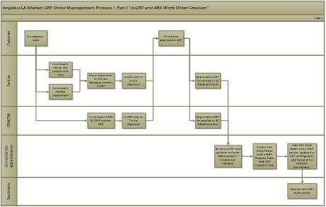

Operational Excellence – Process Excellence
BPI 7
8 D
Process Development, Improvement & Management
Systematic & Team-Based Problem Solving
5. Pursuit
Perfection
4. Establish
Pull
1. Define
Value
Lean
Principles
3. Create
Flow
2. Map Value
Stream
Lean Management
Six Sigma Methodology

Slide 25

Operational Excellence – Process Excellence
Project Management
D
M
A
I
C
Lean = Efficiency
is about reducing the lead time of a process or value stream.
Six Sigma = Effectiveness
is about reducing the variation in a process or value stream.
Process
Excellence

Slide 26
Operational Excellence – Process Excellence
Process Input:
Strategic and Annual Operating Plan (Objectives, Goals, Initiatives)
Process Output:
Exceeding the Plan
Develop and Implement Improvement Plans
Manage for Excellence in Execution
Select the Right Projects
Select and Train the Right People
Sustain the Gains
Clarify big picture using strategic & operating plan
Prioritize projects based on impact, value, resources, timing
Select key projects with leadership buy-in
Check accountability - business and personal
Ensure the right leadership and ownership
Select the right team leader & team
Develop a training plan
Dedicate time for training & application
Ensure the right support resources are available
Utilize the right improvement methodology for the right project
Stay focused
Frequently review progress and remove barriers
Check real business impact
Continuously communicate progress
Link to performance management and R&R
Implement effective control plans
Conduct regular training focused on the process
Review the system effectiveness at least quarterly
Continually identify and launch new projects based on strategic & operating plan

Slide 27
Operational Excellence – Process Excellence
Linking Performance Management & Process Excellence through focused Project Selection

Slide 28
Operational Excellence – Process Excellence
Linking Performance Management & Process Excellence through focused Project Selection
3
1
4
5
2
Size of the Ball = Size of the Risk

Slide 29
Operational Excellence – Process Excellence
State of Michigan Department of Management and Budget (DMB)
Coordinator Kathe Carter:
"Our management team evaluates potential new programs/initiatives by seeing how they fit in with our strategy. In the past we would continue stacking new projects on everyone's plates, but now if it doesn't fit with our strategy we don't do it." Just as important for the DMB is that "whenever a new project or initiative is proposed, our people ask 'how does this fit in with our strategy map /scorecard?' They feel that this connection attaches a higher level of importance to the initiative."

Slide 30
Process Excellence – Resources
Ballé, Michael and Ballé, Freddy - Lead with Respect - A Novel of Lean Practice (Cambridge, Massachusetts: The Lean Enterprise Institute, 2014)
George, Mark O. – The Lean Six Sigma Guide to Doing More with Less (Hoboken, New Jersey: John Wiley & Sons, Inc., 2010)
Harry, Mikel and Schroeder, Richard – Six Sigma: The Breakthrough Management Strategy Revolutionizing the World’s Top Corporations (New York , New York: Random House, Inc., 2000)George, Mark O. - The Lean Six Sigma Guide to Doing More with Less (Hoboken, New Jersey: John Wiley & Sons, Inc., 2010)
Martin, Karen and Osterling, Mike - Value Stream Mapping: How to visualize Work and align Leadership for Organizational Transformation (New York, New York: McGraw Hill Education, 2014)
Rother, Mike and Shook, John - Learning to See - Value-Stream Mapping to create Value and eliminate Muda (Cambridge, Massachusetts: Lean Enterprise Institute, 2009)

Slide 31
What is Operational Excellence?
Achieving Operational Excellence requires the successful implementation of a integrated Business Execution System that effectively and seamlessly integrates the following four building blocks: Strategy Deployment, Performance Management, Process Excellence, and High Performance Work Teams.
Operational Excellence can be achieved and sustained with the right attitude, the right mindset, and the right competencies.
Strategy or Policy Deployment is the process that aligns and links business strategy and execution.
Well designed, efficient, and effective Management, Value Chain, and Support Processes are necessary to deliver world-class results.
Performance Management is the process that translates strategic initiatives into measurable objectives and goals.

Slide 32
“The rate at which organizations learn may soon become the only sustainable source of competitive advantage.”
Peter Senge
“The thing I have learned at IBM is that culture is everything.”
Louis V. Gerstner, Jr.

Slide 33
Operational Excellence – High Performance Work Teams
Operational Excellence can and can only be achieved and sustained with the right attitude, the right mindset, and the right competencies.
Empowerment = f (Authority, Resources, Information, Accountability)
Empowerment = 0,
if Authority or Resources or Information or Accountability = 0
Selected Employee
Input
Ongoing Employee
Taskforces
High Performance
Work Teams
Low
High
The Empowerment
Continuum

Slide 34




Operational Excellence – High Performance Work Teams
In their book Gung Ho ! – Turn on the People in any Organization, Ken Blanchard and Sheldon Bowles describe three distinctive phase of transforming a traditional organization to an organization based on high performance work team.
Spirit of the Squirrel
Way of the Beaver
Gift of the Goose

Slide 35
Operational Excellence – High Performance Work Teams
Spirit of the Squirrel
WORTHWHILE WORK
Knowing we make the world a better place.
Everyone works toward a shared goal.
Values guide plans, decisions, and actions.

Slide 36
Operational Excellence – High Performance Work Teams
Way of the Beaver
IN CONTROL OF ACHIEVING THE GOAL
A playing field with clearly marked territory.
Thoughts, feelings, needs, and dreams are respected, listened to, and acted upon.
Able but challenging.

Slide 37
Operational Excellence – High Performance Work Teams
Gift of the Goose
CHEERING OTHERS ON
Active or passive, congratulations must be TRUE.
No score, no game, and cheer the progress.
E = m · c² – Enthusiasm equals mission times cash and congratulations.

Slide 38
Operational Excellence – High Performance Work Teams
While an organization transitions from a more traditional “top-down” organization to an organization build around high performance work teams, the role of a supervisor or manager changes to the role of a leader and coach, with six distinctive capabilities.
Coach
Living
Example
Barrier
Buster
Leader ≠ Manager
Result
Catalyst
Business
Analyzer
Facilitator

Slide 39
High Performance Work Teams – Resources
Arussy, Lior - Excellence Every Day: Make the Daily Choice - Inspire Your Employees and Amaze Your Customers (Medford, New Jersey: Information Today Inc., 2008)
Blanchard, Ken and Bowles, Sheldon – Gung Ho ! – Turn on the People in any Organization (New York, New York: William Morrow and Company, Inc. 1998)
Canfield, Jack, Hansen Mark V. and Hewitt, Les - The Power of Focus (Deerfield Beach, Florida: Health Communications Inc., 2000)
Cobb, Charles G - From Quality to Business Excellence: A Systems Approach to Management (Milwaukee, Wisconsin: ASQ Quality Press, 2003)
Fisher, Kimball – Leading Self-Directed Work Teams (New York, New York: McGraw-Hill, 2000)
Spong, David E. and Collard, Debbie J. - The Making of a World-Class Organization (Milwaukee, Wisconsin: ASQ Quality Press, 2009)

Slide 40
What is Operational Excellence?
Achieving Operational Excellence requires the successful implementation of a integrated Business Execution System that effectively and seamlessly integrates the following four building blocks: Strategy Deployment, Performance Management, Process Excellence, and High Performance Work Teams.
Operational Excellence can be achieved and sustained with the right attitude, the right mindset, and the right competencies.
Strategy or Policy Deployment is the process that aligns and links business strategy and execution.
Well designed, efficient, and effective Management, Value Chain, and Support Processes are necessary to deliver world-class results.
Performance Management is the process that translates strategic initiatives into measurable objectives and goals.

Slide 41

Why Working with Us.
“In the global and competitive environment of today and tomorrow, organizations must rethink and reshape their approach to execution in order to stay competitive. Operational Excellence is the strategic initiative under which this process can take shape.”
We work with our clients, primarily smaller and medium-sized manu-facturing and service organizations, hands-on and side-by-side to achieve their strategic and operational goals and objectives through the innovative application of Operational Excellence principles, methods, and tools.
Email: info@oec-us.com
Phone: +1 (888) 372 – 8705
Website: www.oec-us.com

