Slide 1
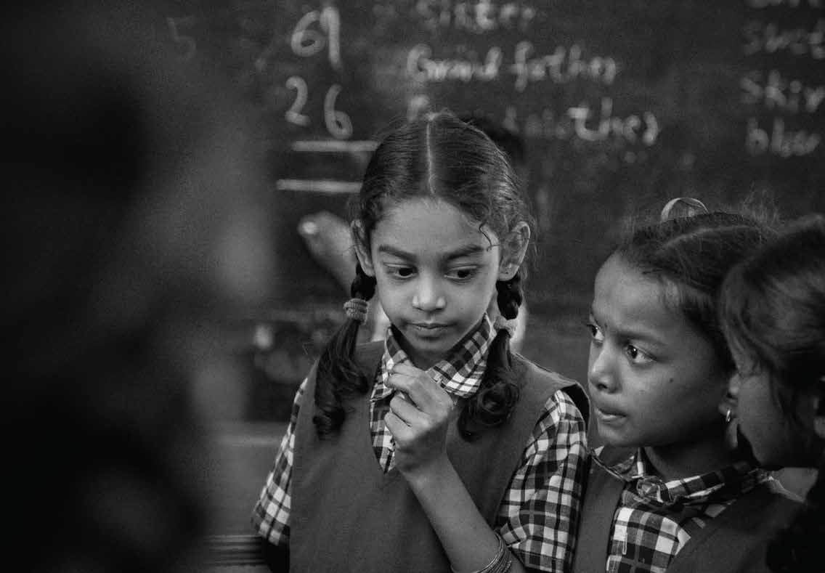
Sewa International’s
Toilet & Hygiene Project for a girl child

Slide 2
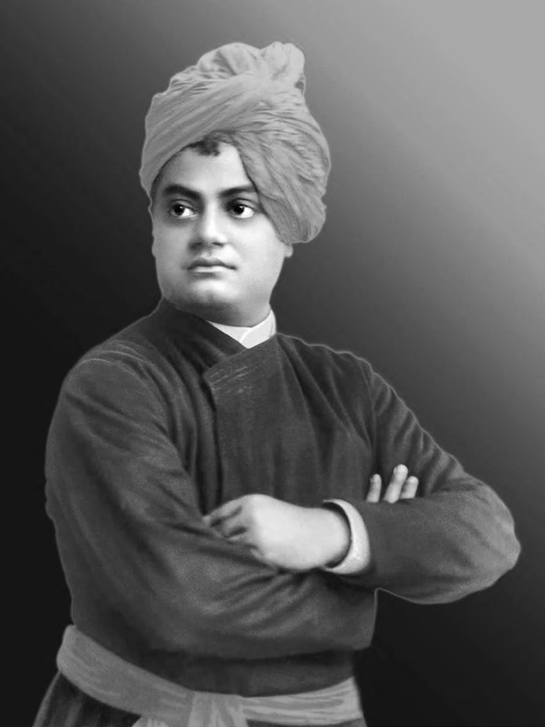


Our Vision
To create a society of equal opportunities to every one regardless of economic,political or caste status.
o
m
l
p
e
e
v
n
e
t
y
D
t
i
n
u
m
Our Mission
m
Sewa International’s Toilet & Hygiene Project
for a girl child
o
C
To empower underprivileged children, youth, men and women through education, healthcare and innovative employment to achieve greater potentials in their lives.
Our Model
Comprehensive approach for development of a girl child.

Slide 3
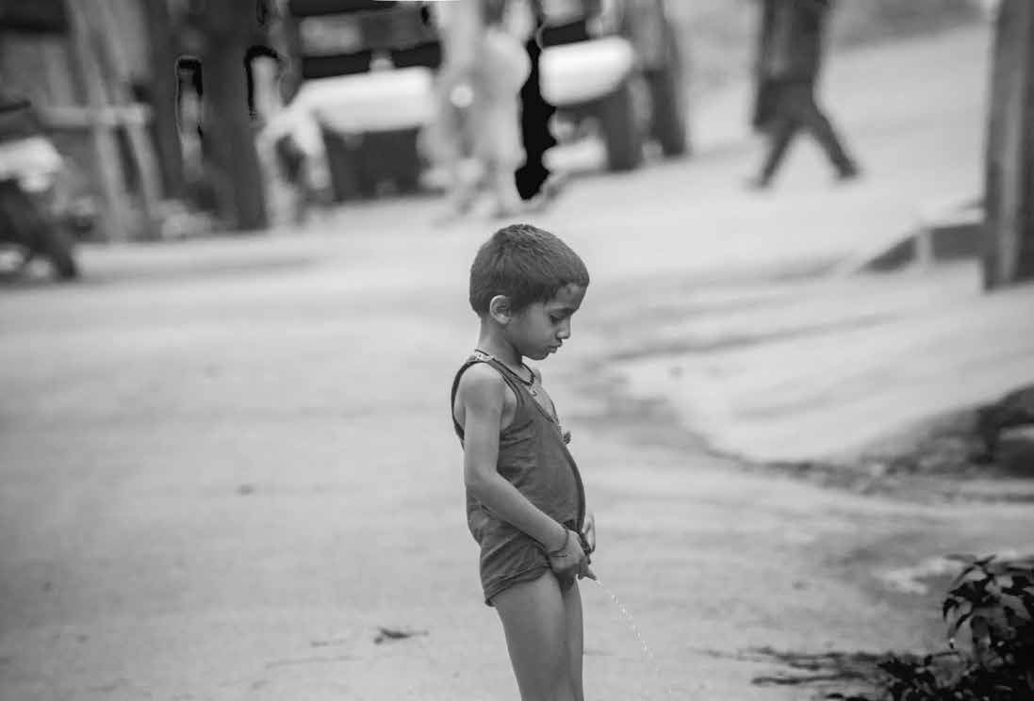
Some facts and figures about sanitation in India
According to the World Bank, over 600 million people, roughly 53% of Indian households don’t have access to toilet facilities. And it is the women and children of India who are paying the highest price.
In India, every year Diarrhea and pneumonia kills 6 lakhs kids under the age of 5 years (The connection between diarrheal disease and malnutrition is well established. Diarrhea is often caused by a lack of clean water for proper hand-washing. A lack of toilet further exacerbates the problem
as feces on the ground contribute to contaminated drinking water and water resources)
Apart from the threat of assault and harassment, not being to access toilets has a serious implication on their health as it elevates chances of
urinary tract and kidney infections.
61% of rural India and 10% of Urban India defecates in open.

Slide 4
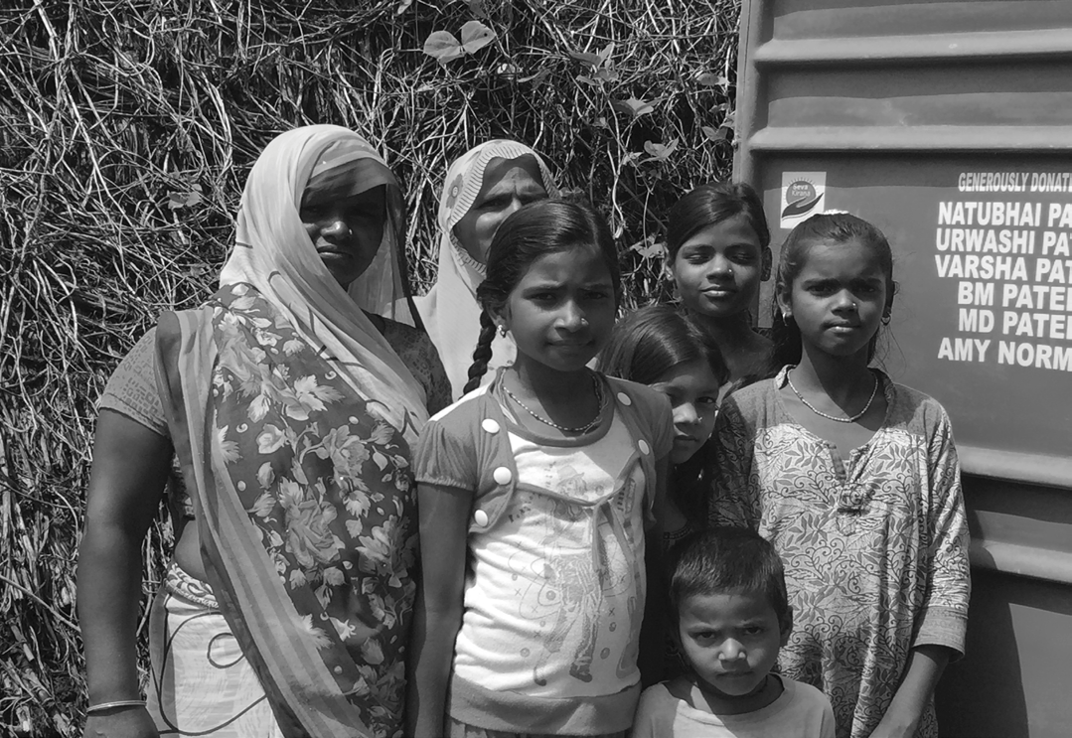
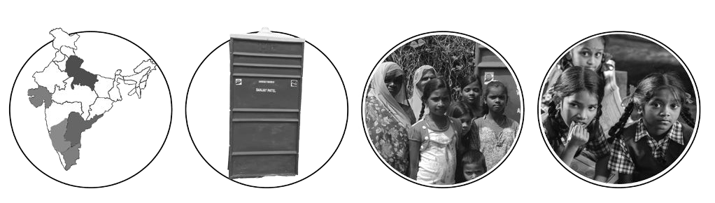
Our work in a snapshot
5
Indian
States
155
Toilets
Constructed
2,255
Families
Benefitted
3,600
Students
Benefitted

Slide 5
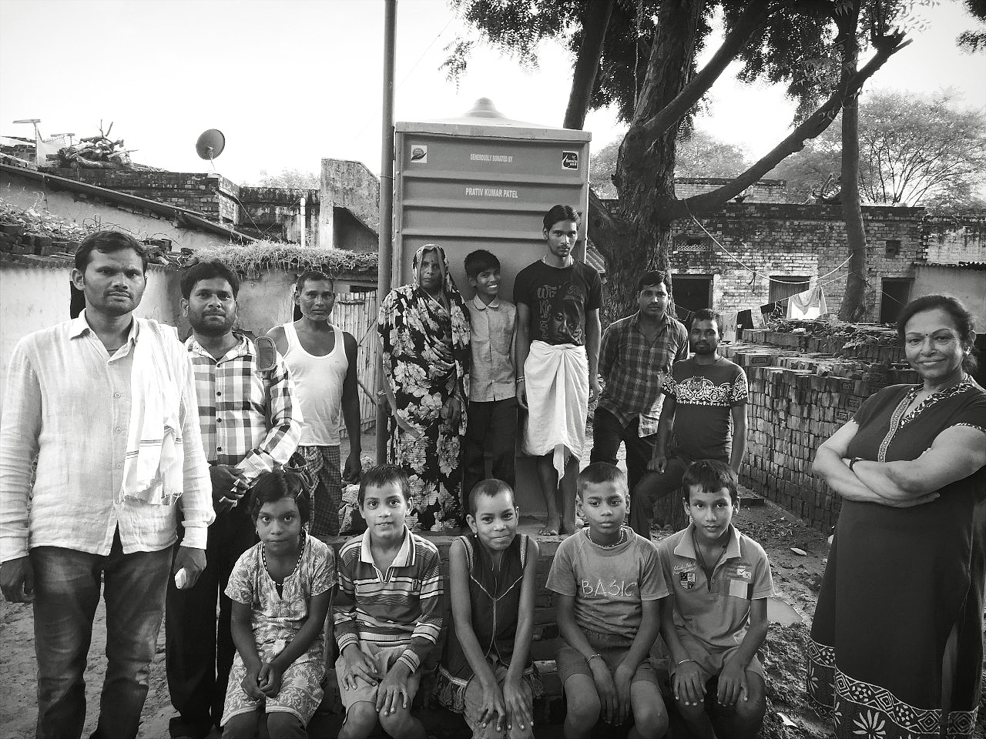
Toilets built in and around Bengaluru
Government schools
Bingipura - 2
Podu - 1
Mantapa - 1
Koppa - 2
Alahalli - 4
Harinagar - 2
Puttenhalli – 6
Slums
Ginishastranagar - 6
Summanahalli - 5
Yeshwanthpura - 2
Mattikere - 9
Sanjaygandhinagar - 13
Thyaginagar - 9
Jaibheemanagar - 6
RRnagar - 4
Bheemshaktinagar - 5
Muthyalammanagar - 6

Slide 6
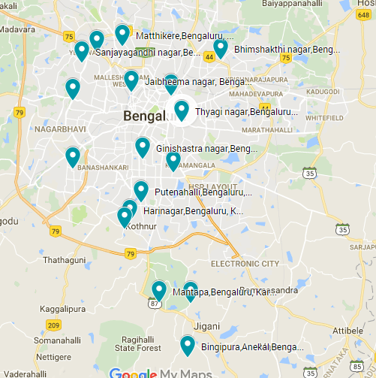

Slide 7
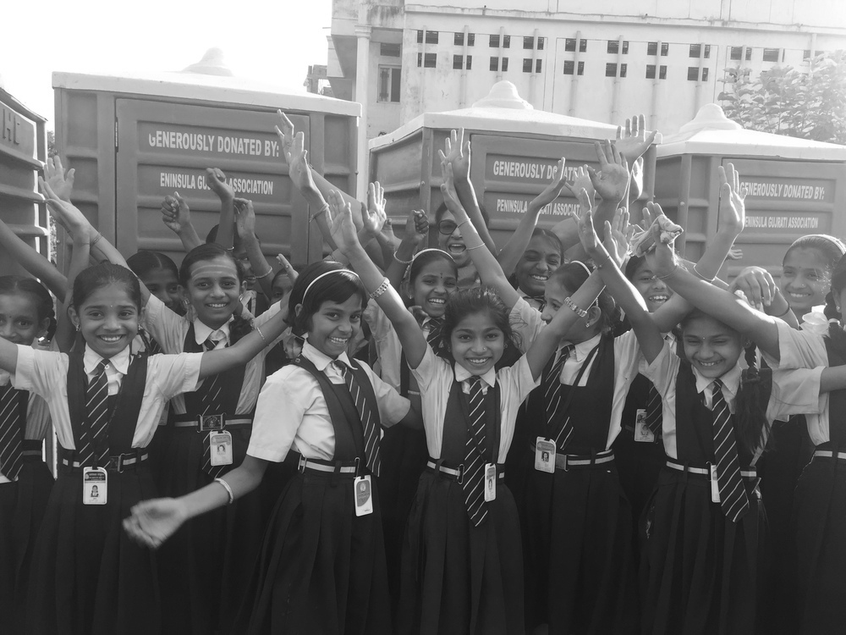
Toilets built in ROI
30 toilets in Basavatheertha Vidyapeeta – 1700 children and more than 60% of them are girls
30 toilets in Varanasi – 5 villages in and around Ramnagar are getting benefited
5 toilets in Bandipur, Karnataka – Tribal community
7 toilets in Dindigul,Tamilnadu – Tribal community

Slide 8
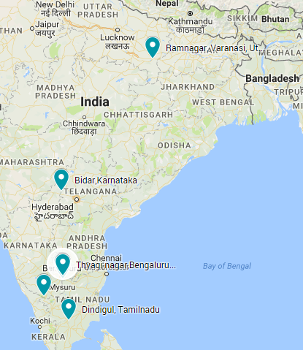

Slide 9
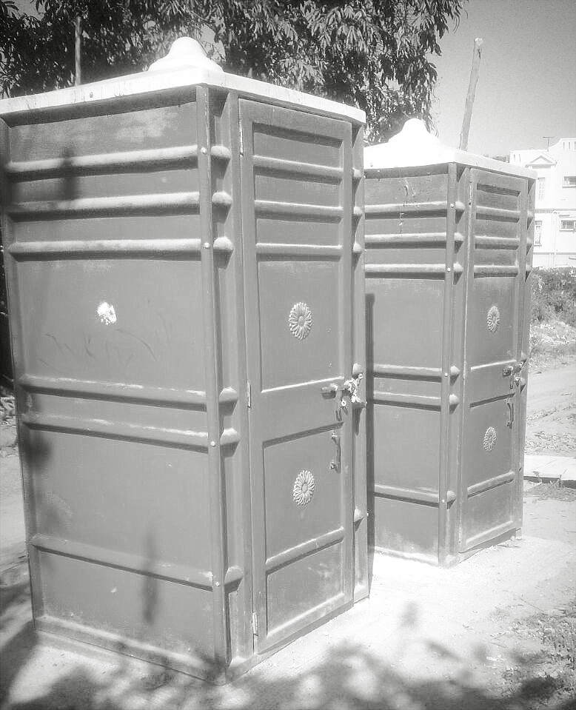
Budget and Time Frame
Each unit costs from 25k to 40k
Manufacturing cost 18k to 25k
Raw materials to install 2k to 5k ( depends on
the distance from water source)
Soak pits 5k to 10k ( In case of absence of
sewage line connection)
Installation timeframe
From one week to one month ( depends on the location, community cooperation, availability of laborers and transportation facilities)

Slide 10
TESTIMONIALS
Saritha ji who is physically handicapped who was suffering the most as she couldn’t walk longer distance as others to defecate was immensely thankful to our team for giving her sanitation facilities, she has even influenced her mother-in- law who with orthodox background strongly felt that toilet in the vicinity of a house is unacceptable and has made her quit defecating in open field and has educated her in using the toilet unit. We need such strong women who will propagate our mission and help us build swatch and surakshit bharath(clean and safe India).
Aisha,16 year old who is studying in BTVP aspires to become a doctor, she is from urdu medium currently studying in BTVP, when we were interacting with girls to know their grievances about the lack of toilet facilities, she mentioned that several times girls skip drinking water in order avoid attending nature in open field. After the installation, she approached us with a huge smile on her face thanking us for fulfilling the promise we made to them. Going through all the trouble of installation (vendor issues) was worth that smile.

Slide 11
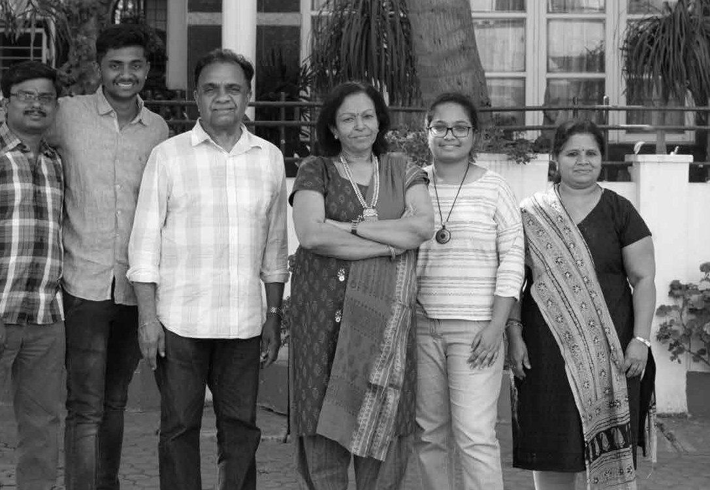
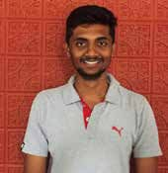
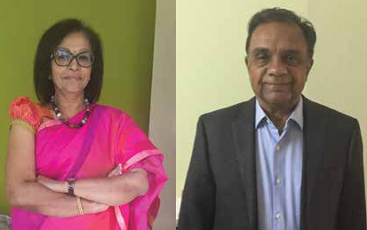
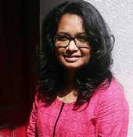
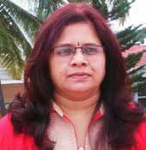
OUR TEAM
Mr Jayanth Bhat Field coordinator
Ms Shruthi Shivanand Management coordinator
Mr and Mrs Ramanan Sewa international Project Directors
Mrs Radhika Sheshadri
Community coordinator

Slide 12
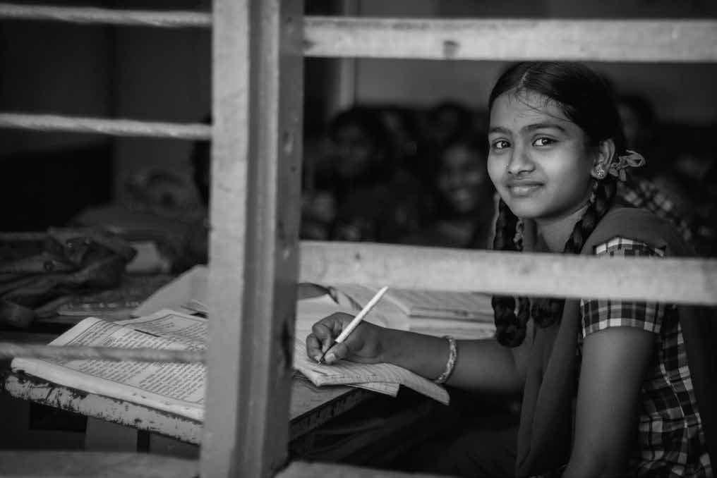
#231, 1st floor, 15th main, 24th cross
Banashankari 2nd stage, Bengaluru
Website : www.yah-i-can.org
Email : support@yah-i-can.org
Contact : + 91 9008415522/4422

