Slide 1


NELE (निले)
Hindu Seva Pratishthana,
“Ajithashree”,
8/28, Bull Temple Road,
Bengaluru-560004
+91-80-2660 8926
www.hinduseva.org
hinduseva@gmail.com

Slide 2
What is Nele?
Rehabilitation centre for homeless children
Nele provides Home for 300 Children
Home means a place to live, study, play and grow
Total 5 Nele. 3 for Girls & 2 for Boys
Supported by 30 Full Time Volunteers
Supported by 40 Part Time Volunteers

Slide 3
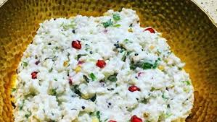
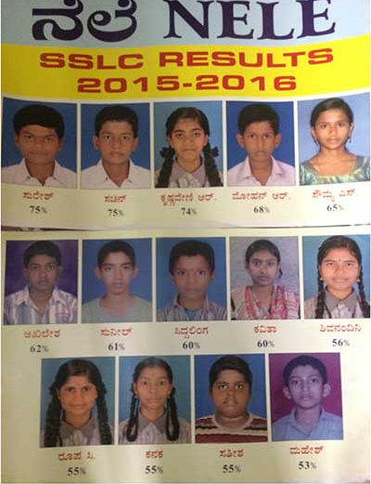
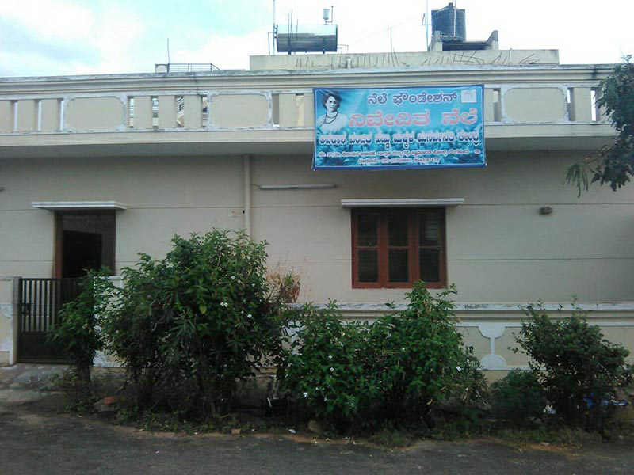
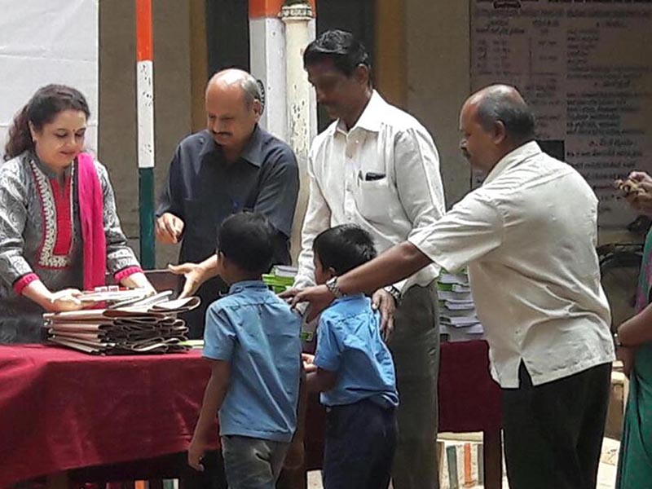
Nele: Scope of Activities
Education:
Inmates currently studying from Nursery to Degree
Study at Government schools in Kannada medium upto 7th Standard
Based on need either Kannada or English medium from 8th standard
Food: Full day nutrition food for every Nele child for all 365 days
Clothing:
Cloth for all Nele children to live a life with Swachh cloths and with honor
Shelter: A decent roof for all Nele children to spent their night and take rest

Slide 4
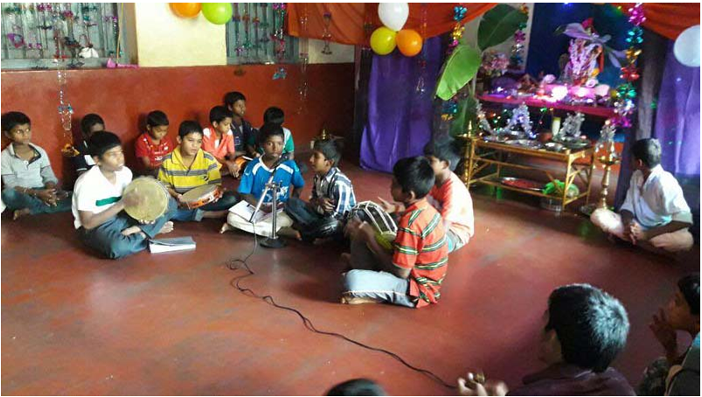
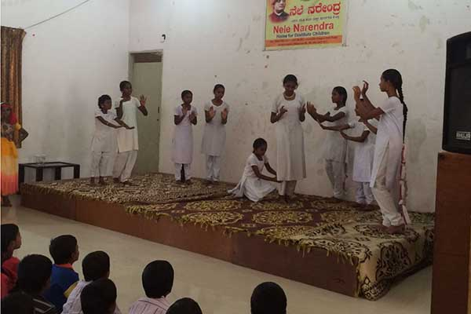
Nele: Scope of Activities
Cultural Activities:
Regular Music training for inmates of Premanjali ?? and Asha Kirana ??
Matrumandali and Balagokulas during week ends
Celebrated Festivals like Krishna JanmashTami, Deepavali, Raksha Bandhan
Training during vacation for holistic development - Yoga, Veda, Painting, Music
Sports: Athletics, Karate , Swimming, Kalari fight, Kabbadi
Health & Hygiene: Health Checkup, Treatment, Spectables, Hearing aid to the needy

Slide 5
Performance of Nele Children
Winners of Kabbadi at Taluk level – Narendra Nele (Photograph?)
First Prize in Taluk level Yoga competition (Photograph?)
Championship award in College Annual Sports Day (Photograph?)
Conducted Interschool cultural competitions (Photograph?)

Slide 6
Why Nele is Important?
Destitute children without education and right cultural value become anti-social element of the society.
No growth is complete if does not nourishes all the aspect of system, society
Prevention of today is cheaper than correction in future.
Just because some child is destitute we as an matured society cannot leave that child to his fate or god.
It is almost impossible for Government of India to remove the problem of destitute children. As a society we need to take the responsibility and partners like corporate and government to help each other

Slide 7
Journey of Nele
May’2000: Started with 15 boys
2003: Started home for girls with 6 girls
2010: Recipient of state award (Award Name??) instituted by Department of Women and Child Welfare
2017: 10 Nele centers across Karnataka benefitting 300 children
Fill this..

Slide 8
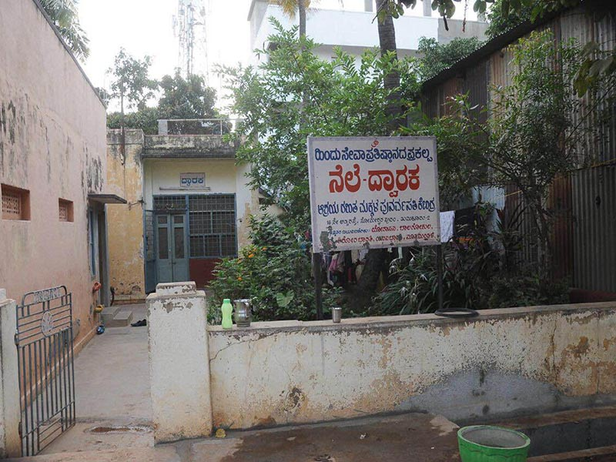
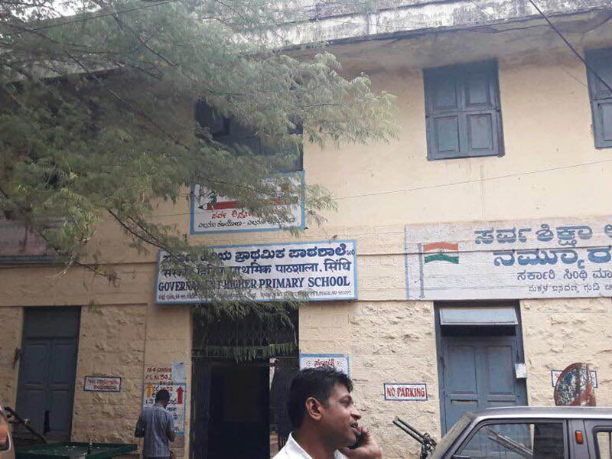
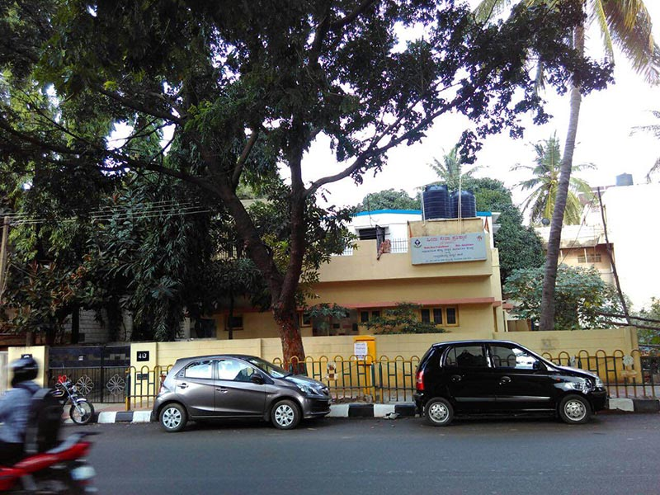
Nele Program Locations?
NELE Dwaraka, Tumakuru
Since 2010
Children: 24
NELE Chandana
Since 2007
Children: 46
NELE Asha Kirana
Since Dec’2006
Children: 24

Slide 9
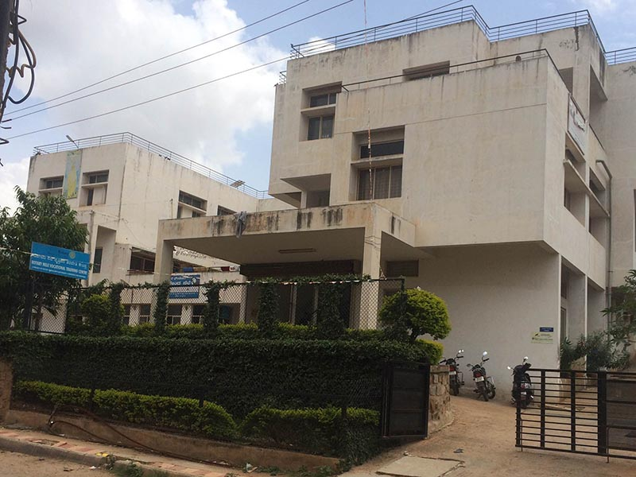
Nele Program Locations?
NELE Narendra
Since Aug’2000
Children: 69
NELE Nivedita
Since Apr’2006
Children: 22
NELE Ajitha, Mysore
Since 2000
Children: 27
NELE Namma Mane
Since Dec’2006
Children: 24
NELE Madhava, Shivamogga
Since April’2006
Children: 25

Slide 10
Who are the resources working?
Financial Resources
Operating Expenses
Capex
Expert Resources
Education expert, Sport expert, Institution Management Expert, Health Expert

Slide 11
Beneficiary of Nele Program
Under Privileged Children
Connected Families
Society
Government

Slide 12
Benefits of Nele Program
Opportunity to the deprived children to become good citizen of the country
300 families get the benefits because children get opportunity to learn, growth and prepare for better Bharat.
Local areas moral values improves
Corporate employees get the opportunity to get connected with under privileged people and have a sense of satisfaction.
Hidden talent get discovered

Slide 13
How we work..
A workflow diagram containing child identification, volunteer/teacher allocation, evaluation of child and program, fund allocation, spending, reporting, audit etc.
Major:
Education
Food
Medical
Clothing & Shoes
Books
Sports & Culture
Infrastructure Maintenance

Slide 14
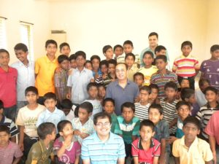
Who are Supporting Nile?
Institutions
Infosys Foundation
SBI
Rotary Club
Lions Club
Families Individual
Ms. Sudha Murthy
Mr. Anil Kumale
Mr. Upendra, Film Star
Dr. Nimalanath SwamiJi
Pejavar Math Swamiji
Mr. Manomurthy
Music Director

Slide 15
Funding Sources of Nele
????
????

Slide 16
Expectations from Partners
Volunteers for
Training & Educating Children
To teach & training Indian games to the children
To train them on music, art etc
Coaching for competitive exams
Funds
To provide healthy and hygenic food for all 365 days in a year
To provide education kit (bag, books, notebooks, pen etc)
To provide clothing
To provide health check up and treatments
To maintain Nele building
To provide basic financial support to full time volunteers

Slide 17
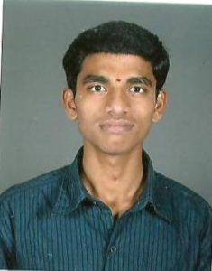
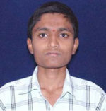
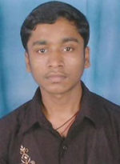
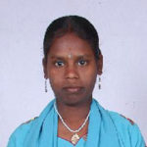
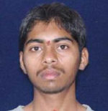
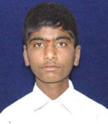
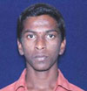
Creating Impact.. Few Stories
Kumar – is studying in 1st year Bcom and aspire to be CA.
Vinoda – is studying in 1st year Bcom in Sheshadripuram Evening PU College.
Mylara – is doing his 2nd PUC in Jantha College Chamarajpet.
Netra – Studying in 1st PUC in Vivekananda College.
Swamy – is doing his Tailoring course.
Manjunath & Surya are doing their ITI course in Bommasandra.
Vinod- is an electrician in Dubai.
Nagesh – is pursuing his BFA degree in Kalamandir College.

Slide 18
Financial Requirements to Run a Nele?
INR 75 L : is money required to run 9 Nele of 900 children for a year!

Slide 19
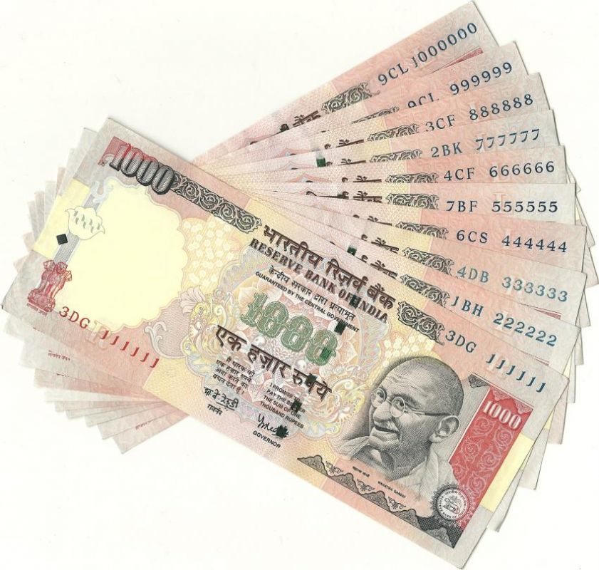
Financial Requirements to Run a Nele?
INR 36000
To support 1 child in Nele for 1 Year

Slide 20
How to work together?

