Slide 1

NELE (SHELTER)
Nele Foundation, No. 9/2, Lakshmidevi Nagara Main Road, Opp : Veena Education Trust, Laggere, Bengaluru – 560096
Phone : 080 – 2837 1474 Email: nelehsp@gmail.com
FB Page : http://www.facebook.com/NeleHSP/
Twitter : https://twitter.com/NeleHSP

Slide 2
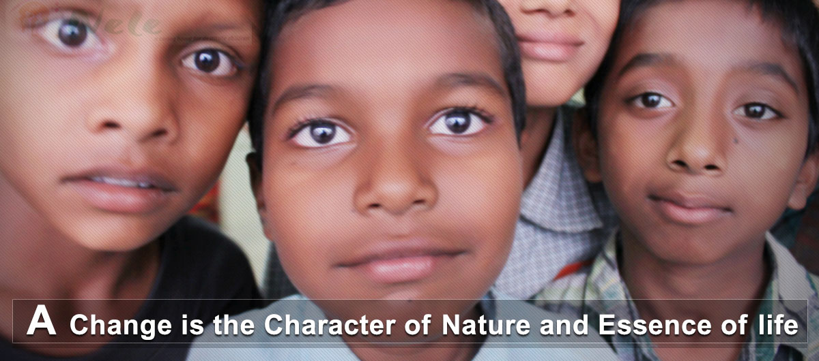
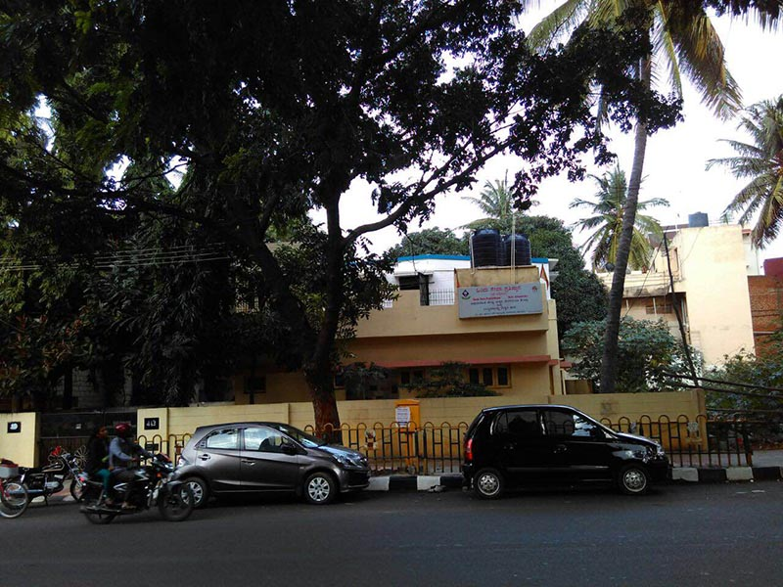
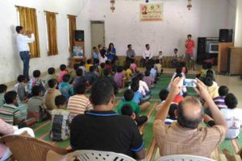
What is Nele?
Nele means Home. Under this program a home is provided to homeless children. Through Nele program we give opportunity to orphan or homeless children to live in brotherhood, play, study, eat healthy, grow and become good citizen of the nation.
At present there are
260 are given home
8 3 for Girls, 4 for Boys and one combined
30 Full Time Volunteers Supports Nele
40 Part Time Volunteers Supports Nele

Slide 3
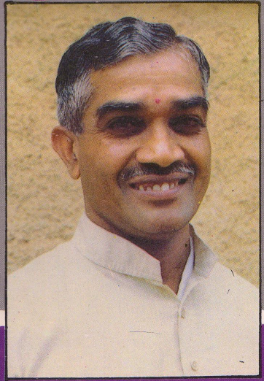
Our Inspiration
A gold medallist in both Electrical and Mechanical Engineering branches, graduated from University Vishweshwaraiah College of Engineering, Bangalore.
He had been a great social worker with many innovative social experiments to his credit. His unique style of functioning was based on ‘Concern for all attachment to none’. He was a full time social worker and a bachelor
The legendry yogacharya Sri. B.K.S. Iynger and Sri. Pattabhi Jois were his mentor and thus he became an authority on yoga and being an expert in the field.
Besides taking up Homeopathy introduced by Dr. Krishnamurthy, he showed great interest in Psychology, Accountancy, Anatomy and such other disciplines.
Late. Sri Ajit Kumar
1934 to 1990

Slide 4
Our Team
Name & Photo of Trustees

Slide 5
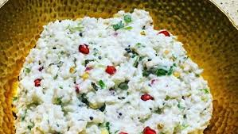
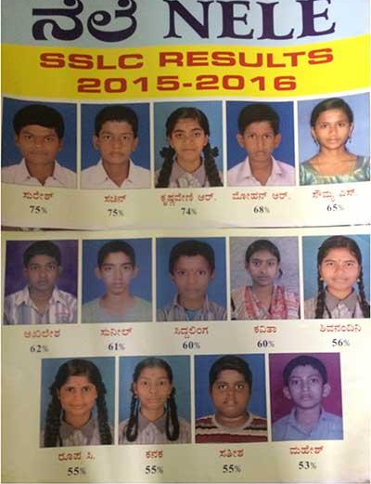
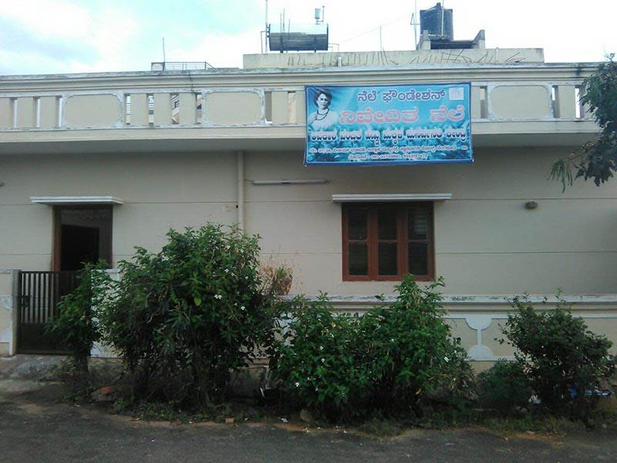
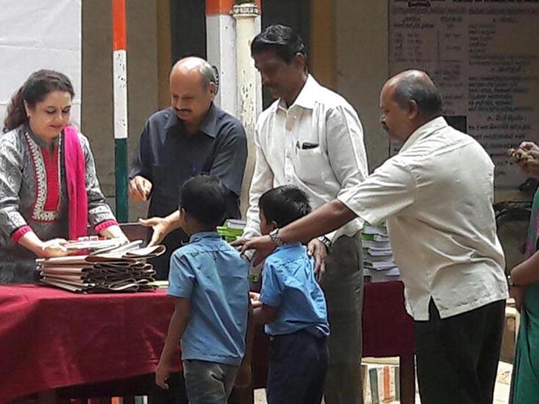
Nele: Scope of Activities
Education:
Inmates currently studying from Nursery to Degree
Study at Government schools in Kannada medium up to 7th Standard
Based on need either Kannada or English medium from 8th standard
Vocational training after SSLC for finding a job
Food: Full day nutrition food for every Nele child for all 365 days
Clothing:
Cloth for all Nele children to live a life with Swachh cloths and with honor
Shelter: A decent roof for all Nele children to spent their night and take rest

Slide 6
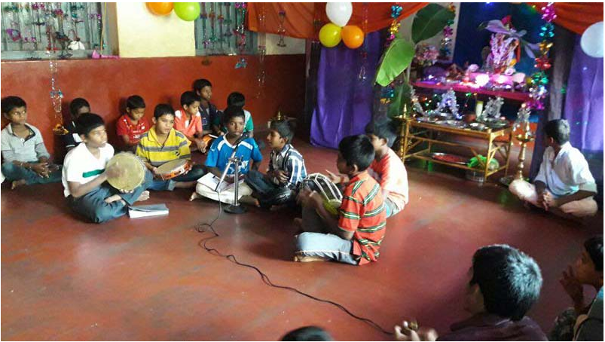
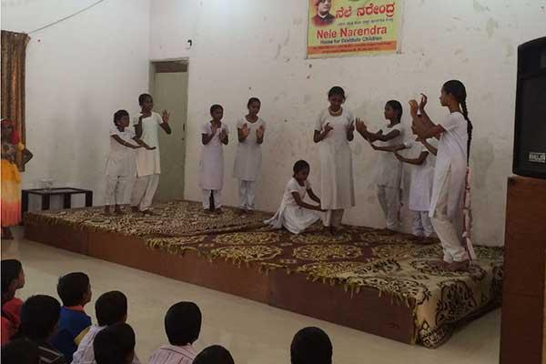
Nele: Scope of Activities
Cultural Activities:
Regular Music training for inmates of Premanjali ?? and Asha Kirana ??
Matrumandali and Balagokulas during week ends
Celebrated Festivals like Krishna JanmashTami, Deepavali, Raksha Bandhan
Training during vacation for holistic development - Yoga, Veda, Painting, Music
Sports: Athletics, Karate , Swimming, Kalari fight, Kabbadi
Health & Hygiene: Health Checkup, Treatment, Spectables, Hearing aid to the needy

Slide 7
Why Nele is Important?
Destitute children without education and right cultural value may become anti-social element of the society.
A society cannot grow in true sense if one aspect of this is left out
Prevention of today is cheaper than correction in future.
Just because some child is destitute we as an matured society cannot leave that child to his fate or god.
It is almost impossible for Governments to eradicate the problem of all destitute children. As a society we need to take the responsibility and partners like corporate and government to help each other

Slide 8
Journey of Nele
May’2000:
Aug’2000:
Apr’2003:
Dec’2006
Apr’2006
Started with 15 boys
NELE Narendra
NELE Nivedita (Started home for girls with 6 girls)
NELE Namma Mane
NELE Madhava, Shivamogga
Dec’2006
NELE Asha Kirana
Year 2007
NELE Chandana
Year 2010
NELE Dwaraka, Tumakuru
Year 2010
Received Rajyothsava Award from Department of Women and Child Welfare, Govt. of Karnataka
Year 2017:
8 Nele centers across Karnataka benefitting 300 children

Slide 9
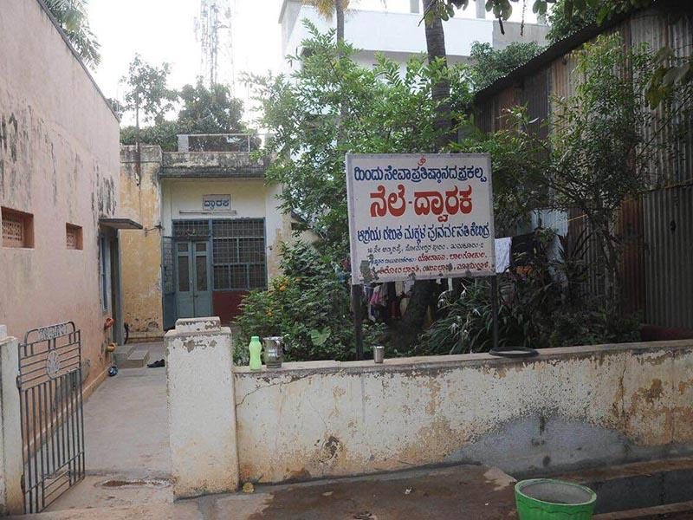
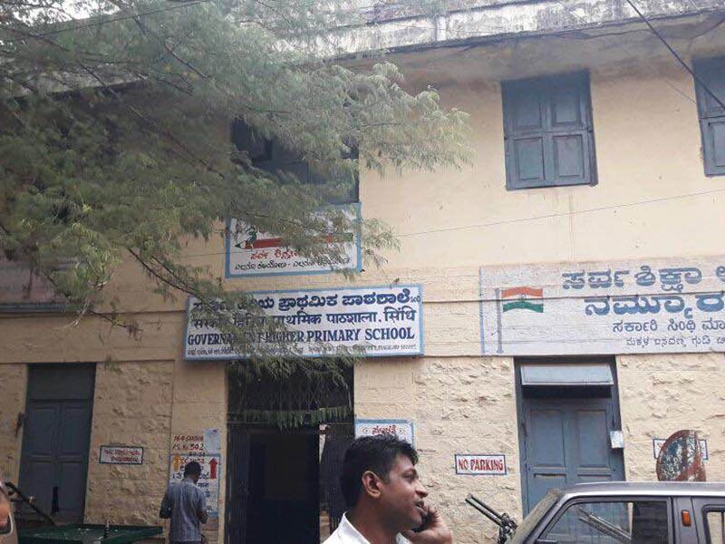
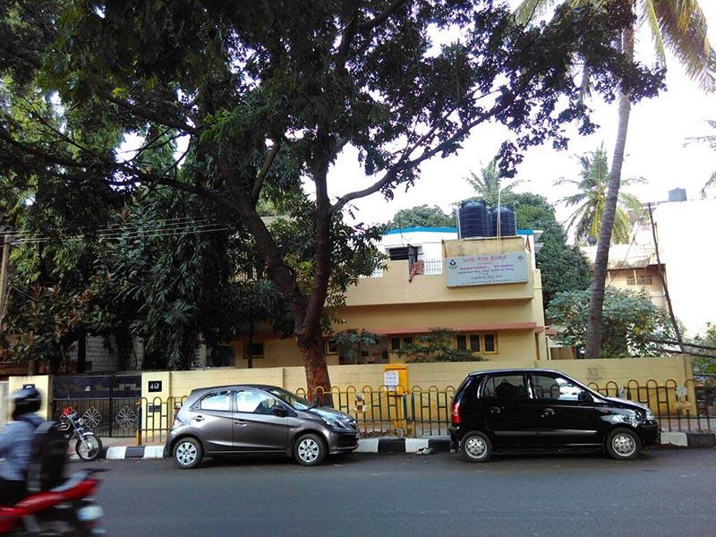
Nele Program Locations?
NELE Dwaraka, Tumakuru
Since 2010
Children: 24
NELE Chandana
Since 2007
Children: 46
NELE Asha Kirana
Since Dec’2006
Children: 24

Slide 10
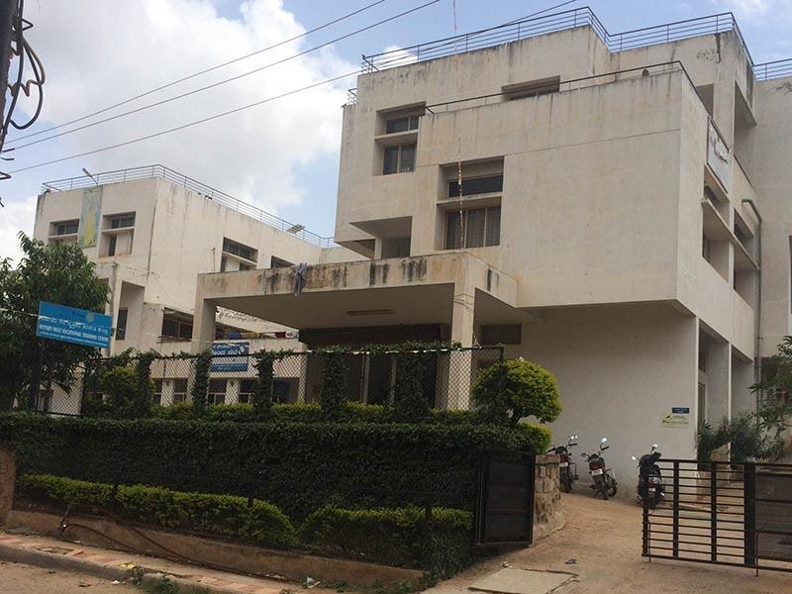
Nele Program Locations?
NELE Narendra
Since Aug’2000
Children: 69
NELE Nivedita
Since Apr’2006
Children: 22
NELE Ajitha, Mysore
Since 2000
Children: 27

Slide 11
Nele Program Locations?
NELE Namma Mane
Since Dec’2006
Children: 24
NELE Madhava, Shivamogga
Since April’2006
Children: 25

Slide 12
Beneficiary of Nele Program
About 2000 children benefitted so far
About 1800 families have taken the benefit
Created a good conducive atmosphere around NELE neighborhood
Enabled many socially conscious people to get associated with
Created an opportunity for many youth volunteers from corporate and education instituions

Slide 13
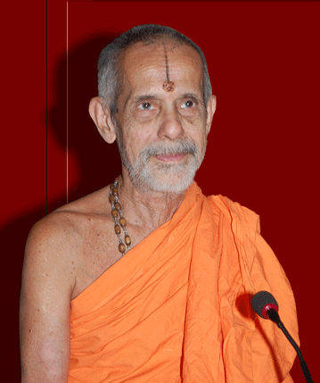
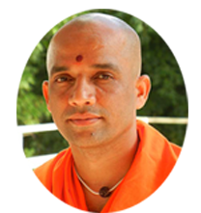
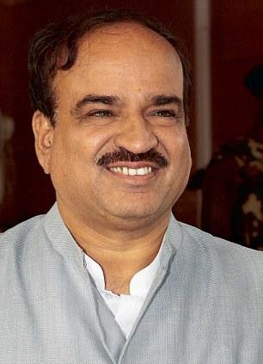
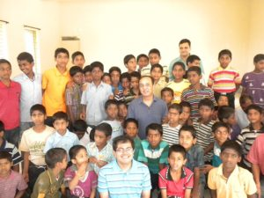
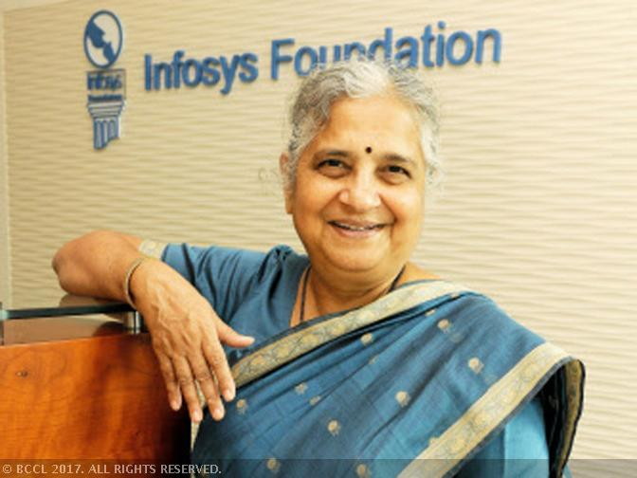
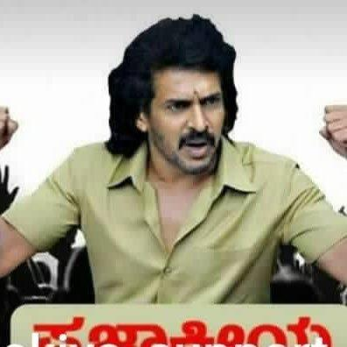
Who are Supporting this cause?
Sri Sri Sri Vishwesha theerthaSwamiji
Pejawar mutt
Sri Sri Sri Nirmalananda Swamiji
Adichunchanagiri mutt
Sri Ananth Kumar
Minister, central cabinet
Mr. Manomurthy
Music Director
Mrs. Sudha Narayan Moorthy
Founder Infosys foundation
Mr. Upendra
Actor

Slide 14
Expectations from Partners
Volunteers for
To teach & train in English, Math, career development issues etc.
Coaching for competitive exams
Extra curricular activities like art and crafts, music, sports etc.
Personality development traits
Financial or in kind Support
Education
Food
Clothing and uniforms
Medical
Cultural and sports activities
Shelter – maintenance of infrastructure

Slide 15
Financial Requirements to Run a Nele?
INR 75 L is money required to run 9 Nele of 900 children for a year!
INR 36K A child/year

Slide 16
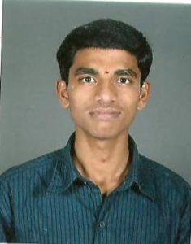
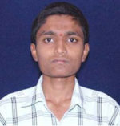
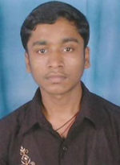
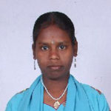
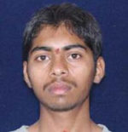
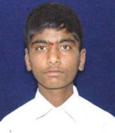
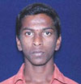
Creating Impact.. Few Stories
Kumar – is studying in 1st year Bcom and aspire to be CA.
Vinoda – is studying in 1st year Bcom in Sheshadripuram Evening PU College.
Mylara – is doing his 2nd PUC in Jantha College Chamarajpet.
Netra – Studying in 1st PUC in Vivekananda College.
Swamy – is doing his Tailoring course.
Manjunath & Surya are doing their ITI course in Bommasandra.
Vinod- is an electrician in Dubai.
Nagesh – is pursuing his BFA degree in Kalamandir College.

Slide 17
How to work together?
You can support in following way
Sponsor 1 or more center for 1 -5 years
Sponsor children in the multiple of 10 for 1 or 5 years (INR 36000 per year per child)
Sponsor for ‘capital expenditure’ requirements at any of the NELEs
Sponsor the honorarium of care takers and other full-time volunteers at all the NELEs
Employees can come and volunteer for teaching and career management services for students

Slide 18
How can we help you
Meet your CSR objectives
If your CSR focus is other than rehabilitation then we can engages with you in other programs
Getting the report from our program needed for your CSR reporting
Together serve the society
Opportunity for volunteering in our programs and projects
Sense of belong to humanity to your employees

Slide 19
How we select child for Nele

