Slide 1




CSR Projects
Samarpaka Seva Foundations
No. 4259, I Floor
2nd Main, Girinagar I Phase,
Bangalore- 560085
Rajanna S, Managing Trustee, hosura@yahoo.com |+91-9845378434
Ramanath Pai, Director Operations, Ramanath.pai@gmail.com |+91-9900951007

Slide 2
Who are we?
Samarpaka Seva Foundation (SSF) is a non profit social platform that connects Corporate CSR initiatives and the NGO projects and ensure high effectiveness and impact for the Corporate CSR Objective.
SSF is a team of 9 humanitarians with 200 years of combined experience in corporate and social sectors. We have deep expertise and network in conceptualizing, incubating and implementing social sector projects across India.
Our platform maximizes the value of investment for all stakeholders – Beneficiaries, NGOs, Donors, Government and Society by and large.

Slide 3
Our Mission & Vision
Vision
To create a platform which enables the social and service organizations, to meet their several resource requirements and thus become a benchmarked organization in social sector.
(I think this very loose statement)
Mission
???

Slide 4
Our Values
Service
Equality
Integrity
Competency
Sampark Seva
Foundation

Slide 5
Proposed Projects Under Our Programs
Year 2017-18

Slide 6
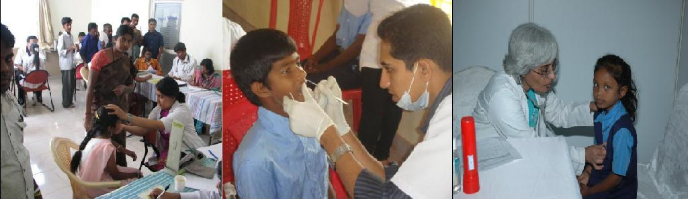
Health & Wellness Health Camps
Objective
This program aims to provide quality, affordable, accessible healthcare to children from government, corporation and government aided schools through team of doctors and non-medical staff.

Slide 7


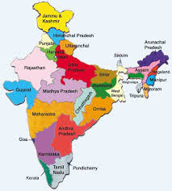



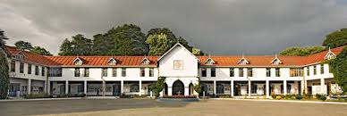
Health & Wellness Health Camps
INR 31 L Project Cost
Health & Wellness Health Camps
13 States 19 Location
October 2017
September 2018
50
16
10,000
70
INR 285 Cost/Child

Slide 8
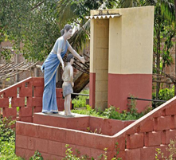
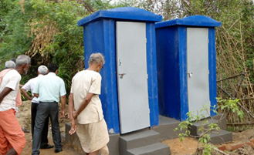
Sanitation Toilet Constructions
Objective
To construct eco friendly toilets and make the area free of open defecation
Standard ready to install toilet. Plumbing & small civil work at location.
(I feel objective need to be refined)

Slide 9

Sanitation Toilet Constructions
INR 40 K
is cost of each Toilet
On Demand
Tribal belt in Karnataka & Tamilnadu - 150
Varanasi -30
150 Toilet Constructions
INR 60 L Project Cost
Bidar - 30
In and around Bangalore rural – 90
Tribal villages - 10
Tribal belt – 4
Villages around Bangalore - 26

Slide 10
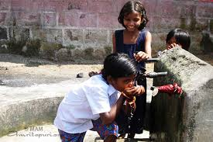
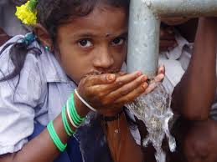
Water Drinking Water Facility at Rural Schools
Objective
Clean drinking water to rural children of government & aided schools
(I think objective need to be defined)

Slide 11
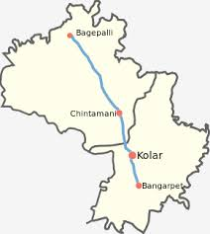
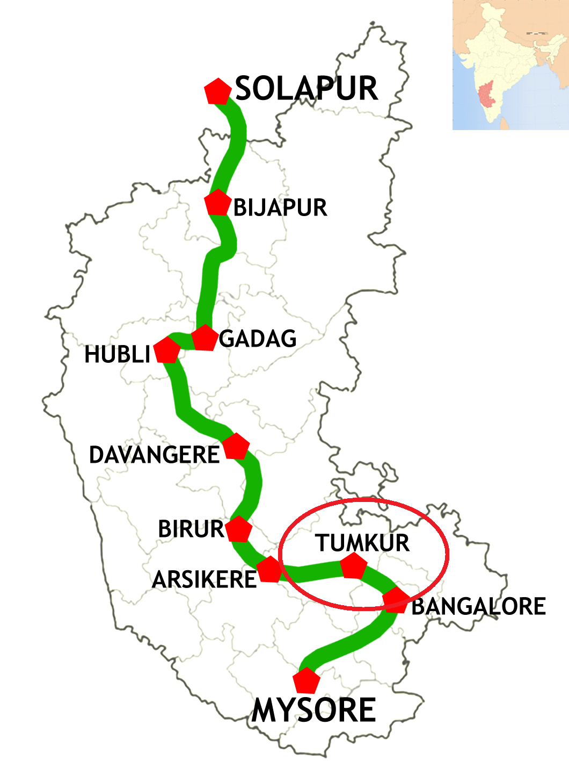
Water Drinking Water Facility at Rural Schools
Rama Lakshmamma Vidhya Samsthe, Munganahalli, Adinaranaiah, Chintamani Taluk
Tumkur village
Need: Bore well & Rainwater harvesting
Water filter & Hand wash basin
For 10 Schools
INR 10L Project Cost
INR 5L Project Cost
Put complete address of school and Picture if possible

Slide 12
Capex Shelter for Destitute children - Nele
Objective
?????
Define objective of this project.
There are 8 Nele where 260 students who are studying from 1st Standard to Master are living. In Nele a child’s holistic development - Education, Health, Food, Cultural, Sports, Counseling, is taken care by us.

Slide 13
Capex Shelter for Destitute children - Nele
INR 6L Project Cost
Requirements | Quantity
Laptops | 2
Washing Machines | 3
Wet Grinders | 2
Computers | 6
DVD Players | 6
Carom board, Cricket set | 2
Badminton Court construction | 2

Slide 14
Our Presence

Slide 15
Benefits of SSF Program

Slide 16
How we work..

Slide 17
Health & Wellness Health Camps with Vistaar Finance

Slide 18
Project Scope
Define project or program scope clearly ??????

Slide 19
Project Phases
Phase1: Identification of locations and schools
Phase 2: Initial screening of ~10,000 school children across 13 different states of Vistaar Finance’s presence
Phase 3: Take-up few critical cases for next level of treatment and referrals
Out of Scope: Dental consultation / treatment not included. Surgeries not included.
INR 31 L Project Cost
Health & Wellness Health Camps
13 States 19 Location
October 2017
September 2018

Slide 20
High Level Project Schedule
 | Schedule 2017 |  |  |  | Schedule 2018
Execution Plan | 15-Sep-17 | 31-Oct-17 | 30-Nov-17 | 31-Dec-17 | 31-Jan-18 | 28-Feb-18 | 31-Mar-18 | 30-Apr-18
Preparation phase
Pre-screening activity
Screening by doctors
Eye screening / treatment
Referrals follow-up / treatment
Reporting
Impact assessment |  |  |  | Data collection & Impact reporting
Preparation phase
Identification of Government schools (along with VISTARA)
Permissions/approvals from concerned Government departments
Hiring/training of coordinators for the project
Sign-off with partners for Dental/Eye screening/treatment
Identification of doctors for the program
Screening
Health screening of all children
Initiate Eye-prescreening / screening activities
Documenting the data
Treatment for needy children at school
Documentation & Reporting
Referrals
Referrals thru specialists after parental consent.
Eye screening / treatments
Dental screening & follow-ups.

Slide 21
Project Estimates & Budget
Account Head | Cost
Direct Cost per camp - first level | 97,000
Print and media | 5,000
Direct Cost per school - follow-up level | 41,000
Admin and Organisation expenses | 17,000
Total budget per location (4 schools/location) | 160,000
Total budget for 19 locations (Approx Project Cost) | 3,100,000
INR 285 Cost/Child

Slide 22
Project Estimates- Headwise
Cost Head | Units | Unit Cost | Cost
Direct Cost per camp - first level
Doctor's honorarium | 3 | 2000 | 6,000
Medicines at the premises | 150 | 100 | 15,000
Volunteers / Area executives | 3 | 6000 | 18,000
Project Coordinator | 1 | 12000 | 12,000
Documentation and reporting | 1 | 5000 | 5,000
Transportation and food | 1 | 13000 | 13,000
Snack for children and teachers | 600 | 20 | 12,000
Coordination cost from the office | 1 | 7200 | 7,200
First aid kit for school | 1 | 1000 | 1,000
Logistics of food, stationary and other items | 1 | 2000 | 2,000
Stationary and others | 1 | 1500 | 1,500
Other direct cost |  |  | 4,535
 |  | Sub-Total | 97,235
Print and media | 1 | 5000 | 5,000
 |  | Sub-Total | 5,000
Direct Cost per school - follow-up level
Spectacles | 40 | 400 | 16,000
Dental follow-up treatment | 0 | 500 | -
Logistics of students and parents | 25 | 800 | 25,000
 |  | Sub-Total | 41,000
Indirect cost during follow-ups
Permissions and laisoning requirements
Special medical testing /doctor's expences |  | Not covered
Hospital and other operating charges
 |  | Sub-Total | -
Admin and Organisation expenses | 1 |  | 16,948
 |  | Sub-Total | 16948
Total budget per location (4 schools/location) |  | Grand-Total | 171,000
Total budget for 19 locations |  |  | 3,043,477

Slide 23
Project Governance
Initial Health Assessment would be conducted and children data captured
Reports of treatments completed, pending cases and overall status
Referrals for each child tracked to closure
Ongoing Treatments recorded
Internal monthly review meetings will be held to review Project Status
If required support (manpower/guidance/re-planning) will be provided to bring project on track
Corrective Actions will be taken as required
Reports will be generated at the end of month. The format will include, but not limited to
Status of the activities for the month
Current status - Data and charts from all schools on number screened, treated & pending under each type of ailment
Plan for next month
Reviews with VISTARA
October 2017 (Preparation and Planning Milestone)
Dec’18 (Milestone review, Execution Phase)
Fe(Milestone review, Execution Phase)
Feb’18 (end of program)
Any other time as it may be appropriate (initiated by VISTARA or SST)

Slide 24
Next Step?

