Slide 1




CSR Projects
Samarpaka Seva Trust
No. 4259, I Floor
2nd Main, Girinagar I Phase,
Bangalore- 560085
Rajanna S, Managing Trustee, hosura@yahoo.com |+91-9845378434
Ramanath Pai, Director Operations, Ramanath.pai@gmail.com |+91-9900951007

Slide 2
Who are we?
Samarpaka Seva Trust (SST) is a non profit social platform that connects Corporate CSR initiatives and the NGO projects and ensure high effectiveness and impact for the Corporate CSR Objective.
SST is a team of 9 humanitarians with 200 years of combined experience in corporate and social sectors. We have deep expertise and network in conceptualizing, incubating and implementing social sector projects across India.
Our platform maximizes the value of investment for all stakeholders – Beneficiaries, NGOs, Donors, Government and Society by and large.

Slide 3
Our Mission & Vision
Vision
A benchmark organization in the social sector which provide a platform to enables other organizations to prioritize and delivery high impact social projects.
Mission
Bridging the resources gap of all social projects by connecting the solution with resources to the social problems.

Slide 4
Our Values
Service
Equality
Integrity
Competency
Sampark Seva
Foundation

Slide 5
Project Disciplines
15+
Active Projects
Children & Education
Health & Wellness
Environment & Sanitary projects
10+
Impact
Areas
Specially Enabled
Women
Welfare
Family Counselling
Rural Welfare
12+
Partner
NGOs
Vocational Training
Volunteering
Tribal Development
10K+
Beneficiaries

Slide 6
Proposed Projects Under Our Programs
Year 2017-18

Slide 7
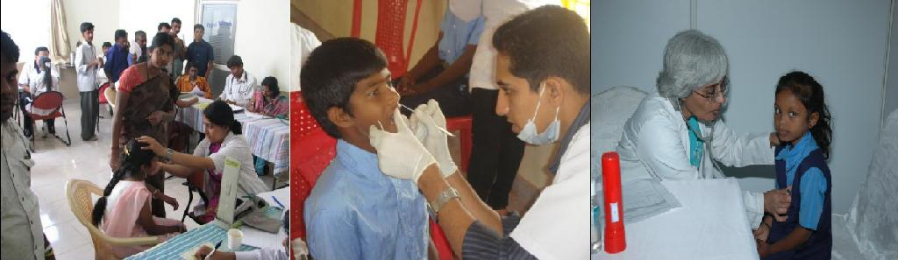
Health & Wellness Health Camps
Objective
This program aims to provide quality, affordable, accessible healthcare to children from government, corporation and government aided schools through team of doctors and non-medical staff.

Slide 8


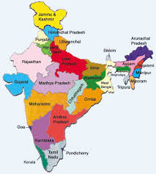



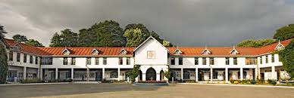
Health & Wellness Health Camps
INR 31 L Project Cost
Health & Wellness Health Camps
13 States 19 Location
October 2017
September 2018
50
16
10,000
70
INR 285 Cost/Child

Slide 9
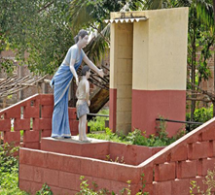
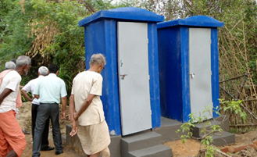
Sanitation Toilet Constructions
Objective
To make the community free from open defection. Construct eco friendly toilets using standard ready to install toilets with minimum plumbing & small civil work at the location.

Slide 10

Sanitation Toilet Constructions
INR 40 K
is cost of each Toilet
On Demand
Tribal belt in Karnataka & Tamilnadu - 150
Varanasi -30
150 Toilet Constructions
INR 60 L Project Cost
Bidar - 30
In and around Bangalore rural – 90
Tribal villages - 10
Tribal belt – 4
Villages around Bangalore - 26

Slide 11
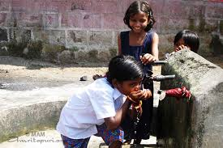
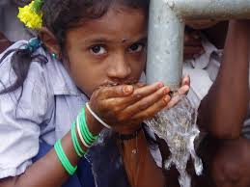
Drinking Water Facility at Rural Schools
Objective
To provide clean drinking water to the rural children of government & aided schools where local ground water is contaminated with fluoride or other impurities.

Slide 12
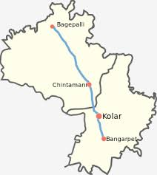
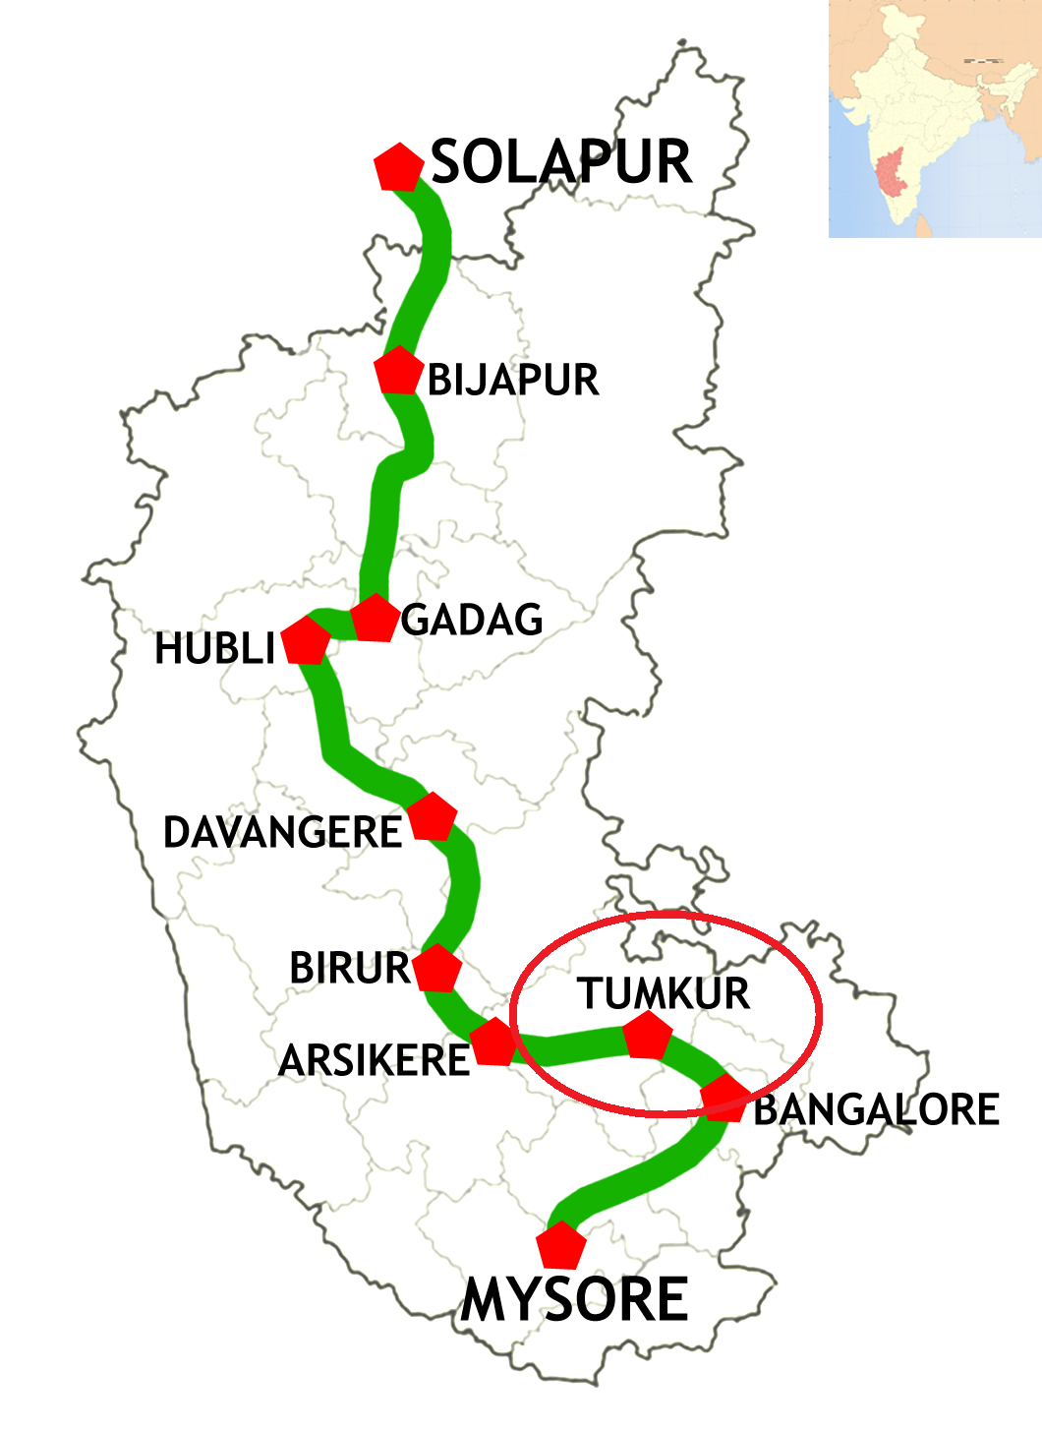
Drinking Water Facility at Rural Schools
Rama Lakshmamma Vidhya Samsthe, Munganahalli, Adinaranaiah, Chintamani Taluk
Tumkur village
Need: Bore well & Rainwater harvesting
Water filter & Hand wash basin
For 10 Schools
INR 10L Project Cost
INR 5L Project Cost

Slide 13
Capex Shelter for Destitute children - Nele
Objective
Objective is to have a owned building with basic required facilities for running the NELE at different places of Karnataka. Thus reducing the operational expenditure for a great extent in the coming years.
There are 6 Nele where 300 students who are studying from 1st Standard to Master are living. In Nele a child’s holistic development - Education, Health, Food, Cultural, Sports, Counseling, is taken care by us.

Slide 14
Capex Shelter for Destitute children - Nele
INR 6L Project Cost
Requirements | Quantity
Laptops | 2
Washing Machines | 3
Wet Grinders | 2
Computers | 6
DVD Players | 6
Carom board, Cricket set | 2
Badminton Court construction | 2

Slide 15
Health & Wellness Health Camps with Vistaar Finance

Slide 16
Project Objective
This program aims to provide quality, affordable, accessible healthcare to children from government, corporation and government aided schools through team of doctors and non-medical staff.

Slide 17
Project Phases
Phase 1: Identification of locations and schools
Phase 2: Initial screening of ~10,000 school children across 13 different states of Vistaar Finance’s presence
Phase 3: Take-up few critical cases for next level of treatment and referrals
Out of Scope: Dental consultation / treatment not included. Surgeries not included.
INR 31 L Project Cost
Health & Wellness Health Camps
13 States 19 Location
Oct’2017
Apr’2018

Slide 18
High Level Project Schedule
 | Schedule 2017 |  |  |  | Schedule 2018
Execution Plan | 15-Sep-17 | 31-Oct-17 | 30-Nov-17 | 31-Dec-17 | 31-Jan-18 | 28-Feb-18 | 31-Mar-18 | 30-Apr-18
Preparation phase
Pre-screening activity
Screening by doctors
Eye screening / treatment
Referrals follow-up / treatment
Reporting
Impact assessment |  |  |  | Data collection & Impact reporting
Preparation phase
Identification of Government schools (along with VISTARA)
Permissions/approvals from concerned Government departments
Hiring/training of coordinators for the project
Sign-off with partners for Dental/Eye screening/treatment
Identification of doctors for the program
Screening
Health screening of all children
Initiate Eye-prescreening / screening activities
Documenting the data
Treatment for needy children at school
Documentation & Reporting
Referrals
Referrals thru specialists after parental consent.
Eye screening / treatments
Dental screening & follow-ups.

Slide 19
Project Estimates & Budget
Account Head | Cost
Direct Cost per camp - first level | 97,000
Print and media | 5,000
Direct Cost per school - follow-up level | 41,000
Admin and Organisation expenses | 17,000
Total budget per location (4 schools/location) | 160,000
Total budget for 19 locations (Approx Project Cost) | 3,100,000
INR 285 Cost/Child

Slide 20
Project Estimates- Head wise
Cost Head | Units | Unit Cost | Cost
Direct Cost per camp - first level
Doctor's honorarium | 3 | 2000 | 6,000
Medicines at the premises | 150 | 100 | 15,000
Volunteers / Area executives | 3 | 6000 | 18,000
Project Coordinator | 1 | 12000 | 12,000
Documentation and reporting | 1 | 5000 | 5,000
Transportation and food | 1 | 13000 | 13,000
Snack for children and teachers | 600 | 20 | 12,000
Coordination cost from the office | 1 | 7200 | 7,200
First aid kit for school | 1 | 1000 | 1,000
Logistics of food, stationary and other items | 1 | 2000 | 2,000
Stationary and others | 1 | 1500 | 1,500
Other direct cost |  |  | 4,535
 |  | Sub-Total | 97,235
Print and media | 1 | 5000 | 5,000
 |  | Sub-Total | 5,000
Direct Cost per school - follow-up level
Spectacles | 40 | 400 | 16,000
Dental follow-up treatment | 0 | 500 | -
Logistics of students and parents | 25 | 800 | 25,000
 |  | Sub-Total | 41,000
Indirect cost during follow-ups
Permissions and laisoning requirements
Special medical testing /doctor's expences |  | Not covered
Hospital and other operating charges
 |  | Sub-Total | -
Admin and Organisation expenses | 1 |  | 16,948
 |  | Sub-Total | 16948
Total budget per location (4 schools/location) |  | Grand-Total | 171,000
Total budget for 19 locations |  |  | 3,043,477

Slide 21
Project Governance
Initial health assessment will be conducted for the children and report is prepared and reviewed
Treatments completion, pending cases and overall status report prepared and reviewed
Referrals for each child tracked to closure. Referral case report prepared and reviewed.
Ongoing Treatments recorded. Summary report prepared and reviewed.
Monthly - internal review meetings to review the overall project status & take corrective or preventive actions, if required.
Monthly- Summary report as per the format agreed.
Reviews with VISTARA
Oct’17 (Preparation and Planning)
Nov’17 (Milestone review)
Dec’17 (Milestone review)
Jan’18 (Milestone review)
Feb’18 (Milestone review)
Mar’18 (Milestone review)
Apr’18 (End of project)

Slide 22
How We Work – A High-level View
Pre Project Approval
Post Project Approval
VISTAR - DONOR Organization
SST – Bridging platform
VISTAR - DONOR Organization
Fund flow line
NGO
NGO
Information flow
SST – Bridging platform
Execution follow-up
PMC charges reimbursed by NGOs to SST
Broad relationship between the Donor, Fund Utilizer, and the bridging platform SST. All the donor organizations are contacted for funds through SST and SST prepares proposals accordingly for donors’ acceptance

Slide 23
What We Offer
Corporate Services
NGO Services
Shared Services
Customized CSR strategies, aligned with vision, philosophy, expertise, stakeholder expectations
Promotion of Corporate CSR activities as per the requirements and create social visibility
Project implementation and management on behalf of corporates
Document and reporting
Corporate volunteer engagement
Champion the overall partnership
Work with network NGOs across India to bring access to funding, partnerships with corporates, best practices
Plan and execute campaigns
Project execution support to NGOs, by bringing in best practices to NGOs
Prepare relevant and particular statistics – charts/highlights/success stories/testimonials/opinions/lessons learnt etc.
Share and spread the expertise and best practices across organizations
Guide to achieve benchmarks in operations, execution and results
Leverage and create multiplier effect
Impact assessments and research

Slide 24
Process and Responsibility Chart
Subject flow of the project | Action responsibility
Finalization of contract | VISTAAR, SST, NGO
Contract acceptance and submission of project plan | SST, NGO
Kick-off of the project | All three organizations
Execution as per the plan submitted | NGO, SST
Project Management and reporting | SST, NGO
Review progress (quarterly once) | All three organizations
Documentation, evidence, testimonials and review | SST , NGO, VISTAAR
Project plan further follow up until closure | SST,NGO
Closure of the project, reporting and impact assessment reports | All three organizations

Slide 25
Next Step?

