Slide 1



CSR Projects
Samarpaka Seva Trust
No. 4259, I Floor
2nd Main, Girinagar I Phase,
Bangalore- 560085
Rajanna S, Managing Trustee, hosura@yahoo.com |+91-9845378434
Ramanath Pai, Director Operations, Ramanath.pai@gmail.com |+91-9900951007

Slide 2
Why we exists?
We understand social project goes through following problems
A good NGO is very busy in doing the ground work and they do not have required resources to present their work and seek the support from donor, volunteers.
A lack of support pull down the enthusiasm of volunteers, planners and community in large
In general NGO do not have required skills to present the work in terms of CSR objectives of corporates
In general NGO do not have required skills for doing detail project planning & project governance
They do not have good tools for program/project management so reporting is manual and delayed.
In general NGO have poor understanding of benefit measurement of the program

Slide 3
Who are we?
Samarpaka Seva Trust (SST) is a non profit organization and platform for social organizations & corporates.
We connect NGO & their projects/programs to the Corporate and their CSR objectives
We ensure that
NGO do their project planning to the details required.
They use some tool to capture the progress data on regular basis
Required program/project management trainings to the project/program team of the NGO
Present the work of NGO in the required form to Corporate
Ensure NGOs spends fund for the purpose for which approval has been taken and achieve the committed benefits
Ensure NGO project leaves a long lasting impact on the society with minimum investments
Connects volunteers to the various NGO projects
SST is a team of 9 humanitarians with 200 years of combined experience in corporate, social sectors and Project Management. We have deep expertise and network in conceptualizing, incubating and implementing social sector projects across India.
Our platform maximizes the value of investment for all stakeholders – Beneficiaries, NGOs, Donors, Government and Society by and large.

Slide 4
Our Team
People with Photo

Slide 5
Our Mission & Vision
Vision
A nodal organization in the social sector which provide a platform to enables NGO & Corporates to prioritize and delivery high impact social projects.
Mission
Bridging the resources gap of all social projects by connecting the solution with resources to the social problems.

Slide 6
Our Values
Sampark Seva
Trust
Honesty
Responsibility
Competency
Respect
Fairness

Slide 7
Project Disciplines
15+
Active Projects
Children & Education
Health & Wellness
Environment & Sanitary projects
10+
Impact
Areas
Specially Enabled
Women
Welfare
Family Counselling
Rural Welfare
12+
Partner
NGOs
Vocational Training
Volunteering
Tribal Development
10K+
Beneficiaries

Slide 8
How We Work – A High-level View
Pre Project Approval
Post Project Approval
DONOR Organization
SST – Bridging platform
DONOR Organization
Fund flow line
NGO
NGO
Information flow
SST – Bridging platform
Execution follow-up
PMC charges reimbursed by NGOs to SST
Broad relationship between the Donor, Fund Utilizer, and the bridging platform SST. All the donor organizations are contacted for funds through SST and SST prepares proposals accordingly for donors’ acceptance

Slide 9
What We Offer
Corporate Services
NGO Services
Shared Services
Customized CSR strategies, aligned with vision, philosophy, expertise, stakeholder expectations
Promotion of Corporate CSR activities as per the requirements and create social visibility
Project implementation and management on behalf of corporates
Document and reporting
Corporate volunteer engagement
Champion the overall partnership
Work with network NGOs across India to bring access to funding, partnerships with corporates, best practices
Plan and execute campaigns
Project execution support to NGOs, by bringing in best practices to NGOs
Prepare relevant and particular statistics – charts/highlights/success stories/testimonials/opinions/lessons learnt etc.
Share and spread the expertise and best practices across organizations
Guide to achieve benchmarks in operations, execution and results
Leverage and create multiplier effect
Impact assessments and research

Slide 10
Process and Responsibility Chart
Subject flow of the project | Action responsibility
Finalization of contract | Donor, SST, NGO
Contract acceptance and submission of project plan | SST, NGO
Kick-off of the project | All three organizations
Execution as per the plan submitted | NGO, SST
Project Management and reporting | SST, NGO & Donor, SST
Review progress (quarterly once) | All three organizations
Documentation, evidence, testimonials and review | Donor, SST, NGO
Project plan further follow up until closure | SST, NGO
Closure of the project, reporting and impact assessment reports | All three organizations

Slide 11
Social Impacts Created by our Programs/Projects

Slide 12
Health & Wellness for Children

Slide 13
Sanitation Toilet Constructions

Slide 14
Drinking Water Facility at Rural Schools

Slide 15
Shelter for Destitute children

Slide 16
Proposed Projects Under various Programs
Year 2017-18

Slide 17
Domain of Working & Programs
Health & Wellness for Children
Manonandana
Arun Chetana
Seva in Action
Sanitation Toilet Constructions
Seva Kiran
Drinking Water Facility at Rural Schools
Seva Kiran
Shelter for Destitute children
Nele
Infrastructure for Destitute children

Slide 18
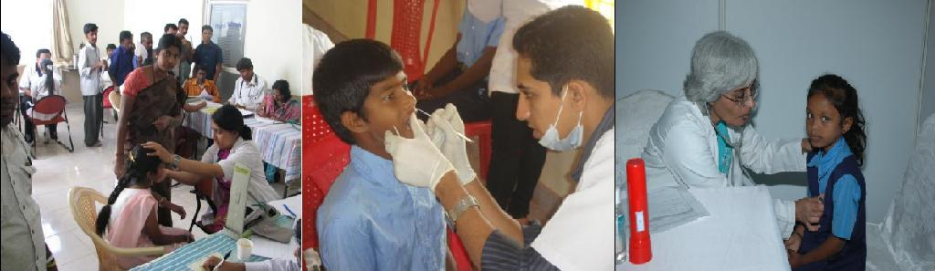
Health & Wellness for Children
Objective
This program aims to provide quality, affordable, accessible healthcare to children from government, corporation and government aided schools through team of doctors and non-medical staff.
Key Programs
Seva in Action
Manonandana
Arun Chetana

Slide 19


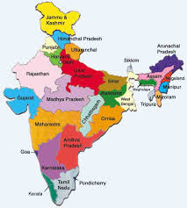



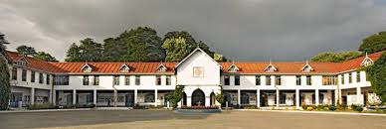
Health & Wellness for Children
INR 31 L Project Cost
Health & Wellness Health Camps
13 States 19 Location
October 2017
September 2018
50
16
10,000
70
INR 285 Cost/Child

Slide 20
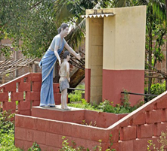
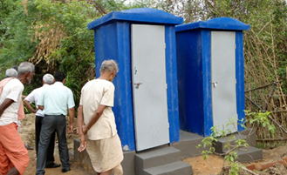
Sanitation Toilet Constructions
Objective
To make the community free from open defection. Construct eco friendly toilets using standard ready to install toilets with minimum plumbing & small civil work at the location.
Key Programs
Seva Kiran

Slide 21

Sanitation Toilet Constructions
INR 40 K
is cost of each Toilet
On Demand
Tribal belt in Karnataka & Tamilnadu - 150
Varanasi -30
150 Toilet Constructions
INR 60 L Project Cost
Bidar - 30
In and around Bangalore rural – 90
Tribal villages - 10
Tribal belt – 4
Villages around Bangalore - 26

Slide 22
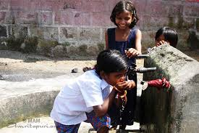
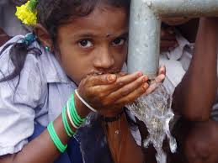
Drinking Water Facility at Rural Schools
Objective
To provide clean drinking water to the rural children of government & aided schools where local ground water is contaminated with fluoride or other impurities.
Key Programs
???

Slide 23
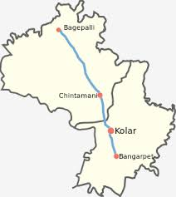
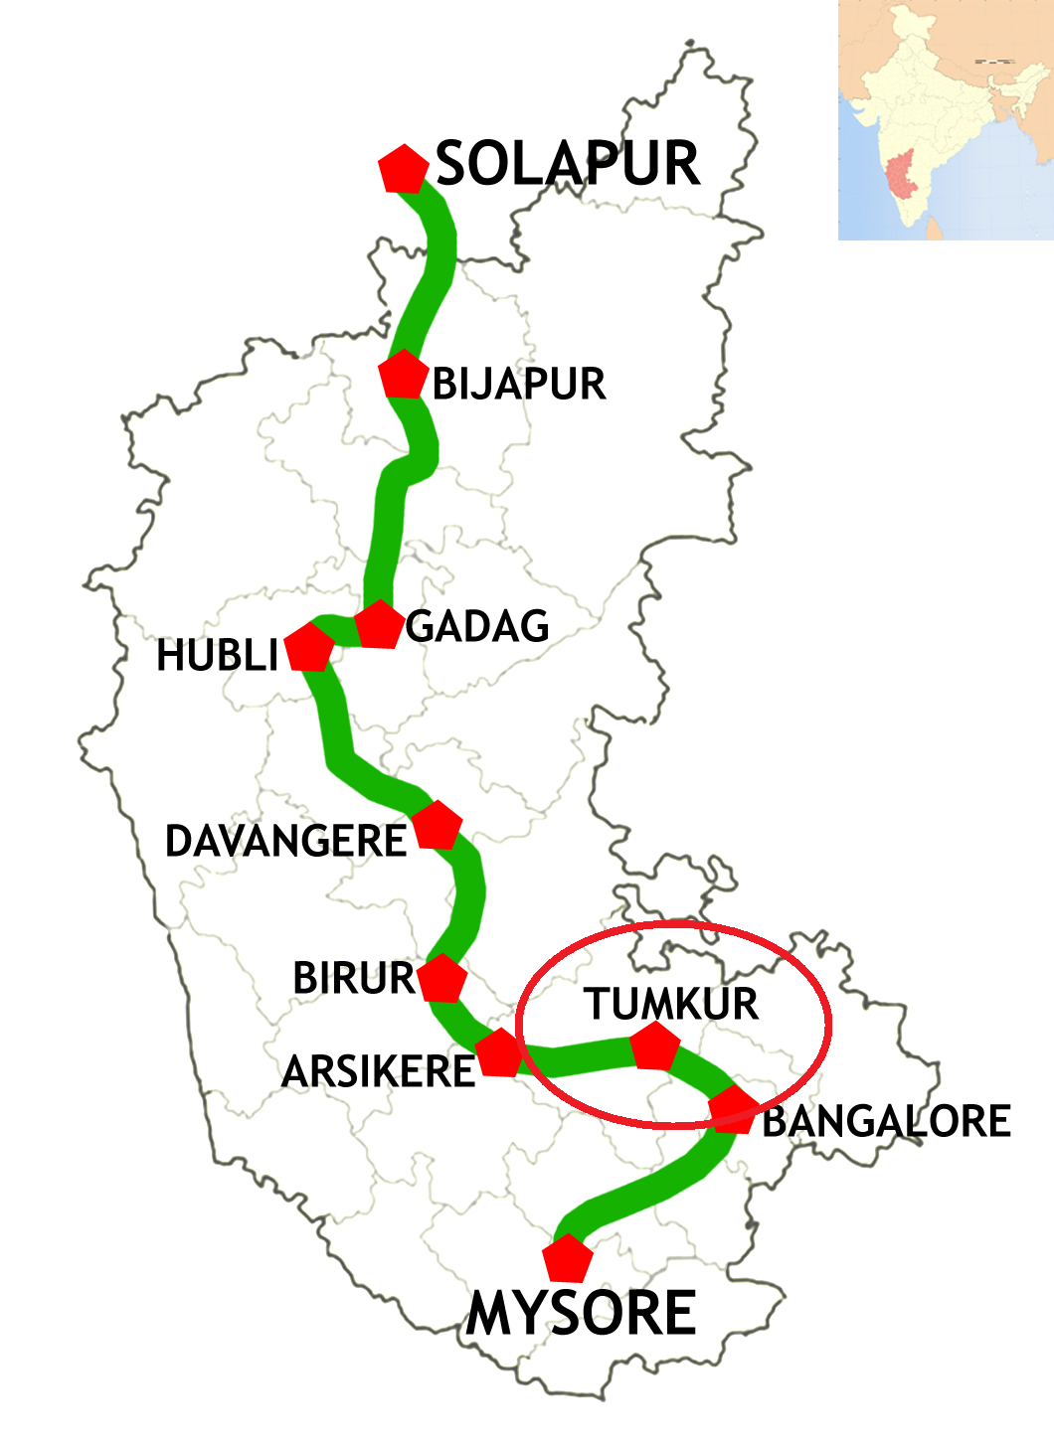
Drinking Water Facility at Rural Schools
Rama Lakshmamma Vidhya Samsthe, Munganahalli, Adinaranaiah, Chintamani Taluk
Tumkur village
Need: Bore well & Rainwater harvesting
Water filter & Hand wash basin
For 10 Schools
INR 10L Project Cost
INR 5L Project Cost

Slide 24
Shelter for Destitute children
Objective
Objective is to have a owned building with basic required facilities for running the shelter at different places of Karnataka. Thus reducing the operational expenditure for a great extent in the coming years.
Key Programs/Projects
Nele: There are 6 Nele where 300 students who are studying from 1st Standard to Master are living. In Nele a child’s holistic development - Education, Health, Food, Cultural, Sports, Counseling, is taken care by us.
Infrastructure for Nele

Slide 25
Infrastructure for Destitute children - Nele
INR 6L Project Cost
Requirements | Quantity
Laptops | 2
Washing Machines | 3
Wet Grinders | 2
Computers | 6
DVD Players | 6
Carom board, Cricket set | 2
Badminton Court construction | 2

Slide 26
Health & Wellness for Children Project: Health & Wellness Camps 2017-18

Slide 27
Project Objective
This program aims to provide quality, affordable, accessible healthcare to children from government, corporation and government aided schools through team of doctors and non-medical staff.

Slide 28
Project Phases
Phase 1: Identification of locations and schools
Phase 2: Initial screening of ~10,000 school children across 13 different states of Vistaar Finance’s presence
Phase 3: Take-up few critical cases for next level of treatment and referrals
Out of Scope: Dental consultation / treatment not included. Surgeries not included.
INR 31 L Project Cost
Health & Wellness Health Camps
13 States 19 Location
Oct’2017
Apr’2018

Slide 29
High Level Project Schedule
 | Schedule 2017 |  |  |  | Schedule 2018
Execution Plan | 15-Sep-17 | 31-Oct-17 | 30-Nov-17 | 31-Dec-17 | 31-Jan-18 | 28-Feb-18 | 31-Mar-18 | 30-Apr-18
Preparation phase
Pre-screening activity
Screening by doctors
Eye screening / treatment
Referrals follow-up / treatment
Reporting
Impact assessment |  |  |  | Data collection & Impact reporting
Preparation phase
Identification of Government schools (along with VISTARA)
Permissions/approvals from concerned Government departments
Hiring/training of coordinators for the project
Sign-off with partners for Dental/Eye screening/treatment
Identification of doctors for the program
Screening
Health screening of all children
Initiate Eye-prescreening / screening activities
Documenting the data
Treatment for needy children at school
Documentation & Reporting
Referrals
Referrals thru specialists after parental consent.
Eye screening / treatments
Dental screening & follow-ups.

Slide 30
Project Estimates & Budget
Account Head | Cost
Direct Cost per camp - first level | 97,000
Print and media | 5,000
Direct Cost per school - follow-up level | 41,000
Admin and Organisation expenses | 17,000
Total budget per location (4 schools/location) | 160,000
Total budget for 19 locations (Approx Project Cost) | 3,100,000
INR 285 Cost/Child

Slide 31
Project Governance
Initial health assessment will be conducted for the children and report is prepared and reviewed
Treatments completion, pending cases and overall status report prepared and reviewed
Referrals for each child tracked to closure. Referral case report prepared and reviewed.
Ongoing Treatments recorded. Summary report prepared and reviewed.
Monthly - internal review meetings to review the overall project status & take corrective or preventive actions, if required.
Monthly- Summary report as per the format agreed.
Reviews with VISTARA
Oct’17 (Preparation and Planning)
Nov’17 (Milestone review)
Dec’17 (Milestone review)
Jan’18 (Milestone review)
Feb’18 (Milestone review)
Mar’18 (Milestone review)
Apr’18 (End of project)

Slide 32
Next Step?

