Slide 1


Agile-Scrum
1 Day- Introductory Training
Prepared By: Hari P Thapliyal
Mobile: +91 9535999336
email : hari.prasad@vedavit-ps.com

Slide 2
Faculty & Participants
An Introduction
Name, Company, Current Designation, Why Certification, Hobb(y/ies)

Slide 3
Workshop Ground Rules
Please keep your mobile on the silent mode. Always take your calls outside the training room.
No corner talk! Discussions only when group discussion is allowed
Keep your focus on the ongoing topic. Await your turn during the questionnaire round.
Strictly follow the workshop schedule for management of time.
There is parking lot. Write you questions and post with your name on parking lot.
Breaks only on agreed time
  Tea
  Lunch
  Tea
Everybody need to contribute
Use your experience only for relating the processes and best practices. To avoid confusion keep it outside of the class. Unlearning is first and biggest learning to learn something new.
Two Bowls
Notes:
Project Management Concepts
06/28/13
Version 3.1, 4/01 © 2003 by AstroWix

Slide 4
Workshop Objective
Learn Agile Project Management best Practices as per PMI-ACP certification requirements
Getting accustomed to new terminology of Agile Project Management
Notes:
Project Management Concepts
06/28/13
Version 3.1, 4/01 © 2003 by AstroWix

Slide 5
Agenda
What is Project?
What is Agility?
Why Agile?
Estimation in Scrum
Scrum Roles
Scrum Artifacts
Release Planning
Sprint Planning
Tracking in scrum
Exercises
  Velocity calculation, Planning Poker
  Scrum Simulation Exercise(Sprint Planning, Execution)

Slide 6

What is Project???
Introduction / Project Management

Slide 7
What is Project?
Introduction / Project Management
  Project – A temporary endeavor undertaken to create a unique product, service or result
How Temporary?
  Has a definite beginning and end, not an on-going effort
  Ceases when objectives have been attained
  Team is disbanded upon project completion
Unique?
  The product or service is different in some way from other product or services
  Product characteristics are progressively elaborated
Source PMBOK Guide Version 5.0

Slide 8
Project ..…
Project Characteristics
Introduction / Project Management
  Is goal oriented (verifiable and measurable)
  Finite duration with a beginning and end
  Uniqueness to a great extent and related uncertainties
  Coordinated undertaking of interrelated activities
  Performing the activities involve resources
  Resources cost money

Slide 9
“Projects” different from “operations”?
Contrast Projects & Operations
Introduction / Project Management
  Projects
  Permanent Project Charter
  Catalyst for change
  Unique product or service
  Heterogeneous teams
  Start and end date
  Progressive elaboration
  Operations
  Semi-permanent charter
  Maintains status quo
  Standard product or service
  Homogeneous teams
  Ongoing
  Predefined product

Slide 10






Project Constraints
Project Constraints
Introduction / Project Management
Risk
Scope
Project and Product Quality
Schedule
Cost
Resource

Slide 11
Before we go ahead…
Introduction / Agile Project Management
Lets see one case study on agile project management

Slide 12
Modern Project Management Challenges
Introduction / Agile Project Management
Uncounted uncertainties
Very tough to negotiate with stakeholders a change in baselined plan
Product value realization at the end of project lifecycle
Huge difference between expectations of end user, customer and sponsor
Typically development team is isolated from business scenario and it becomes very difficult to implement change request
Technology and project environment changes during project execution
Customer does not want to hear about new timelines even after requirement changes. Because project is baselined!
Customer end up paying more because critical dates missed, non-usable product features, less-value product
Not enough decentralized power stations to make decisions during project execution
Execution team and project management teams are different. Execution team does not have power and execution does not happen as per initial plan
Work product delivered at the end of every phase is not usable work product. Typical it is some paper prototype, document or some other thing.

Slide 13
How to address modern day PM challenges?
Introduction / Agile Project Management
Involve end user
Engage relevant stakeholders
Produce in increment
Deliver high value feature first
Take frequent feedback and allow customer to change original requirements
Allow customer to prioritize
Get commitment from team for valuable product not of activities
Employ the power of level of planning
Involve team in risk identification and responding to risk
Transparency in project management
Continuous improvement
Learn quickly

Slide 14
Challenges in Starting Agile Project Management
Introduction / Agile Project Management
Team
  Getting experienced team member
  Getting 100% committed team
  Getting collocated team in early agile adoption
  Team’s mindset shifting from action to delivery
  A cross disciplined team with generic skills
Environment
  Trust building
  Open communication with customer
  Keeping politics out
Infrastructure & Support
  Active risk management framework
  Robust, flexible and adaptable configuration and data management systems
  You need a variety of communication, collaboration, management and development tools. Therefore a culture is required to support and facilitate this endeavors.
  Management need a framework from where they get to know what is happening in the project.
  Upfront training
  Supporting in early period when velocity is less

Slide 15
What is Agility?
Introduction / Agile Project Management
Agility is about quickly responding to changes
Learning quickly from mistakes and incorporate lessons learned
Being proactive
It helps in all aspects of success- Personal, Technical and Organizational

Slide 16

Which PM Methodology is best?
Introduction / Agile Project Management
Agile Project Management
Low <- Certainty ->High
Traditional Project Management

Slide 17
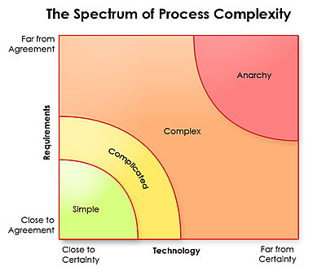
Which PM Methodology is best?
Introduction / Agile Project Management
Nothing works here
Ralph Stacey's complexity matrix
Waterfall

Slide 18
Complex Adaptive Systems
Introduction / Agile Project Management
Think about how newly born child is going to learn about talking, walking, learning, eating etc.
What process you use to climb mountain?
In the last couple of decades scientists and managers have articulated a profound shift in their view about how organisms and organizations evolve, respond to change, and manage their growth.
Complex Adaptive Systems theory is one of the root threads of agile development. The concepts about how biological systems evolve and adapt have relevance, if only metaphorically, to organizations and how they evolve and adapt.
Creativity and innovation are the emergent results of well-functioning agile teams.
In complex system things get done because people adapt not because they blindly follow
Former Visa International CEO Dee Hock coined the word “chaordic” to describe both the world where Order exists in Chaos.

Slide 19
Defined vs Empirical Processes
Introduction / Agile Project Management
Defined Processes
Assumes that every piece of work is completely understood
Input is well-defined
A set of well-defined input produces same output every time within known variance limit
Has tightly coupled steps
No checkpoint and feedback steps

Slide 20
Defined vs Empirical Processes
Introduction / Agile Project Management
Empirical Processes
Relies on frequent inspections and adaption
Applies to those process which are loosely defined because of their complexity
Understand that output of a process can be unpredictable and unrepeatable

Slide 21
Value in Agile Manifesto
Introduction / Agile Project Management
“We are uncovering better ways of developing software by doing it and helping others do it. Through this work we have come to value”
Individuals and interactions over processes and tools
Working software over comprehensive documentation
Customer collaboration over contract negotiation
Responding to change over following a plan
That is, while there is value in the items on the right, we value the items on the left more.
www.agilemanifesto.org

Slide 22
Agile Principles
Introduction / Agile Project Management
Satisfy customer by continuous delivery of valuable product
Welcome Change even at late stage
Deliver working software Frequently
Business and Developer work together
Build around Motivated Individuals- Give team opportunity, trust them
Face-to-face communication
Working software is the primary measure of progress.
Sustainable Development
Continuous Technical Excellence
Simplicity--the art of maximizing the amount of work not done--is essential.
Self Organizing Team
Team reflection at regular intervals
www.agilemanifesto.org

Slide 23
Agile Core Practices
Introduction / Agile Project Management
Active Stakeholder Participation
Apply the Right Artifacts
Collective Ownership
Create Several Models in Parallel
Create Simple Content
Depict Models Simply
Display Models Publicly
Iterate to Another Artifact
Model in Small Increments
Model with Others
Prove it with Code
Single Source Information
User the Simplest Tools

Slide 24
Agile Characteristics
Introduction / Agile Project Management
Adaptability not Predictability
Accepting that outcomes are not predictable and process are not repeatable
Values and Principles of Collaboration
The conventions which we agree we define those
Processes are in manuals; practices are in field.

Slide 25
Agile Methodologies
Introduction / Agile Project Management
Scrum
Extreme Programming (XP)
Lean Software Development (LSD)
Feature Driven Development (FDD)
Dynamic System Development Methods (DSDM)
Kanban
Scrum-Ban
Crystal Methods

Slide 26
Agile Methodologies- Scrum
Introduction / Agile Project Management/ Agile Methodologies
Scrum is widely accepted agile project management methodology among dozen of methodologies.
Scrum is lightweight management framework with broad applicability for managing iterative and incremental projects of all type of projects
Typical iteration (also called “Sprint”) length varies between 2-4 weeks.
Scrum Values
  Commitment
  Focus
  Openness
  Respect
  Courage

Slide 27
Agile Methodologies- Scrum
Introduction / Agile Project Management/ Agile Methodologies
Scrum Practices
  Backlog Grooming
  Sprint Planning
  Daily Standup
  Sprint Review
  Sprint Retrospective

Slide 28
Agile Methodologies-XP
Introduction / Agile Project Management/ Agile Methodologies
Originally devised by Kent Beck as an agile method focused on engineering practices. Typical iteration length varies between 1-3 weeks.
XP Values
  Communication
  Simplicity
  Feedback
  Respect
  Courage

Slide 29
Agile Methodologies- XP
Introduction / Agile Project Management/ Agile Methodologies
XP Practices
Fine scale feedback
  Test Driven Development via Programmer Tests and Customer Tests (Unit Tests & Acceptance Tests)
  Planning Game
  Whole Team (including on-site customer)
  Pair Programming (2 people sitting on one work station, one writing test case on notes and another writing code)
Continuous process rather than batch
  Continuous Integration
  Design Improvement / Refactoring
  Small Releases

Slide 30
Agile Methodologies- XP
Introduction / Agile Project Management/ Agile Methodologies
XP Practices
Shared understanding
  Simple Design (Do Simple Things, You Aren’t Gonna Need It (YAGNI), Once And Only Once (DRY), Simplify Vigorously)
  System Metaphor
  Collective Code Ownership
  Coding Standard or Coding Conventions
Programmer welfare
  Sustainable Pace

Slide 31
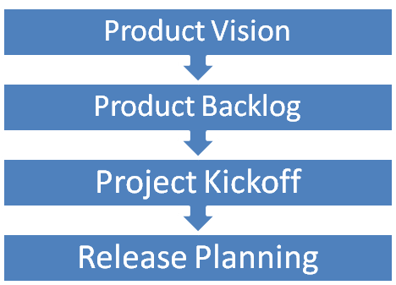
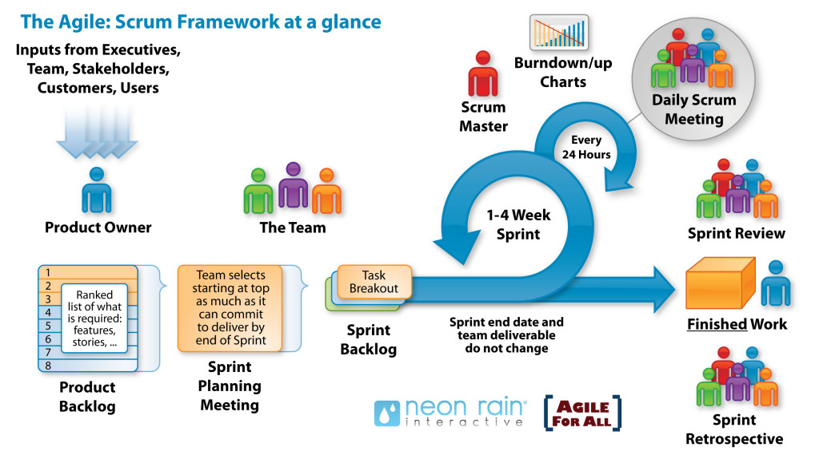
Agile Project Life-cycle
Introduction / Agile Project Management
Inside Story

Slide 32
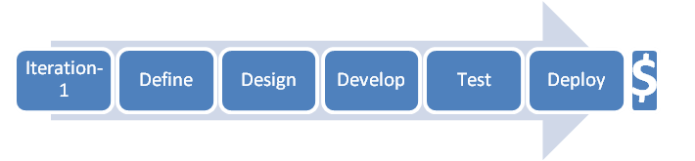
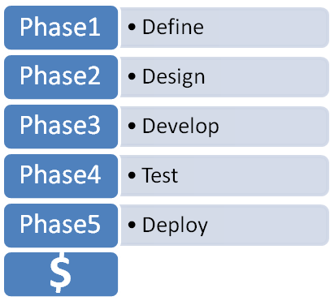



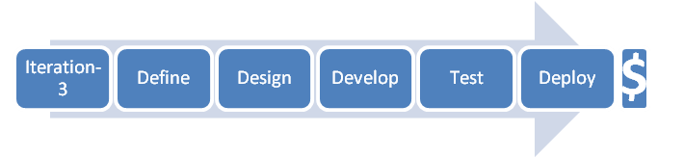

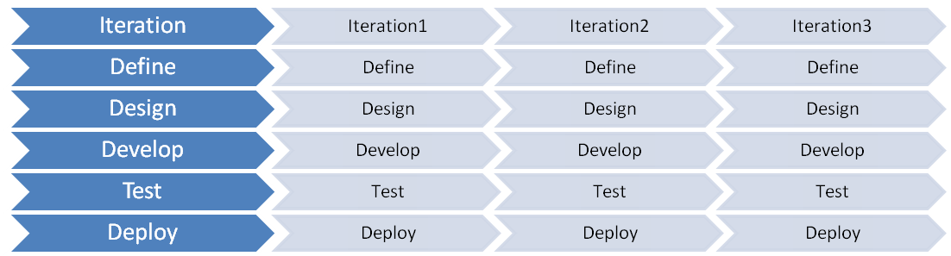
Value Delivery & Project Life Cycle
Introduction / Agile Project Management
Lifecycles: Waterfall- Iterative- Agile

Slide 33
Iteration / Sprint
Introduction / Agile Mindset
Agile project management relies on planning, developing and delivering product features in iterations
Iteration or sprint are time-boxed and duration can not changed from one iteration to another
Iteration is fixed time period in which team need to deliver some valuable product to customer
Prescription for duration length varies from one method to another in agile. In XP iteration length varies 1-3 week (typically one week), scrum and other methods it varies between 2-4 weeks (typically 4 weeks)
Iteration is also known as Sprint in Scrum Methodology

Slide 34
Incremental Delivery
Introduction / Agile Mindset
Delivering the complete product of a project in iterations. It helps in
Learning from previous iteration
Delivering high business value earlier
Adapt to change
Delivering more business value
Removing the waste by not doing those things which are not needed

Slide 35
Travel Light
Introduction / Agile Mindset
You need far less than what you think. Therefore carry on only those things which are most important and urgent.
YAGNI (You aren’t gonna need it)
TAGRI (They aren't gonna Read It)
This is different type of mountaineering. You may need to come back, you may need to change your path, trust that you will get stuff you need on the way etc factor exists here.

Slide 36
Agile Product Building
Introduction / Agile Mindset
Build complete product, all the time
One button should produce needed documentation, build the product executables, create installation materials, produce test results and tested components
Build should also work from command line
Everyone in team should use the same build process

Slide 37
Agile Documentation
Introduction / Agile Mindset
Maximize stakeholder investment. Produce document only when
  It is needed by a stakeholder
  Needed to define contract model
  You need to think something in many iterations involving multiple groups
  It is needed for external communication
Document only those things which are least likely to change
First identify the specific customer of the document
The document facilitates in estimating
Sufficiently index, details, accurate and consistent

Slide 38
Agile Documentation
Introduction / Agile Mindset
Strategies for reducing documentation CRUFT
C- How correct is document?
R- Will document be read?
U- Will document be understood?
F- Will document be followed?
T- Will document be trusted?

Slide 39
Agile Architecture
Introduction / Agile Mindset
Do the simplest thing possible which makes future changes/additions easier
No up-front high-level system architecture
No up-front high-level component architecture
No up-front high-level data model
Determine the details of technology when building functionality

Slide 40
Agile Testing
Introduction / Agile Mindset
All code must have test cases, ideally they should be created earlier
Unit tests should be executed during automated build
A build should be performed many times a time, ideally whenever anything is checked-in or committed to configuration server
If anybody’s code causing crash he should be informed immediately and that person should fix that problem first
All unit test must pass before code can be released

Slide 41
Last Responsible Moments
Introduction / Agile Mindset
Delay the decisions till the moment you have option to exercise because after this point one important options may be eliminated
It helps you in delivering more value in less time by doing only those things which are of high priority
It reduces inventory carrying cost
Getting more information and making more informed decision at last moment

Slide 42
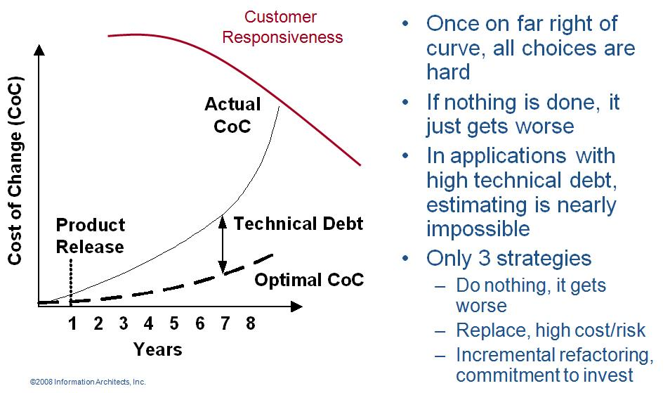
Refactoring
Introduction / Agile Mindset
Agile programmer writes simple and bare minimum code they do not complicate the code
Down the line structure the code without changing its behavior. It helps in improving the quality (maintainability, readability) of code

Slide 43
Technical Debt
Introduction / Agile Mindset
While writing code agile programmer do not pay attention to structure, duplication etc but to functionality and make sure that code is passing all unit test cases
In this process if they do not clean the code by structuring (refactoring) it will become unreadable and un-maintainable and over a period of time this cause increases response time to fix the problems, adding new feature and deteriorate the quality.
The concept of unclean code is called technical debt. Technical debt keep increasing over the period of time therefore Agile team need to pay this debt back by putting efforts in refactoring.

Slide 44
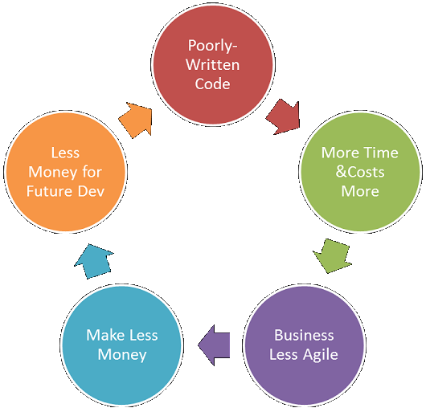
Technical Debt
Introduction / Agile Mindset
Vicious Cycle of Technical Debt

Slide 45
Mindfulness
Introduction / Agile Mindset
Agile team need to be conscious all the time, they need to keep observing patterns and proactively resolving the issues at root.
For example if they know that now it is taking more time to add even simple thing in existing code then it means time has come and they need to pay technical debt by refactoring

Slide 46
Energized Work
Introduction / Agile Mindset
Love your work: When you feel that I enjoy programming. I enjoy solving problems, writing good code, watching tests pass, and especially removing code while refactoring. I love to program in my spare time and sometimes even think about work in the shower. You love your work
Do not work overtime, enjoy balanced life, remain healthy, energetic and excited about work
When at work completely cut off from interruption like phone, email, IM etc. Pay 100% attention to work at hand
If you are making more mistake than progress then that is the time for break.

Slide 47
Agile Roles
Introduction / Agile Mindset
Pigs vs Chickens
  Pigs are those roles which are committed
  Chickens are those roles which are involved
Product Owner
  Grooms product backlog, interface between product user and team
  Prioritizes requirements based on value
  Has authority to change requirement, reject product
  Justify the importance of product and its features
Scrum Master
  Process owner, ensures that stakeholders follow the processes
  Removes impediments
  Works as a servant leader
The Team
  Includes architect, developer, tester, UI Desiger
  Cross functional multi skilled team
  Responsible for quality of the product

Slide 48
Daily Stand-ups
Tools & Techniques / Communication
Daily stand-up is heart beat of agile project management
Team meets daily (typically in working area, war room) at fixed time (time should not be changed) preferable first thing in morning
This is not reporting session but information sharing among team members
Only “Pigs” allowed to speak, “chicken” should listen (they are not allowed to interfere or ask while stand up meeting is in progress)
It is 15-20 min meeting, conducted while everybody is standing (showing the sense of urgency). A person should not take more than 2 min to update this work status.
Any one in the team can facilitate this meeting
Project manager notes the impediments and start working on those immediately after the meeting is over.

Slide 49
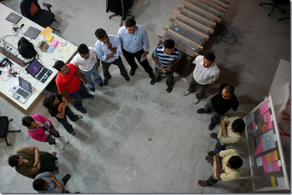
Daily Stand-ups
Tools & Techniques / Communication
3 Questions of standup meeting which every team member must address are
What did they do yesterday?
What are they planning to do today?
Any impediments on the way today?

Slide 50
Progressive Elaboration
Tools & Techniques / Planning, Monitoring & Adapting
Requirements in a project may not be known fully at the start of project. Because
  Future requirements depends upon the results of earlier stages
  It will be decided based on the reaction of market
  Business conditions are too volatile so nothing can be predicted right now
Progressive elaboration relies on planning and executing only that work which is clearly known, has high priority and must be done in current period. Planning for remaining work can be done in future as and when detail requirements are known
School Management Application
Teacher Registration
Module
(1 Release of 3 Iteration; estimation possible because end user knows what exactly needed)
Student Registration
Module
(Complete requirements not available)
Some other N modules
Rolling wave planning means planning of one iteration at a time
Notes:
You have to develop one application for a university which has many campus and each campus offer multiple courses, each course involve multiple subject, a subject may have multiple professor, professor may be part time or visiting faculty. Requirements goes on and on. If you know what is the scope of work predictive planning makes sense but when all set of requirements are not know we should go for adaptive planning

Slide 51
Adaptive Planning
Tools & Techniques / Planning, Monitoring & Adapting
Adaptive planning is about incorporating lessons learned. Adjusting your future pace, processes, resources etc based on previous cycle of delivery.
Adaptive planning is required because what we want to develop may not be completely known or other factors like processes, tools, technologies, skills availability, business environment, market condition etc are not fully known or reliable and they all affect your planning.
It is complete opposite of predictive planning where everything is known at the time of planning.
In modern time it is extremely difficult to know about all the factors, which are affecting project success, in advance
Adaptive planning and empirical processes are the truth of 21st century! Days of definitive processes and predictive planning are not many.

Slide 52
User Story
Tools & Techniques / Planning, Monitoring & Adapting
A user story concept is kernel of Agile Project Management
A user story is work which a user want system to accomplish because it meets some of his objectives.
A user story is not functional specification document. It is a promise of product owner to the team that he will explain the requirements in details when the team is working on this
User story template
  “As a user I want to accomplish something so that business value”
“There have been great societies that did not use the wheel, but there have been no societies that did not tell stories.” Unknown

Slide 53
Types of User Stories
Tools & Techniques / Planning, Monitoring & Adapting
Business user story
  “As a class teacher I want to mark attendance of student so that we can issue them certificate”
Bug user story
  “An error message is displayed whenever I try to save file in pdf format”
Technical user / Technical Spikes story
  “Research a search component in .NET3.5 which is fit for our application”
Non-functional user story
  “The Student Affairs Information System is up and running 99.9% during the registration time period defined in the Academic Calendar.”
Documentation user story
  “Develop a user manual for teachers to use teacher module”

Slide 54
3Cs of User Story
Tools & Techniques / Planning, Monitoring & Adapting
Card
Conversation
Confirmation

Slide 55
INVEST Model of User Story
Tools & Techniques / Planning, Monitoring & Adapting
INVEST model defines following characteristics of a user story
  Independent
  Negotiable
  Verifiable
  Estimatable
  Sized Appropriately
  Testable

Slide 56
Epic, Feature, Story, Task
Tools & Techniques / Planning, Monitoring & Adapting
Epic is a collection of features. An epic is typically 1-3 months in duration
Feature is collection of stories. A feature is typically 2-4 weeks in duration
User-story is smallest unit of requirement created from features. A user-story is typically less than a week in duration
Task are smallest unit of executable items which team members assign to themselves to complete a user story. A task is typically of 8 hours in duration

Slide 57
Agile Planning
Tools & Techniques / Planning, Monitoring & Adapting
Agile project management does not rely on big bang planning rather it believes in level of planning.
Three level of planning in agile are
  Release Planning
  Iteration Planning
  Daily Planning

Slide 58
Agile Planning
Tools & Techniques / Planning, Monitoring & Adapting
Release Planning
Creating a release plan is responsibility of product owner
If some user story cannot be estimated due to technical complexity then technical spikes are created
Typical length of a release varies between 3-6 months. For every month of work you can spend max one day for release planning. Thus 3 month release you can spend max 3 days.
Release planning should not be done without knowing velocity
It takes 3-4 uninterrupted iterations to benchmark velocity for a project team
Release planning depends upon
  Deadline from competitor
  Supporting the contract
  To meet predetermined schedule
  Supporting financial deadline
  When there is enough value
  To test the product
Two types of release plan
  Scope-boxed release plan
  Time-boxed release plan

Slide 59


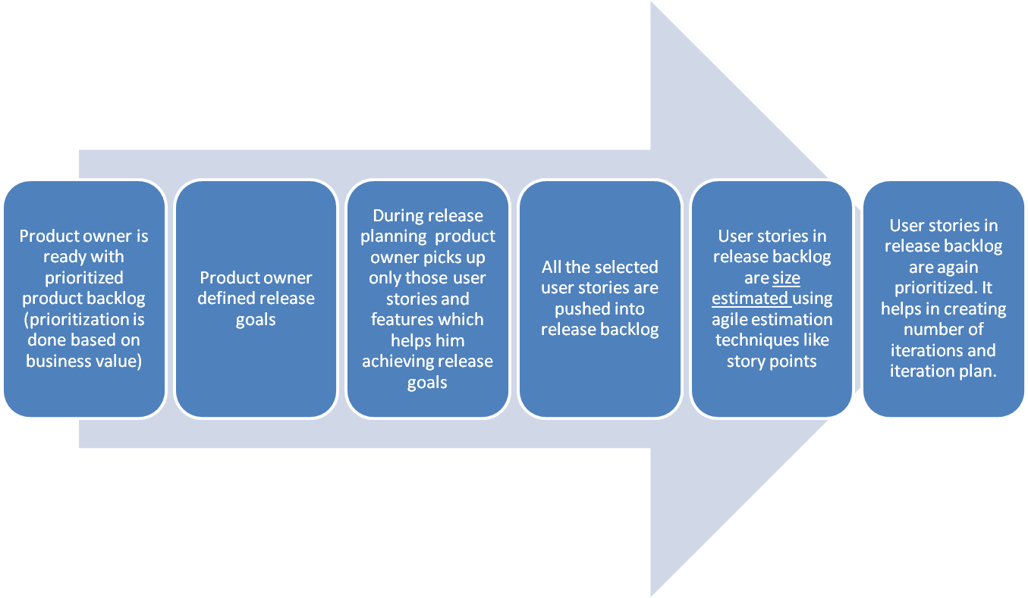

Agile Planning
Tools & Techniques / Planning, Monitoring & Adapting
Release Planning

Slide 60
Agile Planning
Tools & Techniques / Planning, Monitoring & Adapting
Iteration/Sprint Planning
In iteration planning team identifies the task to be performed for each user story.
Task are pushed into iteration backlog
Iteration planning is held after retrospective meetings of last iteration
Typical iteration length varies from 1-4 weeks.
  Iteration planning duration (1 hour for every week of iteration)
  Iteration planning identifies iteration backlog items, assumptions, risks, actions, dependencies
  Some team start counting iteration from zero so the initial iteration is called Sprint 0 or Iteration 0. In this iteration they take all technical spike which will help them in estimating size of complex user stories. Preparing initial architecture, solving infrastructure setup and configuration issues. Following Sprint 0 they start release planning
Tasks in iteration backlog are not assigned to any team member. Agile teams are self-organized and they pickup the task on their base.
Number of hours available in any iteration are calculated as Ideal engineering hours.

Slide 61
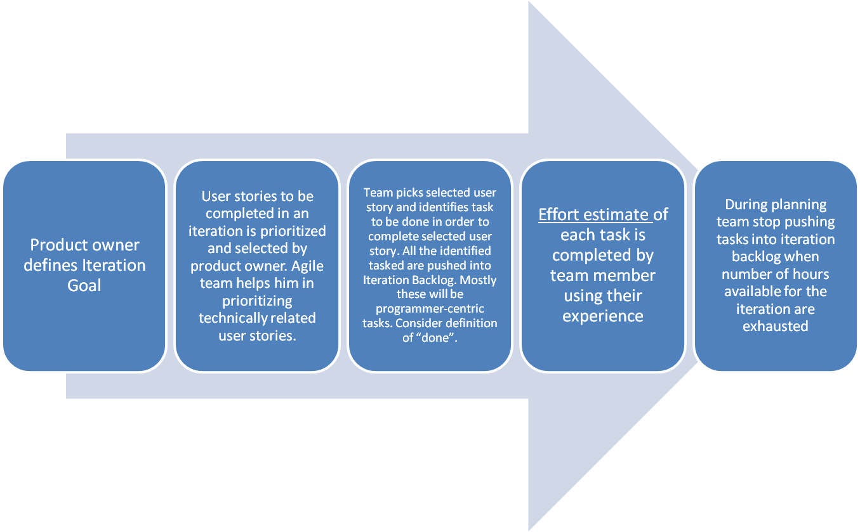
Agile Planning
Tools & Techniques / Planning, Monitoring & Adapting
Iteration Planning

Slide 62
Agile Planning
Tools & Techniques / Planning, Monitoring & Adapting
Daily Planning
Immediately after or before daily standup meeting sessions and the team updates the kanban board.
This reflects the progress and planning of the day based on
  The work progress of previous day
  Any internal or external dependency not met
  Something critical comes up
  Client want to drop some user story

Slide 63
Time-boxing
Tools & Techniques / Planning, Monitoring & Adapting
Iteration length is time-boxed.
Following sequence of activities takes place in any time-boxed iteration
  Grooming product backlog (done by product owner, in parallel to iteration work)
  Iteration Planning (1 hour for every week of iteration)
  Daily stand-up (15 min, max 2 min for one person, typical team size of agile team is 7±2)
  Regular iteration work
  Iteration Review (1 hour for every week of iteration)
  Iteration Retrospective (1 hours for every week of iteration)

Slide 64
Minimum Marketable Features (MMF)
Tools & Techniques / Planning, Monitoring & Adapting
MMF is basic minimum set feature of the product so that people can start using it
MMF can be made of a single or combined of multiple user stories
MMF has business value to the end user

Slide 65
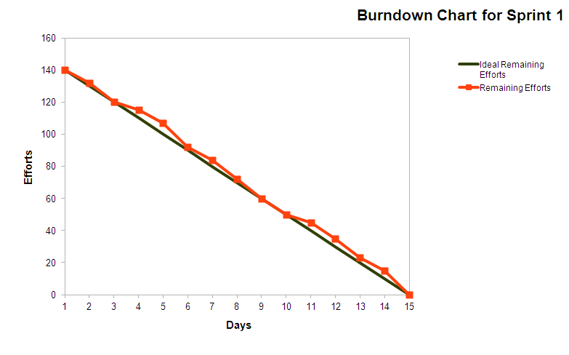
Burn Chart
Tools & Techniques / Planning, Monitoring & Adapting/ Agile Project Tracking
Burn Down Chart

Slide 66
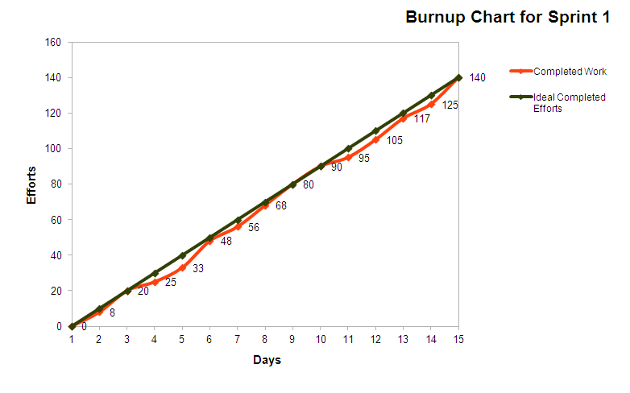
Burn Chart
Tools & Techniques / Planning, Monitoring & Adapting/ Agile Project Tracking
Burn Up Chart

Slide 67
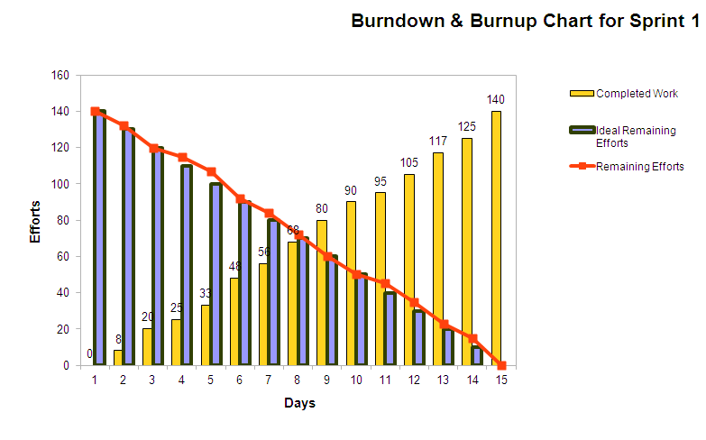
Burn chart
Tools & Techniques / Planning, Monitoring & Adapting/ Agile Project Tracking
Burn-down & Burn-up combine chart

Slide 68
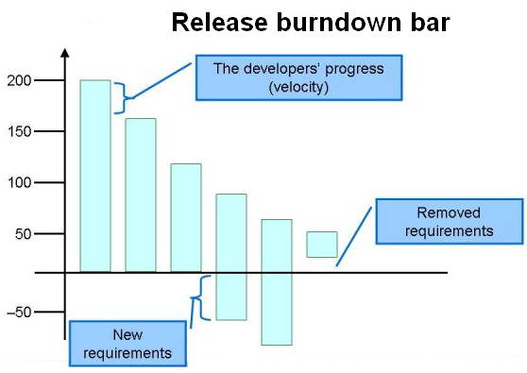







Burn Chart
Tools & Techniques / Planning, Monitoring & Adapting/ Agile Project Tracking
Burn Down Bar Chart

Slide 69
Retrospectives
Tools & Techniques / Planning, Monitoring & Adapting/ Agile Project Tracking
Retrospective is conducted by agile team at the end of each sprint and each release
Retrospective sessions are self-reflection sessions, to understand how we are doing and how can we improve it further. Kaizen is at the heart of every retrospective session.
Retrospective leads to adaptive planning
Depending upon the need, confidence of team, time of retrospective, nature of team members structure of retrospective can be adopted

Slide 70
Retrospectives
Tools & Techniques / Planning, Monitoring & Adapting/ Agile Project Tracking
Structure of retrospective
Set the stage (set ground rule/ working agreement)
Gather Data (Share relevant data)
Generate Insights (ask why it happened and how it happened)
Decide what to do (Action plan)
Close Retrospective (Appreciate participation)

Slide 71
Relative Sizing
Tools & Techniques / Agile Estimating & Metrics/ Size Estimation Techniques
We know at the start of project not enough detail is available to estimate the size of work. But high level requirements are available in the form of epic or module
Best way to estimate in this situation is relative sizing method
Based on current understanding of system and modules team picks up smallest size epic and then start comparing that with other modules.
Down the line at the time of release planning features or user stories are identified in epic and finer estimation is possible but again at this level preferred method of estimation is Relative Sizing
Hours, duration, cost based quantitative estimation makes sense only when you know the task to be done. But even for user story level estimation in release planning neither you have time not it is worth to identify task to do quantitative estimation

Slide 72
Story Points
Tools & Techniques / Agile Estimating & Metrics/ Size Estimation Techniques
User story is the functionality of the system which has value in the eyes of customer
Count of user stories is called story points this is used to size user stories.
Because all stories are not same in efforts, complexity and risk therefore different methods are used to normalize this factor
Size is function of relative efforts, complexity and risk not of duration or IEH etc. Therefore when estimating size take away duration, number of people etc from your mind.
Some story point estimation methods are
  T-shirt size – Story Point Estimation
  Fibonacci Series – Story Point Estimation
  Fruit size – Story Point Estimation

Slide 73
Story Points
Tools & Techniques / Agile Estimating & Metrics/ Size Estimation Techniques
Let us say our product back log has
  8 x bananas (5 points each) = 40 story points
  10 x pineapple (20 points each) = 200 story points
  6 x oranges (8 points each) = 48 story points
  30 x bunches of grapes (2 points each) = 60 story points
Total story points in product backlog is 40+200+48+60 = 348
Les us assume that based on guess or some previous release teams knows that their velocity is 30 story points
Total iterations required = 348 / 30 = 11 iterations
If iteration is of 2 weeks then 22 weeks required to finish the work in product backlog

Slide 74
Planning Poker
Tools & Techniques / Agile Estimating & Metrics/ Size Estimation Techniques
Planning poker is widely used estimation technique in agile projects. This is a variation of Wideband Delphi.
Logistic Required for Planning Poker Estimation
  As many set of deck cards as many estimators in the room
  All the team members with a deck of cards inside the room
  A coordinator with laptop
  A facilitator
  Product owner
Planner Poker Process
  Facilitator projects the product backlog on wall using a projector
  He reads loudly a user story at a time so that everybody in the room understand what they need to estimate
  Estimator estimates it silently and shows the card only to the coordinator
  Coordinator documents all the estimates provided by all estimator
  If there is difference between estimates then estimators who provided two extreme estimates need to talk the basis of estimates.
  After a short discussion. Next round of estimation starts the same way as before and coordinator document the estimate provided by estimator
  Keep repeating steps 3,4,5,6 till estimates provided by estimators are not converged
  Read next user story

Slide 75
Affinity Estimation
Tools & Techniques / Agile Estimating & Metrics/ Size Estimation Techniques
If product backlog has more than 20 items then implementing planning poker method of estimation is too much time consuming. In that case affinity estimation technique is most suitable
This helps in providing coarse estimates and good enough for release planning but for iteration planning you should use Planning Poker.
Logistics for Affinity Estimation
  As may set of cards with printed user story. A story on a card.
  A wide magnetic board with magnetic balls
  All the team members inside the room
  A coordinator with laptop
  A facilitator
  Product owner

Slide 76
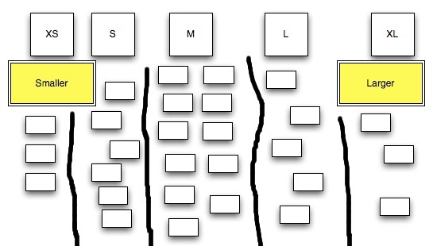
Affinity Estimation

Slide 77
Metrics
Tools & Techniques / Agile Estimating & Metrics/ Metrics
Velocity
Velocity is number of story a team can do in an iteration.
When you are starting a new project that point of time best way to know the productivity is guess based on previous experience. But never benchmark velocity of team based on previous project
It takes 3-4 iteration to stabilize velocity of team
Team members should not be added or removed from development team otherwise it destabilized the velocity
Methods to improve velocity
  Periodically pay down technical debt
  Improve customer involvement
  Support energized work environment
  Provided needed resources (people, equipment, software etc)
  Offload admin duties of programmer
  Add experienced programmers

Slide 78
Metrics
Tools & Techniques / Agile Estimating & Metrics/ Metrics
Escaped Defects
In Agile escaped defects mean those defects which are leaked to next iteration or sprint.
Escaped Defect Rate = Total number of weighted defects for a sprint / number of total stories delivered in that sprint
Tracking the trend of this metrics helps you understanding the quality of product and maturity of testing process

Slide 79
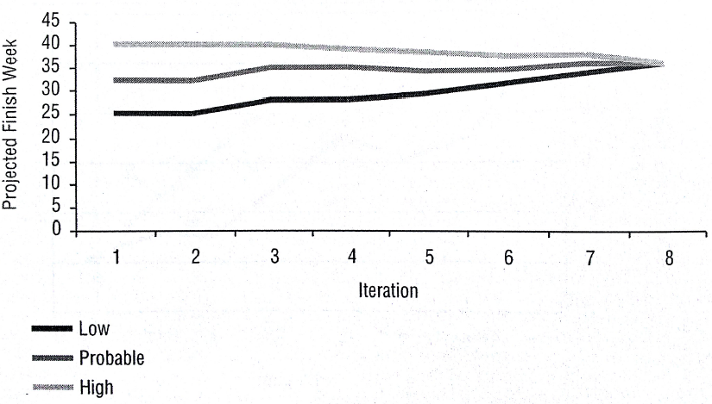
Metrics
Tools & Techniques / Agile Estimating & Metrics/ Metrics
Projected Scheduled
With x probability how much time is required to complete the project. Track this information for every iteration

Slide 80
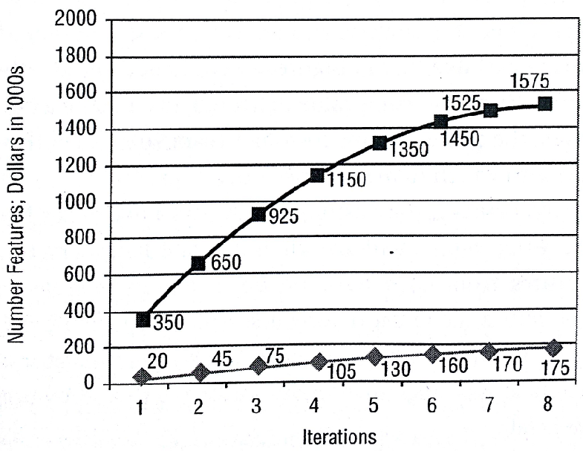
Metrics
Tools & Techniques / Agile Estimating & Metrics/ Metrics
Features & Value Delivered

Slide 81
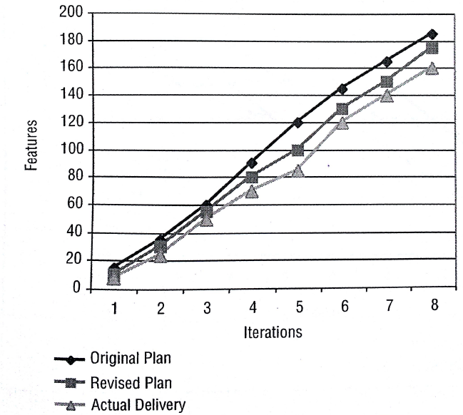
Metrics
Tools & Techniques / Agile Estimating & Metrics/ Metrics
Delivery Performance

Slide 82
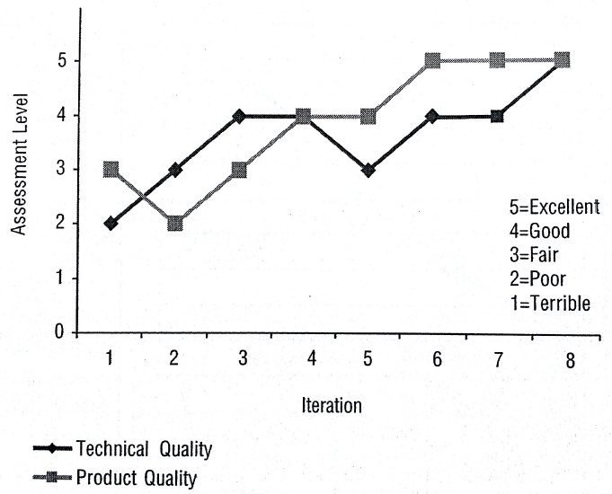
Metrics
Tools & Techniques / Agile Estimating & Metrics/ Metrics
Product and Technical Quality Assessment

Slide 83
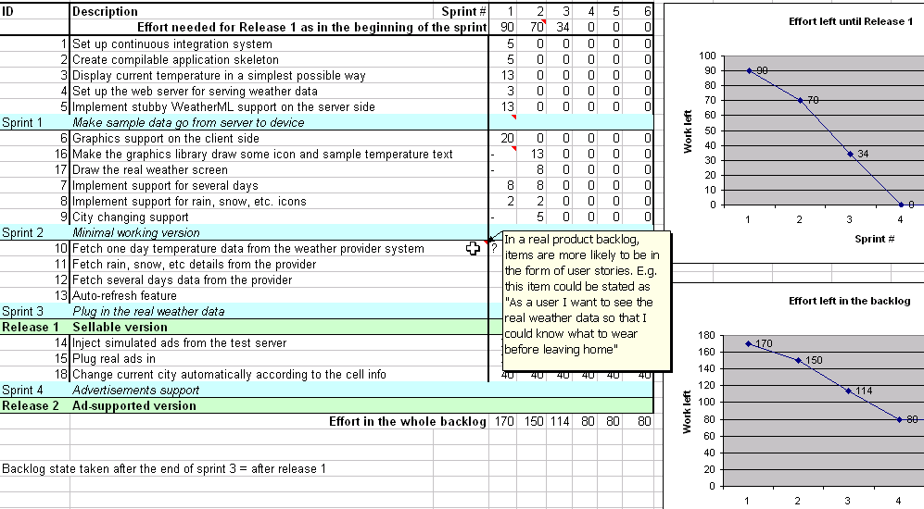
Backlog
Tools & Techniques / Agile Analysis & Design/ Backlog
Release Backlog
Release backlog is created during release planning meetings. PO is responsible for this

Slide 84
Backlog
Tools & Techniques / Agile Analysis & Design/ Backlog
Sprint Backlog
Unlike product backlog and release backlog which is comprised by user stories, sprint backlog is comprised of task
Sprint Backlog can have following types of tasks
  Design Tasks
  Coding Tasks
  Testing Task
  Documentation Tasks
No one is allowed to add user story or task in Sprint backlog but team can delete task if they feel out of time
Sprint backlog is developed at the time of sprint planning

Slide 85
Backlog
Tools & Techniques / Agile Analysis & Design/ Backlog
Sprint Backlog
Generally every task in sprint backlog should be related to some user story
To identify task for user story programmers need to do the detail discussion about user story with PO
Each task in sprint back log should have following information in the form of Task card
  Task description
  Estimated hours
  Owner name (if taken by any team member)
  Exit criteria
  Verification method (test or inspection)
  Who will perform verification

Slide 86
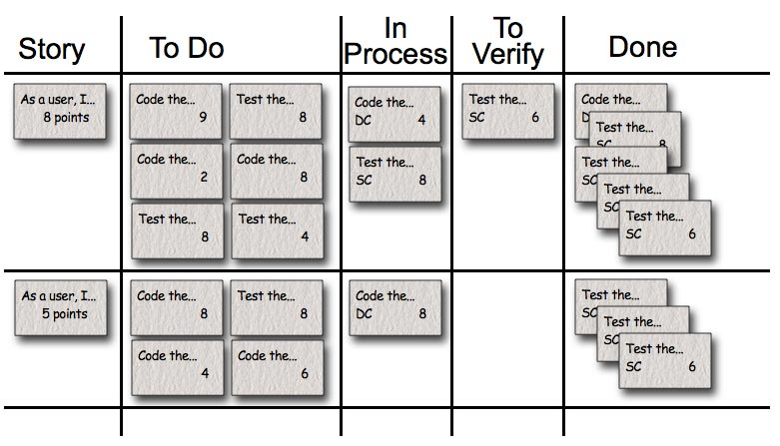
Backlog
Tools & Techniques / Agile Analysis & Design/ Backlog
Sprint Backlog

Slide 87
Definition of Done (DoD)
Tools & Techniques / Product Quality
The DoD changes over time. Organizational support and the team’s ability to remove impediments may enable the inclusion of additional activities into the DoD for features or sprints.
Continuous Integration (CI) helps you validating the “Doneness”
There are 3 level of DoD
  Story DoD
  Iteration DoD
  Release DoD

Slide 88
Definition of Done (DoD)
Tools & Techniques / Product Quality
Story “Done”
  Unit test should provide 60-70% test coverage
  Story is either written in pair or reviewed by peer
  All code checked in
  All unit code passed
  All acceptance test case passed
  Story accepted by owner

Slide 89
Definition of Done (DoD)
Iteration “Done”
  Iteration should have defined Iteration Goal
  All acceptance test cases should run for all user stories in Iteration
  All stories completed must be accepted by the product owner
  Defects identified are fixed or planned for future
  Code performance is tested and accepted
  If database is involved then database script should be available, automated and tested
  Backup of iteration work product is taken

Slide 90
Definition of Done (DoD)
Release “Done”
  Release should have defined Release Goal
  Product has formal release date
  Product is deployed on staging area
  Stress testing done and results accepted
  All non-functional requirements are tested and results accepted
  Required documentation is available
  Release should not have any known bug

Slide 91
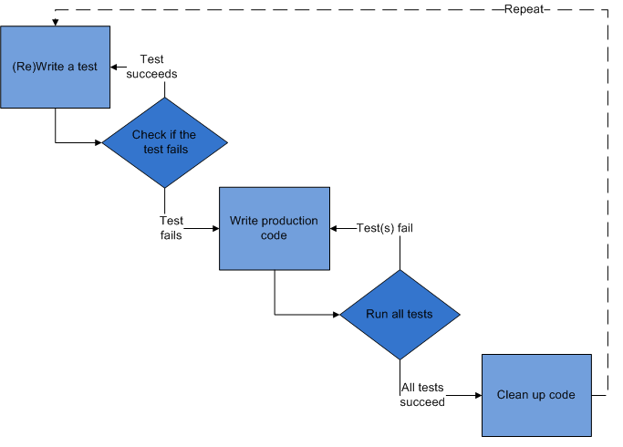
Test Driven Development (TDD)
Tools & Techniques / Product Quality
Programmer should not consider exception cases and error handling initially. Those can be considered in next cycle, once basic functionality is working.
If built passes unit test then only it is promoted to the next step as a candidate for acceptance test build

Slide 92
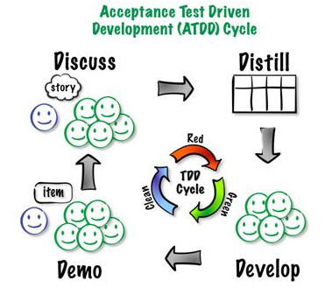
Acceptance Test Driven Development (ATDD)
Tools & Techniques / Product Quality
Major difference between ATDD and TDD is in ATDD user story or functionality is tested not the task like in TDD.
Using ATDD practice you are not allowed to add more functionality until earlier user stories are successful.
Collection of acceptance test cases forms regression test and it should run automatically on built server

Slide 93
Exploratory Testing
Tools & Techniques / Product Quality
After acceptance test cases are passed then Agile tester may choose to perform exploratory testing
In exploratory testing agile tester tests those scenario which system user is not supposed to perform but if he perform in that case system should give proper message.

Slide 94
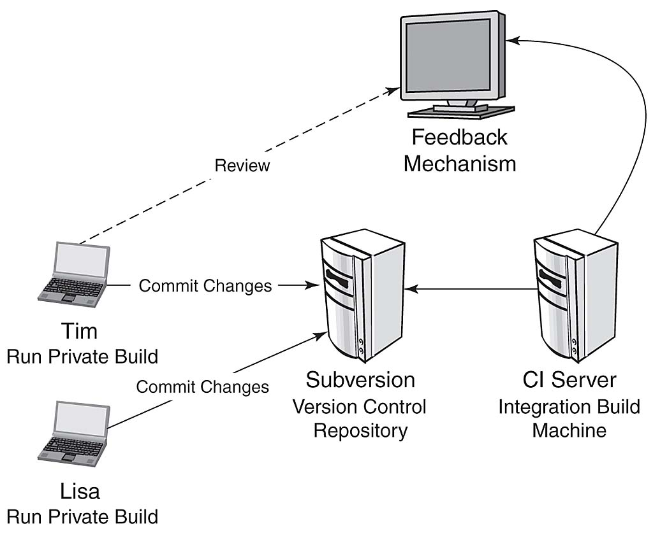
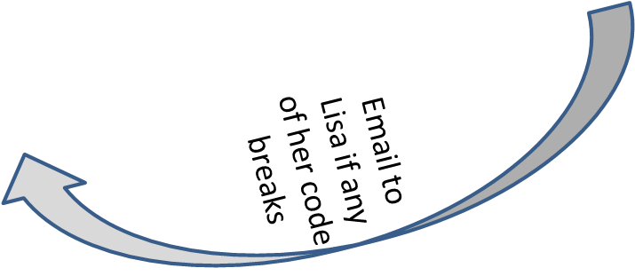
Continuous Integration
Tools & Techniques / Product Quality
Tool: CruiseControl for Java & .NET
Build should happen within 10 min, else change server
No partial build

Slide 95
Shu-Ha-Ri
Tools & Techniques / Soft Skills
Shu-Ha-Ri is Japanese term according to this a student or team goes through three stages of learning. Whatever you teach them it takes time to master the art. Three stages are
  Shu: This is the initial obedient stage, when the student just follows the rules.
  Ha: The student questions the rules, understands their importance, and makes innovations within the rules.
  Ri: The student breaks the rules and creates his own rules, thereby escalating to the master level.

Slide 96
Agile Team
Tools & Techniques / Soft Skills/ Team Management
Agile team is smaller compare to Waterfall team size
Scrum suggests team size of 7 ± 2. But maximum team size recommended in Agile is 20
If you need to add more resource than add more experienced people rather adding junior people
If you further need to add more team member then use agile scaling principle

Slide 97
Agile Team Scaling
Tools & Techniques / Soft Skills/ Team Management
Create feature team (vertical team) do not create skill wise (horizontally).
Create high level scrum of scrum teams
Everyday standup meeting is joined by one designated person from each team
Extra four questions for Scrum of Scrum Daily Standup meeting
  What has your team done since we last met?
  What will your team do before we meet again?
  Is anything slowing your team down or getting in their way?
  Are you about to put something in another team's way?

Slide 98
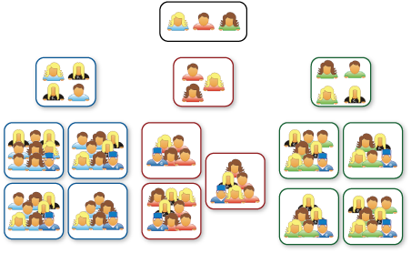
Agile Team Scaling
Tools & Techniques / Soft Skills/ Team Management

Slide 99
Type of Teams
Tools & Techniques / Soft Skills
 | Manager lead team | Self-managing team | Self-organizing team | Self-governing team
Setting overall direction for the team
Designing the team and its context
Managing work processes and monitoring progress
Executing the team task

Slide 100
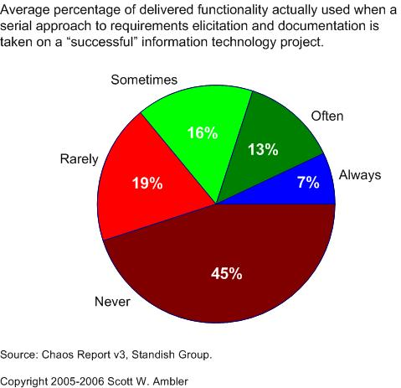
Value of Delivered and non-used Features
Tools & Techniques / Value Based Prioritization & Value Streaming

Slide 101
JIT in Value Delivery
Tools & Techniques / Value Based Prioritization & Value Streaming
Your customer asks you to develop an application with 50 features, out of these 10 are business critical. Application will be ready in 12 months. You are in 3rd week in the project and ask these questions to yourself
  What is the value of detail plan of this whole application?
  What is the value of hiring those resources/expertise which you need after 6 month (that too not sure)?
  What is the value of detail design, SRS, Functional specification (especially when you know they are going to change)?
  What is the value of writing test cases for complete application?
  What is the value of hardware, software, infrastructure which you do not need today?
JIT (Just In Time) principle helps controlling our greed and maximizing value.
Companies like Toyota, Dell start using this concept early in the industry.

Slide 102
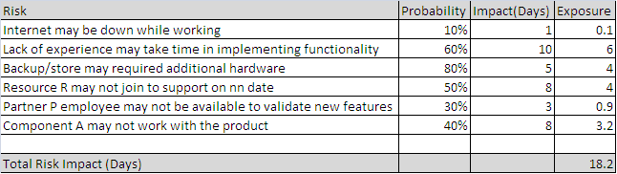
Risk Adjusted Backlog
Tools & Techniques / Agile Project Risk Management
Risk Score

Slide 103
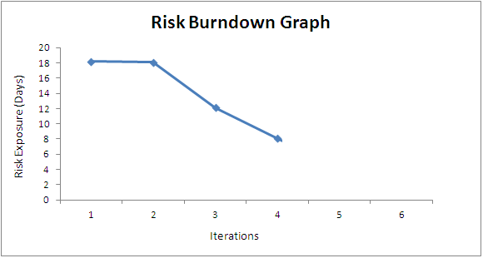
Risk Burn-down Graph
Risk Responses: Threats & Opportunities
Tools & Techniques / Agile Project Risk Management
Actual Risk Trend line
Ideal Risk Trend line
If actual risk trend line is above than ideal trend line then it means risks are not coming down at the appropriate rate
Notes:
PMP Preparation Processes
www.Compulinkgroup.com

Slide 104
State of Scrum
Survey Conducted by scrumalliance.org

Slide 105
ScrumAlliance.Org Survey in 2013
500 Participants from 70+ countries
Majority of participants from USA, India, Canada, Austria, UK, Germany

Slide 106
Where are they now?
13% of those who started with waterfall now use Scrum exclusively
Most ended up with a mix of waterfall and scrum
8% went back to Waterfall

Slide 107
Why Scrum?
41% Fulfilling customer needs
18% Meeting budget, time and scope constraints
9% Unknown
11% Adding new features and functionality
18% Completing projects that will drive innovation and market share
3% Others

Slide 108
State of Scrum
27% Frequently Used
25% Sometimes
13% Usually
15% Rarely
20% always

Slide 109
Who are using Scrum?
28% CSM
28% PMP
6% CSPO
3% CSP
3% PMI-ACP
1% CSD
1% PgMP

Slide 110
Which Industry Using?
41% IT
12% Finance
6% Government
6% Healthcare
5% Telecom
4% Construction
4% Education
2% Manufacturing
2% R&D
2% Retail
1$ Aerospace

Slide 111
Scrum Roles
41% projects have a dedicated ScrumMaster
24% projects have a dedicated Product Owner

Slide 112
Team Size
10% have <=3
71% have 4-9
19% have >=10

Slide 113
Sprint Duration
8% has 1 week
75% 2-6 weeks

Slide 114
Team Size
85% project has team size between 3-9

Slide 115
Recap
What is Project?
Why Agile?
  Traditional v/s Agile Software Development
  Agile Values and Principles
  Key Benefits
  Scrum Overview
  Essence of Scrum
  Scrum values
  The key roles within SCRUM( Scrum Master, Product Owner , Agile Project Manager and Team)
  The key artefacts within SCRUM
Sprint Meetings
  Understanding daily scrums
  Understanding sprint review meetings

Slide 116
Recap Continue.1
Estimation in Scrum
  User stories and story points
  Velocity? How to Compute Velocity
  Planning poker for Product Back log size estimation
  Estimation using Story Points
Release Planning
  Estimation of Product back Log Size
  Estimating number of sprints
  Deciding Release date
  Creating Release Burn down
Sprint Planning
  Identifying Sprints Backlog Tasks from User stories
  Creating Sprint Backlog
  Creating and Updating Sprint Burn down

Slide 117
Recap Continue.2
Tracking in scrum
  Tracking releases, sprints
  Accumulating Burn down
  Measure sprint effectiveness

Slide 118

Hari P Thapliyal,
PMP, PMI-ACP, MCITP, Princ2 Practitioner, CSM, MBA, MCA, CIC, PGDFM
PMO Architect & Project Management Evangelist
Reach Me:
hari.prasad@vedavit-ps.com, hari.prasad@pm-learn.com
Skype: hari.thapliyal, YM: hari_thapliyal, Twitter: harithapliyal
Profile: http://in.linkedin.com/in/harithapliyal

