Slide 1
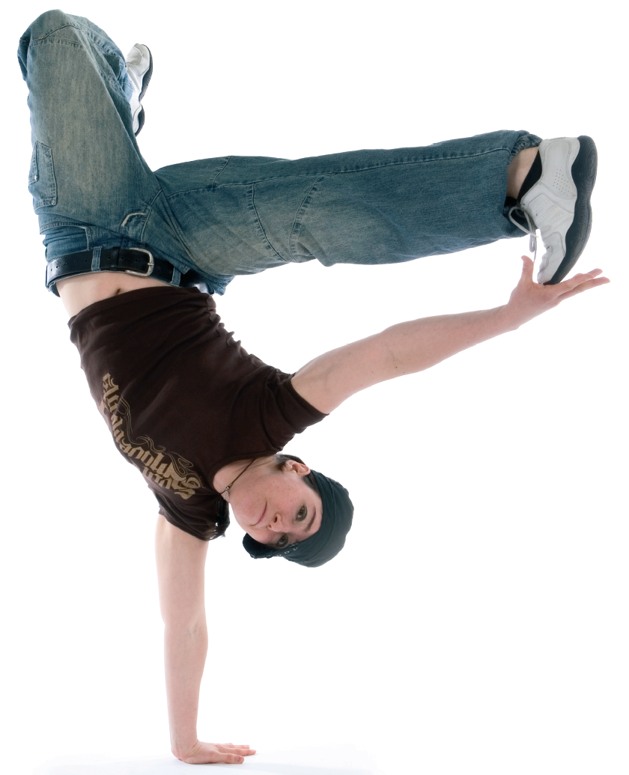
Agile In Action

Slide 2
Why do projects
fail?

Slide 3


Slide 4

Waterfall

Slide 5
B-DUF

Slide 6
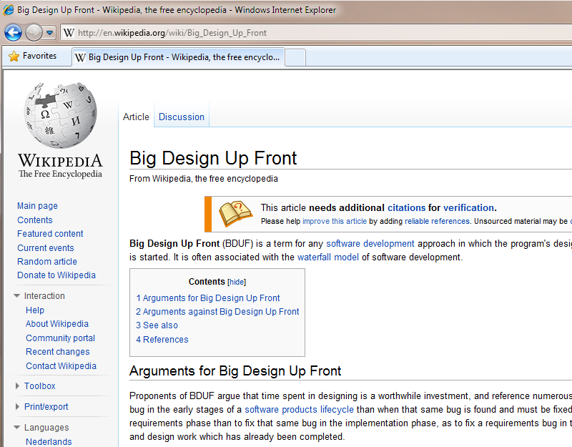

Slide 7
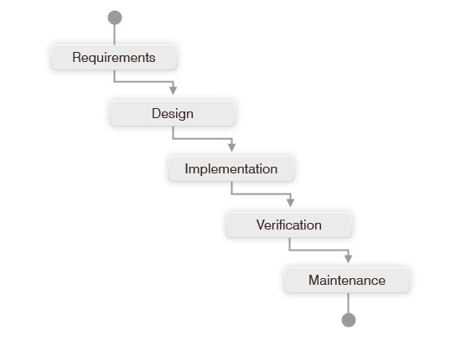

Slide 8
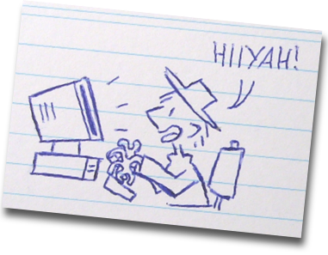
Cowboy Coding

Slide 9
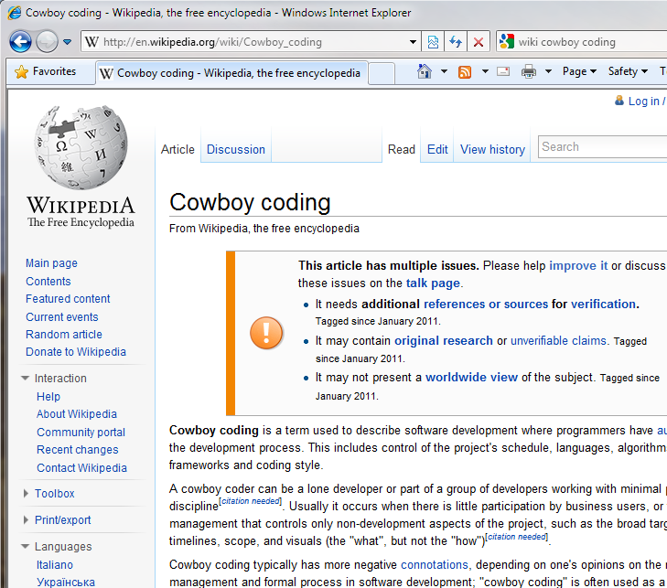

Slide 10
N-DUF

Slide 11
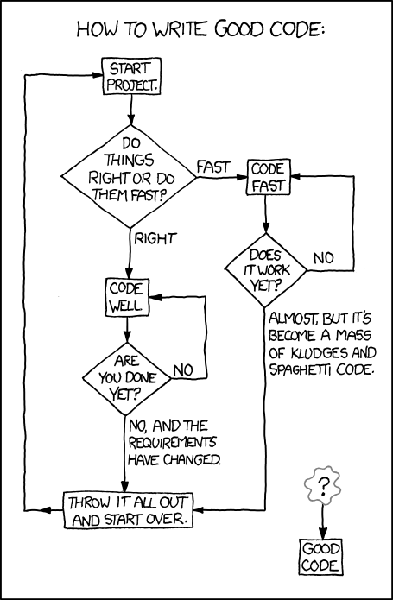

Slide 12
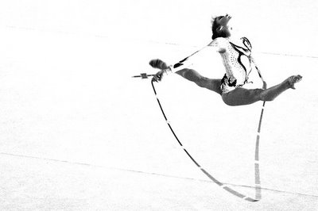
Agile

Slide 13
E-DUF

Slide 14
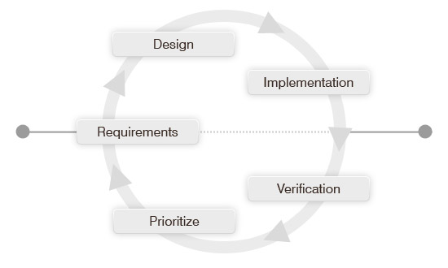

Slide 15

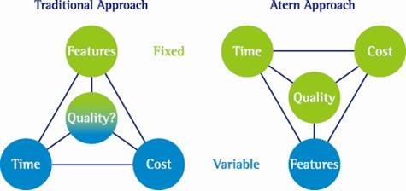
Project Variables
Process Driven
Value Driven

Slide 16
Agile Drawbacks
Can get out of control (if you break the rules)
Can be difficult to scale
Requires users to fully engage and be disciplined
Requires a ‘no blame’ culture
Can be difficult to estimate costs
Requires faith

Slide 17
Agile Benefits
Delivers real business benefits not unnecessary fluff
Deeply involves users in the development process
Users feel involved and empowered
Gives visibility of working prototypes early
Receive user feedback early
Reduces software testing and defects
Reduces unnecessary processes and documentation
Lessens management overhead
Delivers on time!

Slide 18

Our use of Agile

Slide 19
History of DSDM
Started early 1990s
Reaction to Rapid Application Development (RAD)
Unstructured processes across organisations
DSDM Consortium founded 1994
Initiated by blue chip organisations including:
  British Airways
  American Express
  Oracle
  Logica
  Data Sciences
  Allied Domecq
First version published February 1995

Slide 20
History of SCRUM
Described in 1986 by Hirotaka Takeuchi and Ikujiro Nonaka
Called the ‘Holistic’ or ‘Rugby’ approach
Whole process performed by one multi-functional team
By 1991 became known as SCRUM
In 1995 first formal presentations and workshops
formalising methodology

Slide 21
Our use of Agile
8 Principals
Project Roles
Project Lifecycle
Prioritised List of Requirements
MoSCoW Prioritisation
Timeboxing
Backlogs
Burn Down Charts
Daily Stand-ups
Sprints
User Stories
Story Points (Estimating)

Slide 22
8 Principals
1. Focus on the business need
2. Deliver on time
3. Collaborate
4. Never compromise quality
5. Build incrementally from firm foundations
6. Develop iteratively
7. Communicate continuously and clearly
8. Demonstrate control

Slide 23
8 Principals
Project Roles
Project Lifecycle
Prioritised List of Requirements
MoSCoW Prioritisation
Timeboxing
Backlogs
Burn Down Charts
Daily Stand-ups
Sprints
User Stories
Story Points (Estimating)

Slide 24
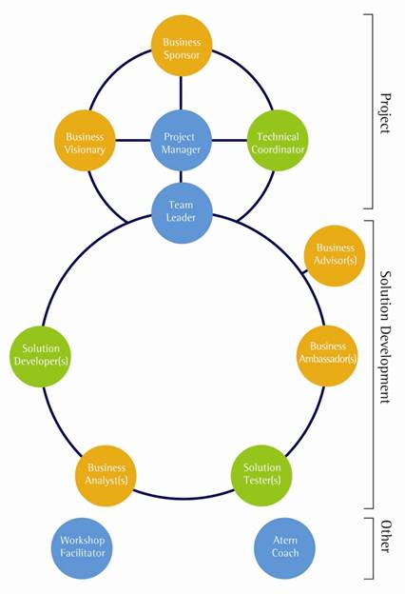
Project Roles

Slide 25
8 Principals
Project Roles
Project Lifecycle
Prioritised List of Requirements
MoSCoW Prioritisation
Timeboxing
Backlogs
Burn Down Charts
Daily Stand-ups
Sprints
User Stories
Story Points (Estimating)

Slide 26
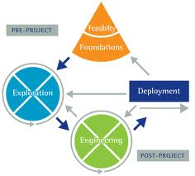
Project Lifecycle

Slide 27
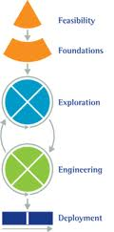
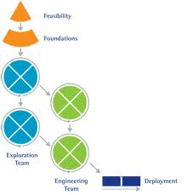
Project Lifecycle
Example 1
Example 2

Slide 28
8 Principals
Project Roles
Project Lifecycle
Prioritised List of Requirements
MoSCoW Prioritisation
Timeboxing
Backlogs
Burn Down Charts
Daily Stand-ups
Sprints
User Stories
Story Points (Estimating)

Slide 29
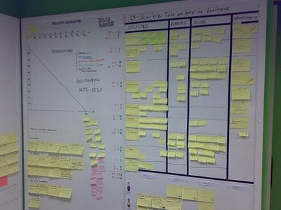
Requirements

Slide 30
User Stories
As a <type of user> I want <some goal> so that <some reason>.

Slide 31
Estimating
Point Scale (Story Points)
  Linear (1,2,3,4,5)
  Power of 2 (1,2,4,8)
  Alphabet (A,B,C,D)
  Clothes sizes (XS,S,M,L,XL)
Avoid assigning actual time (hours or days)
Helps to determine project velocity
Costs can be estimated based on points and velocity

Slide 32
Prioritised List of Requirements
2 Control Documents:
List of Requirements
Detailed Specification Document (The Spec.)
See sample documents

Slide 33
8 Principals
Project Roles
Project Lifecycle
Prioritised List of Requirements
MoSCoW Prioritisation
Timeboxing
Backlogs
Burn Down Charts
Daily Stand-ups
Sprints
User Stories
Story Points (Estimating)

Slide 34
MoSCoW Prioritisation
M - MUST have this time
S - SHOULD have this if at all possible
C - COULD have this if it does not affect anything else
W - WON'T have this time but WOULD like in the future

Slide 35
When is it a MUST?

Slide 36
8 Principals
Project Roles
Project Lifecycle
Prioritised List of Requirements
MoSCoW Prioritisation
Timeboxing
Backlogs
Burn Down Charts
Daily Stand-ups
Sprints
User Stories
Story Points (Estimating)

Slide 37
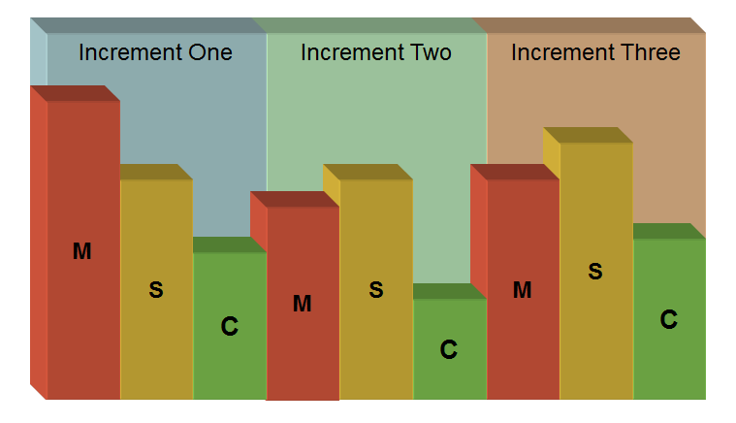
Timeboxing

Slide 38
Timeboxing
Example:
Set an objective for a 10 day Timebox
Load the 10 day Timebox with 10 days work
Then do 10 days work!
If you are falling behind, drop something out.

Slide 39
8 Principals
Project Roles
Project Lifecycle
Prioritised List of Requirements
MoSCoW Prioritisation
Timeboxing
Backlogs
Burn Down Charts
Daily Stand-ups
Sprints
User Stories
Story Points (Estimating)

Slide 40
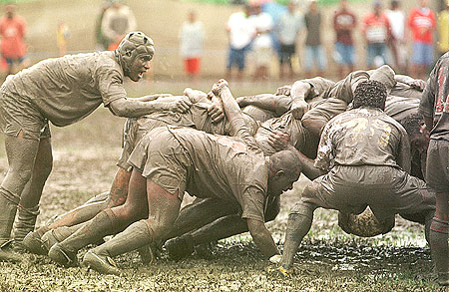
Daily Stand-ups

Slide 41
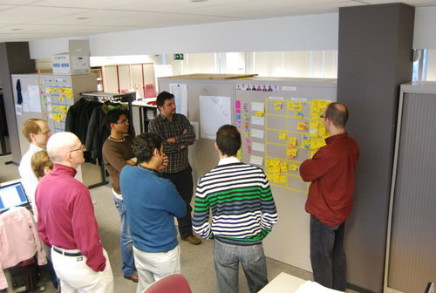
Daily Stand-ups
What did you do yesterday?
What are you going to do today?
What’s stopping you from achieving this?

Slide 42
8 Principals
Project Roles
Project Lifecycle
Prioritised List of Requirements
MoSCoW Prioritisation
Timeboxing
Backlogs
Burn Down Charts
Daily Stand-ups
Sprints
User Stories
Story Points (Estimating)

Slide 43
http://www.rspb.org.uk/common_tern.html
http://en.wikipedia.org/wiki/Dynamic_Systems_Development_Method
http://www.dsdm.org/

Slide 44
http://www.rfu.com/
http://en.wikipedia.org/wiki/Scrum_(development)
http://www.scrumalliance.org/

