Slide 1
A case study on
Agile Project Management

Slide 2
Background
The Quecreek Mine Rescue took place in Somerset County, Pennsylvania, when nine miners were trapped underground for over 78 hours, from July 24 to 28, 2002. All nine miners were rescued.

Slide 3
Scenario
A tragedy started when the crew accidentally bored into an adjacent, abandoned mine that was flooded with water. The miners’ map told them, incorrectly, that the abandoned mine was hundreds of yards away. The men scrambled to reach the exit, but the rising water blocked the way out. Their only option was to seek out the highest point in the mine.
Word of the accident spread above ground and a rescue team was formed. The rescue team estimated where the crew was located in the mine and picked a spot to drill. Maps revealed a gas line that ran close to the target drilling point; and if their coordinates were incorrect, they might rupture the line and create an explosion. Being careful to avoid the gas line, the team began drilling a small, exploratory hole. After 90 minutes the drill broke through the wall of the tunnel, and the rescuers listened anxiously for any sounds from the miners. After minutes of sobering silence, the rescuers could hear the trapped men pounding on the drill bit with their hammers. The miners had been located. Now the challenge was to get them out of the mine before hypothermia set in.
Set 2

Slide 4
Scenario……
The rescue team outlined a two-part plan. First, they would drill additional holes to help pump water from the mine. Second, they would use a “super drill” to create a 2-foot-wide escape tunnel for the miners. The drilling work began without a hitch, but then the super drill bit broke 105 feet below the surface. A special “fishing” tool was needed to extract the bit. In the past it had taken 3 days to build such a tool. The rescuers knew they did not have 3 days to get to the miners out.
Rescue workers contacted Frank Stockdale, the plant manager at Star Iron Works, and asked him to build the tool they needed. They faxed engineering prints to Stockdale and explained the dire situation to him. Using his 95-member machine shop, Stockdale was able to reduce a 3-day job to 3 hours. The rescue team then removed the broken bit and resumed drilling the rescue tunnel.
Finally, 78 hours after the tragedy began, the drill penetrated the shaft and the drill operator shouted with joy. The last miner was pulled to safety 5 hours later from the Quecreek Mine in Somerset County, Pennsylvania on July 28, 2002. After being trapped 240 feet below the surface, and with body temperatures as low as 92.5 Fahrenheit, they would all make full recoveries (see Figure 1.1).

Slide 5
Your Responses?
How can you handle this problem using traditional project management?
Are your project much different than this kind of fire fighting?
Set 2

Slide 6
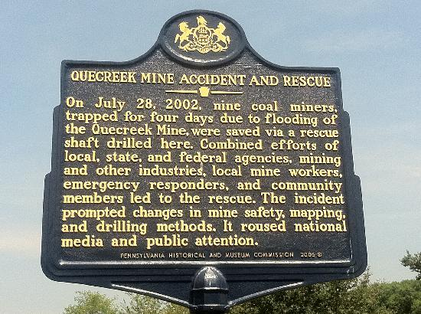
Few Photograph of the Site

Slide 7
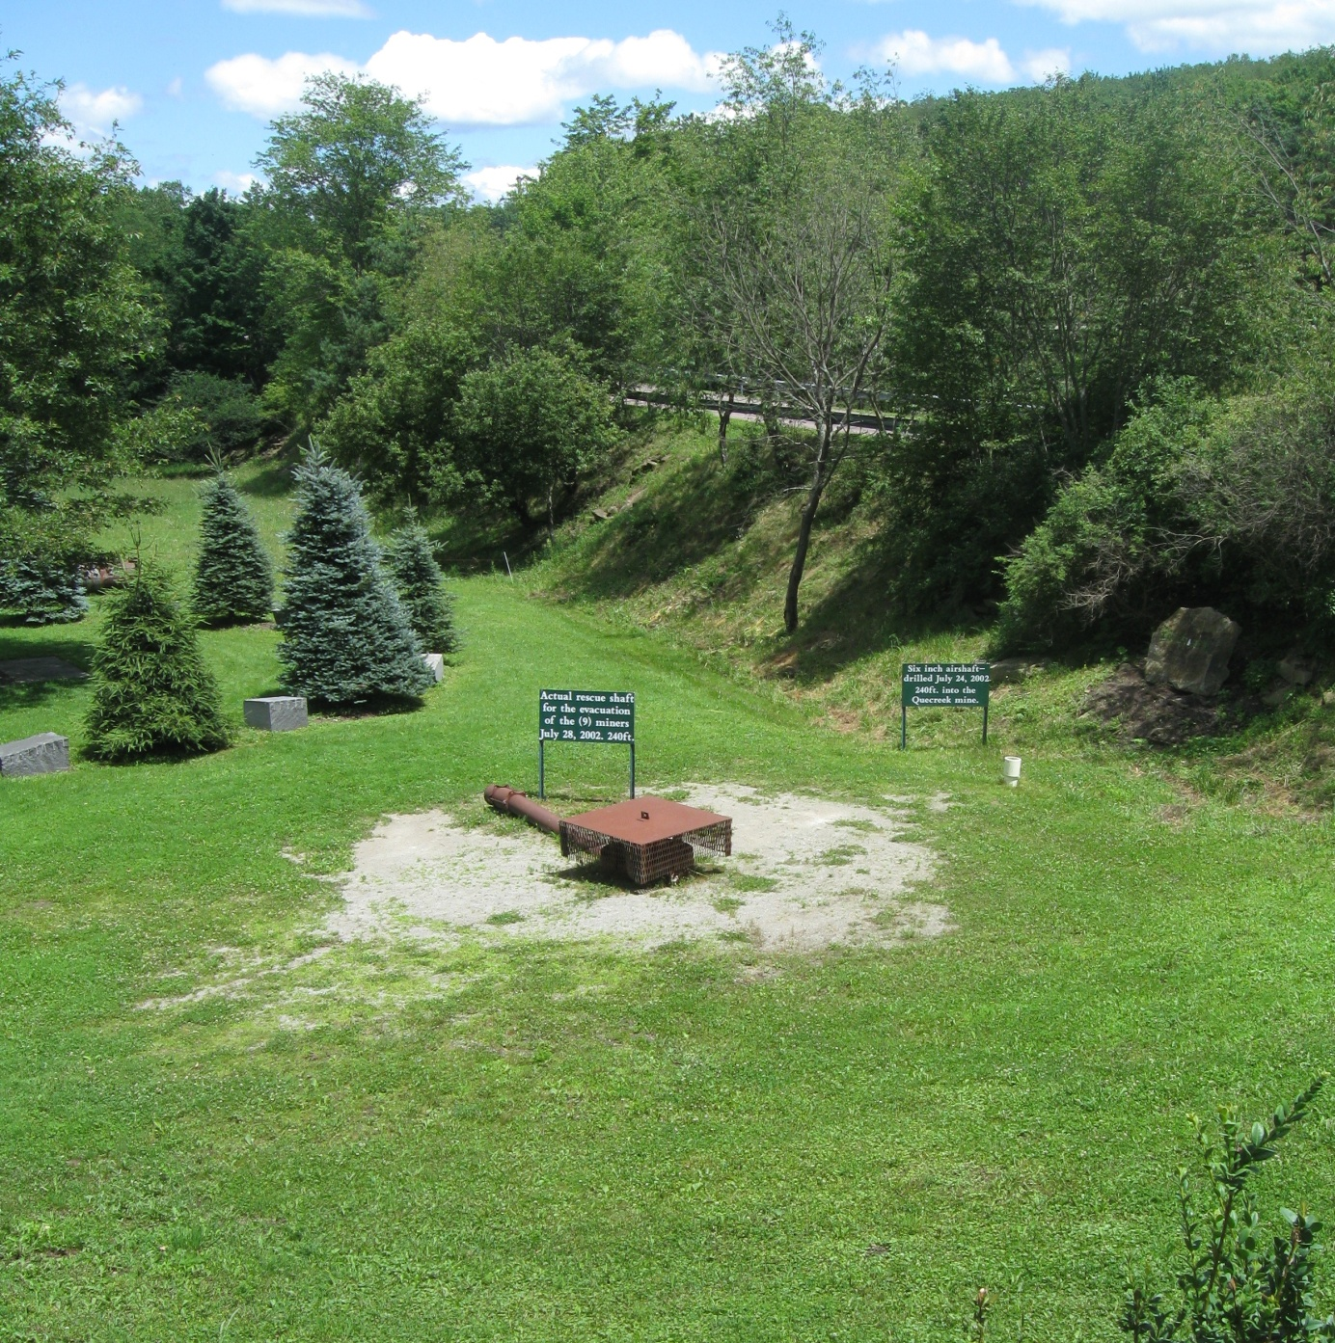
Few Photograph of the Site
Site, with capped rescue hole (center), in July 2013.

Slide 8
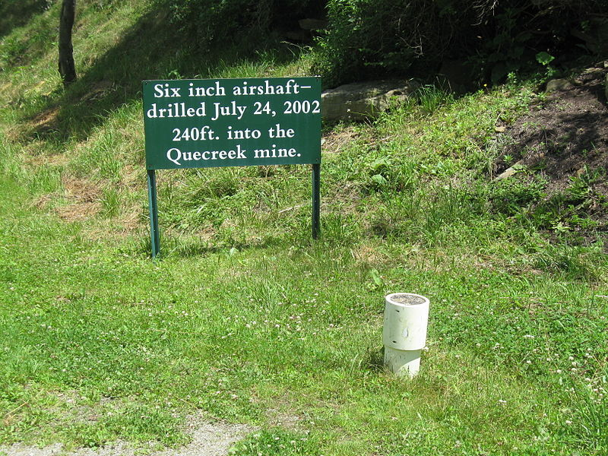
Few Photograph of the Site
The 6 in (15 cm) diameter, 240 ft (73 m) deep air shaft drilled early in the response effort to ensure the miners were able to breathe.

Slide 9
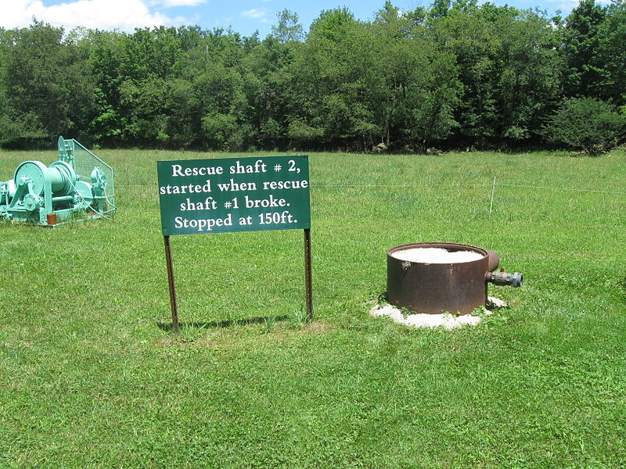
Few Photograph of the Site
Second rescue shaft, located near the initial hole, drilled in case issues prevented further drilling of Rescue Hole No. 1. Drilling of this hole ceased at 150 ft (46 m) after the first shaft reached the mine.

Slide 10
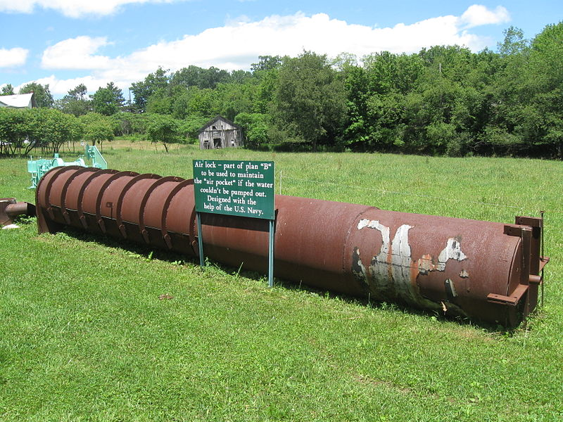
Few Photograph of the Site
The airlock fashioned to be installed on top of the rescue shaft, designed to equalize the pressure between the mine and the surface and prevent an influx of water created by a pressure imbalance.

Slide 11
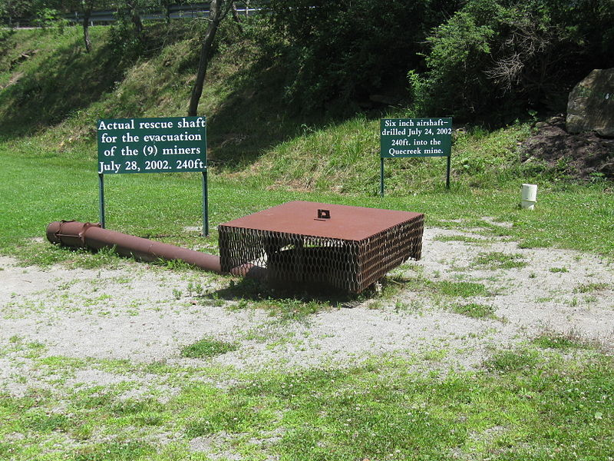
Few Photograph of the Site
Rescue Hole No. 1, now capped, used to rescue the miners. The white pipe to the right is the air shaft used to get air to the miners.

Slide 12
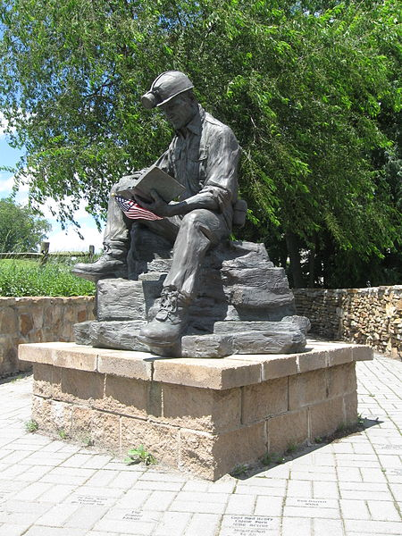
Few Photograph of the Site
Bronze statue of a miner at the entrance to the rescue site.

