Slide 1
Introduction to Project Management
Day 1
Version 1.2
Last Updated: 26 February 2007

Slide 2


Introductions
Name
Current role
Level of experience in project management
Expectations from this class
Someone you admire and why
Notes:
Speaker notes:
Capture participants expectations on the whiteboard.

Slide 3

Learning objectives
Explain the role of the Project Manager
Articulate what Project Management at Sapient means
Understand the basic elements of delivering the product and services using Sapient|Approach
Understand what is involved in dealing with clients
Practice dealing with a difficult client situation
Understand what is involved in leading a team at Sapient
Practice dealing with a difficult team situation
Articulate what Sapient leadership expects from Project Managers
Notes:
Speaker notes:
Walk through each objective and hence set expectations as to what will be covered during the day.
Note that this course is part of an overall program for Project Managers.
Specifically:
NetG courses and pre-requisites
Introduction to Project Management – 1 day instructor-lead training
Project Management using S|A – 3 day instructor-lead training
Sape operational issues to be rolled out first to CEs and other sr folks and then on down
Note also, that the content in this course has been discussed with People Strategy (ie has been mapped to the career stage goals for PMs).This is good for now.

Slide 4
Some expectation setting
This course will not make you are great Project Manager, but it will be a good start and teach you the basics that you will ultimately learn best by doing
The focus for this course is project management, and not program management
While we will do a S|A 3 overview, it will be covered in detail in the 3 day “Project Management using S|A” training
You will get the most out of this course if you share your experiences and learn from each other
There is no EM- or SAP-specific content (generic material applies)
This course will not cover operational activities in depth
Notes:
Speaker notes:
There is a course being prepared which covers Operational activities.

Slide 5
2 Day Agenda
DAY 1
DAY 2
Leading the team
What Sapient expects from PMs
PM Overview
Delivering the product and services
Lunch
Working with the client
Notes:
Speaker notes:
Day 1 focuses on a Project Manager’s areas of responsibility prior to the project being sold.
Day 2 focuses on a Project Manager’s areas of responsibilitiy during project execution.
Day 3 provides the group with the opportunity to bring everything together and practice what they have learnt.

Slide 6
Day 1 Agenda
09:00 – 09:45 Kickoff
09:45 – 10:15 Project Management Overview
10:15 – 13:00 Delivering the product and services (+Break)
13:00 – 14:00 Lunch
14:00 – 16:30 Working with the client (+Break)
16:30 – 17:00 Close and feedback
Notes:
PUT ON WALL

Slide 7
Ground rules
Start on time
Mobile phones off
No side conversations
No beating a dead horse
No whining
Suggested fine?

Slide 8

Project Management Overview
Notes:
MESSAGE: We’ll look at a few diff models to get the ideas flowing, then focus on one for the course.

Slide 9
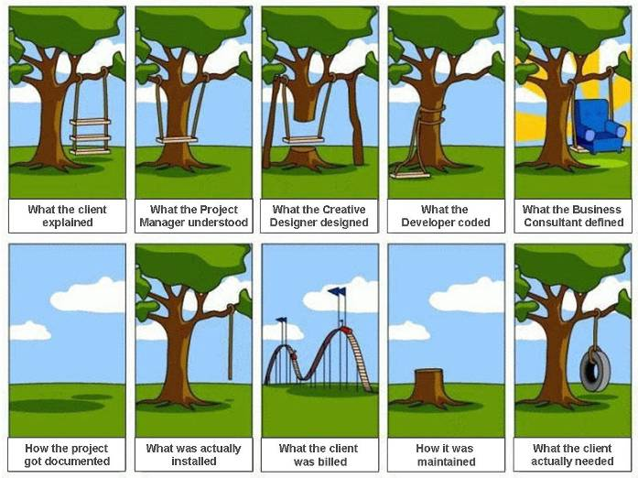
Project Management – Bringing it all together!
Notes:
Speaker notes:
Key message: Project Management involves bringing a lot of different views and elements together to deliver something that fulfils the client’s true business need. Our role as Project Managers is to get from the first box to the last box, all the while maintaining a healthy client relationship, a happy and motivated team, and financial success for Sapient!
Ask the participants what could have been done differently to avoid these scenarios. (Select a couple)
Sample answers:
Understand the true client needs through regular communication and feedback loops, ask the right questions to get there, build and checkpoint with the client, rigorous testing, not over engineering, the right level of documentation, defining contracts that allow us to build what the client needs, managing the work appropriately after it was built, making sure the team is on the same page, etc.
WHITEBOARD (optional):
While slide is showing, draw a person with an idea-> to reality. Idea of PM Is to get from IDEA to REALITY. This is the WHAT

Slide 10

Project Parameters
The project parameters form a system in balance
  Scope
  Quality
  Time
  Cost
  People availability
If you increase/decrease any one of them, at least one other must increase/decrease in order to restore balance
Scope and Quality
Time
Cost
People Availability
Source: Effective Project Management,
Wysocki, et al 2000
Notes:
Speaker note:
The facilitator has the option of hiding this slide and “whiteboarding” it covering the following key points:
Scope and quality are bounded by cost, time and resources. When scope increases at least one of the triple constraints must increase in order to accommodate the larger scope. ASK has anyone ever seen scope decrease?
The project is a system in balance. Think of this graphic geometrically. The three sides are just long enough to enclose the area occupied by the scope and quality. On day zero of the project this system is in balance. On day two the customer says “Oops, I forgot to tell you, we also will need. This puts the system out of balance due to the scope increase. The project manager has several choices (1) they can swap something else out. But if this is not possible they will (2) have to adjust the sides to bring the project back into balance.
Quality: may be defined as conformance to requirements
Scope: various versions exist
(1) what is in the client’s head
(2) What is in the project’s teams collective heads
(3) What is documented
People availability: who will do the required work?
WHITEBOARD (option): draw this on the whiteboard and hold the discussion with scenario --- if the previous was the WHAT, this is the HOW – by balancing.
Cannot staff up in time
Scope increase requested
Unforseen hardware/software neede
Time crunch – does quality suffer?

Slide 11



Project Success
Project success
  Meeting the objectives of the project
  Meeting schedule, cost, and quality goals
Project critical success factors
  Alignment in project objectives
  An agreed-to overall plan
  Effective communication
  Management support
Typical project challenges
  People
  Communication
  Balancing needs
    Client focuses on scope / time / cost
    PM focuses on scope / time / cost + quality / Sapient needs / team morale etc
Notes:
Speaker notes:
The facilitator has the option of hiding this slide and “whiteboarding” it.
WHITEBOARD: continue earlier discussion of this – what does it mean to SUCCESSFULLY do the what and the how?

Slide 12

Definitions
Project
  Work that produces a unique product (tangible or intangible)
Project management
  The body of knowledge, techniques and associated skill sets that deals with how to run projects for success
Project manager
  The person accountable for the delivery of the project
Notes:
Speaker notes:
Walk through the definitions. Note that these are standard industry definitions.
WHITEBOARD: have one of the PM trainees keep a running list during the session.

Slide 13
Top 10 Reasons for Project Success
Industry-wide*
Sapient**
On time,
on budget
29%
83%
On time,
on budget
Challenged
53%
Cancelled
18%
17%
Challenged
*Source: “The Chaos Chronicles,” The Standish Group, 2004
**Based on over 2,700 engagements completed from 1997–2004
Client/Sapient team structure, Sapient|Approach
Sapient|Approach Fusion
Sapient|Approach Fusion
Sapient hires and grows great PMs
Scope prioritised on business value, Short iterations
Sapient|Approach
People growth
Sapient|Approach
We measure our PMs on financial success
ResultSpace, Sapient|Approach Technology Stack
Top 10 reasons for project success Sapient
User involvement
Executive management support
Clear business objectives
Experienced project manager
Minimizing scope and requirements
Iterative and agile process
Skilled resources
Formal methodology
Financial management
Standard tools and infrastructure
Notes:
Speaker notes:
Before building the slide, ask what Sapient does to make sure we are doing the right things to make projects successful.
Now pick one, and ask individuals what they personally do related to that point.
The point re: "minimised scope and req." taken from CHAOS not only refers to business-value prioritisation but also to the idea of the minimum marketable feature set and agile requirements management techniques.

Slide 14
One view of Project Management
Business needs are derived from the future direction and intended actions of the organisation.
Business
Needs
People
PM
Tools
People are responsible for carrying out the processes, using the tools and understanding and addressing the business needs.
Tools are used as an enabler to facilitate effective project planning and execution.
Processes
Processes are
the methods and techniques used to fulfill the business needs and deliver the project.
Notes:
Speaker notes:
There are many ways to think of project management. This is one way to think about it, and the way that many people do think about project management (esp those that are not actually doing it).
The PM is acountable for bringing all these elements together to ultimately deliver products and services that fulfil the client’s true business needs.
As a hand-out you’ll see we have something similar to this, but it’s not ideal because you lose sight of the WHAT and focus too much on the HOW

Slide 15
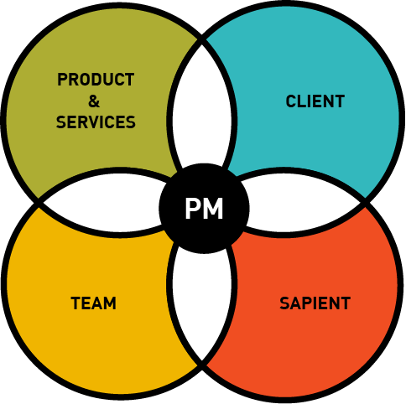
Sapient Project Management Model
The team delivers the products and services that fulfill the client‘s specific business needs
The clients have business needs that need to be addressed to contribute to their organisation‘s success, as well as their success within the organisation
The team consists of the people who will deliver the product, be it Sapient people or contractors
Sapient leadership has specific needs that are critical in order to fulfill the strategic context
Notes:
Speaker notes:
This diagram needs to be plotted out and referred to throughout the training.
This is another way to think about project management and each model highlights the integrated nature of the varous elements of project management. This is the model we are going to focus on for the rest of this course and highlights key elements that are critical for project success.
A PM is responsible for the delivery of a project and this can be broken into 4 key elements: (1) leading the team, (2) delivering the product, (3) working with the client, (4) fulfilling Sapient leadership needs. Each of these key elements have a direct impact on Sapient being able to fulfill the strategic context.
The PM needs to make sure each key element is optimal, and furthermore the PM is responsible for making sure that the interaction between each element is optimal.
Example:
Is the team interacting with the client as needed?
Is the client checkpoint at the end of each iteration to see the progress of the product?
Is the team building a product that fulfills the client needs?
Etc
The rest of the course is going to focus on each of these element.
Element examples:
Client
Relationship management
Client communication management
Reporting status to the client
Etc
Product & Services
Defining the scope
Driving the estimate
Kicking off the project
Etc
Team
Leading the team
Staffing the team
Motivating the team
Etc
Sapient
Driving project profitability
Managing margin
Managing time cards for the PM and the team
etc
Note that there are going to be overlaps between elements. Eg communication is a key R&R for the team, however it is also critical for the client.

Slide 16
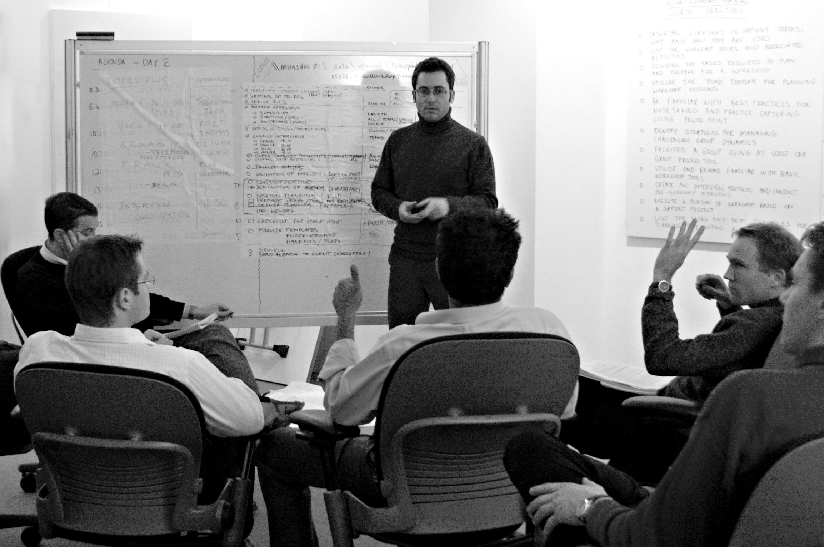
Class Exercise #1
What are the responsibilities of a Project Manager?
  Instructions (Total time required 15 min)
  Split into 4 groups, and each group pick a corner of the room
  Spend 5 minutes brainstorming a list of the Project Manager responsibilities on a whiteboard as follows:
  Group 1 - Delivering the product and services Group 2 - Working with the client
  Group 3 - Leading the team
  Group 4 - Fulfilling Sapient needs
  After afew minutes, rotate to the next corner and add any additional points
  Repeat until each group has looked at all 4 areas
  Debrief (10 min)
Notes:
Speaker notes:
The idea is to get the participants to whiteboard their ideas fast in a brainstorm fashion, then rotate. After the first brainstorm, the second team will require less time to brainstorm, as they will only be adding to what is already there.
It is important to time box each cycle, as we will be visiting each section in further details as part of the rest of the course and comparing their answers to the ones in the pres.
See the Facilitator Notes word document for details on how to facilitate this session.

Slide 17
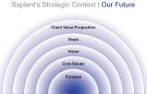
Project Management and the Strategic Context
Purpose: Being a great company enabling human potential
  Our commitment to Client Success is legendary
  We “get” the significant impact that we make in people’s lives
  We are the standard for growing and developing people
  We actualize “team” to the highest level in business
Core Values
  Client focused delivery, Creativity, Leadership, Openness, People growth, Relationships
Vision: By 2012, our Client Success Model drives the consulting market
  We deliver Client Success not “consulting”
  Our clients are clients for life
5-3-1 Year Goals
  Our overriding goal for 2006 is to establish and experience "Winning Performance Everyday."
Notes:
Speaker notes:
In each key element of the strategic context, the PM plays an absolutely critical role in enabling Sapient to fulfill the Strategic context, because the PM has exposure to each part of each project. And ultimately it is through winning performance every day on our projects that we will succeed in reaching our strategic context goals.
Eg
Being a great company enabling human potential
The PM is a key role in ensuring client success through developing and maintaining a good relationship, understanding the clients needs, and what needs to happen to make them truly successful.
The PM is leading a team, and has responsibility for a large number of people on a day-to-day basis. This provides the opportunity to grow our people more than nearly any other role.
We deliver Client Success not “consulting”
We are in the business of making our clients extraordinarily successful: the client success business. Our Client Success Model enables us to consistently create and sustain extraordinary client success with much higher returns at a very competitive price. We make our clients fundamentally more successful than anyone else does and this is widely recognized in the marketplace.
=> Since the Project Management interacts with our clients day-to-day, PMs can hold the key to truly understanding the client needs, and making sure these needs are truly met in order to make then successfully in every way.
Our clients are clients for life
We engage with our clients in a fun, collaborative and innovative way that they truly enjoy and believe in. They know we always do the right thing and do whatever it takes to make them successful. They trust us completely.
The PM is integral for managing client relationships, and hence plays a pivotal role in making a client a “client for life”
On a final note, stress that the PM must lead the way in showing our clients and teams how we work differently compared to our competitors eg in how we run meetings, in our rigour etc.
WHITEBOARD:
Near the lists from each group, focus the attention and see how the PM relates. Do this for 5 mins only and drive home the point that the PM Is a critical vehicle for our successful strategic context

Slide 18
Delivering the Product and Services

Slide 19


How do we define “Product and Services”?
The product and services include anything we have committed to delivering to the client
Examples:
  Software application
  Consulting services
  IT strategy
  …
Sapient uses a standard approach (Sapient|Approach) to deliver the product and services
Evolution – not everything is covered today
Notes:
Speaker notes:
Do not build the slide. First ask the group how they would define “the product”.
Once the participants have thought about it, let the slide build.
Ask the group why they think it is important that Sapient uses a standard approach to deliver the product.
Examples answers include:
So that our clients have a consistent experience
So that our people are not re-inventing the wheel each time they go on a new project
So that the organisation can build metrics that provide insight into where we could improve how we run our projects
Etc
Show the Case Study proposal as an example of the product and services that we sell.

Slide 20
What are PM responsibilities related to “Product and Services”?
Prep – preparing for the project
  Define the scope
  Drive the estimate
  Develop the project schedule
  Support development of the price
  others...
Kickoff – getting the project off the ground
  Drive definition of project vision and goals
  Work with staffing to staff the project
  Plan the project
  Drive the project kick-off
  others...
Execute – running and wrapping up the delivery
  Plan iterations
  Track overall progress
  Drive iteration execution
  Drive iteration closure
  Manage issues and risks
  Manage changes to scope
  Ensure audits and project reviews are happening
  Monitor quality
  Ensure that the tools are in place and are being used correctly
  Ensure Sapient|Approach is being used correctly and consistently
  others...
Red items will be covered today
Notes:
Speaker notes:
See how the group answers compared to the slide. Note that this is only a subset, and there are many more
Also keep in mind, that many of these responsibilities are shared with the Arch (when it is a software project) eg monitor quality

Slide 21
Sapient|Approach
Sapient|Approach (S|A) defines the delivery model used to create success for our clients and includes:
  Methodology
  Standardized tools and techniques
  Team structure and organization
  Distributed delivery - work anywhere, anytime
Based on Agile principles
  Iterative
  Evolutionary design instead of “big upfront design”
  Embraces the reality that requirements change over time
  Working software (or completed deliverables) is the primary measure of progress
  Focus on process automation
  Client collaboration, visibility and control
Notes:
Speaker notes:
Note that for this course, we are not going to go into details for each and every area of responsibility regarding S|A. We will highlight the key concepts in this course, and then in the 3 day PM training, we will go into more details regarding how to manage a project using S|A.
Set expectations that we’ll 1st give overview of SA, then dive into the diff aspects of SA as regards the PM role
HOW IS THIS DIFF THAN A TRADITIONAL PM?
More focus given to team
PM is not a task master
Removes obstacles

Slide 22
S|A versus traditional waterfall
Waterfall
Fusion
Requirements Definition
Implementation Phase
Maintenance
Go Live
Sapient|Approach
Fusion
Exec. Architecture Release
Release 2
Release 3
Manage
It 1
It 2
It 3
It 4
It 5
It 6
It 7
It 8
It 9
It 10
It 11
It 12
Go Live
Iteration N
Mon
Client team: acts as interface to client, does some dev work
GDD Team: develops and tests
Fri
How does Agile feel different for a PM?
More
  Focus on the teams’ skills to work with the business
  Trust, openness, honesty
  Expectation management
Different
  Letting go
  Constant visibility of problems
  Build relationships instead of doing work
Notes:
Speaker notes:
The facilitator has the option of hiding this slide and whiteboarding it covering the following key points:
The waterfall model as we know it is being replaced by an iterative development model.
Key changes:
(1) The phases as we know them will no longer be the same. Instead a project will be broken down into releases, of which the first release is called the Executable Architecture Release.
(2) Executable Architecture Release (EAR)
The purpose of the EAR is to do the minimum amount of work to understand the problem and commit to a solution
To achieve this each team must assess what combination of requirements, analysis, development and design activities are necessary to mitigate both requirement and technical risks associated with the project
(3) Release Planning
A release must happen no later than every 4 months
Release lengths can be different from release to release
Work with client to identify target functionality for first release: what is their “minimal marketable feature set?”
The smallest subset of the solution’s capabilities that would have value for the client
Know that the mid-level plan will change, don’t try to get too precise
(4) Iteration Planning
An iteration length is 1-4 weeks in duration. Key point…it must be a consistent length.
Focus on “Done is Done” while talking about iteration planning
Deliverables must be production-ready at end of every iteration
No separate “clean up” phase
Forces decision making and closure on the things of immediate concern
POSTER: print this as a poster,.

Slide 23
S|A features and benefits
Features | Benefits | Deltas vs. waterfall
Regular releases and iterations, with frequent checkpoints Transparency Incremental delivery Continuous QA | Reduced risk Visibility into progress Flexibility to change Earlier delivery Better quality based on ongoing feedback Control | More frequent interaction w/team More responsibility for scope Terminology to learn Dirty laundry visible
TDD, CI Configuration Mgmt ResultSpace^{RM} Adaptive planning Continuous improvement | Full lifecycle exposure Closer to business Ongoing sense of accomplishment Improved progress visibility Less wasted replanning Improved WBL | Greater rigor and discipline Regular rhythm instead of huge swings Control pushed to developers Increased focus on business Planning approach
Client
Delivery Team
Notes:
Speaker notes:
Ignore 3rd column if you’re not familiar w/waterfall
Example of performance risk
Display this while the poster is displayed

Slide 24
Project lifecycle using S|A
Sapient|Approach
Fusion
Exec. Architecture Release
Release 2
Release 3
Manage
It 1
It 2
It 3
It 4
It 5
It 6
It 7
It 8
It 9
It 10
It 11
It 12
Fusion
  Align stakeholders around the problem, potential solutions and the feasibility of moving forward
  Organized around one or more facilitated workshops
Executable Architecture Release
  Gather and document requirements at varying degrees of detail depending on risk and complexity
  Build and test the core components of the solution (roughly 10%-20% of the final system).
Ongoing releases
  Deliver functionality based on value
Notes:
Speaker notes:
The facilitator has the option of hiding this slide and whiteboarding it covering the following key points:
Executable Architecture Release (EAR)
The purpose of the EAR is to do the minimum amount of work to understand the problem and commit to a solution
To achieve this each team must assess what combination of requirements, analysis, development and design activities are necessary to mitigate both requirement and technical risks associated with the project
Release Planning
A release must happen no later than every 4 months
Release lengths can be different from release to release
Work with client to identify target functionality for first release: what is their “minimal marketable feature set?”
The smallest subset of the solution’s capabilities that would have value for the client
Know that the mid-level plan will change, don’t try to get too precise
Iteration Planning
An iteration length is 4 weeks
Focus on “Done is Done” while talking about iteration planning
Deliverables must be production-ready at end of every iteration
No separate “clean up” phase
Forces decision making and closure on the things of immediate concern
Need to leave time to do closeout within the iteration

Slide 25
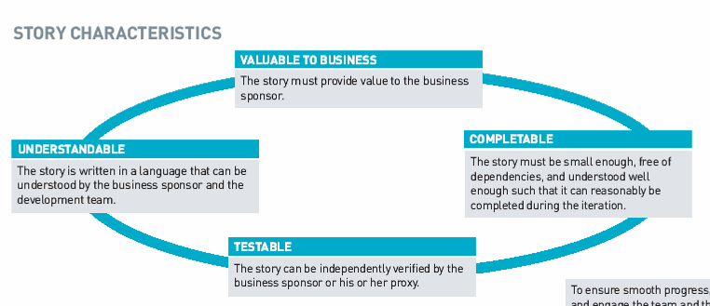
Story definition
A story is the fundamental unit of work and the primary unit of planning, execution and communication between client and the team
Notes:
Speaker notes:
Emphasise the fact that a story is really a way of breaking down work into smaller more manageable pieces.
Also mention that some stories are going to be paper based during the EAR eg „Document logical architecture“, „Document the site map“. However these will be refactored throughout the project, as small tweaks are made to account for new functionality.
Re-iterate that early on in the project, many stories may be paper based to document the breadth of requirements.
Ask participants for examples of what a good or bad story is.

Slide 26

Prep: Preparing for the project
PM activities
  Define the scope
  Drive the estimate
  Develop the project plan
  Support development of the price
  others...
You will have to answer the following questions:
  What are we going to do?
  Why are we doing it?
  How will it be done?
  What risks are there?
  What is the effort required?
  Who will do it?
  When will it be done?
  What assumptions are we making?
  How much will it cost? (NOTE: this will not be covered in this course)
Notes:
Speaker notes:
A critical part of selling a project is planning it. Typically a BD team will consist of a CE, a senior PM, Arch and perhaps other SMEs. Typically the senior project manager will drive and own planning the project. The planning should be treated as a mini-project in itself ie it needs to be planned, managed and tracked.

Slide 27
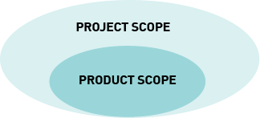
What is project scope?
Project Scope defines what Sapient commits to delivering to the client
Product Scope is documented in the Scope Matrix and consists of:
  Functional Requirements
    List of Use Cases
      Requirements may come in other forms such as declarative statements from the client
      Use Cases may not be appropriate for some projects eg EAI, middle tier etc
    Reports
    Feeds and interfaces
    etc
  Non-Functional Requirements
    Performance
    Availability
    Scalability
    etc
  Assumptions
  Deliverables
Develop a business plan
FUNC REQUIREMENT 123
Execute a 2-party trade
NON-FUNC REQUIREMENT
Response time on IE less than
1.5 sec per transaction
Notes:
Speaker notes:
Speaker notes:
Scope is actually part of a contract and hence Sapient’s liability is at stake.
Initial scope development provides a means to make sure that Sapient, the client, and any third parties are on the same page about what is being done and what is expected, and when. It is a critical step in setting and managing the expectations of the team, client sponsor, client stakeholders, third-parties, etc.
Something in-scope is a scope item that will be addressed in the project’s current release.
Out-of-scope can be defined as an item that is scheduled for a future release or not in scope for any planned initiatives.

Slide 28
Define the scope
Demo: Scope Matrix template
NOTE: Always download the latest version of the Scope Matrix from the S|A Intranet!!!

Homework:
Spend 15 minutes reviewing the following artifacts on the S|A site:
  (1) the Scope Matrix template
  (2) the Example Scope Matrix
Notes:
Speaker notes:
Show the participants where the scope matrix is, and make a point of telling them to always go to the S|A site to get the latest version as updates are made regularly.
(1) Go to the S|A website.
Go to the left navigation bar, and click on Tools
Click on Scope Matrix
Spend 15 minutes walking through the template, and mention that they will go into more detail during the 3 day Project Management training.
However it will be assumed that they have a basic understanding of the Scope Matrix, so it is critical that participants look at the template in detail as homework. Even if they do not have the opportunity to participate in the 3 day training directly after, it will be expected that they understand the basics of the Scope Matrix.

Slide 29
Drive the estimate
An estimate predicts the amount of effort required (in person days) to deliver the project
Types of estimates
  Bottom-up
  Top down
  Size based
  Capacity based
Level of accuracy
  Ballpark – gut based / range based on expert’s experience
  Rough order of magnitude – wide range based on other projects
  Detailed – based on detailed understanding of requirements
Notes:
Speaker notes:
Mention that there are all sorts of ways to estimate, and we have listed only a subset of the many different ways of scoping.
Talk about the each type of estimation.
Mention that historically Sapient has focused on the bottoms up estimation type and has done very detailed estimation.
Ask the group what the downside of this approach is.
Ask participants about their thoughts on the level of accuracy and time taken.
Ball park – can be a very quick way to estimate, however can be wildly off
Rough order of magnitude looks at similar projects, but takes few to several hours
Detailed – can take any where from a day to weeks
Talk about the fact that Sapient is going to start using Size Based estimation for estimating software projects which takes project parameters to determine the number of function points in an application, then adjusts these based on project characteristics.
However when using the size based estimation, before starting a project, you will need to do a work breakdown.
Mention that historically Sapient has focused on bottoms up estimation

Slide 30
Drive the estimate
To do a bottom-up estimate for a project, one of the critical steps is to break down scope (functional and non-functional requirements) into components that provide business value i.e. stories
Story**
Story**
Story
Story**
Requirement
Story
Story**
Story**
Story**
Story**
Scope
Requirement
Story
Story**
Story**
Story**
Story**
Requirement
Story**
Story**
** The estimate is done at this level
Notes:
Speaker notes:
When doing a bottom up estimate, most of the work is spent breaking down the requirements to a size and level of detail that we feel comfortable estimating. This is done by using the Work Breakdown technique where we start with the requirements (as defined in the scope matrix), and then proceed to break then down into stories, and then potentially smaller stories until we feel we can comfortably estimate it.
At Sapient the stories are vertical slices ie the work is broken down into business functions and features, as opposed to technical components.
Furthermore, when breaking down the work, it is assumed that each line-item is mutually exclusive (i.e. no overlap). So, if a story must be done to satisfy two different requirements, it gets counted only once even though the resulting functionality is distinct.

Slide 31

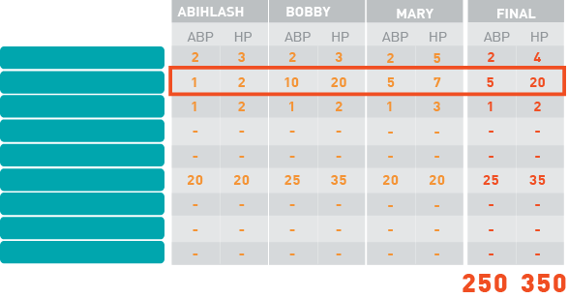

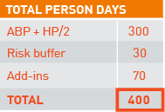
Drive the estimate
Notes:
Speaker notes:
When doing a bottom up estimate, most of the work is spent breaking down the requirements to a size and level of detail that we feel comfortable estimating. This is done by using the Work Breakdown technique where we start with the requirements (as defined in the scope matrix), and then proceed to break then down into chunks of work (vertical slices), and then potentially smaller chunks of work until we feel we can comfortably estimate it.
At Sapient the chunks of work are vertical slices ie the work is broken down into business functions and features, as opposed to technical components.
Furthermore, when breaking down the work, it is assumed that each line-item is mutually exclusive (i.e. no overlap). So, if a "chunk" of work must be done to satisfy two different requirements, it gets counted only once even though the resulting functionality is distinct.

Slide 32
Drive the estimate
Demo: Estimation Tool template can be found on the S|A site
Estimation Tool exports data to:
  Deal tool (to determine the price)
  ResultSpace Plan tool (used to manage the project)
NOTE: Always download the latest version of the Estimation Tool from the S|A Intranet site!!!

Homework:
Spend 15 minutes reviewing the following artifacts on the S|A site:
  (1) the Estimation Tool template
  (2) the estimation examples
Notes:
Speaker notes:
Show the participants where the estimation tool is, and make a point of telling them to always go to the S|A site to get the latest version as updates are made regularly.
(1) Go to the S|A website.
Go to the left navigation bar, and click on Tools
Click on the Estimation Tool
Spend 15 minutes walking through the template, and mention that they will get a chance to go into more detail during the 3 day Project Management training.
Make sure that the participants understand that during the 3 day training, it will be assumed that they have a basic understanding of the Estimation tool, so doing homework is critical! Even if they do not have the opportunity to participate in the 3 day training directly after, it will be expected that they understand the basics of the estimation tool.

Slide 33
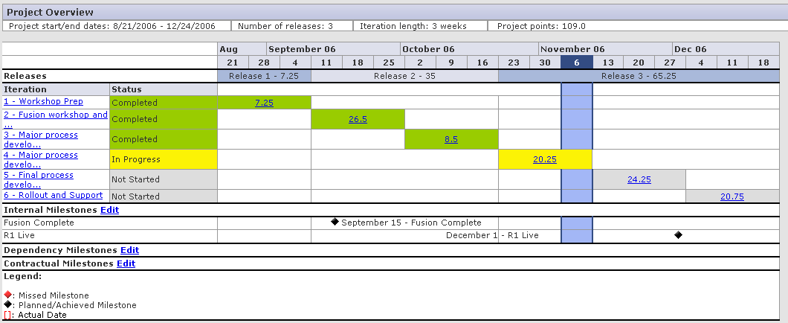
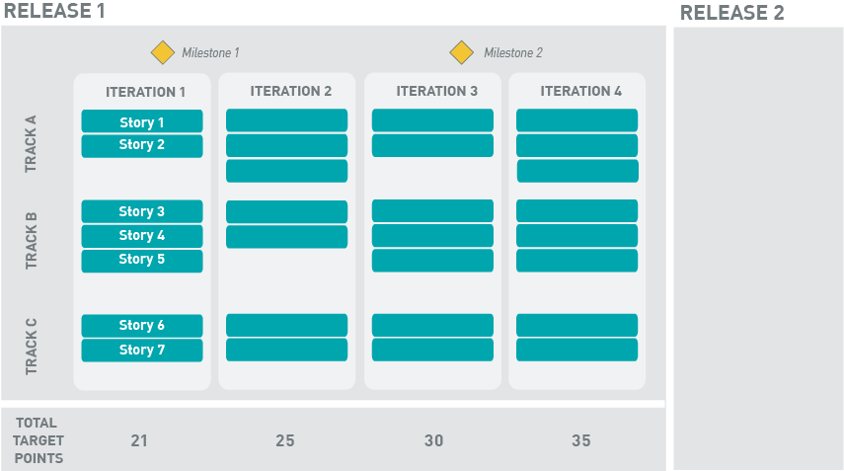
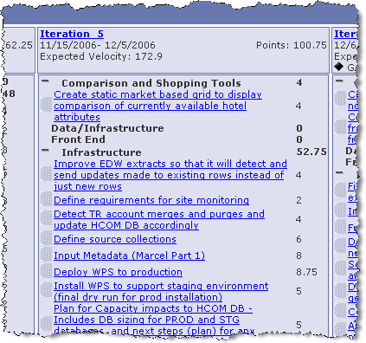
Develop the project plan
  High level plan
  Iteration Plan
  Release Plan

Homework:
Spend 30 minutes reviewing the ResultSpace “Example Project” Plan Tool
Notes:
Speaker notes:
Planning an agile project is significantly different to planning a waterfall project. In an agile project, there is less emphais on big upfront planning eg a detailed mid-level plan. Instead it is acknowledged that the plan will change, so a high level plan is developed, and then a release plan is also developed, however a more detailed plan is developed just-in-time.
Talk about the different types of project plans, their audience, level of change, and tools used for each
High level plan
– used mostly for the client to highlight key milestones
- once defined, should not change frequently
- primary audience is the client, however team should be intimately aware of the milestones on the high level plan
Release plan and Iteration Plan
This is the plan used to manage the team, and allocate the chunks of work
Tool used for this is ResultSpace Planning Tool (this will be covered in the 3 day PM training)
Release plan changes at the start of each iteration
Iteration plan is updated daily

Slide 34
Kickoff – getting the project off the ground
PM activities
  Drive definition of project vision and goals
  Work with staffing to staff the project
  Plan the project
  Drive the project kick-off
  others...
You will have to answer the following questions:
  Has the project been estimated for success?
  Is the project staffed for success?
  Has the project been planned for success?
  How will the team be ramped up for success?
  Is the hardware and software procurement done?
  Are the basic processes and tools understood?
  Is the communication plan in place?
  Are the expectations of the individuals and team understood?
  Are the exit criteria for the current release documented and understood?
Notes:
note that the PM here may be diff (hence the new “Plan” activity)
Speaker notes:
Planning and setting up a project is not only about defining up the project schedule, it involves a much broader set of activities such as defining the roles and responsibilities, the training plan, hardware and software requirements, planning communication and so forth. Typically the high level project plan has been defined prior to the sale of the project.
Ask the participants: Why do you think it is important to do the rudimentary project planning and setup activities well when a project starts?
Answer: This is where we have seen projects go wrong at Sapient. If the project has not been started off on the right foot, it is extremely challenging for the PM and team to turn it around into a smoothely running project. You are then relying on heroics of team members, long hours etc for the project to be successful. The PM can mitigate this by thoroughly and diligently checking that all setup and planning activities have been effectively addressed, and hence gives the PM the chance to fix it or sound the alarm if there is a major issue.

Slide 35

Execution – running and wrapping up the delivery
PM activities
  Plan iterations
  Track overall progress
  Drive iteration execution
  Drive iteration closure
  Manage issues and risks
  Manage changes to scope
  Ensure audits and project reviews are happening
  Monitor quality
  Ensure that the tools are in place and are being used correctly
  Ensure Sapient|Approach is being used correctly and consistently
  others...
Notes:
note that the PM here may be diff (hence the new “Plan” activity)
Speaker notes:
Planning and setting up a project is not only about defining up the project schedule, it involves a much broader set of activities such as defining the roles and responsibilities, the training plan, hardware and software requirements, planning communication and so forth. Typically the high level project plan has been defined prior to the sale of the project.
Ask the participants: Why do you think it is important to do the rudimentary project planning and setup activities well when a project starts?
Answer: This is where we have seen projects go wrong at Sapient. If the project has not been started off on the right foot, it is extremely challenging for the PM and team to turn it around into a smoothely running project. You are then relying on heroics of team members, long hours etc for the project to be successful. The PM can mitigate this by thoroughly and diligently checking that all setup and planning activities have been effectively addressed, and hence gives the PM the chance to fix it or sound the alarm if there is a major issue.

Slide 36
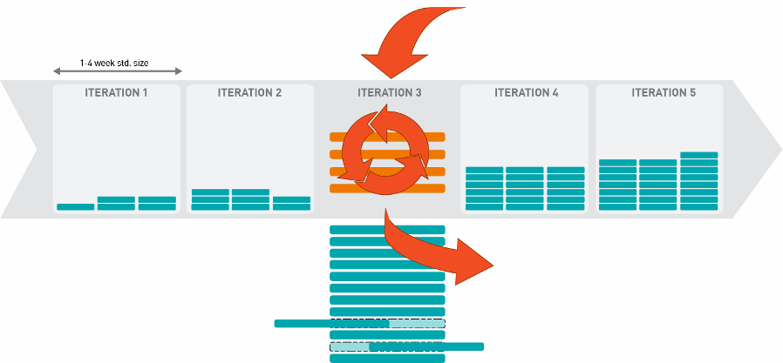
Drive iteration execution
Notes:
Speaker notes:
The S|A iteration is more specific than many definitions seen in other well-known methodologies. Specifically: the team must deliver something that is of such high quality (ie no P1s and P2s) that it could potentially be deployed.
The PM is key in enforcing this level of discipline and holding the team accountable for the high quality.
It is typically the role of the PM to facilitate the iteration kick-off meeting.
This includes showing the client what was originally planned for the iteration, and then providing them with the option to swap scope if they feel it is necessary. It is providing this choice that is very powerful. We have seen from projects that many times, after seeing what was delivered, clients have made scope choices that they may not have if they had not seen working code.

Slide 37
Manage issues and risks
“Risk”
  A potential problem or issue looming in the future that may evolve out of the current general state of things OR
  The harmful indirect result of a particular current situation that is not in itself harmful
How/when to identify risks
  Weekly risk brainstorming sessions
  Daily team meetings
  Progress reviews
Tool
  ResultSpace Risk Tracker
“Issue”
  An existing problem or indecision that prevents progress
How/when to identify issues
  Issues brainstorming sessions
  Daily team meetings
  Progress reviews
Tool
  ResultSpace TAR Tracker
Notes:
Speaker notes:
Describing risks:
It may be helpful to describe risks using the following language, to separate the cause from the impact. Understanding the cause may help you identify “leading indicators” that can be used to monitor the likelihood that the risk will occur.
i.e. As a result of <a definite cause>, <an uncertain event> may occur, which would lead to <a specific impact or consequence>.
Identifying risk:
Review the questions found in the Delivery Focus Areas document – these can be a good source of discussion for surfacing project risks
Review project artifacts with any eye toward uncovering risks, for example:
WBS
Project plan
Estimate assumptions
Client drivers / MBRs
List of project deliverables
Technical solution / Technical architecture
Sapient teams often have difficulty identifying risks. Adopting the view point of others (client business sponsor, client IT director, etc) can help to uncover some of these risks
Ask the group to identify what elements are tracked and used to manage risk
Write these up on the board as the group comes up with them.
The list of items used to track risk are:
Risk
Likelihood that risk will occur
Severity/Impact
Mitigation
Owner
Continegency plan
=> See ResultSpace Risk tracker for complete list
Quantifying risk:
The objective is to go beyond simply identifying risks as “High”, “Medium”, or “Low” by estimating the probability that the risk will occur as well as the severity of the impact if the risk is realized. By better quantifying the risks, you can put emphasis on those risks that have a higher probability of occurrence and a higher impact in terms of severity.

Slide 38
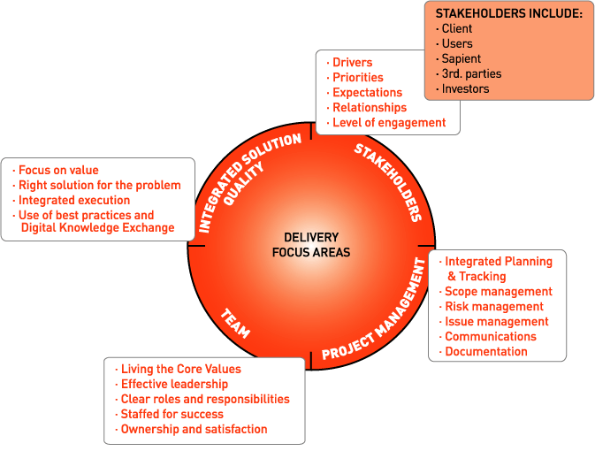
Manage issues and risks: Delivery Focus Areas
Notes:
Speaker notes:
Note that delivery focus areas are a great tool to get a holistic view on where the project is at, as well as provide the team the opportunity to identify issues and risks that they would be too “in the weeds” to notice.
It also provides you with an insight into how the team is doing, and how they feel the project management is proceeding.
A delivery focus area session should be scheduled at least once every 2 weeks, and should take an hour.
Techniques for running this include listing the subsections and askin the team to vote whether we are “Green” (no issues), “Yellow” (some issues that need to be resolved) or “Red” (urgent issues that need to be resolved.
Note how many votes for each colour per sub-section. The important part is to understand why, to undercover things that are not working or that are working (and that should be continued).
It is alo recommended to track the results each time a session is run to see how the results are trending.

Slide 39
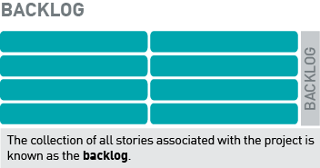
Manage scope
Scope change management occurs when the client requests additional scope that has previously not been planned for, and that has an impact on the overall project cost or schedule
S|A is “iterative” but the focus is on incremental delivery -- it does NOT imply that scope can be “iterated”
In Sapient|Approach, a typical team defines a backlog of stories that is driven from the scope
Before a story has been started, it can be swapped out for another
Once a story has been completed, any changes represent new scope
Notes:
Speaker notes:
This is a very simplified view of the process, but it captures the essence of the process.
In reality the CR must be captured in ResultSpace, and the status changed accordingly.
Ask the participants what potential outcomes of an approved change request may be:
Potential outcomes are:
Change can be accomodated within the project resources and timelines
The change will require an extension to the timeline
Can be accomodated within the current schedule, however extra resources will be needed
Can be accomodated but additional resources AND an extension of the schedule will be required
Cannot be accomodated without a signficant change to the project

Slide 40
Recap
Prep – preparing for the project
  Define the scope
  Drive the estimate
  Develop the project schedule
  Support development of the price
  others...
Kickoff – getting the project off the ground
  Drive definition of project vision and goals
  Work with staffing to staff the project
  Plan the project
  Drive the project kick-off
  others...
Execute – running and wrapping up the delivery
  Plan iterations
  Track overall progress
  Drive iteration execution
  Drive iteration closure
  Manage issues and risks
  Manage changes to scope
  Ensure audits and project reviews are happening
  Monitor quality
  Ensure that the tools are in place and are being used correctly
  Ensure Sapient|Approach is being used correctly and consistently
  others...
Red items covered today

Slide 41
Working with the client

Slide 42
Who is “the client”?
The Client includes anyone who belongs to the client organization who is impacted by the project outcome
Examples:
  Key sponsor
  Subject Matter Experts
  End users
  Procurement clerks (clients dealing with invoicing)
The sponsor is the champion of the project, and ultimately accountable
The PM must control who becomes a client stakeholder for the project and guide them to fulfil project goals
Decision making authority must be clarified for each “client”
Notes:
Speaker notes:
Do not build the slide. First ask the group how they would define “the client”.
Once the participants have thought about it, let the slide build.

Slide 43
What are PM responsibilities related to “Working with the Client”?
Relationships
  Understand client drivers and priorities
  Provide guidance, coaching and leadership to the client
  Manage client relationships
  Manage expectations
  Ensure roles and responsibilities are understood
  Ask for regular feedback, and act on the feedback
  Manage communication
  Etc...
Operational
  Facilitate decision making
  Facilitate issue identification and resolution
  Facilitate workshops
  Manage level of engagement
  Report status
  Invoice the client
  Gather the client satisfaction score
  Etc...
Red items will be covered today
Notes:
Speaker notes:
See how the group answers compared to the slide. Note that this is only a subset, and there are many more
Key messages:
(1) Mention that one of the primary responsibilities of the PM is to provide the client guidance and leadership, as well as to facilitate issue and decision making. A strong client relationship can be the difference between client success or failure.
(2) A big differentiator with how we run projects at Sapient is the level of transparency and openess with our clients. This happens through our use of ResultSpace, realising our core values, open discussions, which is all part of our approach to truly partnering with clients.
Note that the there is an even more complete list in the People Strategy Competency model on the Intranet.
Note: We will talk a lot more about leadership in the “Team” section.

Slide 44
Manage client relationships
Know who’s who
Become familiar with the organisation management and communication styles
Understand individual drivers and motives
  Personal agendas
  Preferences
  Hot buttons
  What does success mean to them
Find out personal styles and preferences
Be flexible
Map Sapient roles to client roles
Others?
Notes:
Speaker notes:

Slide 45

Manage client relationships: relationship map
CLIENT
SAPIENT
CLIENT
SAPIENT
CLIENT
SAPIENT
CLIENT
SAPIENT
CLIENT
SAPIENT
$
CLIENT
SAPIENT
CLIENT
SAPIENT
CLIENT
SAPIENT
CLIENT
SAPIENT
CLIENT
SAPIENT
CLIENT
SAPIENT
CLIENT
SAPIENT
CLIENT
SAPIENT
CLIENT
SAPIENT
LEGEND
Budget Owner Sapient Champion
Decision Maker Sapient Challenger
Project Manager Project Sponsor
$
CLIENT
SAPIENT
Notes:
Facilitator Notes:
Objective:
Understand the Client / Project organization so we can facilitate decision making and communicate effectively
Shows the senior management of the client organization, as well as the middle management and working-level staff for the relevant business units we are dealing with.
Understand the client’s decision making processes, internal politics, and personal drivers of the key stakeholders.
For each of the key stakeholders, assign ownership to a Sapient account team member. The owner is responsible for building the relationship with that stakeholder.
Our success in both sales and delivery is dependent on establishing long-term, trusted relationships

Slide 46
Manage communication
Definition:
  Defines who is informed of what information, by which medium, and when
  Defines the escalation process
What does this mean for the Sapient PM?
  Create the plan
  Facilitate the meetings / processes
  Escalate according to plan
  Drive resolution of open items
  Own the process
Why is this important?
  Sets expectations
  Ensures open lines of communication
  Keeps the client/team actively engaged
  Critical to successful delivery
  Facilitates relationship-building
Tool used:
  S|A Communication Plan template
Notes:
Facilitator Notes:
Definition:
Communications Planning involves defining the formal communications schedule and processes that will be used on an engagement. The plan should include all communication processes. These could be between Sapient and the Client, internal to the Sapient team only (i.e. communication between US and India teams in a GDD scenario), between Sapient and any third parties, etc. The plan should include the schedule for all formal meetings (status meetings, checkpoints,Steering Committee meetings, etc.), as well as a description of the issue resolution and escalation processes. Depending on the size of the project, the project team, and the client project team, these process may be described formally in a set of documents for approval by the client, or may be agreed to verbally by the client. Whether formally documented and signed-off or not, a clear understanding needs to exist between various parties with regard to how and when various types of communications will occur. Larger projects and programs, involving larger teams or multiple project teams, will typically require more formalized processes due to the number of people involved.
What does this mean for Sapient PMs?
PM needs to drive the planning process and get buy-in from all appropriate parties (team, client, etc.) on the communication plan. Needs to set clear expectations with the team and the client about how issues will be handled and in what timeframes, when and to whom escalation will be done, how status will be communicated and to whom, etc. Formalizing these processes helps to ensure that there is are open lines of communications between parties
PM will facilitate many of the formal communications processes
PM will trigger most of the issues and will be responsible for escalation to both the Sapient leadership team and the client and will be responsible for driving open issues to conclusion
The PM is ultimately responsible for the success of the project – managing communications among all concerned parties is a critical project success factor.

Slide 47
Client communication soft skills
Listen
“Talk the client’s language”
Provide options and recommendations
Negotiate (“win/win”, “Getting to yes”)
Push back when appropriate
Be confident (as opposed to arrogant)
Set expectations
Speak clearly and articulately (especially on conference calls!)
Be honest
Notes:
Speaker notes:
Discuss the importance of excellent verbal communication eg facilitating meetings, phone meetings etc.
Why is it important to have excellent communication skills?
What are other best practices regarding communication – verbal, written

Slide 48

Class Exercise #2
Difficult conversation with
the client
  Instructions (Total time required 90 min)
  Split into 4 groups
  Assign 2 people to play the client, one person to play the Sapient client-based PM, and a person to play the Sapient GDD PM (if needed assign one person to play the Sapient Architect)
  Prepare for a meeting with the client to discuss an issue that has arisen on the project, using the scenarios from the Case Study (10 min)
  Role play the client meeting in the main room (10 min per group)
Notes:
Speaker notes:
Details in the Facilitator notes document.

Slide 49
Recap
Relationships
  Understand client drivers and priorities
  Provide guidance, coaching and leadership to the client
  Manage client relationships
  Manage expectations
  Ensure roles and responsibilities are understood
  Ask for regular feedback, and act on the feedback
  Manage communication
  Etc...
Operational
  Facilitate decision making
  Facilitate issue identification and resolution
  Facilitate workshops
  Manage level of engagement
  Report status
  Invoice the client
  Gather the client satisfaction score
  Etc...
Red items covered today
Notes:
Speaker notes:
See how the group answers compared to the slide. Note that this is only a subset, and there are many more
Key messages:
(1) Mention that one of the primary responsibilities of the PM is to provide the client guidance and leadership, as well as to facilitate issue and decision making. A strong client relationship can be the difference between client success or failure.
(2) A big differentiator with how we run projects at Sapient is the level of transparency and openess with our clients. This happens through our use of ResultSpace, realising our core values, open discussions, which is all part of our approach to truly partnering with clients.
Note that the there is an even more complete list in the People Strategy Competency model on the Intranet.
Note: We will talk a lot more about leadership in the “Team” section.

Slide 50
Close and Feedback

Slide 51
Homework Summary
Go to the S|A site and review the following:
  Scope Matrix template
  Example Scope Matrix (type “example” in the Search box)
  Estimation tool template
  Estimation tool example (type “example” in the Search box)
Go to the ResultSpace “Example Project” and review the following:
(To access Example project: Click on Projects in top nav, scroll down to All Projects, select “Example Project”)
  Plan Tool
    Project Overview
    Release Plan (EAR)
    Iteration Plan (Iteration 1 and 2)
  Trackers
    Issues, Risks, Change Requests, Defects
  Tasks
  Wiki
    Meeting minutes
    Project Work Plan
Total time required: 1 hour

Slide 52
Feedback for the day
Plus
Delta
Notes:
Speaker notes:
Depending on the amount of time you have left, ask each participant for one plus and one delta, and one key take-away from today’s session. Capture these on the whiteboard or swammies.

Slide 53
Thank You!

