Slide 1
Introduction to Project Management
Day 2
Version 1.2
Last Updated: 26 February 2007

Slide 2

Day 2 Agenda
08:30 – 08:45 Kickoff
08:45 – 11:45 Leading the team (+Break)
11:45 – 12:30 What Sapient expects from PMs
12:30 – 13:00 Conclusion and feedback
Notes:
PUT ON WALL

Slide 3

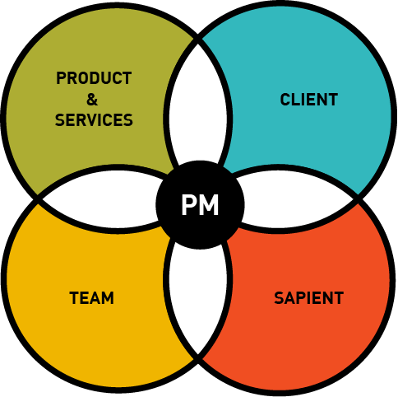
Leading the team

Slide 4


Who is “the team”?
The team includes anyone who is part of the engagement, who can impact the project outcome, and falls under the responsibility of the Sapient project leadership
Examples:
  Sapient people
  Contractors
  Client SMEs
  …
Notes:
Speaker notes:
Do not build the slide. First ask the group who they would define as “the team”.
Once the participants have thought about it, let the slide build.
We are adopting a relatively broad definition of team in this context.

Slide 5


What are PM responsibilities related to “Leading the Team”?
Leadership
  Provide leadership and direction
  Develop relationships
  People growth
  Coach team members
  Ensure roles and responsibilities are understood
  Bring different domain expertise together
  Motivate the team
  WBL
Management
  Manage communication (locally and globally)
  Define the team structure
  Staff the team
  Manage contractors
  Act as a point of escalation
  Facilitate decision making
  Manage expectations
  Facilitate and drive meetings
  Align team around vision
  Facilitate conflict resolution
  Help team understand client business
Red items will be covered today
Notes:
Speaker notes:
Build the slide and see how the group compared to the answer…note that this is only a subset, and there are many more
Note that again leadership and providing direction are key responsibilities to leading a team.

Slide 6
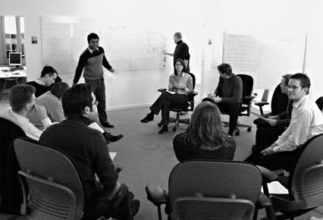
Motivate the team
Recognition
  Acknowledge good work
  Ask for an opinion or advice
  Take a personal interest
  Increase responsibility
  Rewards and ceremonious recognitions
  e.g. weekly Core Value awards
Monitor morale
  Weekly morale sessions
  Morale tracker
  Follow up and act
Getting the right chemistry
  Team kick-off
  Plan and participate in team events
  Clarity on roles and responsibilities
  Make relevant project information available, visible and accessible
  Deal with under-par performers
Others?
Notes:
Speaker notes:
This slide should be as interactive as possible.
Walk through the points, and ask participants to share experiences where these things have worked or have not worked.
As participants to share other ways to motivate teams.
Ask participants, what in the past has motivated them when they were on a project that they were not leading.

Slide 7
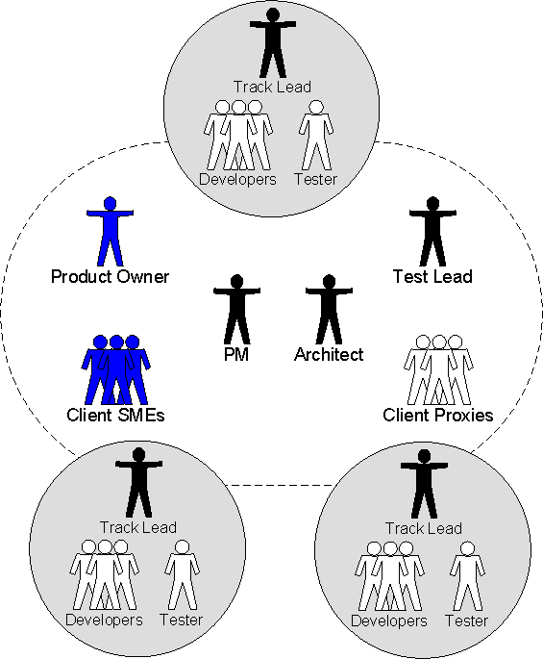
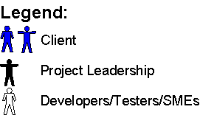
Define the team structure
A “virtual” team requires diligent communication of project information
Co-equal Project Manager and Architect roles
  PM owns schedule and budget
  Architect owns quality
Decision making is decentralized into tracks
  Tracks are semi-autonomous units tasked with achieving specific objectives
  Tracks self organize to achieve the
  objectives in the most efficient way possible
Testing/QA functions are embedded into
each track
  Entire track is responsible for working
  together to create a high quality product
  Removes “us versus them” tension where accountability is tossed back and forth between development and QA groups
Notes:
Speaker notes:
Key messages:
Arch and PM share ownership (see below for more details)
One product owner from the client side who participates in iteration checkpoints, and is accountable for the iteration and project scope decisions
Self managed tracks
Note that a typical track size is 4 – 10.
Tracks should be structured around functionality, NOT domain (as has been the case in the past)
Each track has a combination of developer and tester
Creative Designers will typically have their own track (for tracking purposed), however operationally CD track members will work across tracks.
Try and avoid distributed tracks ie avoid a track split across multiple geographies
Ask the participants what they see as the difference between PM and an Arch
Draw the Slide 10 scope triangle on the board and use that as a reference for splitting the Arch verus PM R&R.
High level: PM owns scope schedule and budget, Arch owns quality
Explain how separating ownership of quality and scope/resources leads to a more optimal outcome for the project.
More details:
PM: scope matrix, client relationship with product owner, team management, overall tracking, risk and issue management,
Architect: estimate, technical solution, testing quality, builds and releases, technical component of configuration management
Side note:
Point out that the client proxy is a role played by a Sapient person at the client site in addition to their assigned project role. It is not given to a person who is playing the client proxy role and nothing else.

Slide 8
Staff the team
Account Team enters “staffing plan” into Pyramid at 50%
Prob. | Description
10% | Initial meeting held, potential project identified, further information/qualification needed
25% | Need identified, process understood, Sapient is one of the contenders, but not necessarily in the lead
50% | Proposal submitted, short listed by the client (#1 or #2). Staffing plans are entered into Pyramid
75% | Client told us we are the preferred vendor
90% | Verbal commitment, paperwork submitted with terms and prices, work has not started yet
95% | Work has started, but contract is not signed yet
100% | Work has started, contract is signed
Staffing team considers potential team members
Staffing team monitors projects in the pipeline and starts thinking through options
Candidate is slated
Staffing team slates people
PM reaches out to the potential team member
Staffing team slates and closes people against needs
Candidate is closed against project
Candidate rolls off project
Notes:
Speaker notes:
This process flow comes directly from the Standard staffing presentation.
The staffing process is driven by the sales probability
Each sales probability has very explicit definitions
First key step for the PM is when the sales probability is at 50%, at this point, the staffing plan needs to be entered into Pyramid
People are assigned to these roles typically at sales probability 75%. These are closed at 90%.

Slide 9
Manage contractors
Staff
Ramp-up
Deliver
Roll-off
Process
Screen and interview candidates
Prepare the contract
Contractor must sign NDA
Request PO (not reqd in Germany)
Acquire approval by BU lead for contracts > 6 mths
Prepare logistics Eg Pyramid record creation, computer, VPN access, ResultSpace login, allocation to PID etc
Intro to Sapient
Client background
Project background
Role and responsibilities
Sapient tools, processes, working style
Client communication guidelines eg say they work for Sapient
Immerse contractors in the Sapient team, processes, tools and culture
Monitor quality of deliverables through more frequent peer reviews
Ensure deliverables are fully complete and saved centrally
Capture lessons learnt that the contractor has uncovered
Define post-project communication strategy eg contact information etc
Sit with the contractor and provide feedback
Best
Practices
Staff contractors who are local to where the team spends most time
Set up contract using daily rate as opposed to hourly
Treat contractor as a Sapient team member
For “first time” contractors, staff them in junior roles with appropriate supervision
If the client asks about the contractor, respond with “This person works regularly with Sapient”
Maintain relationships after the project, in case they are needed again
Notes:
Speaker notes:
Before going into details on this slide, ask participants when it is appropriate to staff a contractor as opposed to a Sapient person.
Answer:
(1) the project requires a specific skill set that is not available at Sapient, or
no Sapient person is available to staff a need
For more details go to:
http://intranet/Staffing/Contractor%20Process/Section1.asp
Key take-away from this slide is to immerse contractors in the Sapient way of working. Treat them almost like a new hire, however keep an eye on quality. Keep in mind that when they leave, they are not just leaving the project, but the company.

Slide 10
Best practices for leading a Globally Distributed Team
Plan the project collaboratively
Build in additional communication time, and ensure there is a detailed communication plan between the geographies
Plan for face-to-face project leadership meetings at kickoff and every one or two months
Use collaborative tools such as WebEx, NetMeeting, IM etc to facilitate effective communication
Do not split tracks across geographies
Use standard facilitation tools and techniques
Notes:
Speaker notes:

Slide 11




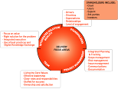
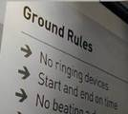
Team Tools
Collaboration Tools
ResultSpace & Subversion
(www.resultspace.sapient.com)
WebEx Online conferencing
(www.webex.sapient.com)
MSOffice Communicator
Instant Messanger
Team Communication Tools
Morale Tracker
Bob ☺
Ashish 😐
Anubhav ☺
Project Room
(aka War Room)
Delivery Focus
Area sessions
Notes:
Speaker notes:
Visibility, transparency and accessibility is key to the success of a project, and something that culturally differentiates Sapient from other companies. There are many ways to collaborate and communicate, thus ensuring that the right people have access to the right information.
Some of the typical Sapient methods are listed.
Ask the participants who have been with Sapient for a while to wall through what each of these are, and what they should be used for.

Slide 12

Best Practices for facilitating a GDD team meeting
Prepare for the call
  Prepare the meeting purpose, agenda and outcomes
  Set up the tools and logistics
Set up the meeting request, including:
  The conference call number and an online conferencing tool (WebEx)
  Purpose/agenda/outcomes
  Request for participants to dial in and log on a couple of minutes prior to the call
Facilitate the call
  Introduce the people on the call
  State the meeting purpose/agenda/outcome
  Document the meeting minutes real-time (Tip: Use the RS Wiki for this)
  Call on individuals to keep them involved
  Don’t be afraid of silent pauses, sometimes people need time to think!
  Ask for feedback at the end
Follow up
  Update any Next Steps or To Dos in RS
  Send out meeting minutes(or link to RS) within 24 hours
Notes:
Speaker notes:

Slide 13
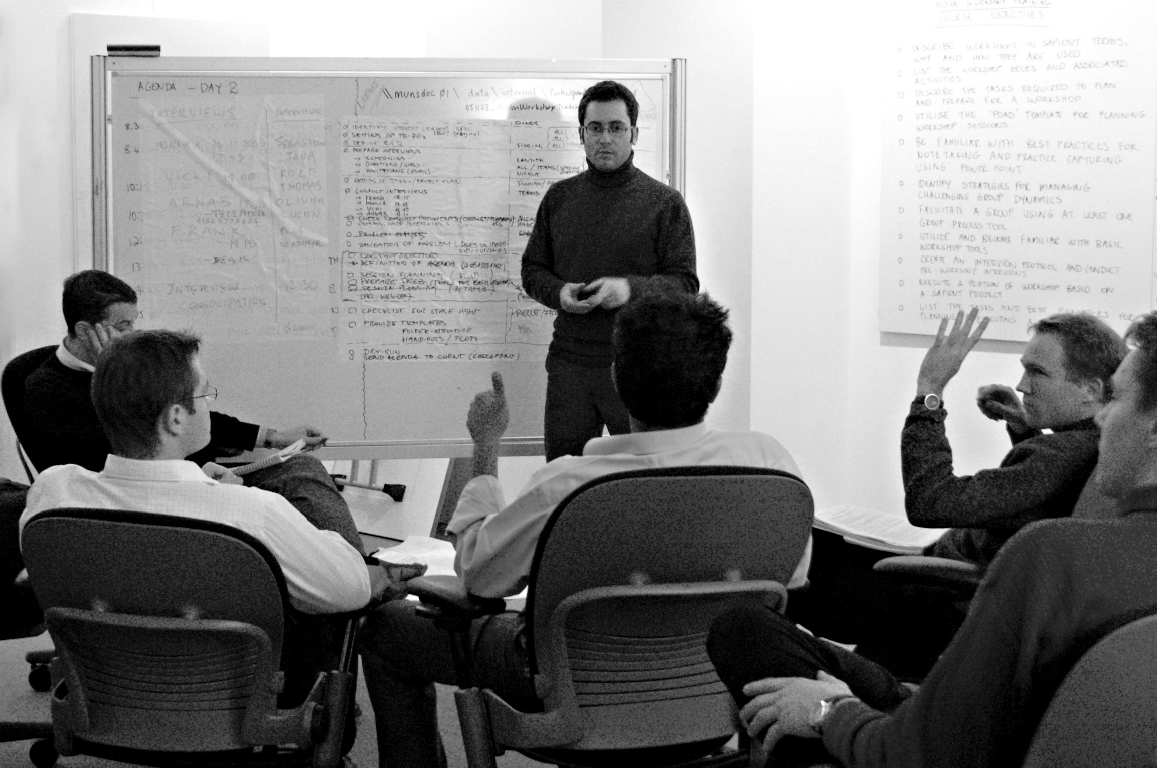
Class Exercise #3
Facilitating globally distributed team meetings
  Instructions (Total time required 60 min)
  Split into 2 groups as follows
    Group 1: Prepare an issues and risk session
    Group 2: Prepare a track leads meeting
  Select one person in each group to play the PM, and one person to do online note-taking
  Each group will go to a break-out room and spend 20 min preparing to facilitate their meeting using an online conference tool (NetMeeting or WebEx) and speaker phone. Communication with the other team is allowed via email or IM in order to set up the call etc. Use the scenario handout and WebEx Cheat Sheet.
  Each team will role-play their meeting for 10 min, with the other team as the participants
  Debrief (10 min per team)
Notes:
Speaker notes:
Details in the Facilitator notes document.

Slide 14
Facilitate conflict resolution
The Game Theory
I don’t win
I win
You win
Submission
Collaboration
Assertiveness
Compromise
You don’t win
Withdrawal
Blocking/Sabotage
Aggression
Dominance
Underlying assumption
  Everyone is trying to achieve a specific goal
  Achieving your specific goal = “I win”
2 types of games
  Cooperative – striving towards “win/win”
  Competitive – one party wins, one party loses eg tennis
Notes:
Speaker notes:
In a high performing team or a non-performing team, conflict will arise.
Ask participants why they think it is important to manage conflict.
Answer: If you do not manage conflict well it can stop teamwork and hinder individual goals, and ultimately potentially hinder project success.
Ask participants what the benefits of managing conflict well can be.
Answer: If conflict is managed well it can lead to better decisions, more creative ideas and higer quality output.
The underlying assumption is that everyons is trying to achieve some kind of goal or payoff.
Examples of this may be:
gaining a sense of achievement from completing a worthwhile and/or high quality job
obtaining financial reward
making a profit for the company
getting the job done as quickly as possible in order to go somewhere better
having a feeling of self-esteem or self-worth
being recognised for one’s efforts
A competitive game means that one person wins and someone has to lose eg sports, competitive bid for a project
To play the cooperative game, you need to find ways of working where you get your payoff and your partner/person/organisation gets their payoff. This is called a win-win position.
Problems arise when you try and play a cooperative game competitively.
The box describes the behaviour that results in each state.
Eg if I am overall agreesive and dominant, the resulting state may be “I win” and “You don’t win”.
Or if I try and block or sabotage, the resulting state is “I don’t win” and “You don’t win” ie noone wins
Ultimately we want our teams to be assertive and collaborate to reach a “I win” and “You win” state.
See the next slide for how we get there.
See: http://www.teamtechnology.co.uk/conflictresolution.html

Slide 15
Conflict Resolution Model
Win / Win
Clarify
what the conflict is
Find out
win position
of each party
Brainstorm
ideas
Evaluate
ideas
Articulate
conclusion
Compromise
Find out
compromise position
of each party
Re-evaluate
ideas
Articulate
conclusion
Lose / Lose
Win / Lose
Lose / Win
Third Party resolves
(Track Lead or PM)
Articulate
conclusion
Notes:
Speaker notes:
There are many scenarios for the PM in which conflict will arise. The conflict may involve team members, it may involve the PM, or it may require the PM to step in. But conflict must be managed in order to keep the team working efficiently and effectively.
Often it will be up to the PM to help facilitate this process or at a minimum to help teams understand it themselves.
Ultimately we want the conflict to result in the green area ie as a win/win.
The more steps undertaken the less likely that it will be win/win.
STAGE 1:
Clarify what the conflict is or the joint decision that needs to be made.
Find out the win position of each party
This involves:
listening, without judging or arguing against the other parties' views.
declaring your own win position so that other parties understand what you need.
accepting others’ win positions and not arguing with others' win positions
This can be difficult, because most people only see their only point of view and, in a conflict situation, emotion can make one blind to alternatives. In extreme cases, you may need to get each party to articulate/summarise the others’ argument until the other party agrees with the summary. This is a very important stage and should not be rushed, because this stage (done properly) ensures that any conflict is based on real differences and not misperceptions.
Brainstorm ideas.
This is to generate creative ideas for meeting the desires of both/all parties. Brainstorm rule is to generate ideas without evaluating them - eg: do not express disagreement with ideas at this point in the process.
Evaluate those ideas to see if any meet the win criteria of both parties. This process takes a positive approach of making proposals that meet both win positions. If you don't take a positive approach (ie suggesting solutions rather than criticising others' views) the argument can end up going round in circles.
STAGE 2
If, after evaluation, no ideas meet the win criteria of both parties, then ask parties to declare how they might also be prepared to compromise.
Reevaluate the ideas to see if any of them meet the new, compromise positions.
STAGE 3
If, after this stage, there are still no ideas that meet the compromised win-win position, then the PM/Track Lead must resolve it. This might involve referring to an independent senior manager to make an executive decision.
In extreme cases, where games reach this stage the result is usually a lose for one or other party, and often a lose-lose scenario.
Finally, once agreement is reached then don’t skip the final step - articulating the conclusion. If you don’t ensure everyone remembers what the final decision was and why, you may get more conflict in the future (memories tend to be subjective).
See: http://www.teamtechnology.co.uk/conflictresolution.html

Slide 16
Class Exercise #4
Resolving conflict
in the team
  Instructions (Total time required 70 min)
  Split into 4 groups
  Select one person to play the PM, one person to play the Architect, and the other 2 people to play Sapient team members who are in conflict and have called for help to resolve their conflict. If there is a fifth person, they can play the GDD PM.
  The 2 Sapient team members must prepare a conflict based on the scenario they are given by the instructor (10 min)
  Role play the conflict in the main room (10 min per group)
  Debrief (10 min per group)
Notes:
Speaker notes:
Details in the Facilitator notes document.
You will most likely only have time for 3 groups to do this role play.

Slide 17
Recap
Leadership
  Provide leadership and direction
  Develop relationships
  People growth
  Coach team members
  Ensure roles and responsibilities are understood
  Bring different domain expertise together
  Motivate the team
  WBL
Management
  Manage communication (locally and globally)
  Define the team structure
  Staff the team
  Manage contractors
  Act as a point of escalation
  Facilitate decision making
  Manage expectations
  Facilitate and drive meetings
  Align team around vision
  Facilitate conflict resolution
  Help team understand client business
Red items covered today
Notes:
Speaker notes:
Build the slide and see how the group compared to the answer…note that this is only a subset, and there are many more
Note that again leadership and providing direction are key responsibilities to leading a team.

Slide 18
What Sapient as an organisation expects from PMs

Slide 19
Who “Sapient the organisation” includes
All Sapient delivery people
Global Leadership Team
BU and Animal/Colour leads
Legal
Marketing team
People Success team
Delivery Success team
Financial Success team
IT and Office services
Notes:
Speaker notes:
Do not build the slide. First ask the group who they would define as “Sapient the organisation”.
Once the participants have thought about it, let the slide build.
We are adopting a relatively broad definition of team in this context.

Slide 20
What are PM responsibilities related to “Fulfilling Sapient Expectations”?
Grow Sapient
  Make our clients successful
  Support hiring
  Identify potential business development opportunities
  Keep project turnover to acceptable levels
  Be the Reviewer for PPG rounds
  Contribute to marketing collateral eg case studies
  Communicate successes
Operational
  Participate in and lead Progress Reviews
  Keep staffing plans up-to-date
  Referencability
  S|A compliance
  Manage project profitability (Margin, DOP etc)
  Manage and approve time tracking
  Manage team travel issues
  Manage and approve project expenses
  Report to leadership
Notes:
Speaker notes:
Managing a project does not just require a project manager to ensure it is delivered. There are many more things expected from a PM to ultimately help Sapient reach the strategic context.
These are not only things that the PM has to do, but things that the PM needs to make sure the entire team takes care of.

Slide 21
Financial Success
Key metrics
  Days Over Plan = # Actual days – Days sold
  Profit = Revenue - Costs
  Margin = Profit / Revenue
Tools
  PM Dashboard
  Project P&L Report
  PID Expense Report
  Metrics Tool (development in progress)
Notes:
Speaker notes:

Slide 22
People Success
Hiring
  Conduct phone interviews
  Conduct in-person interviews
On boarding
  Ensure new hires who join your project are being integrated and given the support they need
Learning
  Ensure that team members are appropriately trained
People growth
  Participate in official feedback rounds (PPG)
  Career management
Turnover
  Have one-on-one conversations with people who are at risk, to find out the root cause
Non-performers
  Provide feedback to individuals who are not performing
  Escalate to People Strategists
Notes:
Speaker notes:

Slide 23
Delivery Success
S|A Compliance
  Help your teams take training
  Lead and support your teams
  Complete the S|A Adoption Plan
  Plan and prepare for audits which are conducted by a S|A Consultant every 4 weeks
Progress Reviews
  Lead (Snr Managers and above) and participate in Progress Reviews
  Plan and prepare for Progress Reviews which are conducted every 4 weeks for Plan/Create, and every 12 weeks for Manage engagements
Notes:
Speaker notes:

Slide 24
Summary of key Sapient Applications
Pivotal
  Track and manage sales opportunities
Pyramid
  Staffing plan and allocation
  Days Over Plan
  Billing rates
  Client satisfaction scores
Oracle
  Expenses
  LMS
Time tracker
  Track time
  Invoice clients
  Recognise revenue
ResultSpace and Subversion
  Manage projects (plan tool, trackers, Wiki, Dashboard, etc)
  Version control
  Metrics tool (development in progress)
  S|A Adoption tool
Report Center
  PM Dashboard
  Forecast
  Project P&L Report
  PID Expense Report
Notes:
Speaker notes:

Slide 25
Demo
PM Dashboard
Notes:
Speaker notes:

Slide 26
Recap
Grow Sapient
  Make our clients successful
  Support hiring
  Identify potential business development opportunities
  Keep project turnover to acceptable levels
  Be the Reviewer for PPG rounds
  Contribute to marketing collateral eg case studies
  Communicate successes
Operational
  Participate in and lead Progress Reviews
  Keep staffing plans up-to-date
  Referencability
  S|A compliance
  Manage project profitability (Margin, DOP etc)
  Manage and approve time tracking
  Manage team travel issues
  Manage and approve project expenses
  Report to leadership
Notes:
Speaker notes:
Managing a project does not just require a project manager to ensure it is delivered. There are many more things expected from a PM to ultimately help Sapient reach the strategic context.
These are not only things that the PM has to do, but things that the PM needs to make sure the entire team takes care of.

Slide 27
Conclusion and Feedback

Slide 28
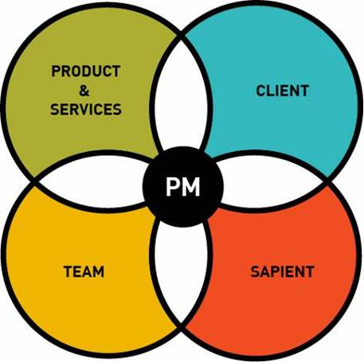
What’s the right balance?
The team delivers the products and services that fulfill the client‘s specific business needs
The clients have business needs that need to be addressed to contribute to their organisation‘s success, as well as their success within the organisation
The team consists of the people who will deliver the product, be it Sapient people or contractors
Sapient leadership has specific needs that are critical in order to fulfill the strategic context
Notes:
Speaker notes:
As we have seen, there is A LOT of “stuff” that a PM has to deal with.
Now that we have explored each area in detail, how does a PM know how to load balance all these elements?
=> There is no right or wrong answer to this question. The answer depends on the critical project drivers.
=> Learn how to prioritise, delegate, and manage your time
When do you ask for help?
=> Don’t wait until it is too late. Be aware that at the start of the project, the PM has A LOT to do, and as the project goes into steady state, this should stabalise. However if you find yourself working late night after night, things falling through the cracks, then start having the conversation with the delivery lead about seeking help. Waiting until you are burnt out is too late. Waiting until the project has failed, and the team has quit is also too late.
Where do you ask for help?
=> The person you are reporting to – most likely the engagement lead. Then to staffing
How can you delegate things to the team? Should you delegate things to the team?
=> One of the biggest mistakes of a new PM is to try and take on everything. Learn to delegate. Again this is a balancing act, as the team also has a lot on their plate. However more often than not, it can serve as an opportunity to give team members more responsibility, and can in fact motivate them.
Scenarios:
->

Slide 29
QUIZ!!
  Instructions
  Instructor will ask questions
  You answer as a team!
Notes:
Speaker notes:
Instructions and questions are in the facilitator notes.

Slide 30
Feedback
Plus
Delta
Key take-away for the last 1.5 days
NOTE: Please don’t forget to fill in the online feedback in http://sapeu !!
Notes:
Speaker notes:
Depending on the amount of time you have left, ask each participant for one plus and one delta, and one key take-away from today’s session. Capture these on the whiteboard or swammies.

Slide 31
Thank You!

