Slide 1
Microsoft Project 2007
One Day FasTrack Workshop
Hari P Thapliyal, PMP, MCITP, MBA, MCA, PGDFM
PMP Trainer, PMO & EPM Evangelist & Consultant
Vedavit Project Solutions

Slide 2
An Introduction
Name, Company, Current Designation, Why Certification, Hobby
Faculty & Participants

Slide 3
Workshop Ground Rules
Please keep your mobile on the silent mode.
Always take your calls outside the training room.
Keep your focus on the ongoing topic.
Await your turn during the questionnaire round to avoid chaos.
Strictly follow the workshop schedule for management of time.
Clapping for every answer & performance
Group will decide who will present the work
Everybody need to contribute
Use two bowls one empty and another with Green & Red chits
Notes:
Project Management Concepts
Version 3.1, 4/01 © 2003 by AstroWix

Slide 4
Agenda
Understand & Define Project New
Managing Task
Managing Resources
Managing Work Assignments
Resolving resource conflicts
Working with Views & Tables
Working with Critical Paths
Tracking Project Cost & Schedule Grouped
Managing Baseline
Project Tracking
Project Reports
MCITP Certification & Road Ahead
Vedavit Project Solutions

Slide 5
What is Project?
A project is temporary endeavour
Produces unique product, services or results
A project has a life cycle with a beginning and an end
Projects consume resources
A project has funding limits as outlined in its budget
Vedavit Project Solutions

Slide 6
Initiate a Project
Set Objectives
Deliverables
Milestones
Quality Criteria of deliverables
Cost limits
Identify Assumptions
Depends on the work of others
Resource availability (people, material, equipments)
Task duration estimates based on certain assumptions
Task cost estimates based on certain assumption. Know who approves them
Deadlines
List of project dependencies and deliverables between you and your stakeholders must match
You can develop cross-functional flowchart in visio to represent the dependency
Vedavit Project Solutions

Slide 7
Initiate a Project…
Identify Constraints
Schedule (fixed end date, deadline, milestone)
Resource (predefined budget)
Scope (what must be done in this phase)
Document the approach of responding to unexpected constraints, if they arise in project
Develop Scope Management Plan
= How the project scope will be managed + How any change in scope will be integrated into the project + assessment of how likely the scope is to change (how often + how much) + How scope change will be identified and classified + What to do when scope change is identified
Project's Scope = All Project Objectives and Tasks + Works required to accomplish them
Vedavit Project Solutions

Slide 8
Practice Topic: Project
Create a project from black “My House”
Set Project Title
Set Project Author
Assign Start date (forward scheduling)
Create Project Calendar
Assign Calendar
Set currency (options/ view)
Working hours (options/ calendar)
Save project as “MyHouse.mpp” on desktop
Vedavit Project Solutions

Slide 9
1. Managing Task
  Discuss & Demo & Practice
  Task Attributes
  Task dependency and dependency type
    FS, SF, FF, SS
  Task constraints and constraint type
    ASAP, ALAP, MSO, MFO, FNLT, FNET, SNET, SNLT
  Lead / Lag
Vedavit Project Solutions

Slide 10
Task Information Form
6 Major Tabs
General
Predecessors
Resources
Advance
Notes
Custom Fields
Vedavit Project Solutions

Slide 11
Practice Topic: Task
Create Deliverables of the project
Create Activities under each deliverable
Assign the sequence & dependency
Assign the lead / lag time
Define Task type
Assign duration/ work for each task
Vedavit Project Solutions

Slide 12
Which Value is re-calculated ?
Created Three task of type FU, FD & FW (Effort Driven) and change Duration, work, resource for each one of the them and observe the impact
 | You Change
Task Types | Units/ Add Resource | Work | Duration
Fixed Units
Fixed Work
Fixed Duration
Duration
Duration
Work
Duration
Duration
Units
Work/ Unit
(Work will divide)
Units
Work
Vedavit Project Solutions

Slide 13
Which Value is re-calculated ?
Created Three task of type FU, FD & FW (Not Effort Driven) and change Duration, work, resource for each one of the them and observe the impact
 | You Change
Task Types | Units/ Add Resource | Work | Duration
Fixed Units
Fixed Work
Fixed Duration
Duration/
Work
Duration
Work
Duration
Duration
Units
Work
Units
Work
Vedavit Project Solutions

Slide 14
2. Managing Resources
  Discuss & Demo & Practice
  What is resource?
  What are Resource Attributes?
  Type of Resources
    Generic Resource, Budget Resource, Named Resource
    Work Resource, Material Resource, Cost Resource
Vedavit Project Solutions

Slide 15
Practice Topic: Resource
Open Resource Sheet
Create resource for project
Assign type to resource
Create resource calendar
Define their unit of measurement, normal & overtime rates
Vedavit Project Solutions

Slide 16
3. Managing & Working with Assignments
  Discuss & Demo & Practice
  Resource Assignment
  Removing/ Replace Assignments
Vedavit Project Solutions

Slide 17
Practice Topic: Assignment
Assign resource to previous created task
Check Resource Loading
Vedavit Project Solutions

Slide 18
4. Resolving Resource Conflicts
Discuss the ways
Splitting tasks
Adding delays to tasks until the resources that are assigned to the task is no longer overloaded
It can be done through Resource Leveling feature of MSP 2007
Vedavit Project Solutions

Slide 19
Resource Leveling
Keynotes about MSP 2007 Resource Leveling
Project levels only the work resources, generic resources and committed resources
It does not level the material resources, cost resources and proposed resources
Prior to level set the task priorities
If you don't want project to level a particular task, set its priority level to 1000
Task with lower priority level are split before those that have higher priority
MS Projects calculates everything to Minutes and some resource red does not mean that it is over-allocated on week or day basis
Vedavit Project Solutions

Slide 20
Resource Leveling- Workshop
Step1
  Create two task (same starting date)
  Set priority of a task1 to 400
  Assign the Same resource to them
  Resource Usage View
  Run the resource level menu
  Observe the impact on schedule of project
Step2
  Cancel leveling
  Set priority of a task1 to 600
  Task1: Change the % complete of first task to 50%
  Go to resource leveling option and change leveling order
  Resource Usage View
  Level resource now
  Observe the schedule and resource allocation
Vedavit Project Solutions

Slide 21
Working with Usage View
Task Usage View
  Changing the scale and entering actual/planned data for task
  Select Actual, Planned, Cumulative fields and enter data
Resource Usage View
    Changing the scale and entering actual/planned data for resource
Vedavit Project Solutions

Slide 22
Task Usage View- Assignment Form
General
  Assignment
  Work Contour
  Cost Rate Table
Tracking
  Actual work
  Actual start
  Actual finish
  % work complete
  Remaining work
Notes
Vedavit Project Solutions

Slide 23
5. Working with Views & Tables
Discuss
Vedavit Project Solutions

Slide 24
Task Views & Tables
Views
  Bar Rollup
  Calendar
  Descriptive Network Diagram
  Detail Gantt
  Leveling Gantt
  Milestone Date Rollup
  Milestone Rollup
  Multiple Baselines Gantt
  Network Diagram
  Relation Diagram
  Task Detail Form
  Task Entry
  Task Form
  Task Name Form
  Task Sheet
  Task Usage
  Tracking Gantt
  You can create you own View
Tables
Baseline
Constraint Dates
Cost
Delay
Earned Value
Earned Value Cost Indicators
Earned Value Schedule Indicators
Entry
Export
Hyperlink
Rollup Table
Schedule
Summary
Tracking
Usage
Variance
Work
You can create you own table
Vedavit Project Solutions

Slide 25
Resource Views & Tables
View
Resource Allocation
Resource Form
Resource Graph
Resource Name Form
Resource Sheet
Resource Usage
You can create you own view
Tables
Cost
Earned Value
Entry
Entry- Material Resources
Entry- Work Resources
Export
Hyperlink
Summary
Usage
Work
You can create you own table
Vedavit Project Solutions

Slide 26
Network Diagram- Notations
Critical Task - Red parallelogram
Summary Task- Blue Parallelogram
Task - Rectangle Box
Task Completed- Rectangle box (cross)
Milestone- Hexagon
Vedavit Project Solutions

Slide 27
Gantt Chart - Notations
Critical Task – Color (Red) + End Shape
Normal Task – Color (Blue) + End Shape
Summary Task – Color (Black) + End Shape
Milestone Task – Color (Black) + End Shape
Vedavit Project Solutions

Slide 28
Practice Topic: View & Tables
Do you want to do it?
Vedavit Project Solutions

Slide 29
6. Working with Critical Paths
  Discuss & Demo & Practice
What is critical path?
How many critical path possible?
Vedavit Project Solutions

Slide 30
Practice Topic: Critical Path
Customize Gantt view for critical path
View only critical path activities
Vedavit Project Solutions

Slide 31
7. Managing Baseline
  Discuss & Demo & Practice
What is baseline
Base line Phase-I of the project
Vedavit Project Solutions

Slide 32
Practice Topic: Baseline
Select Gantt View with Baseline Table
Base line Phase-I of the project
Vedavit Project Solutions

Slide 33
8. Project Tracking
  Discuss & Demo & Practice
What is tracking?
What do you want to track?
How do you want to track?
Decide tracking method (time or work?)
Earn Value Management
Vedavit Project Solutions

Slide 34
Practice Topic: Tracking
Open Task Usage view
Enter actual work
Update remaining work (time or work)
Select Gantt View & Select Table- Earned Value Schedule Indicators OR
Select Gantt View & Select Table- Earned Value Cost Indicators
Observe Earned values
Select tracking Gantt view & observe the bar lines
Vedavit Project Solutions

Slide 35
9. Project Reports
  Discuss & Demo & Practice
Visual Reports
Copy Picture
Normal Tabular Reports
Vedavit Project Solutions

Slide 36
Normal Reports
Overview
  Project Summary
  Top-Level Tasks
  Critical Task
  Milestones
  Working Days
Current Activity Reports
  Un-started Tasks
  Tasks Starting Soon
  Tasks in Progress
  Completed Tasks
  Should Have Started Tasks
  Slipping Tasks
Workload Reports
  Task usage
  Resource Usage
Vedavit Project Solutions

Slide 37
Normal Reports….
Cost Reports
  Cash Flow
  Budget
  Over-budget Tasks
  Over-budget Resources
  Earned Value
Assignment Reports
  Who Does What
  Who does what when
  To-do List
  Over-allocated Resources
Custom Reports
Vedavit Project Solutions

Slide 38
Visual Reports
Assignment Usage
  Baseline Cost Report
  Baseline Work Report
  Budget Cost Report
  Budget Work Report
  Earned Value over Time Report
Task Usage
  Cash Flow Report
Resource usage
  Resource Cost Summary Report
  Resource Summary
  Resource Remaining Work Report
Vedavit Project Solutions

Slide 39
Visual Reports….
Resource work Availability Report
  Resource Work Summary Report
Assignment Summary
Task Summary
Vedavit Project Solutions

Slide 40
Practice Topic : Reports
Print Gantt in email
Print one Earned value report
Print who does what report
Vedavit Project Solutions

Slide 41
Revisit Workshop Objectives
Understand & Define Project New
Managing Task
Managing Resources
Managing Work Assignments
Resolving resource conflicts
Working with Views & Tables
Working with Critical Paths
Tracking Project Cost & Schedule Grouped
Managing Baseline
Project Tracking
Project Reports
Vedavit Project Solutions

Slide 42
Before we conclude
Vedavit Project Solutions

Slide 43
Facts of MS Project
MS Project is a Database
MS Project is a time calculator
Start each project schedule by checking your basic configuration settings (default calendar, calculation, metadata, currency, time setting)
Let MS Project Calculate schedule for you
MS Project is already programmed to be ASAP (do not put constraints initially)
Use an outline code to discern your task levels and WBS structure
Input fields has 3 personalities - planned, baseline, actual
Set the timescales to weeks and months for easier management
Distinguish between time and work. Think in work-terms as much as possible. Have good eye on task type at all times. Works only exists when resources are assigned. Work can be in hours or man days. Express duration in weeks.
Tracking a project=entering actuals
No earned value calculation without baseline and with entering cost
Vedavit Project Solutions

Slide 44

Vedavit Project Solutions

Slide 45
Contact Details
Hari P Thapliyal, PMP, MCITP, MBA, MCA, PGDFM
PMP Trainer, PMO & EPM Evangelist & Consultant
hari.p@pmi-chennai.org; hariprasad.pmp@gmail.com
Ph: 9566002948
https://sites.google.com/site/lifeisprojectplus
Skype: hari.thapliyal
YM: hari_thapliyal
Twitter: harithapliyal
Vedavit Project Solutions

Slide 46
Few More Concepts
Vedavit Project Solutions

Slide 47
The Project 2007 Product Suite
Windows based application designed for single project manager
Project
Standard
2007
Provide all the features of standard 2007 and additionally provides enterprise level team planning and communication features when used with project server 2007
Project
Portfolio
Server
2007
Project
Professional
2007
Project
2007
Product
Suit
A portfolio management solution that helps organizations identify, select, manage and deliver portfolios that align with their strategies
Internet based solution that provides enterprise level project collaboration, time sheet reporting and status reporting features when used with project professional 2007
Project
Web Access
2007
Project
Server
2007
Provides and internet based interface to work with Project Server 2007 like timesheet entry interface.
Vedavit Project Solutions

Slide 48
Templates
Project 2007 provides standard templates that you can use to create your project plan.
The templates include the standard tasks that need to be carried out to complete a project.
These tasks vary based on the type of project.
You can select a template that best suits the project on which you are working.
You can create your own templates
Organizations often create templates with standard high level WBS/list of activities that are common in all projects
Activity: Modify an existing template and save as My-Template
Vedavit Project Solutions

Slide 49
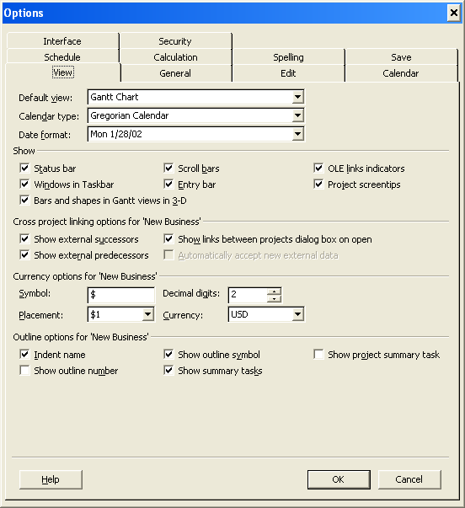


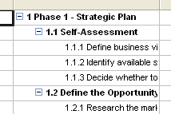
Create a New Project
Specifies whether you want to display a project-level summary task, which would have an ID of 0
If checked, project name is displayed as top most summary task at level 0
Indents the names of subtasks in the Task Name column.
If you clear this check box, tasks that have subtasks are hidden from view
Vedavit Project Solutions

Slide 50
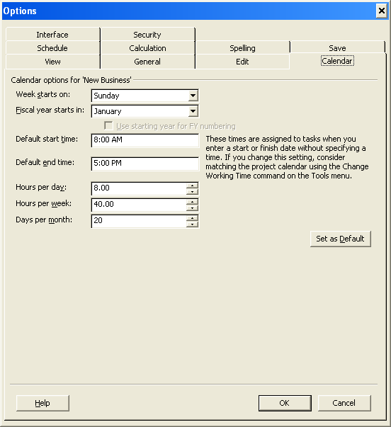
Create a New Project
Vedavit Project Solutions

Slide 51
Revisit Objectives
Get familiar with Project 2007 environment.
Create a project plan
Know general options to setup project environment
Learn about templates
Setup Project Calendar
Learn common view
Add tasks
Organize tasks
Know about task relationship
Link tasks
Vedavit Project Solutions

Slide 52
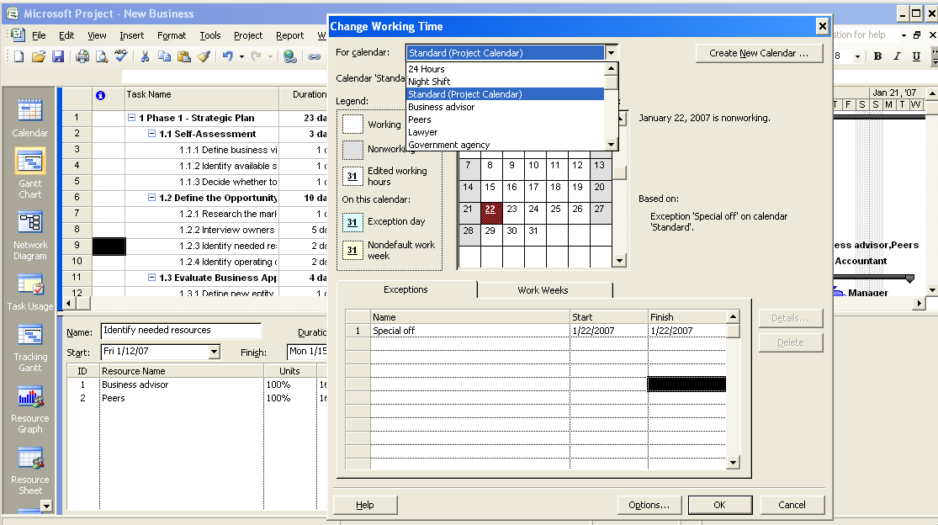
Set Up the Project Calendar
3 Base Calendar
Resource Calendars
Create a New Calendar
Enter specific non working days
Vedavit Project Solutions

Slide 53
Set Up the Project Calendar
A project calendar defines the general working and nonworking time for tasks and resources.
Set Up the Project Calendar
  To specify the nonworking hours for the project, click Tools, and then click Change Working Time.
  To select a base calendar for the project, in the For calendar box, click the down arrow.
  To set the Standard base calendar as the project calendar, in the list, click Standard (Project Calendar).
  To set a nonworking day, in the Exceptions tab, click in the Name field, type Special Off and then click in the Start field.
  To set the date for the nonworking day, in the Start field, type 1/22/2007 and then press ENTER.
  To close the Change Working Time dialog box, click OK.
  To verify the change made to the project calendar, in the right pane, scroll to the right to the week indicated by Jan 22, ‘07.
Vedavit Project Solutions

Slide 54
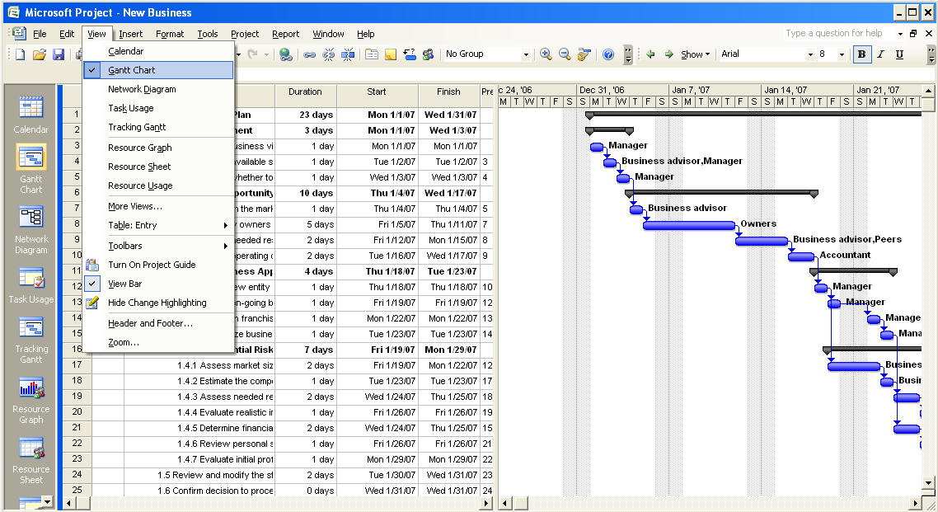
Working with views
Default View
Vedavit Project Solutions

Slide 55
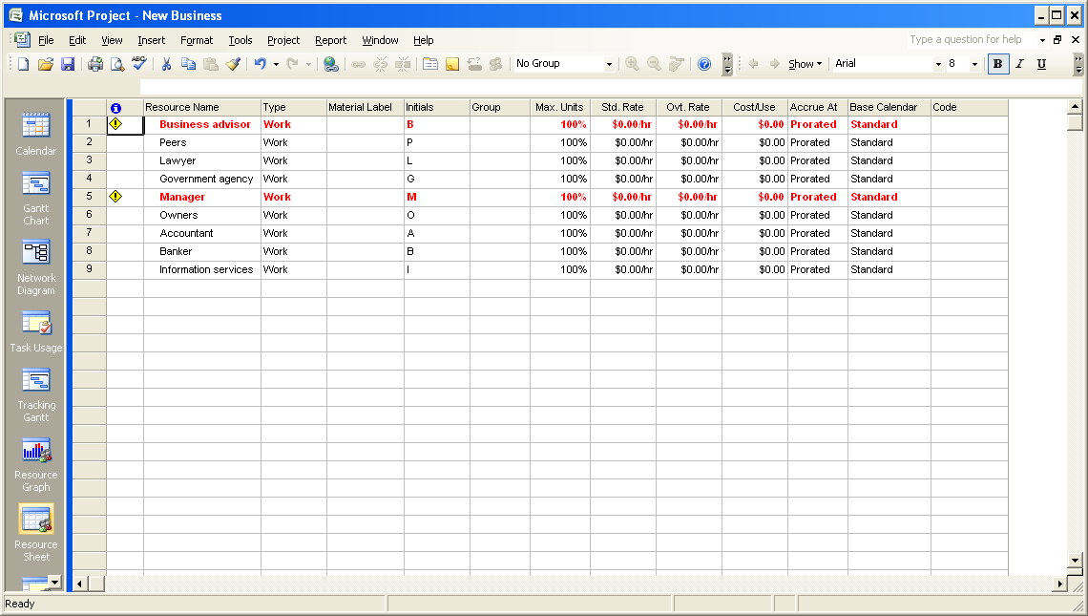
Working with views
Vedavit Project Solutions

Slide 56
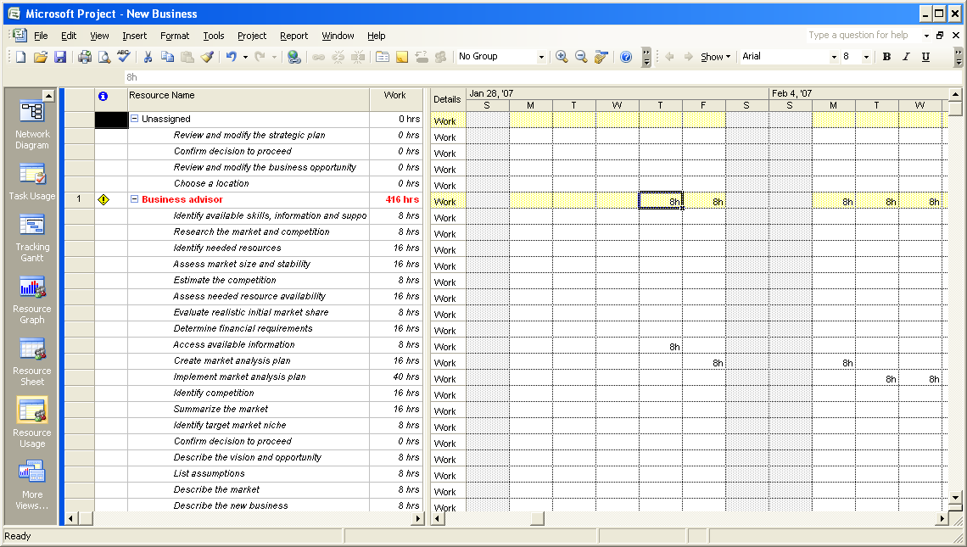
Working with views
Vedavit Project Solutions

Slide 57
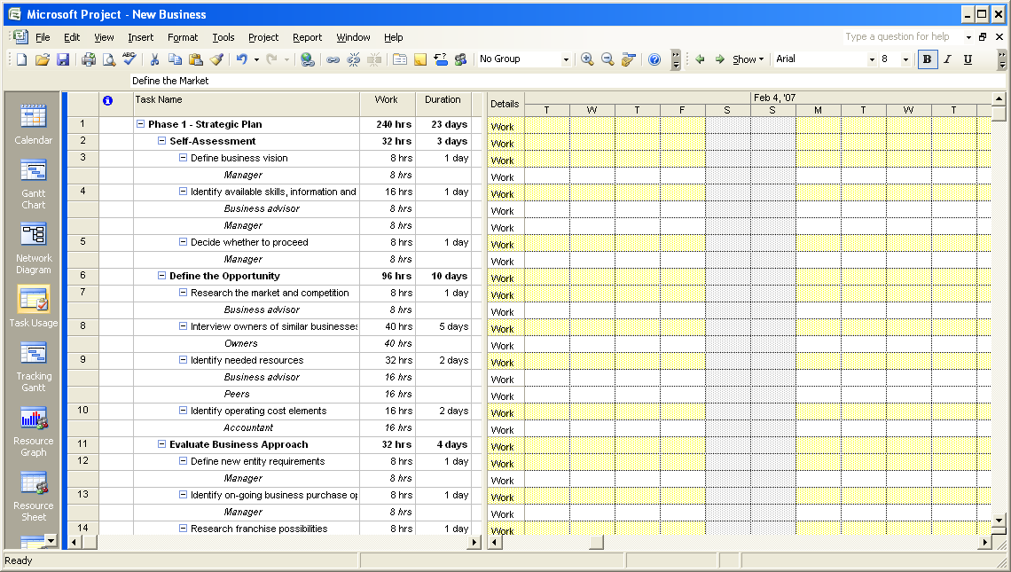
Working with views
Vedavit Project Solutions

Slide 58
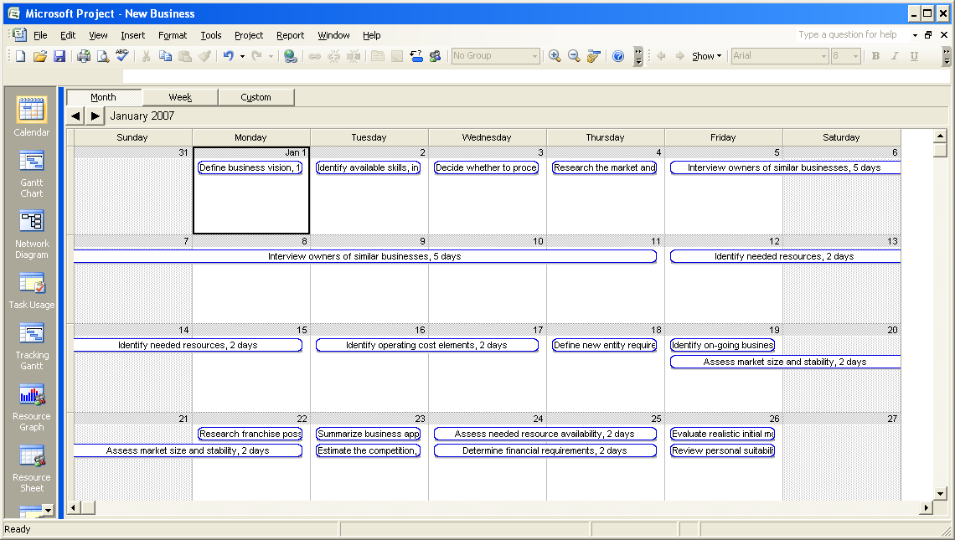
Working with views
Vedavit Project Solutions

Slide 59
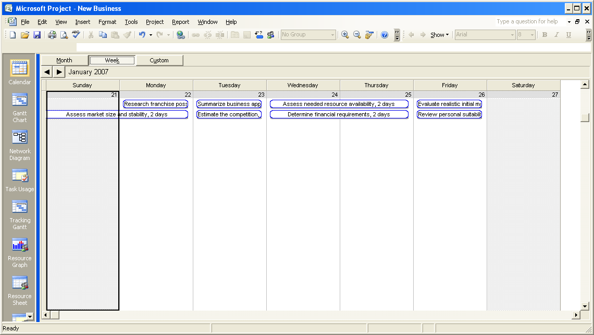
Working with views
Vedavit Project Solutions

Slide 60
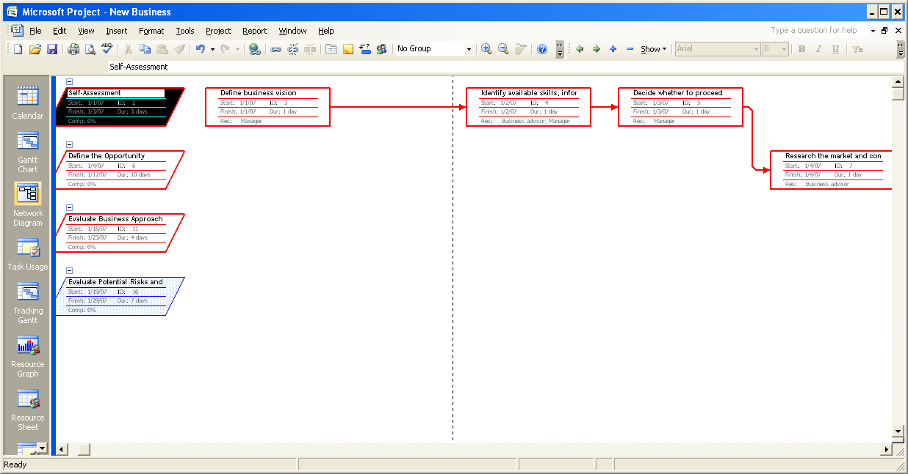
Working with views
Vedavit Project Solutions

Slide 61
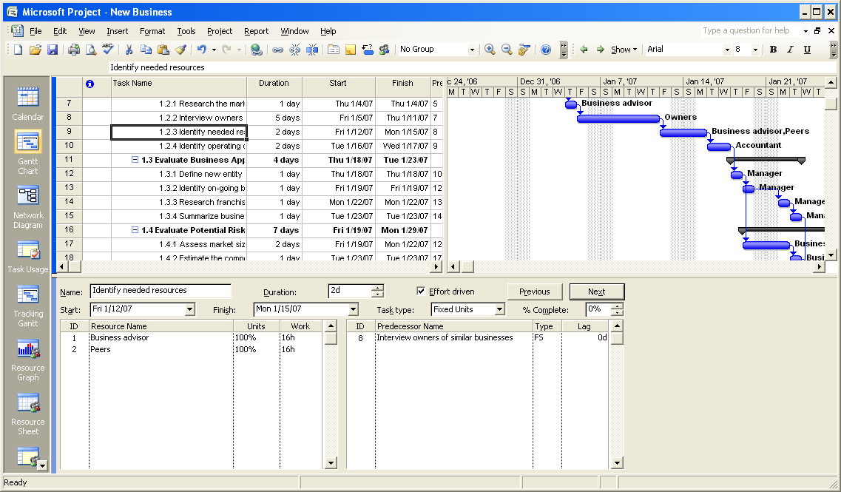
Working with views
Combination View Views → More Views → Task Entry
Vedavit Project Solutions

Slide 62
Question
You have been assigned a critical project that needs to be completed in a limited number of hours. Therefore, you need to extend the working hours and working days for this project. You want to set the working hours for your project as Monday to Saturday, 8.30 A.M. to 5.30 P.M., with a one-hour lunch break. Which of the following base calendars will you use?
Select the one best answer.
  24 Hours base calendar.
  Night Shift base calendar.
  Standard base calendar.
  New custom base calendar.
Correct answer is 4.
You must create a new custom base calendar because the base calendars included with Project 2007 are not suitable for the specified working hours.
Vedavit Project Solutions

Slide 63
Revisit Objectives
Get familiar with Project 2007 environment.
Create a project plan
Know general options to setup project environment
Learn about templates
Setup Project Calendar
Learn common view
Add tasks
Organize tasks
Know about task relationship
Link tasks
Vedavit Project Solutions

Slide 64
Adding Tasks to a Project
When you add a task,
  For every new task you add, Project 2007 assigns a duration of one day.
  The question mark in the Duration column indicates that this is an estimated duration.
  The Gantt Chart displays a corresponding task bar of one day’s length.
  By default, the start date of the task is set to the start date of the project.
  The task is automatically assigned an ID number. This ID number is unique to each task.
  However, the ID number does not necessarily represent the order in which the tasks occur.
Vedavit Project Solutions

Slide 65
Task notes
Task notes provide addition information about the task. Often it is an information that is required to perform the task or it helps performing the tasks
Adding task notes
  In the project plan, select the task for which you want to provide additional information.
  On the Project menu, click Task Notes.
  In the Task Information dialog box, in the Notes box, type the required information, and then click OK. A note icon appears in the Indicators column for the selected task.
  In the Indicators column, point to the note icon. The note appears as a ScreenTip. If you cannot view the entire note, double-click the note icon to display the complete note.
  To create a hyperlink to additional information, select a task, and then on the Insert menu, click Hyperlink. Alternatively, you can click the Insert Hyperlink button on the Standard toolbar, or right-click the task name and click Hyperlink on the shortcut menu.
  In the Insert Hyperlink dialog box, in the Text to display box, type the text that will appear as a hyperlink.
  In the Address box, type the location of the file or the URL of the page on the Internet or the intranet, and then click OK. A hyperlink icon appears in the Indicators column for the selected task.
  In the Indicators column, point to the hyperlink icon. The descriptive text that you specified when you created the hyperlink appears as a ScreenTip.
  Click the hyperlink icon to open the specified Web page or file.
Vedavit Project Solutions

Slide 66
Working with Tasks
Task duration.
Add task duration.
Describe milestones.
Organize tasks by creating summary tasks and subtasks.
Describe how tasks can be linked with each other.
  Finish-to-start (FS)
  Start-to-start (SS)
  Finish-to-finish (FF)
  Start-to-finish (SF)
Link tasks and calculate the project duration.
Vedavit Project Solutions

Slide 67
Task duration
Time Duration Abbreviation
  Minute – ‘m’ appears as min in the project plan
  Hour – ‘h’ appears as hr in the project plan
  Day – ‘d’ appears as day in the project plan
  Week – ‘w’ appears as wk in the project plan
  Month – ‘mo’ appears as mon in the project plan
To specify the durations for days, weeks, and months, go to:
Tools → Options → Calendar Tab
Vedavit Project Solutions

Slide 68
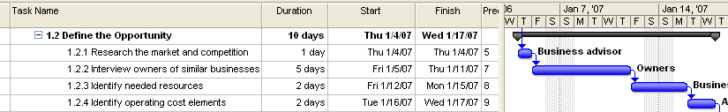
Specifying task duration
For efficient project management, it is a good practice to specify the task durations ranging from eight hours (one day) to 80 hours (10 days). Tasks that require less than one day for completion will be too granular, while tasks that require more than 10 days to complete might be too long to be managed properly.
Vedavit Project Solutions

Slide 69
Question
You have been assigned the project of creating small animations. One of the tasks involved in this project is to record the audio required for the animations by using a voice-over artist. A list of selected voice-over artists has been posted on the intranet. You need to provide this list of voice-over artists to the team member who will record the audio. How will you provide this information in your project plan?
Select the one best answer.
  Create a task for sending a contract to the voice-over artist and provide a hyperlink to the list of voice-over artists on the intranet.
  Create a task for sending a contract to the voice-over artist and provide the list of voice-over artists in the Task Information page.
  Create a task for sending a contract to the voice-over artist.
Option 1 is correct:
You must create a task for sending a contract to the voice-over artist and provide a hyperlink to the list of voice-over artists on the intranet.
Vedavit Project Solutions

Slide 70
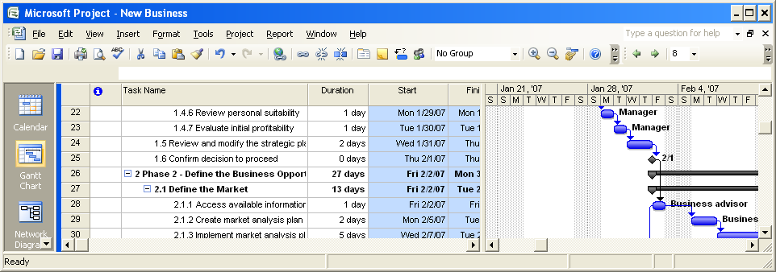
Milestone
Milestones indicate important events of your project. For example, a milestone can indicate the end of one phase of the project
A milestone is represented as a task with zero duration because the milestone usually does not involve any work.
Vedavit Project Solutions

Slide 71
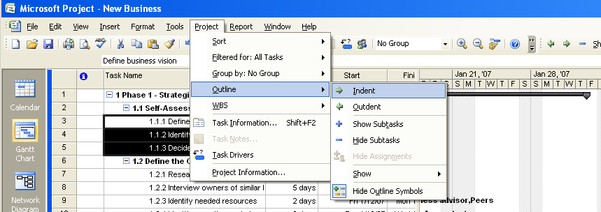
Summary and Sub tasks
Select the tasks that you want to group into a phase, and then indent the tasks. The task that appears before the first indented task becomes the summary task. The summary task name is formatted in bold and a summary task bar appears in the Gantt Chart. Project 2007 calculates the duration of a summary task as the period between the start date of the subtask that is scheduled to start first and the finish date of the subtask that is scheduled to finish last.
Summary Task
Sub Tasks
Vedavit Project Solutions

Slide 72




Task Relationship
Projects often require that the tasks be performed in a specific order.
  The second task must occur later than the first task. This relationship is called sequence.
  The second task can occur only if the first task is completed. This relationship is called dependency.
  First task is call predecessor and second task is called successor
There are 4 type of relationship
  Finish to start (FS)
    Indicates that the finish date of the predecessor task determines the start date of the successor task.
  Start to start (SS)
    Indicates that the start date of the predecessor task determines the start date of the successor task.
  Finish to finish (FF)
    Indicates that the finish date of the predecessor task determines the finish date of the successor task.
  Start to finish (SF)
    Indicates that the start date of the predecessor task determines the finish date of the successor task.
Vedavit Project Solutions

Slide 73
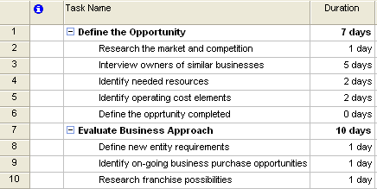
Lab: Linking Tasks
Create a new project
Create following list of activities
Vedavit Project Solutions

Slide 74
Lab: Linking Tasks
To create a link between task 2 and task 3, click to select task 2, hold down the SHIFT key, and then click task 3.
Click Edit, and then click Link Tasks.
To create another task relationship, click to select task 3, hold down SHIFT, and then click task 6.
Click Edit, and then click Link Tasks.
To link tasks by using the Task Information dialog box, click to select task 9, click Project, and then click Task Information.
In the Task Information dialog box, click the Predecessors tab.
In the Predecessors table, click the first row in the Task Name column, and then click the down arrow.
To set the predecessor for this task as task 8, in the list, click Define new entity requirements, and then press ENTER.
Click OK to close the Task Information dialog box.
Vedavit Project Solutions

Slide 75
Lab: Linking Tasks
To link task 9 and task 10, click to select task 9, hold down SHIFT, and then click task 10.
Click Edit, and then click Link Tasks.
To link the two summary tasks, select task 1, hold down the CTRL key, and then select Task 7.
Click Edit, and then click Link Tasks.
To calculate the project duration, click Project, and then click Project Information.
To view more details of the duration information, in the Project Information for ‘Linking Tasks’ dialog box, click Statistics.
To close the Project Statistics for ‘Linking Tasks’ dialog box, click Close.
To view the project duration in the Gantt Chart view, click View, and then click Zoom.
To change the timescale in the Gantt Chart view, in the Zoom dialog box, click to select the Entire project option, and then click OK.
Vedavit Project Solutions

Slide 76
Questions
You have created a project plan for your project. For this project, Task 10 must start when Task 5 finishes and Task 10 must finish when Task 7 finishes. What relationship will you specify between these tasks?
FS relationship from Task 10 to Task 5 and FF relationship from Task 10 to Task 7.
FS relationship from Task 5 to Task 10 and FF relationship from Task 10 to Task 7.
FS relationship from Task 10 to Task 5 and FS relationship from Task 7 to Task 10.
SF relationship from Task 5 to Task 10 and FF relationship from Task 10 to Task 7.
Option 2 is correct.
You must specify an FS relationship from Task 5 to Task 10 and an FF relationship from Task 10 to Task 7.
Vedavit Project Solutions

Slide 77
Questions
In your project plan, you have added a task with the duration of 0d. What is this task called?
  Predecessor.
  Successor.
  Milestone.
  Summary task.
  Subtask
Option 3 is correct
A milestone is a task with the duration of zero days.
Vedavit Project Solutions

Slide 78
Revisit Objectives
Get familiar with Project 2007 environment.
Create a project plan
Know general options to setup project environment
Learn about templates
Setup Project Calendar
Learn common view
Add tasks
Organize tasks
Know about task relationship
Link tasks
Vedavit Project Solutions

