Slide 1
Business Vision & PMO Vision
Presented by
  Hari Prasad Thapliyal
  PMO & EPM Evangelist & Consultant
  Vedavit Project Solutions
Notes:
Click to add notes

Slide 2
Business

Slide 3
Business SWOT Analysis- Output
List of objectives
List of goals
Mission Statement
Vision Statement
List of services & review of each stream
High level Organization structure

Slide 4
Business Vision
What are you doing today?
  Services
  Existing revenue streams
  Geographical locations
  Key pain areas
What do you want to?
  Services
  Expected revenue streams
  Geographical locations
  Key challenges

Slide 5

SWOT Analysis- Business

Slide 6
List of organization’s Strengths

Slide 7
List of organization’s Weaknesses

Slide 8
List of Opportunities for org.

Slide 9
List of Threats to organization

Slide 10
Convert threat into opportunities
Come up with creative solutions/ideas

Slide 11
Convert Weakness into Strengths
Come up with creative solutions/ideas

Slide 12
Output- Did we get what we wanted?
List of objectives
List of goals
Mission Statement
Vision Statement
List of services & review of each stream
High level Organization structure

Slide 13
PMO

Slide 14
PMO- SWOT Analysis- Output
PMO Objectives & Missions Statement
What processes, resources, training, infrastructure, money required to meet business objectives?
What we have?
What is the gap?
Plan for acquiring and filling gap
Plan for optimum utilization of all we have
Plan for monitoring and controlling of utilization against the plan
Plan for measuring the success against business objectives

Slide 15
PMO Vision
What are you doing today?
  Services to various department
  Services to external customers
  Existing revenue streams
  Resources allocation today
  What are we controlling today?
  Key pain areas
What do you want to?
  Services
  Expected revenue streams
  What do we wish control & why?
  Key challenges

Slide 16
SWOT Analysis- PMO

Slide 17
List of PMO Strengths

Slide 18
List of PMO Weaknesses

Slide 19
List of Opportunities for PMO

Slide 20
List of Threats to PMO

Slide 21
Output- Did we get what we wanted
PMO Objectives & Missions Statement
What processes, resources, training, infrastructure, money required to meet business objectives?
What we have?
What is the gap?
Plan for acquiring and filling gap
Plan for optimum utilization of all we have
Plan for monitoring and controlling of utilization against the plan
Plan for measuring the success against business objectives

Slide 22
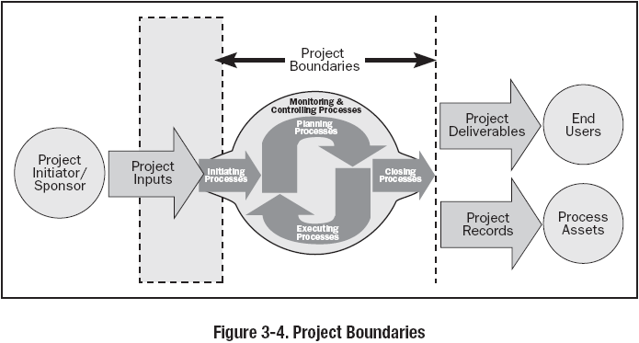
Project:
Measuring Success
against business objective
Project:
Monitor & Control of Utilization
Project:
Utilization of Assets
Project:
Acquisition of Assets

Slide 23
Contact Details
Hari P Thapliyal, PMP, MCITP, MBA, MCA, PGDFM
PMO & EPM Evangelist
hari.p@pmi-chennai.org; hariprasad.pmp@gmail.com
Ph: 9566002948
https://sites.google.com/site/lifeisprojectplus

