Slide 1

Training Presentation
Communication- Verbal
Hari P Thapliyal, PMP, MCITP, MCA, MBA, PGDFM

Slide 2

Introduction
Topic for this training is Verbal communication.
At the end of this training you will be
  Able to know about phonetic language and its role in the pronunciation
  Syllables
  Intonation
  Few styles of expressing your opinion
  Asking sensible questions even if you are not well acquaint with topic
  effective listening
Have you ever gone through any communication training formally?

Slide 3
Agenda
Start Training at 10.30 AM
Session Part I (1 Hour)
Tea break at 11.30 AM (10 Minutes)
Session Part II (1.20 Hours)

Slide 4
Overview
Phonetic
Pronunciation
Syllables
Intonation
Expressing yourself
Agreeing & Disagreeing sentences
Interrupting sentences
Type of question & Asking Questions

Slide 5
Vocabulary
Phonetic Language
Communication Structure
Effective Communication

Slide 6
Need Analysis
Why do you feel the need to improve spoken skills
What are you expecting from this course
Have you done anything to improve your spoken English
If you are not sure how to pronounce a word, how can you find out?
Is a fast speaker a fluent one?

Slide 7
Phonetic- Vowel (Single sound)
Sheep Horse
Ship Man
Bush Cup
Boot Car
Bread Clock
Bananas
Girl

Slide 8
Phonetic- Vowel (Double sound)
Ear Bear
Face Eye
Cure Mouse
Boy
Note (ओ)

Slide 9
Phonetic- Consonant
Pens Sun
Bus Zoo
Tomato Shoe
Dice Television
Church Moon
Jug Nine
Cat Ring
Goldfish Hat
Foot Lion
Van Rabbit
Thumb Window
Weather Yacht

Slide 10
Pronunciation -1
V and W
Vet Wet
Via Wire
Vest West
Veil Wail
Verse Worse
Vine Wine
V we
Veal Wheel

Slide 11
Pronunciation -2
ä ओ / ô औ / ō उअ
Not Nought Note
Stock Stack Snow
Cock Cork Cold
Stop Saw Sew

Slide 12
Pronunciation -3
द/ थ
They The Health Thick
Thank Theme Sheath Them
Theory Fourth Thin Throat
Three Thigh Path Death
Their North Theatre Mother

Slide 13
Pronunciation -4
स / श / ज़
Shall Sea Seat Sheet
Photos Shell Sip Suit
Is Us Press Has
Sore Slippers Ship Save
So Gloves Pension Sausages
Clothes Surprised Pencils Sore
Doesn’t Start Sure Sell

Slide 14
Pronunciation -5
Man Men
Bad Bed
Pan Pen
Sat Set
Mash Mesh
Cattle Kettle
Tamper Temper
Salary Celery
Landing Lending
Lass Less
Mass Mess
Mansion Mention
Ham Hem
Jam Gem
Land Lend
Flashy Fleshy
Latter Letter

Slide 15
Syllables-1
A syllable is part of word that contains a single vowel sound and is pronounced as unit.
Single syllable words are often stressed at the end of the syllable
Two syllable words are often stressed on the first syllable
Most words don’t have more than four syllables
Prefixes and suffixes are never usually stressed

Slide 16
Syllables-2
How many syllables and which is strong syllable
Chocolate Comfortable
Different Documentary
Strawberry Apple
Millionaire Interested
Miserable Mountain
Receipt Tourist
Country Football

Slide 17
Syllables-2
When a noun and a verb have the same form, the stress is on the first syllable when it’s a noun and the second syllable when it’s a verb
We must Record (ri) the Record (re) made by topper
The Contract does not allow sub-contracting
The Export facility is not Exporting the document
This was a good time to Present (pri) the Present (pra)
The soldier decided to Desert (di) in the Desert (dai)
We must Polish (pau) the Polish (po) furniture
The farm was used to Produce (c) the Produce (z)
The dump was so full that it had to Refuse (ri) more Refuse (rai)
When shot at, the dove (dav) dove (dov) into the bushes
I did not Object (abject) to the Object (o:bjikt)
The insurance was Invalid (invailid) for the Invalid (invlid)
The bandage was Wound (waund) around the Wound (wund)
There was a row (rau) among the oarsmen about how to Row (ro)

Slide 18
Intonation Patterns-1
Neutral (when thinking and concentrating)
Rising tone (surprise, asking question)
Falling tone (certain and confident)
I didn’t say he beats his wife
I didn’t say he beats his wife
I didn’t say he beats his wife
I didn’t say he beats his wife
I didn’t say he beats his wife

Slide 19
Tongue Twister
She sells sea-shells by the sea shore
The shells that she sells are sea-shells I’m sure
Which rich wicked witch wished the wicked wish?
Top chopsticks shops stock top chopsticks
Round and round the ragged rock the ragged rascal ran
Six thick thistle sticks. Six thick thistles stick.

Slide 20
Intonation Patterns-2
I think you’ve done a good job
I think you’ve done a good job
I think you’ve done a good job
I think you’ve done a good job
I think you’ve done a good job

Slide 21
Expressing Opinions
In my opinion……
I think…..
I feel…..
I’m convinced that…..
I (strongly) believe that ….
I’m absolutely certain that ….
I personally feel ……
I personally believe ….
What I’m concerned with is…..
As far as I’m concerned …
The point I want to stress is…
On the contrary ….
On the other hand ….
What I’m trying to say is …..

Slide 22
Agreeing and disagreeing
That’s true!
Definitely right!
Absolutely right!/correct!
Yes, I tend to agree with you
That’s what I feel too.
Exactly
I think you’re correct in saying that …
Absolutely not!
I’m afraid I have to disagree with you.
That’s not right!/correct!
But surely….
What about ….
I don’t agree with you/that
I don’t think so
I don’t see it like that.

Slide 23
Justifying Opinions
I think …. is right because ….
……….. that’s why I feel that ….
…………and so I feel that …….
………..for this reason…….
The reason why ………

Slide 24
Asking for opinions
Do you think that …. ?
What do you think/feel about ….. ?
Are you sure that ……?

Slide 25
Interrupting
For some information and help
Excuse me
Excuse me for interrupting but…..
May I interrupt for a moment?
In the middle of conversation
I’d like to comment on that
Can I add something here?
Can I say something?
I’d like to say something if I may?
Can I ask a question?
May I ask something?
Sorry, but………
To respond in a friendly manner to a polite interruption
Certainly
Please go on
To return to topic after an interruption
Anyway …
In any case …
To get back to what I was saying
Were was I?

Slide 26
Structuring Language
I’d like to outline……
Let me briefly state …
Firstly, secondly…
In the first place….
What’s more ….
And another thing….
On top of that ….
Besides…
In addition…
Furthermore….
Moreover …..
Finally….
For example …
For instance ….
Then …
Next ….
Finally
To summarize ….
To recap on the main points….

Slide 27
Restating something
Please tell me more about ….
……. Sounds interesting
I’d like to know more about …
So what you are saying is…
In other words ….
If I understand you correctly …
So you mean that …
What was that again?
Do you mean to say

Slide 28
Showing interest
Right
Okay
Yes?
And?
Really?
And then?
Did you?
Is that right?
How interesting!
Fine
I see
What a shame
That’s great/terrible
Oh, no!
I know
I understand what you mean
Carry on

Slide 29
Listening
Most people speaks @125 words PM and can think @500 words PM. Then what do to do when person is not speaking. Listen…
6 type of listening are.
Basic: You listen for a specific sound
Active: You listen hard to catch all the message, to recall it later
Therapeutic: You listen to help others with a problem/worry
Critical: You evaluate the message to make a decision
Defensive: You listen to some kind of criticism
Social: You listen to share ideas, interact with others and feel good

Slide 30
Effective Listening
Give me the gift of a listening heart
King Solomn

Slide 31
Listening Architecture
Attend
Listen
Acknowledge
Respond
Clarify

Slide 32
Type of Questions-1
Echo: Repetition of content words with rising intonation
  A: I ate fruits today
  B: Fruits?
Paraphrase: Rephrasing in the form of question
  A: Knowing about networking is essential for all
  B: Do you mean to say that networking can help us working in a better way?

Slide 33
Type of Questions-2
Open: Forcing person to provide no objective fix answer
  What do you think about Java Technology
Closed: Forcing person to provide answer by selecting one of the provided options
  Do you think there is difference between TSQL and PL/SQL

Slide 34
Type of Questions-3
Leading: A question that the speaker already know the answer
  You didn’t answer the phone when I called you. Weren’t you at your desk?
Hypothetical: Forces a person to think about the situation which does not exists in reality
  Suppose there is fire in this room what will you do?
  Suppose you win 1m$ lottery what will you do?

Slide 35
Type of Questions-4
Probing: Intend to move the issue from general to specific point
  So you mean that this requirement is not there in approved SRS. Therefore it is new requirement and not a change request.
Multiple: Ask multiple open, close ended questions
  When was the last time project plan updated? was it approved? Why did you updated the project plan?

Slide 36
Summary
Briefly review what was presented
Identify ways to apply training
Request feedback on training session

Slide 37
More Information
Listening for Success by Steve Shapiro

Slide 38
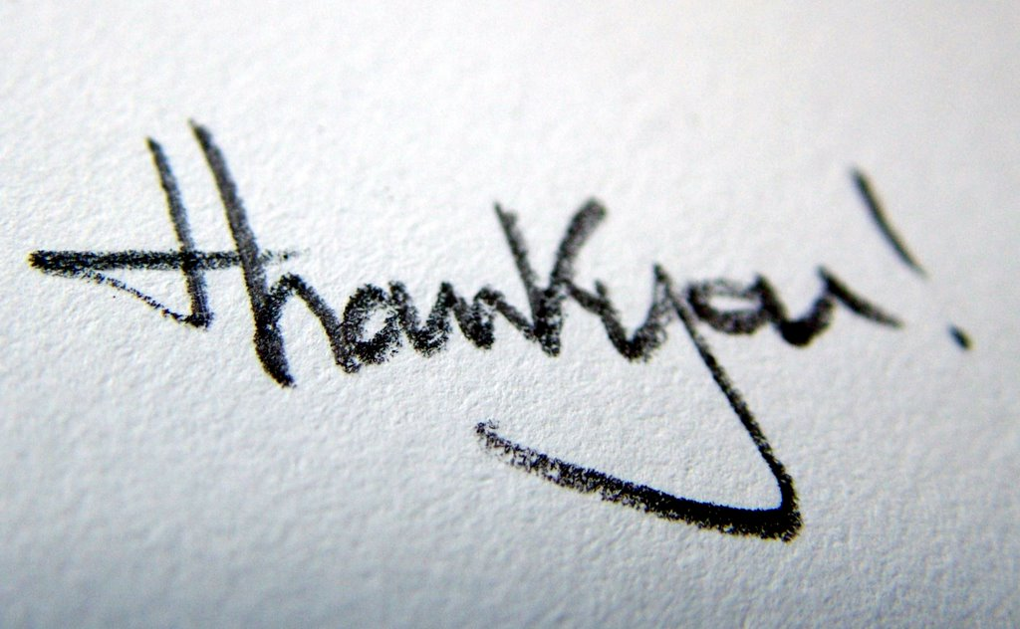
For listening & appreciating the importance of subject for yourself

