Slide 1
So what is HIPAA?
Health Insurance Portability and Accountability Act of 1996 (PL 104-191)
FEDERAL legislation
It’s actually an amendment to the Internal Revenue Code of 1986 which should tell you all you want to know

Slide 2
What is EDI?
Electronic Data Interchange
Standardized electronic exchange of data between computers
Way of arranging data so a computer can read it
No human intervention
Transact business quickly, cost effectively

Slide 3
Why EDI, Security, and Privacy Requirements?
EDI – Improves efficiency, effectiveness of electronic exchange of administrative/financial data
  Electronic Transactions and Code Sets – Mandates standard codes and transaction formats
  Unique Identifiers - Providers will have one ID number
Security – Defines process and technology standards for electronic protected health information
Privacy – Defines rights of individuals and responsibilities of providers, health plans

Slide 4
Electronic Data Exchanges
Eligibility Inquiry - 270
H
E
A
L
T
H
P
L
A
N
S
Plan Enrollment - 834
P
R
O
V
I
D
E
R
S
S
P
O
N
S
O
R
S
Eligibility Response - 271
Premium Payment - 820
Request for Authorization- 278
Approval of Authorization- 278
Claims / encounters 837
[Claim Attachment - 275]
Claims Status Inquiry - 276
Claims Status Response -277
Remittance - 835

Slide 5
What Is a HIPAA Transaction?
A method of moving data in a standard way electronically between healthcare entities
HIPAA transactions expand on existing standards
Standard transactions provide more consistency and efficiency

Slide 6
HIPAA Standard Transactions
Claims
Payment and remittance advice
Claim status inquiry and response
Referral certification and authorization inquiry and response
Enrollment and disenrollment in a health plan
Health Plan premium payments
Coordination of benefits
Claims attachments (under development)
First report of injury (under development)

Slide 7
HIPAA Standard Code Sets
Medical code sets include:
  ICD-9CM International Code for Diseases
  CPT-4/HCPCS alphanumeric Healthcare Common Procedure Coding System
  NDC National Drug Code
Non-medical
  Gender, race
  Claim adjustment reason codes
No “local codes”

Slide 8

ISA*00* *00* **ZZ*003000 *ZZ*WHY INC
*020524*1718*U*00401*000000001*0*T:~
GS*HC*0003000*WHY INC*20030114*1615*1*X*004010X098~
ST*837*0001~
BHT*0019*00*0001*2003014*1645*CH~
REF*87*004010X098~
MN1*41*2*MARY SMITH CLEARINGHOUSE*****46*0003000~
PER*IC*MARY SMITH*TE*9135551234*FX*6123334567*ED*6125559876~
NM!*40*2*MEDICARE PART B*****46* WHY INC~
HL*1*20*1~
MNI*85*2*EYEBALL SURGERY ASSOCIATES*****24*123456789~
N3*PO BOX 1234~
N$*SALISBURY*MO*660453565*US~
REF*1C*09876~
PER*1C*BILLING PROVIDER CONTACT OFFICE NURSE*TE*9135551234*FX*
6123334567TE* 6125559876~
HL*2*1*22*0~
SBR*P*18**MEDICARE PART B*****MB~
NM!*IL*1*BENNING*CARRIE****MI*134-56-7890A~
N3*PO BOX 123~
N4*NEOMA*MO*67799*US~
DMB*D8*19330324*M~
MN1*PR*2*MEDICARE PART B*****PI*00065~
N3*1000 MAIN ST~
N$*ST LOUIS*MO*66666*US~
CLM*MEDBGOOD-MIS1*1500***11::1*Y*C*Y*Y*B******P~
RE*X4*32D1234567~
NTE*ADD*CLAIM NOTE TEXT~
HI*BK:3999~
NM1*DN*1*FOLLARD*BEN*J**M.D.*24-111223333~
PRV*RF*ZZ*101Y00000N~
RED*1C*B11277
NM!*82*1*TREPED*HOWARD****24*88899-1111~
PRV*PE*ZZ*101Y00000N~
RED*1C*2327870~
LX*1
SV1*HC:99213*15000*UN*1*11**1:::**N~
DTP*472*DB*81298399~
RE*X4*32D1234567~
SE*36*0001~
GE*1*1~
IEA*1*000000001~
What Your Computer Sees
During an 837 Transaction

Slide 9
Green Cross
Professional Claims
Professional Claims
Professional Claims
A series of envelopes
Dr Smith
Dr Smith
Dr Smith
Patient
Patient
Patient
Claim
Claim
Claim
Claim
Line Item
Information
Line 1
Line 2
Line 3
Line 1
Line 2
Line 3
Line 1
Line 2
Line 3

Slide 10
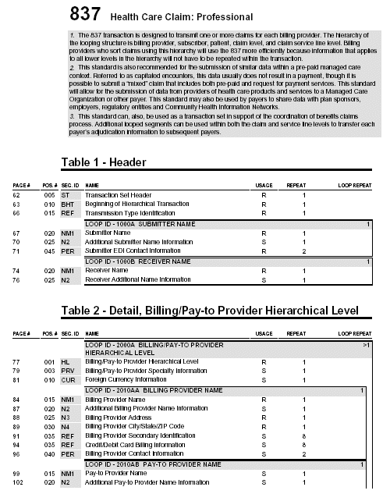
Implementation Guide

Slide 11
XML Layout
ISA
  GS
    ST
    SE
  GE
IEA

Slide 12
Claims Attachment Transaction
ISA X12 Interchange Control Header
GS X12 Functional Group Header
ST 275 X12 Transaction Set Header for Pt. Info.
...
TRN
...
BIN X12 Binary segment contains HL7 message
MSH ORU HL7 Message Header for Observed Result
...
OBX HL7 Codified Result Value
| | | | | multiple iterations
OBX HL7 Codified Result Value
SE X12 Transaction Set Trailer
GE X12 Functional Group Trailer
IEA X12 Interchange Control Trailer

Slide 13
Data Segment vs. Database Field
DTM*002*20040723
Delivery Requested Date
07/23/2004

Slide 14
Data Segment Group or Loop vs. Database Record
ST*850*00023
BEG*00*SA*0101
DTM*002*20040723
Message No | Purchase Order No | Delivery Requested Date
0023 | 0101 | 07/23/2004

Slide 15
Loops vs. Database Table
ST*850*00023
BEG*00*SA*0101
DTM*002*20040723
…
SE
…
ST*850*00024
BEG*00*SA*0102
DTM*002*20040723
…
SE
…
ST*850*00025
BEG*00*SA*0107
DTM*002*20040723 ……

Slide 16
Loops vs. Single Database Table
Message No | Purchase Order No | Delivery Requested Date
0023 | 0101 | 07/23/2004
0024 | 0102 | 07/23/2004
0025 | 0107 | 07/23/2004

