Slide 1
What is Six Sigma?

Slide 2
Basics
A new way of doing business
Wise application of statistical tools within a structured methodology
Repeated application of strategy to individual projects
Projects selected that will have a substantial impact on the ‘bottom line’

Slide 3
Six Sigma
A scientific and practical method to achieve improvements in a company
Scientific:
Structured approach.
Assuming quantitative data.
Practical:
Emphasis on financial result.
Start with the voice of the customer.
“Show me
the data”
”Show me
the money”

Slide 4
Where can Six Sigma be applied?
Service
Design
Management
Purchase
Administration
Six Sigma Methods
Production
IT
Quality
Depart.
HRM
M & S

Slide 5


The Six Sigma Initiative
integrates these efforts
SPC
Improvement teams
Problem
Solving teams
Strategic
planning
Knowledge
Management
ISO 9000
DOE
Benchmarking
and more

Slide 6




‘Six Sigma’ companies
Companies who have successfully adopted ‘Six Sigma’ strategies include:

Slide 7
GE “Service company” - examples
Approving a credit card application
Installing a turbine
Lending money
Servicing an aircraft engine
Answering a service call for an appliance
Underwriting an insurance policy
Developing software for a new CAT product
Overhauling a locomotive

Slide 8
General Electric
In 1995 GE mandated each employee to work towards achieving 6 sigma
The average process at GE was 3 sigma in 1995
In 1997 the average reached 3.5 sigma
GE’s goal was to reach 6 sigma by 2001
Investments in 6 sigma training and projects reached 45MUS$ in 1998, profits increased by 1.2BUS$
“the most important initiative GE has ever undertaken”.
Jack Welch
Chief Executive Officer
General Electric

Slide 9
MOTOROLA
“At Motorola we use statistical methods daily throughout all of our disciplines to synthesize an abundance of data to derive concrete actions….
How has the use of statistical methods within Motorola Six Sigma initiative, across disciplines, contributed to our growth? Over the past decade we have reduced in-process defects by over 300 fold, which has resulted in cumulative manufacturing cost savings of over 11 billion dollars”*.
Robert W. Galvin
Chairman of the Executive Committee
Motorola, Inc.
*From the forward to MODERN INDUSTRIAL STATISTICS by Kenett and Zacks, Duxbury, 1998

Slide 10
Positive quotations
“If you’re an average Black Belt, proponents say you’ll find ways to save $1 million each year”
“Raytheon figures it spends 25% of each sales dollar fixing problems when it operates at four sigma, a lower level of efficiency. But if it raises its quality and efficiency to Six Sigma, it would reduce spending on fixes to 1%”
“The plastics business, through rigorous Six Sigma process work , added 300 million pounds of new capacity (equivalent to a ‘free plant’), saved $400 million in investment and will save another $400 million by 2000”

Slide 11
Negative quotations
“Because managers’ bonuses are tied to Six Sigma savings, it causes them to fabricate results and savings turn out to be phantom”
“Marketing will always use the number that makes the company look best …Promises are made to potential customers around capability statistics that are not anchored in reality”
“ Six Sigma will eventually go the way of the other fads”

Slide 12
Barriers to implementation
Barrier #1: Engineers and managers are not interested in mathematical statistics
Barrier #2: Statisticians have problems communicating with managers and engineers
Barrier #3: Non-statisticians experience “statistical anxiety” which has to be minimized before learning can take place
Barrier # 4: Statistical methods need to be matched to management style and organizational culture

Slide 13
MBB
BB
Master Black Belts
Statisticians
Black Belts
Technical Skills
Quality Improvement Facilitators
Soft Skills
Notes:
17

Slide 14
Reality
Six Sigma through the correct application of statistical tools can reap a company enormous rewards that will have a positive effect for years
or
Six Sigma can be a dismal failure if not used correctly
ISRU, CAMT and Sauer Danfoss will ensure the former occurs

Slide 15
Six Sigma
The precise definition of Six Sigma is not important; the content of the program is
A disciplined quantitative approach for improvement of defined metrics
Can be applied to all business processes, manufacturing, finance and services

Slide 16
Focus of Six Sigma*
Accelerating fast breakthrough performance
Significant financial results in 4-8 months
Ensuring Six Sigma is an extension of the Corporate culture, not the program of the month
Results first, then culture change!
*Adapted from Zinkgraf (1999), Sigma Breakthrough
Technologies Inc., Austin, TX.

Slide 17
Six Sigma: Reasons for Success
The Success at Motorola, GE and AlliedSignal has been attributed to:
  Strong leadership (Jack Welch, Larry Bossidy and Bob Galvin personally involved)
  Initial focus on operations
  Aggressive project selection (potential savings in cost of poor quality > $50,000/year)
  Training the right people

Slide 18
The right way!
Plan for “quick wins”
  Find good initial projects - fast wins
Establish resource structure
  Make sure you know where it is
Publicise success
  Often and continually - blow that trumpet
Embed the skills
  Everyone owns successes

Slide 19
The Six Sigma metric

Slide 20
Consider a 99% quality level
5000 incorrect surgical operations per week!
200,000 wrong drug prescriptions per year!
2 crash landings at most major airports each day!
20,000 lost articles of mail per hour!

Slide 21
Not very satisfactory!
Companies should strive for ‘Six Sigma’ quality levels
A successful Six Sigma programme can measure and improve quality levels across all areas within a company to achieve ‘world class’ status
Six Sigma is a continuous improvement cycle

Slide 22
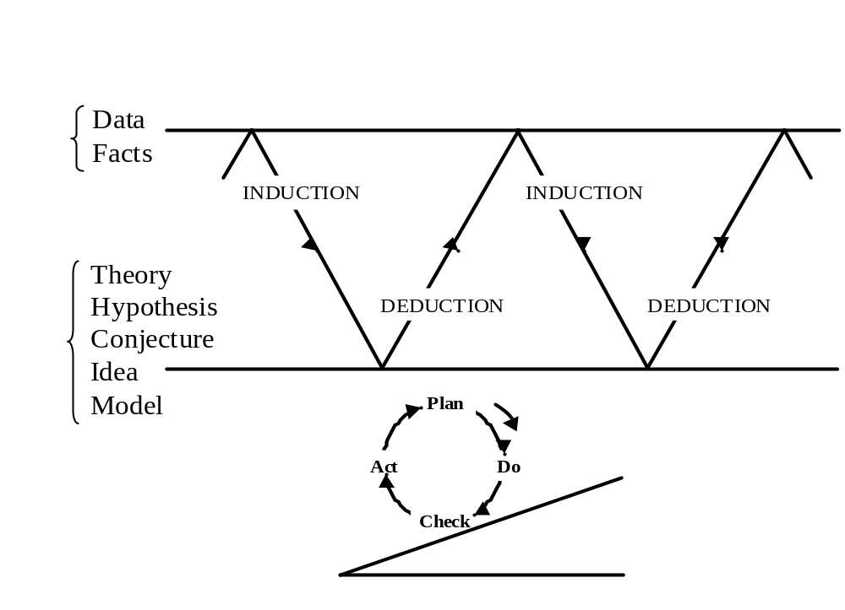
Scientific method (after Box)

Slide 23
Improvement cycle
PDCA cycle
Plan
Act
Do
Check

Slide 24
Alternative interpretation
Prioritise (D)
Hold
gains (C)
Measure (M)
Improve (I)
Interpret
(D/M/A)
Problem (D/M/A)
solve

Slide 25
Statistical background
Some Key measure
Target = μ

Slide 26
Statistical background
‘Control’ limits
+
/
−
3
σ
Target = μ

Slide 27
Statistical background
Required Tolerance
L
S
L
U
S
L
+
/
−
3
σ
Target = μ

Slide 28
Statistical background
Tolerance
L
S
L
U
S
L
+
/
−
3
σ
Target = μ
+
/
−
6
σ
Six-Sigma

Slide 29
Statistical background
Tolerance
L
S
L
U
S
L
+
/
−
3
σ
1
3
5
0
1
3
5
0
p
p
m
p
p
m
Target = μ
+
/
−
6
σ

Slide 30
Statistical background
Tolerance
L
S
L
U
S
L
+
/
−
3
σ
1
3
5
0
1
3
5
0
0
.
0
0
1
p
p
m
p
p
m
0
.
0
0
1
p
p
m
p
p
m
Target = μ
+
/
−
6
σ

Slide 31
Statistical background
Six-Sigma allows for un-foreseen ‘problems’ and longer term issues when calculating failure error or re-work rates
Allows for a process ‘shift’

Slide 32
Statistical background
Tolerance
L
S
L
1
.
5
σ
U
S
L
3
.
4
6
6
8
0
3
0
p
p
m
p
p
m
p
p
m
3
.
4
p
p
m
μ
+
/
−
6
σ

Slide 33
Performance Standards
σ
PPM
Yield
2
3
4
5
6
308537
66807
6210
233
3.4
69.1%
93.3%
99.38%
99.977%
99.9997%
Current standard
World Class
Process
performance
Defects per
million
Long term
yield

Slide 34
Performance standards
First Time Yield in multiple stage process
Number of processes
3σ
4σ
5σ
6σ
1
10
100
500
1000
2000
2955
93.32
50.09
0.1
0
0
0
0
99.379
93.96
53.64
4.44
0.2
0
0
99.9767
99.77
97.70
89.02
79.24
62.75
50.27
99.99966
99.9966
99.966
99.83
99.66
99.32
99.0

Slide 35
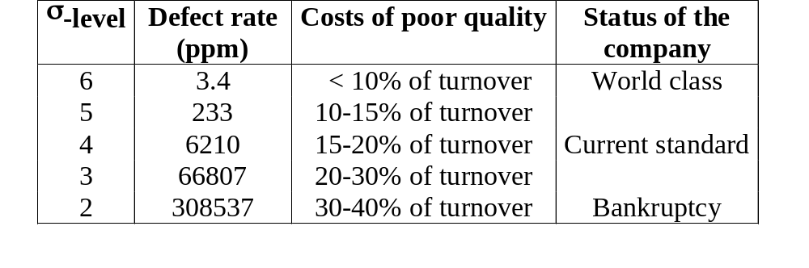
Financial Aspects
Benefits of 6σ approach w.r.t. financials

Slide 36
Six Sigma and other Quality programmes

Slide 37
Comparing three recent developments in “Quality Management”
ISO 9000 (-2000)
EFQM Model
Quality Improvement and Six Sigma Programs

Slide 38
ISO 9000
Proponents claim that ISO 9000 is a general system for Quality Management
In fact the application seems to involve
  an excessive emphasis on Quality Assurance, and
  standardization of already existing systems with little attention to Quality Improvement
It would have been better if improvement efforts had preceded standardization

Slide 39
Critique of ISO 9000
Bureaucratic, large scale
Focus on satisfying auditors, not customers
Certification is the goal; the job is done when certified
Little emphasis on improvement
The return on investment is not transparent
Main driver is:
  We need ISO 9000 to become a certified supplier,
  Not “we need to be the best and most cost effective supplier to win our customer’s business”
Corrupting influence on the quality profession

Slide 40
EFQM Model
A tool for assessment: Can measure where we are and how well we are doing
Assessment is a small piece of the bigger scheme of Quality Management:
  Planning
  Control
  Improvement
EFQM provides a tool for assessment, but no tools, training, concepts and managerial approaches for improvement and planning

Slide 41
The “Success” of Change Programs?
“Performance improvement efforts …
have as much impact on
operational and financial results as a
ceremonial rain dance has on the weather”
Schaffer and Thomson,
Harvard Business Review (1992)

Slide 42
Change Management:
Two Alternative Approaches
Activity Centered
Programs
Change
Management
Result Oriented
Programs
Reference: Schaffer and Thomson, HBR, Jan-Feb. 1992

Slide 43
Activity Centered Programs
Activity Centered Programs: The pursuit of activities that sound good, but contribute little to the bottom line
Assumption: If we carry out enough of the “right” activities, performance improvements will follow
  This many people have been trained
  This many companies have been certified
Bias Towards Orthodoxy: Weak or no empirical evidence to assess the relationship between efforts and results

Slide 44
No Checking with Empirical Evidence, No Learning Process
ISO 9000
Data
Deduction
Induction
Hypothesis

Slide 45
An Alternative:
Result-Driven Improvement Programs
Result-Driven Programs: Focus on achieving specific, measurable, operational improvements within a few months
Examples of specific measurable goals:
  Increase yield
  Reduce delivery time
  Increase inventory turns
  Improved customer satisfaction
  Reduce product development time

Slide 46
Result Oriented Programs
Project based
Experimental
Guided by empirical evidence
Measurable results
Easier to assess cause and effect
Cascading strategy

Slide 47
Why Transformation
Efforts Fail!
John Kotter, Professor, Harvard Business School
Leading scholar on Change Management
Lists 8 common errors in managing change, two of which are:
  Not establishing a sense of urgency
  Not systematically planning for and creating short term wins

Slide 48
Six Sigma Demystified*
Six Sigma is TQM in disguise, but this time the focus is:
  Alignment of customers, strategy, process and people
  Significant measurable business results
  Large scale deployment of advanced quality and statistical tools
  Data based, quantitative
*Adapted from Zinkgraf (1999), Sigma Breakthrough
Technologies Inc., Austin, TX.

Slide 49
Keys to Success*
Set clear expectations for results
Measure the progress (metrics)
Manage for results
*Adapted from Zinkgraf (1999), Sigma Breakthrough
Technologies Inc., Austin, TX.

Slide 50
Key personnel in successful Six Sigma programmes

Slide 51
Black Belts
Six Sigma practitioners who are employed by the company using the Six Sigma methodology
work full time on the implementation of problem solving & statistical techniques through projects selected on business needs
become recognised ‘Black Belts’ after embarking on Six Sigma training programme and completion of at least two projects which have a significant impact on the ‘bottom-line’

Slide 52
Black Belt requirements
Black Belt required resources
Training in statistical methods.
Time to conduct the project!
Software to facilitate data analysis.
Permissions to make required changes!!
Coaching by a champion – or external support.

Slide 53
Black Belt role!
In other words the Black Belt is
Empowered.
In the sense that it was always meant!
As the theroists have been saying for years!

Slide 54
Champions or ‘enablers’
High-level managers who champion Six Sigma projects
they have direct support from an executive management committee
orchestrate the work of Six Sigma Black Belts
provide Black Belts with the necessary backing at the executive level

Slide 55
Further down the line - after initial Six Sigma implementation package
Master Black Belts
Black Belts who have reached an acquired level of statistical and technical competence
Provide expert advice to Black Belts
Green Belts
Provide assistance to Black Belts in Six Sigma projects
Undergo only two weeks of statistical and problem solving training

Slide 56
Six Sigma instructors (ISRU)
Aim: Successfully integrate the Six Sigma methodology into a company’s existing culture and working practices
Key traits
Knowledge of statistical techniques
Ability to manage projects and reach closure
High level of analytical skills
Ability to train, facilitate and lead teams to success, ‘soft skills’

Slide 57
Six Sigma training package

Slide 58
Aim of training package
To successfully integrate Six Sigma methodology into Sauer Danfoss’ culture and attain significant improvements in quality, service and operational performance

Slide 59
Six-Sigma - A “Roadmap” for improvement
Define
Select a project
Measure
Prepare for assimilating information
Analyze
Characterise the current situation
Improve
Optimize the process
Control
Assure the improvements
DMAIC

Slide 60
Example of a Classic Training strategy
Define
Throughput time project
Measure
4 months (full time)
Analyze
Training (1 week)
Improve
Work on project
(3 weeks)
Control
Review

Slide 61
ISRU program content
Week 1 - Six Sigma introductory week (Deployment phase)
Weeks 2-5 - Main Black Belt training programme
Week 2 - Measurement phase
Week 3 - Analysis phase
Week 4 - Improve phase
Week 5 - Control phase
Project support for Six Sigma Black Belt candidates
Access to ISRU’s distance learning facility

Slide 62
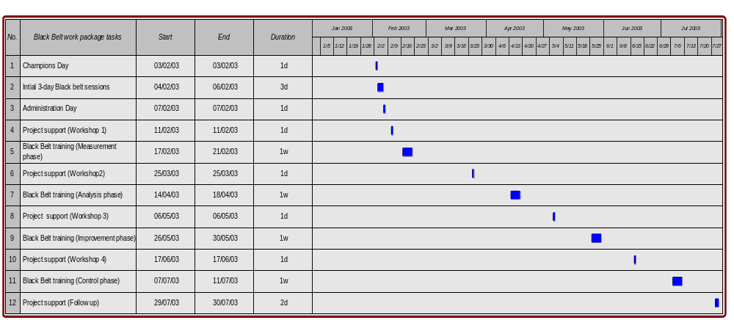
Draft training schedule

Slide 63
Training programme delivery
Lectures supported by appropriate technology
Video case studies
Games and simulations
Experiments and workshops
Exercises
Defined projects
Delegate presentations
Homework!

Slide 64
5 weeks of training
Define
Measure
Analyze
Improve
Control

Slide 65
Deployment (Define) phase
Topics covered include
Team Roles
Presentation skills
Project management skills
Group techniques
Quality
Pitfalls to Quality Improvement projects
Project strategies
Minitab introduction

Slide 66
Measurement phase
Topics covered include:
Quality Tools
Risk Assessment
Measurements
Capability & Performance
Measurement Systems Analysis
Quality Function Deployment
FMEA

Slide 67
Example - QFD
A method for meeting customer requirements
Uses tools and techniques to set product strategies
Displays requirements in matrix diagrams, including ‘House of Quality’
Produces design initiatives to satisfy customer and beat competitors

Slide 68
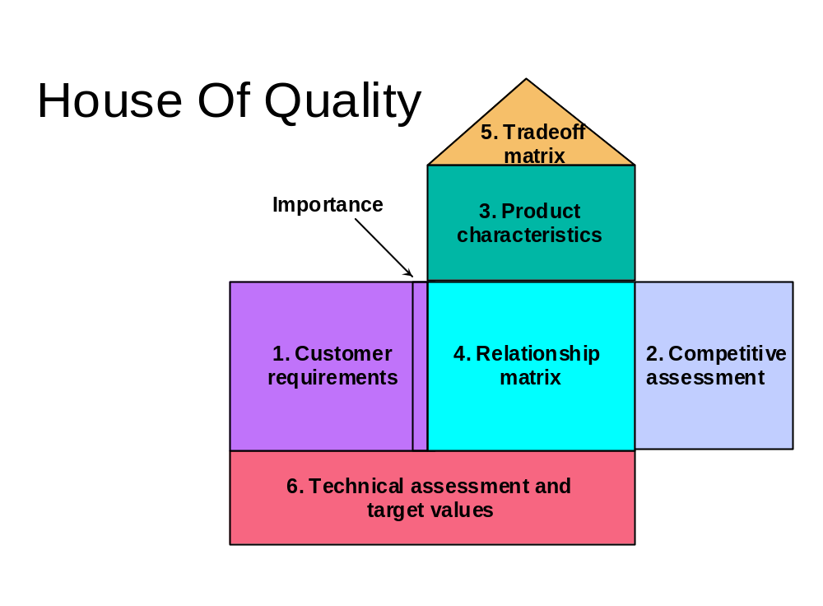

Slide 69

QFD can reduce
Lead-times - the time to market and time to stable production
Start-up costs
Engineering changes

Slide 70
Analysis phase
Topics include:
Hypothesis testing
Comparing samples
Confidence Intervals
Multi-Vari analysis
ANOVA (Analysis of Variance)
Regression

Slide 71
Improvement phase
Topics include:
History of Design of Experiments (DoE)
DoE Pre-planning and Factors
DoE Practical workshop
DoE Analysis
Response Surface Methodology (Optimisation)
Lean Manufacturing

Slide 72
Example - Design of Experiments
What can it do for you?
Minimum cost
Maximum output

Slide 73
What does it involve?
Brainstorming sessions to identify important factors
Conducting a few experimental trials
Recognising significant factors which influence a process
Setting these factors to get maximum output

Slide 74
Control phase
Topics include:
Control charts
SPC case studies
EWMA
Poka-Yoke
5S
Reliability testing
Business impact assessment

Slide 75
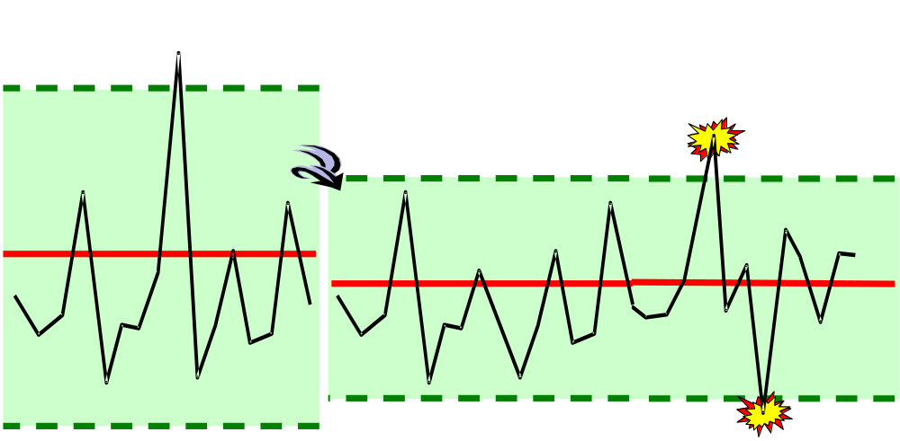
Example - SPC (Statistical Process Control)
- reduces variability and keeps the process stable
Disturbed process
Temporary upsets
Natural process
Natural boundary
Natural boundary

Slide 76
Results of SPC
An improvement in the process
Reduction in variation
Better control over process
Provides practical experience of collecting useful information for analysis
Hopefully some enthusiasm for measurement!

Slide 77
Project support
Initial ‘Black Belt’ projects will be considered in Week 1 by Executive management committee, ‘Champions’ and ‘Black Belt’ candidates
Projects will be advanced significantly during the training programme via:
continuous application of newly acquired statistical techniques
workshops and on-going support from ISRU and CAMT
delivery of regular project updates by ‘Black Belt’ candidates

Slide 78
Project execution
Black Belt
Review
Training
ISRU,
Champion
ISRU
Application
ISRU,
Champion

Slide 79
Conducting projects
Traditional
Six Sigma
Project leader is obliged to make an effort.
Set of tools .
Focus on technical knowledge.
Project leader is left to his own devices.
Results are fuzzy.
Safe targets.
Projects conducted “on the side”.
Black Belt is obliged to achieve financial results.
Well-structured method.
Focus on experimentation.
Black Belt is coached by champion.
Results are quantified.
Stretched targets.
Projects are top priority.

Slide 80
The right support
+
The right projects
+
The right people
+
The right tools
+
The right plan
=
The right results

Slide 81
Champions Role
Communicate vision and progress
Facilitate selecting projects and people
Track the progress of Black Belts
Breakdown barriers for Black Belts
Create supporting systems

Slide 82
Champions Role
Measure and report Business Impact
Lead projects overall
Overcome resistance to Change
Encourage others to Follow

Slide 83
Project selection
Define
Select:
- the project
the process
the Black Belt
the potential savings
time schedule
team

Slide 84
Project selection
Projects may be selected according to:
A complete list of requirements of customers.
A complete list of costs of poor quality.
A complete list of existing problems or targets.
Any sensible meaningful criteria
Usually improves bottom line - but exceptions

Slide 85
Key Quality Characteristics “CTQs”
How will you measure them?
How often?
Who will measure?
Is the outcome critical or important to results?

Slide 86
Outcome Examples
Reduce defective parts per million
Increased capacity or yield
Improved quality
Reduced re-work or scrap
Faster throughput

Slide 87
Key Questions
Is this a new product - process?
Yes - then potential six-sigma
Do you know how best to run a process?
No - then potential six-sigma

Slide 88
Key Criteria
Is the potential gain enough - e.g. - saving > $50,000 per annum?
Can you do this within 3-4 months?
Will results be usable?
Is this the most important issue at the moment?

Slide 89
Why is ISRU an effective Six Sigma practitioner?

Slide 90
Reasons
Because we are experts in the application of industrial statistics and managing the accompanying change
We want to assist companies in improving performance thus helping companies to greater success
We will act as mentors to staff embarking on Six Sigma programmes

Slide 91


INDUSTRIAL STATISTICS
RESEARCH UNIT
We are based in the School of Mechanical and Systems Engineering, University of Newcastle upon Tyne, England

Slide 92
Mission statement
"To promote the effective and widespread use of statistical methods throughout European industry."

Slide 93

The work we do can be broken down into 3 main categories:
Consultancy
Training
Major Research Projects
All with the common goal of promoting quality improvement by implementing statistical techniques

Slide 94
Consultancy
We have long term one to one consultancies with large and small companies, e.g.
Transco
Prescription Pricing Agency
Silverlink
To name but a few

Slide 95
Training
In-House courses
SPC
QFD
Design of Experiments
Measurement Systems Analysis
On-Site courses
As above, tailored courses to suit the company
Six Sigma programmes

Slide 96

European projects
The Unit has provided the statistical input into many major European projects
Examples include -
Use of sensory panels to assess butter quality
Using water pressures to detect leaks
Assessing steel rail reliability
Testing fire-fighter’s boots for safety

Slide 97

European projects
Eurostat - investigating the multi-dimensional aspects of innovation using the Community Innovation Survey (CIS) II
- 17 major European countries involved -determining the factors that influence innovation
Certified Reference materials for assessing water quality - validating EC Laboratories
New project - ‘Effect on food of the taints
and odours in packaging materials’

Slide 98

Typical local projects
Assessment of environmental risks in chemical and process industries
Introduction of statistical process control (SPC) into a micro-electronics company
Helping to develop a new catheter for open-heart surgery via designed experiments (DoE)
‘Restaurant of the Year’ & ‘Pub of the Year’ competitions!

Slide 99

Benefits
Better monitoring of processes
Better involvement of people
Staff morale is raised
Throughput is increased
Profits go up

Slide 100
Examples of past successes
Down time cut by 40% - Villa soft drinks
Waste reduced by 50% - Many projects
Stock holding levels halved - Many projects
Material use optimised saving £150k pa - Boots
Expensive equipment shown to be unnecessary - Wavin

Slide 101
Examples of past successes
Faster Payment of Bills (cut by 30 days)
Scrap rates cut by 80%
New orders won (e.g £100,000 for an SME)
Cutting stages from a process
Reduction in materials use (Paper - Ink)

Slide 102
Distance Learning Facility

Slide 103

Distance Learning
Statistical Process
Control
or Flexible training
or Open Learning
Designed Experiments
your time
your place
your study pattern
your pace
Problem Solving

Slide 104
Distance Learning
http://www.ncl.ac.uk/blackboard
Clear descriptions
Step by step guidelines
Case studies
Web links, references
Self assessment exercises in ‘Microsoft Excel’ and ‘Minitab’
Help line and discussion forum
Essentially a further learning resource for Six Sigma tools and methodology

Slide 105
Case study

Slide 106
Case study: project selection
Savings:
Savings on rework and scrap
Water costs less than coffee
Potential savings:
500 000 Euros
Coffee
beans
Roast
Cool
Grind
Moisture content
Pack
Sealed
coffee

Slide 107
Case study: Measure
Select the Critical to Quality (CTQ) characteristic
Define performance standards
Validate measurement system

Slide 108
Case study: Measure
1. CTQ
Moisture contents of
roasted coffee
2. Standards
Unit: one batch
Defect: Moisture% > 12.6%
Notes:
Operational definition of CTQ: measurement procedure + reliability/validity -> better measurement system!
Operational definition of requirements
Current performance
Objective

Slide 109
Case study: Measure
3. Measurement reliability
Gauge R&R study
Measurement system too unreliable!
So fix it!!

Slide 110
Case study: Analyse
Analyse
4. Establish product capability
5. Define performance objectives
6. Identify influence factors

Slide 111
Improvement opportunities
USL
USL

Slide 112
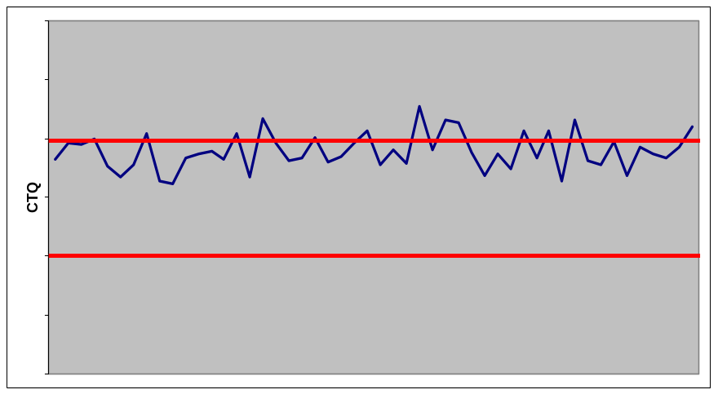
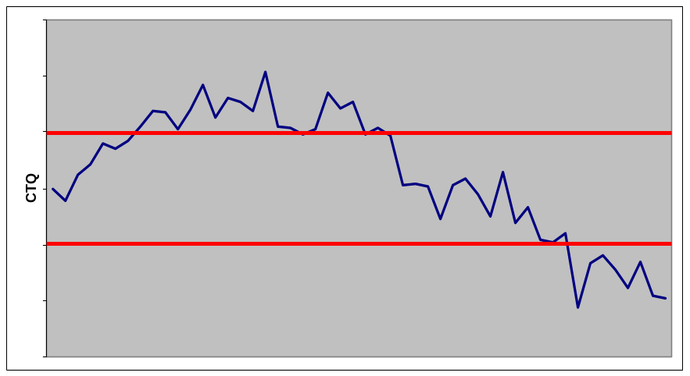
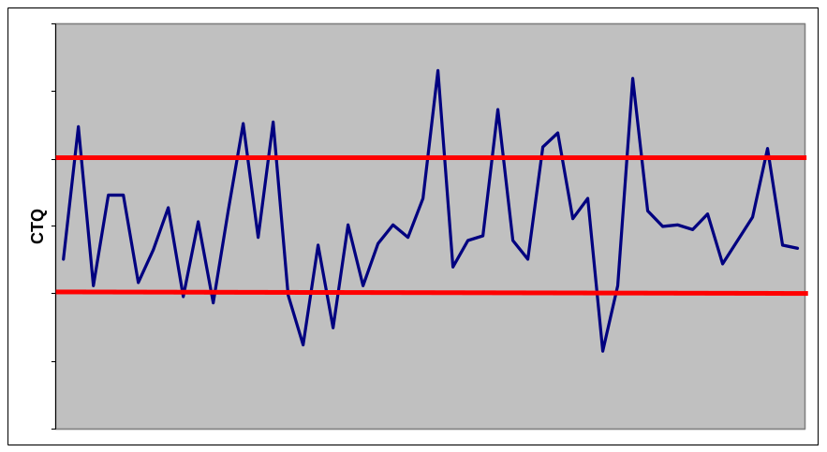
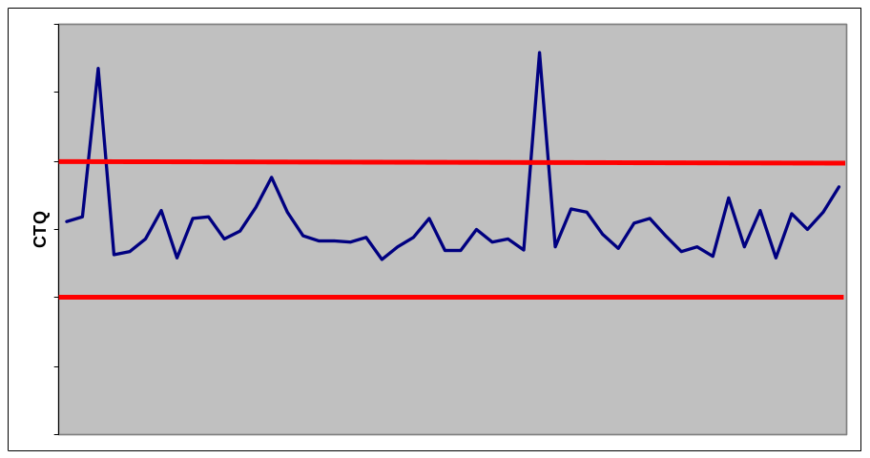
Diagnosis of problem

Slide 113
Discovery of causes
6. Identify factors
Man
Machine
Material
Brainstorming
Exploratory data analysis
Roasting
machines
Batch
size
Moisture%
Amount of
Reliability
Weather
added water
of Quadra Beam
conditions
Method
Measure-
Mother
ment
Nature

Slide 114
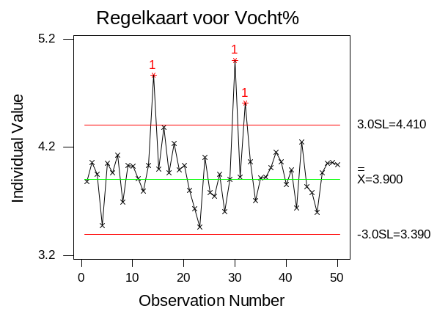
Discovery of causes
Control chart for moisture%

Slide 115
A case study
Potential influence factors
Roasting machines (Nuisance variable)
Weather conditions (Nuisance variable)
Stagnations in the transport system (Disturbance)
Batch size (Nuisance variable)
Amount of added water (Control variable)

Slide 116
Case study: Improve
Improve
7. Screen potential causes
8. Discover variable relationships
9. Establish operating tolerances

Slide 117
Case study: Improve
7. Screen potential causes
Relation between humidity and moisture% not established
Effect of stagnations confirmed
Machine differences confirmed
8. Discover variable relationships
Design of Experiments (DoE)

Slide 118
Experimentation
How do we often conduct experiments?
Experiments are run based on:
Intuition
Knowledge
Experience
Power
Emotions
X
X
X: Settings with which
an experiment is run.
X
Possible settings for X₂
X
X
Actually:
we’re just trying
unsystematical
no design/plan
X
X
Possible settings for X₁

Slide 119
Experimentation
A systematical experiment:
Organized / discipline
One factor at a time
Other factors kept constant
X
Procedure:
X: First vary X₁; X₂ is kept constant
O: Optimal value for X₁.
X: Vary X₂; X₁ is kept constant.
: Optimal value (???)
X
X
Possible settings for X₂
X
X
X
X
X
X
X
O
X
X
X
X
X
X
Possible settings for X₁

Slide 120
Design of Experiments (DoE)
One factor (X)
X₁
1
2
low
high
Two factors (X’s)
Three factors (X’s)
high
high
X₂
2
2
3
2
X₂
X₁
low
high
X₃
X₁
low
high

Slide 121
Advantages of multi-factor over one-factor

Slide 122
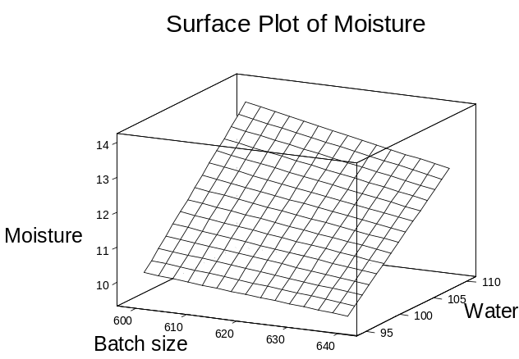
A case study: Experiment
Experiment:
Y: moisture%
X₁: Water (liters)
X₂: Batch size (kg)

Slide 123
A case study
9. Establish operating tolerances
Feedback adjustments for influence of weather conditions

Slide 124
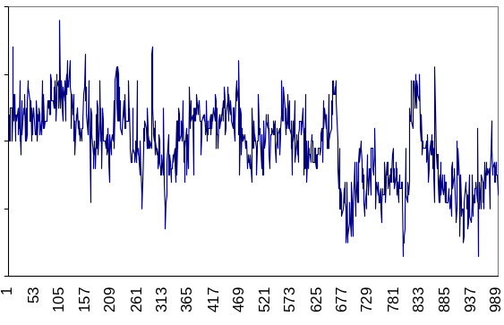
A case study: feedback adjustments
Moisture% without adjustments

Slide 125
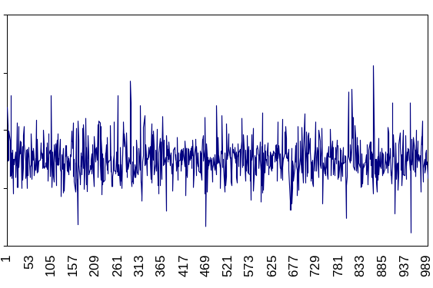
A case study: feedback adjustments
Moisture% with adjustments

Slide 126
Case study: Control
Control
10. Validate measurement system (X’s)
11. Determine process capability
12. Implement process controls

Slide 127
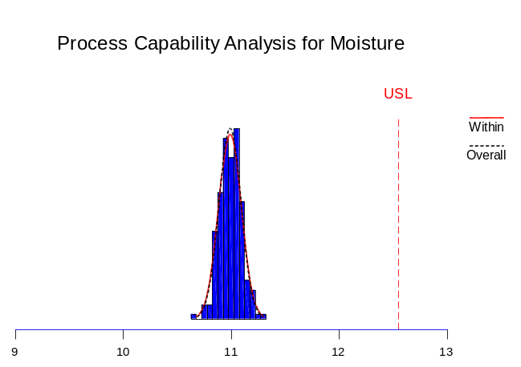
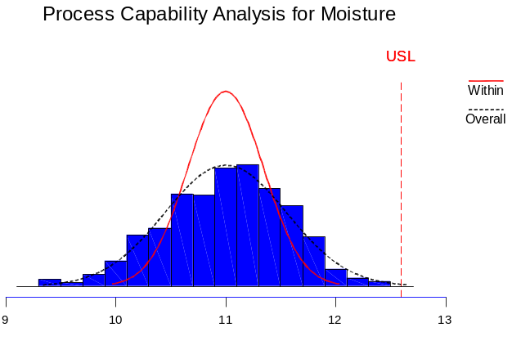
Results
Before
σ_{long-term} = 0.532
Objective
σ_{long-term} < 0.280
Result
σ_{long-term} < 0.100

Slide 128
Benefits
Benefits of this project
σ_{long-term} < 0.100
P_{pk} = 1.5
This enables us to increase the mean to 12.1%
Per 0.1% coffee: 100 000 Euros saving
Benefits of this project:
1 100 000 Euros per year
Approved by controller

Slide 129
Case study: control
12. Implement process controls
SPC control loop
Mistake proofing
Control plan
Audit schedule
Project closure
Documentation of the results and data.
Results are reported to involved persons.
The follow-up is determined

Slide 130
Six Sigma approach to this project
Step-by-step approach.
Constant testing and double checking.
No problem fixing, but: explanation → control.
Interaction of technical knowledge and experimentation methodology.
Good research enables intelligent decision making.
Knowing the financial impact made it easy to find priority for this project.

Slide 131
Re-cap I!
Structured approach – roadmap
Systematic project-based improvement
Plan for “quick wins”
  Find good initial projects - fast wins
Publicise success
  Often and continually - blow that trumpet
Use modern tools and methods
Empirical evidence based improvement

Slide 132
Re-cap II!
DMAIC is a basic ‘training’ structure
Establish your resource structure
- Make sure you know where external help is
Key ingredient is the support for projects
- It’s the project that ‘wins’ not the training itself
Fit the training programme around the company needs
- not the company around the training
Embed the skills
- Everyone owns the successes

Slide 133
ENBIS
All joint authors - presenters - are members of:
Pro-Enbis or ENBIS.
This presentation is supported by Pro-Enbis a Thematic Network funded under the ‘Growth’ programme of the European Commission’s 5th Framework research programme - contract number G6RT-CT-2001-05059

