Slide 1

System Engineering
Process Improvement
In Today’s Life Cycle Context
Mike Bloom, Joe Duquette
Organization: ESC/EN
Version 2.2

Slide 2
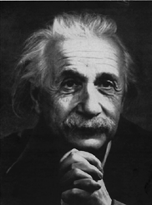
“The only source of
knowledge is experience”
A. Einstein
We Need to Leverage Our Process
Experience and Use It To Succeed

Slide 3
Purpose
Define the life cycle and life cycle attributes that the
EN CMMI System Engineering Process Improvement Program
will apply to and operate in.
The life-cycle for the C² Product Line
is unique and complex

Slide 4
Major ESC Life Cycle Challenges
Acquisition Environment
- Shared responsibilities
Enterprise Architecture
- External requirements beyond the product function
Life Cycle and Spiral
- Simultaneous life-cycle phases - including O&M
Stakeholders
- Many external stakeholders - continuously involved
Our System Engineering Processes
Need to Address These Challenges

Slide 5
ESC Life Cycle Focus
We are spending increasing effort on each
of our programs responding to daily crises
and asynchronous initiatives - it is consuming
We need to devote our energy on the programs to
product innovation not process reinvention.
EN’s CMMI based processes are built to
meet the C² product line challenges

Slide 6
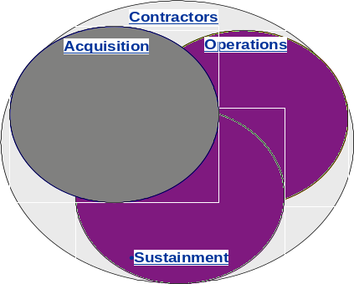
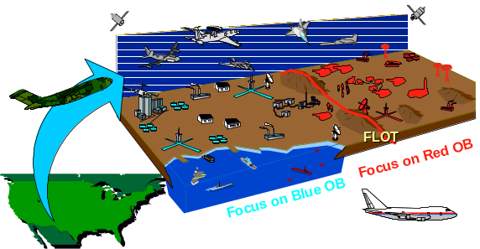
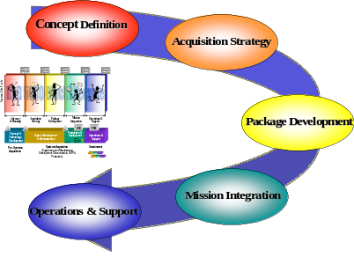
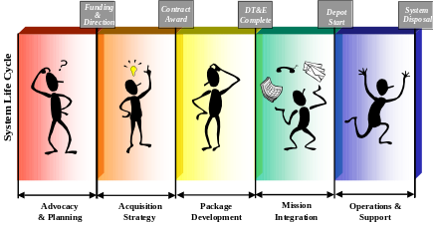
Overview
Architectures
I
Environment
II
Life Cycle
Business Model
Stakeholders
Relationships
III
IV

Slide 7
Environment

Slide 8
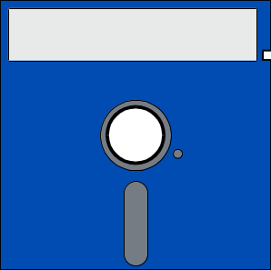

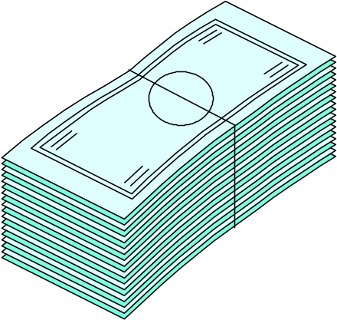
Business Environment - 1980s
Independent Organizations
Acquisition
Operations
80s Technology
Formal
Communications
Stovepipe
Systems
Large
Defense Budgets
Sustainment
Contractors
Time and Money Permitted Independent Organizational Processes

Slide 9



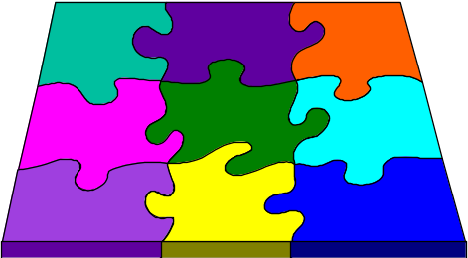
Business Environment - Today
Interdependent Organizations
Contractors
Acquisition
Operations
Smaller
Defense Budgets
IPTs
Shared
Data and
Responsibilities
COTS
System of Systems
Integration
Rapid Technology
Change
Sustainment
Organizational Processes Today Must
Provide for Shared Data and Responsibilities

Slide 10
How Do CMMI Based Processes
Help With Shared Responsibilities?
Both industry and government are developing processes
under the same framework
Same Language
DoD will most likely encourage process improvement
through CMMI - AFMC will be doing likewise
DoD and Industry Wide
Process Areas are envisioned to be shared or not shared
- depending on the negotiated arrangement between the
program office and the contractor
Supports Process Sharing

Slide 11
CMMI Process Area Categories
E
M
Engineering
  Requirements Management
  Requirements Development
  Technical Solution
  Enterprise Integration
  Verification
  Validation
Project Management
  Project Planning
  Monitoring & Control
  Supplier Agreements
  Integrated Management
  Risk Management
S
P
Support
  Configuration Management
  Quality Assurance
  Measurement & Analysis
  Causal Analysis & Resolution
  Decision Analysis & Resolution
Process Management
  Process Focus
  Process Definition
  Training
  Process Performance
  Innovation & Deployment
  Quantitative Management

Slide 12




Shared Responsibilities
Requires Process Sharing
Notional Allocation of Process Responsibility
Project Management
Project Planning (G)
Acquisition Strategy
Project Monitoring and Control (S)
and / or
Supplier Agreement Management (G)
Life Cycle Phase
Integrated Project Management (S)
Government (G)
Risk Management (S)
[User, SPO, Test]
Engineering
Conscious
Requirements Management (S)
Allocation
Requirements Development (G)
Technical Solution (S)
Product Integration (S)
System Engineering
Product Verification (S)
Contractor (C)
Execution Process
Support
Validation (G)
Allocation
Configuration Management (S)
Process and Product Quality Assurance (C)
Measurement and Analysis (S)
Causal Analysis and Resolution (S)
Shared (S)
Decision Analysis and Resolution (S)
Tailored
Organizational Process Management
CMMI
Process Focus (S)
Process Definition (S)
Innovation and Deployment (S)
Core Group
Training (S)
Infrastructure
Process Performance (S)
Responsibilities
Quantitative Management (S)

Slide 13
Shared Processes
Require Shared Data
Support
Processes
Engineering
Processes
Management
Processes
Shared Data from
Shared Processes
User
ORD(s)
View
Integrated Digital
Project
Engineering
View
Environment
t
t
IDE
AFOTEC
Testing
View
"The truth
is in the
Database"
Project
Management
View
t
t
SM
Funding
View
Project
Support
View
t
t
Shared Data Assures Accurate and Timely
Information Exchange Among Stakeholders

Slide 14
Architectures

Slide 15
Architecture Is ...
Architecture is a set of tenets used to harmonize design
choices across multiple disciplines used to solve problems
in a specified domain
Architecture is used to manage the complexity of the
information system capability in a domain
Architecture impacts the individual system by showing
the required relationship to other systems in the domain
and requiring all systems to adhere to tenets to implement
the relationship
Architecture Imposes Requirements Beyond
a Program’s Functional Capabilities

Slide 16



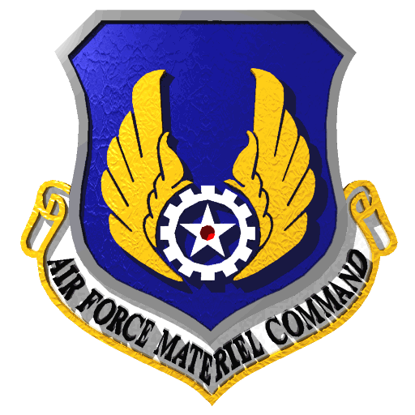
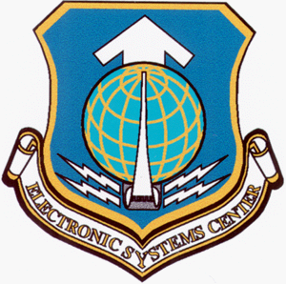
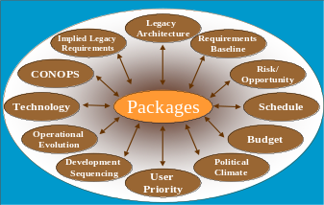

Functional Requirements plus ...
Enterprise
Architecture
Program
Architecture
Program Constraints
POM Cycle, Budget Cuts,
Management Considerations,
Support Resource Inadequacy,
and Political Considerations
“To Be” System
“To Be” System
Program
Requirements
Systems and interconnections
Transition
Systems and interconnections
providing for or supporting
Transition
military operation
providing for or supporting
Physical
military operation
Physical
Physical
System Tech
Physical
System Tech
Data Model
Systems and interconnections
Data Model
System Tech
System Tech
Data Model
Systems and interconnections
Forecast
“As Is” System
Data Model
Sys Node
Forecast
System
providing for or supporting
Sys Node
System
System
Forecast
System
Sys Node
Forecast
System
providing for or supporting
Sys Node
System
System
Connectivity
Performance
System
military operation
Connectivity
Performance
Rules
Rules
Connectivity
Performance
System Event/
Physical
military operation
System Event/
Physical
Connectivity
Performance
Rules
System Event/
Physical
Rules
Element
System Tech
System Info
System Event/
Physical
Functional
Capabilities
Trace Desc
System Info
Element
System Tech
Data Model
Systems and interconnections
Trace Desc
Data Model
Element
System Tech
System Info
Trace Desc
System Info
Element
System Tech
Data Model
Exchange
Systems and interconnections
Iface
Forecast
Exchange
Trace Desc
Data Model
Sys Node
Forecast
System
Iface
System
Exchange
Sys Node
System
System
System
Iface
Forecast
Exchange
Op Activity
System
Sys Node
Forecast
System
Iface
providing for or supporting
Op Activity
Sys Node
System
System
System
Connectivity
Functionality
Performance
System
Op Activity
System
Connectivity
Functionality
Performance
Rules
Op Activity
System Event/
-to-
Rules
Connectivity
Functionality
Performance
military operation
Performance
System Event/
Physical
Connectivity
Rules
-to-
Functionality
Rules
System
Physical
System Event/
-to-
System Event/
Physical
System
System Info
-to-
Element
Trace Desc
System Info
Physical
Element
System Tech
System Func
System
State
System Func
System Tech
Data Model
Trace Desc
System
System Info
State
Data Model
Element
Trace Desc
System Info
Evaluation
Element
System Tech
System Func
State
System Func
System Tech
Data Model
Evaluation
Exchange
Trace Desc
Iface
Forecast
Exchange
State
Data Model
Iface
Transitions
Evaluation
Sys Node
Forecast
System
Sys Node
System
Transitions
Iface
Evaluation
Exchange
System
System
System
Forecast
Exchange
Op Activity
System
Iface
Transitions
Sys Node
Forecast
System
Op Activity
Sys Node
System
Transitions
System
System
System
Connectivity
Functionality
Performance
Op Activity
System
Connectivity
Functionality
Performance
Rules
Op Activity
System Event/
-to-
Rules
Connectivity
Functionality
Performance
System Event/
-to-
Connectivity
Functionality
Performance
Rules
System
System Event/
-to-
Rules
System
System Info
System Event/
-to-
Element
Trace Desc
System Func
State
System Info
Element
System Func
System
Trace Desc
System
System Info
State
Element
Trace Desc
System Func
Evaluation
State
System Info
Evaluation
Exchange
Element
Trace Desc
System Func
Iface
Transitions
Exchange
Evaluation
State
Iface
System
Transitions
Evaluation
Exchange
System
Op Activity
Iface
Transitions
Exchange
Op Activity
Iface
System
Transitions
Functionality
System
Op Activity
Functionality
-to-
Functionality
Op Activity
System
-to-
Functionality
-to-
System
State
System Func
-to-
System Func
System
Evaluation
State
System
State
System Func
Evaluation
Transitions
Evaluation
State
System Func
Transitions
Evaluation
Transitions
Transitions
Program
Spirals
Architectures and Program Constraints Both Constrain
and Define the Individual Program Approach

Slide 17
Processes Need to Address ...
Enterprise Integration
Directives,
Mission Shortfalls
Constraints,
Mission Area Planning
Budgeting Priority
Requirements Definition
Decision Analysis and Resolution
Requirements Development
Standardization,
Roadmaps
Contracting
Activity Planning
Supplier Agreement
Management
Project
Planning
Product Control
Integrated Project
Management
Requirements
Management
Technical
Solution
Risk Management
Configuration
Management
Project Monitoring
and Control
Quality Assurance
Product
Integration
Causal Analysis
and Resolution
Technical Execution
Program Management
Deficiencies
Assessment & Certification
Product
Measurement
Validation
SOS Integration & Delivery
Outcome & Feedback
Verification
and Analysis
Products
Organizational Process Management
Enterprise Integration is a “Custom” C² Overarching
Process Area Influencing Program Requirements
Process
Process
Innovation and
Process
Quantitative
Focus
Definition
Deployment
Training
Performance
Mgmt
Process Maturation

Slide 18
Processes Need to Address ...
Enterprise Integration
Directives,
Mission Shortfalls
Constraints,
Mission Area Planning
Budgeting Priority
Requirements Definition
Decision Analysis and Resolution
Requirements Development
Standardization,
Roadmaps
Contracting
Activity Planning
Supplier Agreement
Management
Project
Planning
Key
Concurrent
Up Front
Program
Activities
Product Control
Integrated Project
Management
Requirements
Management
Technical
Solution
Risk Management
Configuration
Management
Project Monitoring
and Control
Quality Assurance
Product
Integration
Causal Analysis
and Resolution
Technical Execution
Program Management
Deficiencies
Assessment & Certification
Product
Measurement
Validation
SOS Integration & Delivery
Outcome & Feedback
Verification
and Analysis
Products
Organizational Process Management
CMMI Based Engineering Process Improvement
Addresses Key Concurrent Up Front Activities
Process
Process
Innovation and
Process
Quantitative
Focus
Definition
Deployment
Training
Performance
Mgmt
Process Maturation

Slide 19
Processes Need to Address ...
Enterprise Integration
Enterprise Integration
Directives,
Mission Shortfalls
Constraints,
Mission Area Planning
Budgeting Priority
Requirements Development
Decision Analysis and Resolution
Requirements Definition
Decision Analysis and Resolution
Requirements Development
Standardization,
Roadmaps
Contracting
Activity Planning
Project
Planning
Supplier Agreement
Management
Project
Planning
Integrated Project
Management
Product Control
Requirements
Management
Technical
Solution
Integrated Project
Management
Requirements
Management
Technical
Solution
Risk Management
Configuration
Management
Risk Management
Configuration
Management
Product
Integration
Project Monitoring
and Control
Quality Assurance
Product
Integration
Project Monitoring
and Control
Causal Analysis
and Resolution
Technical Execution
Program Management
SoS Integration
and Delivery
Deficiencies
Assessment & Certification
Validation
Product
Measurement
Validation
SOS Integration & Delivery
Outcome & Feedback
Verification
and Analysis
Products
Organizational Process Management
Architecture Impact On Our
CMMI Based Engineering Process Improvement
Process
Process
Innovation and
Process
Quantitative
Focus
Definition
Deployment
Training
Performance
Mgmt
Process Maturation

Slide 20
Processes Need to Address ...
Enterprise Integration
Enterprise Integration
Directives,
Mission Shortfalls
Constraints,
Mission Area Planning
Budgeting Priority
Requirements Development
Requirements Definition
Decision Analysis and Resolution
Requirements Development
Standardization,
Roadmaps
Contracting
Activity Planning
Project
Planning
Supplier Agreement
Management
Project
Planning
Product Control
Requirements
Management
Integrated Project
Management
Requirements
Management
Technical
Solution
Risk Management
Configuration
Management
Risk Management
Project Monitoring
and Control
Quality Assurance
Product
Integration
Causal Analysis
and Resolution
Technical Execution
Program Management
Deficiencies
Assessment & Certification
Product
Measurement
Validation
SOS Integration & Delivery
Outcome & Feedback
Verification
and Analysis
Products
Organizational Process Management
Chief Engineer Key Process Areas Include
CMMI Based Engineering Process Improvement
Process
Process
Innovation and
Process
Quantitative
Focus
Definition
Deployment
Training
Performance
Mgmt
Process Maturation

Slide 21

CMMI Fits Our Needs
ESC “Custom” Process Area for Enterprise Integration
CMMI explicitly addresses key up front project processes
CMMI accommodates Architecture impacts on the process implementation at ESC
CMMI provides for key processes for ESC/EN execution of Chief Engineer function to include:
  Requirements Development and Management
  Risk Management
  Enterprise Integration
  Project Planning
CMMI

Slide 22
Life Cycle
Business Model
Life Cycle
Business Model

Slide 23
Program Life Cycle
Funding
Contract
DT&E
Depot
System
&
Award
Complete
Start
Disposal
Direction
DoD 5000 Block Lifecycle
System Life Cycle
Advocacy
Acquisition
Package
Mission
Operations &
& Planning
Strategy
Development
Integration
Support
A
B
C
IOC
FOC
Concept &
Production &
Technology
System Development
Deployment
Operations &
Development
& Demonstration
FRP
Support
OT&E
Decision
Review
Pre - Systems
Systems Acquisition
Sustainment
Acquisition
(Engineering and Manufacturing
Development, Demonstration, LRIP &
BLOCK 2
Production)
BLOCK 3

Slide 24
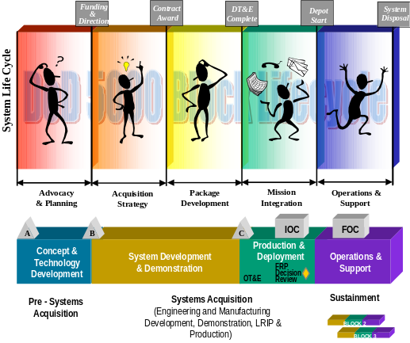
Program Life Cycle
Concept Definition
Acquisition Strategy
Package Development
Mission Integration
Operations & Support

Slide 25
In the C² World
Ops Architecture
User Requirements
Investment Funding
Experimentation
ATDs & ACTDs
Transition Decisions
Experiment on
Next Generation
Concept Definition
System Architecture
Product Requirements
Technology Change
Design & Test
Define, Design,
and Test New
Capabilities
Fielding
Decisions
In any
Program
All Four
Phases
Can Be
Running
Concurrently
Acquisition Strategy and
Package Development
Tech Architecture
Interoperability
Infrastructure
Certification
Previous Versions
Other Systems
Ops Environment
Shortfall Fixes
Mission Integration
System Employment
Parallel Operations
User Feedback
Plug and Play
Mission Shortfall Fixes
“As Is” Architectures
Operational Changes
User Feedback
Operations Budgeting
Operations & Support
Sustain the
Legacy System(s)
Life Cycle Detail

Slide 26
Program Life Cycle - Multiple Types of Spirals
New
Contract
Action
Functional or
Performance
Baseline
Change
Concept Definition
Acquisition Strategy
ATD
Experiment
ACTD
Beta or
Development
Only
COTS
Product
Integration
Package Development
Plug & Play
or Bug Fix
Program
Direction
Change
Mission Integration
Operations & Support

Slide 27
Individual Spiral Considerations
Legacy
Implied Legacy
Architecture
Requirements
Requirements
Baseline
CONOPS
Risk/
Opportunity
Technology
Spiral N+1
Schedule
Operational
Budget
Evolution
Development
Political
Sequencing
User
Climate
Priority
Engineering Processes Must Accommodate A Complex Set of Variables

Slide 28
A Program’s Engineering Scope
Traditional System Engineering Focus
Concept
Definition
Acquisition &
Development
Mission
Integration
Operations &
Support
Concept
Planning
Development
Planning
Enterprise
Planning
O&S
Planning
Budgeting Priority
Budgeting Priority
Budgeting Priority
Budgeting Priority
Concept
Definition
Requirements Definition
SoS Requirements
and Ops Architecture
Mod Requirements Definition
Experiment
Planning
Package
Planning
Version
Planning
Mod Deployment Planning
Contracting
Contracting
Contracting
Contracting
Activity
Execution
Development Execution
Production/Deploy
Integration Execution
Mod Development Execution
Assessment
Assessment & Certification
Assessment & Certification
Assessment & Certification
Another
Spiral
Operations
Deployment
Yes
Fielding
Decision
Yes
Transition
to
Development
?
Operations
No
Yes
Stop
Infrastructure
Mod
Maint
Fix
Integration
Only
?
Application Mod
Shortfalls
?
No
Yes
Yes
Try
Again?
Plug &
Play
?
Stop
Yes
Shortfalls
?
Stop
No
Stop
System Engineering Processes Need to Have
Enterprise Focus and Life Cycle Applicability

Slide 29
Initial Processes Cut Across
The Life Cycle
Concept
Definition
Acquisition &
Development
Mission
Integration
Operations &
Support
Concept
Planning
Development
Planning
Enterprise
Planning
O&S
Planning
Budgeting Priority
Budgeting Priority
Budgeting Priority
Budgeting Priority
Concept
Definition
Requirements Definition
SoS Requirements
and Ops Architecture
Mod Requirements Definition
Requirements
Development & Management
Experiment
Planning
Package
Planning
Version
Planning
Mod Deployment Planning
Contracting
Contracting
Contracting
Contracting
Activity
Execution
Development Execution
Production/Deploy
Integration Execution
Mod Development Execution
Assessment
Assessment & Certification
Assessment & Certification
Assessment & Certification
Another
Spiral
Operations
Deployment
Yes
Fielding
Decision
Yes
Transition
to
Development
?
Operations
No
Yes
Stop
Infrastructure
Mod
Maint
Fix
Integration
Only
?
Application Mod
Shortfalls
?
No
Yes
Yes
Try
Again?
Plug &
Play
?
Stop
Yes
Shortfalls
?
Stop
No
Stop

Slide 30
Initial Processes Cut Across
The Life Cycle
Concept
Definition
Acquisition &
Development
Mission
Integration
Operations &
Support
Concept
Planning
Development
Planning
Enterprise
Planning
O&S
Planning
Budgeting Priority
Budgeting Priority
Budgeting Priority
Budgeting Priority
Concept
Definition
Requirements Definition
SoS Requirements
and Ops Architecture
Mod Requirements Definition
Risk Management
Experiment
Planning
Package
Planning
Version
Planning
Mod Deployment Planning
Contracting
Contracting
Contracting
Contracting
Activity
Execution
Development Execution
Production/Deploy
Integration Execution
Mod Development Execution
Assessment
Assessment & Certification
Assessment & Certification
Assessment & Certification
Another
Spiral
Operations
Deployment
Yes
Fielding
Decision
Yes
Transition
to
Development
?
Operations
No
Yes
Stop
Infrastructure
Mod
Maint
Fix
Integration
Only
?
Application Mod
Shortfalls
?
No
Yes
Yes
Try
Again?
Plug &
Play
?
Stop
Yes
Shortfalls
?
Stop
No
Stop

Slide 31
Continuous Life Cycle Process
Enterprise Integration
Directives,
Mission Shortfalls
Constraints,
Mission Area Planning
Budgeting Priority
Requirements Definition
Decision Analysis and Resolution
Requirements Development
Standardization,
Roadmaps
Contracting
Activity Planning
Supplier Agreement
Management
Project
Planning
Spiral Development
Is the Cyclic Application of a Set
of Standard Engineering Processes
Over the Entire Life Cycle
Until System Disposal
Product Control
Integrated Project
Management
Requirements
Management
Technical
Solution
Risk Management
Configuration
Management
Project Monitoring
and Control
Quality Assurance
Product
Integration
Causal Analysis
and Resolution
Technical Execution
Program Management
Deficiencies
Assessment & Certification
Product
Measurement
Validation
SOS Integration & Delivery
Outcome & Feedback
Verification
and Analysis
Products
Organizational Process Management
Process
Process
Innovation and
Process
Quantitative
Focus
Definition
Deployment
Training
Performance
Mgmt
Process Maturation

Slide 32
Stakeholders
Relationships
Stakeholder
Relationships

Slide 33
Stakeholder Considerations
in Today’s Environment
2000’s
Interdependent
Organizations
System of System Demands
Spiral Development & EA
Constant Initiative Flow
Increased ACQTEMPO
Outsourced Workforce
Lifecycle Management
Impatient Customers
Acquisition Reform
“TSPR” Contracts
Experience Drain
Smaller SPOs
Smaller Force
Coalition Operations
Interoperable Systems
Increased OPSTEMPO
Changing Missions
Changing Threats
CONUS Based
Global Commitments
Contractors
Acquisition
Operations
Partnering
& Shared
Processes
Lean Logistics
Experience Drain
Technology Pace
Outsourced Work
COTS vs MILSPEC
Smaller Workforce
Just-In-Time Supply
Contractor Logistics Support
Increased “Command Support”
Fewer and Bigger
ID/IQ Contracts
Fewer New Starts
Out-sourced Work
View CMMI as Imperative
Sustainment

Slide 34
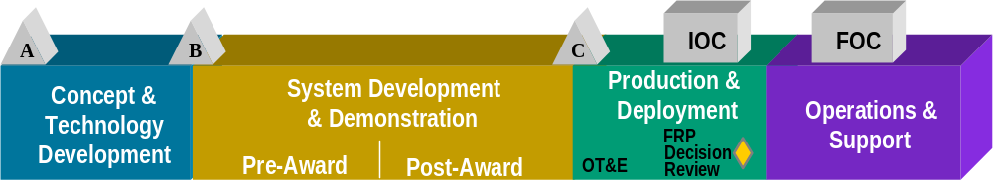
A
B
B
C
C
IOC
FOC
Stakeholders
Concept &
System Development
Production &
& Demonstration
Deployment
Technology
Production &
Support
Development
FRP
✓
Decision
Certification
Congress
Contractor
Customer
Deployment
DOD Policy
Acquisition Agency
Experimentation
Industry
Legal / Contracting
Service HQ & JCS
Safety
Sustainment
Test
Training
User
✓
✓
✓
✓
✓
✓
✓
✓
✓
✓
✓
✓
✓
✓
✓
✓
✓
✓
✓
✓
✓
✓
✓
✓
✓
✓
✓
✓
✓
✓
✓
✓
✓
✓
✓
Spiral Development Involves the Same Set
of Stakeholders in the Conduct of Standard
Engineering Processes Over the Entire Life Cycle
Until System Disposal
✓
✓
✓
✓
✓
✓
✓
✓
✓
✓
✓
✓
✓
✓
✓
✓
✓
✓
✓
✓
✓
✓
✓
✓
✓
Must be involved
May be involved

Slide 35
Shared Responsibilities
Requires Sharing Process
Notional* Allocation of Process Responsibility
Project Management
Project Planning (G)
Acquisition Strategy
Project Monitoring and Control (S)
and / or
Supplier Agreement Management (G)
Life Cycle Phase
Integrated Project Management (S)
Government (G)
Risk Management (S)
[User, SPO, Test]
Engineering
"Shared Processes"
How We Do Business
Conscious
Requirements Management (S)
Allocation
Requirements Development (G)
Technical Solution (S)
Product Integration (S)
System Engineering
Product Verification (S)
Contractor (C)
Execution Process
Support
Validation (G)
Allocation
Configuration Management (S)
Process and Product Quality Assurance (C)
Measurement and Analysis (S)
Causal Analysis and Resolution (S)
Shared (S)
Decision Analysis and Resolution (S)
Tailored
Organizational Process Management
CMMI
Process Focus (S)
Process Definition (S)
Innovation and Deployment (S)
Core Group
Training (S)
Infrastructure
Process Performance (S)
Responsibilities
Quantitative Management (S)
* Can be changed depending on business model or acquisition strategy

Slide 36
Stakeholders Cut Across
The Life Cycle
Concept
Definition
Acquisition &
Development
Mission
Integration
Operations &
Support
Concept
Planning
Development
Planning
Enterprise
Planning
O&S
Planning
Certification
Contractor
Deployment
Experimentation
Acquisition Agency
Industry
Service HQ & JCS
Safety
Sustainment
Test
Training
User
Customer
Contractor
Acquisition Agency
Experimentation
Industry
Legal/Contracting
Safety
Sustainment
Test
Training
User
Congress
Customer
DOD Policy
Acquisition Agency
Experimentation
Service HQ & JCS
Safety
User
Budgeting Priority
Budgeting Priority
Certification
Congress
Contractor
Customer
Deployment
DOD Policy
Experimentation
Acquisition Agency
Industry
Legal/Contracting
Service HQ & JCS
Safety
Sustainment
Test
Training
User
Budgeting Priority
Requirements Process
Stakeholders
Evolve Over Life Cycle
Budgeting Priority
Concept
Definition
Requirements Definition
SoS Requirements
and Ops Architecture
Mod Requirements Definition
Requirements
Development & Management
Experiment
Planning
Package
Planning
Version
Planning
Mod Deployment Planning
Contracting
Contracting
Contracting
Contracting
Activity
Execution
Development Execution
Production/Deploy
Integration Execution
Mod Development Execution
Assessment
Assessment & Certification
Assessment & Certification
Assessment & Certification
Another
Spiral
Operations
Deployment
Yes
Fielding
Decision
Yes
Transition
to
Development
?
Operations
No
Yes
Stop
Infrastructure
Mod
Maint
Fix
Integration
Only
?
Application Mod
Shortfalls
?
No
Yes
Yes
Try
Again?
Plug &
Play
?
Stop
Yes
Shortfalls
?
Stop
No
Requirements
Development & Management
Stop

Slide 37
Stakeholders Cut Across
The Life Cycle
Concept
Definition
Acquisition &
Development
Mission
Integration
Operations &
Support
Concept
Planning
Development
Planning
Enterprise
Planning
Certification
Contractor
Deployment
Experimentation
Acquisition Agency
Industry
Service HQ & JCS
Safety
Sustainment
Test
Training
User
Contractor
Acquisition Agency
Experimentation
Industry
Legal/Contracting
Safety
Sustainment
Test
Training
User
Congress
Customer
DOD Policy
Acquisition Agency
Experimentation
Service HQ & JCS
Safety
User
Congress
Contractor
Customer
Deployment
DOD Policy
Experimentation
Acquisition Agency
Industry
Legal/Contracting
Service HQ & JCS
Safety
Sustainment
Test
Training
User
O&S
Planning
Budgeting Priority
Budgeting Priority
Budgeting Priority
Risk Management Process
Stakeholders
Evolve Over Life Cycle
Budgeting Priority
Concept
Definition
Requirements Definition
SoS Requirements
and Ops Architecture
Mod Requirements Definition
Risk Management
Experiment
Planning
Package
Planning
Version
Planning
Mod Deployment Planning
Contracting
Contracting
Contracting
Contracting
Activity
Execution
Development Execution
Production/Deploy
Integration Execution
Mod Development Execution
Assessment
Assessment & Certification
Assessment & Certification
Assessment & Certification
Another
Spiral
Operations
Deployment
Yes
Fielding
Decision
Yes
Transition
to
Development
?
Operations
No
Yes
Stop
Infrastructure
Mod
Maint
Fix
Integration
Only
?
Application Mod
Shortfalls
?
No
Yes
Yes
Try
Again?
Plug &
Play
?
Stop
Yes
Shortfalls
?
Stop
No
Stop
Risk Management

Slide 38
Conclusion
Architectures
I
Environment
II
Life Cycle
Business Model
Stakeholders
Relationships
III
IV

Slide 39
Conclusion
Acquisition Environment
Acquisition Environment Challenge
  Interdependent Organizations
  Shared Responsibilities
  Shared Data
  Organizational Processes Today
  Must Provide for Shared Data and
  Responsibilities
How Does CMMI Help
  Provides a Common Language
  Developed by Both DoD and Industry
  Used by Both DoD and Industry
  Supports Process Sharing
Environment
EN CMMI-Based Processes Facilitate Shared Responsibilities

Slide 40
Conclusion
Enterprise Architecture
Enterprise Architecture Challenge
  Architecture Imposes Requirements Beyond a Program’s
  Functional Capabilities
  Architectures Constrain and Define
  the Individual Program Approach
  Need “Custom” C² Enterprise
  Integration Process
Architectures
How Does CMMI Help
  Provides for ESC “Custom” Process Area for Enterprise Integration
  Explicitly Addresses Key up Front Project Processes
  Accommodates Architecture Impacts on ESC Process Implementation
  Provides for Key Processes for ESC/EN Execution of Chief Engineer
  Function
EN CMMI-Based Processes
Accommodates Requirements Beyond the Product Function

Slide 41
Conclusion
Life Cycle and Spiral
Life Cycle and Spiral Challenge
  Ability to Accommodate All Four Life Cycle Phases
  Running Concurrently
  Accommodate A Complex Set of
  Variables
  System Engineering Processes Need
  Enterprise Focus and Life Cycle
  Applicability
Life Cycle
Business Model
How Does CMMI Help
  Provides for a Cyclic Application of a Set of Standard
  Engineering Processes Over the Entire Life Cycle Until
  System Disposal
EN CMMI-Based Processes Provide For
Simultaneous Life-Cycle Phases - Including O&M

Slide 42
Conclusion
Stakeholders
Life Cycle and Spiral Challenge
  Interdependent Organizations Require Shared
  Responsibilities
  Shared Responsibilities Require
  Shared Processes
  Shared Processes Require Maximum
  Stakeholder Involvement
Stakeholders
Relationships
How Does CMMI Help
  Provides Common Processes That
  Incorporate The Stakeholders Across the Life Cycle and
  Insures That The Appropriate Stakeholders Are Involved
  As Appropriate As the Program Spirals
EN CMMI-Based Processes Provide For The
Many External Stakeholders and Continuous Involvement

Slide 43
Major ESC Life Cycle Challenges
Acquisition Environment
- Shared responsibilities
Enterprise Architecture
- External requirements beyond the product function
Life Cycle and Spiral
- Simultaneous life-cycle phases - including O&M
Stakeholders
- Many external stakeholders - continuously involved
EN CMMI-Based Processes Address These Challenges

Slide 44
“Not everything that can
be counted counts, and
not everything that counts
can be counted”
A. Einstein
Like Today’s Life Cycle Context

Slide 45
CMMI
Process
Areas

Slide 46
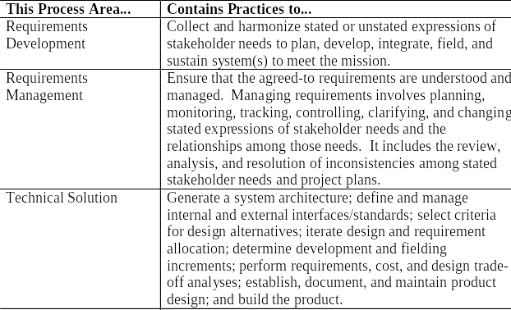
CMMI Based Process Improvement
Process Life Cycle Context
Engineering Process Area
(Part 1of 2)

Slide 47
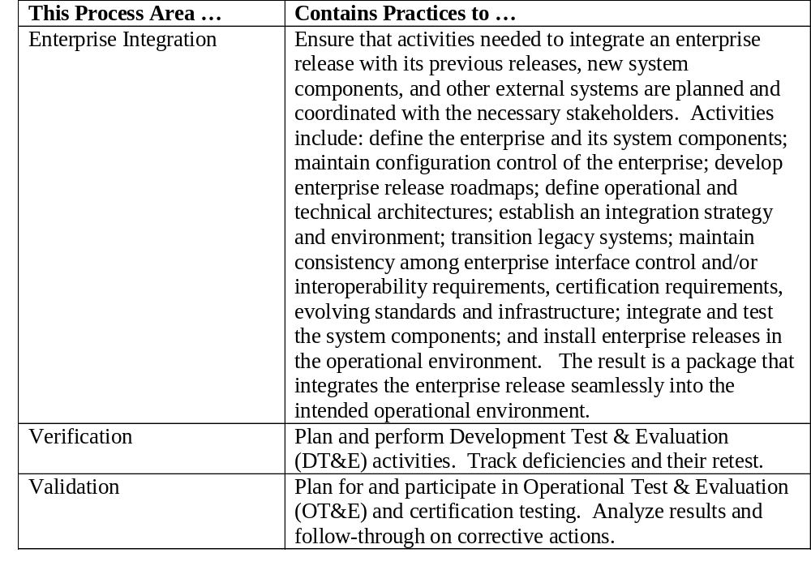
CMMI Based Process Improvement
Process Life Cycle Context
Engineering Process Area
(Part 2of 2)

Slide 48
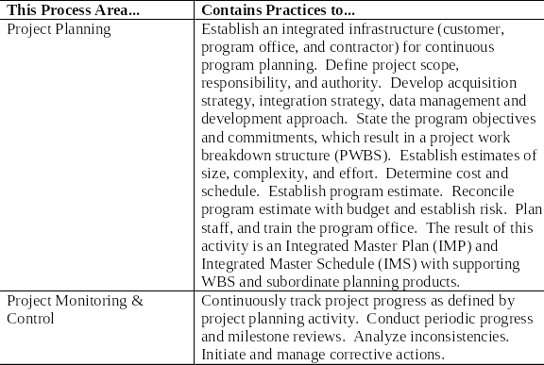
CMMI Based Process Improvement
Process Life Cycle Context
Project Management Process Area
(Part 1of 2)

Slide 49
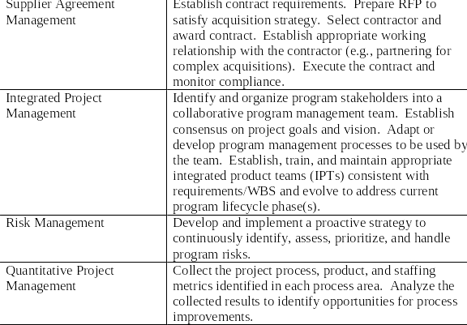
CMMI Based Process Improvement
Process Life Cycle Context
Project Management Process Area
(Part 2of 2)

Slide 50
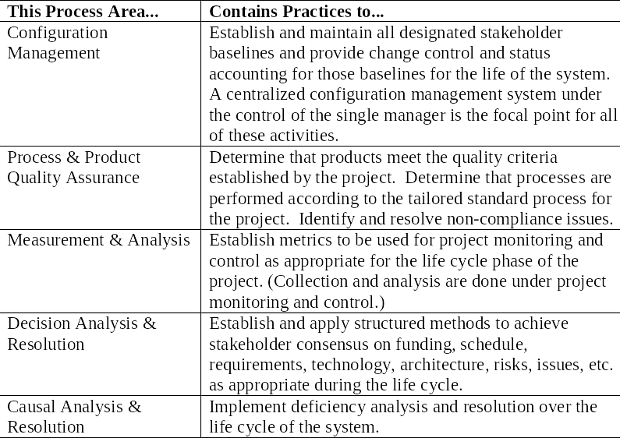
CMMI Based Process Improvement
Process Life Cycle Context
Support Process Area

Slide 51
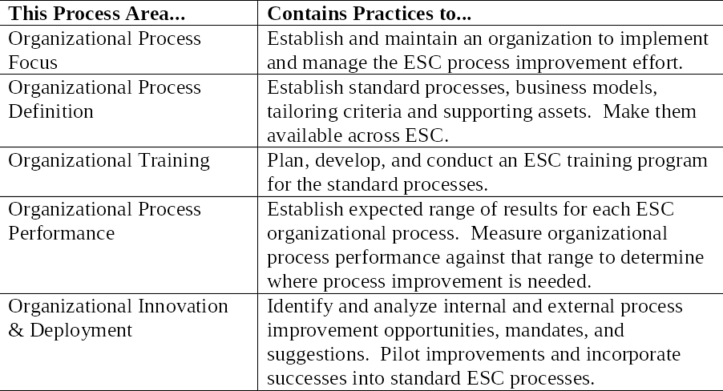
CMMI Based Process Improvement
Process Life Cycle Context
Process Management Process Area

Slide 52
Requirement
Products
Life Cycle
Phase
Expansions

Slide 53
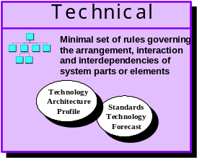
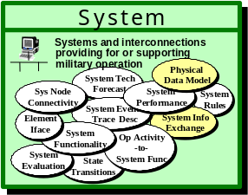
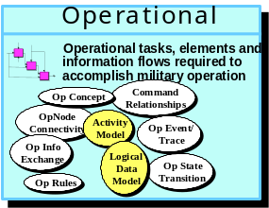
CMMI Process Life Cycle Context
An Enterprise Spiral Development Model
All 4 Levels Exist Simultaneously
Operational Baseline Planning and Control
Operational Baseline
Operations & Support
Shortfall
Operational
Enterprise and Infrastructure Baseline Planning and Control
Mission Integration
Level
Integrate and Field Enterprise Increment 1
Shortfall
Enterprise
Integrate and Field Enterprise Increment 2
Component System Baseline Planning and Control
Yes
Development Increment 1
Transition
?
Beta Test
or
Defer Fielding
Acquisition & Development Level
No
Development Increment 2
Program Office
Development Increment 3
Concept Definition Transition Baseline Planning and Control
COTS/Technology Insertion
Yes
Subsequent Spiral
User Requirements Definition
Yes
Transition
to Development
?
Plug &
Play
?
Process Reengineering
Yes
No
Concept Definition Level
CONOPS
Yes
No
Integration
Only
?
Try
Again ?
Experimentation
No
Planning and Experimentation
Stop
No

Slide 54
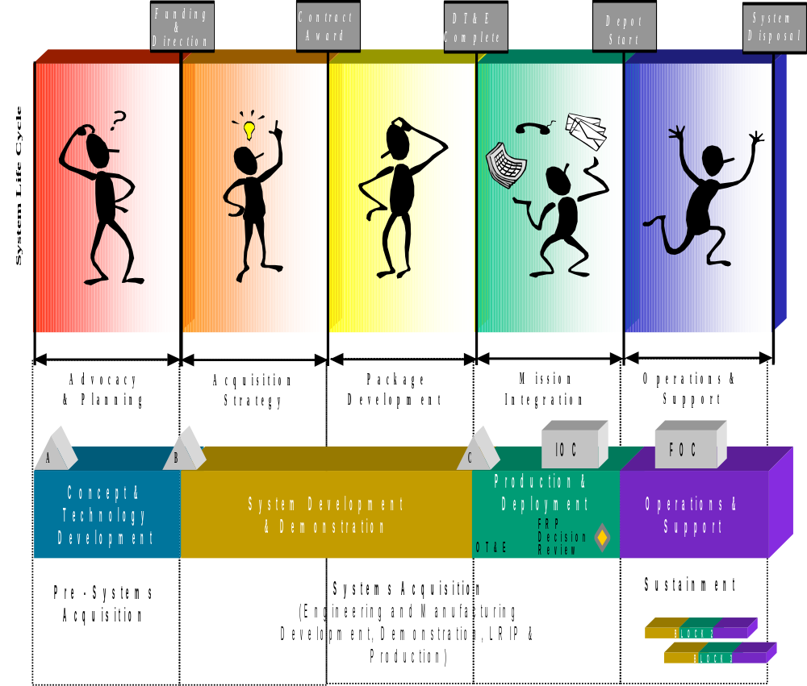


CMMI Process Life Cycle Context
Program Life Cycle
Concept Definition
Process Modeling
Mission Area
Planning
Shortfalls &
Opportunities
JV 2020
Vision & Goals
EFX, ATD, ACTD
Experimentation
Capstone
Architecture
PPBS
User Requirements
Definition
Spiral Feedback
STAR
Threat Change
Budgeting & Tradeoffs
EAF
Mission Shift
Operational &
Technical
Architecture(s)
Existing Direction
Requirement Feasibility
Program Direction
Program
Planning IPT

Slide 55



CMMI Process Life Cycle Context
Program Life Cycle
Capstone
Acquisition Strategy
Architecture
Funding
Acquisition Strategy
Development
User
Requirements
SRD/TRD
Development (1)
ASP
APB
RFP
Preparation (2)
PMD
Requirements
Feasibility
Source Selection
Ops & Tech
Architectures
Form Program
Office
Contract
Award

Slide 56
CMMI Process Life Cycle Context
Program Life Cycle
Contract
Award
Package Development
Post Award
Conference
System
Architecture
Development
Package Design
& Development
Product
Integration
Define Post Award
Work Packages
and IPTs
Package Design & Development
Back to
Development
Test
Ready?
Product
Integration
Form
Working Level
IPT
Partial
Full
Requirements
Refinement
Package Tradeoff
and Decision
Production
Readiness
Package Consensus
and Contract Action
Spiral “n”
Design
Spiral “n”
Development
Test
Articles
DT&E

Slide 57
CMMI Process Life Cycle Context
Program Life Cycle
Mission Integration
Test
Articles
Form
Test & Integration
Working Group
Certification and
Accreditation
Establish Test
Environments
OT&E
Back to
Development
No
Production
Decision
Yes
Depot
Start
Infrastructure
Readiness
Finalize Production
Readiness
OT&E
System Fixes
Conduct Training, Connectivity,
Installation, Deployment
IOC

Slide 58
CMMI Process Life Cycle Context
Program Life Cycle
Depot
Start
Operations & Support
Begin
Operations
Operate
and
Maintain
Form User
Group
O&M Planning
Begin
Sustainment
Spiral N+1 (e.g. TCTOs, Reprocurement,
Modifications, SLEP Engineering, Mission Shift)
Phase Out & Disposal

Slide 59
Enterprise
Architecture
Expansions

Slide 60
Enterprise Architecture
Enterprise Architecture is an Information Technology Approach
- Our business is a mixture of IT and Weapons Systems
Enterprise Architecture Addresses Systems of Systems Complexity
- A common approach for IT and Weapons Systems
Enterprise Architecture Models Describe Operational Behavior
- System of Systems “Business Models”
Enterprise Architecture Models Describe Required Interfaces
- Permits standardization required for interoperability
Transition Plans from “As Is” to “To Be” for Enterprise Planning
- Powerful enterprise investment planning & management tool
Enterprise Architecture is the Key to Enterprise Integration

Slide 61

Architecture Cycle
Ops
Plan
Baseline
Sys
Tech
Oversight
and
Control
Update
Ops
Transition
Ops
Tech
Sys
Target
Sys
Tech
Implement

Slide 62
C4ISR Architecture Framework
Enterprise Architecture
Ops
“To Be” System
“As Is”
Sys
Tech
“To Be” Technical
Systems and interconnections
Enterprise
Program
Office
Transition
Ops
Minimal set of rules governing
providing for or supporting
Transition
military operation
Physical
Transition
the arrangement, interaction
System Tech
Physical
Ops
and interdependencies of
Systems and interconnections
System Tech
Data Model
“As Is” System
Forecast
Data Model
Tech
Sys
system parts or elements
Minimal set of rules governing
providing for or supporting
“As Is” Technical
Sys Node
Forecast
System
Sys Node
System
System
Connectivity
military operation
System
the arrangement, interaction
Connectivity
Performance
Performance
Rules
Rules
System Event/
Physical
System Event/
Physical
“To Be”
Technology
and interdependencies of
System Tech
System Info
Sys
Element
Systems and interconnections
Technology
Element
Trace Desc
System Tech
System Info
Data Model
Trace Desc
Forecast
Exchange
Data Model
Tech
Architecture
system parts or elements
providing for or supporting
Minimal set of rules governing
Iface
Sys Node
Forecast
System
Architecture
Standards
Iface
Sys Node
Exchange
System
System
System
Systems
Profile
System
Op Activity
System
Standards
Op Activity
Connectivity
military operation
Profile
Technology
Connectivity
Performance
the arrangement, interaction
Functionality
Performance
Rules
Rules
Functionality
System Event/
Physical
Technology
-to-
Physical
System Event/
-to-
Technology
Forecast
System
System Tech
System Info
Technical
and interdependencies of
System
Element
Trace Desc
System Tech
System Info
Data Model
Technology
Forecast
Element
System Func
Data Model
State
Trace Desc
Evaluation
State
System Func
Forecast
Exchange
Architecture
system parts or elements
Evaluation
Iface
Sys Node
Forecast
System
Architecture
Standards
Sys Node
Exchange
Iface
System
System
System
Transitions
System
System
Profile
Transitions
Op Activity
Standards
Connectivity
Op Activity
Performance
Profile
Technology
Connectivity
Performance
Rules
Functionality
Rules
Functionality
System Event/
Technology
-to-
System Event/
System
Element
-to-
System Info
Technology
Forecast
System
Trace Desc
System Info
Technology
Forecast
Element
System Func
State
Trace Desc
Evaluation
Iface
State
System Func
Exchange
Architecture
Evaluation
Iface
System
Exchange
Architecture
Standards
Transitions
System
Profile
Transitions
Op Activity
Standards
Functionality
Op Activity
Profile
Technology
Functionality
-to-
Technology
System
-to-
Forecast
System
State
System Func
Forecast
Evaluation
State
System Func
Operational
Evaluation
Transitions
Transitions
Program A
Program B
Program C
“To Be” Operational
Operational tasks, elements and
Ops
Ops
Transition
Ops
information flows required to
“As Is”
“As Is”
“As Is”
accomplish military operation
Sys
“As Is” Operational
Sys
Sys
Operational tasks, elements and
Command
Op Concept
Command
Tech
Tech
Tech
Op Concept
information flows required to
Relationships
Relationships
OpNode
accomplish military operation
OpNode
Activity
System
Program
Office
System
Program
Office
Activity
Operational tasks, elements and
Connectivity
Op Event/
System
Program
Office
Op Event/
Connectivity
Command
Ops
Ops
Model
Command
Op Concept
Ops
Model
Op Concept
information flows required to
Trace
Relationships
Trace
Op Info
Relationships
Transition
Op Info
OpNode
Logical
accomplish military operation
Transition
OpNode
Transition
Exchange
Logical
Exchange
Activity
Activity
Op State
Ops
Connectivity
Data
Op Event/
Op State
Ops
Connectivity
Data
Op Event/
Ops
Model
Command
Model
Command
Sys
Op Concept
Transition
Sys
Op Concept
Trace
Tech
Model
Sys
Transition
Tech
Op Rules
Model
Trace
Op Info
Tech
Relationships
Op Rules
Relationships
Op Info
OpNode
Logical
Exchange
OpNode
Logical
Exchange
Activity
Op State
Data
Activity
Op State
“To Be”
“To Be”
Connectivity
Data
Op Event/
Sys
“To Be”
Connectivity
Model
Transition
Op Event/
Sys
Sys
Model
Model
Transition
Op Rules
Model
Trace
Op Rules
Trace
Tech
Tech
Op Info
Tech
Op Info
Logical
Exchange
Logical
Exchange
Data
Op State
Data
Op State
Model
Transition
Op Rules
Model
Transition
Op Rules

Slide 63
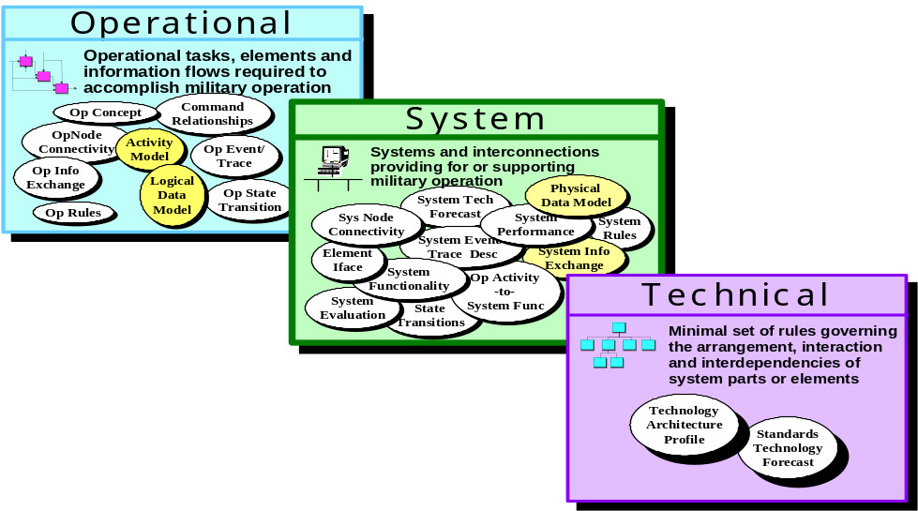
Program Constraints
POM Cycle, Budget Cuts,
Management Considerations,
Support Resource Inadequacy,
and Political Considerations
Enterprise Architecture
Ops
Baseline
Tech
Sys
Oversight
and
Control
Ops
Ops
Transition
Tech
Sys
Program Space
Target
Tech
Sys
Program
Spirals
Requirements
Architectures and Program Constraints Both Constrain
and Define the Individual Program Approach

Slide 64
A Notional Enterprise Architecture Process
Obtain / Renew
Executive Buy-In
and Support
Monitor
& Use
Enterprise
Architecture
Establish /
Revise
Management
Structure
& Control
Ops
Baseline
Sys
Tech
Oversight
and
Control
Ops
Define /
Revise
Architecture
Process &
Approach
Ops
Transition
Develop /
Revise
Transition
Plan
Tech
Sys
Target
Sys
Tech
Develop /
Revise Target
Enterprise
Architecture
Develop / Revise
Baseline Enterprise
Architecture

Slide 65
A Notional Enterprise Architecture Process

