Slide 1
PRINCE2

Slide 2
PRINCE2 Introduction

Slide 3
About PRINCE2
Office of Government Commerce (OGC) under UK Cabinet
Project in Controlled Environment (PR-IN-C-E)
PRINCE2 is Non-proprietary Project Management Method controlled by OGC
PRINCE2 is most generic global standard of PM regardless of size, type, organization, geography and culture
PRINCE2 isolates PM processes from specialist contribution and thus controls specialist work
PRINCE2 sustainably improves organizational capability and maturity

Slide 4
PRINCE2 is Not
Specialist Aspects
Detailed Techniques (like CPM, EVM, Monte Carlo)
Leadership Capability

Slide 5
Why Projects?
To maintain current business operations (business as usual)
  Profitability
  Service Quality
  Customer Relationships
  Brand Loyalty
  Productivity
  Market Confidence
To transform business operations (to survive)

Slide 6
A Project is
Which introduces Change
Temporary in nature
Cross-functional team is involved
Unique in some way
Uncertainty is more than typically encountered in the course of business

Slide 7
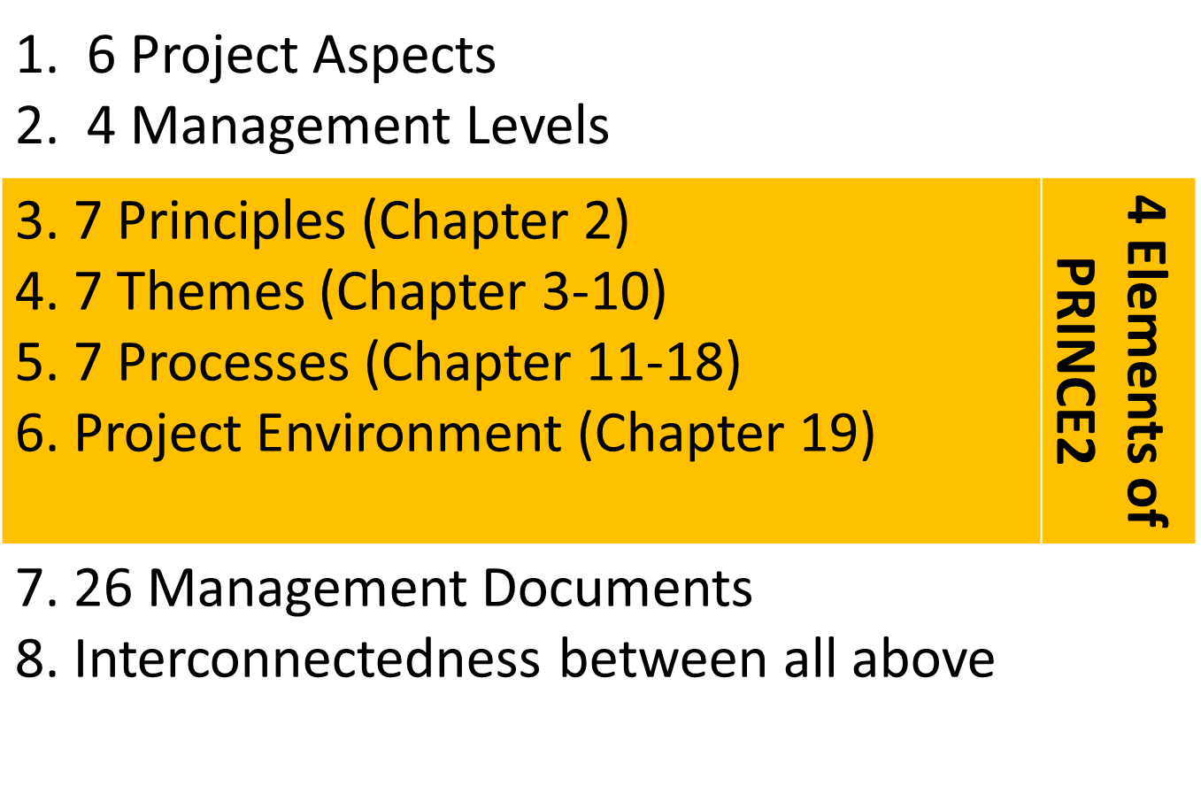
PRINCE2 in Nutshell

Slide 8
6 Aspects of Project
Scope
Time
Cost
Quality
Risk
Benefits

Slide 9
4 Management Levels
Corporate or programme
Directing
Managing
Delivering.

Slide 10
Seven Principles
The principles facilitate good use of PRINCE2 by ensuring that the method is not applied in an overly prescriptive way or in name sake only.
Continued business justification
  To ensure project is viable through out the project lifecycle
Learn from experience
  At the start use from previous project, During progress include in all reports and review, at the end share with org.
Defined roles and responsibilities
  3 Stakeholders: Business, User, Suppliers
Manage by stages
  Status should be assessed, BC and plan should be reviewed to ensure project is viable
Manage by exception
  To delegate authority from one management level to next by setting tolerances against six objectives. Also, put an assurance mechanism in place so that management is confident that such controls are effective.
Focus on products
  To fulfill the stakeholder expectations a common understanding of product required and quality expectation must be agreed
Tailor to suit the project environment.
  To avoid the extremes of project management robotic vs heroic, tailoring of project management process is required
BJ – LE – RR – S – E –PF –T

Slide 11
Seven Themes
1. Business Case (Why?)
2. Organization (Who?)
3. Quality (What?)
4. Plans (How? How Much? When?)
5. Risk (What if? )
6. Change (What’s the impact?)
7. Progress (On Target? Tolerance?)

Slide 12
Seven Processes
1. Starting Up A Project (SU)
2. Directing A Project (DP)
3. Initiating a Project (IP)
4. Controlling A Stage (CS)
5. Managing Product Delivery (MP)
6. Managing Stage Boundaries (MSB)
7. Closing a Project (CP)

Slide 13
Project Environment
Tailoring PRINCE2 to create fit with project environment and context of the project. PRINCE2 can be tailored to any type or size of project.

Slide 14
PRINCE2 Documents / 26-Management Products
Baselines | Report | Records
Communication Management Strategy Configuration Management Strategy Quality Management Strategy Risk Management Strategy Business Case Benefits Review Plan Plan (Project, Stage, Team) Product Description Project Brief Project Initiation Documentation Project Product Description Work Package | Issue Report Lessons Report End Stage Report Exception Report Highlight Report Checkpoint Report End Project Report Product Status Account | Configuration Item Record Daily Log Lessons Log Issue Register Quality Register Risk Register

Slide 15
High level Content of Important Documents
Project Brief = Project Definition + Outline Business Case + Project Product Description + PM Approach + PMT Structure + Role Description
Project Initiation Document (PID) = Project Brief + 4 Strategies + Detailed Business Case + Appropriate Project Controls + PMT Structure + Role Description + Project Plan + Process Tailoring
Project Product Description (PPD) = Product Breakdown Structure (PBS)+ Product Description (PD) + Product Flow Diagram (PFD)
Business Case = Exec Summary + Reasons + Expected Benefits + Expected dis-benefits + Timescale + Costs + Investment appraisal + Major Risks

Slide 16
Project vs Program
 | Project | Program
Driver | Driven by Deliverables | Driven by vision of ‘end state’
Path | Finite- Defined start and finish date | No Pre-defined Path
Scope | Bounded and scoped deliverables | Changes to the business capability
Output | Delivery of Product | Coordinated outputs delivery- Includes projects not directly delivering benefits
Benefits | Benefits usually realized after project closure | Benefits realized during the programs and afterwards
Timescale | Shorter Timescale | Longer Timescale

Slide 17
Roles, Responsibilities & Competencies
Project Board
Executive (supported by senior user and senior supplier)
Senior User
Senior Supplier
Project Manager
Team Manager
Project Assurance (Business, User, Supplier)
Change Authority
Project Support

Slide 18
Type of Responsibilities
Organize | Confirm | Maintain | Resolve
Advise | Design | Make | Respond
Appoint | Ensure | Manage | Review
Approve | Escalate | Monitor | Setup
Assess | Establish | Motivate | Transfer
Assist | Identify | Notify | Undertake
Authorize | Implement | Plan | Verify
Brief | Inform | Prepare
Check | Lead | Produce
Communicate | Liaison | Provide

Slide 19
What to do under various themes

Slide 20
What to do under theme: Business Case
 | Business Case
Starting Up a Project (SU) | During start up an outline Business case is compiled together with the Project End Product. This is used to judge the viability and feasibility of the project
Directing A Project (DP) | Consecutive versions of the Business Case are approved during: Authorize Initiation, Authorize Project, Authorize Stage or Exception Plan
Initiating A Project (IP) | After planning the project and setting-up project controls the Detailed Business Case is created together with the Benefits Review Plan
Managing Stage Boundaries (MSB) | After the next stage is planned The project Plan and Business Case are updated including the Benefits Review Plan
Controlling a Stage (CS) | The business case is verified against issues and risks

Slide 21
What to do under theme: Organization
 | Organization
Starting Up a Project (SU) | During start Up the first action is to appoint a Project Executive and a Project Manager. After examining lessons from earlier projects the project management team (PMT) is designed and appointed
Directing A Project (DP) | The PMT structure and roles are approved as part of the Project Brief and the PID
Initiating A Project (IP) | During IP some extra roles may be described in the strategies for Quality, Risk and Configuration Management
Managing Stage Boundaries (MSB) | Some role adjustments are possible for a following stage
Controlling a Stage (CS)

Slide 22
What to do under theme: Quality
 | Quality
Starting Up a Project (SU) | The Quality Theme is triggered during SU when the Project Product Description is made with Quality Expectations and Acceptance Criteria
Directing A Project (DP) | Project Product Description (SU) and Product Descriptions (IP) are approved (Baselined) by the Project Board
Initiating A Project (IP) | A Quality Management Strategy is created. The Project Product Description is improved and Product Descriptions are generated also the Quality Register is created
Managing Stage Boundaries (MSB) | Product Descriptions are made or updated. Quality review is planned and the Quality Register is updated
Controlling a Stage (CS) | Quality issues are dealt with within tolerances or escalated to the Project Board

Slide 23
What to do under theme: Plans
 | Plans
Starting Up a Project (SU) | The last step during SU is the making of the Initiation Stage Plan.
Directing A Project (DP) | Approval of: Initiation Stage Plan (SU), Project Plan (IP), Stage Plan (MSB), Exception Plan (MSB) Updated Project Plan (MSB), Benefits Review Plan (IP, MSB)
Initiating A Project (IP) | Plans are designed and overall Project Plan is created
Managing Stage Boundaries (MSB) | Stage or Exception Plan is Created
Controlling a Stage (CS) | Stage Plan and Project Plan are used to control progress Work Packages are Created

Slide 24
What to do under theme: Risk
 | Risk
Starting Up a Project (SU) | During SU some major risks may be identified as part of the outline Business Case.
Directing A Project (DP) | Approval of Risk Management Strategy, Risk planning, Risk Tolerances and Risk Budget
Initiating A Project (IP) | Prepare the Risk Management Strategy
Managing Stage Boundaries (MSB) | Manage Risk
Controlling a Stage (CS) | Manage Risk

Slide 25
What to do under theme: Change
 | Change
Starting Up a Project (SU) | The Quality Expectations in the Project Product Description may provide clues to implementing this theme during initiation
Directing A Project (DP) | Approval of Configuration Management Strategy & setting the Change Budget
Initiating A Project (IP) | Prepare the Configuration Management Strategy & establish procedures for Configuration Management, issue & change control
Managing Stage Boundaries (MSB) | Manage issues
Controlling a Stage (CS) | Manage issues

Slide 26
What to do under theme: Progress
 | Progress
Starting Up a Project (SU) | Project tolerance are set by Corporate or Program Management
Directing A Project (DP) | Stage tolerances are set by the Project Board
Initiating A Project (IP) | Define Management Stages, establish event driven and time-driven controls. Format highlight and checkpoint reports
Managing Stage Boundaries (MSB) | Update Project Plan & set stage tolerances in Stage Plan
Controlling a Stage (CS) | Monitor Progress against Stage Plan

