Slide 1

Applying COSO’s
Enterprise Risk Management — Integrated Framework
September 29, 2004

Slide 2

Today’s organizations are concerned about:
Risk Management
Governance
Control
Assurance (and Consulting)

Slide 3
ERM Defined:
“… a process, effected by an entity's board of directors, management and other personnel, applied in strategy setting and across the enterprise, designed to identify potential events that may affect the entity, and manage risks to be within its risk appetite, to provide reasonable assurance regarding the achievement of entity objectives.”
Source: COSO Enterprise Risk Management – Integrated Framework. 2004. COSO.

Slide 4
Why ERM Is Important
  Underlying principles:
    Every entity, whether for-profit
    or not, exists to realize value for
    its stakeholders.
    Value is created, preserved, or eroded by management decisions in all activities, from setting strategy to operating the enterprise day-to-day.
Notes:
Value is created by informed and inspired management decisions in all spheres of an entity’s activities, from strategy setting to operations. Entities failing to recognize the risks they face, from external or internal sources, and to manage them effectively can destroy value – in absolute or relative terms – for shareholders and other stakeholders, including the community and society at large.
For companies, shareholders realize value when they recognize value creation and benefit from share-value growth. For governmental entities, value is realized when constituents recognize receipt of valued services at acceptable cost.
Enterprise risk management:
Facilitates management’s ability deal effectively with potential future events that create uncertainty.
Provides the mechanisms to respond in a manner that reduces the likelihood of downside outcomes and increases the upside
Enhances the ability to communicate value creation and preservation programs and goals, communicate with stakeholders, and deliver as planned, with few surprises.

Slide 5
Why ERM Is Important
ERM supports value creation by enabling management to:
  Deal effectively with potential future events that create uncertainty.
  Respond in a manner that reduces the likelihood of downside outcomes and increases the upside.
Notes:
Value is created by informed and inspired management decisions in all spheres of an entity’s activities, from strategy setting to operations. Entities failing to recognize the risks they face, from external or internal sources, and to manage them effectively can destroy value – in absolute or relative terms – for shareholders and other stakeholders, including the community and society at large.
For companies, shareholders realize value when they recognize value creation and benefit from share-value growth. For governmental entities, value is realized when constituents recognize receipt of valued services at acceptable cost.
Enterprise risk management:
Facilitates management’s ability deal effectively with potential future events that create uncertainty.
Provides the mechanisms to respond in a manner that reduces the likelihood of downside outcomes and increases the upside
Enhances the ability to communicate value creation and preservation programs and goals, communicate with stakeholders, and deliver as planned, with few surprises.

Slide 6
Enterprise Risk Management — Integrated Framework
This COSO ERM framework defines essential components, suggests a common language, and provides clear direction and guidance for enterprise risk management.

Slide 7
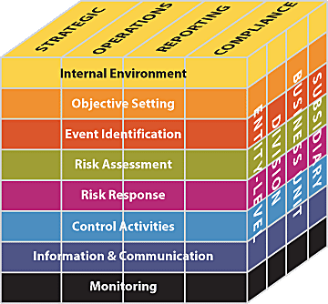
The ERM Framework
Entity objectives can be viewed in the
context of four categories:
  Strategic
  Operations
  Reporting
  Compliance

Slide 8
The ERM Framework
ERM considers activities at all levels
of the organization:
  Enterprise-level
  Division or
  subsidiary
  Business unit
processes

Slide 9
The ERM Framework
Enterprise risk management
requires an entity to take a portfolio view of risk.

Slide 10
The ERM Framework
Management considers how
individual risks interrelate.
Management develops a portfolio view from two perspectives:
    - Business unit level
    - Entity level

Slide 11
The ERM Framework
The eight components
of the framework
are interrelated …

Slide 12
Internal Environment
Establishes a philosophy regarding risk management. It recognizes that unexpected as well as expected events may occur.
Establishes the entity’s risk culture.
Considers all other aspects of how the organization’s actions may affect its risk culture.

Slide 13
Objective Setting
Is applied when management considers risks strategy in the setting of objectives.
Forms the risk appetite of the entity — a high-level view of how much risk management and the board are willing to accept.
Risk tolerance, the acceptable level of variation around objectives, is aligned with risk appetite.

Slide 14
Event Identification
Differentiates risks and opportunities.
Events that may have a negative impact represent risks.
Events that may have a positive impact represent natural offsets (opportunities), which management channels back to strategy setting.

Slide 15
Event Identification
Involves identifying those incidents, occurring internally or externally, that could affect strategy and achievement of objectives.
Addresses how internal and external factors combine and interact to influence the risk profile.

Slide 16
Risk Assessment
Allows an entity to understand the extent to which potential events might impact objectives.
Assesses risks from two perspectives:
- Likelihood
- Impact
Is used to assess risks and is normally also used to measure the related objectives.

Slide 17
Risk Assessment
Employs a combination of both qualitative and quantitative risk assessment methodologies.
Relates time horizons to objective horizons.
Assesses risk on both an inherent and a residual basis.

Slide 18
Risk Response
Identifies and evaluates possible responses to risk.
Evaluates options in relation to entity’s risk appetite, cost vs. benefit of potential risk responses, and degree to which a response will reduce impact and/or likelihood.
Selects and executes response based on evaluation of the portfolio of risks and responses.

Slide 19
Control Activities
Policies and procedures that help ensure that the risk responses, as well as other entity directives, are carried out.
Occur throughout the organization, at all levels and in all functions.
Include application and general information technology controls.

Slide 20
Information & Communication
Management identifies, captures, and communicates pertinent information in a form and timeframe that enables people to carry out their responsibilities.
Communication occurs in a broader sense, flowing down, across, and up
the organization.

Slide 21
Monitoring
Effectiveness of the other ERM components is monitored through:
  Ongoing monitoring activities.
  Separate evaluations.
  A combination of the two.
Notes:
Monitoring helps determine the effectiveness of the processes, technologies and personnel executing enterprise risk management. The entity establishes minimum standards for each component of enterprise risk management. The entity’s performance against these standards can then be monitored objectively.
Monitoring can be done in two ways: through ongoing activities or separate evaluations. Enterprise risk management mechanisms usually are structured to monitor themselves on an ongoing basis, at least to some degree.
Ongoing monitoring is built into the normal, recurring operating activities of an entity. Ongoing monitoring is performed on a real-time basis, reacts dynamically to changing conditions and is ingrained in the entity. As a result, it is more effective than separate evaluations.
The greater the degree and effectiveness of ongoing monitoring, the lesser need for separate evaluations. The frequency of separate evaluations is a matter of management's judgment. In making that determination, consideration is given to
the nature and degree of changes occurring, from both internal and external events, and their associated risks;
the competence and experience of the personnel implementing risk responses and related controls; and
the results of the ongoing monitoring.
Usually, some combination of ongoing monitoring and separate evaluations will ensure that enterprise risk management maintains its effectiveness over time.
Deficiencies in an entity’s enterprise risk management may surface from many sources, including the entity's ongoing monitoring procedures, separate evaluations and external parties. All enterprise risk management deficiencies that affect the entity’s ability to develop and implement its strategy and to achieve its established objectives should be reported to those who can take necessary action, as discussed in the next section

Slide 22
Internal Control
A strong system of internal
control is essential to effective
enterprise risk management.
Notes:
Risk Assessment - ERM encompasses the need for management to develop an entity-level portfolio view from two perspectives and highlights the notion of inherent and residual risk
Risk Response - ERM considers risk responses within categories of avoid, reduce, share and accept. Management considers these responses with the intent of achieving a residual risk level aligned with the entity’s risk tolerances. Having considered responses to risk on individual or group basis, management considers the aggregate effect of its risk responses across the entity.
The ERM framework elaborates on other components of IC-IF as they relate to enterprise risk management, most significantly the environment and information and communication
Enterprise risk management must also be applied in setting strategy, and there must be an entity level portfolio view.

Slide 23
Relationship to Internal Control — Integrated Framework
  Expands and elaborates on elements
  of internal control as set out in COSO’s
  “control framework.”
  Includes objective setting as a separate component. Objectives are a “prerequisite” for internal control.
  Expands the control framework’s “Financial Reporting” and “Risk Assessment.”
Notes:
Some differences include (note not all as time is limited):
The choice made by management and its implementation is part of management’s broader role, and are not part of ERM
The Internal Control – Integrated Framework specified the three objective categories of operations, external financial reporting and compliance. Enterprise risk management also specifies three objective categories – operations, reporting, and compliance. The reporting category expands the scope of financial reporting as defined in the Internal Control – Integrated Framework to include a broader array of reporting,
Event identification – ERM considers potential events, defining an event as an incident, or series of incidents emanating from internal or external sources that could affect the implementation of strategy and achievement objectives. ERM also considers alternatives in setting strategy, identifies events using a combination of techniques that consider both past and potential future events as well as emerging trends, considers what triggers events and groups potential events into risk categories.

Slide 24
ERM Roles & Responsibilities
Management
The board of directors
Risk officers
Internal auditors
Notes:
The board of directors is responsible for overseeing management’s design and operation of ERM.
Knowing the extent to which management has established effective enterprise risk management in the organization;
Being aware of and concurring with the entity’s risk appetite;
Reviewing the entity’s portfolio view of risk, and considering it against the entity’s risk appetite; and
Being apprised of the most significant risks, and whether management is taking appropriate responses.
Management:
Is responsible for the design of an entity's enterprise risk management framework
Promotes the desired risk culture, frames risks in the context of strategy and activities
Establishes an entity-level risk appetite
Provides a portfolio view of risk
Enforces compliance individually and in the aggregate.
The risk officer works with managers in establishing and maintaining effective risk management in their areas of responsibility, has the resources to help effect enterprise risk management across subsidiaries, businesses, departments, functions and activities and may have responsibility for monitoring progress and for assisting managers in reporting relevant risk information up, down and across the entity and likely chairs internal risk management committees.
We will come back later on the specific role of internal auditors in ERM

Slide 25
Internal Auditors
Play an important role in monitoring ERM, but do NOT have primary responsibility for its implementation
or maintenance.
Assist management and the board or audit committee in the process by:
- Monitoring - Evaluating
- Examining - Reporting
- Recommending improvements
Notes:
Internal auditors contribute to the ongoing effectiveness of the enterprise risk management, normally by their participation in separate evaluations, but they do not have primary responsibility for establishing or maintaining ERM.

Slide 26
Internal Auditors
Visit the guidance section of
The IIA’s Web site for The IIA’s
position paper, “Role of Internal Auditing’s in Enterprise Risk Management.”

Slide 27
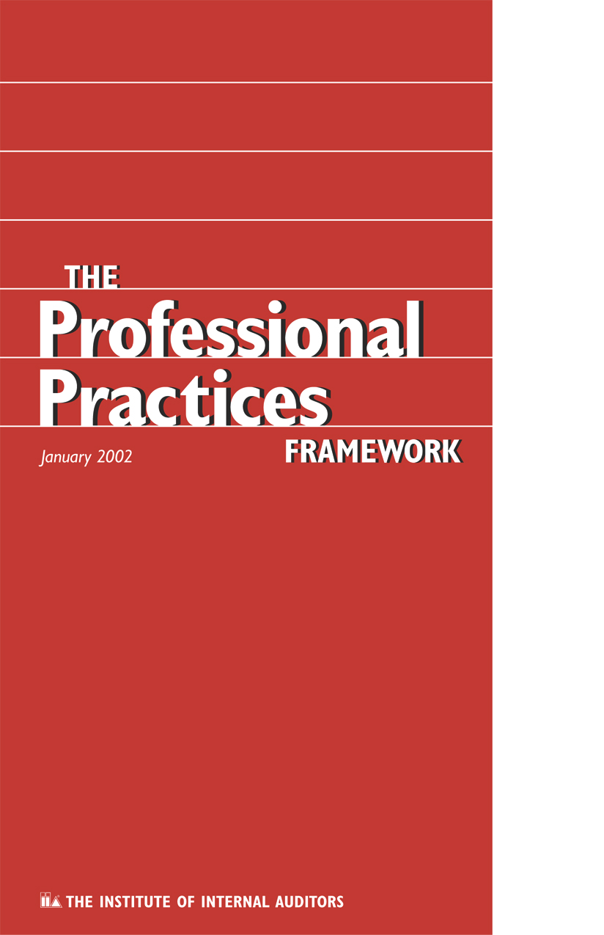
Standards
2010.A1 – The internal audit activity’s plan of engagements should be based on a risk assessment, undertaken at least annually.
2120.A1 – Based on the results of the risk assessment, the internal audit activity should evaluate the adequacy and effectiveness of controls encompassing the organization’s governance, operations, and information systems.
2210.A1 – When planning the engagement, the internal auditor should identify and assess risks relevant to the activity under review. The engagement objectives should reflect the results of the risk assessment.

Slide 28
Key Implementation Factors
Organizational design of business
Establishing an ERM organization
Performing risk assessments
Determining overall risk appetite
Identifying risk responses
Communication of risk results
Monitoring
Oversight & periodic review
by management

Slide 29
Organizational Design
Strategies of the business
Key business objectives
Related objectives that cascade
down the organization from key business objectives
Assignment of responsibilities to organizational elements and leaders (linkage)

Slide 30
Example: Linkage
Mission – To provide high-quality accessible and affordable community-based health care
Strategic Objective – To be the first
or second largest, full-service health
care provider in mid-size metropolitan markets
Related Objective – To initiate
dialogue with leadership of 10 top under-performing hospitals and negotiate agreements with two this year

Slide 31
Establish ERM
Determine a risk philosophy
Survey risk culture
Consider organizational integrity
and ethical values
Decide roles and responsibilities

Slide 32
Example: ERM Organization
Vice President and
Chief Risk Officer
Insurance
Risk Manager
ERM
Director
Corporate Credit
Risk Manager
FES
Commodity
Risk Mg.
Director
ERM
Manager
ERM
Manager
Staff
Staff
Staff

Slide 33
Assess Risk
Risk assessment is the identification and analysis of risks to the achievement of business objectives. It forms a basis for determining how risks should be managed.

Slide 34
Example: Risk Model
Environmental Risks
  Capital Availability
  Regulatory, Political, and Legal
  Financial Markets and Shareholder Relations
Process Risks
  Operations Risk
  Empowerment Risk
  Information Processing / Technology Risk
  Integrity Risk
  Financial Risk
Information for Decision Making
  Operational Risk
  Financial Risk
  Strategic Risk

Slide 35
Risk Analysis
Risk
Assessment
Risk
Management
Risk
Monitoring
Identification
Control It
Process
Level
Measurement
Share or
Transfer It
Activity
Level
Prioritization
Diversify or
Avoid It
Entity Level
Source: Business Risk Assessment. 1998 – The Institute of Internal Auditors

Slide 36
DETERMINE RISK APPETITE
Risk appetite is the amount of risk — on a broad level — an entity is willing to accept in pursuit of value.
Use quantitative or qualitative terms (e.g. earnings at risk vs. reputation risk), and consider risk tolerance (range of acceptable variation).

Slide 37
DETERMINE RISK APPETITE
Key questions:
  What risks will the organization not accept?
  (e.g. environmental or quality compromises)
  What risks will the organization take on new initiatives?
  (e.g. new product lines)
  What risks will the organization accept for competing objectives?
  (e.g. gross profit vs. market share?)

Slide 38
IDENTIFY RISK RESPONSES
Quantification of risk exposure
Options available:
- Accept = monitor
- Avoid = eliminate (get out of situation)
- Reduce = institute controls
- Share = partner with someone
(e.g. insurance)
Residual risk (unmitigated risk – e.g. shrinkage)

Slide 39
Impact vs. Probability
High
Medium Risk
High Risk
I
M
P
A
C
T
Share
Mitigate & Control
Low Risk
Medium Risk
Accept
Control
Low
PROBABILITY
High

Slide 40
Example: Call Center Risk Assessment
High
Medium Risk
High Risk
Loss of phones
Loss of computers
Credit risk
Customer has a long wait
Customer can’t get through
Customer can’t get answers
I
M
P
A
C
T
Low Risk
Medium Risk
Fraud
Lost transactions
Employee morale
Entry errors
Equipment obsolescence
Repeat calls for same problem
Low
PROBABILITY
High

Slide 41
Example: Accounts Payable Process
Control Risk Control
Objective Activity
Completeness Material Accrual of
transaction open liabilities
not recorded Invoices accrued
after closing
Issue: Invoices go to field and AP is not aware of liability.

Slide 42
Communicate Results
Dashboard of risks and related responses
(visual status of where key risks stand relative to risk tolerances)
Flowcharts of processes with key controls noted
Narratives of business objectives linked to operational risks and responses
List of key risks to be monitored or used
Management understanding of key business risk responsibility and communication of assignments

Slide 43
Monitor
Collect and display information
Perform analysis
  - Risks are being properly addressed
  - Controls are working to mitigate risks

Slide 44
Management Oversight & Periodic Review
Accountability for risks
Ownership
Updates
- Changes in business objectives
- Changes in systems
- Changes in processes

Slide 45
Internal auditors can add value by:
Reviewing critical control systems and risk management processes.
Performing an effectiveness review of management's risk assessments and the internal controls.
Providing advice in the design and improvement of control systems and risk mitigation strategies.

Slide 46
Internal auditors can add value by:
Implementing a risk-based approach to planning and executing the internal audit process.
Ensuring that internal auditing’s resources are directed at those areas most important to the organization.
Challenging the basis of management’s risk assessments and evaluating the adequacy and effectiveness of risk treatment strategies.

Slide 47
Internal auditors can add value by:
Facilitating ERM workshops.
Defining risk tolerances where none have been identified, based on internal auditing's experience, judgment, and consultation with management.

Slide 48
For more information
On COSO’s
Enterprise Risk Management
— Integrated Framework,
visit
www.coso.org
or
www.theiia.org

Slide 49
Applying COSO’s
Enterprise Risk Management — Integrated Framework
This presentation
was produced
by

