Slide 1
Risk Management in the Derivatives Markets
Derivatives and Risk Management
in Mexico
May 7, 2001
Dr. Michel Crouhy
Senior Vice President
Risk Analytics and Capital Attribution
Canadian Imperial Bank of Commerce
Dr. Robert Mark
Senior Executive Vice President
Chief Risk Officer
Canadian Imperial Bank of Commerce

Slide 2
Dr. Michel Crouhy is Senior Vice President, Risk Analytics and Capital Attribution, Risk Management Division, at CIBC (Canadian Imperial Bank of Commerce). His responsibilities include the approval of all pricing models, the development and implementation of risk measurement methodologies for market, credit and operational risks, operational risk policy, and firm-wide capital attribution (RAROC).
Prior to his current position at CIBC, Michel Crouhy was a Professor of Finance at the HEC School of Management in Paris, where he was also Director of the M.S. HEC in International Finance. He has been a visiting professor at the Wharton School and at UCLA. Dr. Crouhy holds a Ph.D from the Wharton School.
He is co-author of “Risk Management” (McGraw-Hill) and has published extensively in academic journals in the areas of banking, options and financial markets. He is also an associate editor of the Journal of Derivatives, the Journal of Banking and Finance, and is on the editorial board of the Journal of Risk.

Slide 3
Dr. Robert M. Mark is a Senior Executive Vice President and Chief Risk Officer (CRO) at the Canadian Imperial Bank of Commerce (CIBC). Dr. Mark reports directly to the Chairman and Chief Executive Officer of CIBC, and is a member of the Senior Executive Team (Management Committee). Dr. Mark has global responsibility to cover all credit, market and operating risks for all of CIBC as well as for its subsidiaries. He has been appointed to the Boards of the Fields Institute for Research in Mathematical Sciences, IBM’s Deep Computing Institute and the International Swaps and Derivative Association (ISDA). In 1998 he was awarded the Financial Risk Manager of the Year award by the Global Association of Risk Professionals (GARP).
Prior to his current position at CIBC, he was the partner in charge of the Financial Risk Management Consulting practice at Coopers & Lybrand (C&L). The Risk Management Practice at C & L advised clients on market and credit risk management issues and was directed toward financial institutions and multi-national corporations. This specialty area also coordinated the delivery of the firm’s accounting, tax, control, and litigation services to provide clients with integrated and comprehensive risk management solutions and opportunities.
Prior to his position at C&L, he was a managing director in the Asia, Europe, and Capital Markets Group (AECM) at Chemical Bank. His responsibilities within AECM encompassed risk management, asset/liability management, research (quantitative analysis), strategic planning and analytic systems. He served on the Senior Credit Committee of the Bank. Before he joined Chemical Bank, he was a senior officer at Marine Midland Bank/Hong Kong Shanghai Bank Group (HKSB) where he headed the technical analysis trading group within the Capital Markets Sector.
He earned his Ph.D., with a dissertation in options pricing, from New York University’s Graduate School of Engineering and Science, graduating first in his class. Subsequently, he received an Advanced Professional Certificate (APC) in accounting from NYU’s Stern Graduate School of Business, and is a graduate of the Harvard Business School Advanced Management Program. He was also appointed chairperson of the National Asset/Liability Management Association (NALMA), and an Adjunct Professor at NYU’s Stern Graduate School of Business.

Slide 4
Agenda
I Introduction 5
II Best Practice Risk Management………...…. 11
III Transforming Risk Into Value ……………… 34
IV New Capital Adequacy Framework ….….… 57
V BIS 98 …………………………………………… 59
VI BIS 2000+ …………………………………….. 66
VII Credit Risk Mitigation ………………………. 97
VIII Counterparty Risk …………………………… 114
IX Operational Risk …………………………….. 121
X Appendix……………………………………….. 155
Notes:
Salutation
The objective of today’s presentation s to provide some insight into:
Types of financial risk,
how CIBC manages risk today
Search for aunified risk measure

Slide 5
I.
Introduction
Why do Financial Institutions
try to Manage Risk ?

Slide 6
Introduction
Global trends are leading to …
The rising importance of risk management In financial institutions
More complex markets
  Global markets
  Greater product Complexity
  New businesses (e-banking,
  merchant banking,…)
  Increasing competition
  New players
  Regulatory imbalances
Increased
Risk

Slide 7
Introduction
I
In the Distant Past . . .
  Institutions disaggregated their risks, and
  treated each one separately.
However, today this approach is limited due to increasing
  Linkages between markets
  Importance of calculating portfolio effects, e.g issuer and counterparty risks, credit spread equity risks, etc.

Slide 8
Introduction
In the future . . .
The leading institutions will be distinguished by their intelligent management of risk.

Slide 9
Introduction
Risk is multidimensional
Market Risk
Credit Risk
Financial
Risks
Operational Risk
Reputational Risk
Business and strategic risks
Notes:
The key financial risks that we must address can be broken up into:
Market
Credit
Liquidity
Operational
Regulatory Risk
Human Factor Risk
These risks are meant to be neither mutually exclusive nor exhaustive. We can further divide each one of these risks into its subcomponents. For example, market risk can be broken up into
equity
interest rate
currency
and
commodity
And likewise interest rate risk can be further divided into “Trading” and “Gap” risks.
The risk picture is then depicted on this slide. Let’s now explore credit risk in more detail.

Slide 10
Introduction
One can “slice and dice” these multiple dimensions of risk*
“Specific
Risk”
Equity Risk
Trading Risk
Market Risk
General
Market
Risk
Interest Rate Risk
Gap Risk
Credit Risk
Currency Risk
Commodity Risk
Counterparty
Risk
Financial
Risks
Operational
Risk
Transaction Risk
Reputational
Risk
Issuer Risk
Portfolio
Concentration
Risk
Business and
strategic risks
Issue Risk
* For more details, see Chapter-1, “Risk Management” by Crouhy, Galai and Mark
Notes:
The key financial risks that we must address can be broken up into:
Market
Credit
Liquidity
Operational
Regulatory Risk
Human Factor Risk
These risks are meant to be neither mutually exclusive nor exhaustive. We can further divide each one of these risks into its subcomponents. For example, market risk can be broken up into
equity
interest rate
currency
and
commodity
And likewise interest rate risk can be further divided into “Trading” and “Gap” risks.
The risk picture is then depicted on this slide. Let’s now explore credit risk in more detail.

Slide 11
Best Practice
Risk Management*
II.
* For more details, see Chapter-3, “Risk Management” by Crouhy, Galai and Mark

Slide 12
Best Practice Risk Management
Goal: Independence and Partnership
  Establish a first class risk management function which is independent of the direct risk takers but works in partnership with them
Notes:
To achieve our goal of building a first class Market Risk management function we need to improve our current practices in key aspects.
“Independence and Partnership” succinctly summarizes one of these key aspects needing improvement. Market Risk Management must position itself to be be independent of the direct risk takers, but work in partnership with them.
I will cover the next couple of points
“Policies and Methodologies”,
and “Infrastructure”
in more detail later in my presentation. I would mention now that
· Policies & Methodologies refers to the goal of setting appropriate policies and best practice methodologies that protect against loss while supporting a profitable business. This is easier said than done.
· Infrastructure refers to the goal of providing a best practice infrastructure which enables a first class active management of risk.

Slide 13
Best Practice Risk Management
Framework for Risk Management
can be benchmarked in terms of:
  Policies
  Methodologies
  Infrastructure
METHODOLOGIES
POLICIES
INFRASTRUCTURE
Notes:
CIBC’s framework for MRM can be benchmarked in terms of
Policies
Methodologies
and
Infrastructure
Risk wears many disguises. One can ensure maximum transparency of risk through implementing an independent first class proactive market risk management program.
Click

Slide 14
Best Practice Risk Management
Framework for Risk Management
can be benchmarked in terms of:
  Policies
  Methodologies
  Infrastructure
METHODOLOGIES
Proactive
Risk
Management
POLICIES
INFRASTRUCTURE
Notes:
CIBC’s framework for MRM can be benchmarked in terms of
Policies
Methodologies
and
Infrastructure
Risk wears many disguises. One can ensure maximum transparency of risk through implementing an independent first class proactive market risk management program.
Click

Slide 15
Framework
An Independent and Integrated Business Oriented Process
Framework
Methodologies
Infrastructure
Policies
Analyze Deal
Price Deal
Compare Risk to Limit
Execute
Confirm/ Settle
Manage Business Unit Risk
Credit Risk
Market Risk
Risks
Liquidity Risk
Operational Risk
Regulatory Risk
Direct Risk Takers
Etc.
Notes:
What is the way forward ...
Our risk management plan is to build an independent and integrated business oriented process.
We must develop a bankwide common language of risk. The language must accurately describe the multiple dimensions of risk, as well as accommodate the complexity inherent in restructuring and repackaging risk.
As pointed out earlier, we need to develop policies and methodologies, as well as design an infrastructure which is independent but works in partnership with the risk-takers. For example, we need to appreciate the impact that our measurement of risk will have on the ability of direct risk takers to compete on price.
Direct risk takers are responsible for understanding and pricing the risks they assume in pursuing their business activity. Our direct risk takers will only use measures of risk for pricing if they are based on best practice methodologies with low “ivory tower” content.

Slide 16
Framework
Active portfolio management
is a key component of first
class proactive Risk
Management
= Active Portfolio
Management
+ Facilitate Pricing
INCREASING KNOWLEDGE REQUIRED
}
+ Assign Reserves &
Allocate Economic Capital
}
RAROC
+ Stress Test &
Scenario Analysis
Risk Analysis
+ Measure
(e.g. VaR & CreditVaR)
}
+ Monitor
Identify
& Avoid
Limit Management
First Class Risk Management
Notes:
The implementation of risk measures such as RMUs, sets the stage for pricing in risk as well as provides the ammunition to perform Active Portfolio Management.
Pricing in risk and Active Portfolio Management are key components of a first class proactive market risk management function.
Click

Slide 17
Framework - Policies
Business
Strategies
Risk Tolerance
POLICIES
Independent
First Class
Authorities
Proactive Risk
Management
Disclosure
Notes:
I will first review the progress in the policy dimension. A key component of our policy is to clearly articulate our tolerance for risk. In other words, our risk tolerance needs to express how much we are willing to lose in a worst case scenario. First, let us remember that our risk tolerance must flow directly from our business strategies. Further, our risk tolerance needs to be clearly expressed in our trading authorities. Finally, we need to ensure that our policies encourage a full disclosure of all of our risks.

Slide 18

Framework - Policies
These policies explicitly state our risk appetite, expressed in terms of a potential worst case loss.

Slide 19
Framework - Policies
EXAMPLES
Market Risk Policy
  Measure market risks in terms of a “worst case” loss
Credit Risk Policy
  Measure credit exposure in terms of a daily
  mark-to-market plus “worst case” future exposure
Operational Risk Policy
  Vet all models to be used to revalue positions
Notes:
The Market Risk policy, that we successfully implemented in selective businesses over the past year, states that we will measure market risk in terms of a statistically defined “worst case” loss. The worst case loss is constructed to ensure that there is less than 1/5 of 1% chance that a loss will be more than the worst case. In the case of interest rate risk, we consider complex shifts in the yield curve in arriving at the worst case loss.
We have also stated that we will measure credit risk for our off balance sheet products (such as an interest rate swap) in terms of a daily mark-to-market plus “worst case” future credit risk exposure.

Slide 20
Framework - Policies
Worst Case Market Risk
Worst Case” Market Risk Path
Probability
0%
t_{N}
+
V
A
L
U
Time
E
-
100%
t₀

Slide 21
Framework - Policies
.
Worst Case Credit Risk Exposure
“Worst Case” Credit Risk Exposure Path
Probability
0%
t_{N}
+ Value -
Time
100%
t₀

Slide 22
Framework - Methodologies
Independent
First Class Proactive Risk
Management
METHODOLOGIES
RAROC
VaR
Operational Risk
Valuation
Notes:
Let us next examine what Market Risk Management delivered from a methodology perspective. You will be please to note that I provided a flavor of the technical details associated with our recently implemented proprietary new Risk Measurement Unit Methodology at the December meeting of the Executive Committee. Yesterday, I provided the Risk Management and Conduct Review Committee with a similar review.

Slide 23
Framework - Methodologies
Market and Credit Risk Quantification of Risk
Value at Risk (at N standard deviations)
  Transaction risk
  Portfolio risk (capture correlation effect)
Event Risk
  Reasonable Paranoia
  Scenario Testing
  (e.g. volatility and correlation slippage)

Slide 24
Framework - Methodologies
Value-At-Risk Framework
Construct families of functions f such that:
(
)
f
Volatilities
Correlations
Liquidity Period
Market Value
Etc.
Market
Risk
=
Notes:
I can summarize our approach to the measurement of market risk by stating that we have constructed a family of VaR functions which take into account volatilities, correlations, the liquidity period... otherwise known as time to close, jump parameters... to take into account potential discontinuities in markets and other key considerations such as avoiding concentration risk.
At CIBC our VaR measure is called RMU, which is an acronym for risk measurement units.
Click

Slide 25
Framework - Methodologies
Credit losses are estimated through analyses of the future distributions of risk factors
(
)
Credit
Losses
f
Future Market Value Exposure Distributions
Default Rate
Distributions
Recovery Rate
Distributions
=
Notes:
Likewise we have done the same for contingent credit risk.
We have constructed a family of functions that take into account
exposure distributions,
default rate distributions,
and recovery rate distributions
in order to calculate both the expected and unexpected credit losses.
We utilize default and recovery rate information to translate credit risk exposures into projected credit risk losses. For example,as indicated at the bottom of the screen, if the expected exposure is $200 and the expected default is 1% and the expected recovery rate is 50%, then the expected loss is $200 x 1% x 50% or $1.
Click

Slide 26
Framework - Methodologies
VAR
Scenario Analysis
Works well for normal markets
Total Risk
Management
Accounts for unusual markets
(The past cannot always predict the future)
Scenario
Analysis

Slide 27
Framework - Methodologies
Stress Testing Scenario - Example 1:
US Equity Market Crash
Equity markets fall around the globe (US 10 %, Canada 7%, Hong Kong 15 %, Europe 10 % on average)
An upward shift in implied volatilities of from 15% to 50 %
Dollar rallies against other currencies : Asian Currencies lose 6 - 8 %
Rates fall in Western markets - HKD rates rise by 40 bps

Slide 28
Framework - Methodologies
Stress Testing Scenario - Example 2:
Canada Crisis
10 % drop in TSE
30 % upward shift in implied volatility
6 % depreciation of CAD against USD
FX volatility rise by 40 % in all currency pairs that include CAD
CAD interest rates rise 150 bp at short end and 50 bp at the long end; 20 % upward shift in implied volatility

Slide 29
Framework - Methodologies
Stress Testing Scenario - Example 3:
Credit Spreads Widening
Credit Spreads move upward by 10 bp (AAA)
to 100 bp (B)
Swap spreads increase 7 bp in major currencies
European currencies strengthen by 2 %

Slide 30
Framework - Methodologies
Risk Adjusted Return on Risk Adjusted Capital
Risk-Adjusted
Return on
Capital
Return on
Risk-Adjusted
Capital
Risk-Adjusted
Return on
Risk-Adjusted
Capital
Revenues
Return
on
Assets
Return
on
Equity
Leading
Edge
Methodology
Evolution of Performance Measures

Slide 31
Framework - Methodologies
Calculating Risk Adjusted Return on Risk Adjusted Capital (RARORAC)
(
)
f
Direct & Indirect Revenues
Direct & Indirect Expenses
Credit Risk Factors
Market Risk Factors
Correlation Effect
Balance Sheet Constraints
RARORAC
=

Slide 32
Framework - Infrastructure
Technology
Accurate
Data
INFRASTRUCTURE
Operations
Independent
First Class
Proactive Risk
Management
People
(Skills)
Notes:
When it comes to infrastructure, the most important component is people. Here of course I refer to people throughout the organization, not just those in support functions.
OR
The last component of our integrated market risk management framework is infrastructure.
The most important component of our infrastructure is people. It is self evident that a necessary condition to achieve a first class proactive managment of CIBC’s market risk, as illustrated by the arrow on the screen, is through hiring a highly skilled team of risk management experts.
Click

Slide 33
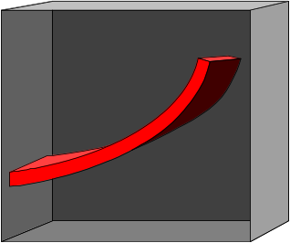
Framework - Infrastructure
Frontier - Risk MIS
6 Regions
Analytical Engine
RMU
Information Delivery
RISK
WAREHOUSE
Transformation
3-D Interface
Notes:
Frontier is designed to support the transportation and integration of risk information from a variety of technology platforms as well as multiple internal and external legacy systems. Information is currently being delivered to Frontier from 6 regions world-wide. Frontier, similar to a highway system, enables these legacy systems to transport any information without continuously building new roads.
Click
The Risk Warehouse is populated daily with CIBC Wood Gundy’s transaction and market information. The transaction information is reconciled daily to ensure that an accurate measure of market risk is being reported. The Risk Warehouse also stores a time series of market data in its financial database.
Click
The RMU reports are generated daily by an analytic engine that has been designed within Frontier. The RMU analytic engine was designed by Global Analytics in partnership with TRMR. The analytic engine was built with a flexible architecture to accommodate the going forward requirements of new advanced risk measures.
Click (3D interface)
Click (next slide)

Slide 34
III.
Transforming Risk into Value
Notes:
Thank you Bruce. Good morning Mr. Chairman, Members of the Board, Ladies and Gentlemen.
Rob, Tony and Bruce have given you a comprehensive overview of the current state of capital and balance sheet management at CIBC. I would like to now provide you with a glimpse into the future of capital and balance sheet management as well as the process through which we transform our management and understanding of risk into value.

Slide 35
We are on the verge of a transformational shift
Advances in Risk Management are being borrowed from the trading world in order to transform the approach to capital and balance sheet management
Notes:
I believe today that we are on the verge of transformation in terms of how leading financial institutions are approaching capital and balance sheet management.
Risk Management tools are being borrowed from the trading world in order to achieve this transformation.

Slide 36
Today
The regulatory community is:
Finding it increasingly difficult to keep pace
Beginning to acknowledge that standardized regulatory measures fail to provide sufficient transparency
Notes:
Regulators are finding it increasingly difficult to keep pace with the transformation that is taking place, as banks are introducing sophisticated measures of risk.
CLICK
On a positive note, the regulators are beginning to acknowledge that the standardized regulatory measure fail to provide sufficient transparency.

Slide 37
Why is this so?
Let’s take a look at a few examples
Notes:
Let’s look at a few examples to illustrate why the standardized regulatory capital rules do not adequately reflect risk. The 1988 Capital Accord aggregates counterparties with widely different credit standings into a small number of risk-weight categories. This simplicity makes it relatively easy to “arbitrage” the system.

Slide 38
Example #1: Short Term Revolvers
An unfunded revolver with a term of less than one year does not require any regulatory capital
Notes:
First, lets look at short term revolvers. Revolvers with a term of less than one year do not require any regulatory capital. As you will recall, a revolver is a facility which allows one to borrow and repay the loan at will within a certain period of time.
The bank is clearly at risk and yet as long as the term is less than one year, there is no regulatory capital required.

Slide 39
Example #2: Corporations vs. OECD Banks
A loan to GE requires 5 times as much
regulatory capital as a loan to Hokkaido
Takushoku
%
8.0
1.6
Hokkaido
Takushoku
General
Electric
Notes:
Let us next examine the regulatory rules as they apply to different classes of borrowers. The current rules assume that a loan to a corporate counterparty has five times the risk as a loan to an OECD Bank, regardless of their respective credit worthiness. For example, a loan to General Electric gets 5 times the regulatory capital of a Japanese bank such as Hokkaido Takushoku. Clearly, this is the opposite of what one would expect.

Slide 40
Example #3: Investment Grade vs. Non-investment Grade Lending
A loan to a AA-rated corporate requires the same amount of capital as a loan
to a B-rated corporate
%
8.0
8.0
AA
B
Notes:
Let’s next examine investment grade vs non-investment grade lending within the same borrower class. Regulatory rules assume that all corporate borrowers are deemed to have equal risk. For example a loan to a AA corporate requires that same amount of regulatory capital as a B rated credit.
This is also clearly inappropriate.

Slide 41
Example #4: Level of Diversification
A single loan requires the same amount of regulatory capital as a diversified portfolio
%
8.0
8.0
1 loan
of $100
100 loans
of $1 each
Notes:
As a final illustration, the current regulatory capital rules do not reflect the degree to which a bank’s portfolio of loans is diversified. For example, a single $100 million corporate loan requires the same amount of regulatory capital as a portfolio of 100 different and unrelated $1 million corporate loans.

Slide 42
Recent Events and
Emerging Trends
Notes:
Let us now examine some recent events and the emerging trends which will have a significant impact on capital and balance sheet management.

Slide 43
Trend #1: Regulatory approval of internal models for trading book
Banks have a choice of using either a standardized or an internal model to calculate regulatory capital for the trading book (1998 Rules)
Notes:
The general trend is that the regulators are moving away from a “one-size-fits-all” paradigm for regulatory capital.
Let’s review some specifics. As you know banks as of January 1998 have a choice of utilizing either a standardized or an internal model to calculate the minimum regulatory capital for the trading book.

Slide 44
Greater transparency and improved ability to manage and price risk
Internal models
Transforming Risk Into Value
Standardized risk-weighted assets
Nominal Assets
Increasing model sophistication
Notes:
Today, leading edge banks like ourselves are implementing sophisticated internal risk models in order to provide greater risk transparency over and above the standardized regulatory risk weighted asset rules that Rob reviewed with you earlier in his presentation. Further, the implementation of sophisticated models improves on our ability to manage and price risk.

Slide 45
Opportunities for a
Regulatory Capital Advantage
Example: 30 year Corporate Bond
Standardized
Model
Internal
Model
Capital
Market
Credit
98 Rules
Notes:
Internal Models also provide opportunities for a regulatory capital advantage.
For example, let’s consider an actual AA long-term corporate bond.
Our internal models reveal that we require less regulatory capital for investment grade bonds in the trading book then the 98 standardized rules CLICK as well as the old 88 rules. Conversely, we require more regulatory capital for non investment grade bonds than the 98 standardized rule as well as the old 88 rules.

Slide 46
Trend #2: Internal Models which measure Intersection of Market Risk and Credit Risk in the Trading Book
Price Risk in the trading book
Market
Risk
Credit
Risk
Notes:
Another key trend is that sophisticated banks are implementing internal models which measure the intersection of market risk and credit risk in the trading book. For example, the price of a AA corporate bond may decline due to a combination of either a rise in interest rates or a decline in credit quality. The ability to measure price risk as a function of both market risk and credit risk provides sophisticated banks with the ability to integrate their management of price risk, as well as an opportunity to gain additional regulatory capital relief.

Slide 47
Trend #2: Internal Models which measure Intersection of Market Risk and Credit Risk in the Trading Book
PRICE RISK IN THE TRADING BOOK
Market
Risk
Credit
Risk
Liquidity
Risk
Notes:
The last two Asian crises of 1997 and 1998 were a wake up call for the banks that neglected liquidity risk in their measurement framework.
So far the industry has not done a good job to address liquidity risk. All our VaR models are static in nature. Extending the horizon from 10 days to 1 year doesn’t make the model more dynamic. At CIBC we are currently implementing a “dynamic VaR” model which allows to incorporate portfolio rebalancing, trading strategies, liquidity risk modelling (bid-ask spread, volume,..)

Slide 48

The Asian Contagion
Trading Market Risk
Liquidity
Risk
Trading Credit Risk
Asian
Currencies
Declined
Market
Liquidity
Dried
Up
Credit
Spreads
Widened
Equities
Fell
Enterprise
Liquidity
Dried Up
Declining
Credit
Quality
Interest
Rates
Unstable
Financial
System
Under Stress
Defaults
Increased
Notes:
We need look no further than the current Asian crisis including the most recent events in Russia to vividly see how market and credit risk as well as liquidity risk in the trading book are interrelated and inseparable. As you may recall, Asian currencies declined led by the falling value of the Thai baht in July 98. Simultaneously, Credit spreads widened and Market Liquidity dried up. Next, equities fell and credit quality declined while enterprise liquidity dried up. Shortly thereafter interest rates were raised to defend the currencies and became highly unstable while defaults increased which put the financial system under increasing strain.

Slide 49
Trend #3: Development of Internal Models for the Banking Book
Sophisticated banks are working hard to develop internal models
  JP Morgan
So are leading model vendors
  KMV
Notes:
Now, let us turn to a third key trend. Leading edge banks are turning their attention to the development of internal risk models for their non trading activities in the banking book.
For example, JP Morgan last year introduced CreditMetrics for measuring credit risk in the banking book. These leading banks are joined by major model developers such as KMV which has a commercially available risk model for loans.

Slide 50
Our internal analytic risk models are being used to assign capital based on risk for the banking book
Capital
A
BBB
BB
B
Credit Rating
Notes:
Banks, in lieu of utilizing the flawed standardized regulatory rules, are developing internal models for the banking book in order to attribute internal economic capital as a function of risk. Our internal models appropriately charge significantly more capital for a non investment grade loan than an investment grade loan. Internal models allow banks to create value through better capital management.

Slide 51
Our internal analytic risk models reflect the level of concentration risk
1 loan
of $100
Capital
100 loans
of $1 each
Increasing Diversification
Notes:
Similarly, our internal models reflect the degree to which we have concentration risk. For example, our internal models indicate the amount of economic capital assigned to a diversified portfolio of 100 loans of $1 million dollars each is substantially less than the amount of economic capital assigned to 1 loan of $100 million dollars.

Slide 52
Trend #4: Regulatory Approval for the Banking Book
Today
Future
Internal models for the
TRADING book
Internal models for the
BANKING book
Transforming Risk into Value
Notes:
A fourth trend is that leading banks are joining forces to ask regulators for approval to use their internal models for the banking book in the same way that regulators have allowed banks to use internal models for the trading book.

Slide 53
Knowledge Transfer from
Trading to Banking Book
Integrated Internal
models for banking book
Transforming Risk Into Value
Knowledge transfer from
trading book to banking book
Integrated Internal models
for trading book
Increasing Model Sophistication
Notes:
The transfer of knowledge gained from applying internal models in the trading book to the banking book, will enhance the way banks manage risks in the banking book, but what will the regulators do?

Slide 54
Trend #5: Regulators will encourage the use of internal models
Regulators concerned about significant reduction in regulatory capital brought about by
  allowing banks to use their internal models
  regulatory arbitrage
Notes:
I believe that the regulators will ultimately accept internal models in lieu of standardized rules to arrive at the minimum required regulatory capital for the banking book, as they already have done for the trading book. Nevertheless, regulators will become increasingly concerned about the reduction in required regulatory capital brought about by the use of internal models in the trading book. CLICK Further, in the short run, regulators are becoming increasingly concerned that sophisticated banks will increase their use of credit derivatives, along with loan sales and trading as well as securitization to arbitrage the standardized one size fits all regulatory rules in order to reduce the amount of regulatory capital.

Slide 55
Future: Regulatory Response
Implications:
  If regulators scale up regulatory capital,
  then sophisticated banks that have internal models will continue to have a relative capital advantage
Notes:
The likely regulatory response to such a concern is to scale up the amount of minimum required regulatory capital by a factor. Nevertheless, if regulators scale up regulatory capital then sophisticated banks with internal models will retain an even greater relative competitive advantage over those that don’t have sophisticated internal models.

Slide 56
New Capital Adequacy Framework*
IV.
* For more details, see Chapter-2, “Risk Management” by Crouhy, Galai and Mark

Slide 57
Menu of Approaches
For Measuring Market Risk - BIS 98
  Standardized Approach
  Internal VaR Models
For Measuring Credit Risk - BIS 2000+
  Standardized Approach
  Foundation Internal Ratings-based Approach
  Advanced Internal Ratings-based Approach
For Measuring Operational Risk - BIS 2000+
  Basic Indicator Approach
  Standardized Business Line Approach
  Internal Measurement Approach

Slide 58
V.
BIS 98*
* For more details, see Chapters 2 and 4, “Risk Management” by Crouhy, Galai and Mark

Slide 59
The New 1998 BIS and
CAD II Accord
Applies to the trading book and encompasses:
General market risk
  Change in market value resulting from broad market movements
Specific risk
(idiosyncratic or credit risk)
  Adverse price movements due to idiosyncratic factors related to individual issuers

Slide 60
BIS 98
Regulatory capital required for market risk associated with the trading book:
  General market risk
  {3 * sqr(10) * market-risk VaR}* (trigger/8)
  Specific risk (equities and corporate bonds)
  {4 * sqr(10) * specific-risk VaR}*(trigger/8)
Notes:
According to the new 1998 BIS Accord the bank’s overall capital requirement is the sum of:
Market risk capital charge for the instruments of the trading book on, as well as off-balance sheet. Market risk encompasses both “general market risk” which refers to changes in market value resulting from broad market movements, and “specific risk” which refers mainly to credit risk.
For general market risk banks have the choice between the standardized approach and their own internal models, i.e. their own market VaR model. Specific risk for bonds can be assessed using a CreditMetrics type of model, although a lot of flexibility is left to the banks at this stage and no great sophistication is still required by the regulators.
Credit risk capital charge as proposed in the initial 1988 Accord and which applies to all positions in the trading and banking books except for debt and equity securities in the trading book, and all positions in commodities and FX.
What is new in the 1998 Accord is the requirement to model market risk for both linear products and derivatives according to best finance theory, while the measurement of credit risk stays archaic and is still based on ad hoc rules. It is very limited since it doesn’t address various complex issues like the credit migration process, default correlations and portfolio diversification, pricing with default risk, etc…
Clearly the next step is to develop a VaR framework for credit risk which is fully consistent with market VaR.

Slide 61
BIS 98
Multipliers (3 for general market risk and 4 for specific risk) reward the quality of the models
The “trigger” relates to the control process (8 to 25)
Total Capital
  1998 BIS Accord
      +
  Modified 1988 BIS Accord
Notes:
According to the new 1998 BIS Accord the bank’s overall capital requirement is the sum of:
Market risk capital charge for the instruments of the trading book on, as well as off-balance sheet. Market risk encompasses both “general market risk” which refers to changes in market value resulting from broad market movements, and “specific risk” which refers mainly to credit risk.
For general market risk banks have the choice between the standardized approach and their own internal models, i.e. their own market VaR model. Specific risk for bonds can be assessed using a CreditMetrics type of model, although a lot of flexibility is left to the banks at this stage and no great sophistication is still required by the regulators.
Credit risk capital charge as proposed in the initial 1988 Accord and which applies to all positions in the trading and banking books except for debt and equity securities in the trading book, and all positions in commodities and FX.
What is new in the 1998 Accord is the requirement to model market risk for both linear products and derivatives according to best finance theory, while the measurement of credit risk stays archaic and is still based on ad hoc rules. It is very limited since it doesn’t address various complex issues like the credit migration process, default correlations and portfolio diversification, pricing with default risk, etc…
Clearly the next step is to develop a VaR framework for credit risk which is fully consistent with market VaR.

Slide 62
BIS 98
Internal models vs Standardized approach
  capture portfolio effects
  allow to incorporate credit risk mitigation techniques and hedging strategies
  provide opportunity for capital reduction through a better risk assessment

Slide 63
BIS 98
…but also for a more accurate allocation of capital
Example: Portfolio of
100 $1 bonds
diversified across industries
Capital charge for specific risk (%)
Internal
model
Standardized
approach
AAA
0.26
1.6
AA
0.77
1.6
A
1.00
1.6
BBB
2.40
1.6
BB
5.24
8
B
8.45
8
CCC
10.26
8

Slide 64
BIS 98
Standardized Approach
Internal
model
AAA
AA
A
BBB
BB
B
CCC

Slide 65
VI.
The New Basel Capital Accord*
(BIS 2000+)
* For more details, see Chapter-2, “Risk Management” by Crouhy, Galai and Mark

Slide 66
BIS2000+
In 1999 several consultative papers have been issued
  Credit Risk Modeling (April)
  A new Capital Adequacy Framework (June)
  Credit Risk Disclosure
  Principles for the management of credit risk
  Settlement risk in foreign exchange
January 16, 2001
  New Basel Accord
  (BIS is seeking comments by the end of May 2001, with expectation that the final version will be published by the end of 2001, and come into effect in 2004)
Notes:
In addition the fed issued sr99-18

Slide 67
Some existing shortfalls
Credit Risk
  Undifferentiated by risk
  No benefit for diversification
  Tenor and structural arbitrage
Interest rate risk in banking book
  No (explicit) capital
Operational risk
  No (explicit) capital
Notes:
There are a number of issues with the banking book. Let’s look at a few examples to illustrate why the standardized regulatory capital rules do not adequately reflect risk.
First, consider revolvers with a term of less than one year. The bank is clearly at risk and yet as long as the term is less than one year, no regulatory capital required.
Next, let’s look at asset securitisation. There is a tremendous amount of regulatory capital arbitrage taking place here today. Banks reduce regulatory capital, while most often transferring no risk.
Or what about interest rate risk in the banking book or the ALM position? Banks often take substantial interest rate bets, and get no incremental capital. This is something that I am certain we will come back to time and time again over the course of this conference.
What about operational risk? It is very real, and yet gets no explicit capital.
Then there is corporate lending. The current regulatory rules assume that all corporate borrowers have equal risk. For example a loan to a AA corporate requires that same amount of regulatory capital as a B rated credit. This is clearly inappropriate. Moreover, the current rules provide no benefit for diversification nor any penalty for concentrations.

Slide 68

The New Basel Capital Accord
Three Basic Pillars
Minimum Capital Requirement
Supervisory
Review Process
Market
Discipline
Requirements
Notes:
The new capital accord would consist of thre basic pillars. Taken together they are seen as essential to the working of an effective regulatory capital framework
1) A minimum capital requirement, which seeks to expand on and develop the concept of standardized rules to calculate a minimum level of capital for any institution.
2) A Supervisory review of an institution’s capital adequacy and internal assessment process. This will seek to ensure that the regulators are comfortable that a bank’s capital position is consistent with its overall risk profile and strategy. Early intervention is envisaged, if a regulator deems there to be deficiencies in either the level of capital or the internal control mechanisms.
3) A Market Discipline pillar, which will act as a lever to strengthen disclosure and encourage safe and sound banking practices. Effective market discipline requires the disclosure of reliable and timely information, so that market participants and creditors can make well founded risk assessments. A significant intention, here, being to lessen the risk of “Moral hazard” to the local regulator. In th past regulators have often felt compelled to bail out creditors who have claimed that a lack of information and discolors prevented them from understanding the risks they were taking.

Slide 69
Scope of Application
Current Accord
  Applicable to banks on a consolidated basis
    including subsidiaries undertaking banking and financial business
    but without further specification

Slide 70
New Scope of Application
Diversified Financial Group
Holding Company
Internationally Active Bank
Internationally Active Bank
Internationally Active Bank
Domestic Bank
Securities Firm

Slide 71
Subsidiaries and Other
Financial Activities
Banking Activities
(as defined under national legislation)
Majority Owned or Controlled
Significant Minority-Owned Investments
Principle Full Consolidation
Pro-rate
Consolidation
Deduction of Investment
Otherwise Deduction

Slide 72
Minimum Capital Requirement
Pillar One
Standardized
Internal Ratings
Credit Risk Models
Credit Mitigation
Credit Risk
Trading Book
Banking Book
Risks
Market Risk
Operational
Other
Other Risks

Slide 73
1. Minimum Capital Requirements
(Pillar One)
Standardized approach
(External Ratings)
Internal ratings-based approach
    Foundation approach
    Advanced approach
Credit risk modeling
(Sophisticated banks in the future)
Minimum Capital Requirement

Slide 74
Evolutionary Structure of the Accord
Credit Risk Modeling ?
Advanced IRB Approach
Foundation IRB Approach
Standardized Approach
Increased level of sophistication

Slide 75
The New Basel Capital Accord
Securitization [Additional work required]
Project Finance [Additional Work Required]
Equity [Additional Work Required]
  Merchant Banking Book

Slide 76
The New Basel Capital Accord
Standardized Approach
Provides Greater Risk Differentiation than 1988
Risk Weights based on external ratings
Five categories [0%, 20%, 50%, 100%, 150%]
Certain Reductions
  e.g. short term bank obligations
Certain Increases
  e.g.150% category for lowest rated obligors

Slide 77
Standardized Approach
Based on assessment of external credit assessment institutions
External Credit Assessments
Sovereigns
Banks/Securities Firms
Corporates
Public-Sector Entities
Asset Securitization Programs

Slide 78
Standardized Approach:
New Risk Weights (June 1999)
Assessment
Claim
AAA to
A+ to A-
BBB+ to
BB+ to
Below B-
Unrated
AA-
BBB-
B-
Sovereigns
0%
20%
50%
100%
150%
100%
Option 1¹
20%
50%
100%
100%
150%
100%
Banks
Option 2²
20%
50%
3
50%
3
100%
3
150%
50%
3
Corporates
20%
100%
100%
100%
150%
100%
¹ Risk weighting based on risk weighting of sovereign in which the bank is incorporated.
² Risk weighting based on the assessment of the individual bank.
³ Claims on banks of a short original maturity, for example less than six months, would receive a weighting that is one category more favourable than the usual risk weight on the bank’s claims
.

Slide 79
Standardized Approach:
New Risk Weights (January 2001)
Assessment
Claim
AAA to
A+ to A-
BBB+ to
BB+ to
Below BB-
(B-)
Unrated
AA-
BBB-
BB- (B-)
Sovereigns
0%
20%
50%
100%
150%
100%
Option 1¹
20%
50%
100%
100%
150%
100%
Banks
Option 2²
20%
50%
3
3
100%
3
150%
50%
3
50%
Corporates
20%
50%(100%)
100%
100%
150%
100%
¹ Risk weighting based on risk weighting of sovereign in which the bank is incorporated.
² Risk weighting based on the assessment of the individual bank.
³ Claims on banks of a short original maturity, for example less than six months, would receive a weighting that is one category more favourable than the usual risk weight on the bank’s claims
.

Slide 80
Internal Ratings-Based Approach
Two-tier ratings system:
  Obligor rating
    represents probability of default by a borrower
  Facility rating
    represents expected loss of principal and/or interest
Pillar 1
Notes:
We suggest adopting a two-tier rating system.
First an obligor rating that can be easily mapped to a default probability bucket .
Second, a facility rating that determines the loss parameters in case of default, such as (I) loss given default (LGD) which depends on the seniority of the facility and the quality of the guarantees, and (ii) usage given default (UGD) for loan commitments which depends on the nature of the commitment and the rating history of the borrower.

Slide 81
ISDA proposed “standard approach”
Example: Relative Capital Weights: 99.5% confidence level; LGD = 100%
Prob. Def. %
≤ 0.5 Yr
0.5-1 Yr
1-2 Yr
2-3 Yr
3-4 Yr
4-5 Yr
5-6 Yr
6-7 Yr
7-8 Yr
8-9 Yr
> 9 Yr
0.00
−
0.025
6
8
12
17
21
25
28
32
36
40
43
0.025
−
0.035
9
12
17
23
29
35
40
46
51
56
60
0.03 5
−
0.045
13
17
24
31
38
46
52
58
66
73
80
0.04 5
−
0.055
16
20
28
36
44
52
59
65
74
81
89
0.055
−
0.065
18
24
32
41
49
58
65
73
81
89
98
0.065
−
0.085
22
29
38
47
56
65
73
81
91
100
109
0.085
−
0.115
27
34
45
56
66
76
85
94
104
114
123
0.115
−
0.165
36
46
59
72
86
97
108
119
130
140
151
0.165
−
0.255
48
60
80
100
118
134
149
164
178
191
203
0.255
−
0.405
72
86
108
130
150
168
186
202
216
230
241
0.405
−
0.635
100
119
145
172
195
216
236
254
269
283
294
0.635
−
0.915
140
163
190
215
238
257
275
292
305
317
327
0.915
−
1.335
181
207
231
253
273
290
307
321
331
342
351
1.335
1.945
240
271
293
312
330
345
359
371
379
388
395
1.945
−
3.875
370
409
420
430
440
450
457
463
466
473
476
3.875
−
7.705
662
716
719
721
724
726
727
727
727
727
727
7.705
−
14.995
1083
1163
1164
1166
1166
1168
1168
1168
1168
1168
1168
14.995
−
20.000
1619
1718
1718
1718
1718
1718
1718
1718
1718
1718
1718
Weights are average values derived by 6 international banks and sponsored by ISDA (BBB 3yr = 3.45% )

Slide 82
Standardized Approach
Internal rating system & Credit VaR
New standardized model
16
12
PER CENT
8
1.6
0
S & P :
AAA
AA
A+
A-
BBB
BB+
BB-
B
CCC
1
2
3
4
4.5
5
5.5
6
6.5
7
RATING
Notes:
This graph shows regulatory capital for various classes of obligors in a well diversified portfolio. The checkered panels represent capital under the new proposal, while the bar chart is the capital for obligors rated 1 to 7 according to CIBC’s internal rating system. The difference between the two is huge.
The new accord penalizes heavily holdings from investment grade borrowers. Conversely, the new accord doesn’t allocate enough capital for speculative grade borrowers rated B and below, as well as the toxic waste CCC and below.

Slide 83
Internal Ratings-Based Approach
Three elements:
  Risk Components [PD, LGD, EAD]
  Risk Weight conversion function
  Minimum requirements for the management of policy
  and processes
  Emphasis on full compliance
Definitions;
PD = Probability of default [“conservative view of long run average (pooled) for borrowers assigned to a RR grade.”]
LGD = Loss given default
EAD = Exposure at default
Note: BIS is Proposing 75% for unused commitments
EL = Expected Loss

Slide 84
Internal Ratings-Based Approach
Risk Components
  Foundation Approach
    PD set by Bank
    LGD, EAD set by Regulator
      50% LGD for Senior Unsecured
      Will be reduced by collateral (Financial or Physical)
  Advanced Approach
    PD, LGD, EAD all set by Bank
    Between 2004 and 2006: floor for advanced
    approach @ 90% of foundation approach
Notes
Consideration is being given to incorporate maturity explicitly into the “Advanced”approach
Granularity adjustment will be made. [not correlation, not models]
Will not recognize industry, geography.
Based on distribution of exposures by RR.
Adjustment will increase or reduce capital based on comparison to a reference portfolio
[different for foundation vs. advanced.]

Slide 85
Exposure at Default
On-balance-sheet items: nominal outstanding amount.
Off-balance-sheet positions
  Foundation approach
    Same credit conversion factors as in 1988 Accord.
    Exception: commitments >75% for undrawn amount
  Advanced Approach
    Banks can use their own internal estimates

Slide 86
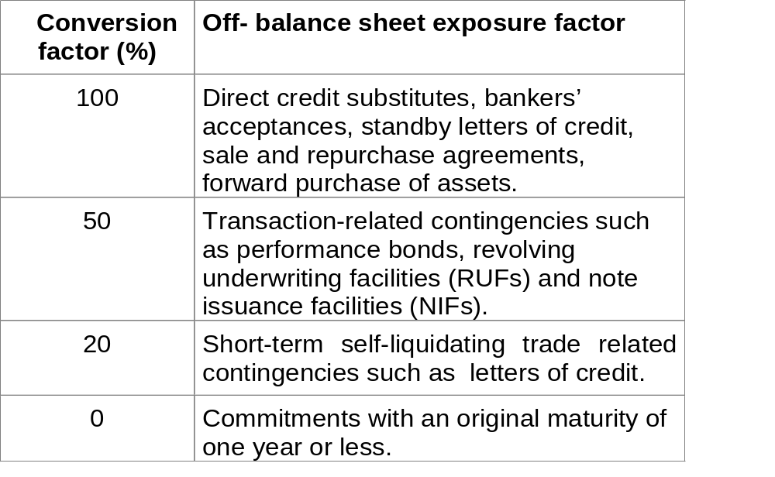
Credit conversion factors for
non-derivative off-balance sheet exposures

Slide 87
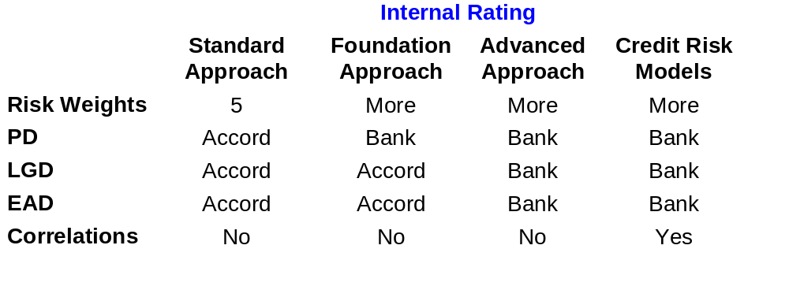
Approach Variations

Slide 88

Corporate benchmark risk weight:
¹ PD is expressed as a decimal (e.g., 0.01 for 1 percent)

Slide 89
N(1.118xG(PD)+1.288) = sum of expected and unexpected losses associated with a hypothetical, infinitely-granular portfolio of one-year loan having an LGD of 100%, using a so-called Merton-style credit risk model in which there is a single systematic risk factor and the values of borrowers’ assets are assumed lognormally distributed, a confidence level of 99.5% and an average correlation of 20%
The term (1+.0470x(1-PD)/PD^{0.44}) is an adjustment to reflect that the IRB benchmark risk weights are calibrated to a 3-year average maturity; and the scaling factor 976.5, which is calibrated so that the IRB benchmark risk weight equals 100% for values of PD and LGD equal to 0.7% and 50% respectively.

Slide 90
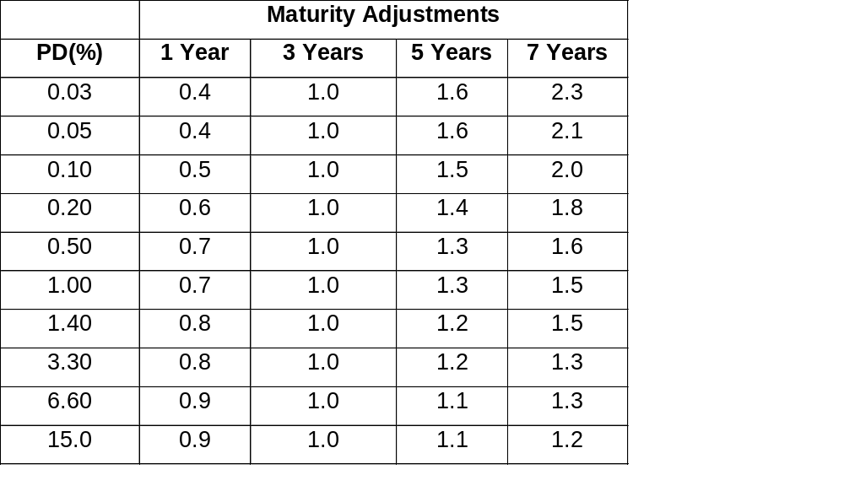
Maturity Adjustments to The Risk Weights, Derived From MTM-models

Slide 91
IRB - Risk Weight Function
Risk weighted assets = risk weight x exposure
Risk weight = f (PD, LGD, EAD, M)
PD estimation
  Underlying historical observation period at least 5 years.
  Transition period 2004-2007 (start 2 years observation period)
Rating system in use for at least 3 years
  Transition period 2004 - 2007

Slide 92
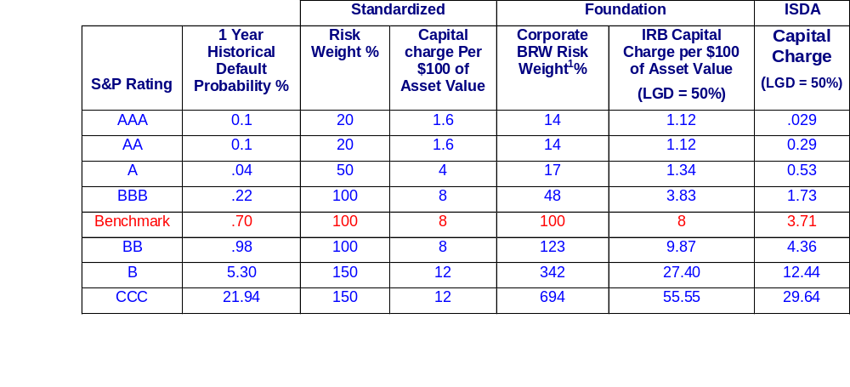
Standardized vs. Foundation IRB Approach vs. Internal Model Approach
Foundation IRB attributes more than twice as much capital as Internal Models (ISDA)
Capital Charges for Standard and Poor’s Rating Categories
BRW = Benchmark Risk Weight
Note: ¹ Formula supplied by BIS.

Slide 93
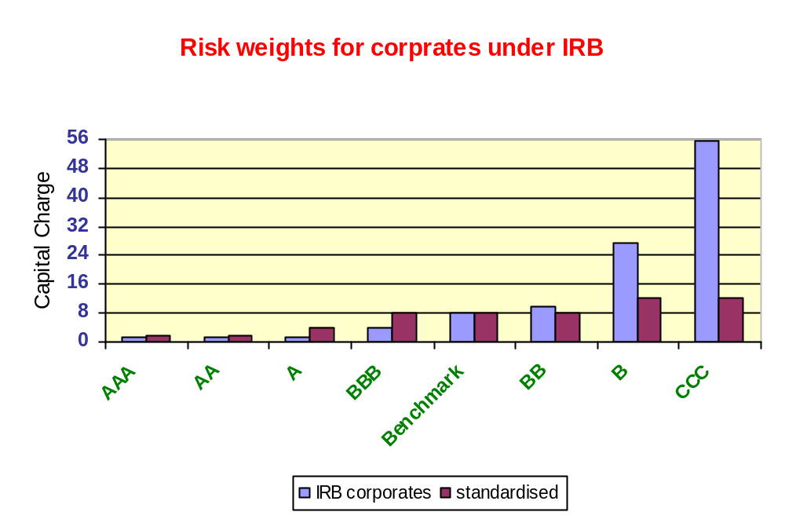
Risk Weights
Standardized vs. Foundation IRB Approach
¹
Note: ¹ Benchmark set at 0.7% PD, 50% LGD, M=3 years

Slide 94
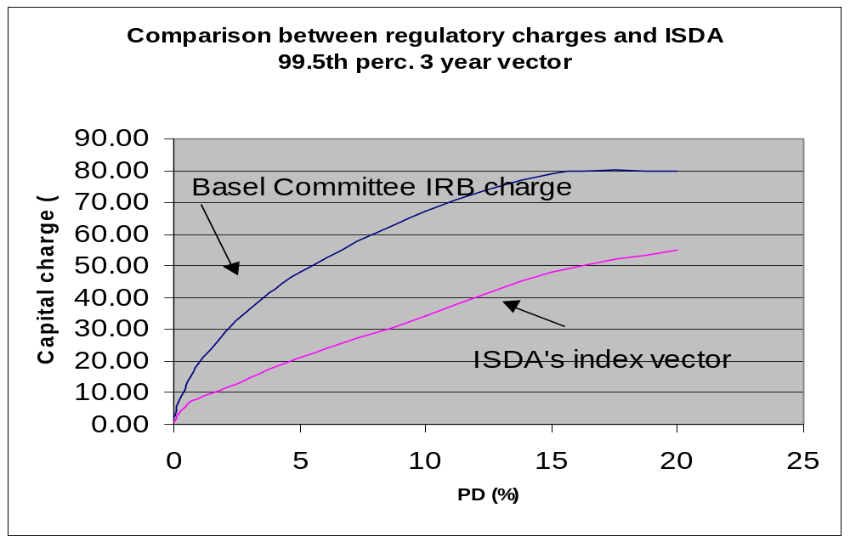
Note: Assumption LGD=100%

Slide 95
Encouragement of models
Regulators welcome the use of credit risk models as part of internal risk management process to manage risk
Regulators will recognize the use of credit risk models as part of their supervisory review process
Notes:
.
As I mentioned before, the committee recognizes that, credit modeling has been introduced at some of the more sophisticated banks.
Regulators are encouraging development of models for internal risk management. Only models will explicitly reflect diversification and concentrations which are present in a bank’s portfolio, and it should be remembered that is concentrations, or worse still the illusion of diversification that has got banks in trouble. True diversification keeps banks out of trouble. Models are the only way to truly understand these phenomena and their sensitivity. Michel will talk more about this later.

Slide 96
Credit Risk Mitigation
VII.

Slide 97
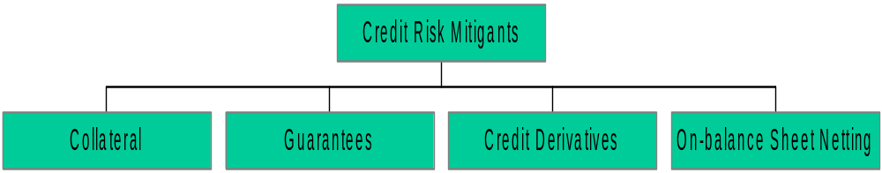
Credit Risk Mitigation
Recognition of wider range of mitigants
Subject to meeting minimum requirements
Applies to both Standardized and IRB Approaches

Slide 98
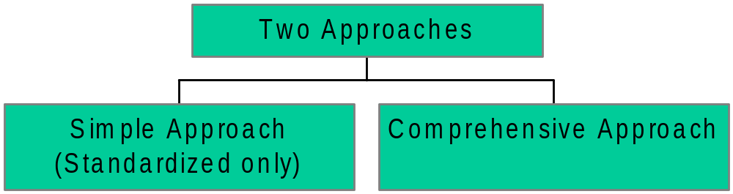
Collateral

Slide 99
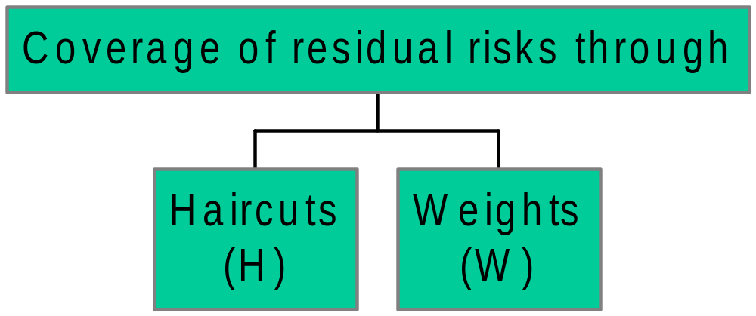
Collateral
Comprehensive Approach

Slide 100
Collateral
Comprehensive Approach
H - should reflect the volatility of the collateral
w - should reflect legal uncertainty and other residual risks.
  Represents a floor for capital requirements

Slide 101
Collateral Example
$1,000 loan to BBB rated corporate
$800 collateralised by bond
issued by AAA rated bank
Residual maturity of both: 2 years

Slide 102
Collateral Example
Simple Approach
Collateralized claims receive the risk weight applicable to the collateral instrument, subject to a floor of 20%
Example: $1,000 - $800 = $200
$200 x $100% = $200
$800 x $20% = $160
Risk Weighted Assets: $200+$160 = $360

Slide 103
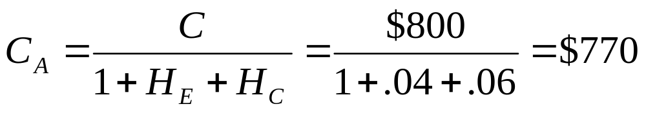
Collateral Example Comprehensive Approach
C = Current value of the collateral received (e.g. $800)
H_{E} = Haircut appropriate to the exposure (e.g.= 6%)
H_{C} = Haircut appropriate for the collateral received (e.g.= 4%)
C_{A} = Adjusted value of the collateral (e.g. $770)

Slide 104
Collateral Example Comprehensive Approach
Calculation of risk weighted assets based on following formula:
r* x E = r x [E-(1-w) x C_{A}]

Slide 105
Collateral Example Comprehensive Approach
r* = Risk weight of the position taking into account the risk reduction (e.g. 34.5%)
w¹ = 0.15
r = Risk weight of uncollateralized exposure
(e.g. 100%)
E = Value of the uncollateralized exposure
(e.g. $1000)
Risk Weighted Assets
34.5% x $1,000 = 100% x [$1,000 - (1-0.15) x $770] = $345
Note: 1 Discussions ongoing with BIS re double counting of w factor with Operational Risk

Slide 106
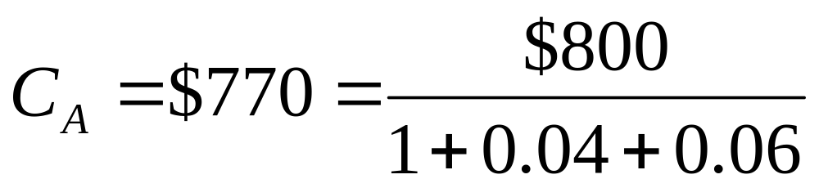
Collateral Example Comprehensive Approach
Risk Weighted Assets
34.5% x $1,000 = 100% x [$1,000 - (1-0.15) x $770] = $345
Note: comprehensive Approach saves

Slide 107
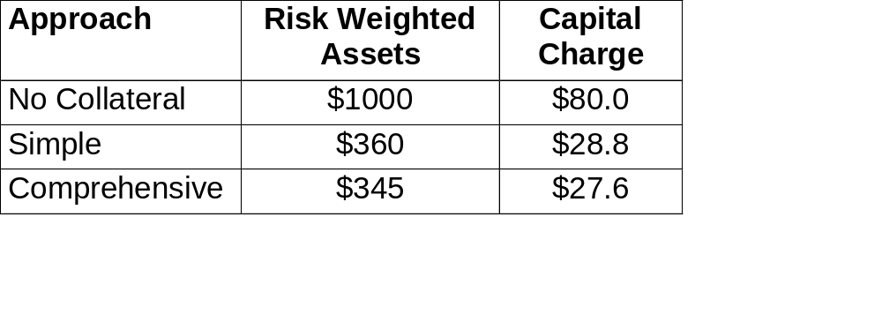
Collateral Example
Simple and Comprehensive Approaches

Slide 108
Guarantees & Credit Derivatives
Based on substitution approach of existing Accord
Minimum operational requirements
Guarantees, must be
    Direct
    Explicit
    Irrevocable
    Unconditional

Slide 109
Guarantee - Example
r* = g+ w * (r-g)
r* = effective risk weight of the position
r = risk weight of the obligor
w = weight applied to the underlying exposure
  (w = 0.15 or 0 for sovereigns and banks)
g = risk weight of the guarantor

Slide 110
Guarantee - Example
$1,000 loan to BBB - rated corporate
$1,000 guaranteed by AAA rated corporate
r* = 20% + 0.15 x (100% - 20%) = 32%

Slide 111

Guarantees & Credit Derivatives
Maturity Mismatches
  < one year will not be recognized
  > one year

Slide 112
Guarantees & Credit Derivatives
where
  r** = weight of the mismatched position
  r = weight of the unhedged position
  r* = weight if position hedged without mismatch
  t = residual maturity of the hedge
  T = residual maturity of exposure

Slide 113
On-Balance Sheet Netting
Netting of loans and deposits will be permitted subject to the following conditions:
  Well-founded legal basis enforceable in each relevant jurisdiction
  Assets and liabilities must be determinable
  Bank monitors roll-off risks
  Bank monitors and controls relevant exposures on a net basis

Slide 114
Counterparty Risk
VIII.

Slide 115
Contents
Forms of credit risk and credit exposure
Methods to measure counterparty credit exposure
  simple add-on method
  counterparty portfolio simulation
Economic Capital
    Default only perspective
    Change in economic value perspective

Slide 116
Type of Credit Risk
Cause of Economic Loss
Lending Risk
Borrower
defaults – an accrual (non MTM) perspective
➢
Or the loan portfolio’s
economic value decreases
because of:
−
Decrease in the credit quality of the obligor.
−
Increase in general market spreads.
Issuer Risk (Specific Risk)
Issuer of security defaults
➢
Or the security’s
market value decreases
because of:
−
Decreases in the credit quality of issuer.
−
Increase in general market spreads.
Counterparty Risk
Counterparty
to trade defaults
Settlement Risk
−
In an exchange: you pay but don’t receive.
Pre-Settlement Risk
−
Counterparty defaults prior to settlement and the
contract (portfolio) has a positive economic value.
➢
Or the
economic value of derivatives
with counterparty
decreases because of
−
Decrease in credit quality of counterparty.
−
Increase in general market spreads

Slide 117
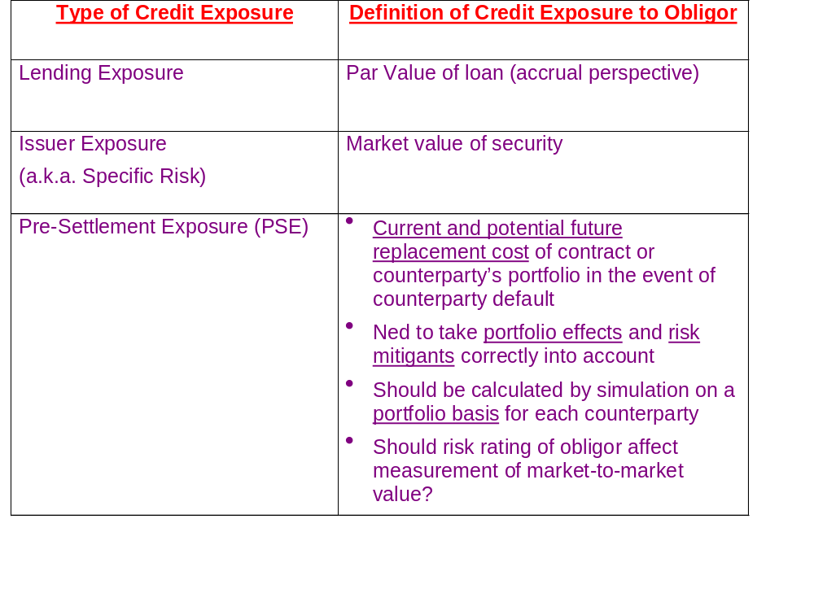
Credit Exposure: The potential loss in the event of default, ignoring recovery value

Slide 118
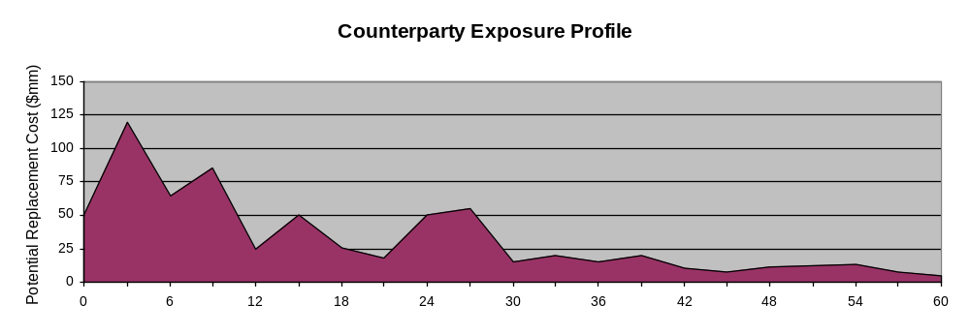
Measuring Counterparty
Pre-Settlement Exposure (PSE)
Two Methods:
  Simple “Add On” Method
    PSE = Current MTM + “Worst Case” potential increase in value
    = Current MTM + Notional Principal * Credit Exposure Factor
  Portfolio Simulation Method
  PSE = Exposure Profile of Counterparty

Slide 119
Simple “Add-On” Method
Liquidation if positive
0 Otherwise
Current Replacement Cost
=
+
Add-on amount
Notional amount
BIS add-on factor
=
*
=
Credit equivalent
Counterparty risk weighting
Risk-weighted amount
*
=

Slide 120
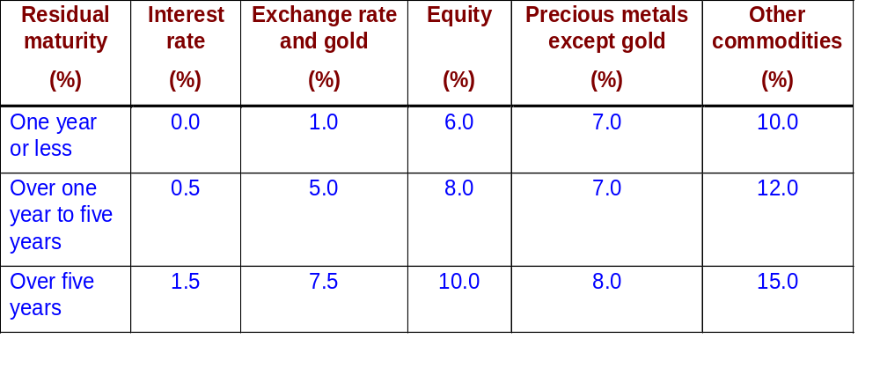
Add-on Factors by Type of Underlying and Maturity

Slide 121
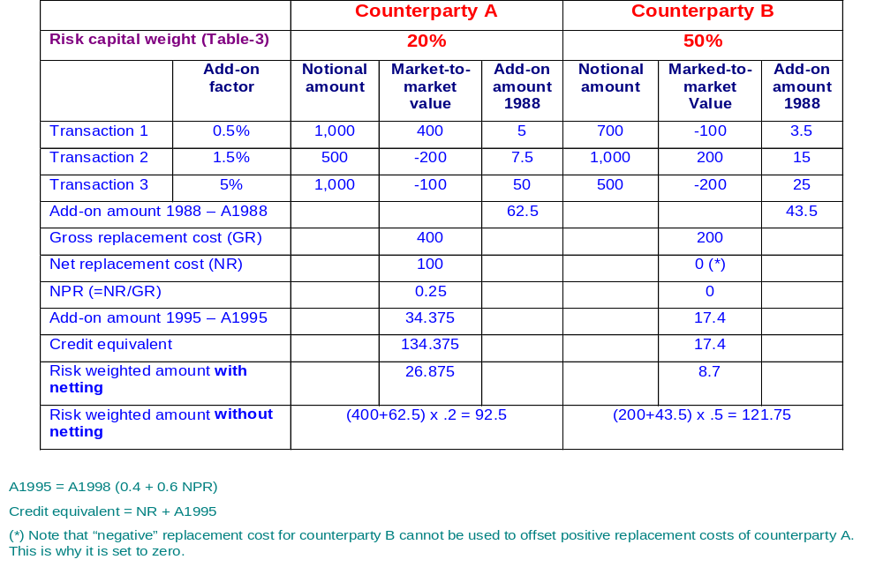
Illustration of the Calculation of the
Add-on and risk-Weighted Amounts
Including Netting

Slide 122
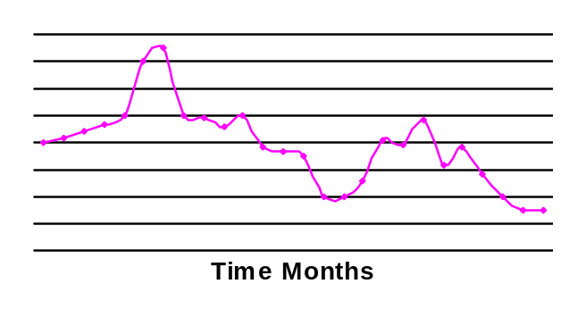
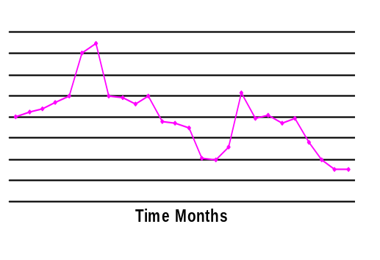
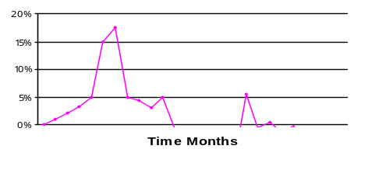
Portfolio Simulation Method
Exposure Profile and Market Rate Scenarios
Example 1: Forward FX, we buy GBP and sell US$ for settlement in two years at 1.5000 US$/GBP.
Random path of forward FX rate over life of forward transaction scenario 1.
Profile of market value of forward FX transaction over its life, for scenario 1.
Exposure Profile of transaction for scenario 1.
We only have exposure when the contract has a positive value to us.

Slide 123
Forward FX
  Three Exposure Profiles for a Two year US$/GBP forward FX transaction, at three confidence levels:
  - 99% CL Exposure Profile
  - 97.7% CL Exposure Profile
  - Expected Exposure Profile
Interest Rate Swap
  Three Exposure Profiles for a three year fixed/floating US$ interest rate swap, at three confidence levels:
  - 99% CL Exposure Profile
  - 97.7 CL Exposure Profile
  - Expected Exposure Profile
99% CL Profile
97.7% CL Profile
Expected Profile

Slide 124
Credit exposure profile for single cash flow products
Worst Case Terminal Exposure (W_{T})
“
Worst Case” Credit
Exposure path
Cumulative Average Worst Case
(FE = 2/3 W_{T})
Expected Terminal Exposure
“Expected” Credit
(= W_{T} /5)
Exposure path
Cumulative Average Expected Exposure
(=2/3 x W_{T} /5)
Best Case (0)
0
Time (T)
T

Slide 125
Contingent Credit Risk - Loss Profile Over Time
  The average of the expected replacement cost curve represents the loan equivalent
Single Currency Swap
Cross Currency Swap
Exposure
Exposure
Average
Average
Maturity
Time
Maturity
Time

Slide 126
Combining credit exposure with the distribution of default rates (net of recovery) yields the distribution of credit risk losses:
Credit Exposure
Distribution of Default Rates
(Net of Recoveries)
Worst Case Terminal
(e.g. 750)
(e.g. 500)
X
=
Credit Risk
Capital
Cumulative Average
Worst Case
Exposure
Expected Terminal
(e.g. 150)
(e.g. 100)
Expected
Probability of
Default
1 %
“Worst Case”
Probability of
Default
3 %
Expected
Credit Loss
“Worst Case”
Credit Loss
Cumulative Average
Expected
$1 (=1% x $100)
$3 (=3% x $100)
2 %
(=3% -1%)
$2
(=$3 -$1)
Time
Note: Assumes Capital = Unexpected Loss

Slide 127
Simplifying the Representation of a Transaction’s potential Exposure
The most realistic representation of a transaction’s potential exposure is as an Exposure Profile.
In the ADD ON METHOD, the transaction’s exposure profile is condensed into a single number.
  PSE = Current Market Value + Potential Increase in Value.
Choices:
  Confidence level at which measure transaction’s exposure profile.
  Potential exposure as: Peak or Average of the transaction’s exposure profile.

Slide 128
PSE = CMTM + “worst” case potential increase in value
= CMTM + Notional Principal * CREDIT EXPOSURE FACTOR (CEF)
CEF = “worst” case potential increase in value / notional principal
      Derived from the transaction’s exposure profile, calculated at very high confidence level, by condensing potential increase in value into a single number.
      Profile based on historical volatilities and correlations of market rates.
      Rests on many simplifying assumptions.
For standard products, tables of CEFs can be specified by:
      Product (form of contract and primary underlying market factor)
      Remaining tenor until final cash settlement
      Volatility of underlying market factors
For non-standard transactions, one-off calculations can be done.
MORE PRECISELY, FOR A SINGLE TRANSACTION:
PSE(t) = max[CMTM(t) + P*CEF(t,T), 0]

Slide 129
CEFS ARE APPROXIMATIONS
Representing the potential exposure of a contract as a SINGLE NUMBER VS. a TIME VARYING EXPOSURE PROFILE.
PRECISION VS. EASE OF IMPLEMENTATION
  Even if Potential Exposure is represented as a single number, a precise calculation of the potential increase in exposure would take into account:
    1. The contract’s specific terms and conditions
      Particular product
      Buy or sell, pay or receive, call or put.
      Non-standard terms and conditions.
    2. Actual Market Rates
      Including shape of yield curve, etc.
      Volatilities and correlations
    3. Moneyness - Relation between (1) and (2)
CEF METHOD CANNOT CORRECTLY HANDLE PORTFOLIO EFFECTS

Slide 130
GENERAL ISSUES APPLICABLE TO SINGLE CONTRACTS OR PORTFOLIOS
  Accuracy of representation of market rates.
  Capturing specific terms and conditions of each contract.
  Representing exposure as a profile, not a single number.
ISSUES SPECIFIC TO PORTFOLIOS
Statistical factor
Portfolio exposure tends to be less than sum of individual contract exposures.
  A single market rate cannot increase and decrease simultaneously.
  Market rates are correlated.
Legal factors
Potential reduction in exposure via contractual risk mitigating agreements:
  Netting Agreements.
  Margin Agreements (affects exposures of both single contract and portfolio).
  Options to early termination agreements (affects both single contract and portfolio).

Slide 131
General Method: Four Steps
1. Simulate changes in market rates Over Time.
  Start with current market rates.
  Simulate scenarios (or paths) of changes in market rates at many future dates, over many years, using tables of volatilities and correlations.
2. For each simulated scenario, measure potential market value of each transaction over time.
  Start with feed of transaction details and legal information.
  For each simulated scenario, calculate the potential market value of each contract at many future dates, using the contract’s terms and conditions, revaluation formula and the simulated state of the market.
3. For each simulated scenario, measure counterparty’s potential exposure over time.
  For each simulated scenario, at each future point in time, transform the potential market value of each contract into the potential exposure of the portfolio through aggregation rules that take risk mitigants and legal context into account.
4. At each forward point in time, calculate potential exposure at some high confidence level

Slide 132
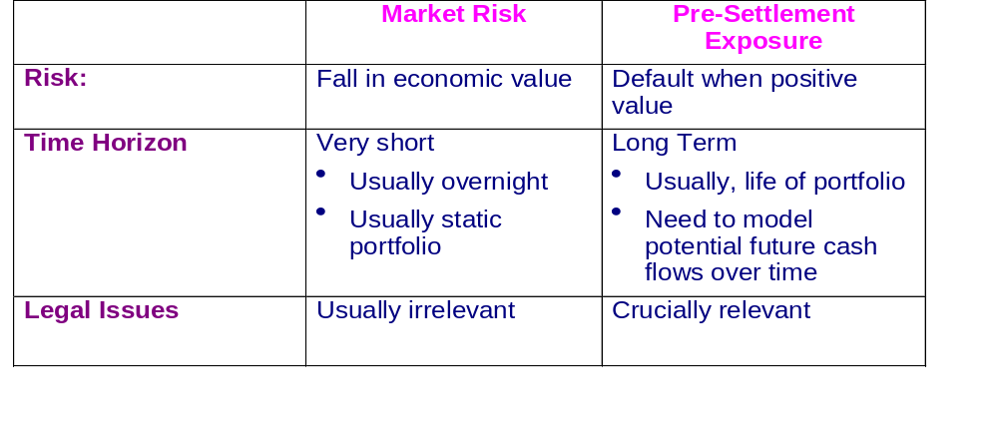

Slide 133
ECONOMIC CAPITAL

Slide 134
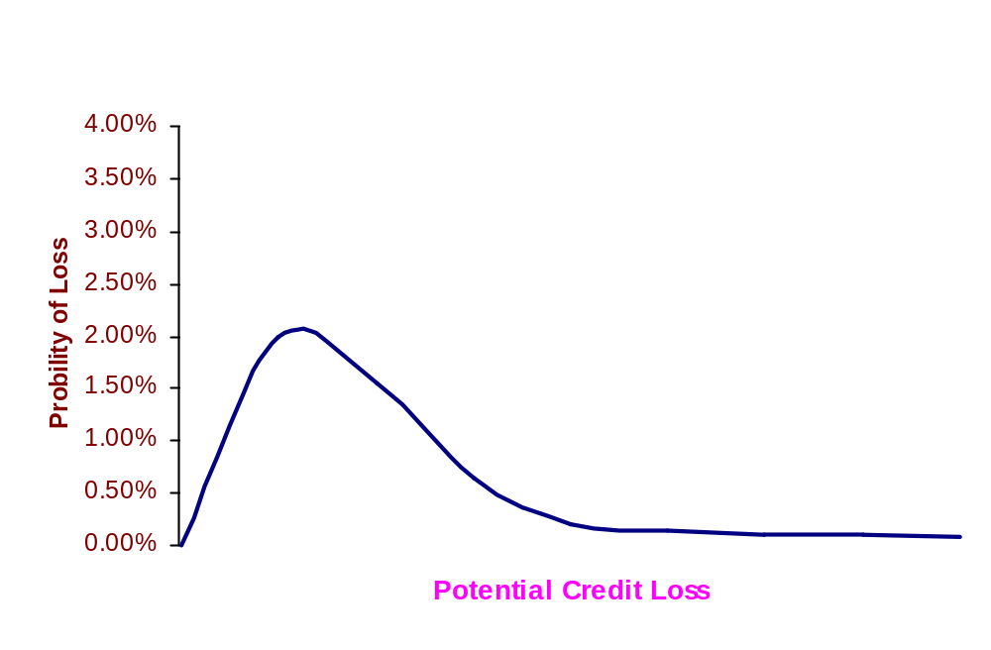
Statistical Measure of Potential Credit Loss
Minimum Return for Credit Risk = Expected Loss + cost of economic capital
Economic Capital for Credit Loss = A “cushion” to absorb unexpected losses,at a high confidence level, in excess of the expected loss
Probability Distribution of Potential Credit Loss (hypothetical) for a set of obligors
Unexpected Loss
Expected Loss
Economic Capital For Credit Risk
The probability distribution of potential credit loss depends on the definition of credit loss.

Slide 135
Importance of Definition of Credit Loss
The PROBABILITY DISTRIBUTION of potential loss depends on:
The Definition of Loss
  Accounting basics
    e.g. default only vs. economic loss
  The type of risks(s) which give rise to loss
    e.g. issuer risk,pre-settlement credit risk or any credit event
  The time horizon over which economic loss could occur (e.g. one year)
THE STATISTICAL PARAMETERS used to simulate potential loss
ECONOMIC CAPITAL will depend on:
  The probability distribution of loss and
  The confidence level (e.g. 99.9%, 99.97%) at which EC is measured

Slide 136
Simulating Loss Distribution of Loan Portfolio: Default Only Analysis
ASSUME ONLY SOURCE OF CREDIT RISK IS DEFAULT
FACTORS NEEDED TO SIMULATE LOSS DISTRIBUTION:
  Credit Exposure per Obligor
  Probability of Default (by risk rating, industry, etc.) and correlations of probability of default
  Probability distribution of Loss in the Event of Default (LIED) (a.k.a. LGD)

Slide 137
Economic Capital
Factors affecting the width of distribution of potential credit loss for default only analysis:
  Statistical uncertainty in how many obligors will default - even if risk ratings, default probabilities and correlations of default were precisely known
  Uncertainty in which obligors default - important for an inhomogeneous book
  Uncertainty in credit exposure at default
  Uncertainty in loss in the event of default
  Uncertainty in assumptions/data
    risk assessment of obligors
      lack of transparency and lack of standardization of financial information.
    Uncertainty in probability of default (e.g. effect of uncertain future economic conditions).
    Uncertainty in correlations of default
TWO PORTFOLIOS WITH CREDIT RISK COULD HAVE IDENTICAL EXPECTED LOSSES AND VASTLY DIFFERENT UNEXPECTED LOSSES.

Slide 138
Simulating Loss Distribution of Loan Portfolio:
Full Economic Analysis
Factors needed for simulation:
  Credit Exposure (particularly important for counterparty risk)
  Volatilities and correlations of changes in general credit spreads (by risk rating, industry etc.)
  Migration of risk rating of individual obligors and correlations of migration.
  Probability of default (by risk rating industry, etc.) and correlations of probability of default.
  Probablity distribution of Loss in the Event of Default (LIED)

Slide 139
Operational Risk
IX.

Slide 140
Operational Risk
Definition:
  Risk of direct or indirect loss resulting from inadequate or failed internal processes, people and systems of external events
  Excludes “Business Risk” and “Strategic Risk”
Spectrum of approaches
  Basic indicator - based on a single indicator
  Standardized approach - divides banks’ activities into a number of standardized industry business lines
  Internal measurement approach
Approximately 20% current capital charge

Slide 141
CIBC Operational Risk Losses Types
1. Legal Liability:
    inludes client, employee and other third party law suits
2 . Regulatory, Compliance and Taxation Penalties:
    fines, or the cost of any other penalties, such as license revocations and associated costs - excludes lost / forgone revenue.
3 . Loss of or Damage to Assets:
    reduction in value of the firm’s non-financial asset and property
4 . Client Restitution:
    includes restitution payments (principal and/or interest) or other compensation to clients.
5 . Theft, Fraud and Unauthorized Activities:
includes rogue trading
6. Transaction Processing Risk:
includes failed or late settlement, wrong amount or wrong counterparty
Notes:
Value - book not economic

Slide 142
The Regulatory Approach:Four Increasingly Risk Sensitive Approaches
Risk Based/ less Regulatory Capital:
Basic Indicator
Standardized
Internal Measurement Approach
Loss Distribution
Standardized
Approach
Internal Measurement Approach
Loss Distribution
Approach
Bank
Bank
Risk Type 1
Risk Type 6
Bank
Rate
β₁
Base
LOB1
LOB1
Rate 1
Rate₁
EI₁
EI₁
Base
Expected
Loss
LOB2
β₂
LOB2
Rate 2
Rate₂
Severe
Unexpected
Loss
Catastrophic
Unexpected
Loss
EI₂
EI₂
Base
Probability
LOB3
LOB3
Base
Base
Loss
LOBn
β_{N}
LOBn
Rate_{N}
Rate_{N}
EI_{N}
EI_{N}
Base
Rate of progression between stages based on necessity and capability

Slide 143
Operational Risk -
Basic Indicator Approach
Capital requirement = α% of gross income
Gross income = Net interest income
+
Net non-interest income
Note: α supplied by BIS (currently α = 30%)

Slide 144
Operational Risk -
Standardized Approach
Banks’ activities are divided into standardized business lines.
Within each business line:
  specific indicator reflecting size of activity in that area
  Capital charge_{i} = β_{i} x exposure indicator_{i}
Overall capital requirement =
sum of requirements for each business line

Slide 145
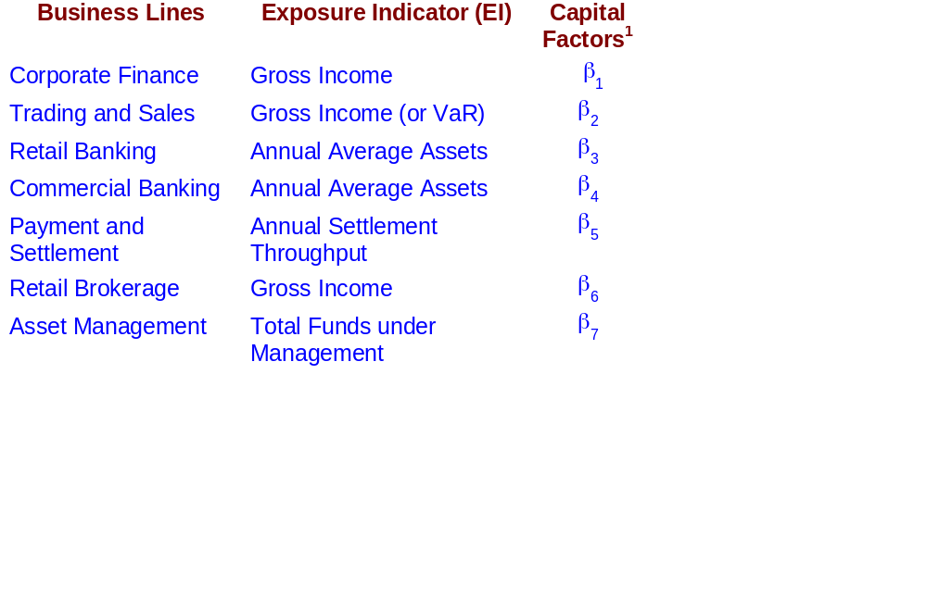
Operational Risk -
Standardized Approach
Example
Note: ¹ Definition of exposure indicator and B_{i} will be supplied by BIS

Slide 146
Operational Risk -
Internal Measurement Approach
Based on the same business lines as standardized approach
Supervisor specifies an exposure indicator (EI)
Bank measures, based on internal loss data,
  Parameter representing probability of loss event (PE)
  Parameter representing loss given that event (LGE)
Supervisor supplies a factor (gamma) for each business line

Slide 147
The Internal Measurement Approach
For a line of business and loss type
Op Risk Capital (OpVaR) = EI_{LOB} x PE_{LOB} x LGE_{LOB} x γ_{industry} x RPI_{LOB}
LR _{firm}
EI = Exposure Index - e.g. no of transactions * average value of transaction
PE = Expected Probability of an operational risk event
        (number of loss events / number of transactions)
LGE = Average Loss Rate per event - average loss/ average value of transaction
LR = Loss Rate ( PE x LGE)
γ= Factor to convert the expected loss to unexpected loss
RPI = Adjusts for the non-linear relationship between EI and OpVar
(RPI = Risk Profile Index)
Rate

Slide 148
The Components of OP VaR e.g. VISA Per $100 transaction
20%
70%
Expected
Loss
16%
60%
Severe
Unexpected
Loss
12%
+
50%
=
Catastrophic
Unexpected
Loss
8%
40%
Probability
4%
30%
1.3
9
0%
Loss
70
100
9
52
Number of Unauthorized Transaction
Loss per $1 00 Fraudulent Transaction
Loss per $1 00Transaction
The Probability Distribution
The Severity
Distribution
The Loss
Distribution
Eg; on average 1.3 transaction per
1,000 (PE) are fraudulent
Note: worst case
is 9
Eg; on average 70% (LGE) of the value of the transaction have to be written off
Note: worst case
is 100
Eg; on average 9 cents per $100 of transaction (LR)
Note: worst case
is 52

Slide 149
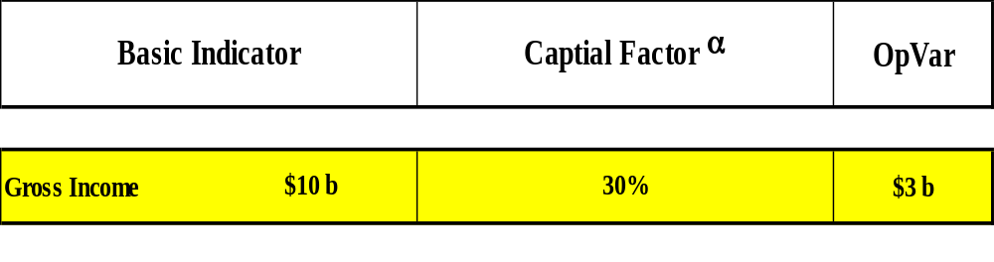
Example - Basic Indicator Approach

Slide 150
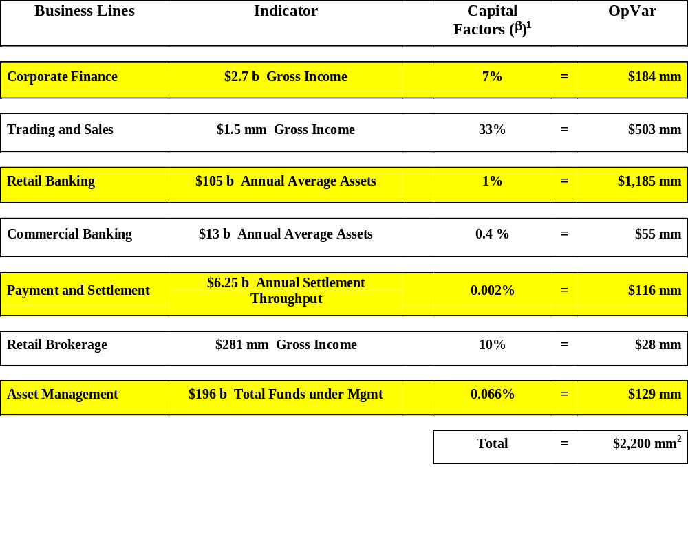
Example - Standardized Approach
Note:
1. β’s not yet established by BIS
2. Total across businesses does not allow for diversification effect

Slide 151
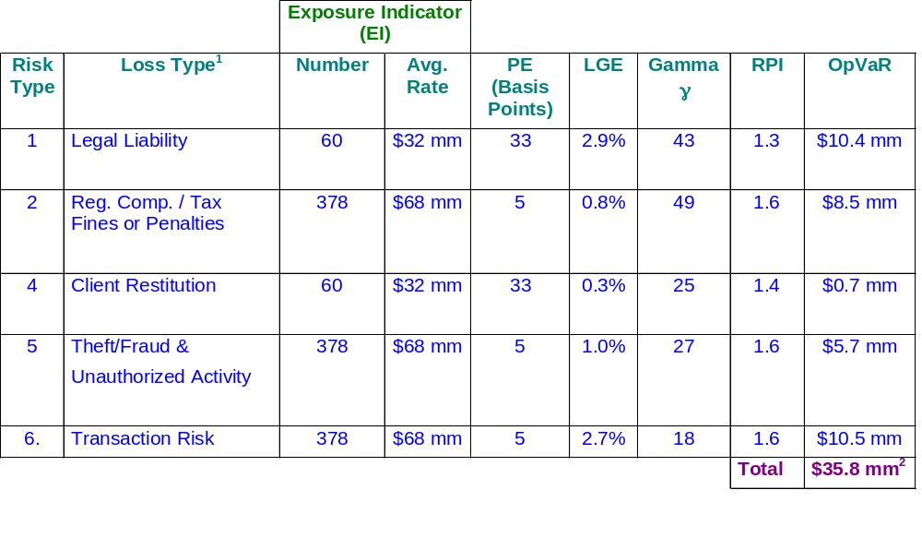
Example - Internal Measurement Approach
Business Line (LOB): Credit Derivatives
Note:
1. Loss on damage to assets not applicable to this LOB
2. Assume full benefit of diversification within a LOB

Slide 152
OpVar Process - Short Term
Adjust for changes in activity
Exposure
Bases
Adjust for changes in risk
Loss
History *
Historic Internal *
PE, LGE, γ
Historic
Internal
+
External
PE, LGE, γ
Current
Internal
+
External
PE, LGE, γ
OpVar
Industry
Loss History
Key Risk
Drivers
Scenario
Analysis
* adjust rates where sufficient internal data is available

Slide 153
OpVar Process - Longer term
Adjust for changes in activity
Exposure
Bases
Adjust for changes in risk
Loss
History
Historic Internal
PE, LGE, γ
Historic
Internal
+
External
PE, LGE, γ
Current
Internal
+
External
PE, LGE, γ
OpVar
Industry
Loss History
Key Risk
Drivers
Scenario
Analysis

Slide 154
Appendix
X.

Slide 155
1. Risk Weight for Corporate Exposure
Operational Risk Related:
2. Operational Risk’s Loss Types
3. Exposure Base, PE, LGE
4. Eligibility Criteria for IMA
5. Operational Risk Disclosures: Pillar 3
6. Book announcement: Risk Management
by M. Crouhy, D. Galai and R. Mark

Slide 156

Risk Weight for Corporate Exposure
Appendix 1
Corporate benchmark risk weight:
¹ PD is expressed as a decimal (e.g., 0.01 for 1 percent)

Slide 157
N(1.118xG(PD)+1.288) = sum of expected and unexpected losses associated with a hypothetical, infinitely-granular portfolio of one-year loan having an LGD of 100%, using a so-called Merton-style credit risk model in which there is a single systematic risk factor and the values of borrowers’ assets are assumed lognormally distributed, a confidence level of 99.5% and an average correlation of 20%
The term (1+.0470x(1-PD)/PD^{0.44}) is an adjustment to reflect that the IRB benchmark risk weights are calibrated to a 3-year average maturity; and the scaling factor 976.5, which is calibrated so that the IRB benchmark risk weight equals 100% for values of PD and LGD equal to 0.7% and 50% respectively.

Slide 158
Maturity Adjustments to The Risk Weights, Derived From MTM-models

Slide 159
Appendix 2
CIBC Operational Risk Loss Types
1. Legal Liability
Employee*
Wrongful termination
Discrimination
Workplace safety
  Privacy violation
Client *
Fiduciary breaches/guidelines
Suitability/ disclosure
Account churning
Aggressive sales
Violation of confidentiality
Lender liability
Third Party *
Copyright/patent /license infringement
Supplier lawsuits
4. Client Restitution *
Goodwill payments
Payments to make client whole
5. Theft, Fraud, Unauthorized Activities
Theft/ Fraud *
Defalcation
Forged Cheques
Worthless deposits
Counterfeit cheques
Account takeover
Robbery
Kiting
Misappropriations of assets
Credit card fraud
Unauthorized Activity *
lending/trading above limits
intentional mismarking of positions
unlicensed activity
hiding trades/ loans
unapproved account access
2. Regulatory, Compliance and Taxation Penalties * Failure to comply with regulations
Money laundering
Tax non compliance
Market manipulation
Insider trading
Bribes
6. Transaction Processing Risk *
Data entry errors
Delivery failure
Collateral management failure
Incomplete legal documents
Reporting errors
Calculation errors
Wrong delivery
Wrong payment amount
Cash shortages
Missing or disputed cheques
3. Loss or Damage to Assets *
Damage to
buildings
equipment
physical certificates
physical commodities holdings (eg gold)
records
* indicates the level at which Op VaR is calculated for each business line

Slide 160
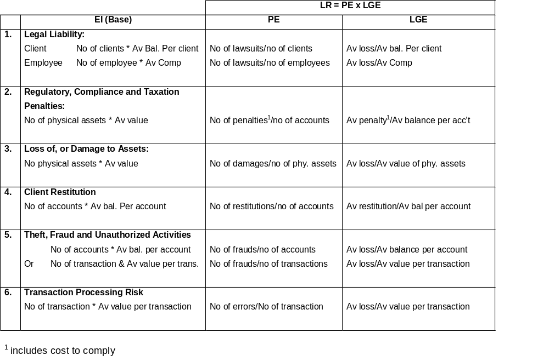
Appendix 3
CIBC Operational Risk EI, PE, LGE

Slide 161
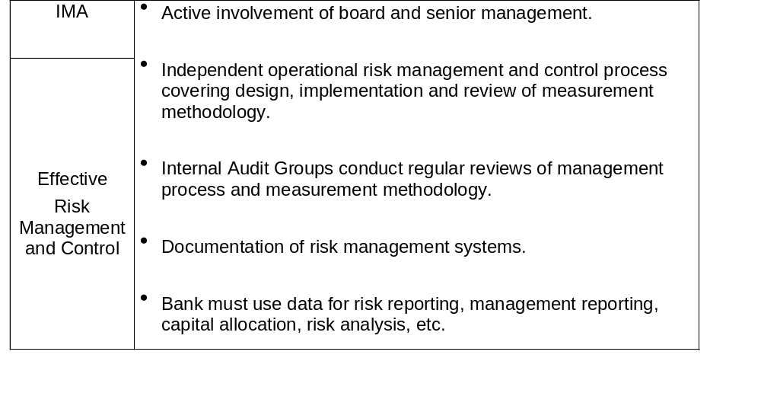
Eligibility Criteria: for IMA
Appendix 4

Slide 162
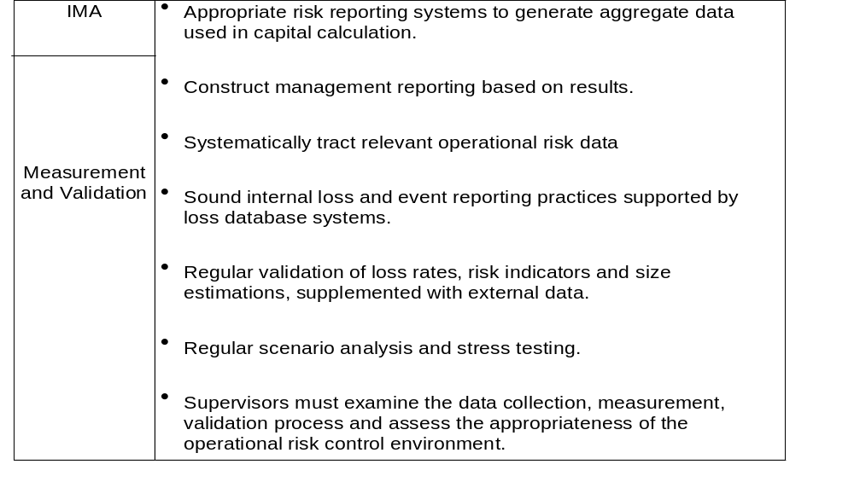
Eligibility Criteria: for IMA

Slide 163
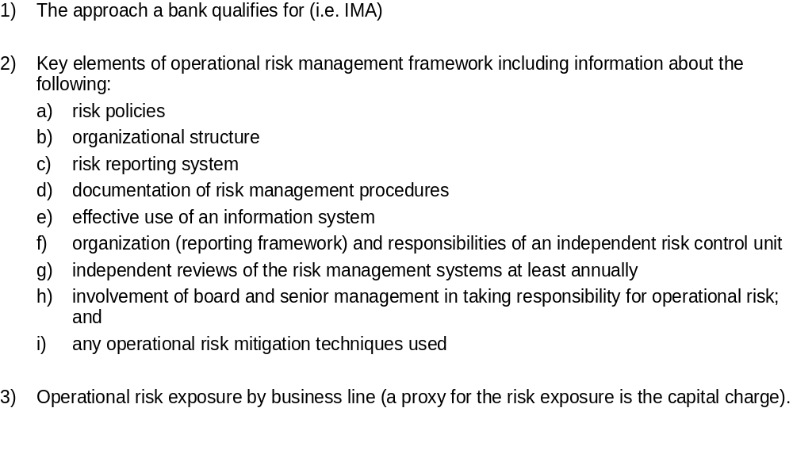
Operational Risk Disclosure: Pillar 3
Appendix 5

Slide 164
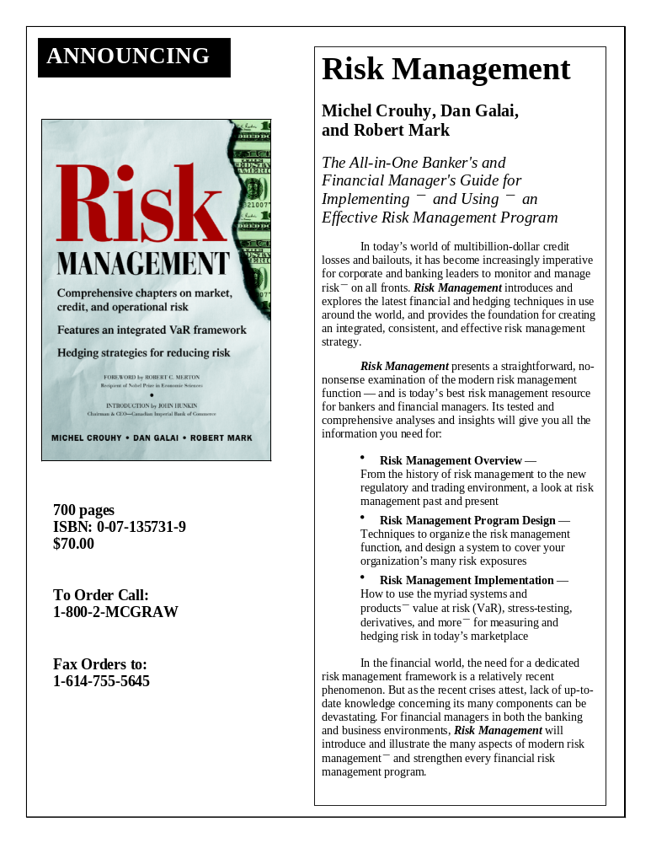

Slide 165


Slide 166
ohg\\\2000\yorku_2000.ppt
Monday March 20, 2000

