Slide 1
Project Management Masterclass
Assumptions, Constraints,
Risks, Issues & Dependencies

Slide 2
Assumptions, Constraints, Risks, Issues & Dependencies
Masterclass Objectives
Be able to differentiate between assumptions, constraints, risks, issues and dependencies
Understand why they need to be identified and monitored
Understand how to identify, analyse and manage them
Notes:
SLIDE OBJECTIVE – State master class objectives

Slide 3

Assumptions, Constraints, Risks, Issues & Dependencies
What have we got already?
Initial constraints, assumptions, risks and dependencies documented in Project Brief
Procedure to Identify Risks, Issues and Dependencies
Procedure to Manage Risks, Issues and Dependencies
Templates for documenting risks, issue and dependencies
  Project Risk Register
  Project Issue Register
  Project Dependencies Register
Maintain external dependencies on Project Schedule
Risks, issues and dependencies reported on Project Progress Report
Project Initiation Document has constraints, assumptions , snapshot of risks, issues and dependencies. If you are using a tool to manage these then this needs stating in the PID e.g. Clarity
Risks, Issues and Dependencies Help includes industry standard list of potential risks
Notes:
SLIDE OBJECTIVE – Show which artefacts have ACRID references
In Concept identify high level risks and dependencies in the Project Brief
Formally identify RIDs in each subsequent planning stage
Managing RIDs is an ongoing PM activity
Registers will be replaced by Clarity
OK to use other tools until Clarity rolled out
Registers exist for each – update them regularly, status, actions, dates, owners all may change. Not just a list but a record of related management activity
Project Progress Report should always contain up to date information
Not just PM documents – Requirements Context also
Schedule has both types of dependencies
Emphasise need to say in PID for each of risks, issues, dependencies (& change, reporting) when you are using a tool not other templates – period of transition

Slide 4
Assumptions, Constraints, Risks, Issues & Dependencies
It isn’t just the Project Manager’s responsibility…
Risks and issues can surface at any point and be identified by anyone!
Requirements Context has a section for assumptions, issues and dependencies
Specific risks, issues, dependencies, assumptions and constraints in Support Approach
Assess Supplier Deliverables recognises that risks, issues and dependencies result from rework or rejection of supplier deliverables
Define Implementation Approach includes a risk assessment
Define Test Approach includes assumptions and a non-functional risk assessment
Execute Test Phase recognises risks and issue may arise from the environment
Prepare for Operational Use requires identification of operational risks
Manage Project Change involves identification of new risks and issues
Notes:
SLIDE OBJECTIVE – Show key involvement of non-PM
Risks and issues can occur at any point in the project – not just where the process mentions them
E.g. engaging suppliers, requesting test environments, managing releases, making working environment requests, quality reviews
And BAs, Technical Consultants, Testers, Architects, QMs, PO all have a responsibility
But these are the explicit (mostly non-PM) touchpoints
All risks, issues etc should go on the same registers – would suggest at the same level of detail, though (e.g. test environment not available, rather than technical detail which should be kept as supporting materials)

Slide 5
Assumptions, Constraints, Risks, Issues & Dependencies
Identify and Manage Risks, Issues and Dependencies Procedure
ARK References 2 Procedures
  Same Activity Steps for Risks, Issues and Dependencies
  Single Help Document – “Risks, Issues and Dependencies Help”
Identify Risks, Issues and Dependencies Procedure
  Review Planning Documents – to Identify
  Analyse Details – likelihood, impact
Manage Risks, Issues and Dependencies Procedure
  Review Existing Documentation – understand current picture
  Update Severity – Escalate if appropriate
  Close – Update status
Notes:
SLIDE OBJECTIVE – Summarise Assets in ARK
There are 2 Procedures covering Identify Risks, Issues and Dependencies and Manage Risks, Issues and Dependencies
One Help Document

Slide 6
Assumptions, Constraints, Risks, Issues & Dependencies
What is the definition of a Constraint?
“A Constraint is ……..
Notes:
SLIDE OBJECTIVE – Agree definitions of assumptions and constraints
They aren’t risks because they are certain, and they aren’t issues because you know them up front and use them to define the project

Slide 7
Assumptions, Constraints, Risks, Issues & Dependencies
What is the definition of a Constraint?
“A Constraint is a barrier or limitation that is either already present and visible, or definitely will be so during the lifespan of the project. Its effects on the project or any part of its planning or execution are beyond dispute.”
(Numerix Consultancy)
Notes:
SLIDE OBJECTIVE – Agree definitions of assumptions and constraints
They aren’t risks because they are certain, and they aren’t issues because you know them up front and use them to define the project

Slide 8
Assumptions, Constraints, Risks, Issues & Dependencies
Constraint Types
Timeframes and deadlines
Funding
Knowledge and skill levels
Availability of resources (people, hardware, software, technology)
Business environment and/or decisions
Compliance with strategic objectives
Organisational issues
Legislation
Co-ordination with external entities
Support and commitment
Business transaction volumes
For IT projects, compliance with architectural directives
Notes:
SLIDE OBJECTIVE – Provide examples of assumptions and constraints
Interactive Activity (optional):
Ask for examples of Constraints from the floor and then reveal bullet points

Slide 9
Assumptions, Constraints, Risks, Issues & Dependencies
Constraint Examples
Project must deliver by end Q2 next year or new legal requirements will apply
Only small % of funding for project available in current financial year – rest will be released in following year
No internal resource has the required level of knowledge of tax law
Because of the type of project, requirements and development team members must be co-located
Company policy is to offshore testing for this technology platform
Project must use a nominated external agency for all promotional materials
Sarbanes-Oxley restrictions apply
Support staff will only be able to deal with a specified number of transactions a day as a result of new product
IT system must comply with recent architectural decision to use .net for this type of solution
Notes:
SLIDE OBJECTIVE – Provide examples of assumptions and constraints
Assumptions and Constraints are documented in Project Brief and PID – but that’s not the end…
You need to monitor assumptions to see they are true and constraints to check they still apply

Slide 10
Assumptions, Constraints, Risks, Issues & Dependencies
What is the definition of an Assumption?
“An Assumption is ……
Notes:
SLIDE OBJECTIVE – Agree definition of assumptions
Ask why we need to identify and document assumptions
It may help if you put confidence/lead time/impact in Project Brief and PID
Assumptions involve a degree of risk, what stops them being documented as risks at this point is that it’s very low

Slide 11
Assumptions, Constraints, Risks, Issues & Dependencies
What is the definition of an Assumption?
“An Assumption is that which is taken for granted or supposed”
(Chambers Dictionary)
Notes:
SLIDE OBJECTIVE – Agree definition of assumptions
Ask why we need to identify and document assumptions
It may help if you put confidence/lead time/impact in Project Brief and PID
Assumptions involve a degree of risk, what stops them being documented as risks at this point is that it’s very low

Slide 12
Assumptions, Constraints, Risks, Issues & Dependencies
What is the definition of an Assumption?
“An Assumption is that which is taken for granted or supposed”
(Chambers Dictionary)
Something that we cannot establish as being true at this point in time, but is likely to be true
With projects there is always a high degree of unknown - have to make assumptions to move forward
Assumptions can be wrong – they have an element of risk
If the assumption proves wrong we need to raise an issue
When documenting assumptions consider
  Confidence.. How sure are we that the assumption is true?
  Lead time. How long before we can prove or disprove the assumption?
  Impact. If the assumption proves incorrect, how much rework is involved?
Notes:
SLIDE OBJECTIVE – Agree definition of assumptions
Ask why we need to identify and document assumptions
It may help if you put confidence/lead time/impact in Project Brief and PID
Assumptions involve a degree of risk, what stops them being documented as risks at this point is that it’s very low

Slide 13
Assumptions, Constraints, Risks, Issues & Dependencies
Assumption Examples
We will obtain 60% of the market over the first year (based on market research)
Project will take no more than 6 months to deliver (all similar projects have taken 4-5 months)
Agreement with new 3rd party supplier will be in place before work begins (negotiations well under way)
No further legislation changes will be announced for next financial year (they would be published by now)
Team will be skilled in the tools and technologies used
Notes:
SLIDE OBJECTIVE – Provide examples of assumptions and constraints
Ask for more assumptions from real projects…
Assumptions and Constraints are documented in Project Brief and PID – but that’s not the end…
You need to monitor assumptions to see they are true and constraints to check they still apply
Good idea to back up your assumptions with evidence

Slide 14
Assumptions, Constraints, Risks, Issues & Dependencies
Risk Definitions
“A Risk is ……
Notes:
SLIDE OBJECTIVE – Agree risk definitions
There are other definitions, but this is pretty standard
Emphasise the existence of opportunities

Slide 15
Assumptions, Constraints, Risks, Issues & Dependencies
Risk Definitions
“A Risk is an uncertain event or set of circumstances that, should it occur, will have an effect (either positive or negative) on achievement of one or more project objectives.”
Notes:
SLIDE OBJECTIVE – Agree risk definitions
There are other definitions, but this is pretty standard
Emphasise the existence of opportunities

Slide 16
Assumptions, Constraints, Risks, Issues & Dependencies
Risk Definitions
“A Risk is an uncertain event or set of circumstances that, should it occur, will have an effect (either positive or negative) on achievement of one or more project objectives.”
“Risk Management is a structured process that allows individual risk events and overall project risk to be understood and managed proactively, optimising project success by minimising threats and maximising opportunities”
(APM BoK Version 5)
Notes:
SLIDE OBJECTIVE – Agree risk definitions
There are other definitions, but this is pretty standard
Emphasise the existence of opportunities

Slide 17
Assumptions, Constraints, Risks, Issues & Dependencies
What we need to do – Risks
Prepare for Risk Management
  Determine Risk Categories
  Define Parameters (including Likelihood/Impact/Severity)
  Identify triggers/thresholds (RAG Status/when to escalate)
  Identify Tools
Identify and Analyse Risks
  Identify Risks
  Classify them according to Parameters
  Document them
Mitigate Risks
  Plan to mitigate risks
  Assign ownership
  Monitor Risks
  Document actions taken
Notes:
SLIDE OBJECTIVE – Communicate what PM needs to do regarding Risks
Good practice
Prepare for Risk Management
This is all in place at organisational level, it’s the processes, standards and templates we’ll look at later
It means having standard risk sources and standard definitions of what is serious.
Identify & Analyse Risks (for your Project).
All team members/stakeholders responsible for identification, though PM must set up the channel.
Use the pre-defined classifications
Put them on Risk Register
Mitigate Risks
develop a mitigation plan for most important risks, carry out actions, document them
PM typically responsible for this, may have POM help
Risks will have individual owners.
Monitor regularly
Proactive management
Escalate issues that have severity > predetermined threshold
Close risks or transfer to BAU at the end of project

Slide 18
Assumptions, Constraints, Risks, Issues & Dependencies Identifying Risks
Risk Workshops are a very effective way of identifying risks
Identify risks at each Stage of the project not just at the beginning
Involve all key stakeholders and team members
Where available, PMO or other external support can be used to facilitate
Use the 5 Categories of Risk from Risks, Issues and Dependencies Help
Where available use Best Practice and Lessons Learnt
Output is a list of risks with likelihood and impact and mitigation actions
All risks should have named owners and review dates
Use Project Risk Register and keep it up to date
Notes:
SLIDE OBJECTIVE – Illustrate ways of identifying risks
Encourage PMs to run risk workshops (not mandated)
Risk Workshops is the best approach
All team responsible for raising risks not just PM
Need to involve other stakeholders (including business)
Remember to schedule risk identification activities
Use the standard SEI Source of Risks List in the Appendix of Help document
Risks from similar projects Lessons Learnt can help
You may want to submit your Risk Register for lessons learnt

Slide 19
Assumptions, Constraints, Risks, Issues & Dependencies Identifying Risks – the 5 Categories
Category 1 – External Risks
Not under control of the Project Team or Project Steering Group
Category 2 – Project Governance
Associated with standardisation and compliance of project management processes
Category 3 – People
Related to human resource issues of the project team or stakeholders
Category 4 – Information
Related to Configuration Management
Category 5 – Execution
Project management lifecycle activities
Relationships with internal and external providers
Product Engineering
Development Environment
Program Constraints
( SEI Carnegie Mellon University)
Notes:
SLIDE OBJECTIVE – Outline the 5 Categories
Appendix A has detailed lists under each category
SW Engineering Institute at Carnegie Mellon University developed CMMI
Category 3 -From BA/Technical perspective during requirements and design it can be very difficult to get the right people involved to sign off requirements, or if you are writing the design, it can be difficult to get people to clarify what they mean – I think that this is a huge risk to projects and one which we tend to sweep under the carpet.

Slide 20
Assumptions, Constraints, Risks, Issues & Dependencies
Identifying Risks – Exercise 1
It is now the beginning of October and you have taken over Project Windfall at the start of Initiation. The objective is to launch a new product, the Windfall Plan, aimed at attracting new customers who have not previously been able to save or invest, but now have an unexpected injection of cash. Similar projects of this type have taken about 6 months to deliver.
Breakout Exercise:
Assumptions and constraints from the example slides apply (listed on handout). Use the list of potential risk sources on the handout to identify at least 3 potential risks to the project for each of the 5 risk categories
(Time: 10 minutes)
Notes:
SLIDE OBJECTIVE – Introduce exercise to familiarise participants with the SEI Taxonomy
Handout: SEI Taxonomy
Divide into groups
Get each group to read some out – ask them why they chose them

Slide 21
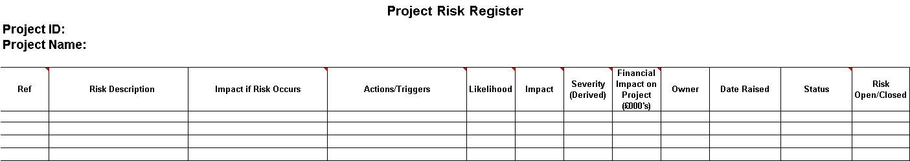
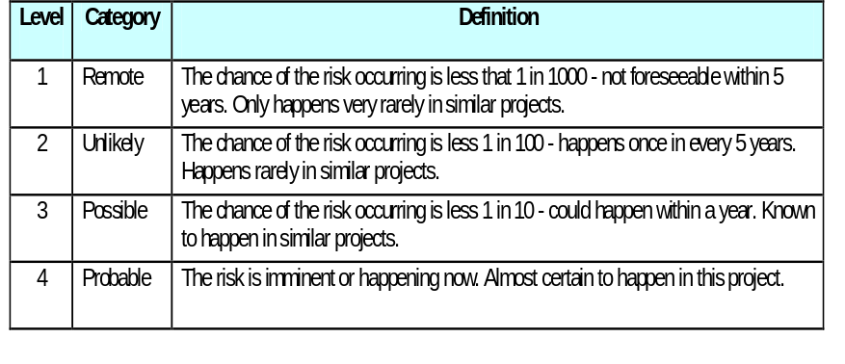
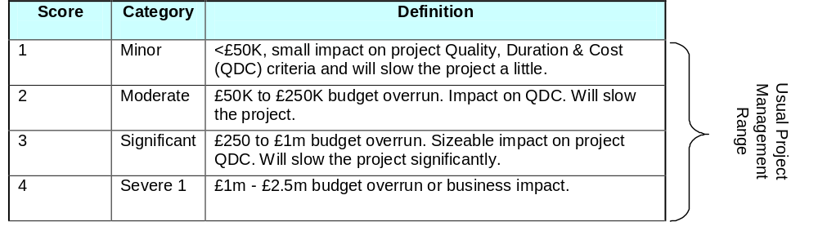
Assumptions, Constraints, Risks, Issues & Dependencies
Analysing Risks – Project Risk Register (1)
Actions / Triggers – mitigation
planned and performed actions
Impact
Likelihood
Notes:
SLIDE OBJECTIVE – Define columns on Risk Register (& next slide)
Actions / Triggers – this is the only place provided for recording what you plan to do and actually do about a risk
You may want to keep additional materials and just refer to them here
Note – the definitions are in the Comment fields and the Help Document
If anyone comments, may need to refer to Severe 2, 3 or 4 which are Operational Risk categories within AXA , Project Risk is a subset

Slide 22
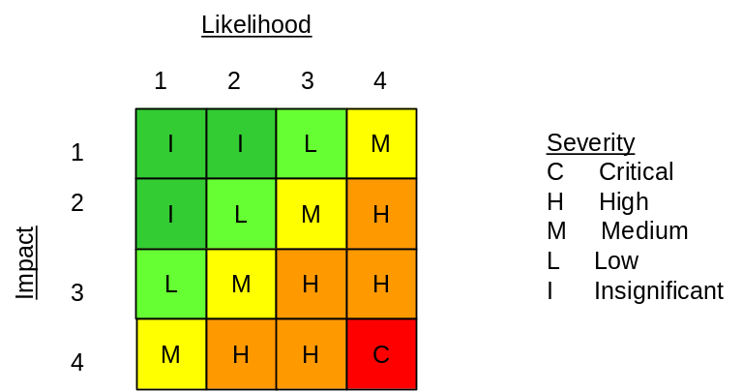
Assumptions, Constraints, Risks, Issues & Dependencies
Analysing Risks – Project Risk Register (2)
Severity
All risks must have an Owner
RAG Status - based on likelihood
Risk Open/Closed – close the risk if transferred to
an issue or it can no longer occur
Notes:
SLIDE OBJECTIVE – Define columns on Risk Register (& previous slide)
Severity = talk through table
We will use same ones in Clarity
Remind them we need to document tool used in PID now
For RAID users Severity should be set to Critical (A+), High (A), Medium (B), Low (C), Insignificant (D)
Must have Owner, date raised, all fields to be filled in, including Open/Closed
If a risk occurs it’s an issue – close it as a risk (unless it might recur)

Slide 23
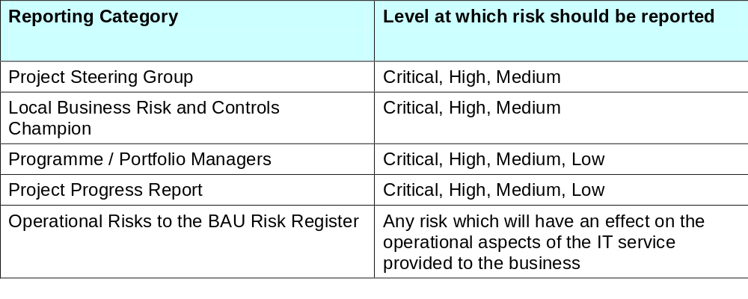
Assumptions, Constraints, Risks, Issues & Dependencies
Managing Risk - Escalation and Reporting
All risks (escalated or not) must be recorded in the Project Risks Register
It is recommended that a Project uses these Severity levels for escalation
Local restrictions may apply
Document your risk escalation triggers in the Project Initiation Document
Notes:
SLIDE OBJECTIVE – Define escalation requirements
These are not mandated – document what you intend to do in PID Risk section

Slide 24
Assumptions, Constraints, Risks, Issues & Dependencies
Issue Definitions
“An Issue is ……
Notes:
SLIDE OBJECTIVE – Agree issue definitions
Prince2 definition includes all problems the PM has, not just the ones s/he can’t control
Ask what is the difference between an issue and a risk
Risks are uncertain in that an event may not occur, whereas issues have already occurred and are therefore not uncertain.
For every issue that occurs on a project, there was a corresponding risk that it might (even if it was not on the Project Risk Register).
If asked CMMI calls it ‘Corrective Action’ defined as ‘Acts or deeds used to remedy a situation, remove an error, or adjust a condition.’

Slide 25
Assumptions, Constraints, Risks, Issues & Dependencies
Issue Definitions
“An Issue is a threat to the project objectives that cannot be resolved by the project manager”
Notes:
SLIDE OBJECTIVE – Agree issue definitions
Prince2 definition includes all problems the PM has, not just the ones s/he can’t control
Ask what is the difference between an issue and a risk
Risks are uncertain in that an event may not occur, whereas issues have already occurred and are therefore not uncertain.
For every issue that occurs on a project, there was a corresponding risk that it might (even if it was not on the Project Risk Register).
If asked CMMI calls it ‘Corrective Action’ defined as ‘Acts or deeds used to remedy a situation, remove an error, or adjust a condition.’

Slide 26
Assumptions, Constraints, Risks, Issues & Dependencies
Issue Definitions
“An Issue is a threat to the project objectives that cannot be resolved by the project manager”
“Issue Management is the process by which concerns that threaten the project objectives and cannot be resolved by the project manager are identified and addressed to remove the threats they pose”
(APM BoK Version 5)
Notes:
SLIDE OBJECTIVE – Agree issue definitions
Prince2 definition includes all problems the PM has, not just the ones s/he can’t control
Ask what is the difference between an issue and a risk
Risks are uncertain in that an event may not occur, whereas issues have already occurred and are therefore not uncertain.
For every issue that occurs on a project, there was a corresponding risk that it might (even if it was not on the Project Risk Register).
If asked CMMI calls it ‘Corrective Action’ defined as ‘Acts or deeds used to remedy a situation, remove an error, or adjust a condition.’

Slide 27
Assumptions, Constraints, Risks, Issues & Dependencies
What we need to do – Issues
Identify issues
Analyse issues
Document them on Project Issue Register
Take corrective action
Report on Issues in Project Progress Report
Escalate as necessary
Manage the issues to closure
Analyse the effectiveness of the corrective action
Notes:
SLIDE OBJECTIVE – Communicate what PM needs to do regarding issues
Good practice (& incidentally CMMI)
If asked this is (mostly) Monitoring & Control (SP2) Manage corrective action to closure
All team members and stakeholders may raise issues – team meetings, stakeholder meetings
Gather them from status reports
It’s worth keeping related emails with your issues (& risks & dependencies)

Slide 28
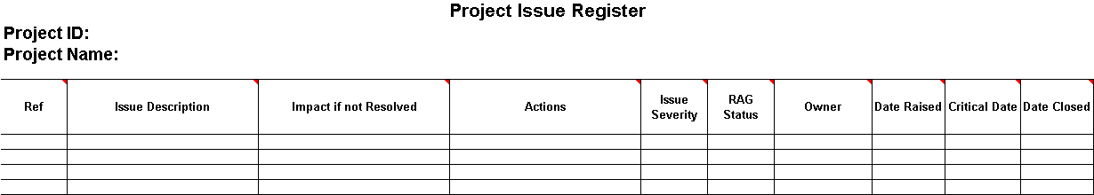
Assumptions, Constraints, Risks, Issues & Dependencies Analysing Issues – Project Issue Register
Description of Actions
taken with Dates
Critical Date Is date by which
issue should be resolved
Severity based on Impact of underlying Risk
Impact
1
2
3
4
M
RAG STATUS
Red - actions will miss target date and
will Impact project delivery
Amber- actions will miss target date and
may impact project delivery
Green - actions are on track
H
H
C
Notes:
SLIDE OBJECTIVE – Define columns on Risk Register
Actions
this is the only place provided for recording what you plan to do and actually do about an issue
Include dates
You may want to keep additional materials and just refer to them here – this is your proof of risk mitigation
Issue Severity - indication of how the issue will affect the Project and is based on the Severity of the underlying Risk: Critical, High, Medium (can’t be lower as it’s happened)
Status
Red - actions will miss target date and will impact project delivery
Amber- actions will miss target date and may impact the project delivery
Green - actions are on track
Owner - must be assigned to someone

Slide 29
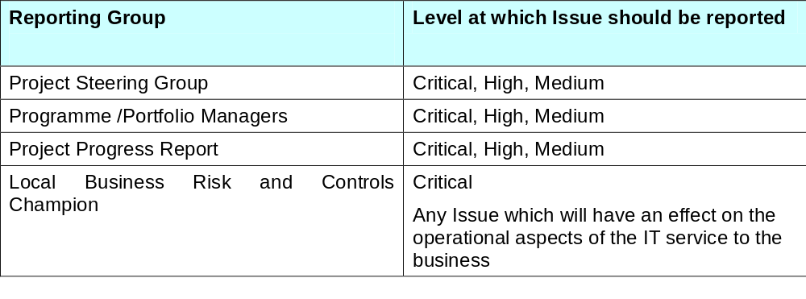
Assumptions, Constraints, Risks, Issues & Dependencies
Managing Issues – Escalation & Reporting
All issues (escalated or not) must be recorded in the Project Issues Register
It is recommended that a Project uses these Severity levels for escalation
Local restrictions may apply
Document your issue escalation triggers in the Project Initiation Document
Notes:
SLIDE OBJECTIVE – Define what to escalate

Slide 30
Assumptions, Constraints, Risks, Issues & Dependencies
Dependency Definitions
“An Internal Dependency is ……a precedence relationship, a restriction that one action has to precede, either in part or in total, another activity”
“An External Dependency is ……something on which the successful delivery of the project critically depends, usually outside the sphere of influence of the project manager”
(APM BoK Version 5)
Notes:
SLIDE OBJECTIVE – Agree dependency definitions
Incoming and Outgoing external dependencies
All external dependencies are a risk – but you don’t automatically document them as such unless real reason to think they will cause an issue
Highlight that we need to look at dependencies in terms of data and infrastructure as well

Slide 31
Assumptions, Constraints, Risks, Issues & Dependencies
Dependency Definitions
“An Internal Dependency is a precedence relationship, a restriction that one action has to precede, either in part or in total, another activity”
“An External Dependency is something on which the successful delivery of the project critically depends, usually outside the sphere of influence of the project manager”
(APM BoK Version 5)
Notes:
SLIDE OBJECTIVE – Agree dependency definitions
Incoming and Outgoing external dependencies
All external dependencies are a risk – but you don’t automatically document them as such unless real reason to think they will cause an issue
Highlight that we need to look at dependencies in terms of data and infrastructure as well

Slide 32
Assumptions, Constraints, Risks, Issues & Dependencies
What we need to do – Dependencies
Identify internal dependencies between tasks on the Project Schedule
  Set up internal dependencies between related tasks on the Project Schedule
Participate with stakeholders to identify, negotiate and track critical external dependencies
  Conduct reviews with relevant stakeholders to identify external dependencies
  Establish dates for delivery of external dependencies
  Enter them as Milestones on the Project Schedule
  Document commitments to dependencies on Project Dependency Register
  Or enter them on Risks, Issues and Change tab on Clarity as a Risk with type External Dependency
  Track dependencies and commitments on the Register and the Project Schedule and take corrective action as appropriate
Notes:
SLIDE OBJECTIVE – Communicate what PM needs to do regarding dependencies
Good practice (& incidentally CMMI)
If asked this is largely from Integrated Project Management
SG2 Coordinate and collaborate with relevant stakeholders
SP2.2 Manage Dependencies

Slide 33
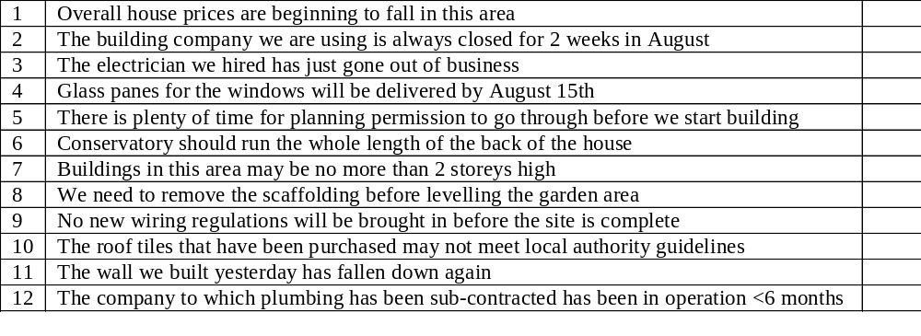
Assumptions, Constraints, Risks, Issues & Dependencies
Quiz – Building a house for sale
Assumption, Constraint, Risk, Issue, Internal or External Dependency or…?
Notes:
SLIDE OBJECTIVE – Practice deciding which is which
Activity: Can be done as class or in groups
Handout: Print slide if in groups
Hint 6 isn’t any of these – what is it (requirement)
You need to talk through when things occur (affects whether assumptions or risks)

Slide 34
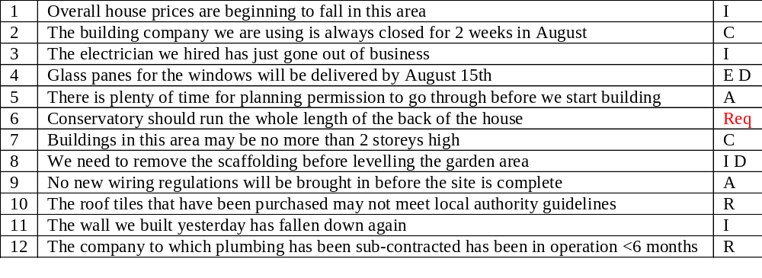
Assumptions, Constraints, Risks, Issues & Dependencies
Quiz – Building a house for sale
Assumption, Constraint, Risk, Issue, Internal or External Dependency or…?
Notes:
SLIDE OBJECTIVE – Practice deciding which is which
Activity: Can be done as class or in groups
Handout: Print slide if in groups
Hint 6 isn’t any of these – what is it (requirement)
You need to talk through when things occur (affects whether assumptions or risks)

Slide 35

Assumptions, Constraints, Risks, Issues & Dependencies
Evidence! Evidence! Evidence!
Quality Reviews need evidence
  SOX
  IT QA Reviews
  Group Internal Audits
  ISO 9001
CMMI Appraisals use documentation as evidence
So, if you’ve done it
Can you demonstrate it?
Notes:
SLIDE OBJECTIVE – Practice deciding which is which
Activity: Can be done as class or in groups
Handout: Print slide if in groups
Hint 6 isn’t any of these – what is it (requirement)
You need to talk through when things occur (affects whether assumptions or risks)

Slide 36
Assumptions, Constraints, Risks, Issues & Dependencies
Did we meet the Objectives?
Be able to differentiate between assumptions, constraints, risks, issues and dependencies
Understand why they need to be identified and monitored
Understand how to identify, analyse and manage them
Notes:
SLIDE OBJECTIVE – State master class objectives

