Slide 1
Risk Management
Presented by
  Hari Prasad Thapliyal
  PMO & EPM Consultant
  dasarpAI
Notes:
Click to add notes

Slide 2
Few Quotes
Problems cannot be solved at the same level of awareness that created them.
- Albert Einstein
Obstacles are those frightful things you see when you take your eyes off your goals.
- Henry Ford
Every thing we count cannot be counted, every counted cannot be count
- Albert Einstein

Slide 3
Risk Q-1
A Risk is?
  Something happening right now.
  Something caused only by the contractor
  A concept having nothing to do with program success.
  A measure of the inability to achieve program objectives
  Only found in my organization

Slide 4
Risk Q-2
Risk Management is?
  Is only necessary if you don't know what you are doing.
  Just another initiative that will go away if you ignore it.
  A common sense approach to decision making.
  Only required before contract award.
  An additional duty assigned to a member of the program team

Slide 5
Risk Q-3
Where do you find risk?
  In the contract.
  In the program/project direction.
  In the minds of the program team.
  At head quarter of my company
  All of the office

Slide 6
Agenda
Introduction to Risk and Risk Management
Risk Planning
Risk Identification Process
Qualitative Risk Analysis
Quantitative Risk Analysis
Strategies for Handling Risks/Risk Response Planning (RM&C)
Managing Project Risks (Risk Monitoring and Control)

Slide 7
Agenda
Introduction to Risk and Risk Management
Risk Planning
Risk Identification Process
Qualitative Risk Analysis
Quantitative Risk Analysis
Strategies for Handling Risks/Risk Response Planning (RM&C)
Managing Project Risks (Risk Monitoring and Control)

Slide 8
1- Introduction to Risk and Risk Management
Understanding risk;
Risk management approaches;
Risk management definitions;
Risk Management Process;
Definition of risk and related topics;
Personal approach to risk;
Types of risks;
Risk factors; and,
Risks in a construction project environment.
Notes:
This introductory session is geared towards helping participants seriously consider risk management and understand its many dimensions

Slide 9

What is Risk?

Slide 10
What is Risk?
Probability of happening some event which can negatively or positively impact on the objectives of the project

Slide 11
What is Risk?
Project risk is always in the future
Risk is an uncertain event or condition
If risk occurs then it has an effect on at least one project objectives
Outcome can be positive or negative
Project objective can be cost, time, quality, scope
Risk has some cause
Cause may be requirement, assumption, constraints, condition
A project risk that has occurred can also be considered an issue
Project risk has their origins in the uncertainty present in all projects.
Known risk- identified, analyzed, planned
Unknown risk- unidentified
Threat of the risk may be accepted if it within the tolerance limit

Slide 12
Context
People work on projects, assignments, operations and perform work, task, activities
Risk are attached to these activities, work, tasks
Probability of happening something like-
  Output of the activity/project may be as you expect and may not be.
  While work progress may go as per plan or may not.
  Stakeholders may be happy or may not by the outcome.
But if things happens
  In your favor it will give huge benefit and courage, benefit to stakeholders.
  Otherwise there can be loss to reputation, finances, life, relations etc.
Lets take calculated risk where negative can be minimized and positive can be optimized
Likelihood of failing and consequences of failing

Slide 13
Context
If you do not have any project plan and still you are delivering without that it means you have well though risk mitigation and contingency plan in place.
Do you know in advance what to do in situations when
  Server crashes at the time of deployment or internet is down
  Your critical resource meets some accident and not able to come to office
  Your customer changes requirements while your team is constructing the product
  Your personal life becomes difficult and you are not able to focus on project
  Customer asks for some modification and the team member who worked on that piece of application is no more with organization
  Critical component need to be available by certain date is not working now
  When your car stops in mid of long lonely roads
  Some critical code has been overwritten
All above is not part of typical project management therefore planning, costing and execution of above activities happens in different style
All above are not certain events when you start the project. Based on your experience you come to know that they have probability of happening
Whether you plan about those or not depends upon risk exposure and your risk appetite, but you should know about those.

Slide 14
Context
You have Rs.10L What do you want?
  Carelessly through that off to others?
  Keep it same till you are alive?
  Earn more money from that so that original remain intact and you earn profit?
What is bottleneck, why are you not able to exercise those options?
Because of different degree of risk attached to these actions. Depending upon your risk appetite and understanding the world of risk management you take decision consciously or unconsciously.
Risk management is about knowing those risk in advance, knowing the alternative in advance, knowing your risk appetite in advance. Plan accordingly and work the plan.

Slide 15
Context
Risk A: Abuse in universities
  Source of risk are Alcohol, Smoke, Girls Teasing, ground rules
Risk B: Burglary at shop
  Burglary alarms, surveillance, petrol's electronic sensors, house keeping
Risk C: Fire in building
  Know about various sources of fire
How to Address these risks
  Plan: Guidelines, policies, processes, reward/punishment
  Plan the cost of risk management
  Execution of risk management plan
  Ensure conformance to plan (risk audits)

Slide 16
What is Risk Management
Preparing for all situation that may occur

Slide 17
Risk Management Process
Risk Identification
Qualitative Risk Analysis
Quantitative Risk Analysis
Risk Analysis
Risk Management
Risk Management Planning
Risk Response Planning
Calculate Contingency
Record & Review Lessons learned
Report Risk situation using Risk Log
Record & Review the Risk Log

Slide 18
Sensitivity Analysis
A technique to determine how different values of an independent variable will impact a particular dependent variable under a given set of assumptions.
E.g.
Like change in interest rate (independent variable) on a bond's price
Quantity of rain on quantity of crop

Slide 19
Risk exposure data
Layout of the plant/office
interconnectivity of roads/accessibility
Proximity to fire station/ police station/ hospital
Condition/ location and number of emergency exits/ stairs/ gates
Earthquake exposure of the building (Seismic Zone)
Flood/ Inundation exposure
Landslide/ Rockslide exposure
Terrorism exposure
Proximity to water bodies- river, lake, sea, drains etc
Internal & external drainage systems
Congestion at the site
Employee- Employer relations (industrial relation)
Type of labour employed- young/mature- skilled/unskilled.
Condition of raw/ Process/ Intermediate & Finished Materials stored- flammable/ Hazardous
Major changes in the future/ near past
Neighboring occupancies & their exposure
History of natural disasters/ AOG Perils- Flood/Eq/Landslide/Storm etc

Slide 20
Risk exposure data
General law & order & political situation in the area
Terrorism exposure in the area
Adherence to No smoking regulation
Installation of FEA- their adequacy and placement- their maintenance
General awareness of the employees and their training regarding FEA appliances installed/ their usage
Presence of trained full time safety & fire officers & staff
ISO certifications
SHE policy/ maintenance philosophy
Enforcement of work permit system
General housekeeping
Management awareness & involvement in safety and security matters
Quantity and quality of security staff
Regulation of entry and exit of persons, vehicles, trucks & materials
Source of water and quantity of storage facility
Condition of electrical wiring and installations
Condition of machinery, their maintenance, hazards involved with them, presence of qualified personnel to handle them
condition of electrical equipment, their maintenance and presence of qualified personnel to handle them
Condition of buildings and their construction
Condition and construction of boundary wall
Exposed openings and presence of combustible materials
Quantity of fire load
Presence of forest/ bushes/ vegetation in the vicinity

Slide 21
Impact of Risks
Financial Risk
Market Risk
Credit Risk
Operation Risk
Reputational Risk
Business and Strategic Risks

Slide 22
Iterative Project Planning
Establish the project constraints
Make initial assessments of the project parameters
Define project milestones and deliverables
while project has not been completed or cancelled loop
  Draw up project schedule
  Initiate activities according to schedule
    Wait ( for a while )
    Review project progress
    Revise estimates of project parameters
    Update the project schedule
    Re-negotiate project constraints and deliverables
    if ( problems arise ) then
    Initiate technical review and possible revision
    end if
end loop
In parallel to each activity above conduct risk management activities at each step so that those activities are on track as per the project objectives.

Slide 23
Why Do Risk Management
Early identification and communication of risk is viewed as a factor in program success
Consistent management approach
Identification and justification of where to put competing resources
Risk identified in time helps in managing them
Risk management gives forum for discussion
Systematic approach for risk management
Forces one to break things down into easy and understanding concepts
Helps in leveraging past experience
Regular risk management meetings helps managing peer pressure
Helps in utilizing a tool to enforce structure
Provides comprehensive picture on project risks, effectiveness of management actions

Slide 24
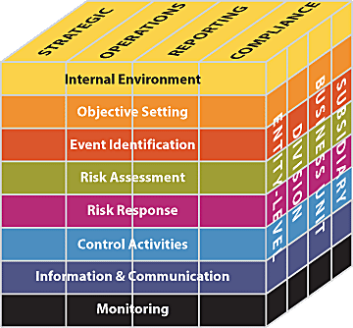
The Enterprise Risk Management Framework
The eight components
of the framework
are interrelated.
Source: COSO Enterprise Risk Management — Integrated Framework, 2004, COSO.

Slide 25
Who uses Risk Management
Risk management practices are widely used in public and private sectors, covering a wide range of activities, project or operations
Finance and investment
Insurance
Health Care
Public Institutions
Governments
Project Management

Slide 26
How Risk Management used
The risk management process steps are a generic guide for any organization, regardless of the type of business, activity or function. There are seven steps
Establish the context
Identify the risks
Analyze the risks
Evaluate the risks
Treat the risks
Monitoring and review
Communication & Consultation

Slide 27
Evaluate Risk
Risks are evaluated against criteria other than just their magnitude. This is place where you take the decision regarding the risk. These criteria include:
  The level of uncertainty associated to each risk;
  The degree of commonality between risks; and
  The regulatory, legal, and financial context of your organization and its collections

Slide 28
Risk Classification
Grouping of different risks according to their estimated cost or likely impact, likelihood of occurrence, countermeasures required, etc.
Credit risk, is classified according to the likelihood of the collection of accounts receivable
Technology risk, is classified according to the likelihood of the problem from technical sources
People risk, is classified according to the likelihood of the problem from human resource/project team

Slide 29
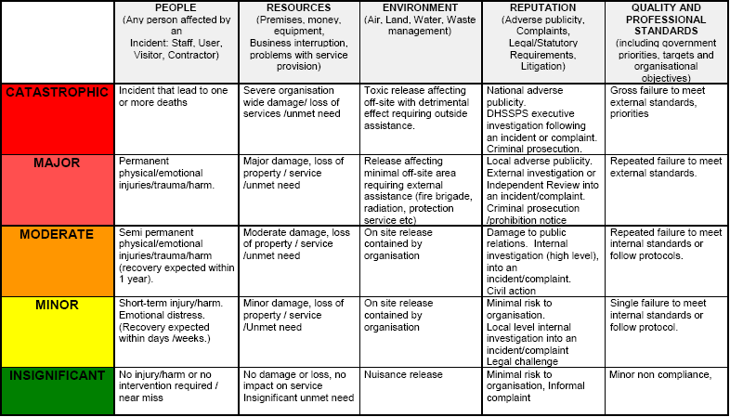
Risk impact on project objectives

Slide 30
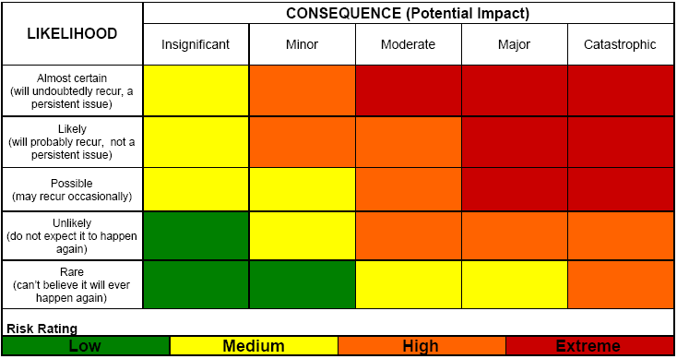
Risk Rating Matrix

Slide 31
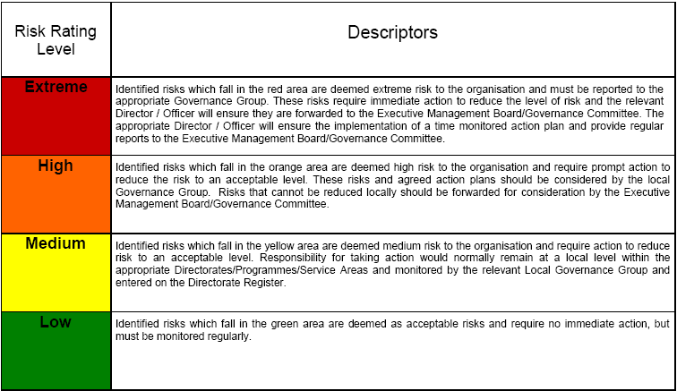
Risk Action Guidance

Slide 32
Should be we RMP for all?
Answer is : Depends upon your risk appetite
Identify the class of project according to your organization risk appetite
Choose the projects of high class

Slide 33
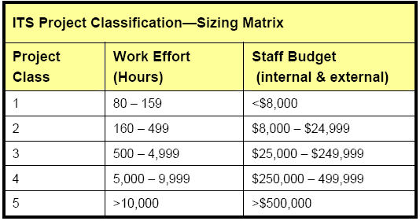
Determine Project Class

Slide 34
Project Classification
Project Classification- Risk Matrix
Risk Factor | Low (0) | Medium (1) | High (2/3) | Very High (4/5)
Total Team Size | <5 | 5 -9 | 10- 14 | > 15
Workgroup Involved | 1 - 2 | 3 - 4 | 5 - 6 | > 7
Technology/ Technique/Process | Expert | Familiar | New to organization | Breakthrough
Complexity | The solution is well defined and no problem are expected | The solution has identified problems | Multiple approaches to the project goal | The solution only vaguely defined
Political Profile/Impact | Unit/Dept | Director Area | VP Leavel | Exterprise wide
Deployment Impact | Unit/Dept | Director Area | VP Leavel | Exterprise wide
Risk Scoring | 0-10 Manageable- No change to classification | 11-17 Moderate- Increase class 1 Level | 18-25 High- Increase class 2 levels | Total

Slide 35
Agenda
Introduction to Risk and Risk Management
Risk Planning
Risk Identification Process
Qualitative Risk Analysis
Quantitative Risk Analysis
Strategies for Handling Risks/Risk Response Planning (RM&C)
Managing Project Risks (Risk Monitoring and Control)

Slide 36
2- Risk Planning
Understanding the project environment and project objectives;
How to plan for risk management processes;
Risk Management Planning process;
Components of Risk Management Plan;
How to focus on project objective.
Notes:
Risk management planning sets the tone for the rest of risk management activities. It address what, who, how and when for the rest of the processes.

Slide 37
Project Environment & Objectives
Schedule
Cost
Quality
Features
Performance

Slide 38
Components of Risk Management Plan
Methodology: Approaches, tools and data sources that may be used to perform risk management on the project
Roles & Responsibility
Budgeting
Timing- when and how throughout the lifecycle perform RM processes. Protocol for application of schedule contingency reserves
Risk categories (RBS). Source from which risk may arise
Definitions of risk probability and impact
Probability and impact matrix
Revised stakeholder's tolerances

Slide 39
RMP: Risk indicators
Risk type | Potential indicators
Technology | Late delivery of hardware or support software, many reported technology problems
People | Poor staff morale, poor relationships amongst team member, job availability
Organisational | Organisational gossip, lack of action by senior management
Tools | Reluctance by team members to use tools, complaints about CASE tools, demands for higher-powered workstations
Requirements | Many requirements change requests, customer complaints
Estimation | Failure to meet agreed schedule, failure to clear reported defects

Slide 40
RPM: Categories/Source of Risks
Technology risks.
People risks.
Organisational risks.
Requirements risks.
Estimation risks.
Procurement/Acquisition Risk.

Slide 41
Risk Management Planning Processes
Plan Risk Management
Identify Risks
Perform Qualitative Risk Analysis
Perform Quantitative Risk Analysis

Slide 42
How to focus on project objectives?

Slide 43
3- Risk Identification Process
What is risk identification?;
Approaches to risk identification;
Risk statement and developing a risk register;
Types of risk and risk categories;
Practical issues related to risk identification; and;
Organizing and running a risk identification meeting.
Notes:
Risk identification is an interactive process and it should involve all key stakeholder. The objective is to compile a long list of opportunities and risks for the team to address later in the process

Slide 44
What is Risk Identification?

Slide 45
Risks and risk types
Risk type | Possible risks
Technology | The database used in the system cannot process as many transactions per second as expected.
 | Software components that should be reused contain defects that limit their functionality.
People | It is impossible to recruit staff with the skills required.
 | Key staff are ill and unavailable at critical times.
 | Required training for staff is not available.
Organisational | The organisation is restructured so that different management are responsible for the project.
 | Organisational financial problems force reductions in the project budget.
Tools | The code generated by CASE tools is inefficient.
 | CASE tools cannot be integrated.
Requirements | Changes to requirements that require major design rework are proposed.
 | Customers fail to understand the impact of requirements changes.
Estimation | The time required to develop the software is underestimated.
 | The rate of defect repair is underestimated.
 | The size of the software is underestimated.

Slide 46
Components of Risk Register
Risk Name
Risk Category
Internal/External
Status
Type
Threat/Opportunity
Probability
Impact
Term
Threshold
Score
Owner
Identification Date
Expiry Date
Mitigation Plan
Assign To
Contingency Plan
Assign To
Current Status
Last Updated on
Consequences
Contingency Reserve ($)
Contingency Reserve (Time)

Slide 47
Approach to Risk Identification
Step 1
  What is the scope of task, work, project
  Who asked for this task, work, project
  Why that work is required
  What decision are related to that task, work, project (what will happen if it does not happen/late happen/ poor quality/ over budget)
Step 2
  What is the mandate of organization, org policies
  What amount of loss is possible
Step 3
  External framework, stakeholder, source of knowledge

Slide 48
Software risks
Risk | Affects | Description
Staff turnover | Project | Experienced staff will leave the project before it is finished.
Management change | Project | There will be a change of organisational management with different priorities.
Hardware unavailability | Project | Hardware that is essential for the project will not be delivered on schedule.
Requirements change | Project and product | There will be a larger number of changes to the requirements than anticipated.
Specification delays | Project and product | Specifications of essential interfaces are not available on schedule
Size underestimate | Project and product | The size of the system has been underestimated.
CASE tool under-performance | Product | CASE tools which support the project do not perform as anticipated
Technology change | Business | The underlying technology on which the system is built is superseded by new technology.
Product competition | Business | A competitive product is marketed before the system is completed.

Slide 49
4- Qualitative Risk Analysis
Introduction to qualitative risk analysis;
Goal of Qualitative Risk Analysis;
Tools for Qualitative Risk Analysis;
Probability and impact analysis of identified risks;
Producing risk matrix;
Producing an updated risk register ;
Calculating risk allowance and risk contingency amount.
Notes:
In this process the project manager will subjectively evaluate all the risks. The goal is to focus on the most critical risks

Slide 50
Risk analysis (i)
Risk | Probability | Effects
Organisational financial problems force reductions in the project budget. | Low | Catastrophic
It is impossible to recruit staff with the skills required for the project. | High | Catastrophic
Key staff are ill at critical times in the project. | Moderate | Serious
Software components that should be reused contain defects which limit their functionality. | Moderate | Serious
Changes to requirements that require major design rework are proposed. | Moderate | Serious
The organisation is restructured so that different management are responsible for the project. | High | Serious

Slide 51
Risk analysis (ii)
Risk | Probability | Effects
The database used in the system cannot process as many transactions per second as expected. | Moderate | Serious
The time required to develop the software is underestimated. | High | Serious
CASE tools cannot be integrated. | High | Tolerable
Customers fail to understand the impact of requirements changes. | Moderate | Tolerable
Required training for staff is not available. | Moderate | Tolerable
The rate of defect repair is underestimated. | Moderate | Tolerable
The size of the software is underestimated. | High | Tolerable
The code generated by CASE tools is inefficient. | Moderate | Insignificant

Slide 52
5- Quantitative Risk Analysis
Introduction to Quantitative Risk Analysis;
Comparison between the qualitative and quantitative approaches;
Steps for Quantitative Risk Analysis;
Quantitative Risk analysis tools;
Output from Quantitative Risk Analysis.
Notes:
In this process, the project manger will address the risk short list objectively. The course material will not get into much math or statistics. I will provide practical and simplified tools to address risk in this process

Slide 53
6- Strategies for Handling Risks/
Risk Response Planning (RM&C)
Definitions;
Steps for developing risk response;
Information/documentation required to prepare for risk response planning;
Tools for generating risk response options;
Strategies for risk response planning;
Risk response options evaluation;
Risk response planning deliverables.
Notes:
Participants will be given the opportunity to apply the tools and techniques learned to an actual construction project’s life cycle

Slide 54
Risk Response planning
Consider each risk and develop a strategy to manage that risk.
Avoidance strategies
  The probability that the risk will arise is reduced;
Minimisation strategies
  The impact of the risk on the project or product will be reduced;
Contingency plans
  If the risk arises, contingency plans are plans to deal with that risk;

Slide 55
Threat
Very High | 100%
 | 90% |  |  |  |  |  |  |  |  | Task8
High | 80% |  |  |  |  |  |  |  |  |  | Task9
 | 70%
 | 60% |  |  |  |  | Task5
Medium | 50% |  | Task1
 | 40% |  | Task6
Low | 30% |  |  |  | Task3
 | 20% | Task2 |  |  | Task7
Very low | 10%
 |  | 10% | 20% | 30% | 40% | 50% | 60% | 70% | 80% | 90% | 100%
 |  | Very low |  | Low |  | Medium |  |  | High |  | Very High

Slide 56
Risk management strategies (i)
Risk | Strategy
Organisational financial problems | Prepare a briefing document for senior management showing how the project is making a very important contribution to the goals of the business.
Recruitment problems | Alert customer of potential difficulties and the possibility of delays, investigate buying-in components.
Staff illness | Reorganise team so that there is more overlap of work and people therefore understand each other’s jobs.
Defective components | Replace potentially defective components with bought-in components of known reliability.

Slide 57
Risk management strategies (ii)
Risk | Strategy
Requirements changes | Derive traceability information to assess requirements change impact, maximise information hiding in the design.
Organisational restructuring | Prepare a briefing document for senior management showing how the project is making a very important contribution to the goals of the business.
Database performance | Investigate the possibility of buying a higher-performance database.
Underestimated development time | Investigate buying in components, investigate use of a program generator

Slide 58
7- Managing Project Risks (Risk Monitoring and Control)
Definition and Risk Management Cycle;
RM&C activities;
Risk documentations;
Risk communications;
Information required to start RM&C;
RM&C tools;
Deliverables;
Practical issues in RM&C.
Notes:
Participants will be given the opportunity to apply the tools and techniques learned to an actual construction project’s life cycle

Slide 59
A few type of RM related reports
Risk Register View
Risk Assignment
Mitigation or Responses
Task-Risk View
Risk category & outcome view
Task-success-duration view
Risk Register View
Risk Category and Outcome
Risk & Risk Assignment

Slide 60
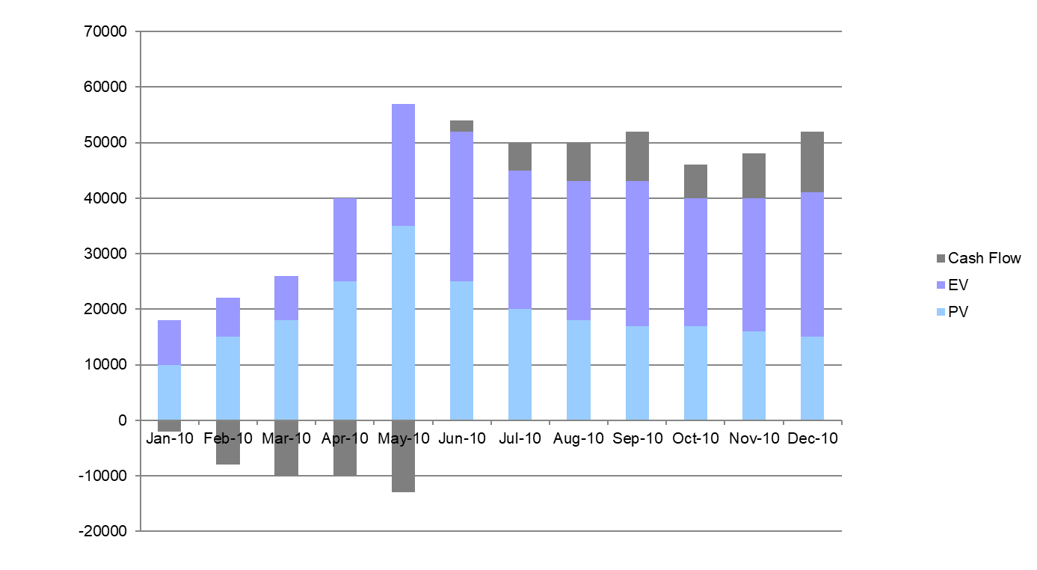
Cash Flow – EV/PV

Slide 61
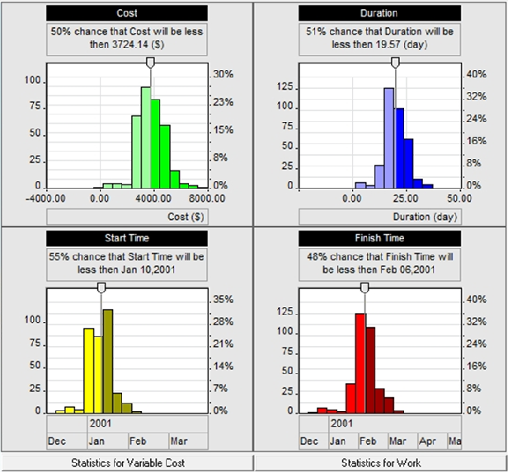

Slide 62
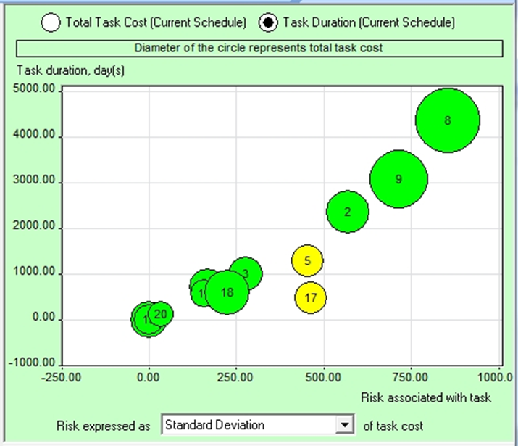

Slide 63
Decision Tree
Senstivity chart & coefficient
PERT
http://www.intaver.com

Slide 64
Take Away
Have one risk manager in project. His job is to identify risk, conduct risk audits and verify whether risk management strategy are sufficient enough or not.
Time to time conduct creative sessions to capture the risk management strategies.

Slide 65
Type of distributions
Beta
Gamma
Lognormal
Triangular
BetaPert
Gumbel
Normal
Uniform
Cauchy
Exponential
Laplace
Custom
Discrete
Rayleigh

Slide 66
Contact Details
Hari P Thapliyal

